Slide 1

Welcome to our class
Nguyen Van Cu Secondary School

Slide 2

What is the video about?
Benefits of Science and Technology

Slide 3

Unit 11: Science and Technology
Period 92 – Lesson 6: Skills 2

Slide 4

Ex1: Listen to the conversation and choose the best summary
a. The benefits that advances in science and technology may bring to people’s lives.
b. The benefits and drawbacks that advances in science and technology may bring to people’s lives
c. The drawbacks that advances in science and technology may bring to people’s lives

Slide 5
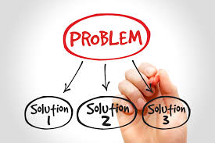
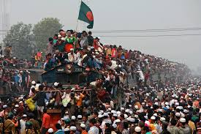
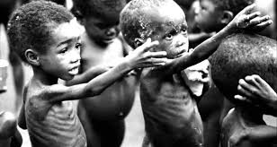
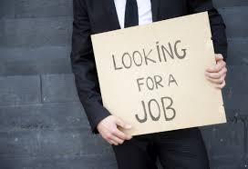
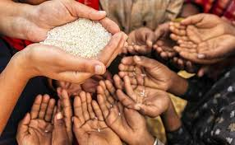
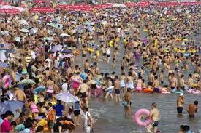
Vocabulary
- Solve (v)
: giải quyết
- Hunger (n)
: nạn đói
- Yield (n)
: sản lượng
- Overcrowding (n)
: quá tải, đông người
- Unemployment (n)
: sự thất nghiệp
- Drawback (n)
: hạn chế

Slide 6
Ex2: Listen again to the conversation between Nick, Duong and Chau. Circle the words and phrases as you hear them
1. problems
4. overcrowding
2. High yields
5. On television
3. The moon
6. Bring unemployment

Slide 7
Ex 3: Listen again and answer the questions
1. What will help feed the large population on Earth?
➔ High yields in farming
2. Where may we be able to live?
➔ On other planets
3. What does Nick say he likes?
➔ He says he likes the idea of having lesson at home with a robot , and on the Internet.
4. Does Chau think science and technology may bring problems?
➔ Yes, she does
5. What does Nick think at the end of the conversation?
➔ He thinks there will be many new problems

Slide 8
WRITING
Writing to express agreement or disagreement
Introduction: I agree/ disagree with the idea that.....................
Explaining your opinion:
Firstly, Secondly,...................
Furthermore, In addition,........................
Conclusion: In short/ For these reasons,...................

Slide 9
Ex 4: Look at the sample paragraph and fill the outline below
I disagree with the idea that robots will only bring benefits to people in the future. Robots will also have some negative effects. Firstly, they will be very expensive and we will spend too much money buying and fixing them. Secondly, robots in factories will be able to do everything the workers do, so robots will make them jobless. Thirdly, robots in our homes will do all the housework for us, so we will become lazy and inactive. In short, robots will do many things for us, but they may not improve the quality of out lives.
Introduction: disagree
Robots will be expensive
Idea 1:.....................................................................................................
They will make people jobless
Idea 1:.....................................................................................................
People will become lazy and inactive
Idea 1:.....................................................................................................
Conclusion: not always good

Slide 10
Ex 5: Make notes, then write a paragraph on the following topic.
“ With the help of technology, students will benefit greatly from Studying by themselves at home”. Do you agree orr disagree with the following idea?
disagree
Introduction: agree/ disagree
Many students are lazy
Idea 1:...............................................................................................
Students can’t understand all information
Idea 2:...............................................................................................
Teacher will explain why is correct or incorrect
Idea 3.................................................................................................
Conclusion: not always good/ good
Not always good.

Slide 11
“ With the help of technology, students will benefit greatly from Studying by themselves at home”. Do you agree orr disagree with the following idea?
Introduction: agree/ disagree
disagree
Many students are lazy
Idea 1:...............................................................................................
Idea 2:...............................................................................................
Students can’t understand all information
Teacher will explain why is correct or incorrect
Idea 3.................................................................................................
Not always good.
Conclusion: not always good/ good
I disagree with the idea that with the help of technology , students will benefit greatly from studying by themselves at home.
Firstly, Many students will be lazy, they will spend almost time on playing games instead of learning.
Secondly , Students can find information on the Internet easily but they can’t understand all information and they won’t know that information is correct or incorrect.
Finally, Students need the teacher to explain what they don’t understand, the teacher will give them some advice to improve their studies.
In short, technology have many benefits but they may not improve the quality of our studies.

Slide 12
HOMEWORK
Learn by heart vocabulary.
Do exercises
Prepare: Unit 12: getting stared

Slide 13

SEE U AGGAIN !
Thank you!

