Slide 1


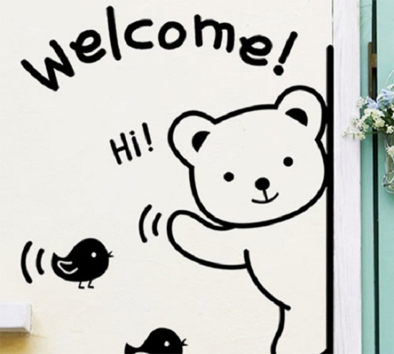
Good morning!
Everybody

Slide 2

UNIT 11: SCIENCE AND TECHNOLOGY
Lesson 2: A Closer look 1 (P.50)

Slide 3

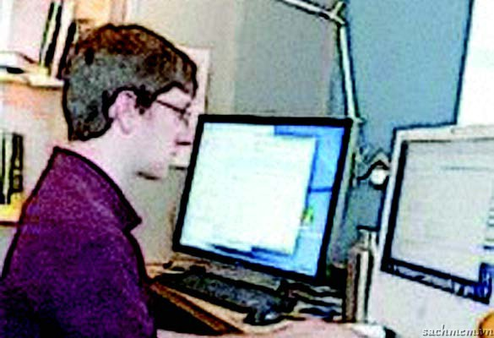
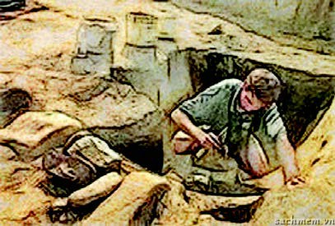
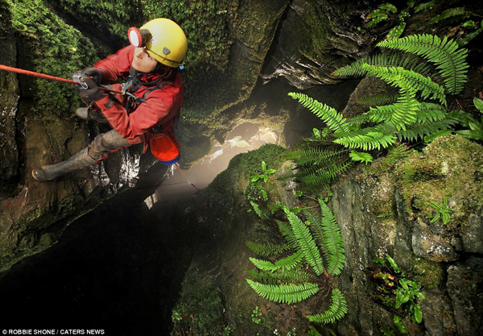
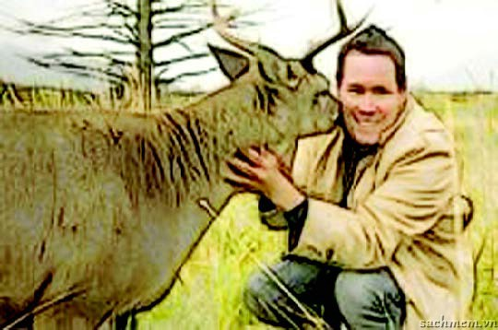
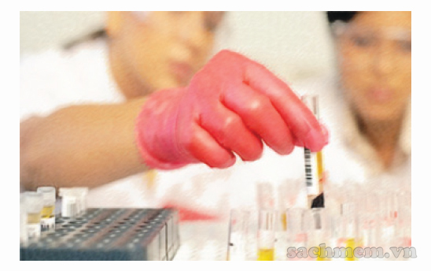
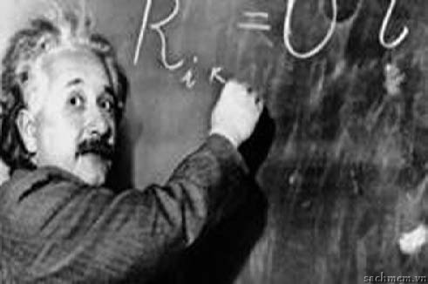
VOCABULARY
A person who studies humans, animals, plants and bacteria to gain a better understanding of how the body and nature works, and how external factors may influence each organism.
A person who gives advice is an _______.
1. adviser/ advisor (n): /ədˈvaɪ.zər/ Người cố vấn
2. Archaeologist (n): /ˌɑː.kiˈɒl.ə.dʒɪst/ nhà khảo cổ
3. Explorer (n): /ɪkˈsplɔː.rər/ người thám hiểm
4. Conservationist (n): /ˌkɒn.səˈveɪ.ʃən.ɪst/ nhà bảo vệ môi trường
5.Marine (adj): /məˈriːn/ (thuộc về) biển
A scientist who studies chemistry
A person who acts for the protection and preservation of the environment and wildlife.
A person who creates the applications or systems that run on a computer or another device.
4. A person whose job is writing programmes for computers.
6. Software developer (n) /ˈsɒft.weər dɪˈvel.ə.pər/
nhà phát triển phần mềm
7. Programmer (n) /ˈprəʊ.ɡræm.ər/ người lập trình (trên máy tính)
8. Biologist (n) /baɪˈɒl.ə.dʒɪst/ nhà nghiên cứu về sinh vật học
9. Chemist (n) /ˈkem.ɪst/ : nhà hóa học
10. Physicist (n) /ˈfɪz.ɪ.sɪst/ nhà vật lí

Slide 4

+ Look out!
- We add -er, -or, or -ist to a verb or noun to form a noun indicating people.
Example:
to learn ->
- to invent ->
- Science ->
learner
inventor
scientist

Slide 5

EXERCISE :
1. To work →
2. To visit →
3. Art →
4. To retail →
Worker
Visitor
Artist
Retailer

Slide 6


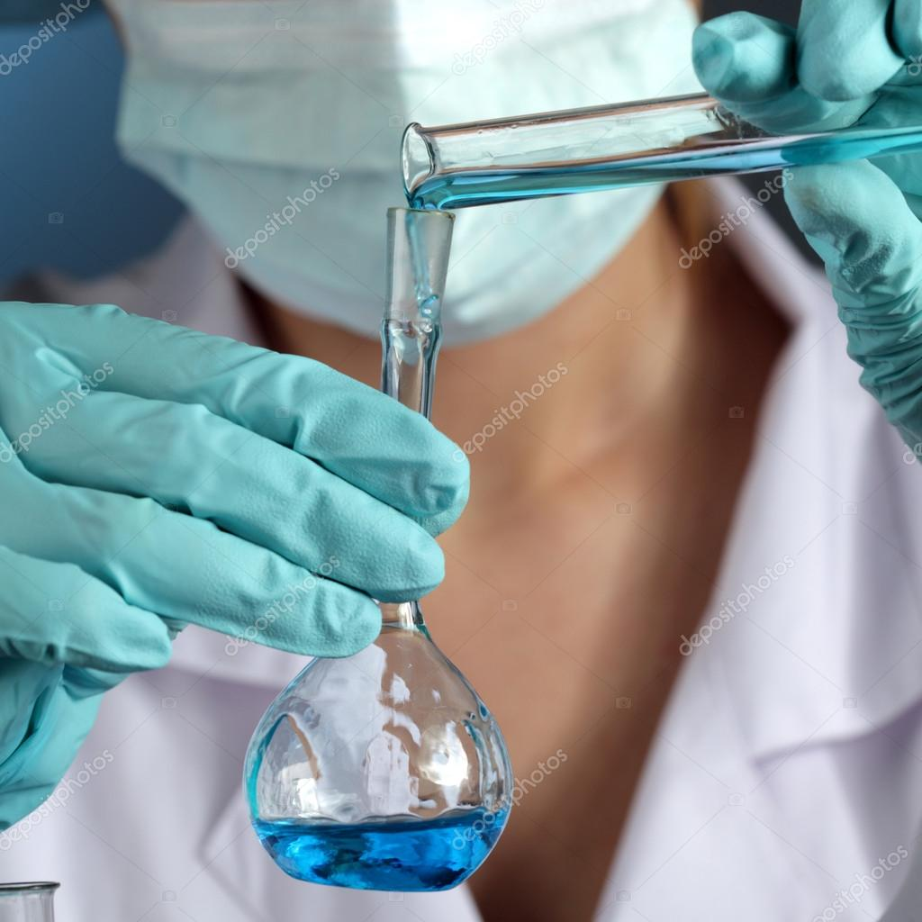
Activity 1. Complete the following sentences with nouns indicating people.
1. A person who gives advice is an _______.
adviser
2. A scientist who studies chemistry is a _______ .
chemist

Slide 7
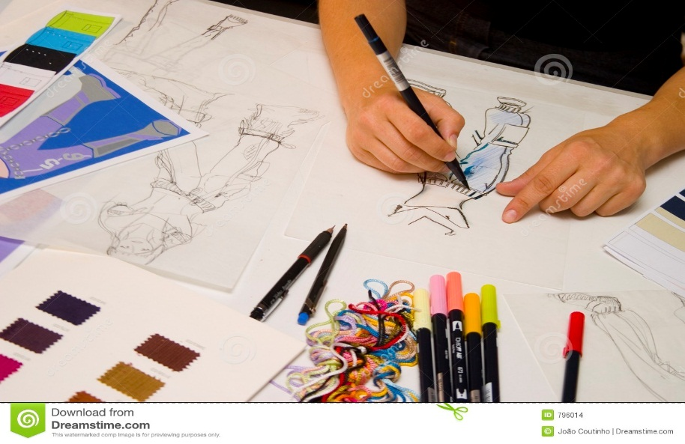
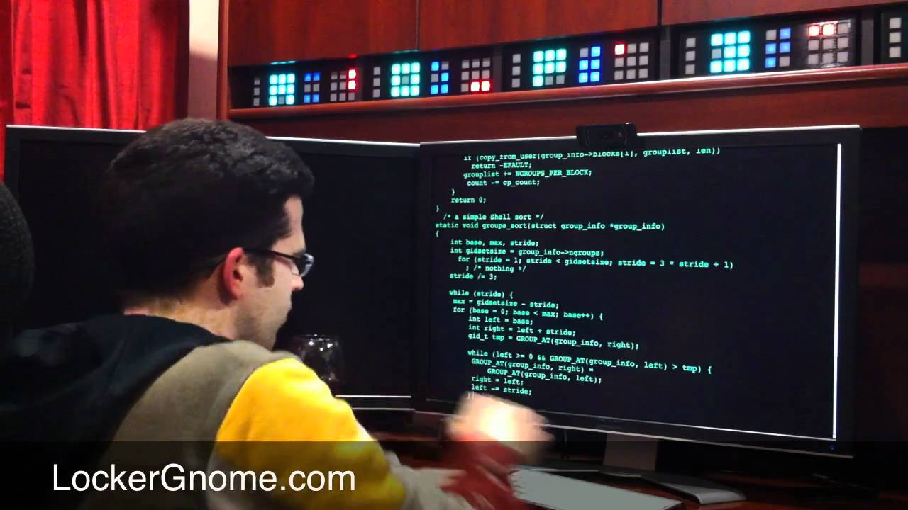
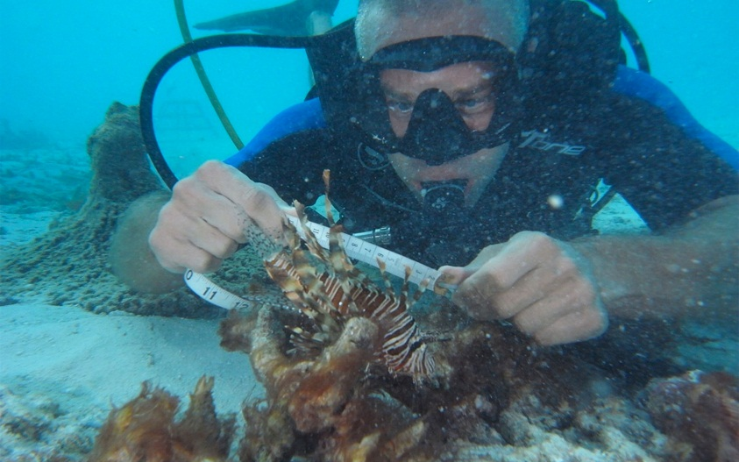
Activity 1. Complete the following sentences with nouns indicating people.
3. A person whose job is to design things is a _______ .
designer
4. A person whose job is writing programmes for computers is a _______ .
programmer
biologist
5. A marine _______ is a scientist who studies life in the sea.

Slide 8
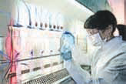
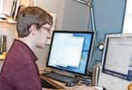
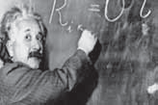
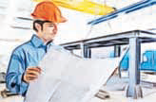
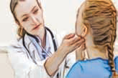
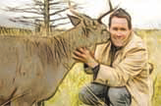
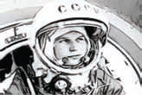
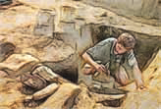
Activity 2. Write a noun from the list under each picture
doctor chemist physicist archaeologist explorer engineer software developer conservationist
Who’s this?
1.
chemist
2.
software developer
physicist
3.
engineer
4.
5.
6.
conservationist
7.
explorer
8.
archaeologist
doctor

Slide 9

Activity 3. Give the correct form of the words in brackets.
development
1. Every day we hear about new (develop) ______ in science and technology.
2. Einstein was one of the greatest (science) ______ in the world.
3. The USA is a world leader in space (explore) ______ .
4. Advances in (medicine) ______ science will help people live longer in the future.
5. There is a link between (economy) _________ development and the environment.
N
scientist
N (people)
explorer
N (people)
medical
ADJ
economic
ADJ

Slide 10

Pronunciation
Stress in words starting with un- and im-
- When we add the prefix un- or im- (meaning ‘not’) to a root word, the stress of the word does not normally change.
Example:
- 'friendly → un'friendly
- 'probable → im'probable
Note: When we add the prefix un- or im- to a one-syllable word, the stress falls on the root word.
Example:
- fair → un'fair
- pure → im'pure

Slide 11


Activity 4. Listen and repeat the following words.
Mark the stressed syllables in the words.
unforeseen unlucky
immature unwise
impatient unhealthy
impure unhurt
impossible unlimited
Unnatural impolite

Slide 12

Activity 5. Put the words from 4 in the right columns.
oO | oOo | ooO | oOoo

Slide 13
Activity 5. Put the words from 4 in the right columns.
oO | oOo | ooO | oOoo
Unwise Impure Unhurt | Unlucky Impatient Unnatural Unhealthy | Impolite Unforeseen Immature | Impossible Unlimited

Slide 14

Activity 6. Fill the gaps with one of the words in 5. Listen and check, then read the sentences.
impure
1. The teacher said this water was ______ and couldn’t be used in our experiment.
2. Scientists have identified a link between an ______ diet and diseases.
3. This job would be ______ without the help of a computer.
4. Our natural resources are not ______ .
5. It’s no good being ______ with small children.
unhealthy
impossible
unlimited
impatient

Slide 15
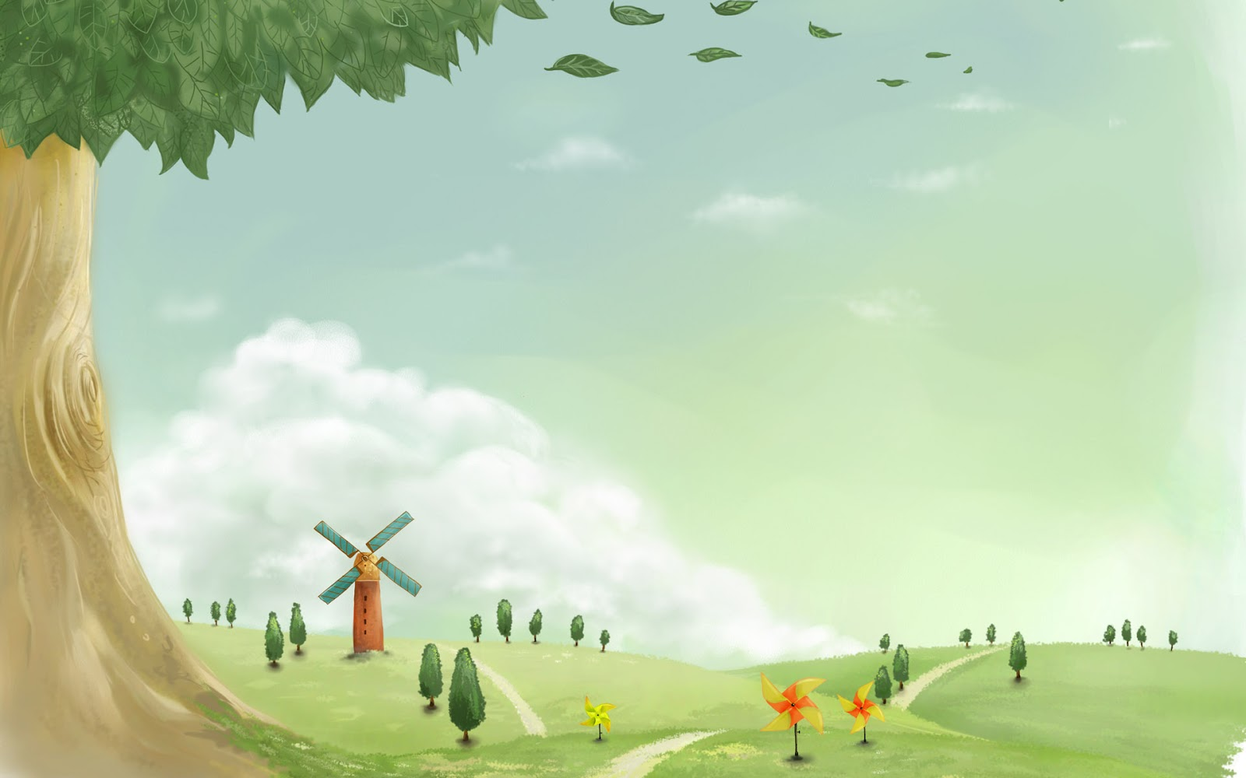
* Homework:
- Learn vocabulary by heart and rewrite them in sentences.
- Prepare for a closer look 2.

Slide 16


