Slide 1
Good morning Everybody
WELCOME TO
OUR CLASS

Slide 2

Objectives:
By the end of the lesson, students will be able to know more about the roles of science and technology in the future.

Slide 3

Unit 11. Science and Technology
Period 86 Lesson 1. Getting started
At the Science Club

Slide 4
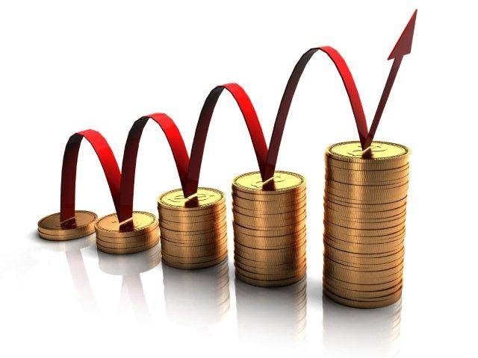
Development /di’velәpmәnt/ (n) :
Sự phát triển
= growth, progress

Slide 5
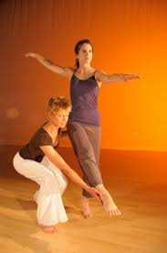
Technique /tek'ni:k/ (n): kĩ thuật
a way of doing an activity which needs skill
Example: she has a great performance because of her technique.

Slide 6
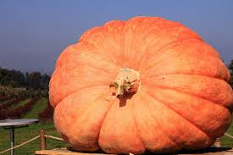
Enormous /i'nɔ:məs/ (adj):
lớn, to lớn
extremely large, very big

Slide 7
Benefit /'benɪfɪt/ (n)
Lợi ích
a helpful or good effect, or
something intended to help
Example: the Internet brings many benefits to our life.

Slide 8
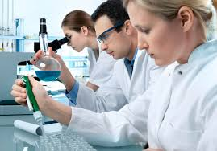
Researcher /ri´sə:tʃə/ (n) nhà nghiên cứu

Slide 9
Role /roul/ (n)
= duty: nhiệm vụ
Example: Schools play an important role in the society.

Slide 10
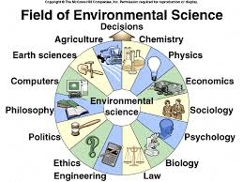
Field /fi:ld/ (n): lĩnh vực
an area of activity or interest
Example: Science and technology are changing our lives in every field.

Slide 11

New words:
Development /di’velәpmәnt/ (n) :
Sự phát triển
Technique /tek'ni:k/ (n):
Thủ thuật, kĩ thuật
Enormous /i'nɔ:məs/ (adj):
To lớn
Benefit /'benɪfɪt/ (n)
Lợi ích, hưởng lợi
Researcher /ri´sə:tʃə/ (n)
Nhà nghiên cứu
Role /roul/ (n)
Vai trò
Field /fi:ld/ (n)
Lĩnh vực

Slide 12
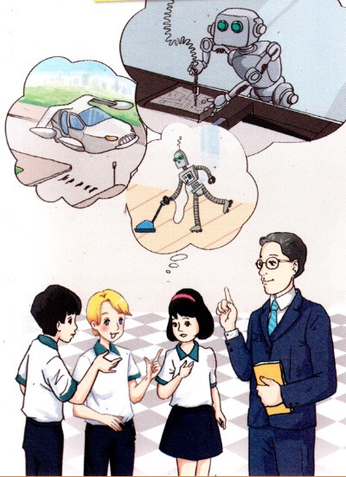
Look at the picture and answer the question.
What are they talking about?

Slide 13

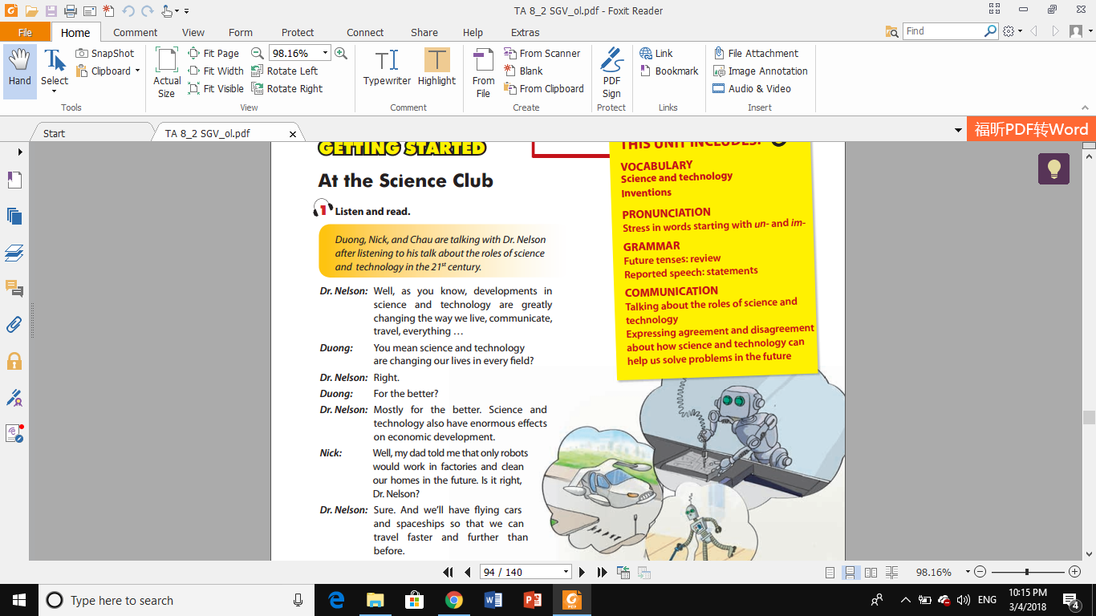
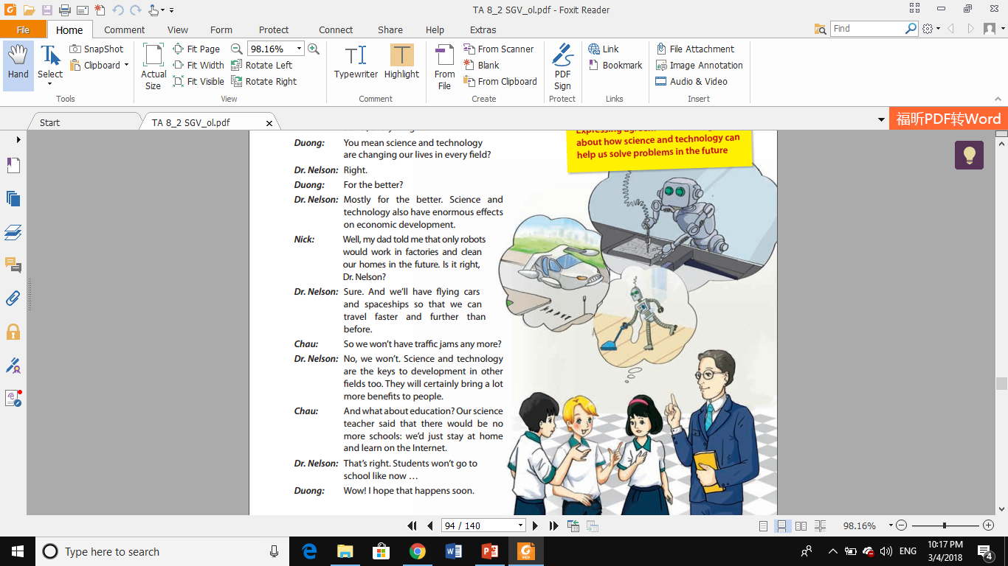
Listen to the conversation between Duong,
Nick , Chau and Dr. Nelson

Slide 14
What are they talking about?
They are talking about the roles of science and technology in the 21st century.

Slide 15
1a. Answer the questions.
1. Where are Nick, Duong and Chau?
2. What is the subject of Dr.Nelson’s talk?
3. What fields are science and technology greatly changing?
4. What did Nick’s dad tell him?
5. What did Chau’s science teacher say?

Slide 16
1. Where are Nick, Duong and Chau?
They are at the Science Club.

Slide 17

2. What is the subject of Dr. Nelson’s talk?

Slide 18

It is the roles of science and technology in
the 21st century.

Slide 19
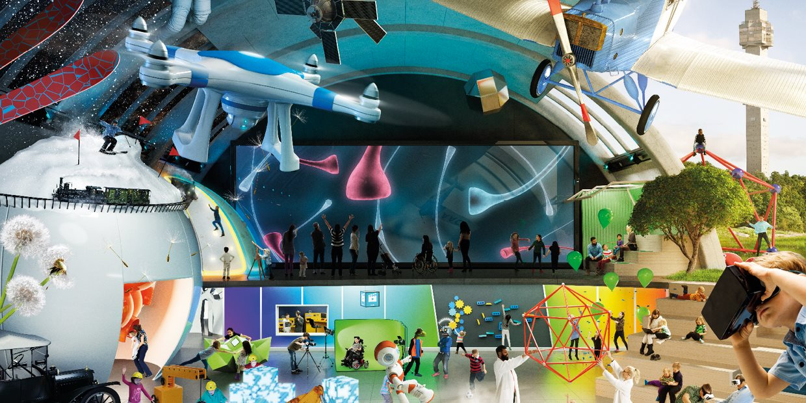
3. What fields are science and technology
greatly changing?

Slide 20
Science and technology are greatly
changing everything.

Slide 21
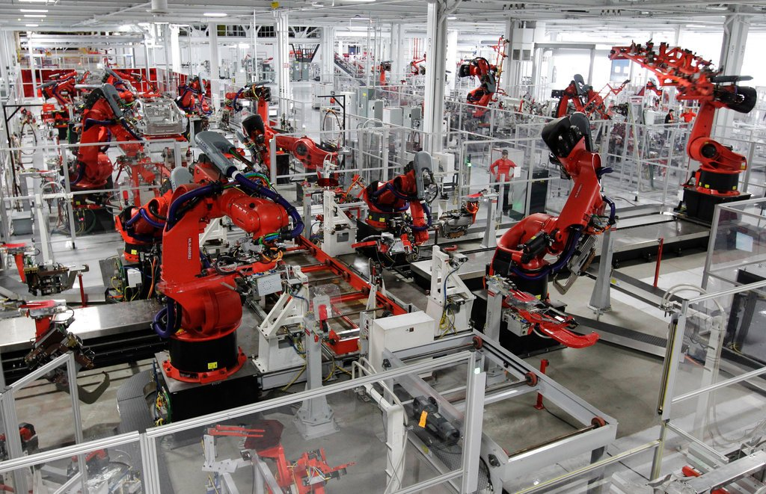
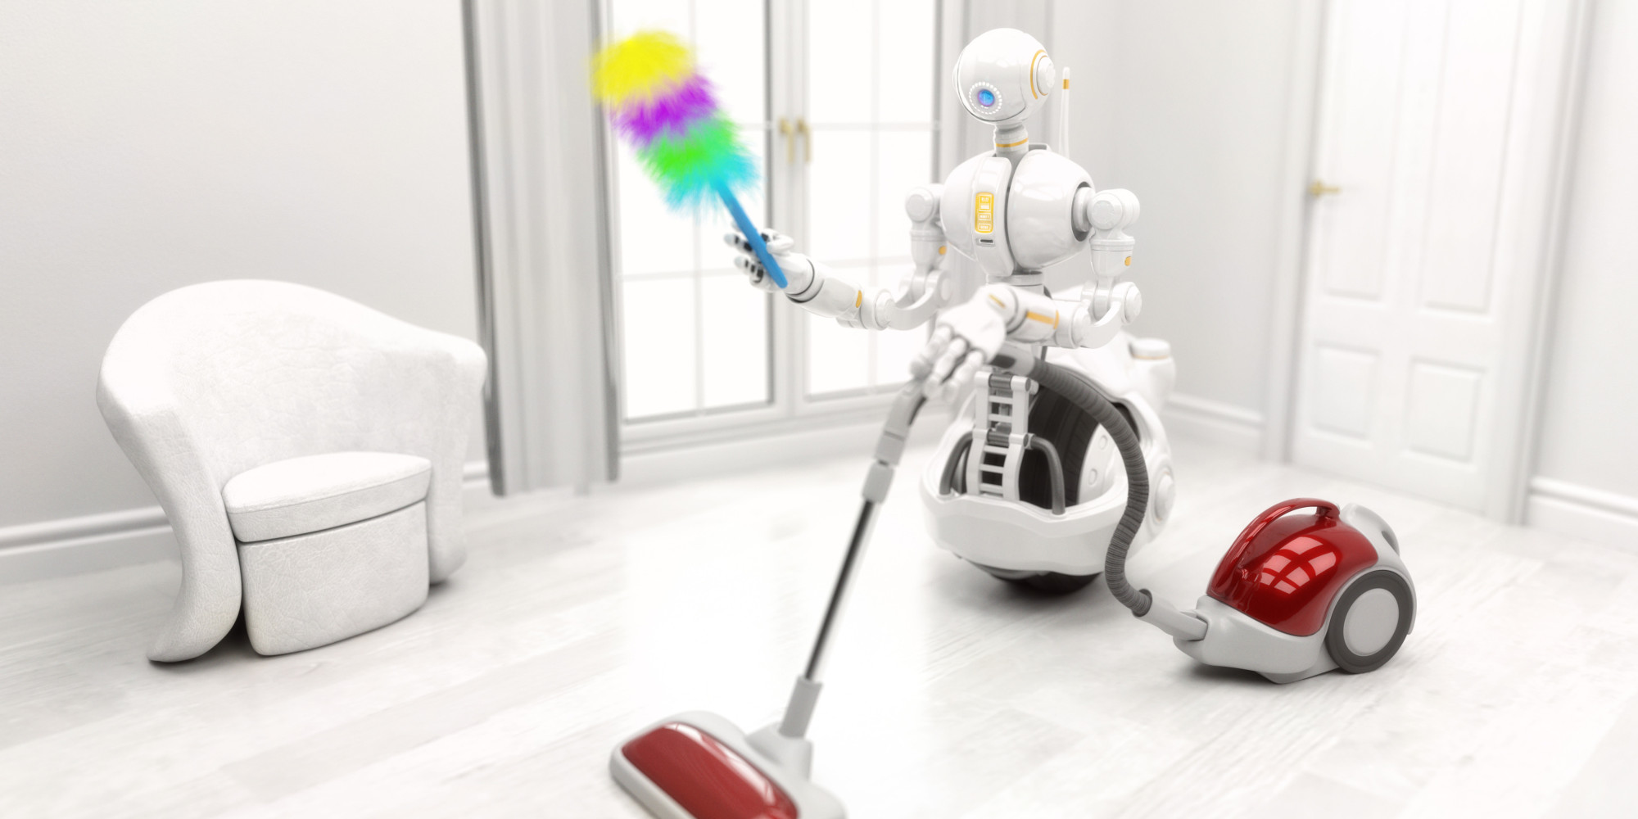
b. What did Nick’s dad tell him?

Slide 22
He told Nick that only robots would work in the
factories and clean our homes in the future.

Slide 23

5. What did Chau’s science teacher say?

Slide 24
He/ She said that there would be no more schools:
They’d just stay at home and learn on the Internet.

Slide 25
1b. Work with a partner. What fields are mentioned
in the conversation which are affected by science
and technology?

Slide 28
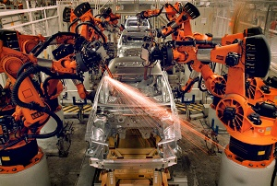
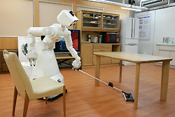

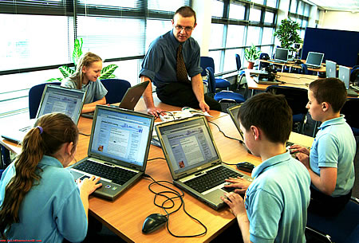
1b. Work with a partner. What fields are mentioned
in the conversation which are affected by science
and technology?
Economy
workplace
Home
travel
education

Slide 29
1c. Put a word/phrase from the box in each blank.
1. Technology in the ______of telecommunications has developed greatly over the last decade.
2. In the future, ordinary people may travel into ______ on spaceships.
3. He said he worked very hard and that was ______ to his success.
4. An international meeting on _______________________ took place in Singapore last week.
5. If we had __________ now, we could solve the problem of traffic jams.
flying car
economic development
field
space
the key

Slide 30
2. Put one of the words/phrases from the box in each gap. There is one extra.
science subjects
technology
technique
machines
scientific progress
researchers
1. Her teacher said she was really good at _______________, but she was not very good at English
2. Advances in _________ have improved crop yields by over 30%
3. Cancer _______________ have made great progress, but many aspects of this disease need further study.
4. Scientists will be trying to invent ____________ to teach children at home.
5. Thanks to _____________________. Our world will be transformed greatly.

Slide 31
3. GAME: FIND SOMEONE WHO
Ask your classmates Yes/No questions, using do or will. If they say “Yes” to a question , write their names in the box. A name can be written down only once. The first person to get a name in each box is the winner.
02:00
01:59
01:58
01:57
01:56
01:55
01:54
01:53
01:52
01:51
01:50
01:49
01:48
01:47
01:46
01:45
01:44
01:43
01:42
01:41
01:40
01:39
01:38
01:37
01:36
01:35
01:34
01:33
01:32
01:31
01:30
01:29
01:28
01:27
01:26
01:25
01:24
01:23
01:22
01:21
01:20
01:19
01:18
01:17
01:16
01:15
01:14
01:13
01:12
01:11
01:10
01:09
01:08
01:07
01:06
01:05
01:04
01:03
01:02
01:01
01:00
00:59
00:58
00:57
00:56
00:55
00:54
00:53
00:52
00:51
00:50
00:49
00:48
00:47
00:46
00:45
00:44
00:43
00:42
00:41
00:40
00:39
00:38
00:37
00:36
00:35
00:34
00:33
00:32
00:31
00:30
00:29
00:28
00:27
00:26
00:25
00:24
00:23
00:22
00:21
00:20
00:19
00:18
00:17
00:16
00:15
00:14
00:13
00:12
00:11
00:10
00:09
00:08
00:07
00:06
00:05
00:04
00:03
00:02
00:01
00:00
Find someone who…
likes science subjects at school | wants to travel into space in the future | wants to become a scientist
knows a Vietnamese scientist | will go into sciences when finishing school | admires a scientist or an inventor

Slide 32
HOMEWORK
Learn new words by reading the conversation
again and again.
Do exercises 1, 2, 3 on pages 36, 37 in workbook.

Slide 33
Slap the board
researcher
development
enormous
benefit
field
role
technique

Slide 34
surface

Slide 35
accommodate

Slide 36
experience

Slide 37
atmosphere

Slide 38
trace

Slide 39
oxygen

