Slide 2


Unit
9
CITIES OF THE WORLD
LESSON 2: A CLOSER LOOK 1
Vocabulary
Pronunciation
1
1

Slide 3
LESSON 2: A CLOSER LOOK 1
Name the pictures
WARM-UP
Vocabulary pre-teaching
Task 1: Fill each box with an adjective.
Task 2: Complete the sentences with the words in 1.
Task 3: Write the words / phrases below under the correct pictures.
VOCABULARY
Task 4: Listen and write the words in the correct column. Then listen and repeat.
Task 5: Listen and repeat. Pay attention to the underlined words.
PRONUNCIATION
CONSOLIDATION
Wrap-up
Homework

Slide 4
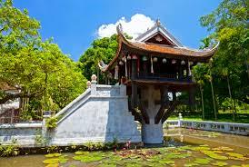
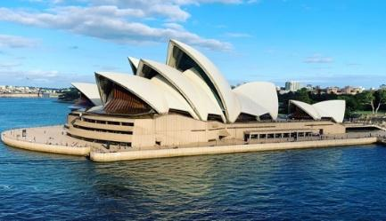
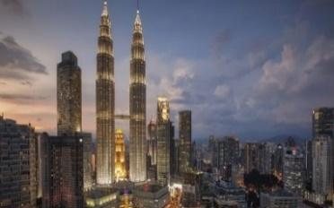
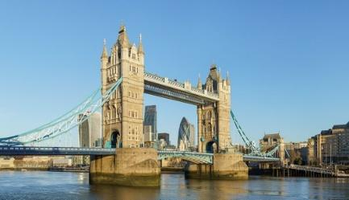
WARM-UP
1
One Pillar Pagoda
Sydney Opera House
Twin Tower
Tower Bridge

Slide 5


VOCABULARY
sunny (adj)
/ˈsʌni/
trời có nắng

Slide 6
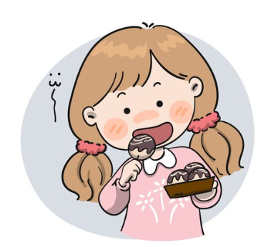
VOCABULARY
delicious (adj)
/dɪˈlɪʃəs/
ngon

Slide 7

VOCABULARY
stall (n)
/stɔːl/
gian hàng, quầy hàng

Slide 8

VOCABULARY
palace (n)
/ˈpæləs/
cung điện, lâu đài

Slide 9
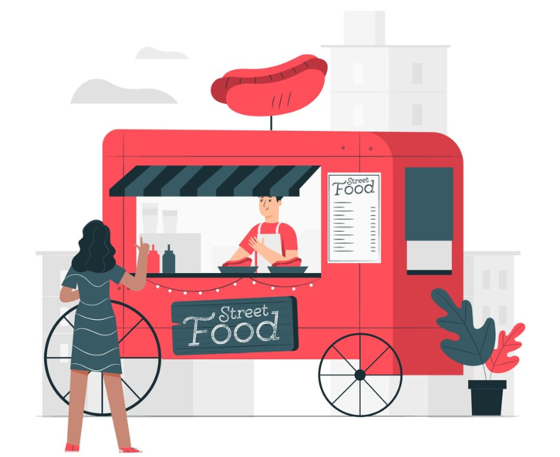
VOCABULARY
street food (n.ph.)
/ˈstriːt fuːd/
thức ăn đường phố

Slide 10
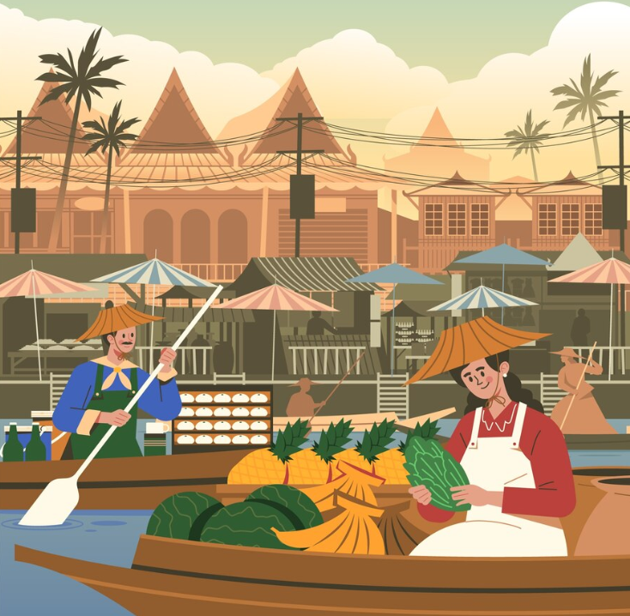
VOCABULARY
floating market (n.ph.)
/ˈfləʊtɪŋ mɑːrkɪt/
chợ nổi trên sông

Slide 11
VOCABULARY
New words | Pronunciation | Meaning
1. sunny (adj) | /ˈsʌni/ | trời có nắng
2. delicious (adj) | /dɪˈlɪʃəs/ | ngon
3. stall (n) | /stɔːl/ | gian hàng, quầy hàng
4. palace (n.ph) | /ˈpæləs/ | cung điện, lâu đài
5. street food (n.ph) | /ˈstriːt fuːd/ | thức ăn đường phố
6. floating market (n.ph) | /ˈfləʊtɪŋ mɑːrkɪt/ | chợ nổi trên sông

Slide 12
VOCABULARY
1
Fill each box with an adjective.
old
exciting
rainy
old
city
delicious
sunny
delicious
tasty
food
exciting
tasty
friendly
helpful
friendly
helpful
people
rainy
sunny
weather

Slide 13
VOCABULARY
2
Complete the sentences with the words in 1.
1.
- What’s the weather like in Sydney in summer?
sunny
- It’s and dry.
old
2.
I love the buildings in Edinburgh. I feel that they can tell stories.
exciting
3.
There are so many things to do in New York. It’s very .
The people in my city are and helpful.
4.
friendly
delicious / tasty
5.
Ha Noi is famous for its street food.

Slide 14
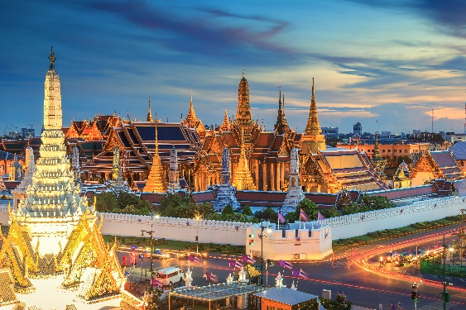
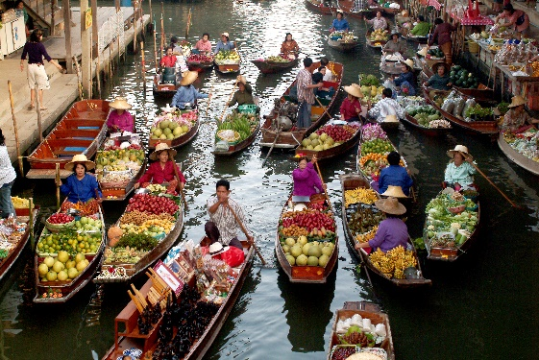
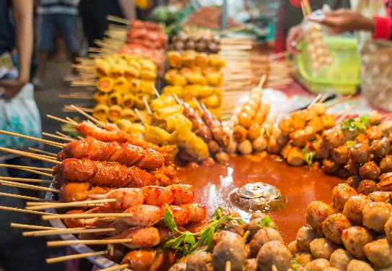
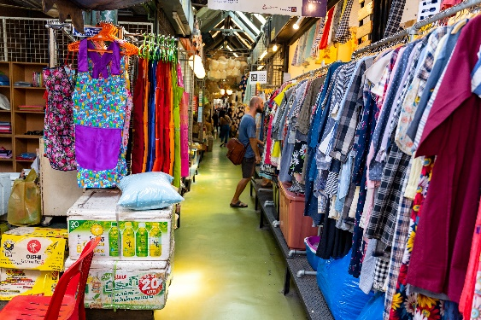
VOCABULARY
3
Write the words / phrases below under the correct pictures.
stall
palace
1.
palace
2.
floating market
street food
floating market
street food
stall
3.
4.

Slide 15

PRONUNCIATION
4
Notes:
Video link: https://www.youtube.com/watch?v=_Mun_h-F04A&list=PL8_ETpRL2xNbMMSCSok5UNHcQOpjKgvAn&index=10

Slide 16
PRONUNCIATION
4
Listen and write the words in the correct column. Then listen and repeat.
boat
house
town
tower
postcard
crowded
coast
pagoda
/əʊ/
/aʊ/
boat
house
postcard
crowded
coast
town
pagoda
tower

Slide 17
PRONUNCIATION
5
Listen and repeat. Pay attention to the underlined words.
1.
The town is crowded at the weekend.
2.
There’s lots of snow in Tokyo in winter.
3.
It’s very cold on the boat.
4.
He’s running around the house.

Slide 18



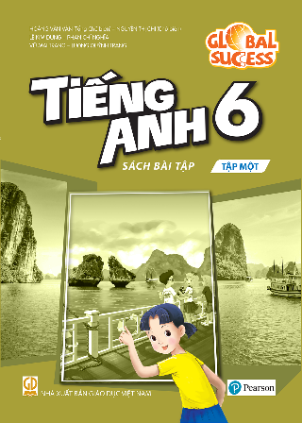


Website: hoclieu.vn
Fanpage: facebook.com/www.tienganhglobalsuccess.vn/

