Slide 2



Unit
9
Cities of the world
LESSON 1: GETTING STARTED
What nice photos!
1

Slide 3
LESSON 1: GETTING STARTED
LESSON 1: GETTING STARTED
WARM-UP
Matching game: Cities and Continents
PRESENTATION
Vocabulary
Task 1: Listen and read.
Task 2: Write the names of the cities in the correct place.
Task 3: Read the conversation again and match the cities with the adjectives describing them.
Task 4: Match the cities with their landmarks.
PRACTICE
PRODUCTION
Task 5: Game: What city is it?
CONSOLIDATION
Wrap-up
Homework

Slide 4
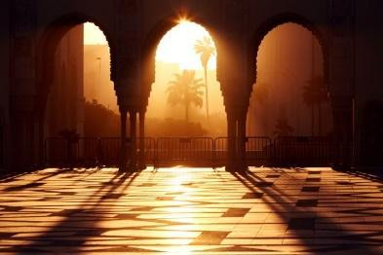
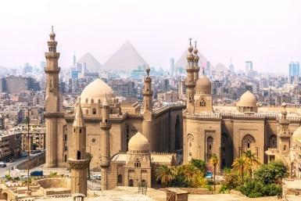
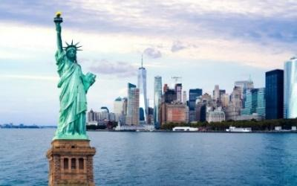
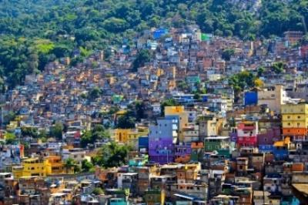
WARM-UP
1
Casablanca
Cairo
Africa
New York
Rio De Janeiro
America

Slide 5
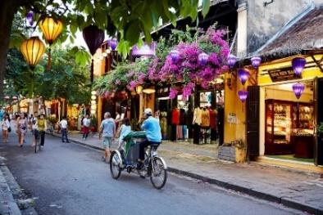
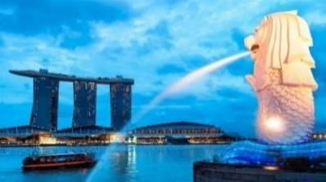
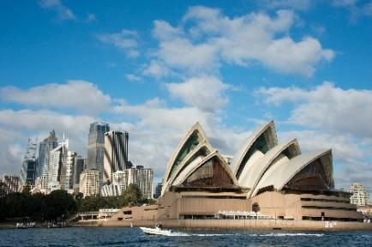
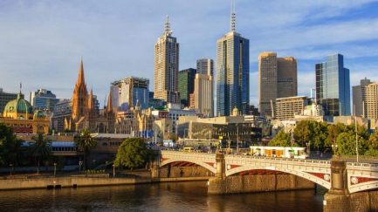
WARM-UP
1
Hoi An
Singapore
Asia
Sydney
Melbourne
Oceania

Slide 6
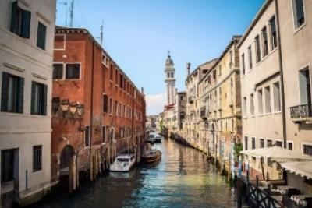
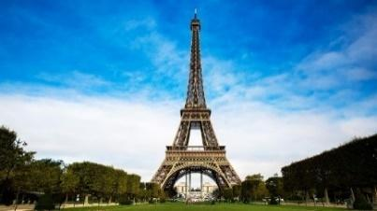
WARM-UP
Venice
Paris
Europe

Slide 7
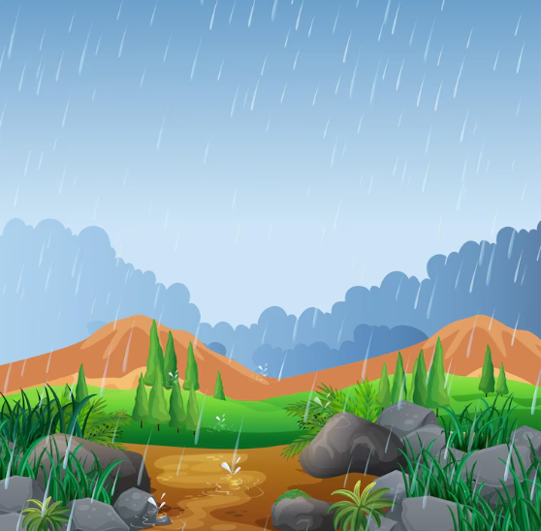

VOCABULARY
rainy (adj)
/ˈreɪni/
trời có mưa

Slide 8

VOCABULARY
crowded (adj)
/ˈkraʊdɪd/
đông đúc

Slide 9

VOCABULARY
beautiful (adj)
/ˈbjuːtɪfl/
xinh đẹp

Slide 10

VOCABULARY
interesting (adj)
/ˈɪntrestɪŋ/
thú vị

Slide 11

VOCABULARY
exciting (adj)
/ɪkˈsaɪtɪŋ/
hào hứng

Slide 12
VOCABULARY
New words | Pronunciation | Meaning
1. rainy (adj) | /ˈreɪni/ | trời có mưa
2. crowded (adj) | /ˈkraʊdɪd/ | đông đúc
3. beautiful (adj) | /ˈbjuːtɪfl/ | xinh đẹp
4. interesting (adj) | /ˈɪntrestɪŋ/ | thú vị
5. exciting (adj) | /ɪkˈsaɪtɪŋ/ | hào hứng

Slide 13

PRACTICE
1
What nice photos!
Listen and read.

Slide 14
PRACTICE
1
Listen and read.
Mai: Tom, are these photos from your vacations?
Tom: Yes, they are. This is Sydney, a city in Australia.
Mai: What’s it like?
Tom: It’s exciting with a lot of beaches.
Mai: What a beautiful place!
Tom: Yes, its beaches are very clean.
Mai: Wonderful. Oh, this is London. Isn’t it raining? What bad weather!
Tom: Yes, it rains all the time. Can you see Big Ben?
Mai: Yeah ... on the River Thames. It’s a landmark of London.
Tom: It is. And this is Times Square in New York, crowded but interesting.
Mai: You’re lucky to visit many places.
Tom: I am. What about your vacations?
Mai: Here are some photos of mine. This is ...

Slide 15

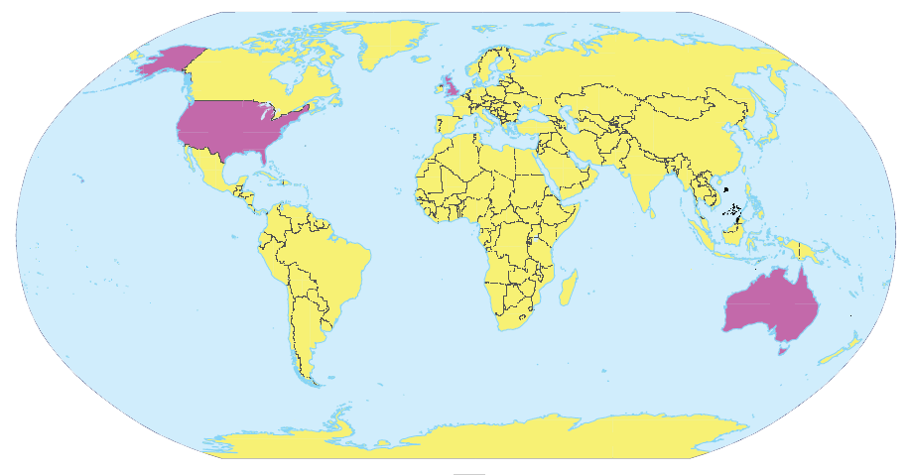
PRACTICE
2
Write the names of the cities in the correct place.
1.
London
New York
2.
Sydney
London
New York
3.
Sydney

Slide 16
PRACTICE
3
Read the conversation again and match the cities with the adjectives describing them.
a. rainy
1. Sydney
b. crowded
2. London
c. exciting
d. beautiful
3. New York
e. interesting

Slide 17
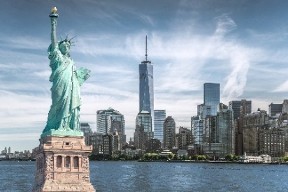
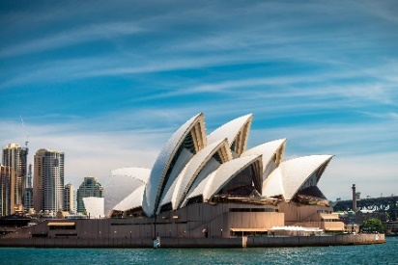
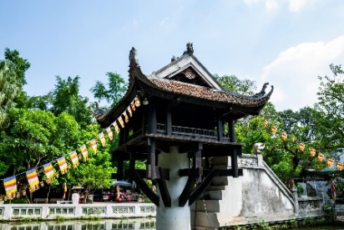
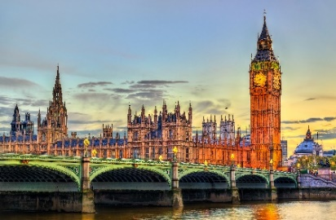
PRACTICE
4
Match the cities with their landmarks.
a
1. Ha Noi
b
2. London
c
3. New York
d
4. Sydney

Slide 18

PRODUCTION
5
What city is it?
Example:
A: What’s it like?
B: It has beautiful beaches.
C: Is it in Australia?
B: Yes, it is.
A: It’s Sydney.
B: Right.

Slide 19

CONSOLIDATION
1
Wrap-up
What have we learnt in this lesson?
identify the topic of the unit
use the words related to cities and landmarks

Slide 20

CONSOLIDATION
2
Homework
- Do exercises in the workbook.
- Prepare for the Project of the unit

Slide 21






Website: hoclieu.vn
Fanpage: facebook.com/www.tienganhglobalsuccess.vn/

