Slide 2


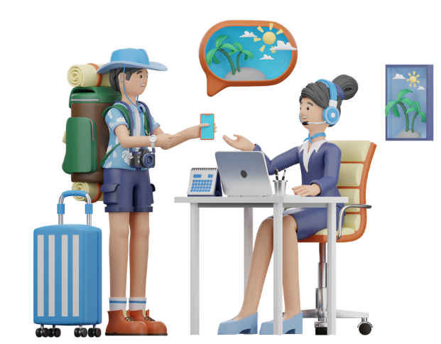
Unit
8
TOURISM
LESSON 7: LOOKING BACK & PROJECT
1

Slide 3
LESSON 7: LOOKING BACK & PROJECT
LESSON 1: GETTING STARTED
WARM-UP
Kim’s game
Task 1: Choose the correct answer A, B, C, or D to complete each sentence.
Task 2: Fill in each blank with a suitable word or phrase. The first letter has been given.
VOCABULARY
GRAMMAR
Task 3: Use a relative pronoun which, who, or whose to complete each sentence.
Task 4: Combine each pair of sentences, using a suitable relative pronoun which, who, or whose.
PROJECT
Making a plan for a two-day trip
CONSOLIDATION
Wrap-up
Homework

Slide 4
WARM-UP
KIM’S GAME
RULES:
Work in groups of three or four students.
Look at the pictures on the screen.
They will disappear after 2 seconds, so try to remember all the pictures without writing them down.
After all the pictures disappear, you have 1 minute to write down the words in each picture in the paper.
2 points for each correct answer.

Slide 5



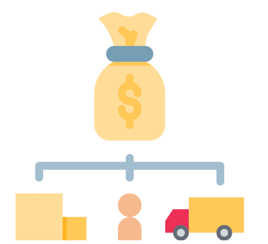


WARM-UP
KIM’S GAME

Slide 6
WARM-UP
KIM’S GAME
itinerary
package tour
holidaymaker
cost
accommodation
travel agency

Slide 7
VOCABULARY
1
Choose the correct answer A, B, C, or D to complete each sentence.
1. If you are travelling abroad for the first time, it’s better to look for a good travel ______ to arrange everything for you.
A. budget B. agency
C. tourism D. homestay
2. Many ______ buildings have become UNESCO World Heritage Sites.
A. modern B. domestic
C. ruinous D. international
Notes:
1. B 2. C 3. C 4. D 5. A

Slide 8
VOCABULARY
1
Choose the correct answer A, B, C, or D to complete each sentence.
3. Young people are usually good at ______ for cheap transportation and accommodation.
A. buying B. booking
C. hunting D. applying
4. Nowadays, people can travel on their own to new places by using ______.
A. tours B. earphones
C. entrance tickets D. Google Maps
5. ______ is for people who love trying different local dishes.
A. Food tourism B. Domestic tourism
C. Ecotourism D. Shopping tourism
Notes:
1. B 2. C 3. C 4. D 5. A

Slide 9
VOCABULARY
2
Fill in each blank with a suitable word or phrase. The first letter has been given.
omestic
1. Would you like to go on an international or a d_______ tour?
2. – Can I make a small change to this itinerary?
– I’m afraid not. It’s f____.
3. Thanks to her skills with a____, she was able to buy cheap tickets to Quy Nhon.
4. They are not experienced enough to go on a s_________ tour. They need an adult to go with them.
5. – What did you enjoy most on your tour to Sa Pa?
– The n______ beauty of the mountains and valleys.
ixed
pps
elf-guided
atural
Notes:
1. domestic 2. fixed 3. apps 4. self-guided 5. natural

Slide 10
GRAMMAR
3
Use a relative pronoun which, who, or whose to complete each sentence.
which
1. Excuse me, could you show me a souvenir shop ______ sells small-size
paintings of this city?
2. We can ask my uncle ______ has a lot of experience in organising tours.
3. A visa is a stamp or mark in your passport ______ allows you to enter or leave a foreign country.
4. I’m lost. The hotel I’m staying in is a white multi-storey one ______ name is Islander Hotel.
5. The police officer is talking to the tourist ______ passport is missing.
who
which
whose
whose
Notes:
1. which 2. who 3, which 4. whose 5. whose

Slide 11
GRAMMAR
4
Combine each pair of sentences, using a suitable relative pronoun which, who, or whose.
1. My family spent four days in India. Its culture is unique.
2. Organising self-guided tours helps develop personal skills. They are important for everybody.
My family spent four days in India, whose cultural life is unique.
Organising self-guided tours helps develop personal skills which are important for everybody.

Slide 12
GRAMMAR
4
Combine each pair of sentences, using a suitable relative pronoun which, who, or whose.
3. Russel stayed in a hotel in Bui Vien Street. It is one of the best streets for foreign tourists.
4. After the Muay Thai Show, my sons talked to the artists. They admired their performance so much.
Russel stayed in a hotel in Bui Vien Street, which is one of the best streets for foreign tourists.
After the Muay Thai Show, my sons talked to the artists whose performance they admired so much.

Slide 13
GRAMMAR
4
Combine each pair of sentences, using a suitable relative pronoun which, who, or whose.
5. We participated in a lot of activities with the local people. They were friendly and helpful.
We participated in a lot of activities with the local people, who were friendly and helpful.

Slide 14

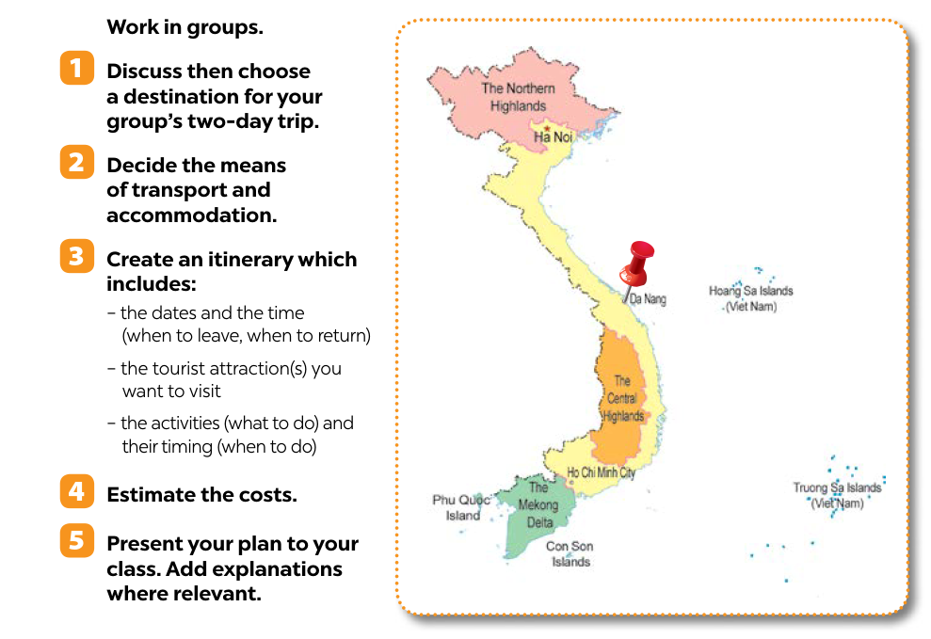
PROJECT
4
Notes:
1. shouldn’t 2. might 3. can 4. must 5. can

Slide 15

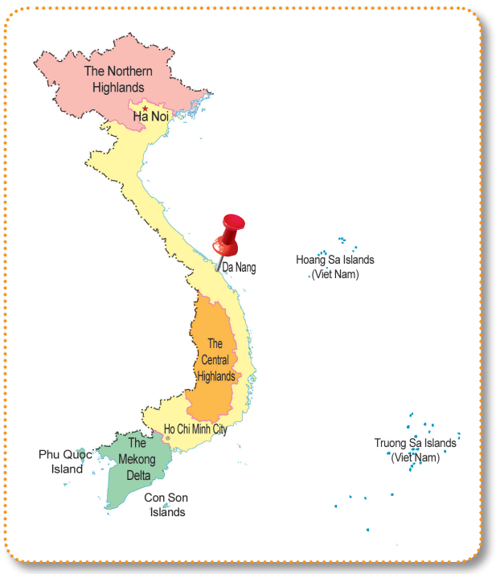

PROJECT
4
Notes:
1. shouldn’t 2. might 3. can 4. must 5. can

Slide 16

CONSOLIDATION
1
Wrap-up
What have we learnt in this lesson?
Revise the vocabulary items learnt in the unit;
Revise uses of relative pronouns;
Plan their own trip.

Slide 17

CONSOLIDATION
2
Homework
Prepare for the next lesson.

Slide 18
Website: hoclieu.vn
Fanpage: facebook.com/tienganhglobalsuccess.vn/

