Slide 1
KIM’S GAME
WARM-UP
Work in groups of three or four.
Watch a video clip and try to remember all types of shops mentioned in the clip without taking notes.
After finishing watching the clip, write down as many stores/ shops as possible.
The group with the most correct answers will win.

Slide 2
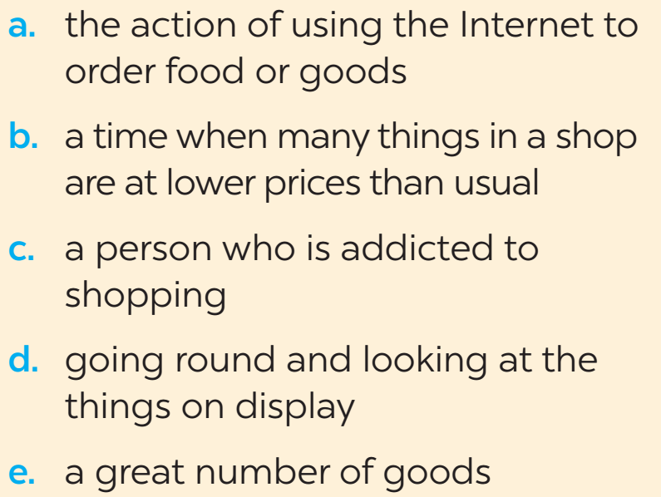
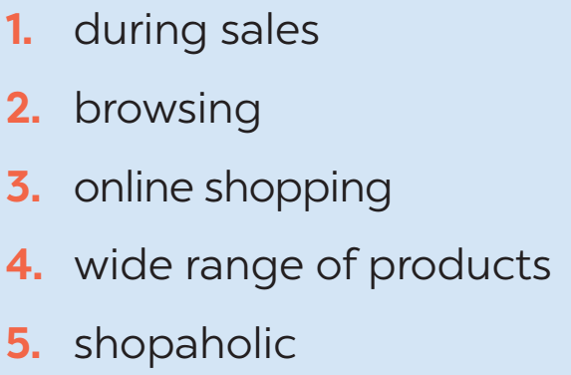
* VOCABULARY
1
Match the words and phrases (1-5) with the meanings (a-e).

Slide 3
2
Complete the sentences with the words and phrases from the box.
Internet access
bargain
offline
on sale
home-grown
1. Look! These sports shoes are __________. They are 30% off.
2. This item has a price tag, so you cannot ___________.
3. Do you have ______________ here? I want to check my email.
4. When you visit a farmers’ market, you will find a lot of ___________
fruit and vegetables.
5. My mother always shops ________. She never shops online.

Slide 4

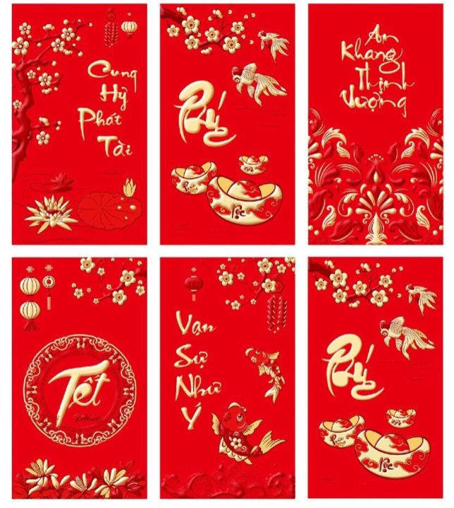
Picking fortune at the beginning of the new year
1
6
5
2
3
4
7
8
9

Slide 5
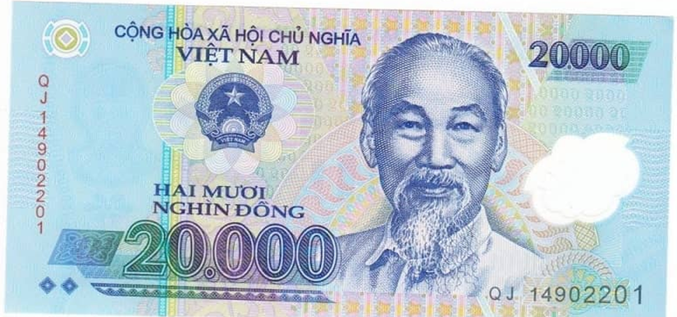
Picking fortune at the beginning of the new year

Slide 6
Picking fortune at the beginning of the new year

Slide 7
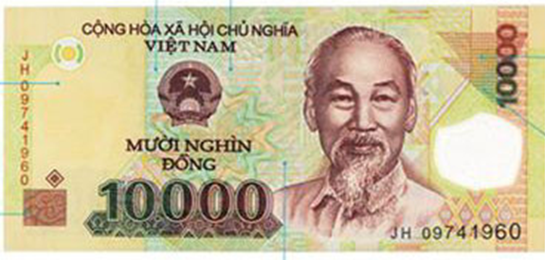
Picking fortune at the beginning of the new year

Slide 8
Picking fortune at the beginning of the new year

Slide 9
Picking fortune at the beginning of the new year

Slide 10
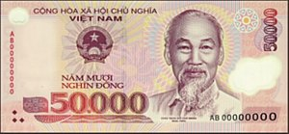
Picking fortune at the beginning of the new year

Slide 11
Picking fortune at the beginning of the new year

Slide 12
Picking fortune at the beginning of the new year

Slide 13
* GRAMMAR
3
Complete each sentence with a suitable adverb of frequency.
1. My sister ________ watches the Junior Master Chef programme. She never misses an episode.
2. My mum ______________ shops at the supermarket. But I don’t go there often.
3. My father ______ goes to a dollar store. He says there’s nothing worth buying there.
4. We don’t ____________ go to the supermarket. It’s far from our home.
5. Theses brands are ______ on sale, just once or twice a year.
always
always/ usually/ often
never
often/ usually
rarely

Slide 14
4
Use the correct tense and form of the verbs in brackets to complete the sentences.
1. The shuttle bus (leave) _______ every 15 minutes to take customers to the parking lot.
2. - Mum, what time (be) ____ the show tonight?
- Let me check.
3. We (can / use) ________ these vouchers for the next shopping.
4. The announcement says that the sale (last) _____ for just two hours, from 17:00 to 19:00 tomorrow.
5. We (not / have) _________ home economics next semester. We have music instead.
leaves
is
can use
lasts
don’t have

Slide 15

YOUR DREAM SHOPPING PLACE
PROJECT
1
Imagine a shopping place you would like to have in your neighbourhood.
I would like to have a new shopping place which has a large playground for the children and a large swimming pool in my neighborhood.

Slide 16
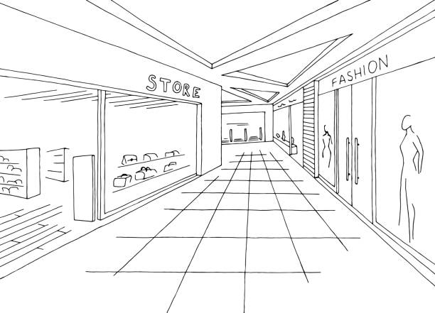
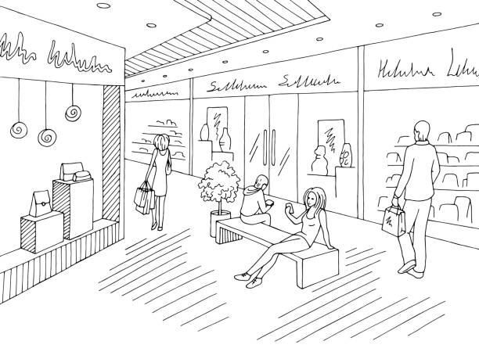
2
Draw it or find a picture similar to it.

Slide 17

2
Homework
Do exercise in the Workbook
Complete Project
Prepair Unit 9: lesson 1( Getting started)

