Slide 1



Slide 2
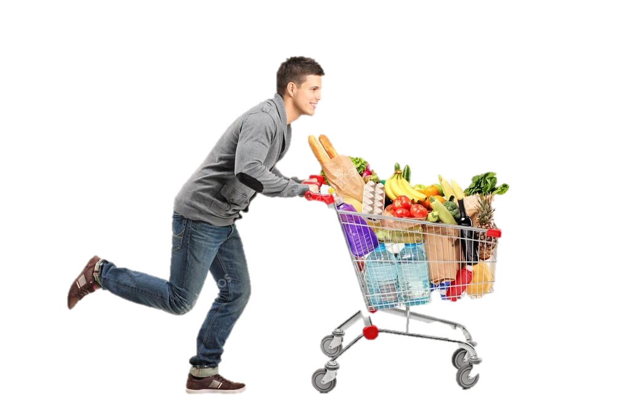
* WARM-UP:
Answer the questions:
SHOPPING
1. Do you like shopping?
2. Where do you often go shopping?
3. Can you name some markets or supermarkets that you know?
4. Do you prefer shopping in an open-air market or in a supermarket?

Slide 3

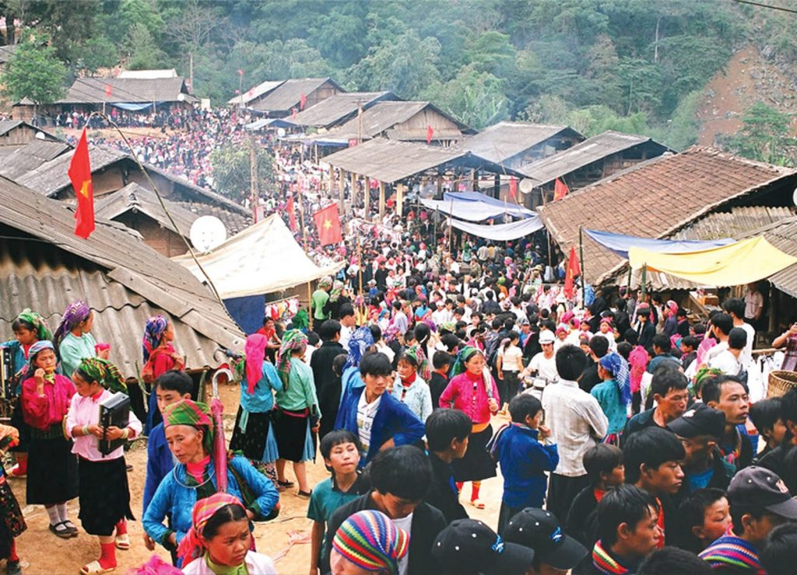
Unit
8
SHOPPING
LESSON 1: GETTING STARTED
My favourite shopping place
1

Slide 4
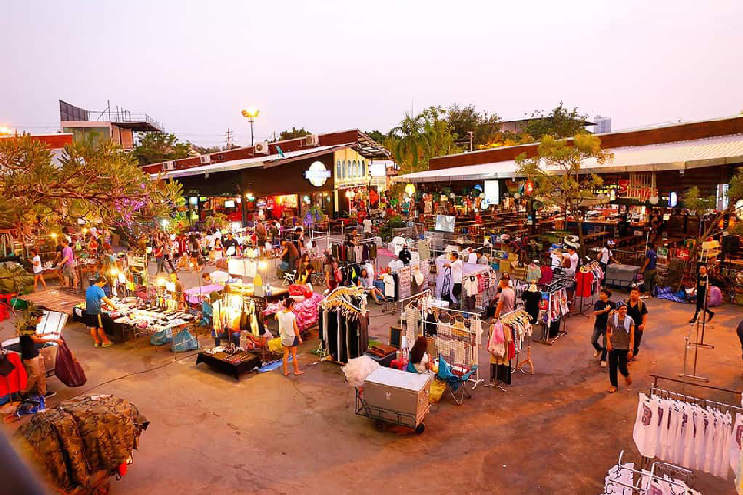

* VOCABULARY
open-air market (n):
chợ họp ngoài trời
/ˌəʊpən ˈeə ˈmɑːkɪt/

Slide 5
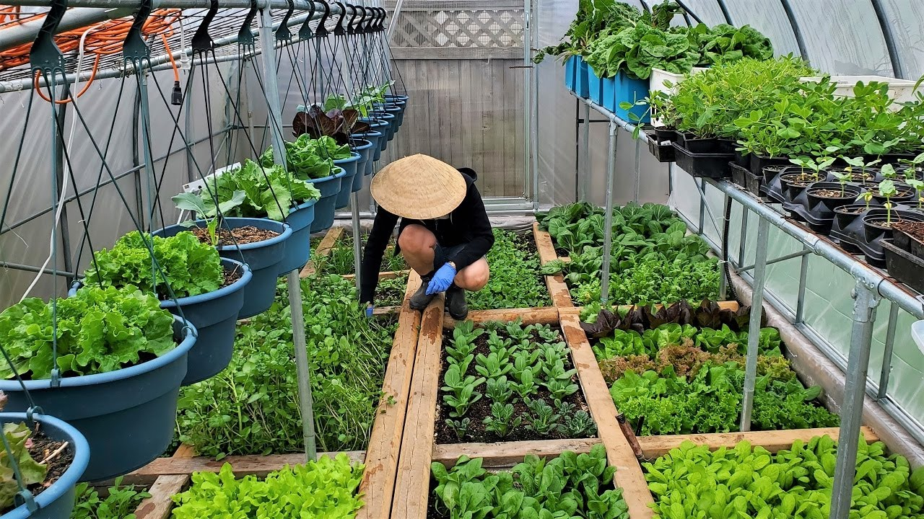
* VOCABULARY
home-grown (adj):
tự trồng
/ˌhəʊm ˈɡrəʊn/

Slide 6

* VOCABULARY
home-made (adj):
tự làm
/ˌhəʊm ˈmeɪd/

Slide 7
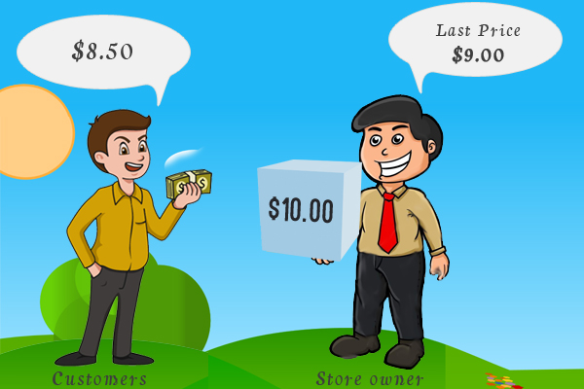
* VOCABULARY
bargain (v):
mặc cả/ trả giá
/ˈbɑːɡən/

Slide 8
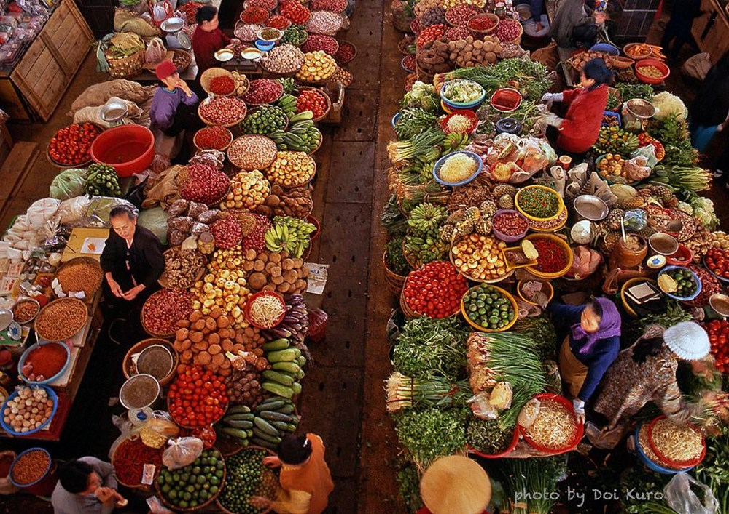
* VOCABULARY
farmers’ market (n):
chợ nông sản
/ˈfɑːməz mɑːkɪt/

Slide 9
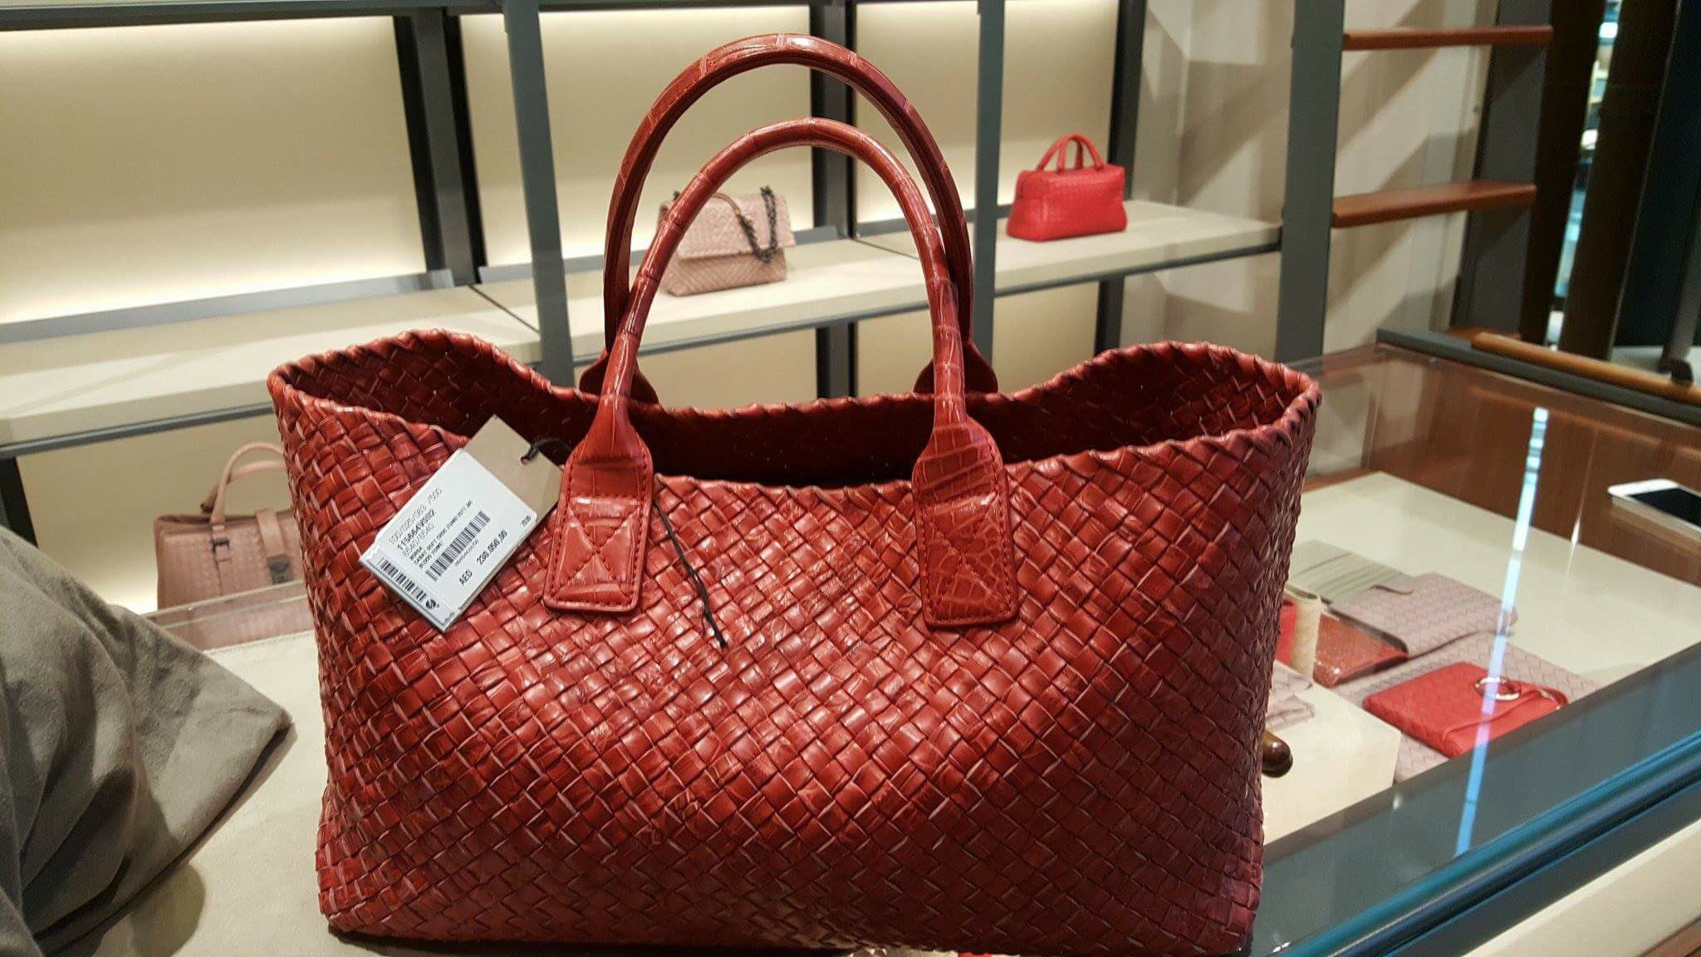
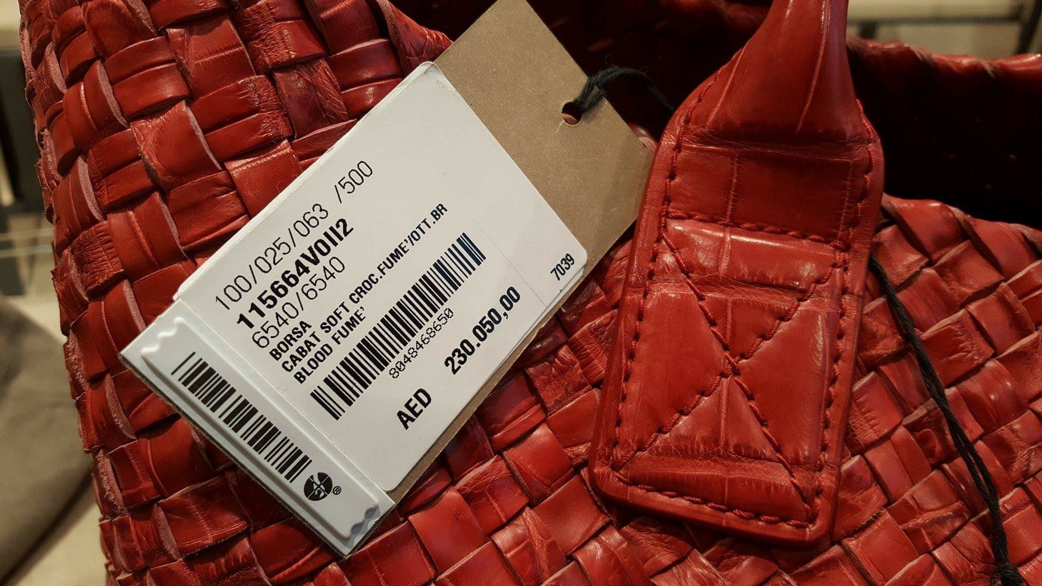
* VOCABULARY
price tag (n):
nhãn ghi giá mặt hàng
/ˈpraɪs tæɡ/

Slide 10
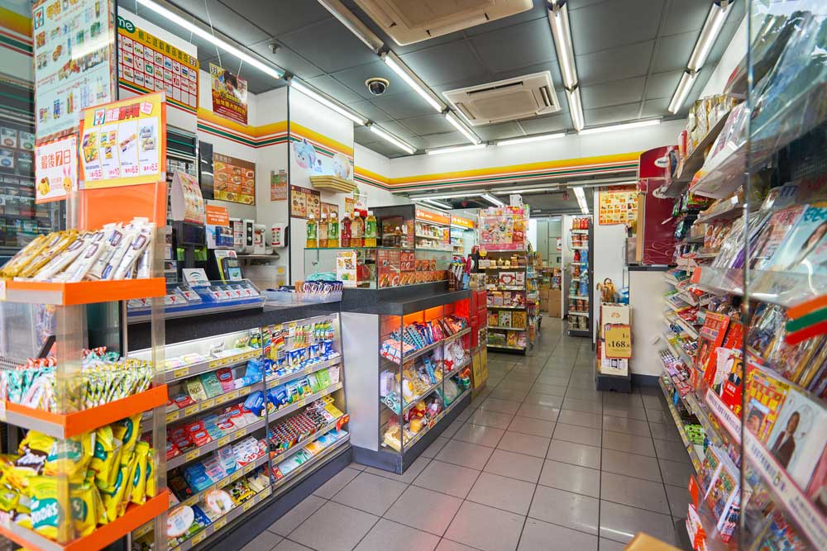
* VOCABULARY
convenience store (n):
cửa hàng tiện lợi
/kənˈviːniəns stɔː/

Slide 11
*VOCABULARY
New words | Pronunciation | Meaning
1. open-air market (n) | /ˌəʊpən ˈeə ˈmɑːkɪt/ | chợ họp ngoài trời
2. home-grown (adj) | /ˌhəʊm ˈɡrəʊn/ | tự trồng
3. home-made (adj) | /ˌhəʊm ˈmeɪd/ | tự làm
4. bargain (v) | /ˈbɑːɡən/ | mặc cả
5. farmers’ market (n) | /ˈfɑːməz mɑːkɪt/ | chợ nông sản
6. price tag (adj) | /ˈpraɪs tæɡ/ | nhãn ghi giá mặt hàng
7. convenience store (n) | /kənˈviːniəns stɔː/ | cửa hàng tiện lợi

Slide 12
* Checking vocabulary
say words in English
Nhãn ghi giá mặt hàng
price tag
convenience store
Cửa hàng tiện lợi
Chợ nông sản
farmers’ market
Tự làm
home-made
Mặc cả
bargain
chợ họp ngoài trời
open-air market
Tự trồng
home-grown

Slide 13
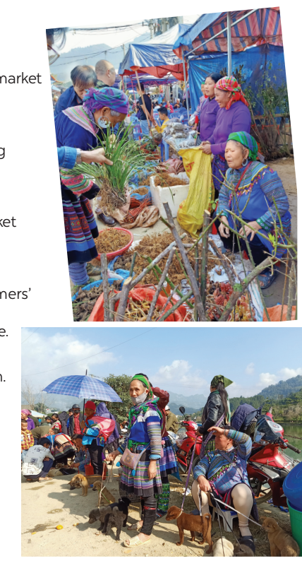

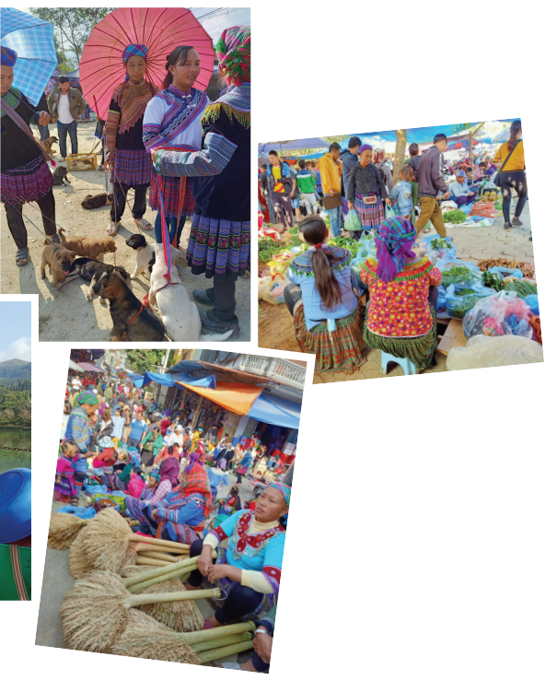
CHATTING
Answer the questions:
1. What are the pictures of?
2. What are the people in the pictures doing?
The pictures are of open-air markets
The people in the pictures are buying
and selling things.

Slide 14
*PRACTICE
1
Listen and read.
Mai: How was your trip to Bac Ha, Alice? Alice: It’s awesome. I like Bac Ha Fair. It’s an open-air market in Lao Cai. Mai: What do you like about it? Alice: Many things. The people at the market were wearing really colourful costumes. Mai: Yeah…They came from different minority groups. Alice: I think so, and most of the products sold at the market were home-grown and home-made.
I love it. Mai: Do you have similar markets in New Zealand? Alice: Yes, we do. Back in my city, Auckland, we have a farmers’ market every Saturday where farmers sell their products. My mother loves shopping there, and she rarely misses one. Mai: I prefer shopping at the supermarket. I can find almost everything I need there, I don’t have to bargain. All the items have fixed prices on their price tags. Alice: Right. It’s more convenient. Mai: Yeah…Oh, I’ve got to go. My art lesson starts at one o’clock, and I want to go to a convenience store on the way. See you later.
Alice: See you.

Slide 15
2
Mai and Alice mentioned four places where they can buy things. Complete the list.
1. open-air market
2. ______________________
3. ______________________
4. ______________________
farmers’ market
supermarket
convenience store

Slide 16
3
Match the types of markets with the features.
Types of markets | Features
open-air market supermarket | It’s outdoor. Goods are displayed on shelves. Shoppers can bargain. All items have fixed prices. The weather does not affect shopping.

Slide 17
4
Complete the sentences with the words and phrases from the box.
home -grown
bargain
home-made
price tag
convenience store
1. - What is ‘_____________’?
- It’s when buyers talk to the sellers to get a lower price.
2. A _______________ is a small shop and is usually open 24/7.
3. This salad is made of ___________ vegetables.
4. How much is this T-shirt? I cannot see the ___________.
5. Try our ___________ bread, Mai. My mother made it this morning.
Game

Slide 18













Gift box secret game

Slide 19







4
Complete the sentences with the words and phrases from the box.
home -grown
bargain
home-made
price tag
convenience store
1. - What is ‘_____________’?
- It’s when buyers talk to the sellers to get a lower price.
bargain
You are given 3 candies
GO HOME

Slide 20
4
Complete the sentences with the words and phrases from the box.
home -grown
bargain
home-made
price tag
convenience store
2. A _______________ is a small shop and is usually open 24/7.
convenience store
You are given 5 candies
GO HOME

Slide 21
4
Complete the sentences with the words and phrases from the box.
home -grown
bargaining
home-made
price tag
convenience store
3. This salad is made of ___________ vegetables.
home -grown
You are given 5k
GO HOME

Slide 22
4
Complete the sentences with the words and phrases from the box.
home -grown
bargaining
home-made
price tag
convenience store
4. How much is this T-shirt? I cannot see the ___________.
price tag
You are given 3 candies
GO HOME

Slide 23
4
Complete the sentences with the words and phrases from the box.
home -grown
bargaining
home-made
price tag
convenience store
5.Try our ___________ bread, Mai. My mother made it this morning.
home-made
You are given 5k and 1 candy
GO HOME

Slide 24
4
Complete the sentences with the words and phrases from the box.
home -grown
bargain
home-made
price tag
convenience store
1. - What is ‘_____________’?
- It’s when buyers talk to the sellers to get a lower price.
2. A _______________ is a small shop and is usually open 24/7.
3. This salad is made of ___________ vegetables.
4. How much is this T-shirt? I cannot see the ___________.
5. Try our ___________ bread, Mai. My mother made it this morning.

Slide 25
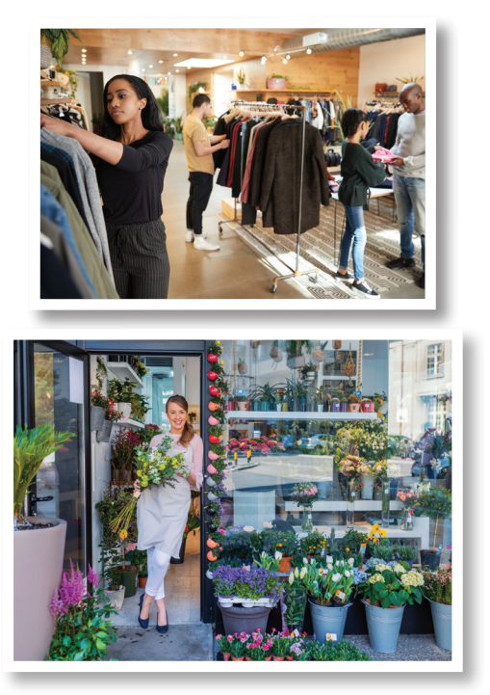

* PRODUCTION
5
Work in groups. Quickly write down the names of some speciality shops. The group with the most correct answers wins.
speciality shop
Example:
- clothes shop
- florist’s
/ˌspeʃiˈæləti ʃɒp/
cửa hàng bán đồ chuyên dụng

Slide 26
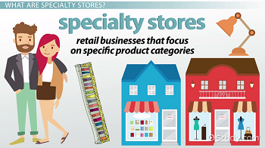
PRODUCTION
5
Suggested answers:
clothes shop
florist’s
bakery
butcher’s
bookshop
greengrocer’s
stationer’s
café
candy shop
music shop
computer shop
barber’s
hairdresser’s
gift shop
pet shop
shoe shop

Slide 27

* CONSOLIDATION
What have we learnt in this lesson?
identify the topic of the unit
use lexical items related to shopping
identify the language features that are covered in the unit

Slide 28

* Homework
- Name some places for shopping they have learnt about in the lesson.
- Learn new words and phrases by heart.
- Start preparing for the Project of the unit:

Slide 29


Goodbye!
See you again!

Slide 30
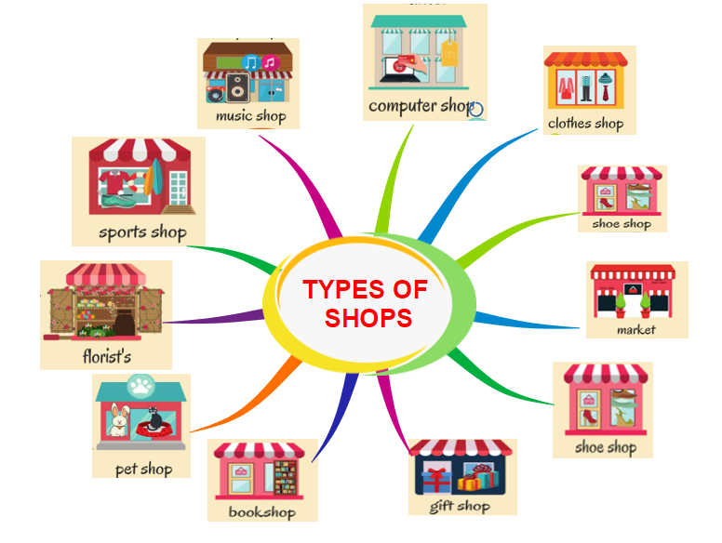
watch store
electronics store

Slide 31
1. Do you like shopping?
2. How often do you go shopping?
3. What types of items do use usually buy?
4. Who do you go shopping with?
5. When do you go shopping?
6. Online shopping and traditional shopping? Which ones do you prefer? Why?

