Slide 1


Unit 7.
Environmental protection

Slide 2
ARE U READY?

Slide 4
Lesson 4. Communication

Slide 5
Lesson 4. Communication

Slide 6

001
002
003
004
005
006
007
008
smile
joke
blow kiss
laugh out loud
grin
angry
cool
sleep
sad
wink
love
cry

Slide 8

OBJECTIVE
Asking for clarification

Slide 9
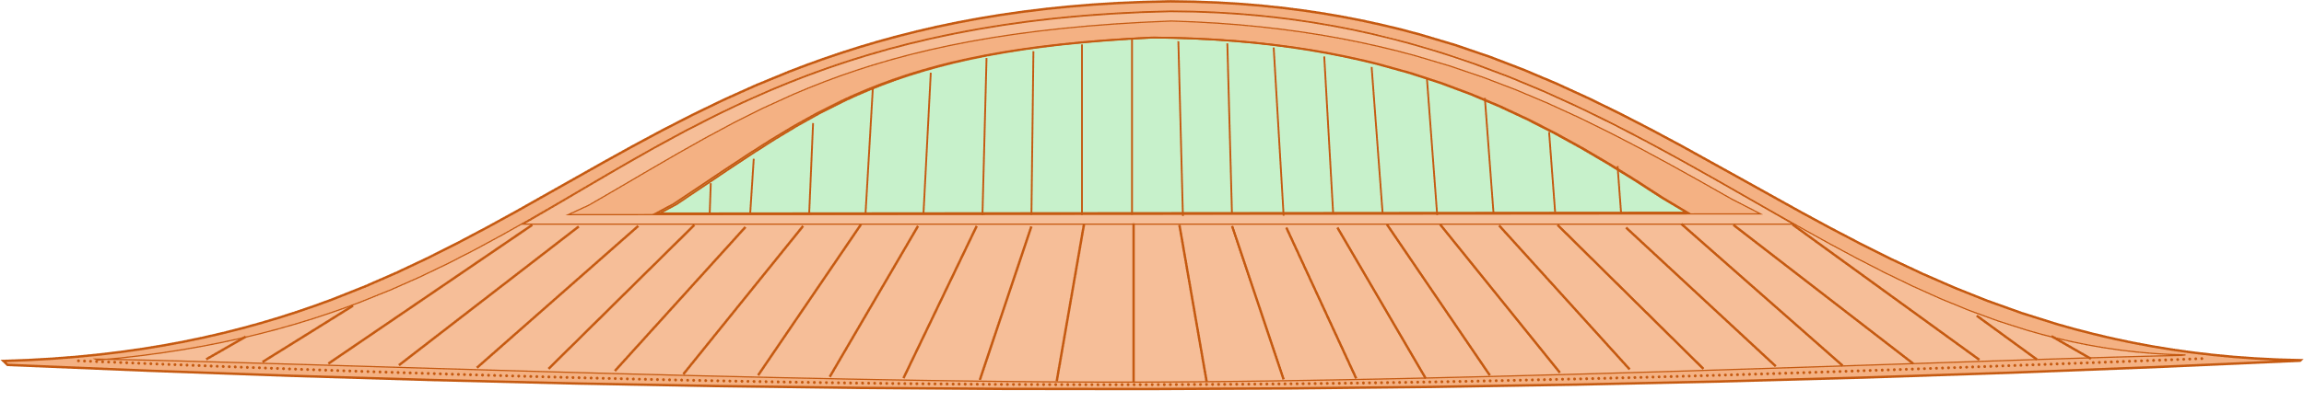

Slide 10

Ex 1. Listen and read the dialogue.
Pay attention to the highlighted sentences.
Mi: Hey, Linda. What does ‘endangered species’ mean?
Linda: Endangered species are animals in the wild that face a high risk of extinction.
Mi: And what do you mean by ‘in the wild’?
Linda: That means animals that live in their natural habitats, not in zoos.
Mi: Oh, I get it now. Thanks, Linda.

Slide 12
Can you tell me the structure from conversation?

Slide 13
Structure
Ex 2. Work in pairs. Make similar conversations to ask for and give clarification for the following.
Question | Answer
It means …
S is/are …
What does S mean?
What do you mean by S?
That means…
• single-use products
• global warming
What are these two questions asking about?
Asking for meaning/ clarification

Slide 14


Slide 15
Ex 3. Read the passage and tick (✓) the correct answers.
Every year on April 22nd, more than 190 countries celebrate Earth Day to protect the planet. The first Earth Day started in 1970 in America. Today more than 1 billion people participate in Earth Day activities each year, making it one of the largest movements. By taking part in activities like picking up litter and planting trees, you can help protect nature and the environment. You can also do things like buying green products and practising reduce, reuse and recycle. We can celebrate Earth Day and protect the earth at the same time. Moreover, we should continue doing things to save the earth every day of the year.

Slide 16
Ex 3. Read the passage and tick (✓) the correct answers.
What activities do people do on Earth Day?
1. picking up litter
✓
2. protecting endangered species
3. planting trees
✓
4. buying green products
✓
5. helping neighbours
By taking part in activities like picking up litter and planting trees, you can help protect nature and the environment. You can also do things like buying green products and practising reduce, reuse and recycle.

Slide 18
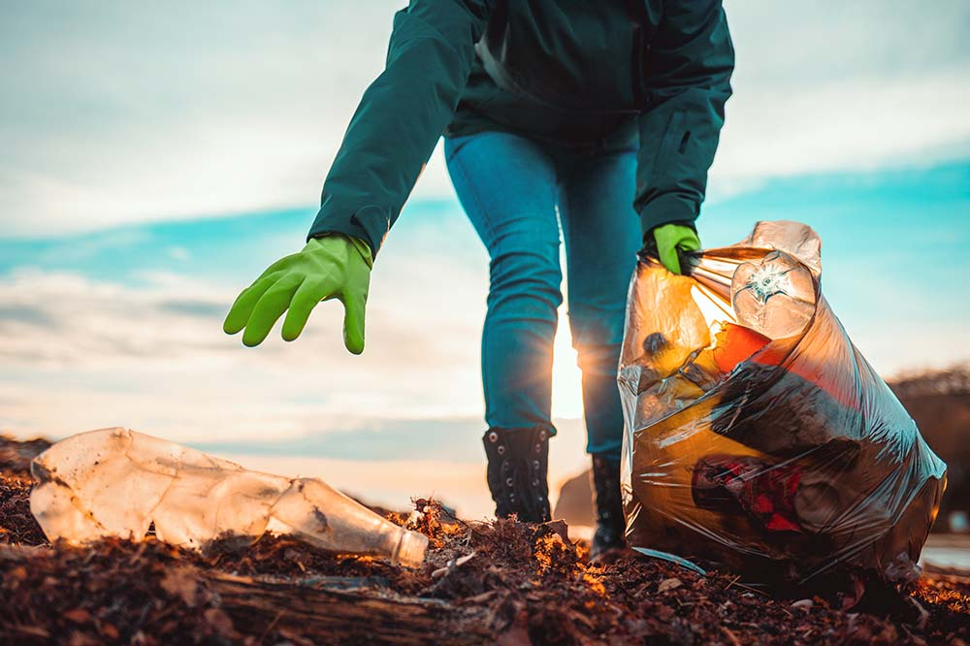
Ex 4. What do you do on Earth Day?
a. making our environment clean, reducing pollution
1. planting trees
2. buying green products
3. picking up litter
4. turning off the lights

Slide 19
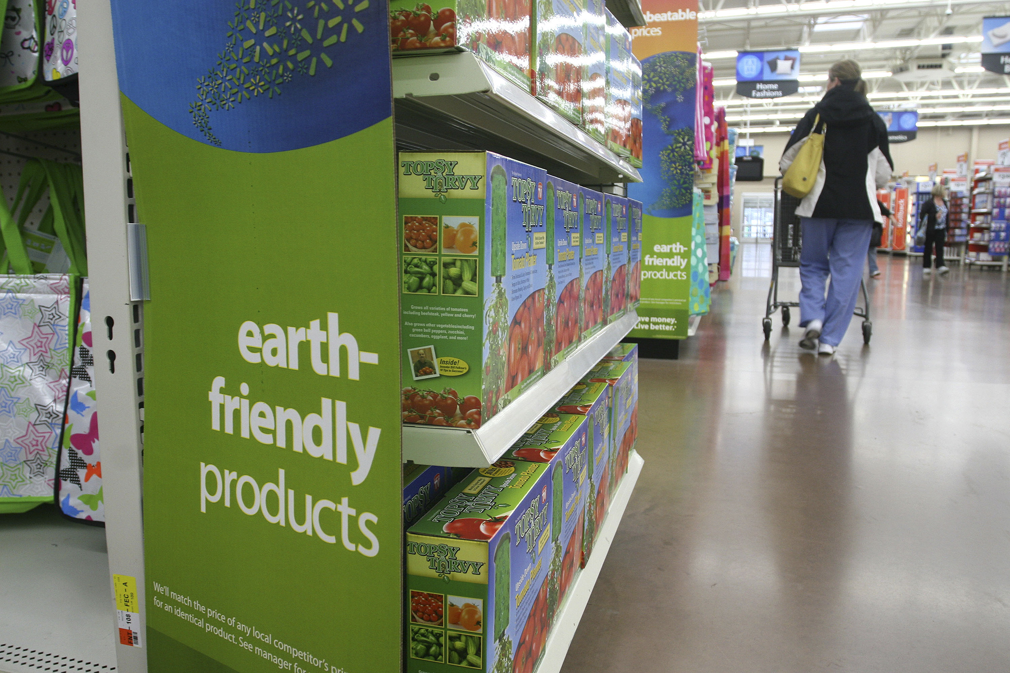
Ex 4. What do you do on Earth Day?
b. reducing global warming, protecting animals habitats
1. planting trees
2. buying green products
3. picking up litter
4. turning off the lights

Slide 20


Ex 4. What do you do on Earth Day?
c. saving electricity to save natural resources
1. planting trees
2. buying green products
3. picking up litter
4. turning off the lights

Slide 21
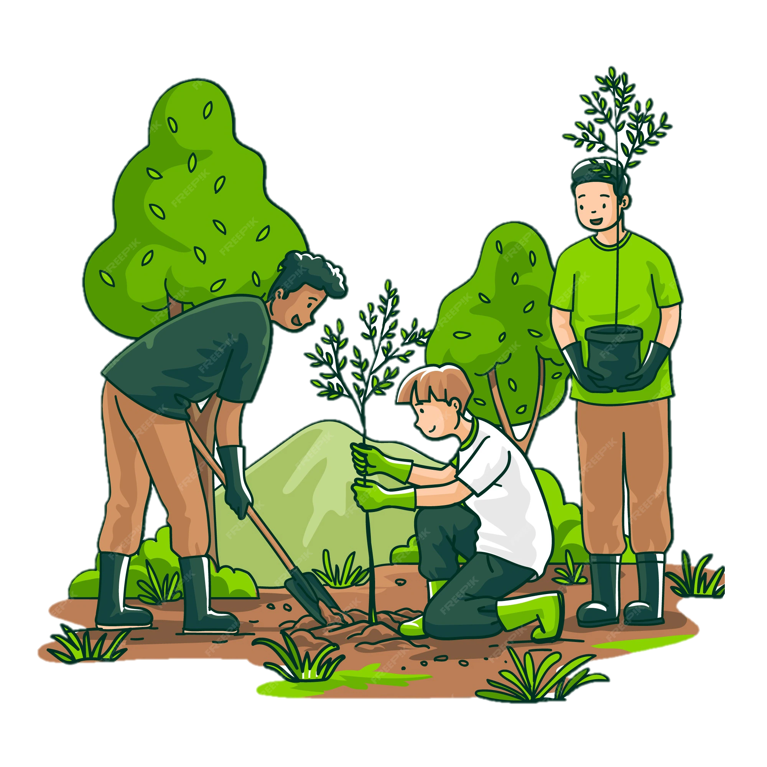
Ex 4. What do you do on Earth Day?
d. improving our health, reducing pollution
1. planting trees
2. buying green products
3. picking up litter
4. turning off the lights

Slide 22


Slide 23

Ex 5. What do you and your friend do on Earth Day?

Slide 24


Slide 25
RECAP
What have we learnt in this lesson?
Asking for clarification
Get to know about Earth Day

Slide 27
Homework
1
2
3
4

Slide 28
Thanks For Watching!

