Slide 1
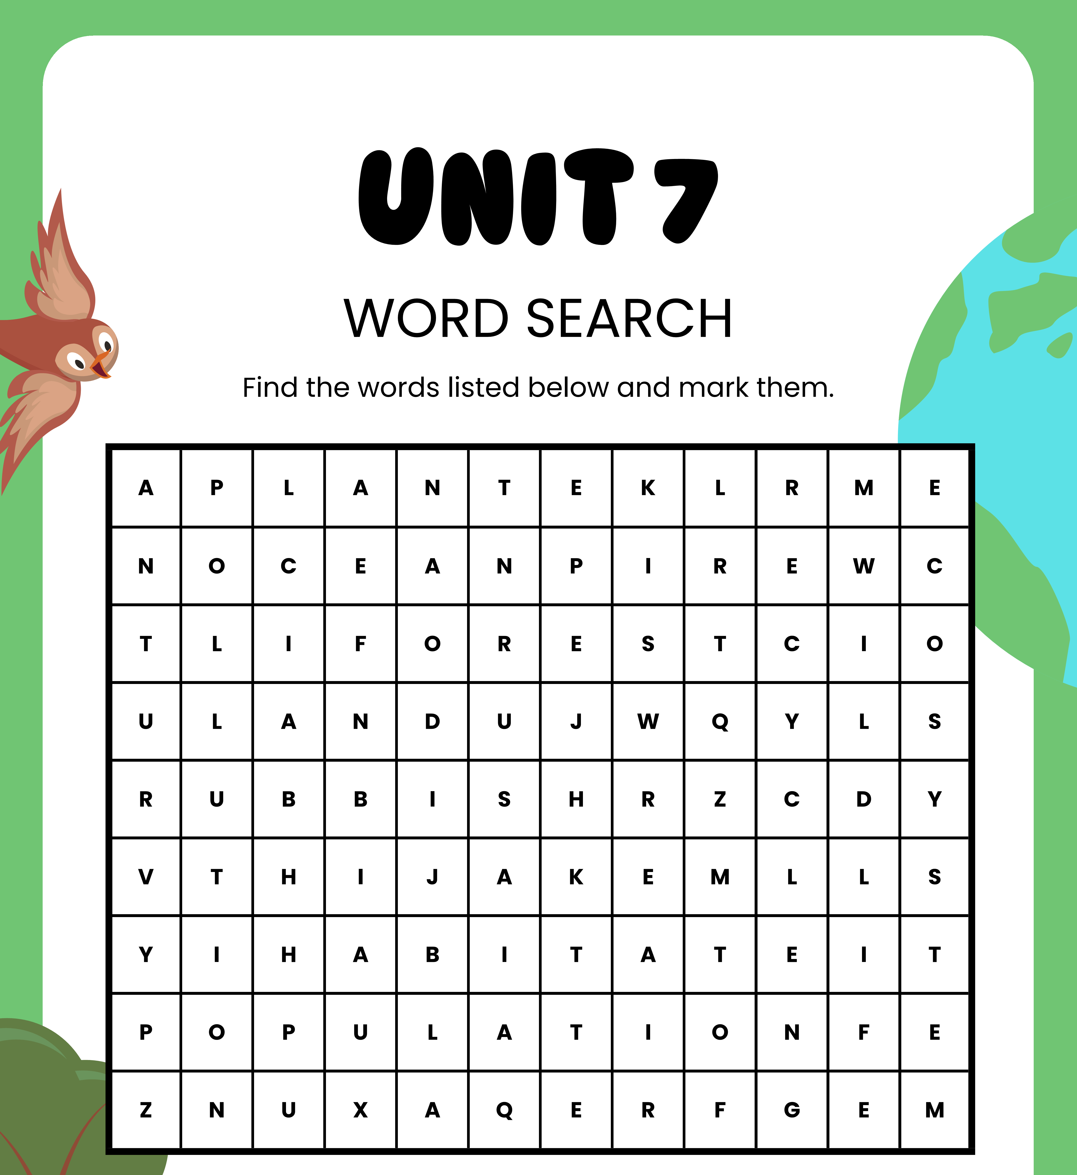

WORD SEARCH
- Do the word search
- Guess the topic

Slide 2

UNIT 7
ENVIRONMENTAL PROTECTION
Lesson 1: Getting stated

Slide 3






OBJECTIVES
After this lesson, students will be able to:
identify the topic of the unit
use lexical items related to environmental protection

Slide 4
Vocabulary

Slide 5
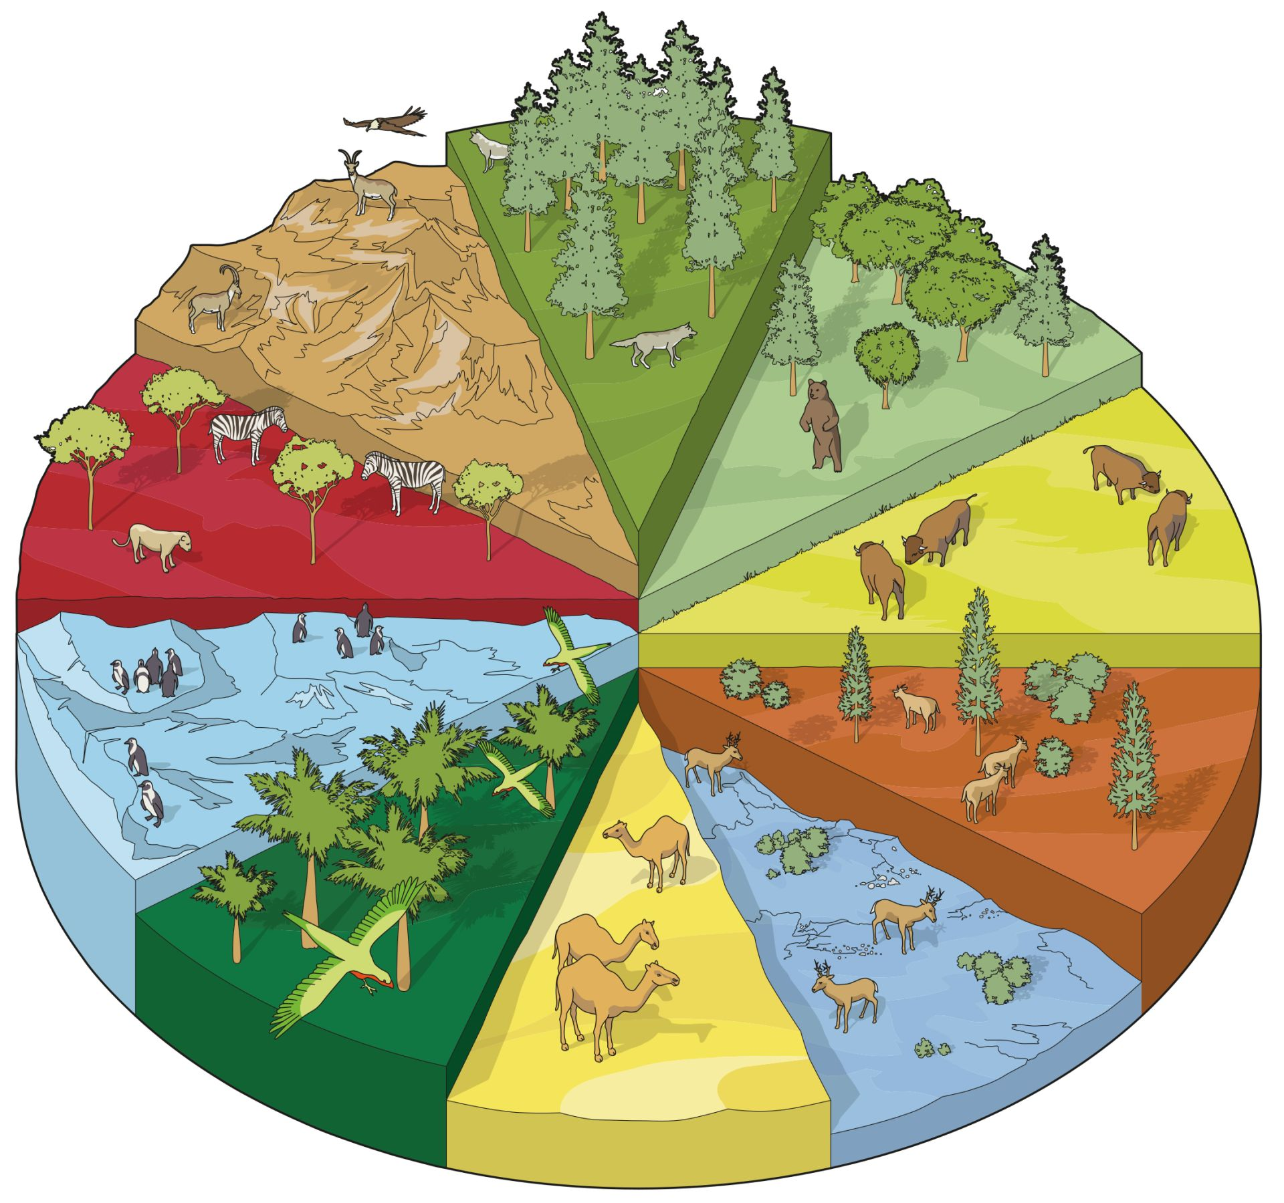

Extra vocabulary
habitat (n)
/ˈhæbɪtæt/
môi trường sống

Slide 6
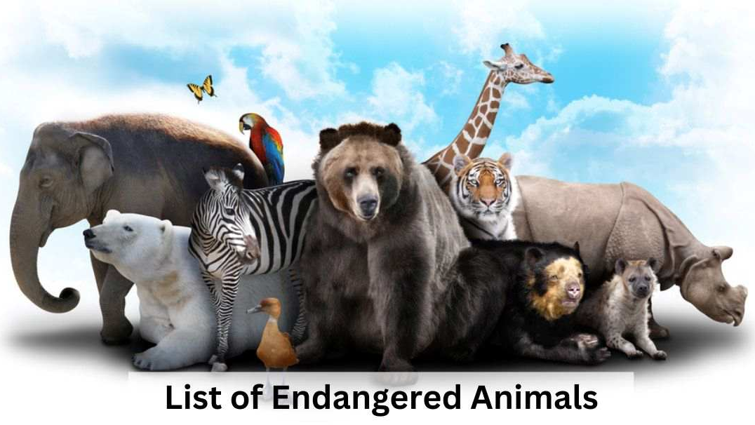
Extra vocabulary
endangered species (n)
/ɪnˈdeɪndʒəd ˈspiːʃiːz/
động vật sách đỏ

Slide 7

Extra vocabulary
carbon footprint (n)
/ˌkɑːbən ˈfʊtprɪnt/
dấu chân các bon

Slide 8
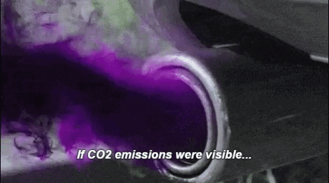
Extra vocabulary
release (v)
/rɪˈliːs/
thải ra

Slide 9

Extra vocabulary
single-use (adj)
/ˌsɪŋɡl ˈjuːs/
dùng một lần

Slide 10
Extra vocabulary
New words | Pronunciation | Meaning
1. habitat (n) | /ˈhæbɪtæt/ | môi trường sống
2. endangered species (n) | /ɪnˈdeɪndʒəd ˈspiːʃiːz/ | động vật sách đỏ
3. carbon footprint (n) | /ˌkɑːbən ˈfʊtprɪnt/ | dấu chân cacbon
4. release (v) | /rɪˈliːs/ | thải ra
5. single-use (adj) | /ˌsɪŋɡl ˈjuːs/ | dùng một lần

Slide 11

01
Listen and Read

Slide 12
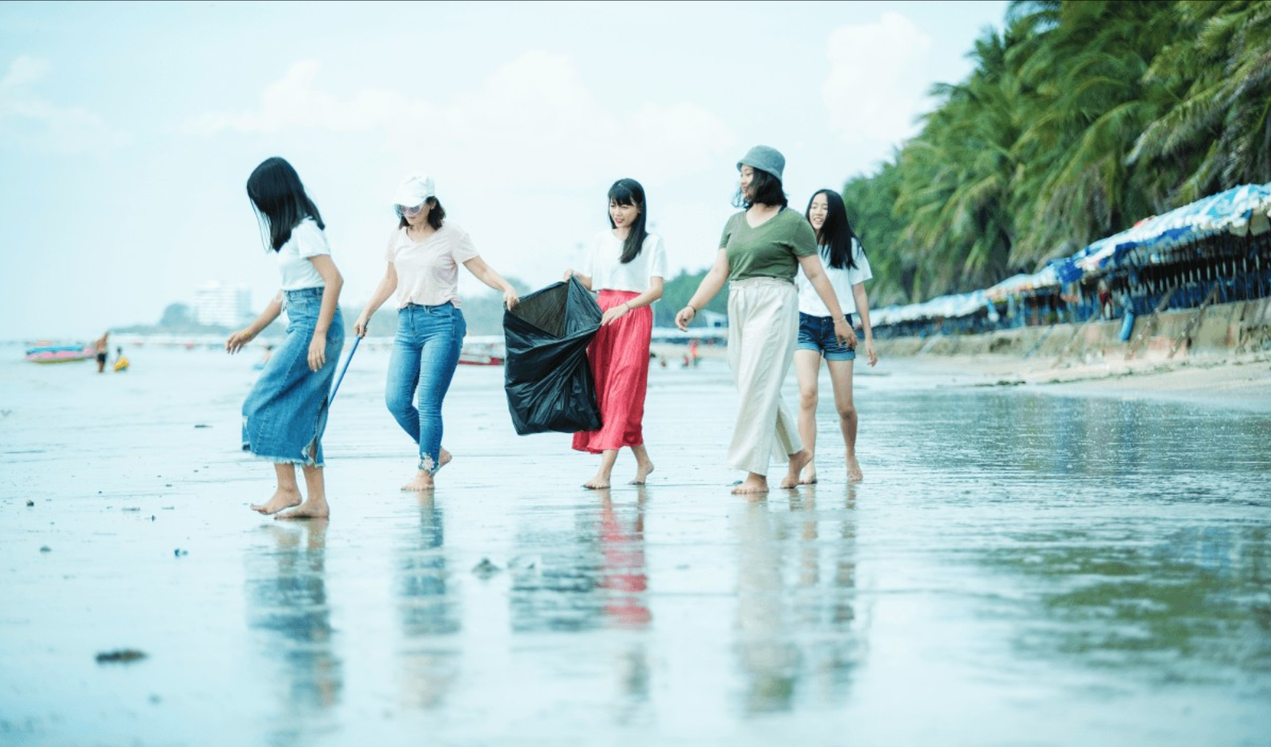
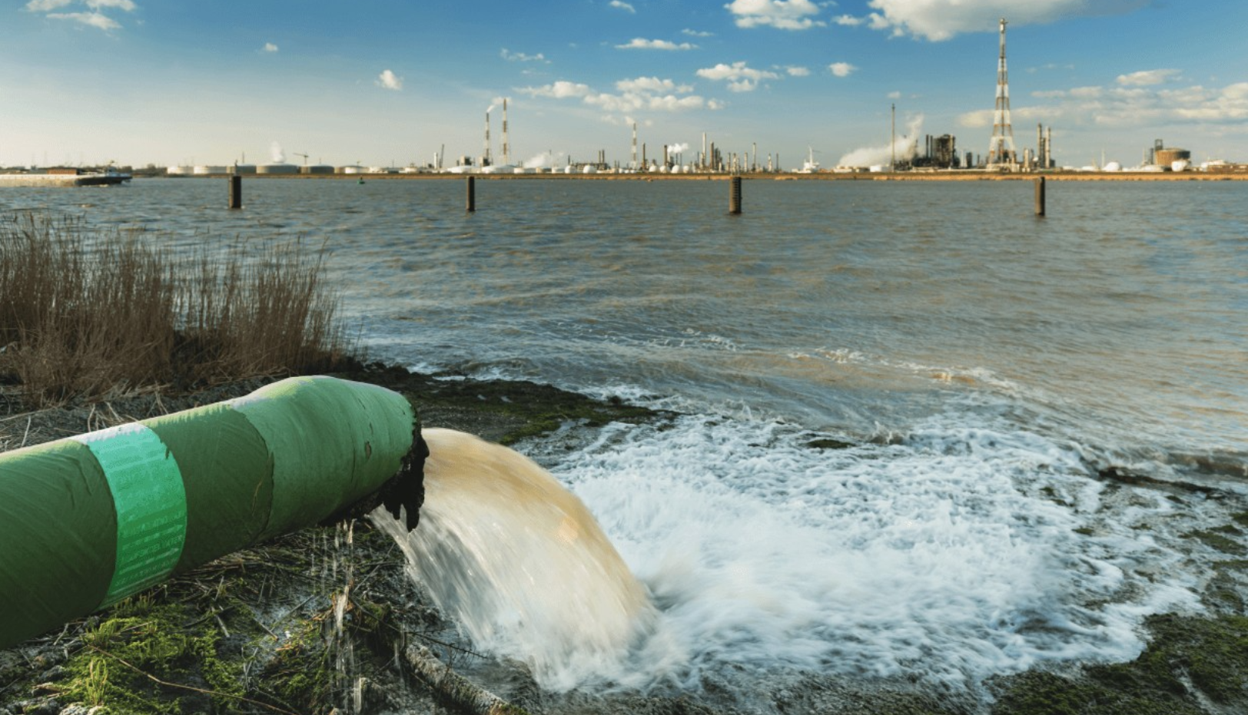
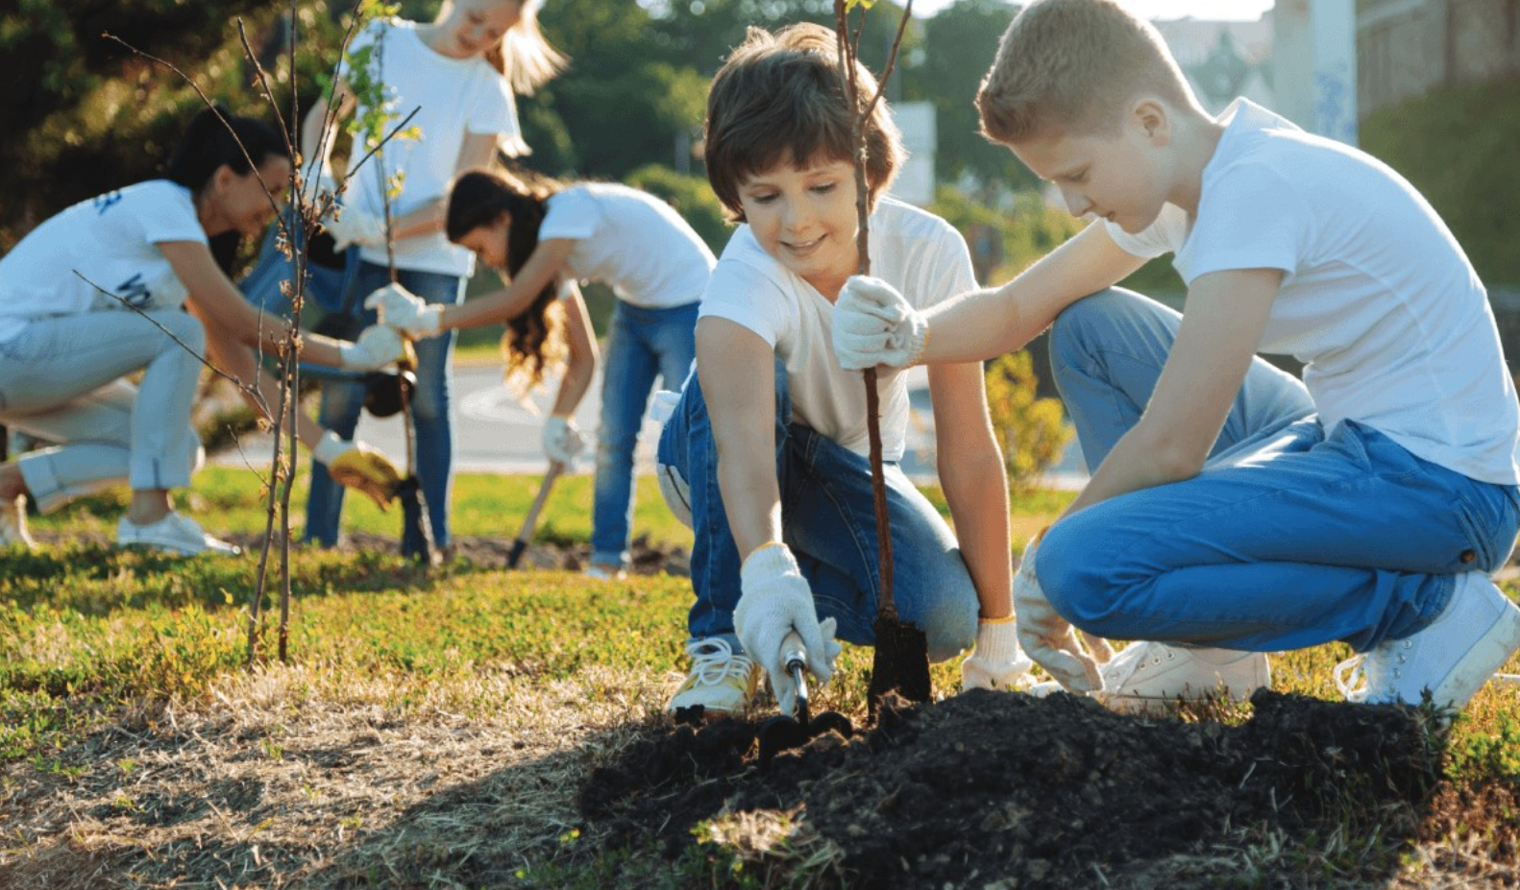
Look and brainstorm.
• Is there a Go Green Club at your school? If yes, are you a member?
• What's the most serious environmental problem in your neighbourhood?
• What do you do to help protect the environment in your area?

Slide 13
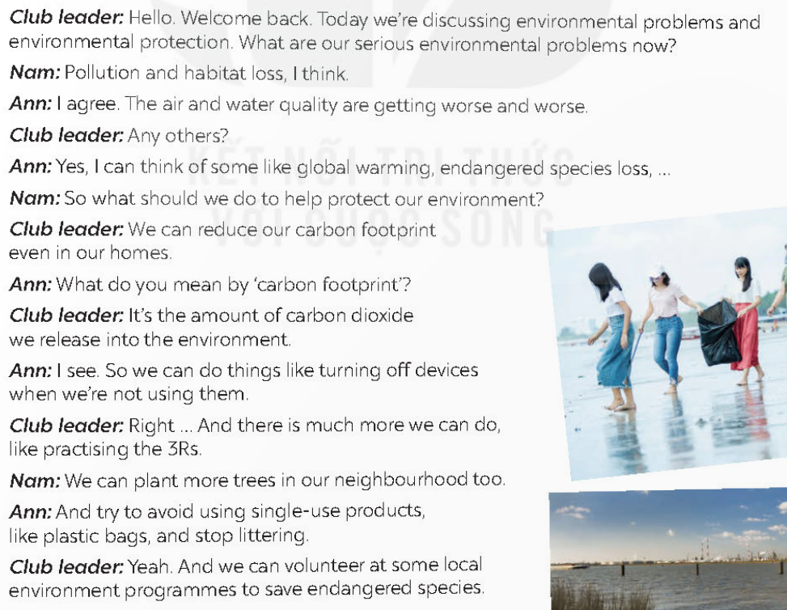
Listen and read

Slide 14


Ex 1 Listen and choose the correct answers.
What's the most serious environmental problem in their neighbourhood?
A. pollution
B. overpopulation
C. habitat loss
D. endangered species loss
E. global warming
Ann
Club leader
Nam

Slide 15
Ex 1 Listen and choose the correct answers.
What's the most serious environmental problem in their neighbourhood?
A. pollution
B. overpopulation
C. habitat loss
D. endangered species loss
E. global warming
Club leader: Hello. Welcome back. Today we’re discussing environmental problems and environmental protection. What are our serious environmental problems now?
Nam: Pollution and habitat loss, I think.
Ann: I agree. The air and water quality are getting worse and worse.
Club leader: Any others?
Ann: Yes, I can think of some like global warming, endangered species loss, …

Slide 16
Ex 1 Listen and match the two halves in the two columns.
To protect the environment, we should
Nam: So what should we do to help protect our environment?
Club leader: We can reduce our carbon footprint even in our homes.
…
Ann: I see. So we can do things like turning off devices when we’re not using them.
…
Nam: We can plant more trees in our neighbourhood too.
Ann: And try to avoid using single-use products, like plastic bags, and stop littering.
1. reduce
a. using single-use products
2. turn off
b. littering
3. plant
c. our carbon footprint
4. avoid
d. devices when we're not using them
5. stop
e. more trees in our neighbourhood

Slide 17
Ex 3 Complete each sentence with one word or phrase from the box.
reduce
single-use
pollution
carbon footprint
environment programme
1. _______________ is a serious problem everywhere.
2. We should avoid dumping waste into lakes and rivers to _______ water pollution.
3. We shouldn’t throw away _________ products but recycle them.
4. ______________ is the amount of carbon dioxide we release into the environment.
5. We hope a lot more people join our _______________.
1. _______________ is a serious problem everywhere.
2. We should avoid dumping waste into lakes and rivers to _______ water pollution.
3. We shouldn’t throw away _________ products but recycle them.
4. ______________ is the amount of carbon dioxide we release into the environment.
5. We hope a lot more people join our _______________.
Pollution
reduce
single-use
Carbon footprint
environment programme

Slide 18



Choose the correct answer.
A. 3Rs
B. saving water
C. ocean
D. The Earth
Notes:
Press the spacebar or down arrow to reveal the answer.
Press the X to go back to the letter slide (wrong answer), press the question box to go the reward slide (correct answer).

Slide 19
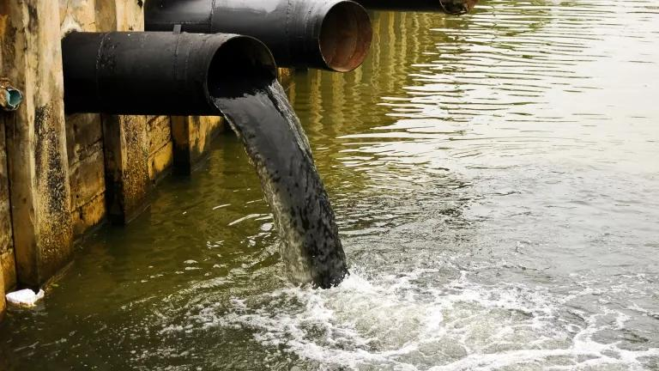
Choose the correct answer.
A. land pollution
B. noise pollution
C. air pollution
D. water pollution
Notes:
Press the spacebar or down arrow to reveal the answer.
Press the X to go back to the letter slide (wrong answer), press the question box to go the reward slide (correct answer).

Slide 20
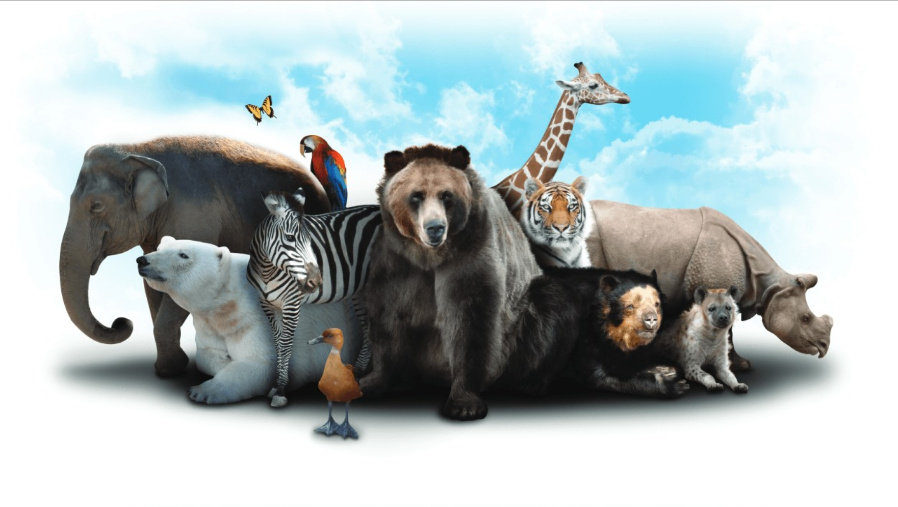
Choose the correct answer.
A. habitat
B. marine life
C. endangered species
D. animals
Notes:
Press the spacebar or down arrow to reveal the answer.
Press the X to go back to the letter slide (wrong answer), press the question box to go the reward slide (correct answer).

Slide 21
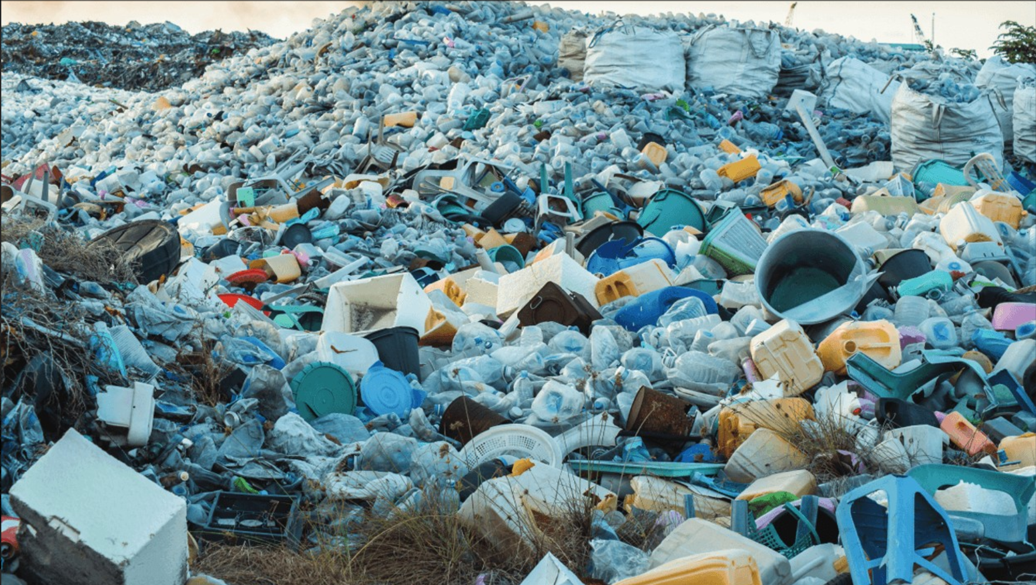
Choose the correct answer.
A. plastic bags
B. plastic rubbish
C. garbage
D. waste
Notes:
Press the spacebar or down arrow to reveal the answer.
Press the X to go back to the letter slide (wrong answer), press the question box to go the reward slide (correct answer).

Slide 22
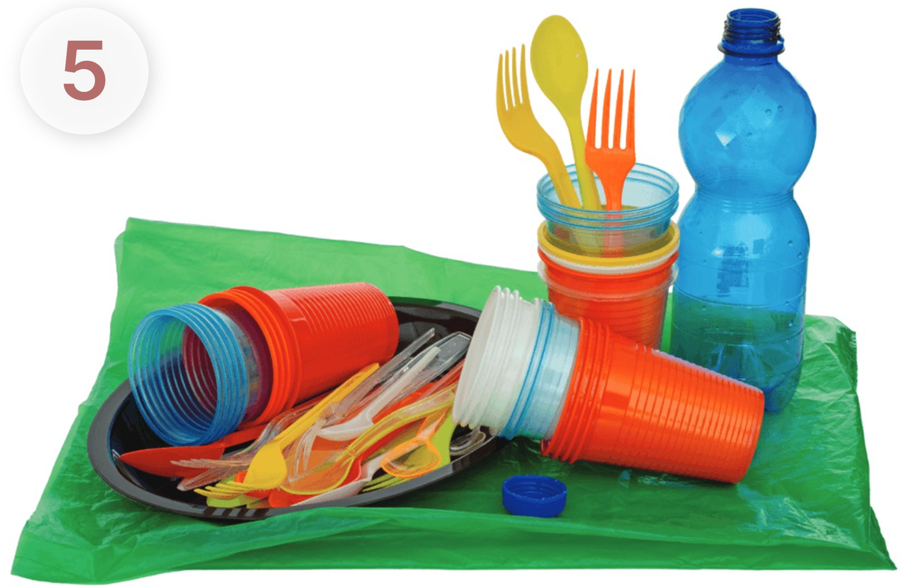
Choose the correct answer.
A. plastic bags
B. single-use products
C. garbage
D. waste
Notes:
Press the spacebar or down arrow to reveal the answer.
Press the X to go back to the letter slide (wrong answer), press the question box to go the reward slide (correct answer).

Slide 23
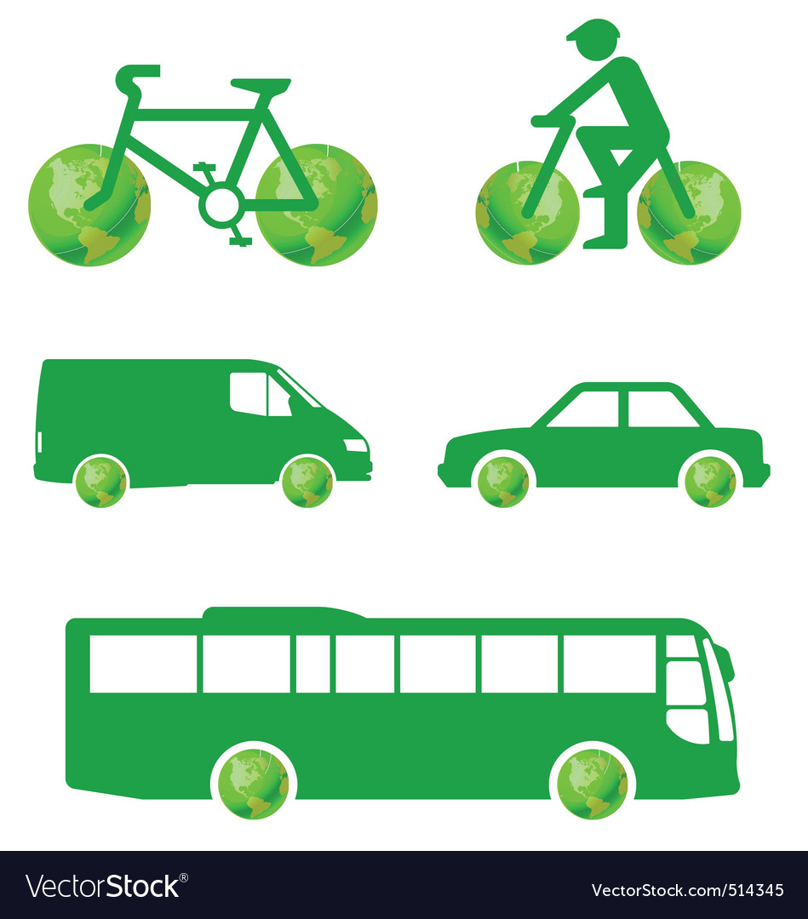
Choose the correct answer.
Which of the following is the greenest form of transport?
A. motorbike
B. Bus
C. Bicycle
Notes:
Press the spacebar or down arrow to reveal the answer.
Press the X to go back to the letter slide (wrong answer), press the question box to go the reward slide (correct answer).

Slide 24

Choose the correct answer.
Which of the following is a renewable source?
A. Coal
B. Oil
C. Wind
Notes:
Press the spacebar or down arrow to reveal the answer.
Press the X to go back to the letter slide (wrong answer), press the question box to go the reward slide (correct answer).

Slide 25
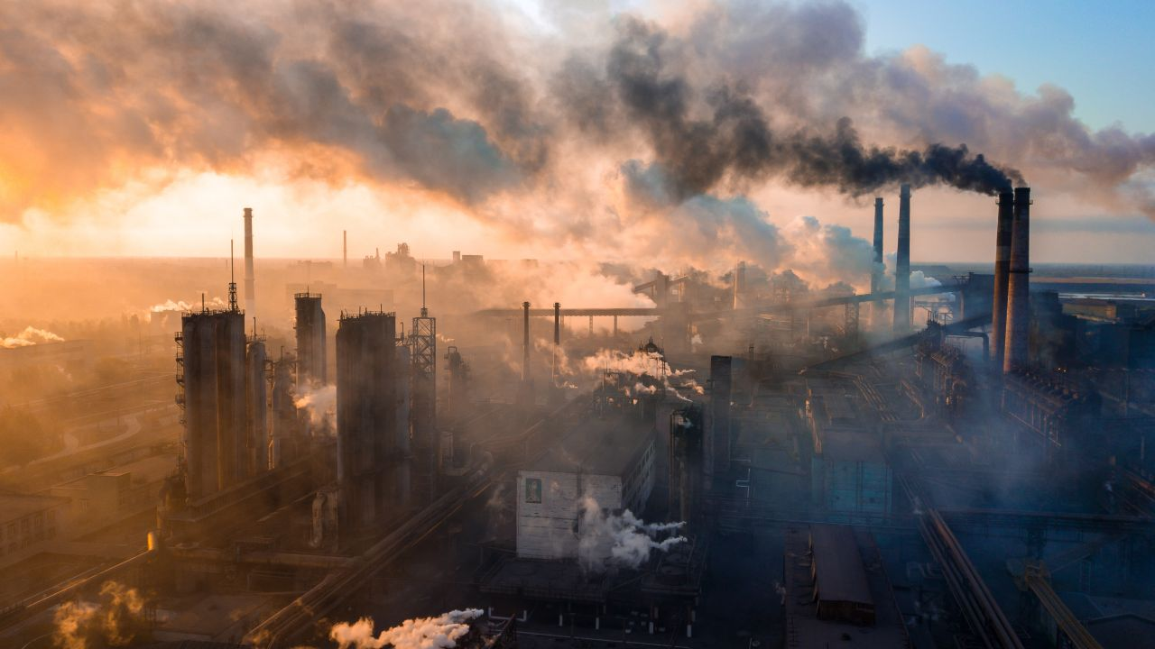
Choose the correct answer.
What causes the most pollution?
A. Factories
B. Animals
C. Hospitals
Notes:
Press the spacebar or down arrow to reveal the answer.
Press the X to go back to the letter slide (wrong answer), press the question box to go the reward slide (correct answer).

Slide 26
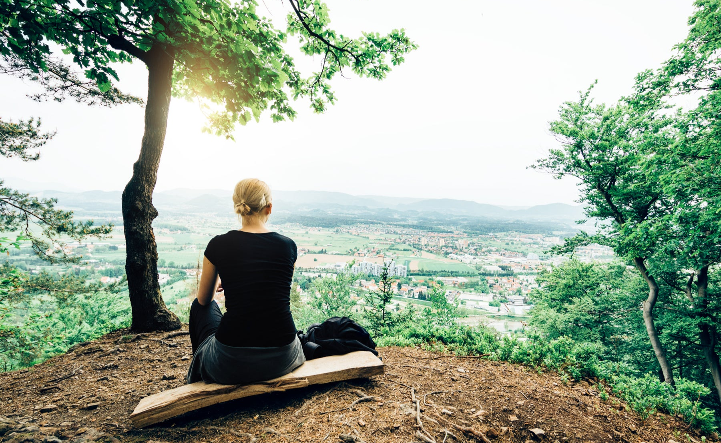
Choose the correct answer.
The surroundings in which we live are our __________.
A. habitat
B. place
C. environment
Notes:
Press the spacebar or down arrow to reveal the answer.
Press the X to go back to the letter slide (wrong answer), press the question box to go the reward slide (correct answer).

Slide 27

Choose the correct answer.
Which of these will reduce your carbon footprint?
A. Cutting down a lot of trees
B. Recycling paper products
C. Leaving the TV on all night
Notes:
Press the spacebar or down arrow to reveal the answer.
Press the X to go back to the letter slide (wrong answer), press the question box to go the reward slide (correct answer).

Slide 28
Recap
What have we learnt in this lesson?
identify the topic of the unit
use lexical items related to environmental protection

