Slide 1




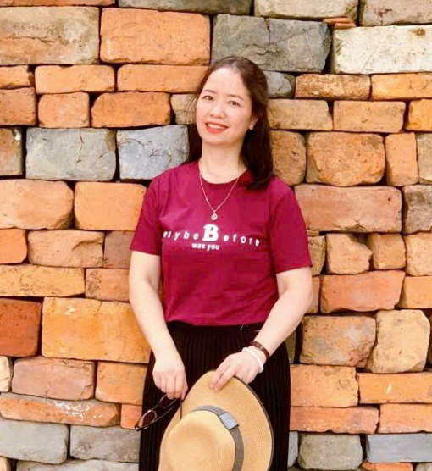

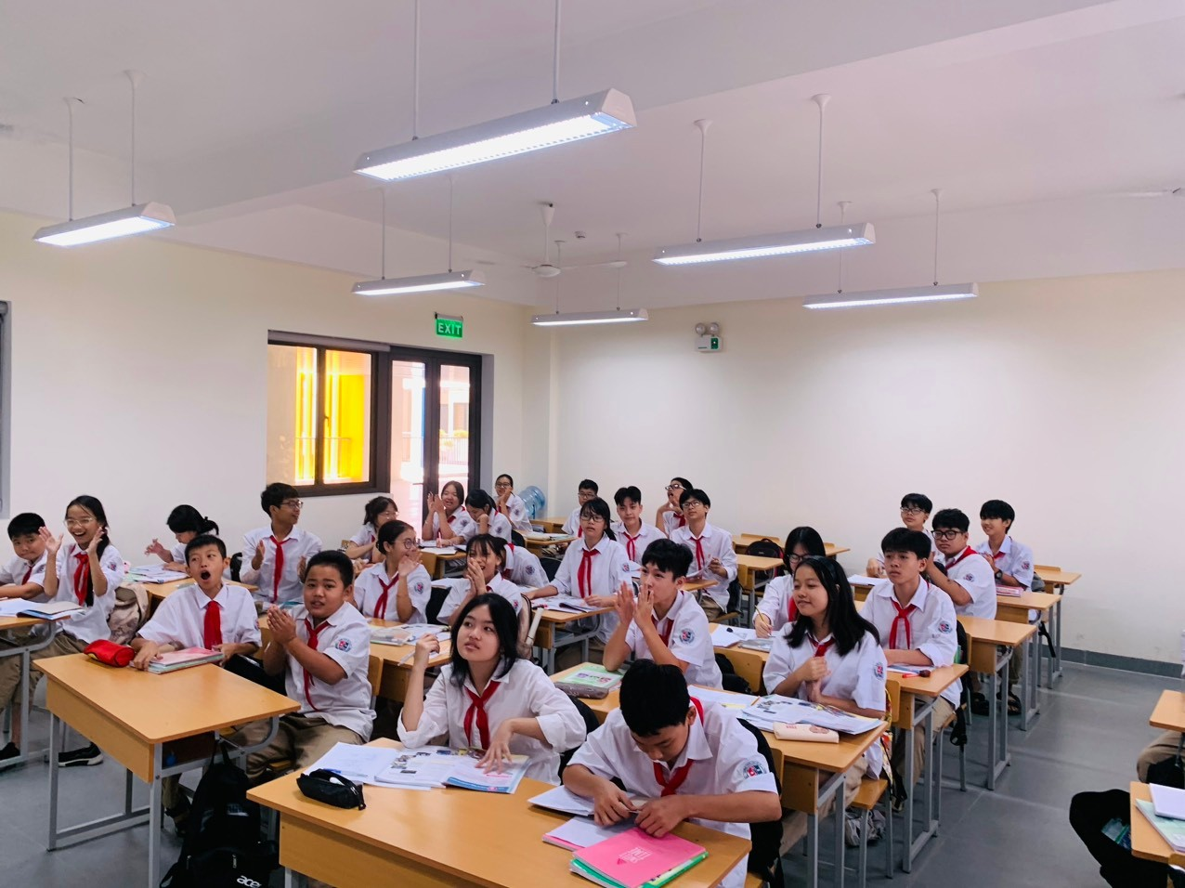


Ly Son Secondary School
Welcome to Our Class!
GRADE 8
Teacher: Ms. Lê Thu

Slide 2

Unit
12
LIFE ON OTHER PLANETS
LESSON 7: LOOKING BACK & PROJECT
VOCABULARY REVIEW
1
GRAMMAR REVIEW
Unit
PROJECT

Slide 3


* WARM-UP

Slide 4
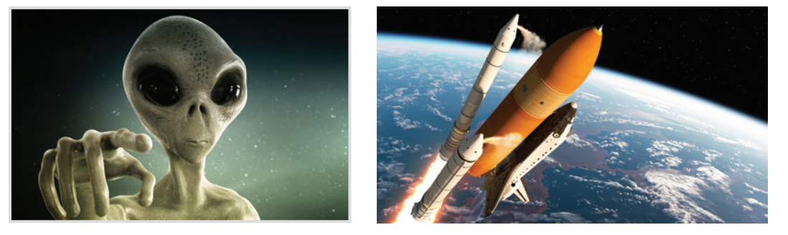
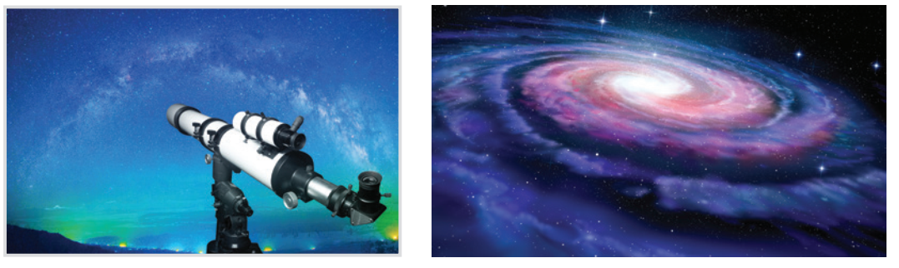
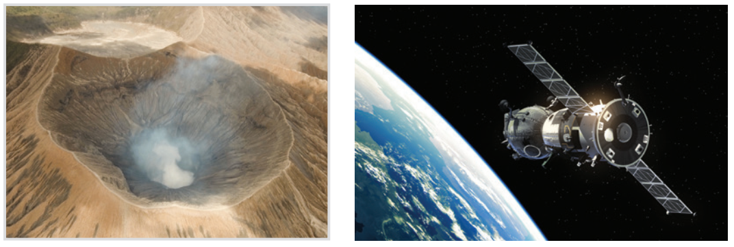
1
Write a word under each picture.
1. a____
alien
rocket
2. r_____
telescope
3. t________
galaxy
4. g_____
5. c____
crater
satellite
6. s______

Slide 5
* VOCABULARY
2
Circle the correct words to complete the sentences.
1. UFOs / Rockets are spaceships from another planet.
2. We have no possibility / condition of making our own spaceship.
3. We can’t find any living craters / creatures in the solar system except for us.
4. Scientists are working to find a habitat / habitable planet.
5. The gravity / atmosphere of the Earth makes things fall to the ground when we drop them.

Slide 6
* GRAMMAR
3
Rewrite each sentence so that it is closest in meaning to the original one.
1. “What is this novel about?” said Mary.
 Mary wanted to know ______________________.
2. “Who’s your favourite actor, Nick?” I said.
 I asked Nick _______________________.
3. “What time does the next train leave?” Mai said to me.
 Mai asked me ________________________.
what that novel was about
who his favourite actor was
what time the next train left

Slide 7
* GRAMMAR
3
Rewrite each sentence so that it is closest in meaning to the original one.
4. How do the scientists observe the other planets?” the students asked.
 The students wondered _______________________ _______________.
5. Mai wondered, “Why can’t humans live on Mars?”
 Mai wondered _____________________________.
how the scientists observed
the other planets
why humans couldn’t live on Mars

Slide 8
* GRAMMAR
4
Which of the underlined parts in each question is incorrect? Find and correct it.
1. The teacher asked the pupils what they are doing then.
2. My father wondered me what I was going to do the following weekend.
3. My brother wanted to know who the scientists were exploring other planets.
A
B
C
 were
A
 asked
B
C
A
B
 how/ why
C

Slide 9
* GRAMMAR
4
Which of the underlined parts in each question is incorrect? Find and correct it.
4. I asked my teacher what food spacemen eat when they were
travelling in a spacecraft.
5. Scientists are still wondering how many planets are there in our galaxy.
A
B
 ate
C
A
B
C
 there are

Slide 10
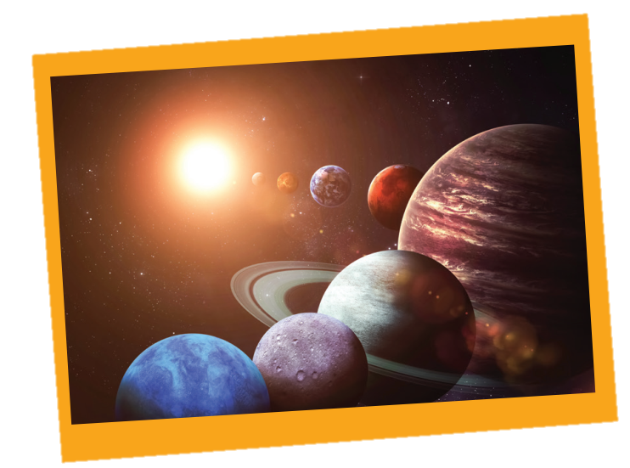
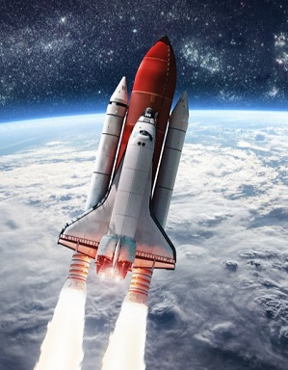
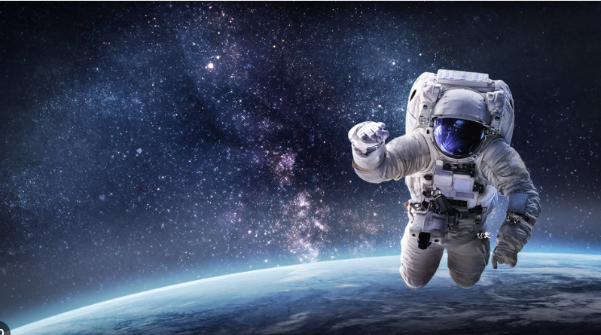
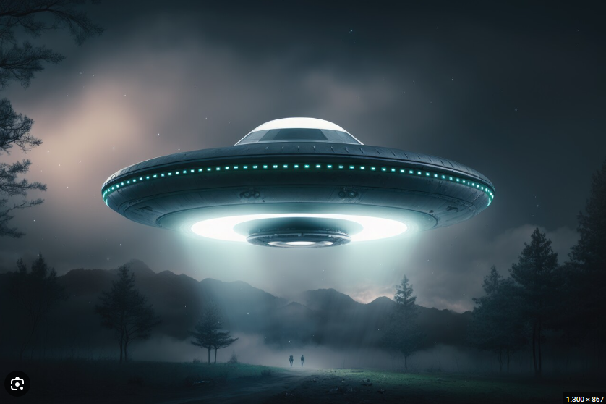
* PROJECT

Slide 11
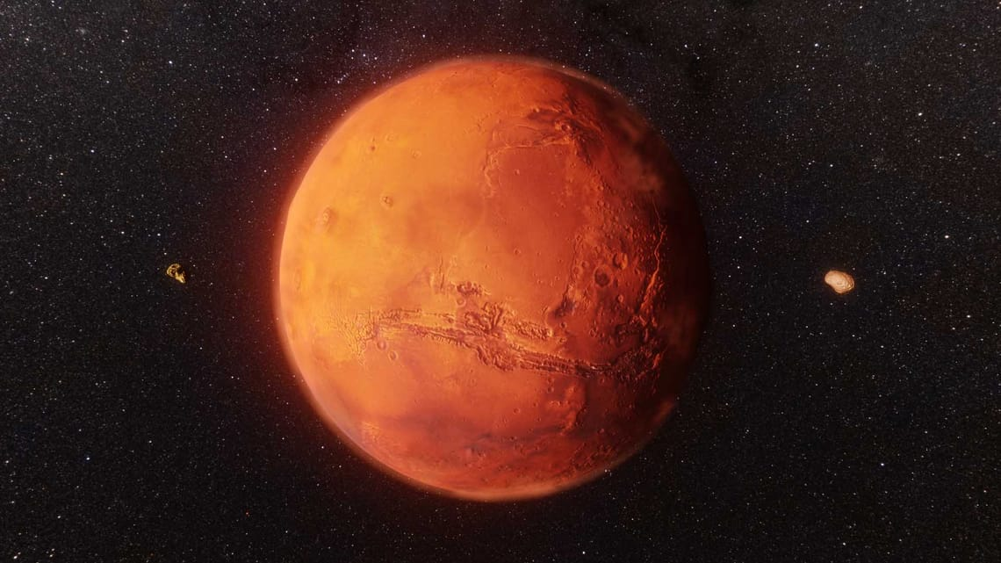
* PROJECT
1. Choose a planet in our solar system that you like and search for the information about it.
Mars - Sao Hỏa.

Slide 12
2. Design a poster about that planet, including:
- Planet's name: Mars
- Meaning of its name: the Roman god of war.
- Size: about half the size of Earth, roughly around 6,779 kilometers.
- Atmosphere: Mars has a thinner atmosphere compared to Earth, primarily composed of carbon dioxide.
- Temperature: The average temperature on Mars is around -80 degrees Celsius, but it can vary from -195 degrees Celsius to 20 degrees Celsius depending on location and time of year.
- Appearance: Mars has a reddish-orange appearance
- Something special: Mars is considered to have the potential to support life due to signs of the existence of water, solar energy source

Slide 13
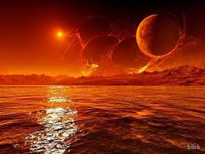
3. Present your poster to the class.
Hello, everyone! Today, I'd like to present some facts about the planet Mars. Its name originates from the Roman god of war. Mars is roughly half that of Earth, measuring around 6,779 kilometers across. This planet has a thinner atmosphere, mainly composed of carbon dioxide. Mars maintains an average of -80 degrees Celsius, but can vary from -195 to 20 degrees Celsius, depending on location and the time of year. Mars is reddish-orange color. Scientists have discovered signs of water on Mars. Furthermore, Mars possesses its own solar energy source.

Slide 14

* CONSOLIDATION
* What have we learnt in this lesson?
Review the vocabulary and grammar of Unit 12.
Make a poster about our favourite planet.

Slide 15

Homework
- Learn new words by heart.
- Review the knowledge & skills of Unit 12.

Slide 16
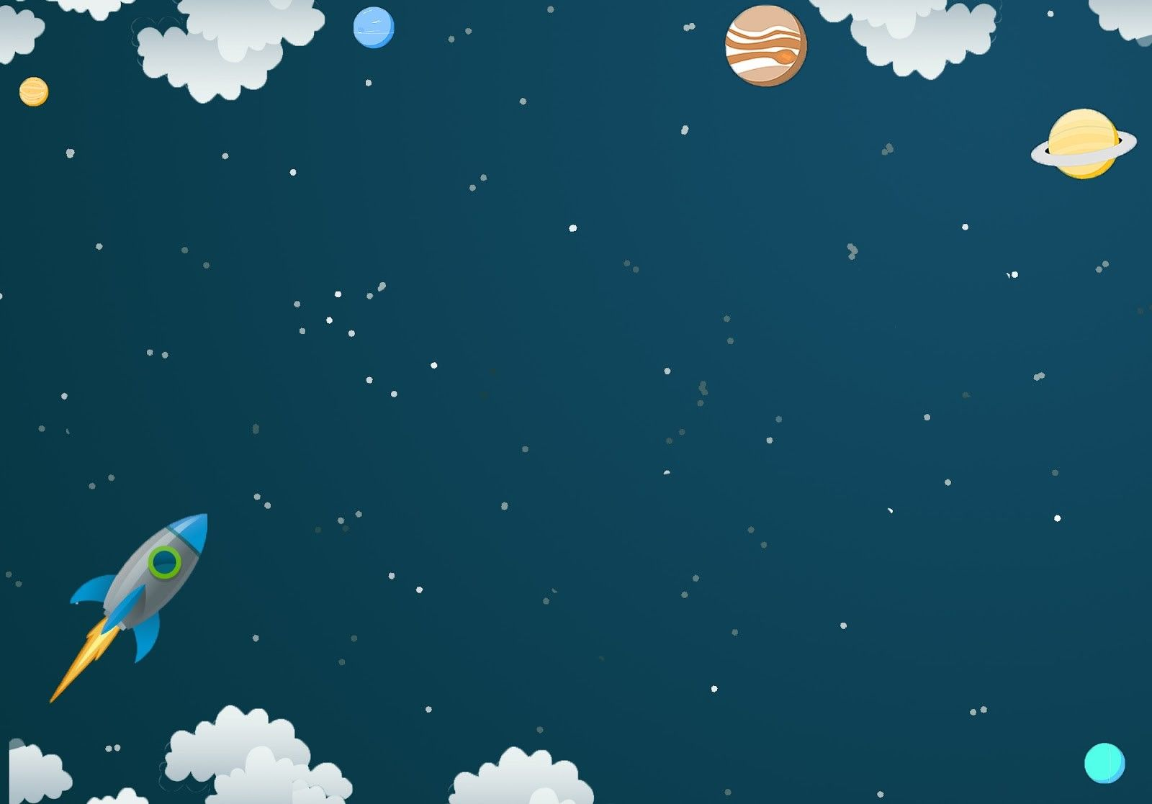
Goodbye.
See you again.

