Slide 1

UNIT 2
MY HOUSE
Lesson 6: skills 2

Slide 2

OBJECTIVES
By the end of the lesson, students will be able to:
Listen for specific information about someone's house;
Write an email to a friend describing a house

Slide 3
Listening
Lesson 6: Skills 2

Slide 4
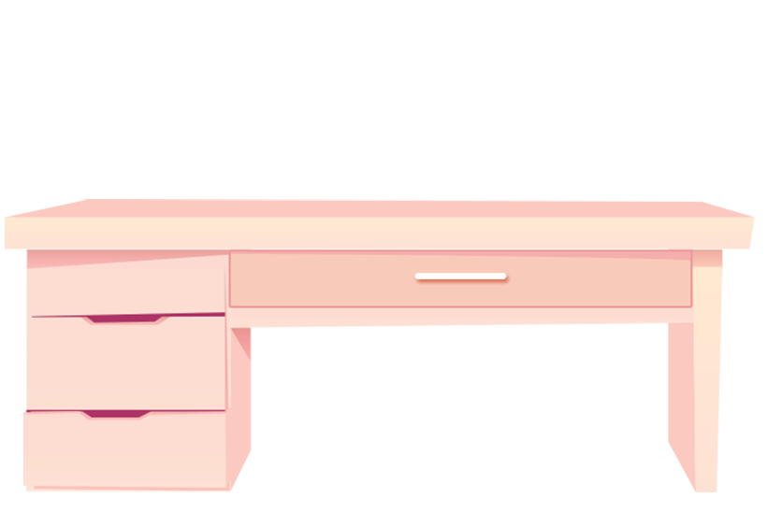





✓
2. SOFA
3. DESK
✓
1. BOOKSHELF
Guess what is mentioned in the listening text
Listen and tick (✓) things you hear
✓
✓
4. CLOCK
5. WINDOW

Slide 5
Ex 2: Listen and tick ( ) T (True) or F (False).
Correct the false ones.
✓
 | T | F
1. There are four people in Mai's family.
2. Mai's house has seven rooms.
3. The living room is next to the kitchen.
4. In her bedroom, there's a clock on the wall.
5. She often listens to music in her bedroom.
three
✓
six
✓
✓
✓
reads books
✓

Slide 6
Writing
Lesson 6: skills 2

Slide 7
Sample email
Group discussion
In groups of three, discuss:
How many parts are there in an email to your friend?
What are they?
What should you include when writing each part?
From: an@fastmail.com
To: sophia@quickmail.com
Subject: My house
Hi Sophia,
Thanks for your email. Now I’ll tell you about my house.
I live with my parents in a flat. It’s big. There is a living room, a kitchen, two bedrooms and two bathrooms. I like my bedroom the best. What about you? Where do you live? Tell me in your next email.
See you soon!
Nick

Slide 8
Sample email
address
From: an@fastmail.com
To: sophia@quickmail.com
Subject: My house
Hi Sophia,
Thanks for your email. Now I’ll tell you about my house.
I live with my parents in a flat. It’s big. There is a living room, a kitchen, two bedrooms and two bathrooms. I like my bedroom the best. What about you? Where do you live? Tell me in your next email.
See you soon!
Nick
subject
greeting
introduction
body
conclusion

Slide 9
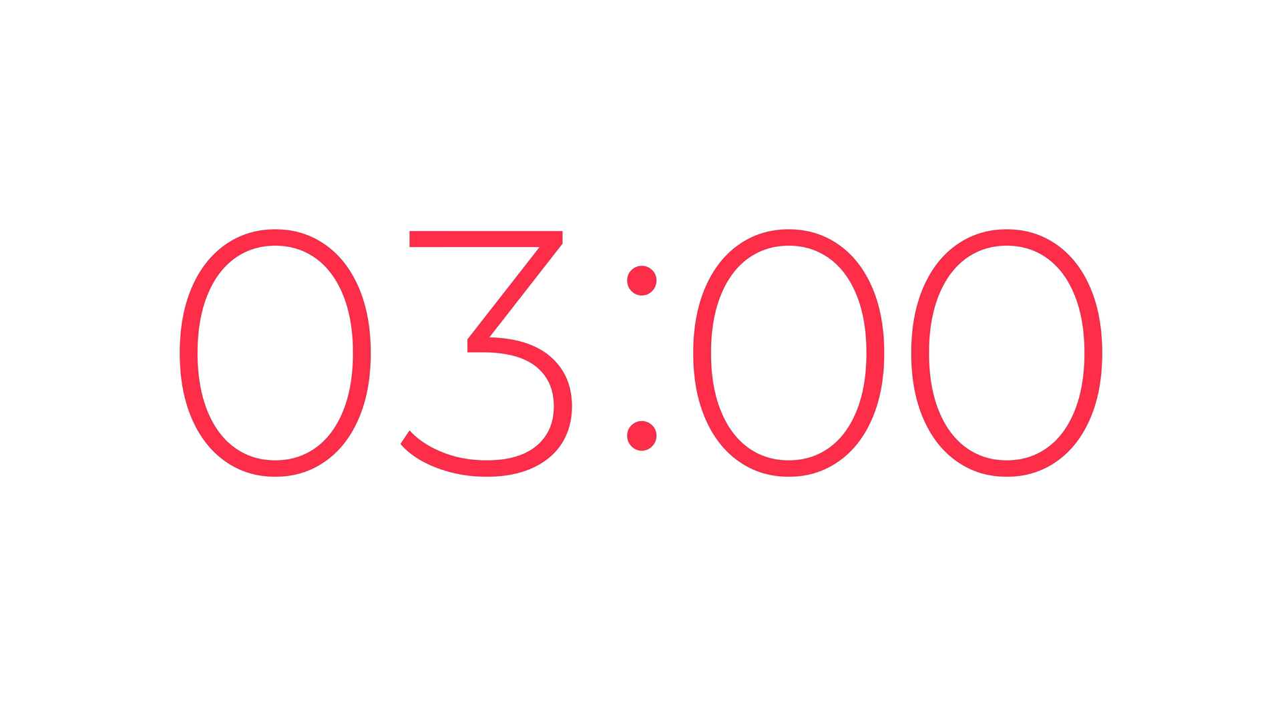
Let’s brainstorm ideas for your email …
In your notebook, write full answers to the following question:
1. Where do you live?
2. How many rooms are there in your house? What are they?
3. Which room do you like the best in your house? Why?
Swap the answer with your partner

Slide 10

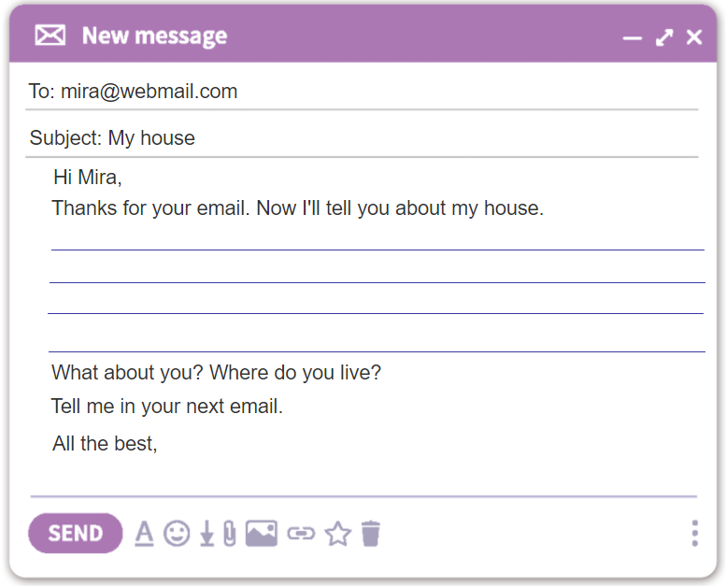
Ex.4: Write an e-mail to your pen friend.
Tell him/ her about your house. Use the answers in Ex.3
1. Where do you live?
2. How many rooms are there in your house? What are they?
3. Which room do you like the best in your house? Why?

Slide 11
SUGGESTION
To: mira@webmail.com
Subject: My house
Hi Mira,
Thanks for your email. Now I'll tell you about my house.
I live in a small townhouse in Ha Noi. There are five rooms: a living room, a kitchen, two bedrooms and a bathroom. My favourite room is my bedroom. It is very cozy. There is a big window, a small bed, a desk and a chair.
What about you? Where do you live?
Tell me in your next email.
All the best,

Slide 12





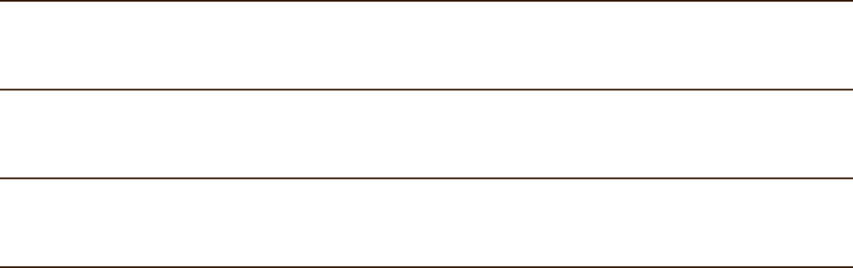


RECAP
Tick what you have learnt in the lesson today?
Listen about someone's house
Write a poster
Write an email

Slide 13
1. Write an email to your teacher about your room in A4 paper.
3. Prepare next lesson: Looking back and project.
Homework

Slide 14

GREAT WORK! SEE YOU NEXT TIME

Slide 15
How to write an email?
In the subject line, write briefly what the email is about.
Begin the email with a greeting (Dear / Hi / Hello).
The introduction is the first paragraph. Ask about his / her health, thank him / her for the previous email or write the reasons for the email, etc.
In the body, write about the subject(s) of the email. Write each subject in a new paragraph.
The conclusion is the last paragraph. Say goodbye, ask your friend to write back, etc.

