Slide 1
UNIT 2
LIFE IN THE COUNTRYSIDE
LESSON 3: A CLOSER LOOK 2

Slide 2
Discuss these questions.
1
What do you like doing in the countryside? Why?
2
What do you like doing in the big city? Why?
3
Which one do you like better? Living in the countryside or in the city?
Making comparison

Slide 3
OBJECTIVES
By the end of the lesson, students will be able to:
use correctly the comparative forms of adverbs

Slide 4
01
Comparative adverbs

Slide 5
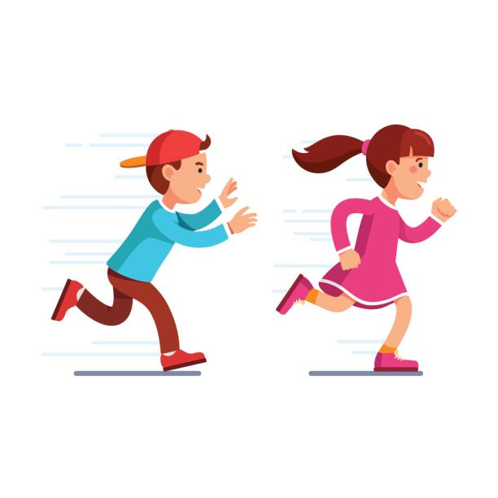
Make comparison.
The girl runs faster than the boy.
The girl runs faster than the boy.
Verb
Comparative adverb
comparative form
Fast (adj, adv)
short adv + er
short adv

Slide 6
Make comparison.
The boy runs more slowly than the girl.
The boy runs more slowly than the girl.
Verb
Comparative adverb
comparative form
slowly (adv)
more + long adv
long adv

Slide 7
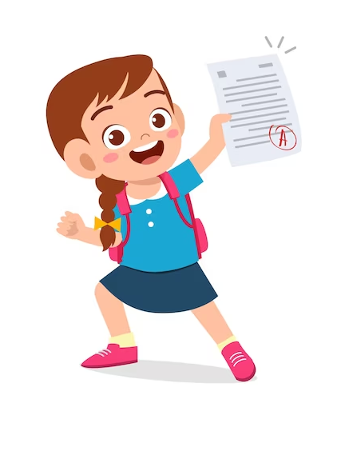

Make comparison.
Susan does the test better than Tom.
Susan does the test better than Tom.
Verb
Comparative adverb
Susan
Tom
well (adv)
comparative form
better
irregular adv
comparative form
worse
badly (adv)

Slide 8
COMPARATIVE FORMS OF ADVERBS
For adverbs that have the same forms as adjectives like fast, hard, soon, etc.
1
short adv + er
2
For most adverbs (often with two or more syllables)
more + long adv
3
Some irregular adverbs:
well  better
badly  worse

Slide 9
02
PRACTICE

Slide 10
Ex 1. Write the comparative forms of the adverbs in the table below.
Adverbs | Comparative forms
long
high
late
quickly
Adverbs | Comparative forms
frequently
early
much
little
longer
more frequently
higher
earlier
later
more
more quickly
less

Slide 11
Game:
HIDDEN PICTURE
Answer questions to guess the hidden picture.

Slide 12
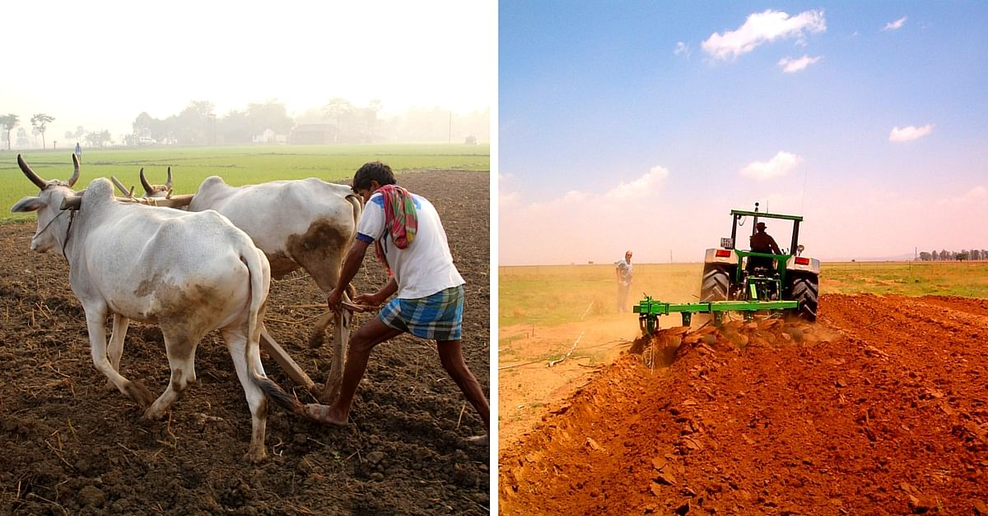
Show picture
Show answer
1
2
3
4
5
6
ploughing a field
Show numbers

Slide 13

Complete the sentences with the comparative forms of the adverbs in brackets.
1. Mai dances (beautifully) _______________ than Hoa does.
more beautifully

Slide 14
Complete the sentences with the comparative forms of the adverbs in brackets.
2. Please write (clearly) _____________.
I can’t read it.
more clearly

Slide 15
Complete the sentences with the comparative forms of the adverbs in brackets.
3. Life in the city seems to move (fast) _______ than that in the countryside.
faster

Slide 16
Complete the sentences with the comparative forms of the adverbs in brackets.
4. If you want to get better marks, you must work much (hard) ________.
harder

Slide 17
Complete the sentences with the comparative forms of the adverbs in brackets.
5. Today it’s raining (heavily) ____________ than it was yesterday.
more heavily

Slide 18
Complete the sentences with the comparative forms of the adverbs in brackets.
6. He did (badly) _______ than he was expecting in the exams.
worse

Slide 19
Ex 3. Complete the sentences with suitable comparative forms of the adverbs from the box.
early
soundly
fast
carefully
quietly
more carefully
1. After his accident last month, he is driving _____________ now.
2. A horse can run ______ than a buffalo.
3. You’re too loud. Can you speak a bit ____________?
4. After working hard all day on the farm, we slept ____________ than ever before.
5. The farmers started harvesting their crops ______ than expected.
faster
more quietly
more soundly
sleep soundly: ngủ sâu
earlier

Slide 20
Ex 4. Read the situations and complete the sentences using the comparative forms of the adverbs in brackets.
1. The red car can run 200 km/h while the black car can run 160 km/h.
 The red car can run _______________________. (fast)
2. Nick can jump 1.5 m high while Tom can jump only 1.3 m.
Nick can jump ___________________. (high)
3. Mai and hoa both did well on the exam. Hoa got 80% of the answers correct and Mai got 90%.
Mai did ___________________________. (well)
4. My dad expected the workers to arrive at 7 a.m., but they arrived at 6:30 a.m.
The workers arrived __________________________. (early)
5. The buses run every 15 minutes. The trains run every 30 minutes.
 The buses run ____________________________. (frequently)

Slide 21
Ex 4. Read the situations and complete the sentences using the comparative forms of the adverbs in brackets.
1. The red car can run 200 km/h while the black car can run 160 km/h.
 The red car can run _______________________. (fast)
2. Nick can jump 1.5 m high while Tom can jump only 1.3 m.
Nick can jump ___________________. (high)
red car
200 km/h
black car
160 km/h
faster than the black car
Nick
1.5 m high
Tom
1.3 m
higher than Tom (can)

Slide 22
3. Mai and Hoa both did well on the exam. Hoa got 80% of the answers correct and Mai got 90%.
Mai did _________________________. (well)
4. My dad expected the workers to arrive at 7 a.m., but they arrived at 6:30 a.m.
The workers arrived _________________________. (early)
5. The buses run every 15 minutes. The trains run every 30 minutes.
 The buses run _________________________. (frequently)
Hoa
80%
Mai
90%
better on the exam than Hoa
My dad expected
at 7 a.m.
6:30 a.m
earlier than my dad expected
buses
every 15 minutes
trains
every 30 minutes
more frequently than the trains

Slide 23

Ex 5. Work in pairs. Ask and answer to find out who:
– can run faster
– can jump higher
– stays up later at night
– gets up earlier in the morning
How fast can you run?
I can run 15 kilometres an hour.
OK, you can run faster than me.
Report the result!

Slide 24
RECAP
Choose the correct answer.
1
My sister speaks English much ____ than I do.
A. more fluent B. more fluently C. fluently
My grandmother always gets up ____ than me.
A. more early B. early C. earlier
2
My mother can cook ____ than I can.
A. more badly B. better C. weller
3

Slide 25
THANKS!
Does anyone have any questions?

