Slide 1
Life in the countryside
UNIT 2
Lesson 1: Getting started

Slide 2
OBJECTIVES
By the end of the lesson, students will be able to:
01
Gain an overview about the topic
Life in the countryside
02
use lexical items related to the topic:
Life in the countryside

Slide 3
NEW WORDS

Slide 4
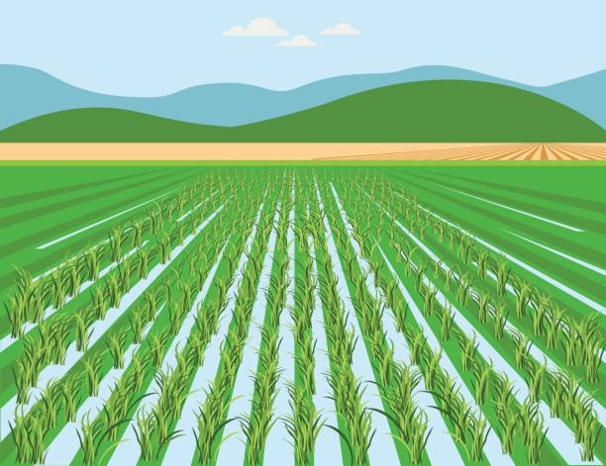

paddy field (n)
/ˈpædi ˌfiːld/
cánh đồng lúa

Slide 5
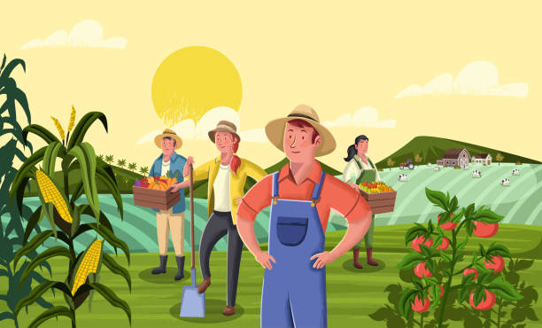
harvest (v)
/ˈhɑːvɪst/
thu hoạch

Slide 6
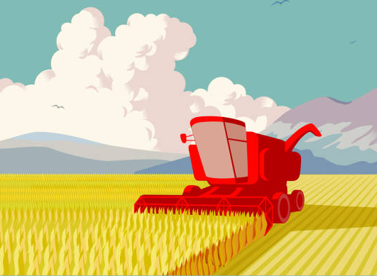
combine harvester (n)
/kəmˈbaɪn ˈhɑːvɪstər /
máy gặt

Slide 7
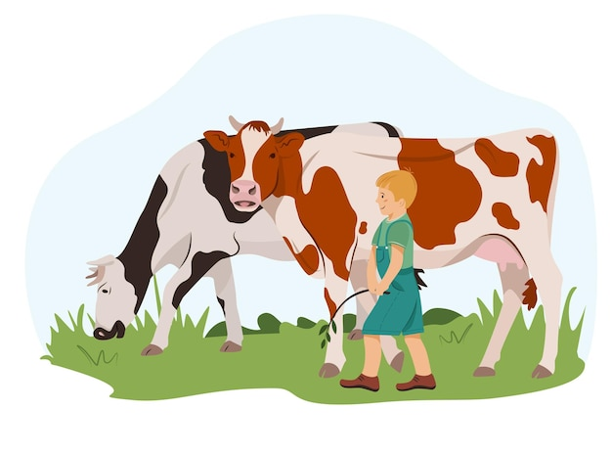
herd (v)
/hɜːd/
chăn (gia súc)

Slide 8
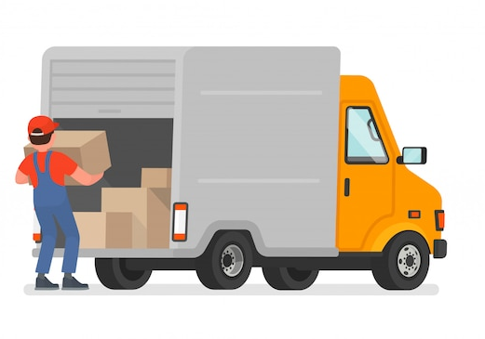
load (v)
/ləʊd/
chất hàng hóa

Slide 9
NEW WORDS
New words | Pronunciation | Meaning
1. paddy field (n) | /ˈpædi ˌfiːld/ | cánh đồng lúa
2. harvest (v) | /ˈhɑːvɪst/ | thu hoạch
3. combine harvester (n) | /kəmˈbaɪn ˈhɑːvɪstər/ | máy gặt
4. herd (v) | /hɜːd/ | chăn
5. load (v) | /ləʊd/ | chất hàng hóa

Slide 10
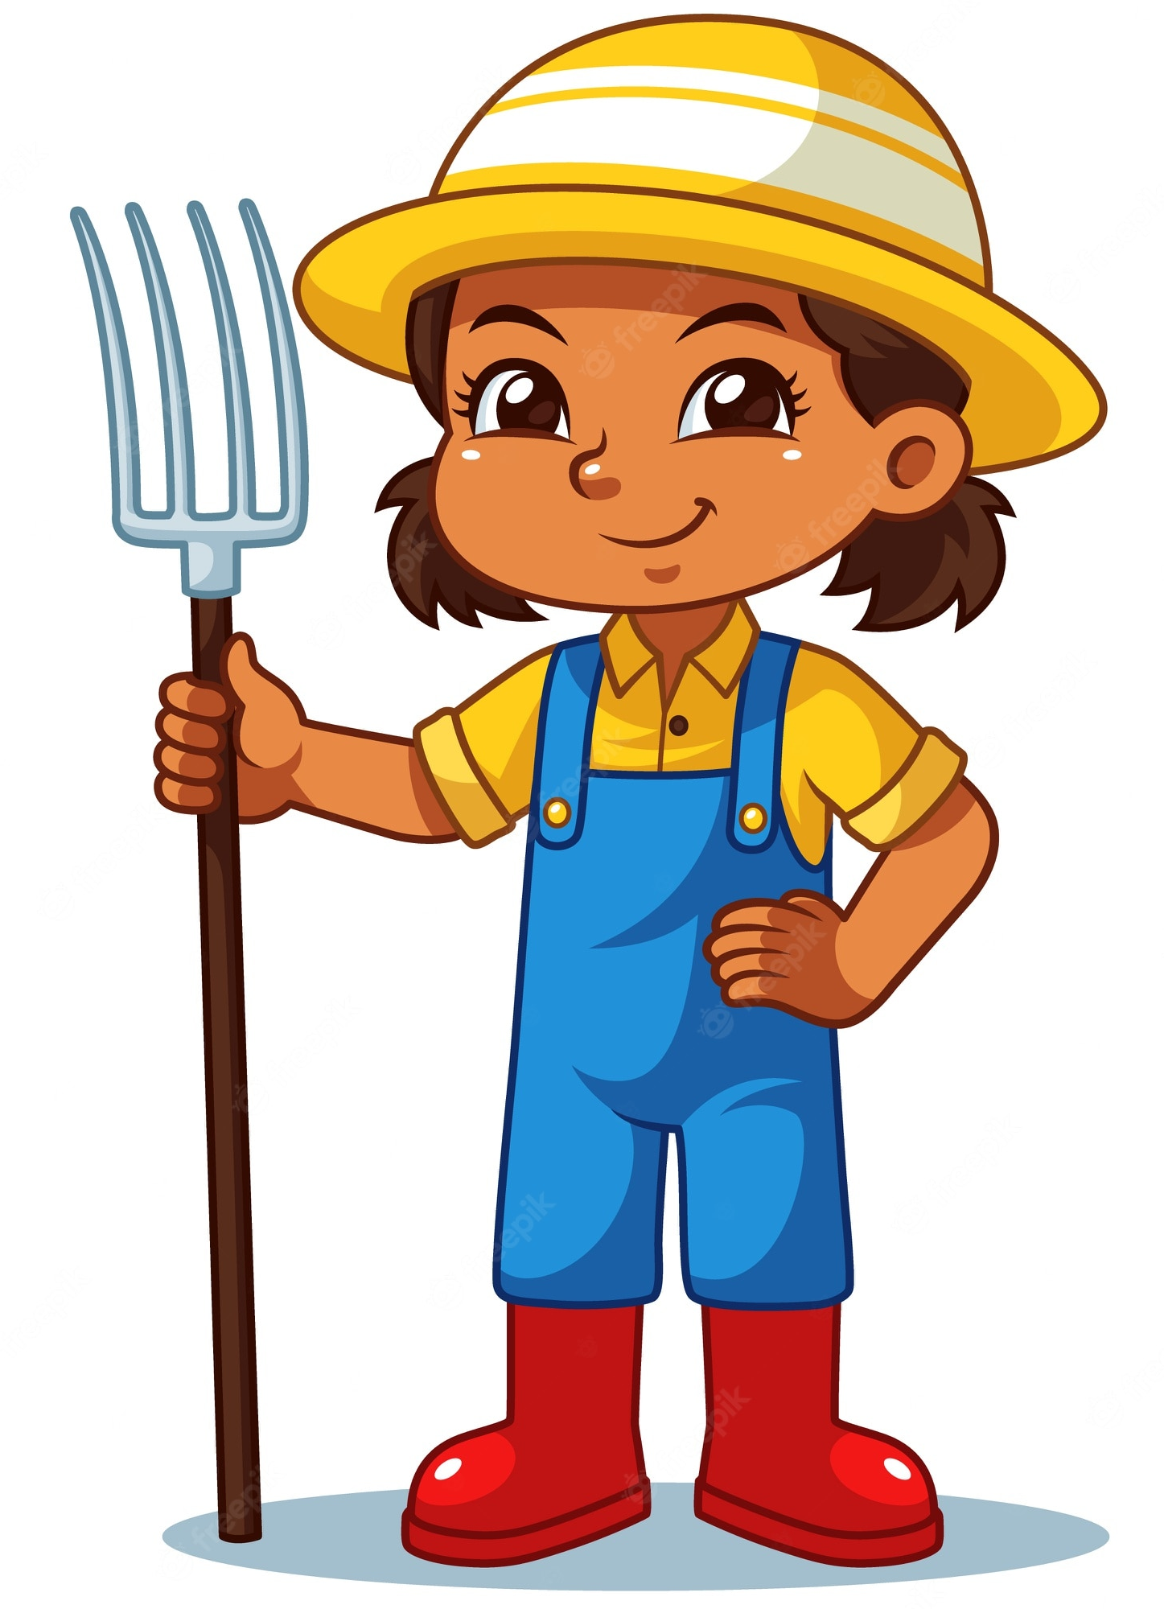


My last summer holiday …..
Where did she spend her last summer holiday?
LISTEN AND CHECK
Mai
Nick
Notes:
Let’s meet our new friend. Can you guess her name?
Yeah, Now she is talking to her friend Nick about her last summer holiday. Can you guess where did she spend her summer vacation?

Slide 11
Ex 1. Listen and read
Nick: You look great with a tan, Mai!
Mai: Thank you. I’ve just come back from a very enjoyable summer holiday.
Nick: Really? Where did you stay?
Mai: I stayed at my uncle’s house in a small village in Bac Giang Province.
Nick: What did you do there?
Mai: A lot of things. It was harvest time. The villagers were harvesting rice with a combine harvester. I helped them load the rice onto a truck. Then we unloaded the rice and dried it.
Nick: Sounds great!
Mai: And sometimes I went with the village children to herd the buffaloes and cows. I made friends with them on my first day.
Nick: Were they friendly?
Mai: Yes, they were. They took me to the paddy fields to fly kites. And in the evening, we played traditional games like bamboo dancing and dragon-snake.
Nick: Oh, I envy you!
Mai: Things move more slowly there than in our city, but people seem to have a healthier life.

Slide 12
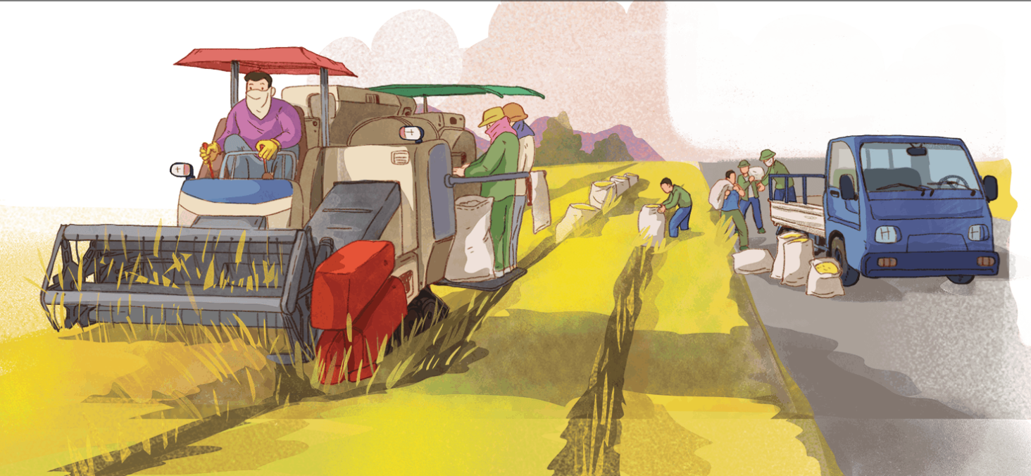
Where did Mai spend her last summer holiday?
In the countryside

Slide 13
Ex 2. Read again and choose the correct answer.
1. How does Mai feel about her summer holiday?
A. She likes it.
B. She doesn’t like it.
C. She thought it was fine.
2. Where did she stay during her summer holiday?
A. At her friend’s house.
B. At her uncle’s house.
C. At her grandparents’ house.
3. During harvest time, people harvest rice by ______.
A. themselves
B. using a truck
C. using a combine harvester
4. Mai thinks people in the countryside lead ______.
A. a healthy life
B. an exciting life
C. an interesting life
Underline key words

Slide 14
Ex 2. Read again and choose the correct answer.
1. How does Mai feel about her summer holiday?
A. She likes it.
B. She doesn’t like it.
C. She thought it was fine.
2. Where did she stay during her summer holiday?
A. At her friend’s house.
B. At her uncle’s house.
C. At her grandparents’ house.
Nick: You look great with a tan, Mai!
Mai: Thank you. I’ve just come back from a very enjoyable summer holiday.

Slide 15
Ex 2. Read again and choose the correct answer.
1. How does Mai feel about her summer holiday?
A. She likes it.
B. She doesn’t like it.
C. She thought it was fine.
2. Where did she stay during her summer holiday?
A. At her friend’s house.
B. At her uncle’s house.
C. At her grandparents’ house.
Nick: Really? Where did you stay?
Mai: I stayed at my uncle’s house in a small village in Bac Giang Province.

Slide 16
Ex 2. Read again and choose the correct answer.
3. During harvest time, people harvest rice by ______.
A. themselves
B. using a truck
C. using a combine harvester
4. Mai thinks people in the countryside lead ______.
A. a healthy life
B. an exciting life
C. an interesting life
Nick: What did you do there?
Mai: A lot of things. It was harvest time. The villagers were harvesting rice with a combine harvester. I helped them load the rice onto a truck. Then we unloaded the rice and dried it.
Nick: Sounds great!

Slide 17
Ex 2. Read again and choose the correct answer.
3. During harvest time, people harvest rice by ______.
A. themselves
B. using a truck
C. using a combine harvester
4. Mai thinks people in the countryside lead ______.
A. a healthy life
B. an exciting life
C. an interesting life
Nick: Oh, I envy you!
Mai: Things move more slowly there than in our city, but people seem to have a healthier life.

Slide 18
ANSWERS
1. How does Mai feel about her summer holiday?
A. She likes it.
B. She doesn’t like it.
C. She thought it was fine.
2. Where did she stay during her summer holiday?
A. At her friend’s house.
B. At her uncle’s house.
C. At her grandparents’ house.
3. During harvest time, people harvest rice by ______.
A. themselves
B. using a truck
C. using a combine harvester
4. Mai thinks people in the countryside lead ______.
A. a healthy life
B. an exciting life
C. an interesting life

Slide 19
Ex 3. Complete the sentences with the words and phrases in the box.
paddy field
herd
load
harvest time
combine harvester
1. It took them an hour to ___________ all the goods onto the truck.
2. Nowadays, people in my village use a __________________ to harvest their rice and separate the grains from the rest of the plant.
3. Today it is my turn to __________ the cows.
4. A place in which people grow rice is called a _______________.
5. A busy time when people cut and gather their crops is called _____________.
load
all the goods onto the truck
combine harvester
harvest
rice
separate
grains from the rest of the plant
herd
the cows
place
grow rice
paddy field
busy time
cut and gather their crops
harvest time

Slide 20
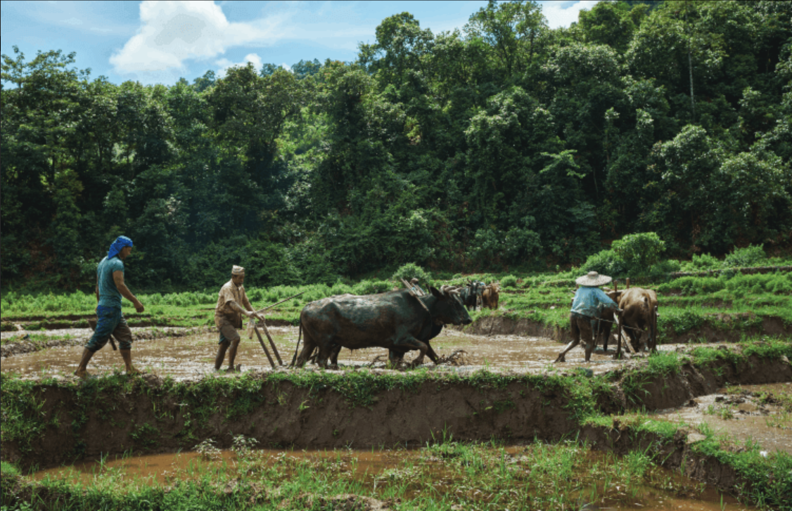
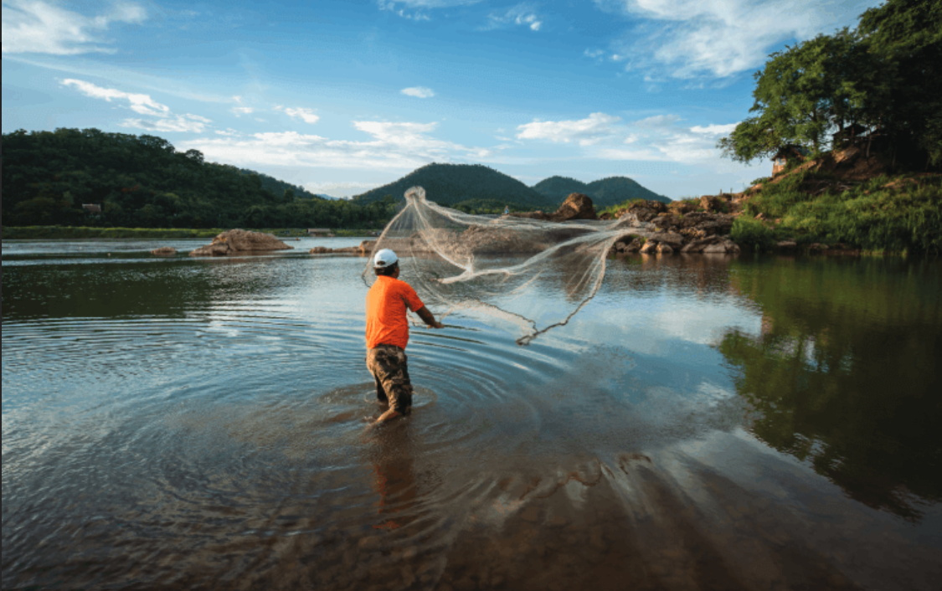
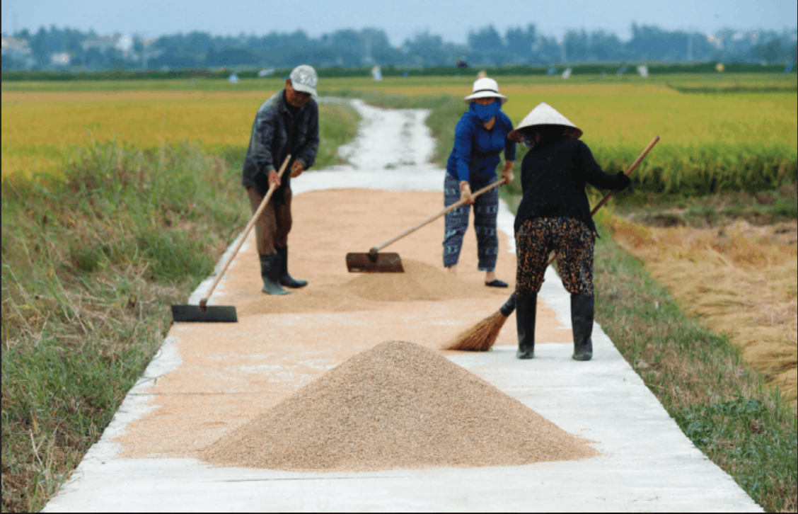
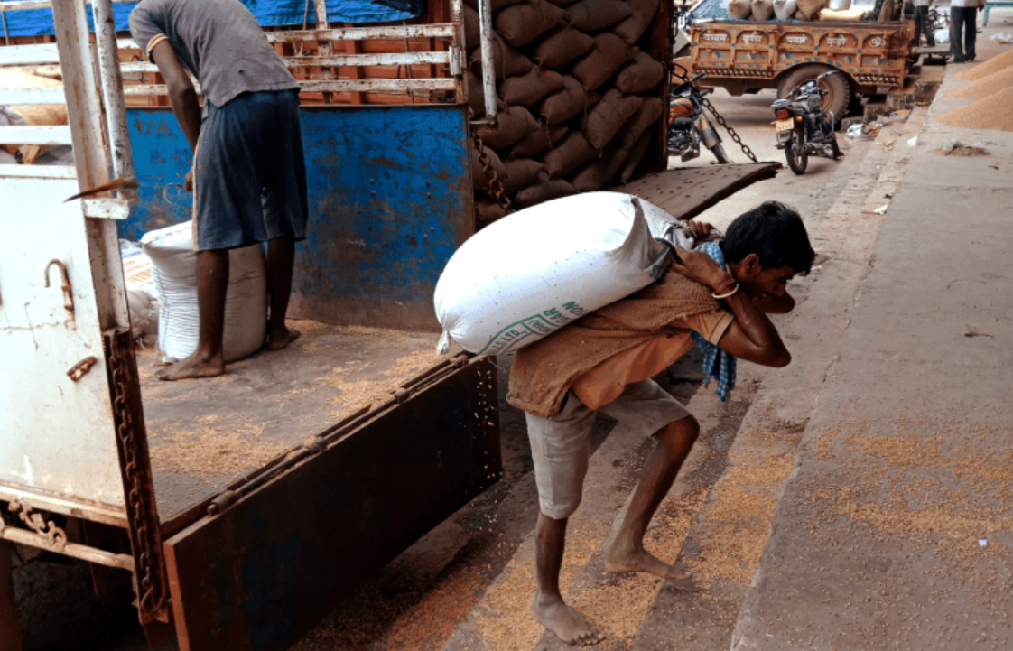
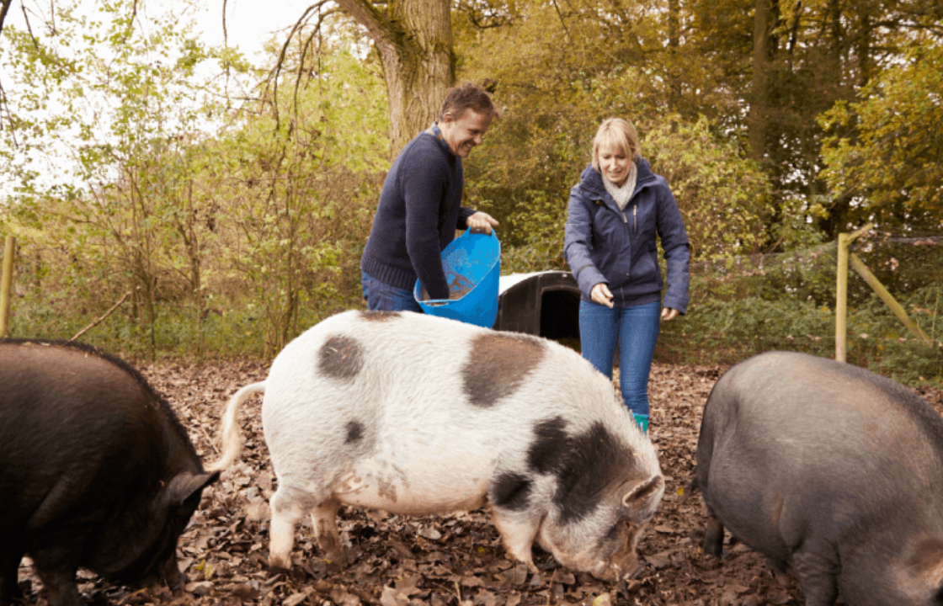
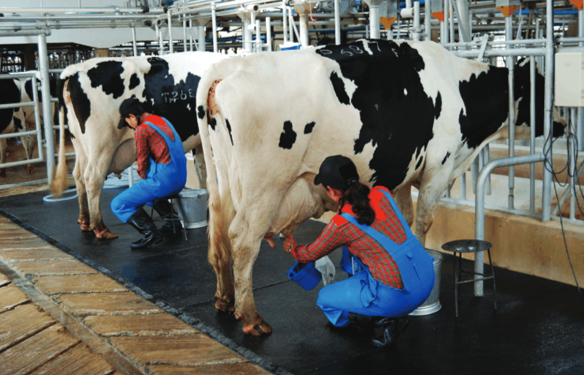
Ex 4. Activities people living in the countryside often do.
unloading rice
ploughing a field
milking cows
feeding pigs
catching fish
drying rice
a
b
c
ploughing a field
catching fish
drying rice
d
e
f
unloading rice
feeding pigs
milking cows

Slide 21
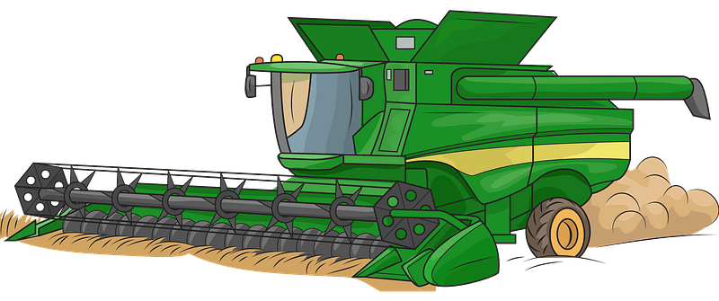
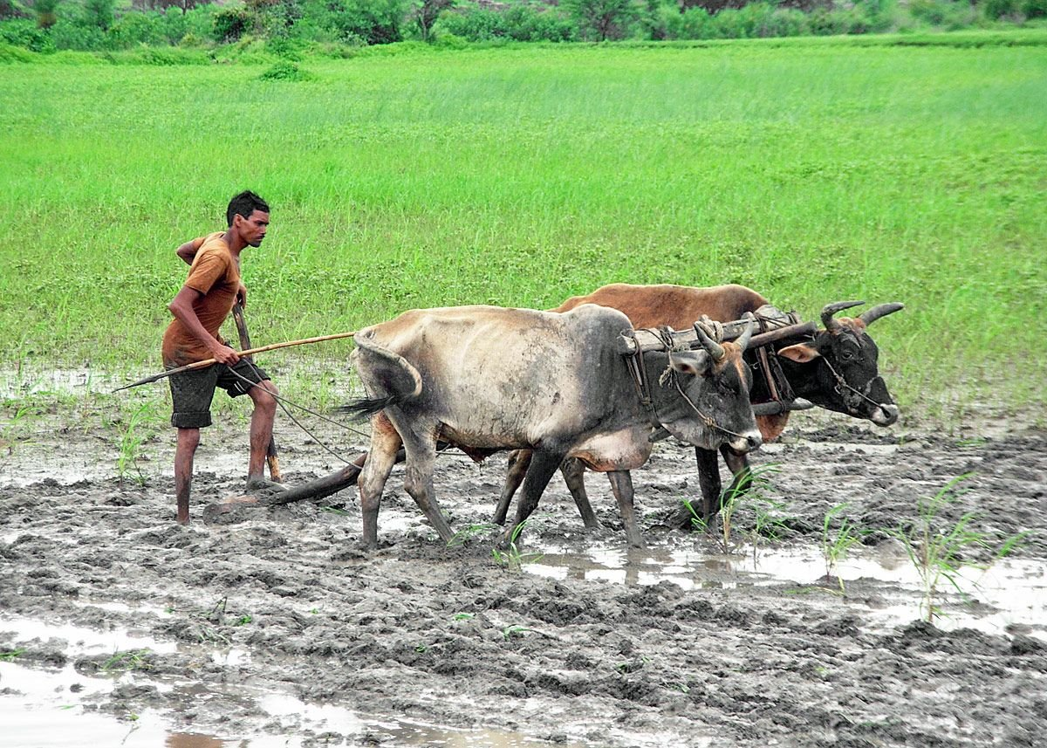
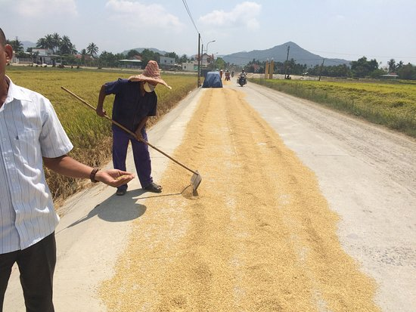
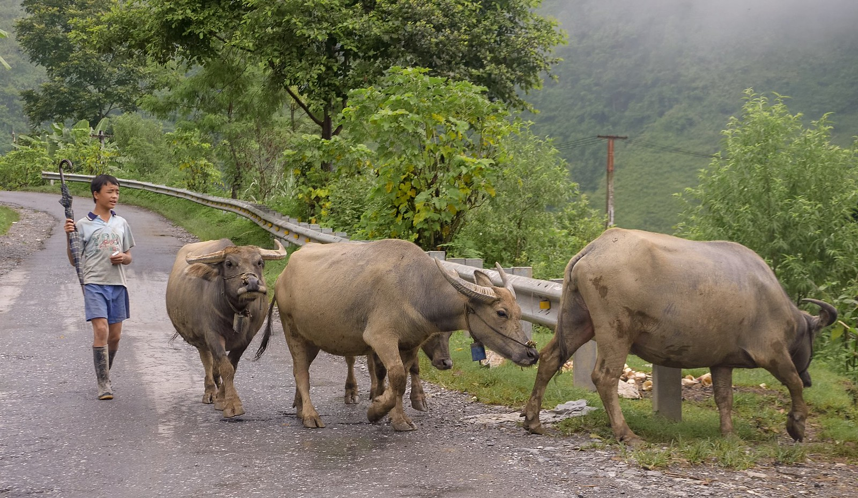
WRAP-UP
1
The farmer used a ____ to efficiently harvest the wheat crop.
A. harvest time
B. paddy field
C. combine harvester
2
Look and say. What are people doing?
ploughing a field
drying rice
herding buffaloes

