Slide 1
UNIT 7 TELEVISION Lesson 4 Communication
Let’s start!

Slide 2
Objectives
After this lesson, students will be able to:
- Ask for and give information about TV programmes.
- Use information about some TV programmes for children to give their own opinion.

Slide 3
01
Everyday English
Home
About me
What I do
My experience
My work
01
Asking for and giving information about TV programmes

Slide 4


Ex 1 (p.11) Listen and read the conversation. Pay attention to the highlighted words.
A: What's your favourite TV programme?
B: The animal programme.
A: Why do you like it?
B: Because I can see the animals in their real life.
Wh-question
What
Why
List other WH- questions you can use to ask about TV programmes.
Ex 2 (p.11) 5 minutes. Work in pair. Use the WH questions, make similar conversation about your friend’s favourite TV programme.

Slide 5
02
TV programmes
Home
About me
What I do
My experience
My work
02

Slide 6



Ex 3 (p.11) Work in groups. Discuss and complete the facts with the countries in the box.
the USA Viet Nam Japan Iceland
Facts
1. Pokemon cartoons are from ___________.
2. Bibi in ___________ shows international and Vietnamese cartoons.
3. In ___________, there was no TV on Thursdays before 1986.
4. Discovery Channel makes education fun for children in ___________.
Japan
Vietnam
Iceland
the USA

Slide 7

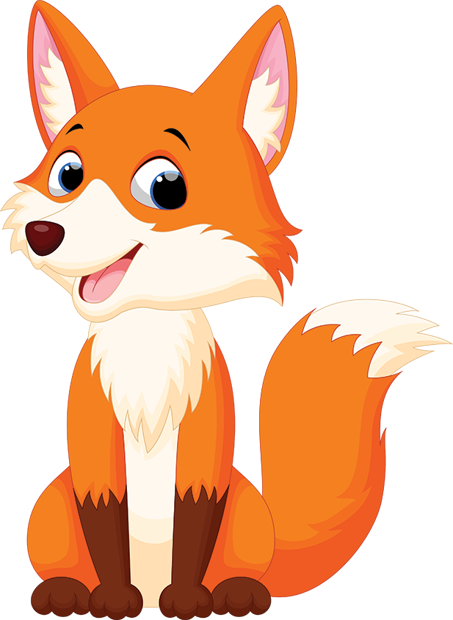
Ex 4 (p.11) Read about the two TV programmes and tick (✓) the correct programme in the table. You may tick both.
Let's Learn is an
educational TV
programme. It makes
learning fun. Children
love it. It has cute characters and fun songs. People in 80 countries watch it today. Both children and their parents like it.
 | Let’s Learn | Hello Fatty
1. It’s educational.
2. It has viewers from 80 countries.
3. Its main character is a clever fox.
4. Both parents and children enjoy it.
5. It’s a cartoon.
Hello Fatty is a popular TV cartoon. It's about a clever fox called Fatty and his friend. Together they go to different places. Children around the world enjoy this programme. It's funny and educational.

Slide 8
Ex 4 (p.11) Read about the two TV programmes and tick (✓) the correct programme in the table. You may tick both.
Let's Learn is an
educational TV
programme. It makes
learning fun. Children
love it. It has cute characters and fun songs. People in 80 countries watch it today. Both children and their parents like it.
educational
 | Let’s Learn | Hello Fatty
1. It’s educational.
2. It has viewers from 80 countries.
3. Its main character is a clever fox.
4. Both parents and children enjoy it.
5. It’s a cartoon.
✓
✓
People in 80 countries watch
Both children and their
parents like it.
✓
Hello Fatty is a popular TV cartoon. It's about a clever fox called Fatty and his friend. Together they go to different places. Children around the world enjoy this programme. It's funny and educational.
✓
TV cartoon.
clever fox
✓
✓
educational

Slide 9
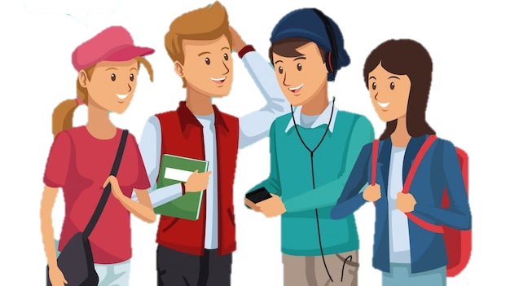
Ex 5 (p.11) Work in groups. Tell your group which programme in 4 you prefer and why.
Let's Learn is an
educational TV
programme. It makes
learning fun. Children
love it. It has cute characters and fun songs. People in 80 countries watch it today. Both children and their parents like it.
I like Let's Learn because it has cute characters and fun songs.
Hello Fatty is a popular TV cartoon. It's about a clever fox called Fatty and his friend. Together they go to different places. Children around the world enjoy this programme. It's funny and educational.

Slide 10
Tick (✓)what you have learnt in the lesson today?
□ Talk about a character
□ Ask for and give information about TV programmes.
□ Give opinion about TV programmes.
✓
✓

Slide 11
THANKS!
Home
About me
What I do
My experience
My work

