Slide 2

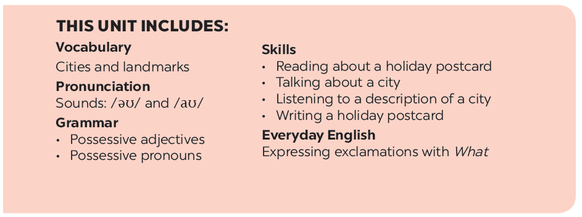

Slide 3
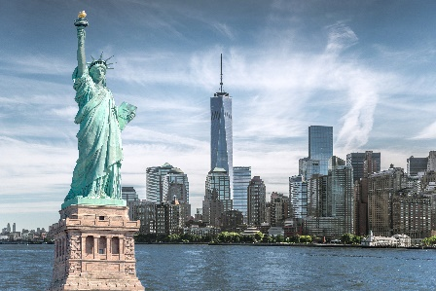
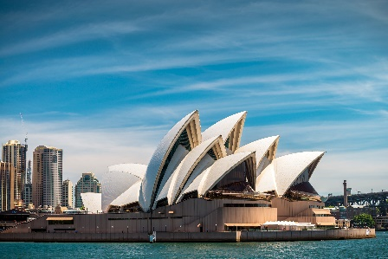
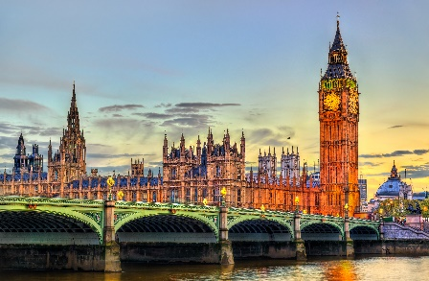
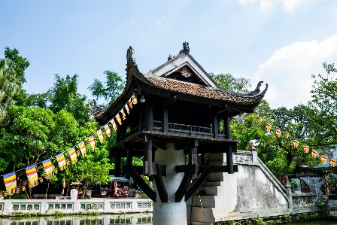
Do you know these places ?
1
2
Statue of Liberty
New York – The USA
Sydney Opera house
Sydney - Australia
3
Big Ben
London - England
4
One Pillar pagoda
Ha Noi – Viet Nam
Great Britain (The UK)

Slide 4
Vocabulary
1. 2. 3. 4. 5. 6. 7. 8. 9. 10. | landmark rainy crowded exciting = delicious beautiful: beach clean River Thames Times Square | /ˈlændmɑːk/ /ˈreɪni/ /ˈkraʊdɪd/ interesting /dɪˈlɪʃəs/ /'bju:tifl/ /bi:t∫/ /kli:n/ | (n): địa danh (adj): có mưa (adj): đông đúc (adj): thú vị, hào hứng (adj): ngon (thức ăn) (adj): đẹp bãi biển sạch sông Thames (London) Quảng trường Thời đại (New York)
Notes:
Thiếu tên bài đọc.

Slide 5
Vocabulary
1. 2. 3. 4. 5. 6. 7. 8. 9. 10. | landmark rainy crowded exciting = delicious beautiful: beach clean River Thames Times Square | /ˈlændmɑːk/ /ˈreɪni/ /ˈkraʊdɪd/ interesting /dɪˈlɪʃəs/ /bi:t∫/ /kli:n/
Notes:
Thiếu tên bài đọc.

Slide 6

What nice photos!
Mai: Tom, are these photos from your vacations?
Tom: Yes, they are. This is Sydney, a city in Australia.
Mai: What’s it like?
Tom: It’s exciting with a lot of beaches.
Mai: What a beautiful place!
Tom: Yes, its beaches are very clean.
Mai: Wonderful. Oh, this is London. Isn’t it raining?
What bad weather!
Tom: Yes, it rains all the time. Can you see Big Ben?
Mai: Yeah ... on the River Thames. It’s a landmark of London.
Tom: It is. And this is Times Square in New York, crowded but
interesting.
Mai: You’re lucky to visit many places.
Tom: I am. What about your vacations?
Mai: Here are some photos of mine. This is ...

Slide 7



Listen and read.
What nice photos!
Notes:
Thiếu tên bài đọc.

Slide 8
What nice photos!
Mai: Tom, are these photos from your vacations?
Tom: Yes, they are. This is Sydney, a city in Australia.
Mai: What’s it like?
Tom: It’s exciting with a lot of beaches.
Mai: What a beautiful place!
Tom: Yes, its beaches are very clean.
Mai: Wonderful. Oh, this is London. Isn’t it raining?
What bad weather!
Tom: Yes, it rains all the time. Can you see Big Ben?
Mai: Yeah ... on the River Thames. It’s a landmark of London.
Tom: It is. And this is Times Square in New York, crowded but
interesting.
Mai: You’re lucky to visit many places.
Tom: I am. What about your vacations?
Mai: Here are some photos of mine. This is ...

Slide 9


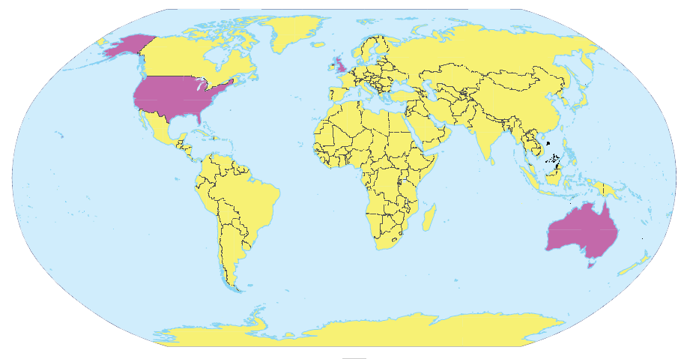
Write the names of the cities in the correct place.
1.
New York
London
2.
Sydney
London
New York
Sydney
3.

Slide 10

Read the conversation again and match the cities with the adjectives describing them.
a. rainy
1. Sydney
?
b. crowded
2. London
c. exciting
?
d. beautiful
3. New York
?
e. interesting

Slide 11
Read the conversation again and match the cities with the adjectives describing them.
a. rainy
1. Sydney
?
b. crowded
2. London
c. exciting
?
d. beautiful
3. New York
?
e. interesting

Slide 12
SUGGEST
What nice photos!
Mai: Tom, are these photos from your vacations?
Tom: Yes, they are. This is Sydney, a city in Australia.
Mai: What’s it like?
Tom: It’s exciting with a lot of beaches.
Mai: What a beautiful place!
Tom: Yes, its beaches are very clean.
Mai: Wonderful. Oh, this is London. Isn’t it raining? What bad weather!
Tom: Yes, it rains all the time. Can you see Big Ben?
Mai: Yeah... on the River Thames. It’s a landmark of London.
Tom: It is. And this is Times Square in New York, crowded but interesting.
Mai: You’re lucky to visit many places.
Tom: I am. What about your vacations?
Mai: Here are some photos of mine. This is…

Slide 13
SUGGEST
What nice photos!
Mai: Tom, are these photos from your vacations?
Tom: Yes, they are. This is Sydney, a city in Australia.
Mai: What’s it like?
Tom: It’s exciting with a lot of beaches.
Mai: What a beautiful place!
Tom: Yes, its beaches are very clean.
Mai: Wonderful. Oh, this is London. Isn’t it raining? What bad
weather!
Tom: Yes, it rains all the time. Can you see Big Ben?
Mai: Yeah... on the River Thames. It’s a landmark of London.
Tom: It is. And this is Times Square in New York, crowded but interesting.
Mai: You’re lucky to visit many places.
Tom: I am. What about your vacations?
Mai: Here are some photos of mine. This is…

Slide 14
SUGGEST
What nice photos!
Mai: Tom, are these photos from your vacations?
Tom: Yes, they are. This is Sydney, a city in Australia.
Mai: What’s it like?
Tom: It’s exciting with a lot of beaches.
Mai: What a beautiful place!
Tom: Yes, its beaches are very clean.
Mai: Wonderful. Oh, this is London. Isn’t it raining? What bad weather!
Tom: Yes, it rains all the time. Can you see Big Ben?
Mai: Yeah... on the River Thames. It’s a landmark of London.
Tom: It is. And this is Times Square in New York, crowded but interesting.
Mai: You’re lucky to visit many places.
Tom: I am. What about your vacations?
Mai: Here are some photos of mine. This is…

Slide 15

Match the cities with their landmarks.
a
1. Ha Noi
b
2. London
c
3. New York
d
4. Sydney

Slide 16
Match the cities with their landmarks.
a
1. Ha Noi
b
2. London
c
3. New York
d
4. Sydney

Slide 17


What city is it?
Example:
A: What’s it like?
B: It has beautiful beaches.
C: Is it in Australia?
B: Yes, it is.
A: It’s Sydney.
B: Right.

Slide 18







