Slide 1


VIETNAMESE LIFESTYLE: THEN AND NOW
Unit
6
LESSON 1: GETTING STARTED
We didn’t do it in my day.

Slide 2

LESSON 1: GETTING STARTED
LESSON 1: GETTING STARTED
WARM-UP
Option 1: Think!
Option 2: Q&A
PRESENTATION
Vocabulary
Task 1: Listen and read.
Task 2: Read the conversation again and circle the correct answers.
Task 3: Write the expressions from the conversation in the correct column.
Task 4: Complete the sentences with the words from the box.
PRACTICE
FURTHER PRACTISE
Task 5: Quiz
CONSOLIDATION
Wrap-up
Homework

Slide 3
WARM-UP
OPTION 1
EXPERIENCES
Take turns to write any words and phrases about the kind of experience and the adjectives describing experiences on the board
For example:
a learning experience, a frightening experience

Slide 4
WARM-UP
OPTION 1
Answer the questions:
- How is shopping now different from that about 10 years ago?
- What is trendy for young people now?
THINK!
What aspect of life you think has changed (transportation, fashion, entertainment, shopping, travelling, learning …)?

Slide 5

WARM-UP
OPTION 2
Topic: Hobbies
- Work in pairs / groups.
- Each pairs / groups will have
a set of questions.
- Take turns asking and answering
the questions in pairs / groups.
Advantages team | Disadvantages team

Slide 6
WARM-UP
OPTION 2
Now, share your ideas.
Questions:
- What are some hobbies that you enjoy or
want to try?
- How do you balance your hobbies and
your work or study?
- What are some benefits or challenges of
having hobbies?
- How did you discover or develop your
hobbies?
Advantages team | Disadvantages team

Slide 7

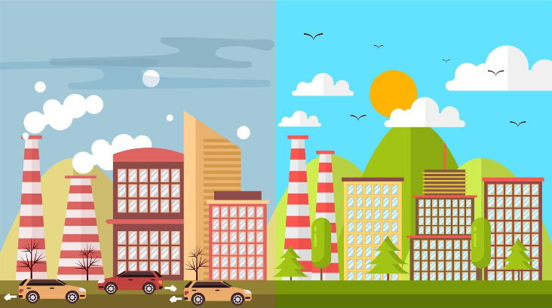

PRESENTATION
living condition
/ˈlɪvɪŋ kənˈdɪʃənz/
điều kiện sống

Slide 8
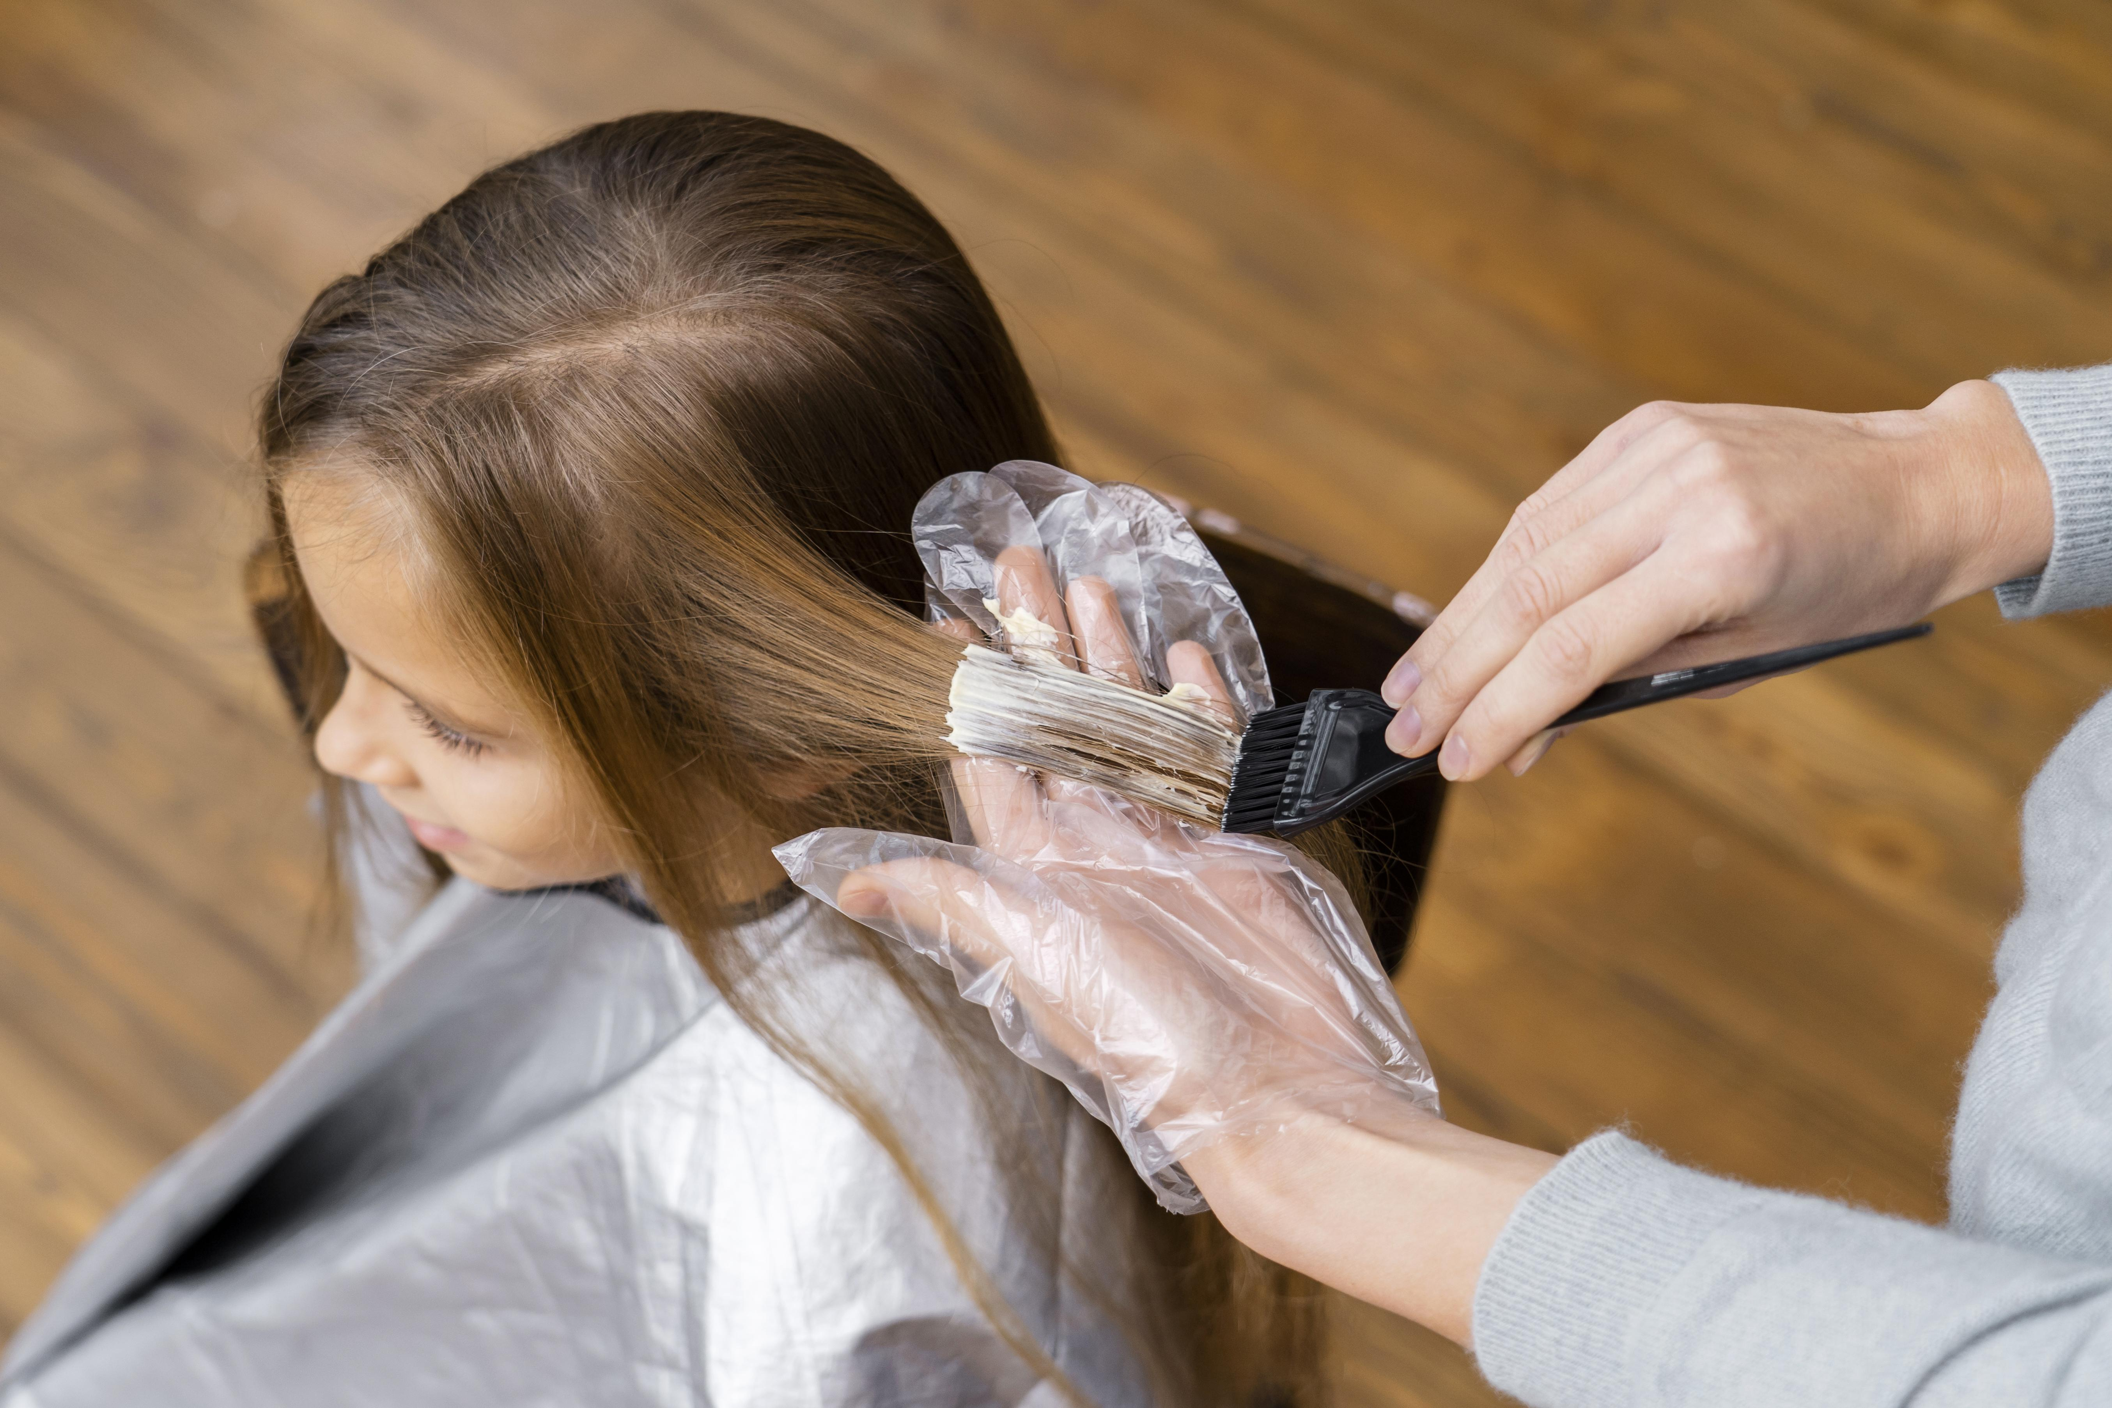

PRESENTATION
opportunity (n)
/ˌɒpəˈtjuːnəti/
cơ hội
Ex: He had a golden opportunity to score in the first half but squandered it.

Slide 9
PRESENTATION
to change the colour of sth using a special liquid.
dye (v)
/daɪ/
nhuộm

Slide 10
PRESENTATION
New words | Pronunciation | Meaning
1. living condition | /ˈlɪvɪŋ kənˈdɪʃənz/ | điều kiện sống
2. opportunity (n) | /ˌɒpəˈtjuːnəti/ | cơ hội
3. dye (v) | /daɪ/ | nhuộm

Slide 11
PRACTICE
Look at the pictures on pages 60-61 and answer.
- What do you think the children / teens in each picture
are doing?
- Do you think the activity in each apicture is popular
in the past or present?

Slide 12
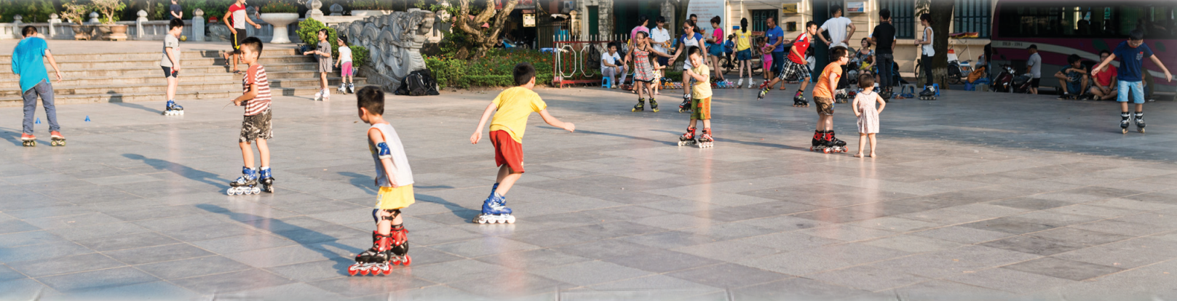
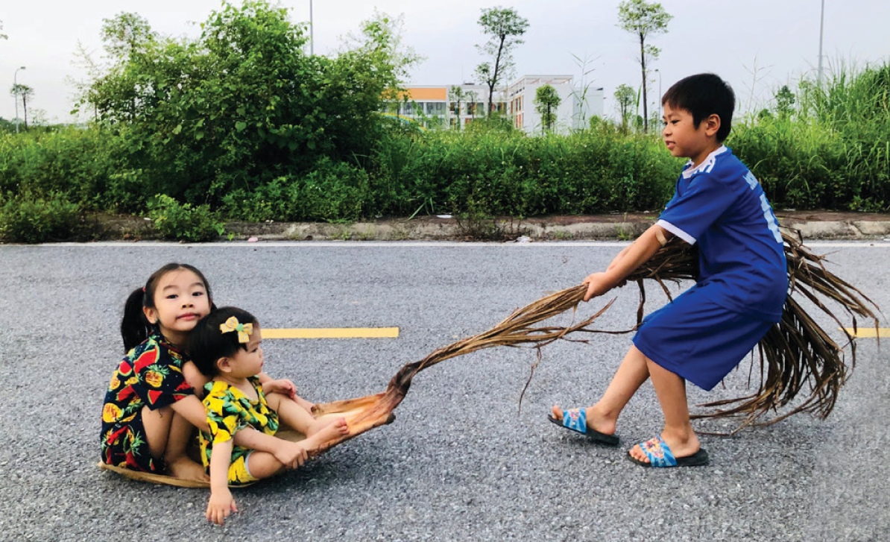
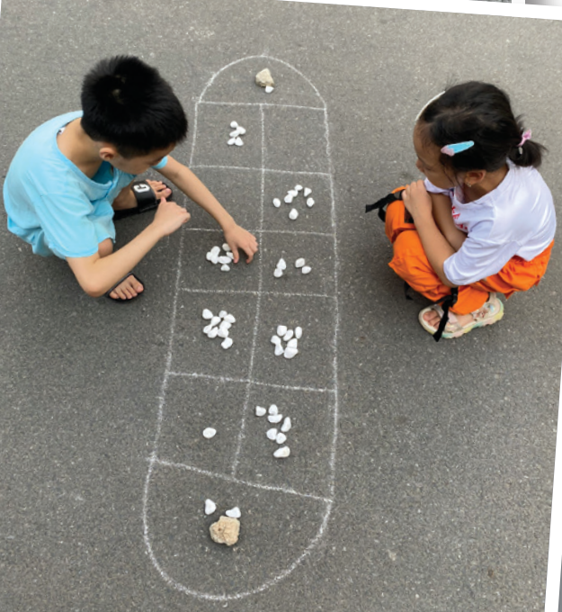
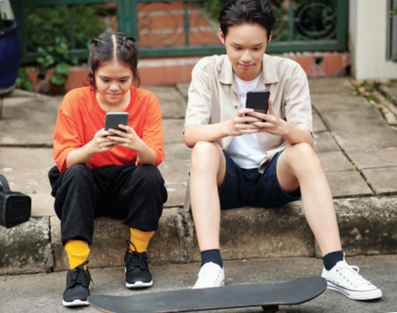
PRACTICE

Slide 13

PRACTICE
1
Listen and read.
Phong: Grandpa, do you mind telling me how our lives are different from yours in the past?
Grandpa: Well, there are many differences. In my day, we mostly played outdoors. The games were simple and cost little. We made our own toys from natural materials.
Phong: That sounds interesting. Nowadays, most leisure games depend on electronic devices.
Grandpa: Right, but that is mostly true in the city only. Many children in the countryside still play traditional games.
Phong: I know.

Slide 14
PRACTICE
1
Listen and read.
Grandpa: Another thing is that children nowadays have more freedom of choice. They wear short dresses and jeans with holes. They also dye their hair purple and green.
Phong: Ha ha … Not many, Grandpa.
Grandpa: Hm … And many children of my generation left school early to support their families. Moreover, there were not many schools then.
Phong: You mean we have more opportunities to learn now?
Grandpa: That’s right.
Phong: Do you think these changes are for the better?
Grandpa: Yes, they mostly are. They have improved our living conditions.
Phong: Thank you, Grandpa.

Slide 15
PRACTICE
2
Read the conversation again and circle the correct answers.
1. Phong and his grandpa are talking about some differences between ______.
A. children in the city and the countryside
B. the living standards in the past and now
C. life in the past and now
D. past and present entertainment
2. Phong’s grandpa mentions ______ differences.
A. two B. three C. four D. five
3. Phong’s grandpa sees most of the changes as ______.
A. positive B. negative C. unnecessary D. necessary

Slide 16
opportunity
freedom
dyed
generations
materials
PRACTICE
3
Write the expressions from the conversation in the correct column.
a. depend on electronic devices
b. leave school early
c. dye their hair
d. have more opportunities to learn
e. make toys from natural materials
THE PAST | THE PRESENT

Slide 17
PRACTICE
4
Complete the sentences with the words from the box.
opportunity
freedom
dyed
generation
materials
1. A few teenagers in my village have ____________ their hair brown.
2. Young people’s lifestyle today is different from that of the previous ____________.
3. Nowadays, nearly all young people have a(n) ____________ to go to school.

Slide 18
PRACTICE
4
Complete the sentences with the words from the box.
opportunity
freedom
dyed
generation
materials
4. He wants to live green, so he uses products made from natural ____________.
5. My parents give me ____________ to pursue my own interests.

Slide 19

FURTHER PRACTISE
5
Work in pairs. Decide if the statements below are TRUE or FALSE
about life in Viet Nam 40 years ago. Share your answers with the class.
40 years ago, ______
False
1. school children didn’t wear uniforms.
2. no Vietnamese student could go and study abroad.
3. most people wrote letters instead of writing emails or
texting messages.
4. bicycles were the main means of transportation.
5. people lit firecrackers at Tet and weddings.
False
True
True
True

Slide 20
PRODUCTION
KNOWLEDGE TIME
1. Many schools in Viet Nam had school uniforms since the 1950s.
2. Students in Viet Nam could go and study abroad as far back as the 1940s.
3. According to Decision no 406-TTg dated 8 August 1994, there was a complete ban on the production, trade and lighting of firecrackers in Viet Nam. (ABOUT 28 YEARS).

Slide 21

CONSOLIDATION
1
Wrap-up
What have we learnt in this lesson?
Use the words related to the topic Vietnamese lifestyle;
Gain vocabulary to talk about some changes in lifestyle .

Slide 22

CONSOLIDATION
2
Homework
- Do exercises in the Workbook.
- Prepare for the Project of the unit.

Slide 23
Website: hoclieu.vn
Fanpage: facebook.com/tienganhglobalsuccess.vn/

