Slide 1

Unit 6:
VIETNAMESE LIFESTYLE: then and now
LESSON 5: SKILLS 1

Slide 2
OBJECTIVES
By the end of the lesson, students will be able to:
1. READING
Read for specific information about the differences in the learning styles of past and present.
2. SPEAKING
Talk about changes in one’s learning style

Slide 3
NEW WORDS

Slide 4
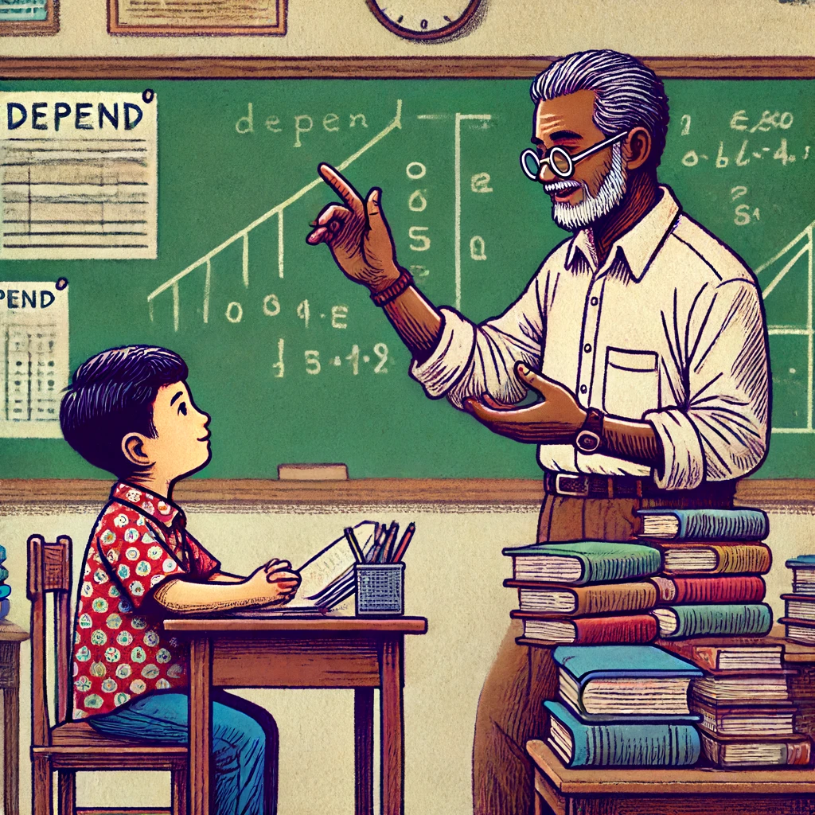

NEW WORDS
depend (v)
/dɪˈpend/
phụ thuộc
= base on
Tom depends on the teacher to understand the lesson on the board.”

Slide 5

NEW WORDS
pursue (v)
/pəˈsjuː/
theo đuổi
The student is running to pursue his dream of graduation

Slide 6
NEW WORDS
NEW WORD | PRONUCIATION | MEANINGS
 |  | phụ thuộc
 |  | theo đuổi
depend (v) | /dɪˈpend/
pursue (v) | /pəˈsjuː/

Slide 7
01
READING

Slide 8
Ex1: Work in groups. Discuss if each of the following phrases describes past or present learning.
Work in groups.
Read the phrases about different learning styles and discuss if each is describing the past or the present
– Depending on textbooks
– Using the Internet
– Learning under an oil lamp
– Being independent and active

Slide 9
Ex1: Work in groups. Discuss if each of the following phrases describes past or present learning.
Possible answers:
Past: depending on textbooks, learning under an oil lamp.
Present: using the internet, being independent and active.

Slide 10
Ex2: Two people of different generations are talking about their learning styles. Read the passages and choose the correct answer A, B, C, or D.
Mr Nam, grandfather, a 70-year-old farmer
I was one of the few children in my village who was still at school at the age of 15. Every day, I got up early and walked to school. Learning then depended mostly on our teachers and textbooks. We had no library or lab. The nearest bookshop was six kilometres away. I learned simply by taking notes during class, memorizing them, and doing the homework. Life then was simple. We rarely travelled outside our village, so we didn’t know much about the world around us.

Slide 11
Ex2: Two people of different generations are talking about their learning styles. Read the passages and choose the correct answer A, B, C, or D.
Mai, granddaughter, a 15-year-old student
Learning today is very different from my grandfather’s time. It is easier and more convenient. Besides learning from teachers and textbooks, we use the Internet. It provides us with various online sources such as documents, clips, and programmes. Google helps us find the answers to almost any questions we have. The Internet also allows us to pursue our own interests. Learning has become more independent. Although most children in my village have fewer private learning facilities than the students in the city, we are still luckier than my grandfather’s generation. We have TVs to watch at home and a library and computers at school.

Slide 12
Read the passages and choose the correct answer A, B, C, or D.
1. In Mr Nam’s time, ______.
A. teachers played an important role
B. there were no bookshops
C. students did experiments in labs
D. all children stayed on at school until they were 15
2. Few people travelled outside their village, so ____.
A. life in the village was simple
B. his school didn’t have any learning facilities
C. the villagers didn’t know much about the world around
D. none of the villagers knew about city life
Learning then depended mostly on our teachers and textbooks.
We rarely travelled outside our village, so we didn’t know much about the world around us.

Slide 13
Read the passages and choose the correct answer A, B, C, or D.
3. Learning now ______.
A. does not require textbooks
B. uses some online programmes
C. depends only on the Internet
D. does not require students to take notes
4. The word “It” refers to ______.
A. learning today
B. my grandfather’s time
C. learning facilities
D. the Internet
[…]we use the Internet. It provides us with various online sources such as documents, clips, and programmes.
Learning today is very different from my grandfather’s time. It is easier and more convenient.

Slide 14
Read the passages and choose the correct answer A, B, C, or D.
5. The word “we” refers to__________.
A. learning facilities
B. students at my grandfather’s generation
C. students in the city
D. children in the village
Although most children in my village have fewer private learning facilities than the students in the city, we are still luckier than my grandfather’s generation.

Slide 15
Ex3: Fill in each blank with ONE word from the passage.
1. Learning then depended mostly on our teachers and textbooks.
2. I learned simply by taking notes during class, memorizing them, and doing the homework.
3. Besides learning from teachers and textbooks, we use the Internet. It provides us with various online sources
1. Mr Nam learned mainly from teachers and _________.
2. He learned by _________ the information he got in class.
3. Nowadays, students can learn from _________ online sources.
textbooks
memorizing
various

Slide 16
Ex3: Fill in each blank with ONE word from the passage.
4. An example of an online source is ________.
5. The Internet helps children _________ their interests.
4. Google helps us find the answers to almost any questions we have.
5. The Internet also allows us to pursue our own interests.
google
pursue

Slide 17
02
SPEAKING

Slide 18
Ex4: Work in groups. Discuss and make a list of the changes in your learning over the past five years.
Work in groups.
Choose to talk about anything related to your learning.
Discuss and take notes of your answers.
You can mention:
– number of subjects
– teachers
– learning facilities
– learning style (dependent / independent ...)

Slide 19
Ex4: Work in groups. Discuss and make a list of the changes in your learning over the past five years.
Sample answers:
Teachers: three or four teachers teach all the subjects -> different teachers for different subjects.
Learning Facilities: almost text book -> use textbooks and internet…
Learning style: dependent -> independent

Slide 20
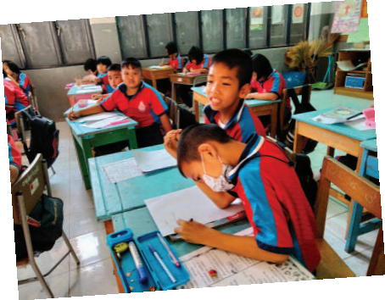
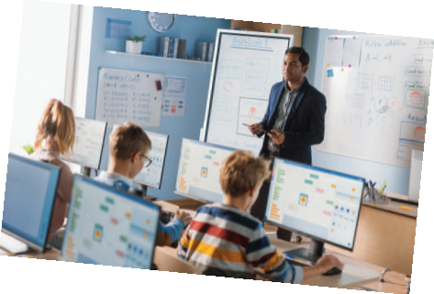
Ex5: Share with the class the list your group has made in 4
Present the changes that your groups have talked about.
Listen and give comment or ask questions if you have any.

Slide 21
Ex5: Share with the class the list your group has made in 4
Example:
Five years ago, we were at primary school. We had only three or four teachers teaching us all the subjects. We depended on the teachers to tell us everything we needed to do: taking notes in our notebooks, doing homework and preparing for exams. We rarely did anything that the teacher did not request. Now, we have different teachers for different subjects. We have also become more independent and active in our learning. We use the internet to learn about our interests. And it costs little to do it.

Slide 22
EXTRA ACTIVITY
Interview two of your classmates and fill in the table below in notes. Then report your findings to the class.
Questions | Student 1 | Student 2
1. What are the three favourite sources for your learning?
2. What do you prefer: learning by yourself or learning in groups?
3. Do you attend extra classes after school?

Slide 23
WRAP – UP
What have we learnt in this lesson?
READING
Read for specific information about the differences in the learning styles of past and present.
SPEAKING
Talk about changes in one’s learning style

Slide 24
THANK YOU!

