Slide 1
Unit 9. Natural Disaster
Lesson 6. Skills 2
Teacher: Dao Hien

Slide 2
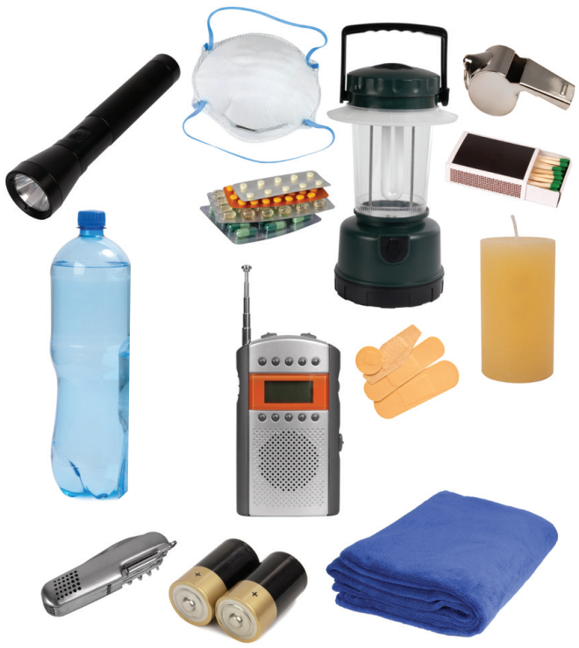

Name all things in this picture in 2 minutes
“This is a quote, words full of wisdom that someone important said and can make the reader get inspired.”
When do we need these things?
Notes:
Divide the class into 2 teams and write the names of the objects in the picture within 3 minutes
Torch
Mask
Bottle water
Medicine
Matches
Whistle
walkie talkie
Candle
Knife
Towel
Battery
electric lamp

Slide 3
Objectives
01
02
Listen and get general and specific about things to do before, during, and after a natural disaster;
Write instructions about things to do before, during, and after a natural disaster.

Slide 4

Ex 2. Listen to a broadcast. Put the activities (1 – 6) in the correct column.
Before a storm
During a storm
After a storm
2
6
3
5
1
4
1. Listen to instructions from local authorities
4. Keep away from dangerous areas
5. Avoid windows and glass doors
2. Prepare an emergency kit
3. Stay inside the house
6. Strengthen houses

Slide 5

Ex 3. Listen again and tick T (True) or F (False) for each sentence.
 | True | False | Proof
1. The broadcast is on TV.
2. You should bring flowerpots and rubbish bins into the house.
3. Right after the storm, you can leave your home.
4. The local authority may warn you about dangerous places.
This is An Binh Commune Radio Station.
Bring in outdoor things like flowerpots or rubbish bin because they can get blown away by strong winds.
After the storm, don't leave your house right away.
Listen to important instructions from local authorities. They may warn you about which parts of your area are dangerous and should be avoided.

Slide 6
What you should do before, during, and after a flood?
Let’s discuss in pair in 4 minutes

Slide 7
Ex 4. Discuss what you should do before, during, and after a flood.
Before a flood
During a flood
After a flood
Prepare an emergency kit.
Stay inside a safe and high place.
Avoid moving water.

Slide 8



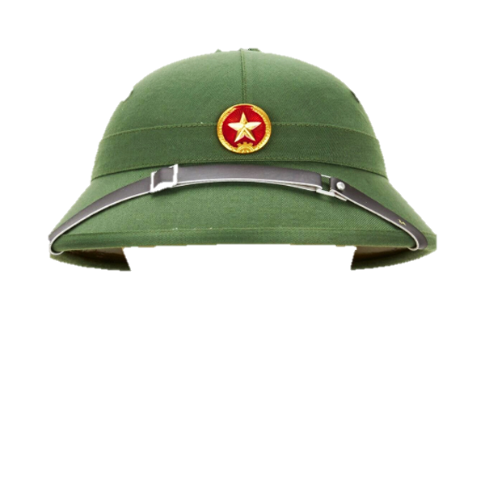
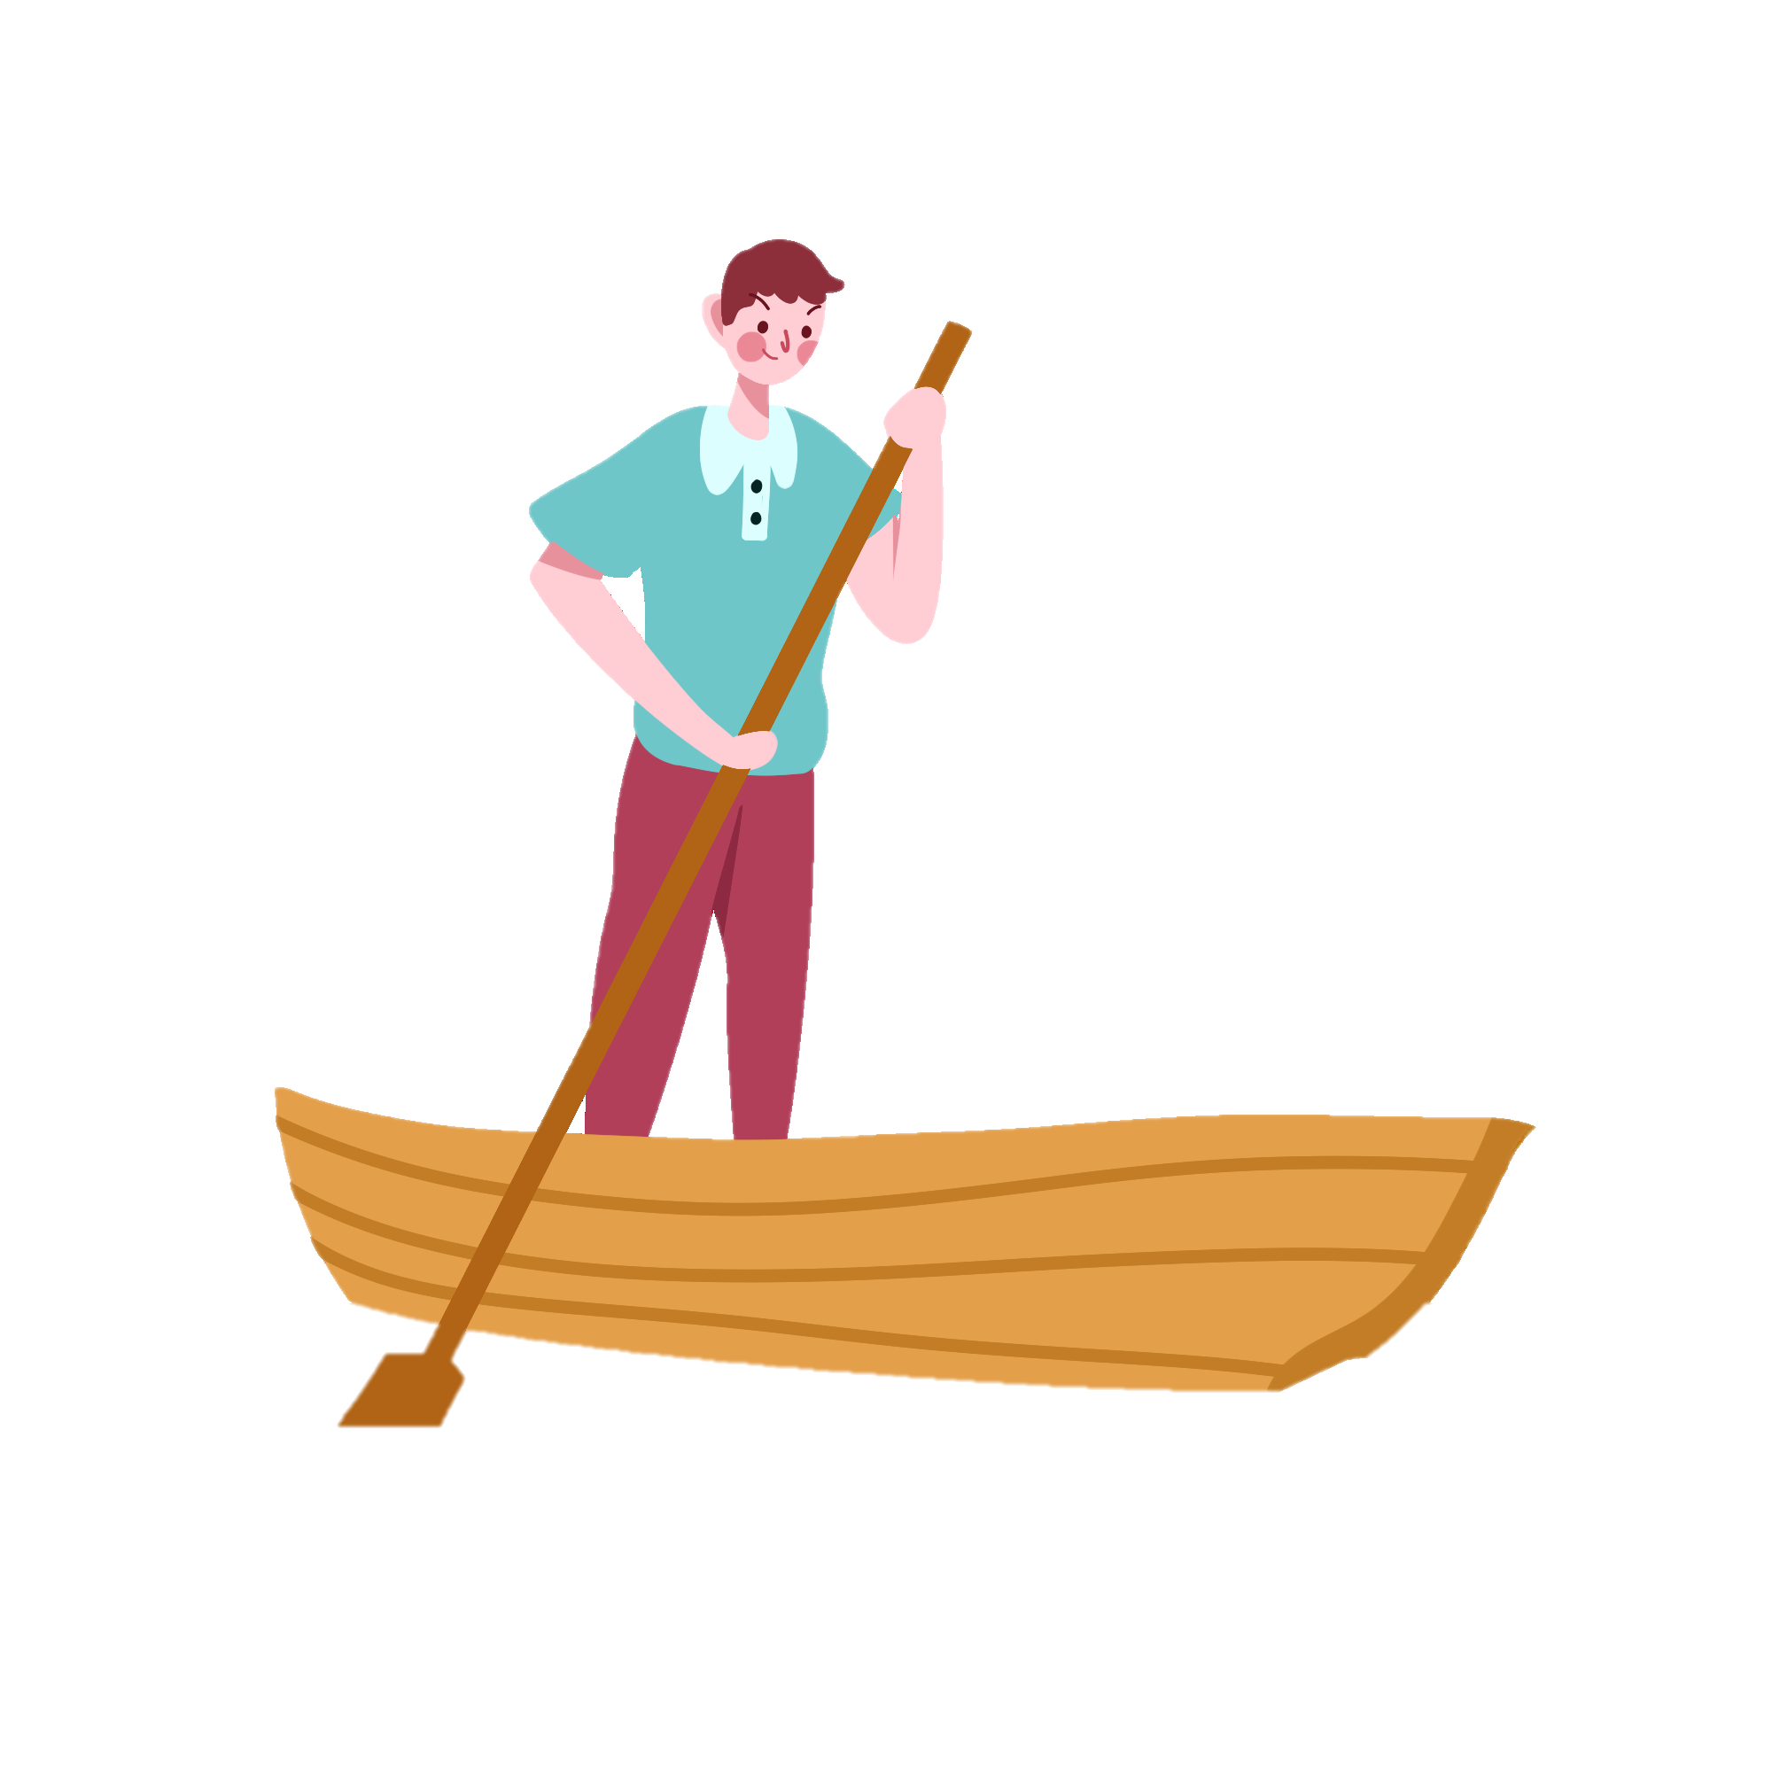
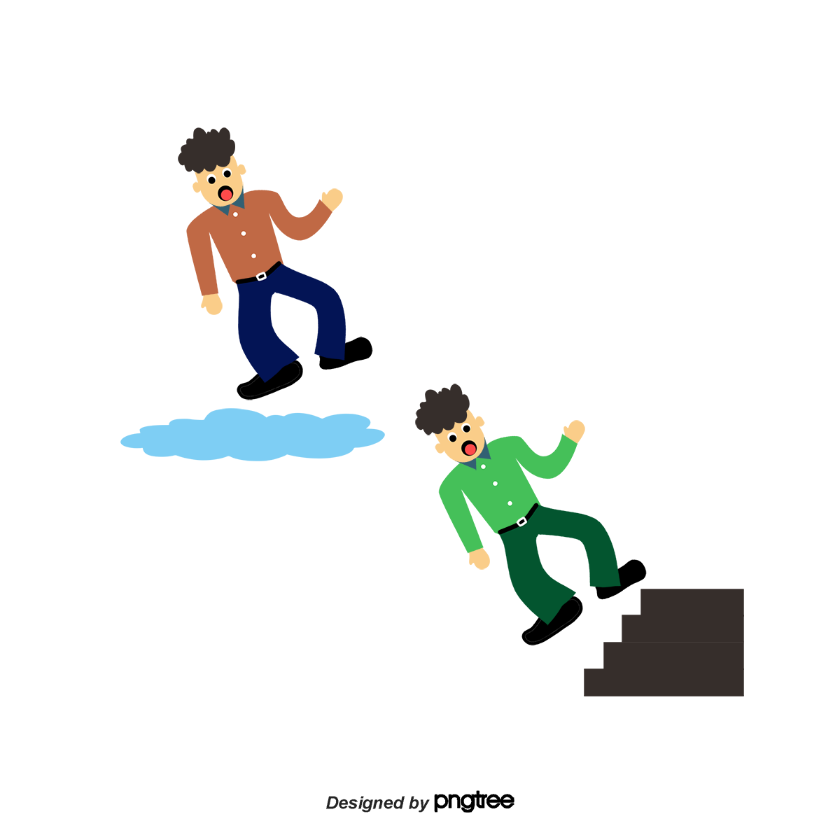

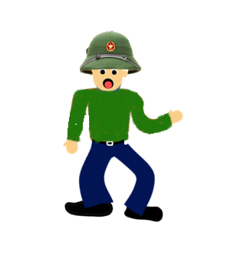


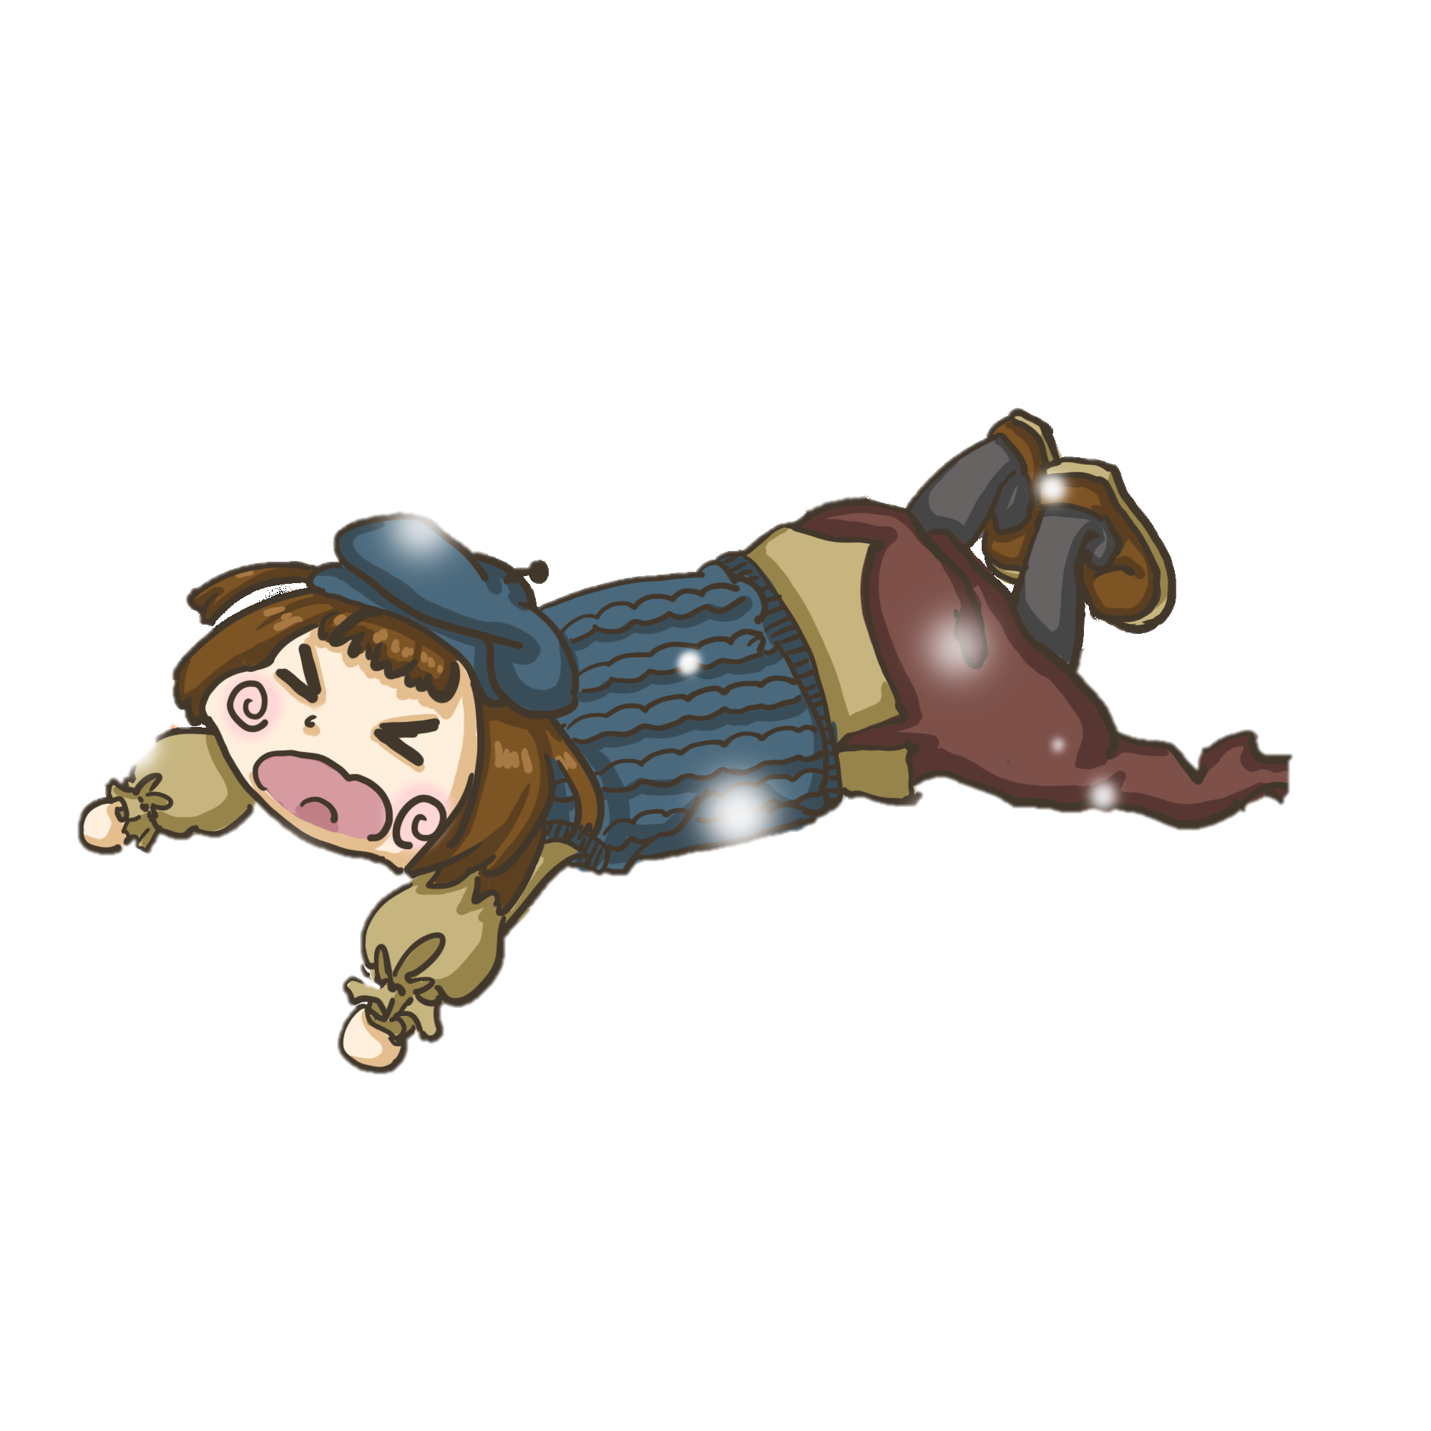


Emergency Rescue

Slide 9
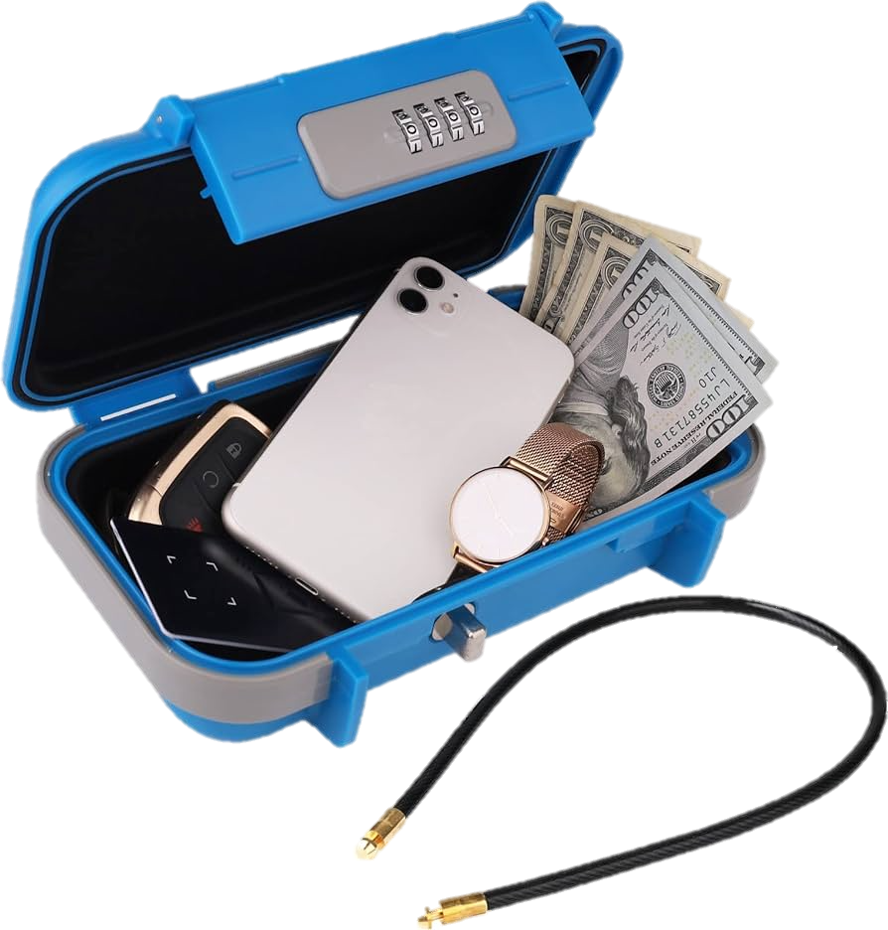




START
Time’s up
A. Protect your valuables in a plastic box
B. Protect your valuables in a safety deposit box
C. Throw away all your valuables to save yourself
D. Protect your valuables in waterproof containers

Slide 10
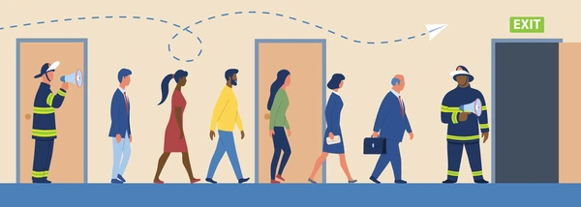
A. Return home and prevent home damage
B. Follow your own opinion
C. Follow the routes specified by officials
D. Stay to protect the workplace and company assets
START
Time’s up

Slide 11

A. Listen to the television for relaxation
B. Watch horror movies together
C. Stay home and watch cartoons
D. Listen to the television for information
START
Time’s up

Slide 12
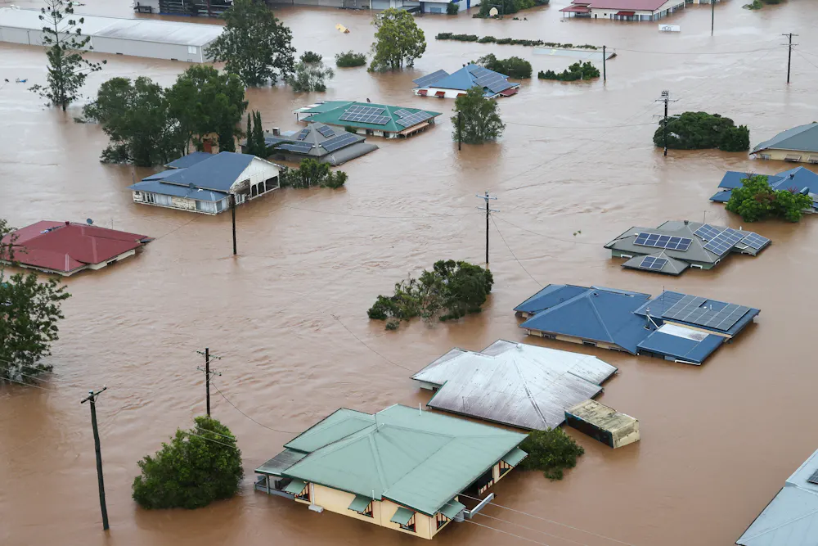
A. Live in flood zones and avoid bare land
B. Clean your house regularly to keep it looking like new
C. Avoid building in a floodplain
D. Build a house on low land
START
Time’s up

Slide 13
What have you leanrt today?
RECAP
Listen and write instruction about things to do before, during and after storm and flood

Slide 14
H0MEWORK
Start as follows:
Here a things you should do before, during and after a flood.
01 | Before
02 | During
03 | After
Ex 5. Write instructions (80 - 100 words) about things to do before, during, and after a flood.

Slide 15
Thank you!

