Slide 1




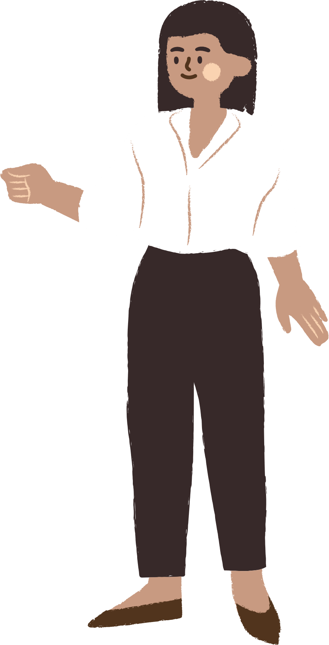
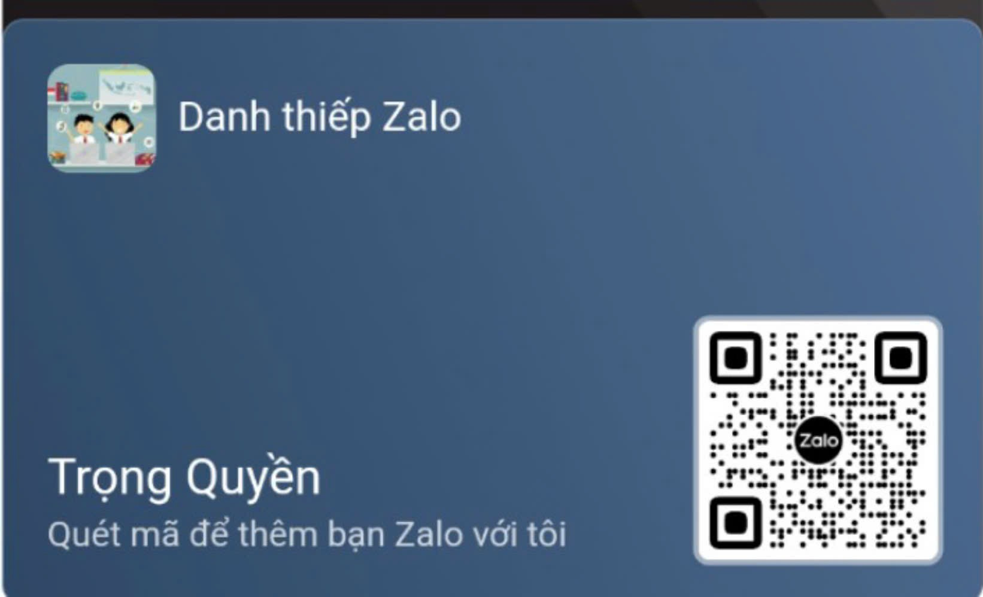




UNIT 11
ELECTRONIC DEVICES
LESSON 1: GETTING STARTED
Notes:
TRUY CẬP MÃ QR ĐỂ NHẬN QUÀ TẶNG
https://facebook.com/groups/853679022766648/

Slide 2





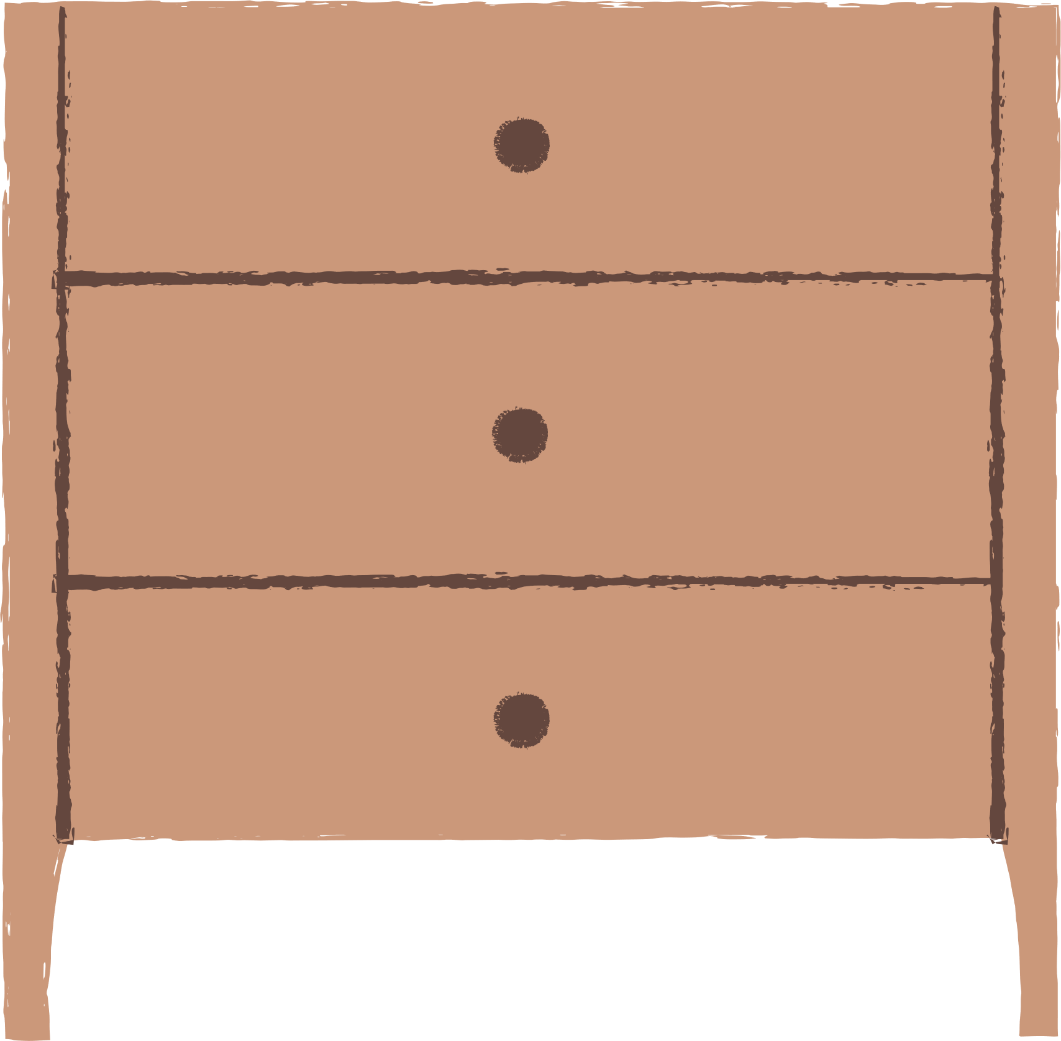
CONTENT
WARM-UP
VOCABULARY
PRACTICE
GAMES

Slide 3

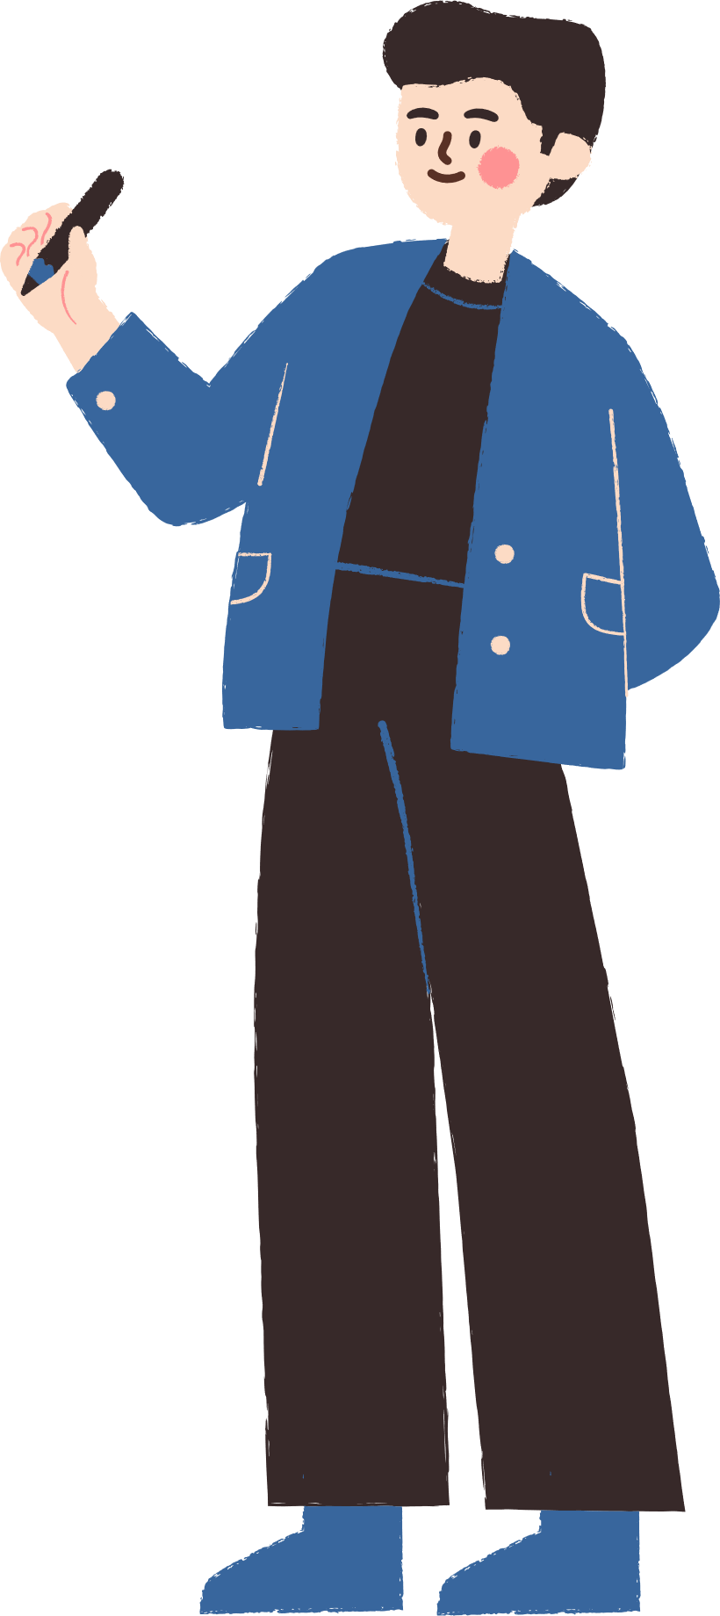


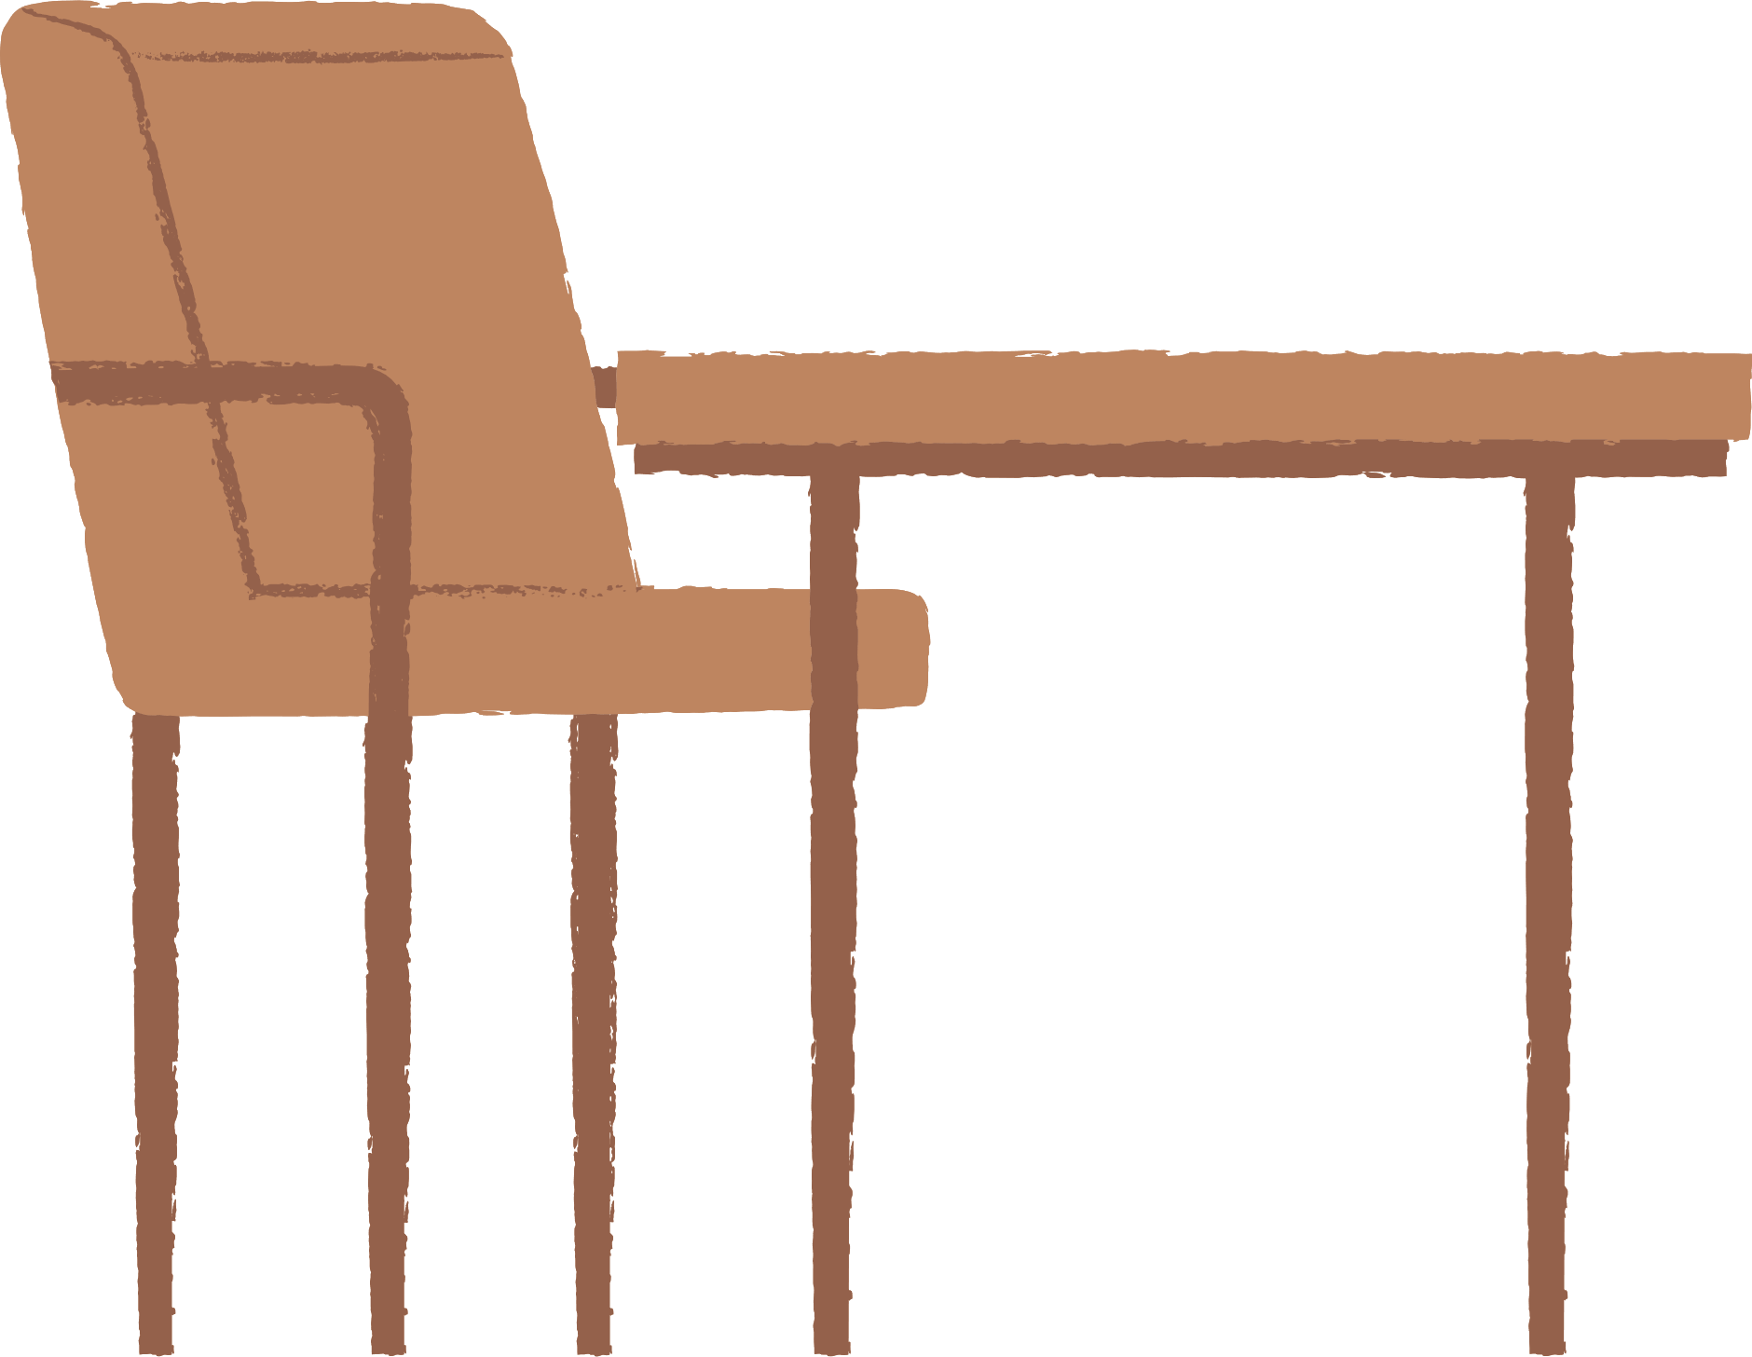
WARM-UP

Slide 4
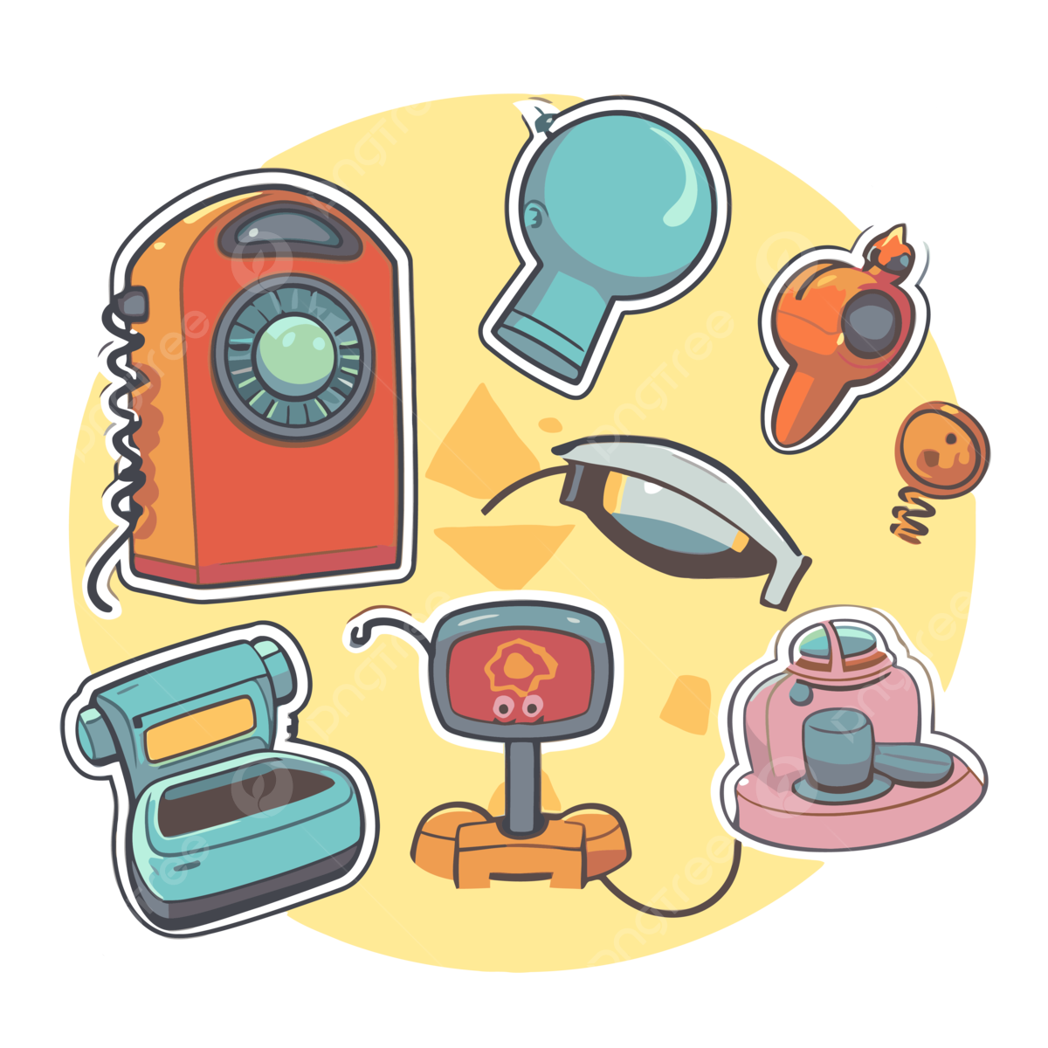
WARM-UP
WHAT ARE ELECTRONIC DEVICES?
PASS
THE CHALK

Slide 5
VOCABULARY

Slide 6




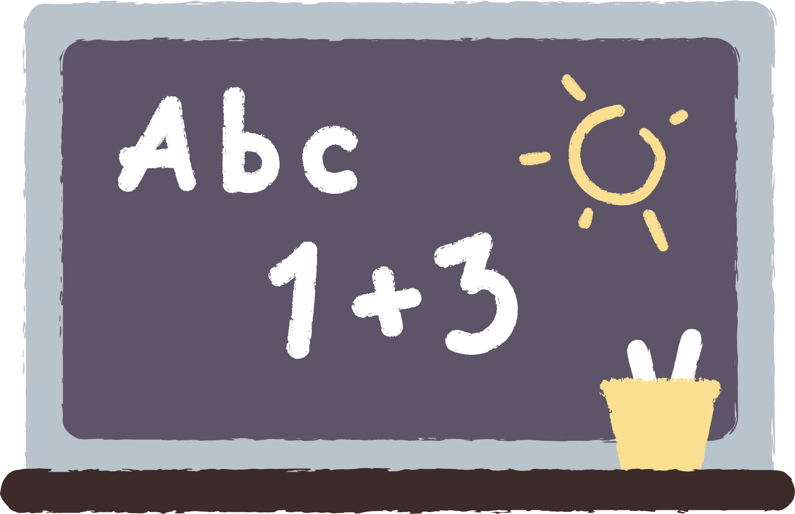
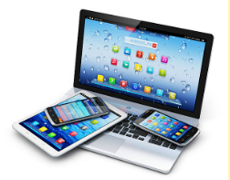

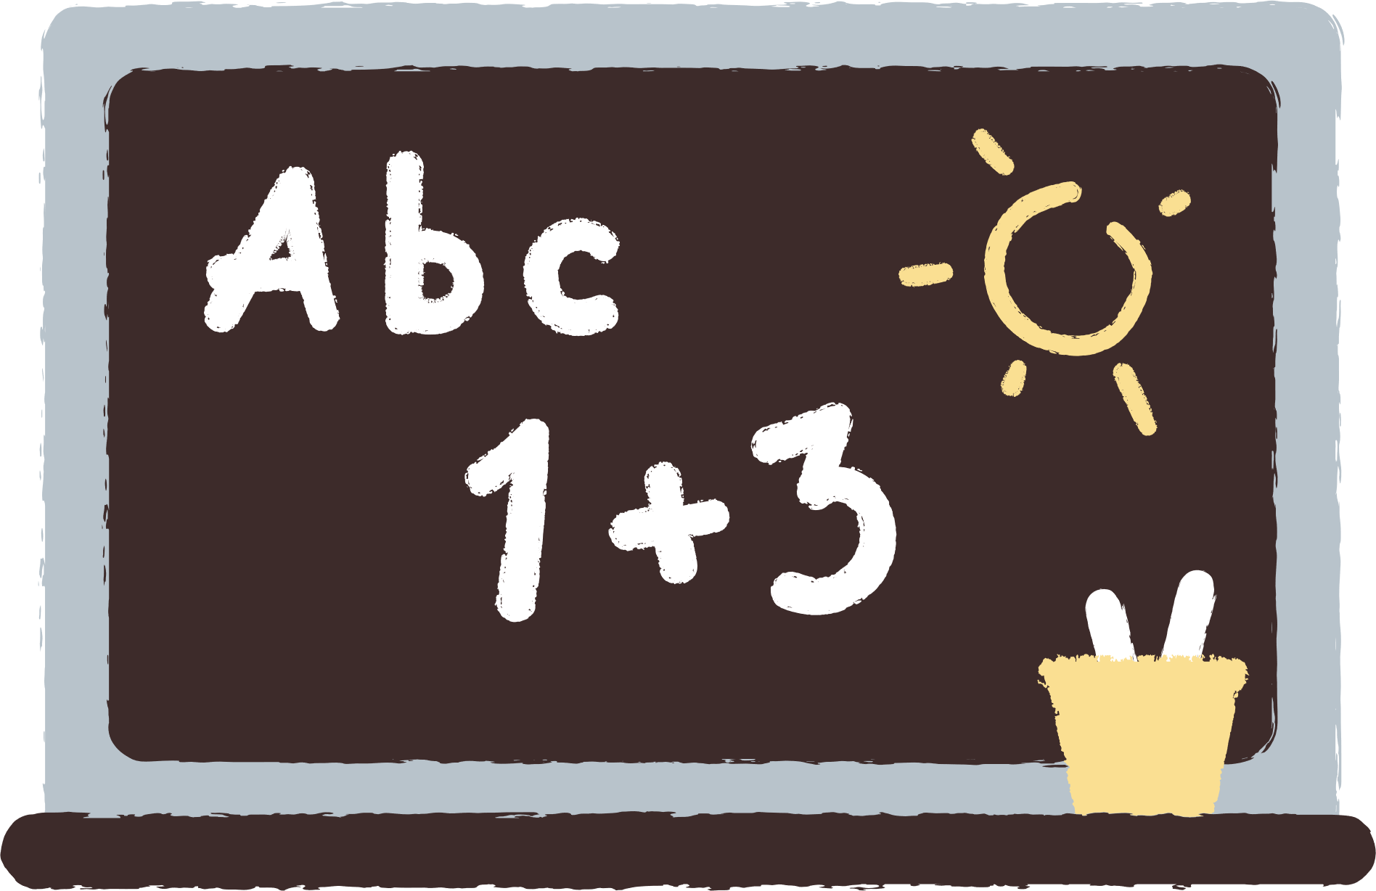

1. electronic device /ˌel.ekˈtrɒn.ɪk dɪˈvaɪs/ (n) thiết bị điện tử
Smartphones and tablets are common electronic devices used by students.(Điện thoại thông minh và máy tính bảng là những thiết bị điện tử phổ biến được học sinh sử dụng.)

Slide 7
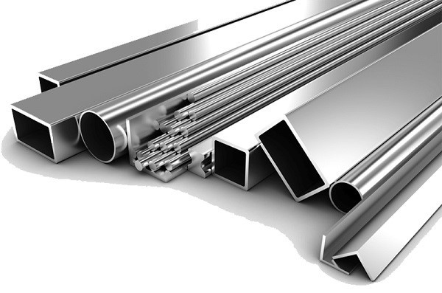
2. aluminium /ˌæljəˈmɪniəm/ (n) nhôm
Many laptops have an aluminium body to make them lightweight.(Nhiều máy tính xách tay có vỏ bằng nhôm để làm chúng nhẹ hơn.)

Slide 8
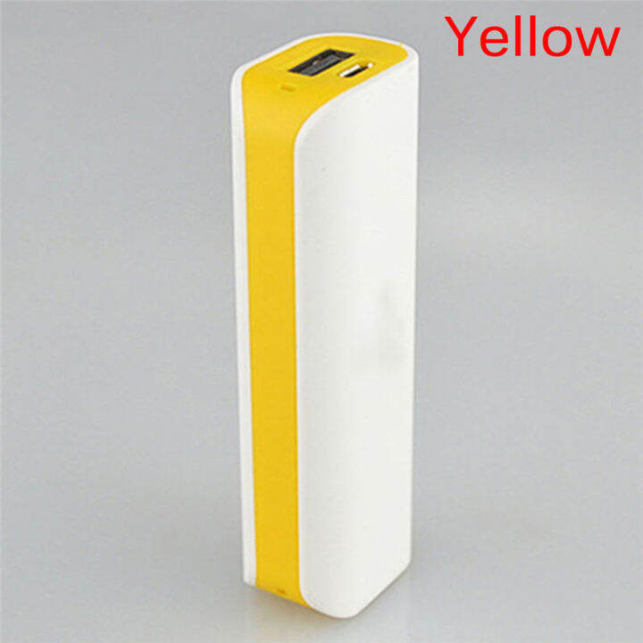
3. portable /ˈpɔːtəbl/ (adj) có thể mang theo được
A portable charger is useful when you're travelling.(Một bộ sạc di động rất hữu ích khi bạn đi du lịch.)

Slide 9
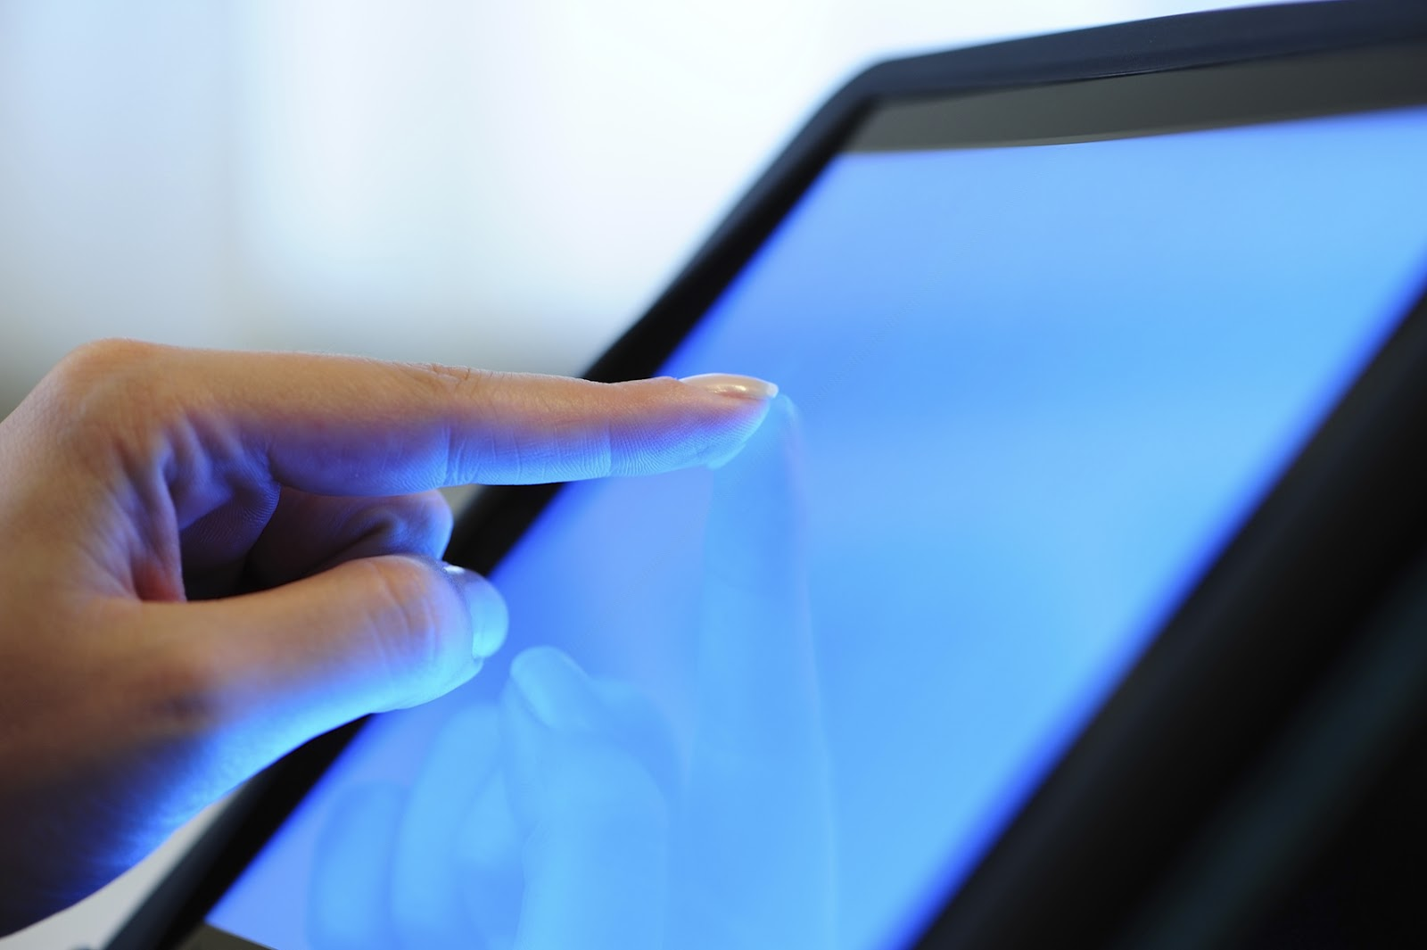
4. touchscreen /ˈtʌtʃskriːn/ (n) màn hình cảm ứng
Most modern smartphones have a touchscreen display.(Hầu hết điện thoại thông minh hiện đại đều có màn hình cảm ứng.)

Slide 10

5. wireless /ˈwaɪə.ləs/ (adj) không dây
Wireless headphones are convenient for listening to music.(Tai nghe không dây rất tiện lợi để nghe nhạc.)

Slide 11

6. virtual /ˈvɜːtʃuəl/ (adj) ảo
Students can attend virtual classes from home using their computers.(Học sinh có thể tham gia các lớp học ảo từ nhà bằng máy tính của mình.)

Slide 12

7. lightweight /ˈlaɪt.weɪt/ (adj) nhẹ
I need a lightweight jacket for the summer
evenings. (Tôi cần một chiếc áo khoác nhẹ
cho buổi tối mùa hè.)

Slide 13

8. navigate /ˈnævɪɡeɪt/ (v) điều hướng
There's nothing worse than navigating through heavy traffic.(Không có gì tệ hơn việc điều hướng khi giao thông đông đúc.)

Slide 14
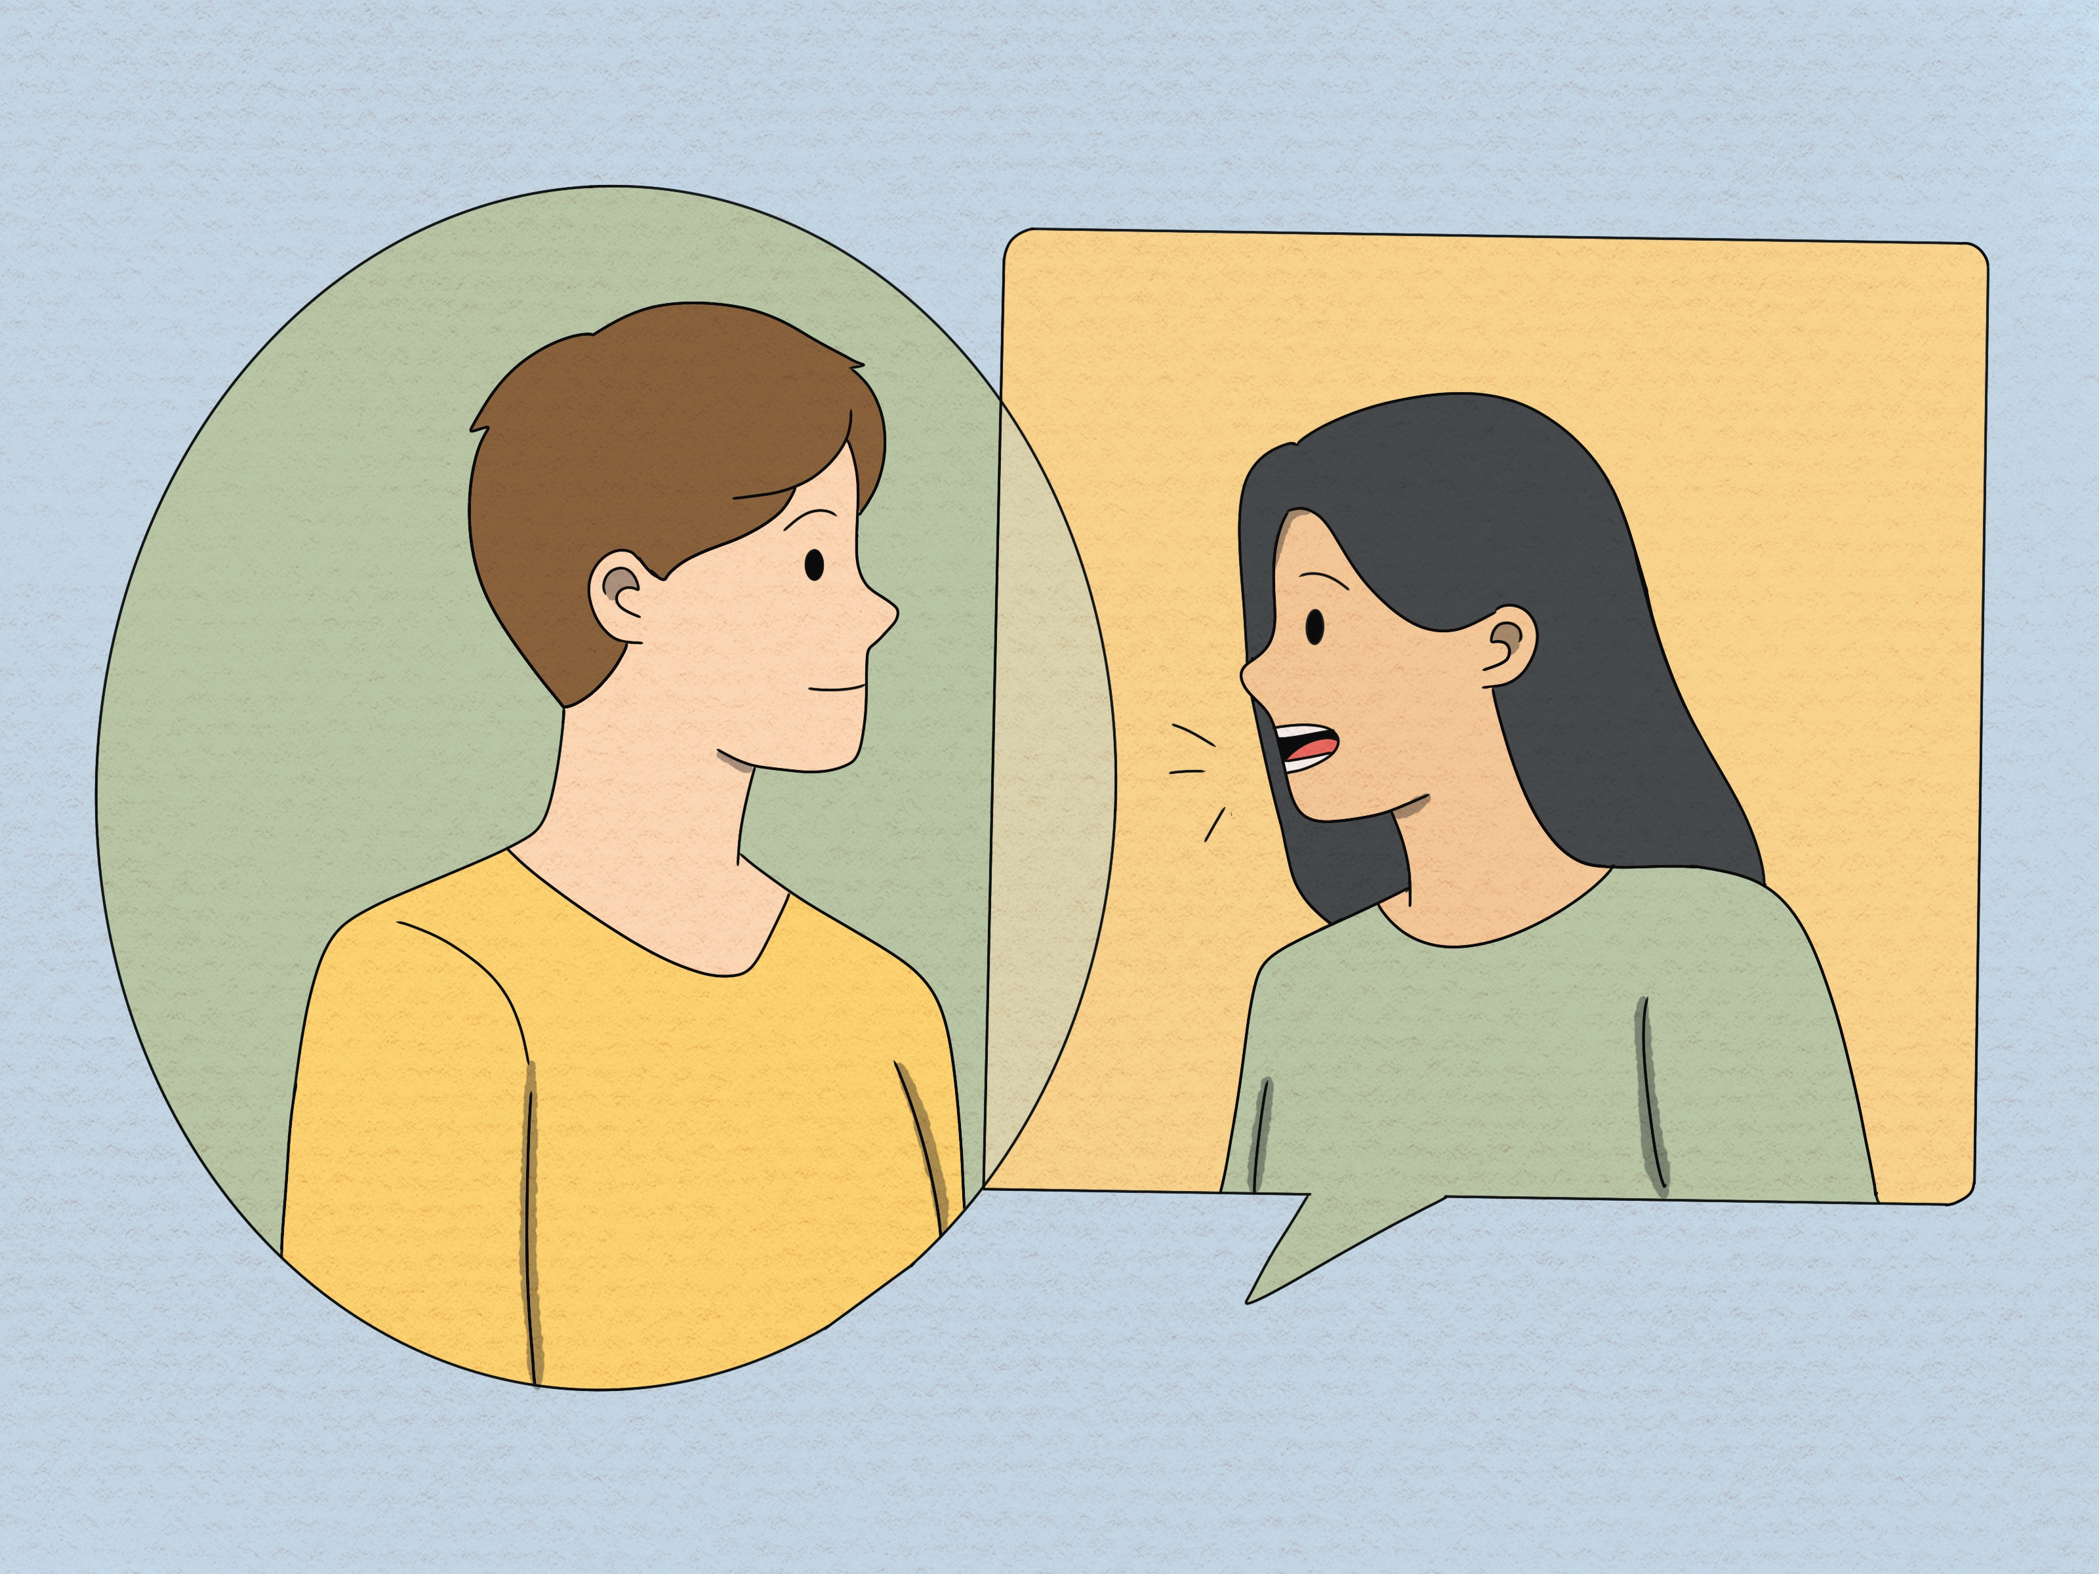
9. interact (with) /ˌɪntərˈækt/ (v) tương tác
Students can interact with their teachers through video calls.(Học sinh có thể tương tác với giáo viên thông
qua các cuộc gọi video.)

Slide 15
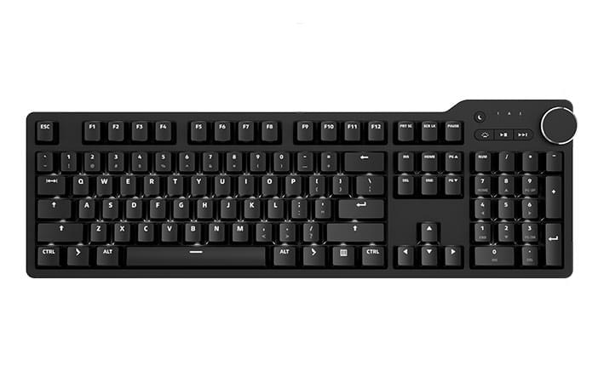
10. keyboard /ˈkiːbɔːd/ (n) bàn phím
A keyboard is used to type words and numbers into a computer.(Bàn phím được sử dụng để gõ chữ và số vào máy tính.)

Slide 16
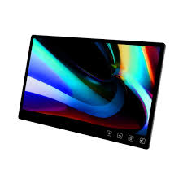
11. screen /skriːn/ (n) màn hình
The screen of a tablet displays images and text.(Màn hình của máy tính bảng hiển thị hình ảnh và văn bản.)

Slide 17
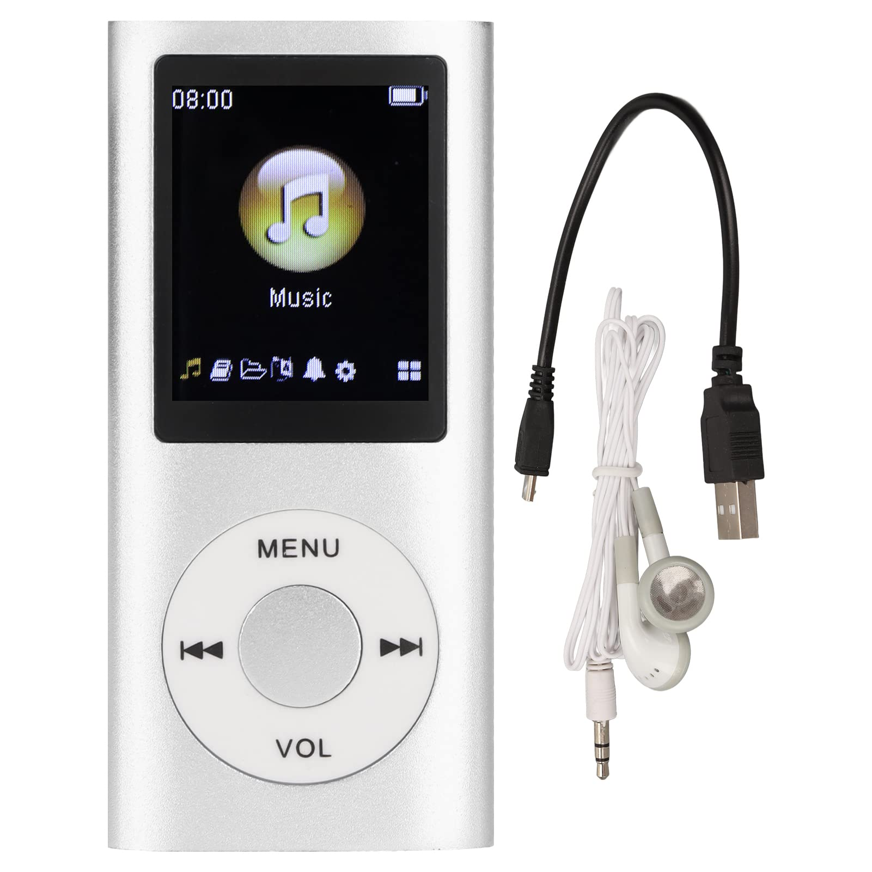
12. music player /ˈmjuːzɪkˈpleɪə(r)/ (n) máy nghe nhạc
Many students use their phones as music players.
(Nhiều học sinh sử dụng điện thoại của họ như máy nghe nhạc.)

Slide 18

13. entertainment /ˌentəˈteɪnmənt/ (n) giải trí
Video games are a popular form of entertainment for many students.(Trò chơi điện tử là một hình thức giải trí phổ biến đối với nhiều học sinh.)

Slide 19

14. take note /teɪk nəʊt/ (phr.v) ghi chú
Students often take notes during class to help them study later.(Học sinh thường ghi chép trong lớp để giúp họ học sau này.)

Slide 20

15. customer /ˈkʌstəmə(r)/ (n) khách hàng
The store offers discounts to student customers (Cửa hàng cung cấp giảm giá cho khách hàng là học sinh)

Slide 21

16. assistant /əˈsɪstənt/ (n) trợ lý, người hỗ trợ
Some smartphones have a virtual assistant to help users.(Một số điện thoại thông minh có trợ lý ảo để giúp đỡ người dùng.)

Slide 22
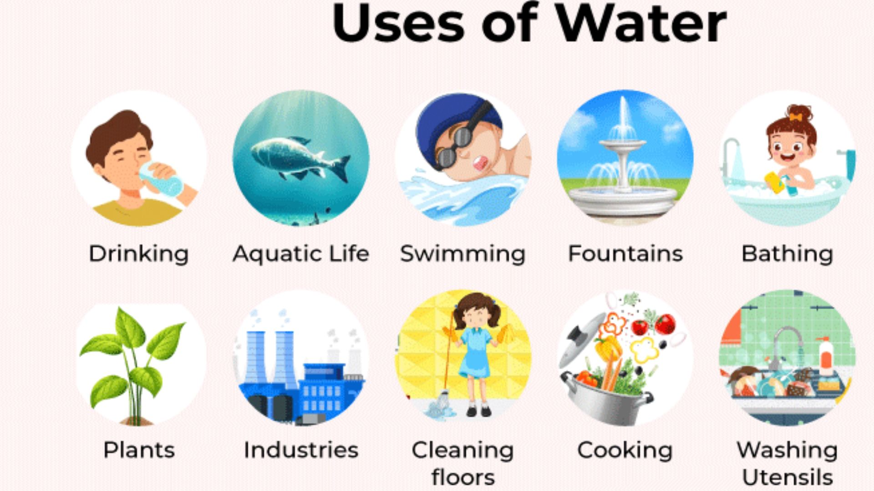
17. use for /juːz fɔː/ (v) sử dụng cho
Students can use tablets for reading e-books and doing research.(Học sinh có thể sử dụng máy tính bảng để đọc sách điện tử và nghiên cứu.)

Slide 23
PRACTICE

Slide 24


LISTEN AND READ
Shop assistant: Good morning! What can I do for you?
Customer: Good morning! I'd like to buy a computer for my son
Shop assistant: We have desktops, laptops, and tablets. Which one are you interested in?
Customer: I want to buy one for my son that is portable and can be used for studying and entertainment.
Shop assistant: Ah, in this case I suggest you should buy a tablet. Look at this grey tablet. It can work as effectively as a laptop. But it's the size of a book. And it's much lighter than a laptop because it's smaller. It also has a lightweight aluminium case.
Customer: Sounds good.
Shop assistant: It also has two cameras to take photos, shoot videos, and scan documents. It has a touchscreen, so you can do everything with your fingers.
Customer: Is it easy to type on?
Shop assistant: Yes, it is. There is a virtual keyboard. If you don't want to use it, you can use the wireless hardware keyboard.
Customer: Can I write and draw on it?
Shop assistant: You can use its pencil to take notes, draw pictures or diagrams, and make 3D designs.

Slide 25
  2. Read the conversation again and answer the following questions.
What does the customer want to buy?
The customer wants to buy a computer for his/her son.
2. What kind of electronic device does the shop assistant suggest the customer should buy?
The shop assistant suggests the customer should buy a tablet.
3. What is the tablet's case made of?
The tablet's case is made of aluminium.
4. What is the tablet's pencil used for?
The tablet's pencil is used for taking notes, drawing pictures or diagrams, and making 3D designs.

Slide 26
  3. Match the following words with their definitions
a. a screen of a laptop or a tablet that enables the user to interact directly with what is displayed.
b. made to appear to exist by the use of computer software, rather than in the real world
c. not needing wires to make a connection or to communicate.
d. a light, silver-grey metal
e. easy to carry or to move
1. aluminium
2. portable
3. touchscreen
4. wireless
5. virtual
.
Notes:
TRUY CẬP MÃ QR ĐỂ NHẬN QUÀ TẶNG
https://facebook.com/groups/853679022766648/

Slide 27
4. Complete the sentences with the words from 3.
virtual
1. The website allows you to take a __________ tour of the art gallery.
2. You can carry your __________ laptop with you from class to class because it's small and light.
3. Nowadays we often use _________ keyboards because they are portable.
4. We often use ___________ to make vehicles like aircraft or cars because of its strength and lightweight.
5. Most smartphones today have a ____________ which allows us to navigate, type, and interact with apps and games easily.
portable
wireless
aluminium
touchscreen

Slide 28
  5. GAME. Work in pairs. Think of an electronic device and describe it to your partner. Can your partner guess what you are describing?
Example:
  A: It's a small, flat computer. We can control it by touching its screen or by using a special pen.
  B: Is that a portable music player?
  A: No. Try again.
Next
Notes:
TRUY CẬP MÃ QR ĐỂ NHẬN QUÀ TẶNG
https://facebook.com/groups/853679022766648/

Slide 29
  5. GAME. Work in pairs. Think of an electronic device and describe it to your partner. Can your partner guess what you are describing?
1.
  A: This device is something almost everyone carries with them everywhere they go. It's small, fits in your hand, and has a touchscreen display. You can use it to make calls, send messages, take photos, surf the internet, and download various apps.
B: Oh, is it a smartphone?
A: Yes, exactly!
2.
  A: This device is usually in living rooms and has a large screen. You can change channels to watch different programs, adjust the volume, and sometimes it even has internet connectivity.
B: Hmm, is it a television?
A: Yes, that's right! It's a television.
.
ANSWER
Notes:
TRUY CẬP MÃ QR ĐỂ NHẬN QUÀ TẶNG
https://facebook.com/groups/853679022766648/

