Slide 1





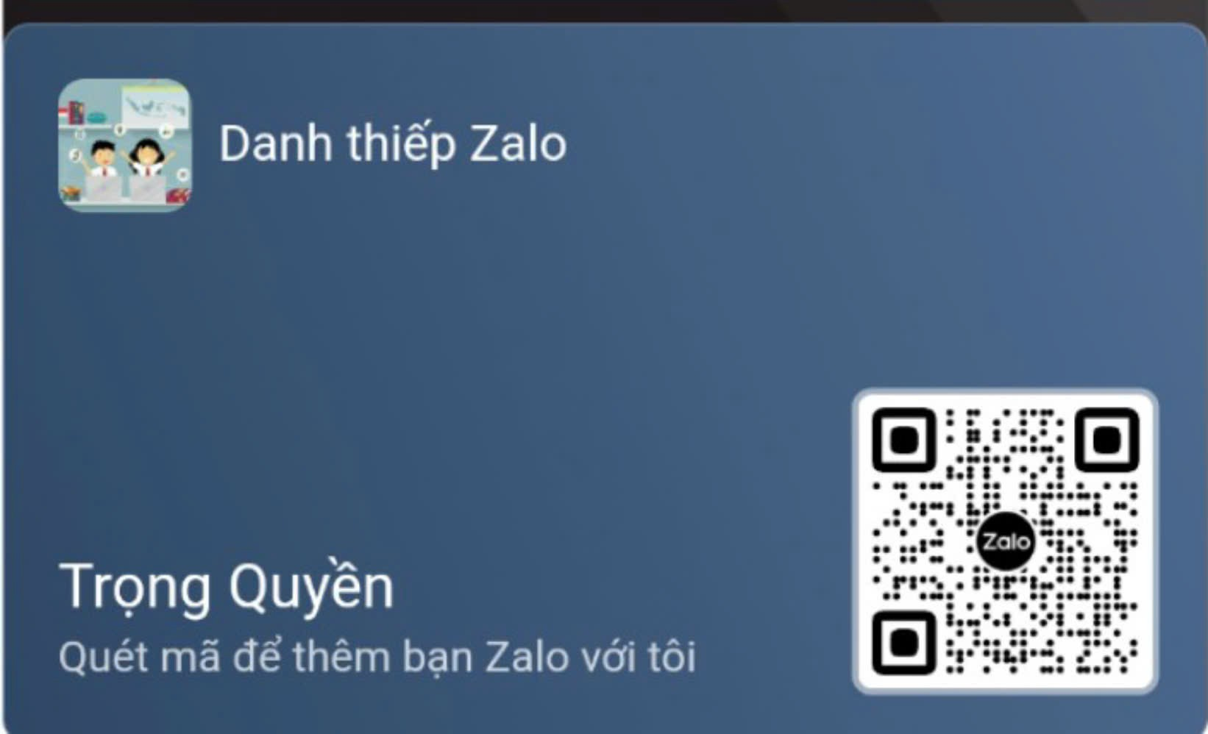




UNIT 11
ELECTRONIC DEVICES
LESSON 3: A CLOSER LOOK 2

Slide 2






CONTENT
WARM-UP
VOCABULARY
PRACTICE
GAMES

Slide 3





WARM-UP

Slide 4
WARM-UP
What do you do when:
+ you have bad marks?
+ you cough a lot?
BRAIN
STORMING
+ your teacher missunderstands you?

Slide 5
VOCABULARY

Slide 6






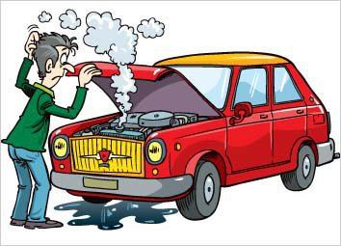



32.break down /breɪk daʊn/ (phr.v) phá vỡ
Our math teacher helps us break down complex problems into simpler steps.(Giáo viên toán giúp chúng tôi phân tích các bài toán phức tạp thành các bước đơn giản hơn.)

Slide 7

33. suggest /səˈdʒest/ (v) gợi ý
The teacher asked students to suggest topics for the group project.(Giáo viên yêu cầu học sinh đề xuất chủ đề cho dự án nhóm.)

Slide 8

34. flexibility /ˌfleksəˈbɪləti/ (n) sự linh hoạt
The new system offers a much greater degree of flexibility in the way work is organized.(Hệ thống mới mang lại mức độ linh hoạt cao hơn nhiều trong cách tổ chức công việc.)

Slide 9
VOCABULARY
Words | Pronunciation | Meanings
break down | /breɪk daʊn/ | (phr.v) phá vỡ
suggest | /səˈdʒest/ | (v) gợi ý
flexibility | /ˌfleksəˈbɪləti/ (n) | (n) sự linh hoạt

Slide 10
PRACTICE

Slide 11
1.Choose the correct answer A, B, C, or D.
1. The sales assistant suggested that Tom _______ the portable laptop
should buy
will buy
buys
bought
suggest + + (that) + sb + (should) + V-inf: gợi ý (rằng) ai đó (nên) làm gì
Notes:
TRUY CẬP MÃ QR ĐỂ NHẬN QUÀ TẶNG
https://facebook.com/groups/853679022766648/

Slide 12
1.Choose the correct answer A, B, C, or D.
2.My smartphone broke down last week, and Mary recommended _______ it to the repair centre.
I will bring
I bringing
I bring
me bring
recommend + (that) + sb + (should) + V-inf: gợi ý (rằng) ai đó (nên) làm gì.
Notes:
TRUY CẬP MÃ QR ĐỂ NHẬN QUÀ TẶNG
https://facebook.com/groups/853679022766648/

Slide 13
1.Choose the correct answer A, B, C, or D.
3. My uncle recommended _______ a robotic vacuum cleaner.
A.to buy
B. buying
C. to buying
D. Buy
recommend + V-ing: gợi ý làm gì
Notes:
TRUY CẬP MÃ QR ĐỂ NHẬN QUÀ TẶNG
https://facebook.com/groups/853679022766648/

Slide 14
1.Choose the correct answer A, B, C, or D.
4. I suggest that you _______ the directions carefully before assembling the computer.
should read
B. would read
C. will read
D. could read
suggest + (that) + sb + (should) + V-inf: gợi ý (rằng) ai đó (nên) làm gì
Notes:
TRUY CẬP MÃ QR ĐỂ NHẬN QUÀ TẶNG
https://facebook.com/groups/853679022766648/

Slide 15
1.Choose the correct answer A, B, C, or D.
5. She advises _______ a yoga class to improve flexibility and relaxation.
to take
took
take
Taking
advise + V-ing: khuyên làm gì
Notes:
TRUY CẬP MÃ QR ĐỂ NHẬN QUÀ TẶNG
https://facebook.com/groups/853679022766648/

Slide 16
2. Write the correct form of each verb in brackets.
collecting
1.I recommended (collect) ___________ old electronic devices.
recommend + V-ing: gợi ý làm gì
2. The sales assistant suggested that I (exchange) _________________ the digital music player I bought last month.
(should) exchange
suggest + (that) + sb + (should) + V-inf: đề xuất (rằng) ai đó (nên) làm gì
Notes:
TRUY CẬP MÃ QR ĐỂ NHẬN QUÀ TẶNG
https://facebook.com/groups/853679022766648/

Slide 17
2. Write the correct form of each verb in brackets.
(should) access
3. The teacher advised that we (access) ______________ the Internet for extra information about our lecture.
advise + (not) + V-ing: khuyên (không) là m gì
not using
4. The doctor advised (not use) ___________digital devices before bedtime
advise + (not) + V-ing: khuyên (không) làm gì
(should) have
5. My classmate recommended that I (have) ________________ the PC repaired as soon as possible.
recommend + (that) + sb + (should) + V-inf: gợi ý (rằng) ai đó (nên) làm gì
Notes:
TRUY CẬP MÃ QR ĐỂ NHẬN QUÀ TẶNG
https://facebook.com/groups/853679022766648/

Slide 18
3. Find a mistake in the underlined parts in each sentence below and correct it.
1. The (A) teacher suggested that we (B) don't waste time (C) playing video (D) games
suggest + (that) + sb + (should) + V-inf: đề xuất (rằng) ai đó (nên) làm gì
2. I advise (A) to try a new workout (B) routine to (C) keep things (C) interesting.
advise + V-ing: khuyên làm gì
3. Her parents recommend (A) that she (B) studies harder (C) so that she can get (D) into a good university.
recommend + (that) + sb + (should) + V-inf: gợi ý (rằng) ai đó (nên) làm gì
Notes:
TRUY CẬP MÃ QR ĐỂ NHẬN QUÀ TẶNG
https://facebook.com/groups/853679022766648/

Slide 19
3. Find a mistake in the underlined parts in each sentence below and correct it.
4. The (A) sales assistant suggested that I (B) must choose a tablet (C) with a brighter (D) colour.
suggest + (that) + sb + (should) + V-inf: đề xuất (rằng) ai đó (nên) làm gì
5. (A) If you (B) like chicken, I recommend (C) eat at the restaurant (D) opposite our office.
recommend + V-ing: gợi ý làm gì
Notes:
TRUY CẬP MÃ QR ĐỂ NHẬN QUÀ TẶNG
https://facebook.com/groups/853679022766648/

Slide 20
4. Fill in each blank with the correct form of the verb in brackets. Then practise the exchanges with your partner.
Example
A: What should we do to keep our house clean?
B: I suggest (buy) __________ a robotic vacuum cleaner.
buying
1. A: What should we do to create three dimensional objects?
B: I recommend (use) _______ a 3D printer.
using
recommend + V-ing: gợi ý làm gì
Notes:
TRUY CẬP MÃ QR ĐỂ NHẬN QUÀ TẶNG
https://facebook.com/groups/853679022766648/

Slide 21
4. Fill in each blank with the correct form of the verb in brackets. Then practise the exchanges with your partner.
2. A: What should we do to prevent global warming?
B: I suggest we should (reduce) _________exhaust fumes.
reduce
suggest + (that) + sb + (should) + V-inf: đề xuất (rằng) ai đó (nên) làm gì
3. A: What should we do if we want to communicate with others on the move?
B: I advise (use) ______ a smartphone.
using
advise + V-ing: khuyên làm gì
Notes:
TRUY CẬP MÃ QR ĐỂ NHẬN QUÀ TẶNG
https://facebook.com/groups/853679022766648/

Slide 22
4. Fill in each blank with the correct form of the verb in brackets. Then practise the exchanges with your partner.
4. A: What should we do to protect and preserve our national parks?
B: I advise that we should (limit) _______ the number of visitors every day.
limit
advise + (that) + sb + (should) + V-inf: khuyên (rằng) ai đó (nên) làm gì
5. A: What should we do to improve our health?
B: I recommend (eat) __________ more fruits and vegetables.
eating
recommend + V-ing: gợi ý làm gì
Notes:
TRUY CẬP MÃ QR ĐỂ NHẬN QUÀ TẶNG
https://facebook.com/groups/853679022766648/

Slide 23
5. Work in pairs. Tell your partner what he/she should do in the following situations, using suggest / advise / recommend + V-ing OR clauses with should.
1. His / Her laptop has broken down
A: Oh no! My laptop has broken. What should I do?
B: I recommend bringing it to a computer repair centre
2. He / She is considering buying a new smartphone.
A: I'm thinking about buying a new smartphone.
B: I advise that you should compare different models before making a decision.
Notes:
TRUY CẬP MÃ QR ĐỂ NHẬN QUÀ TẶNG
https://facebook.com/groups/853679022766648/

Slide 24
5. Work in pairs. Tell your partner what he/she should do in the following situations, using suggest / advise / recommend + V-ing OR clauses with should.
3. He / She likes to read a lot of books but he / she doesn't want them to take up too much space.
A: I love reading, but I'm running out of space for my books.
B: I recommend trying an e-reader like a Kindle.
4. He / She is feeling tired.
A: I'm feeling so tired lately.
B: I suggest that you should get more rest and go to bed early.
Notes:
TRUY CẬP MÃ QR ĐỂ NHẬN QUÀ TẶNG
https://facebook.com/groups/853679022766648/

Slide 25
GAMES

Slide 26







game
Look and answer?
A. break down
B. suggest
C. flexibility

Slide 27
game
2. Look and answer?
A. suggest
B. flexibility
C. break down

Slide 28
game
3. Look and answer?
A. break down
B. flexibility
C. suggest

Slide 29



THANK YOU
See you gain!

