Slide 1

Unit 1: SCHOOL
Lesson 1.3
Page 8

Slide 2
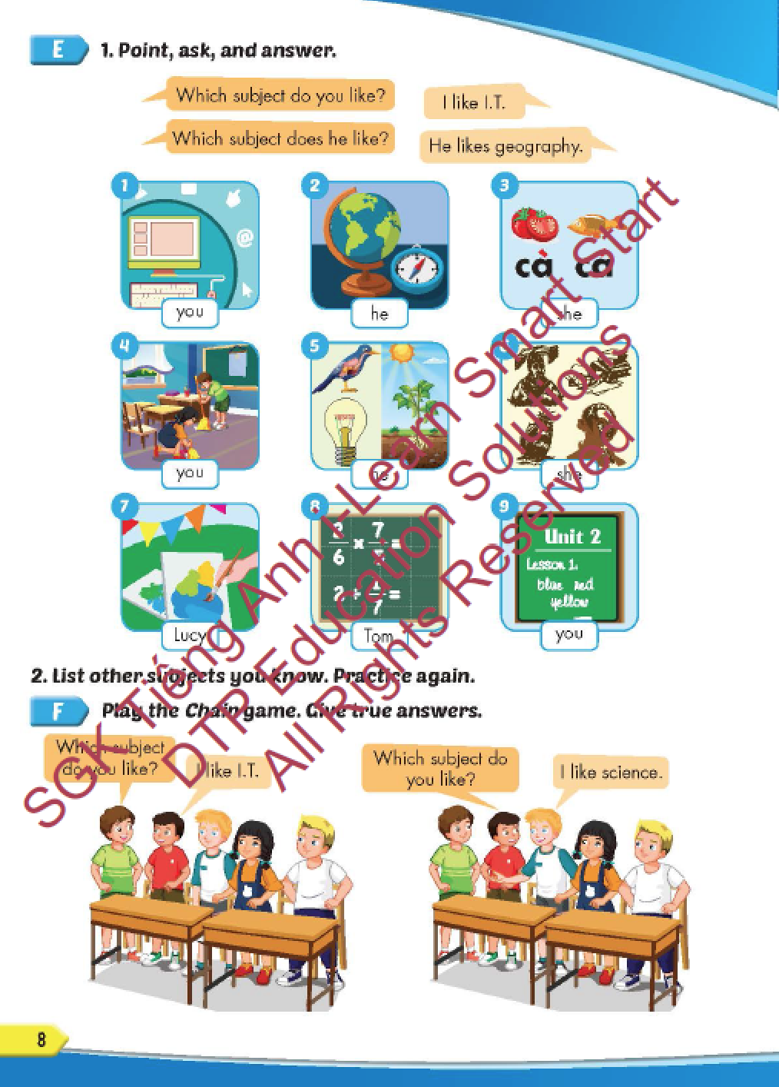
Lesson Outline
Warm-up
Practice
Speaking
Consolidation
Wrap-up

Slide 3
Objectives
By the end of this lesson, students will be able to ask and answer about the school subjects they like.
Vocabulary: geography, history, science, I.T., Vietnamese, ethics.
Structure: Which subject do you like? - I like science.
Which subject does he like? - He likes English.

Slide 4

WARM-UP

Slide 5



Slide 6
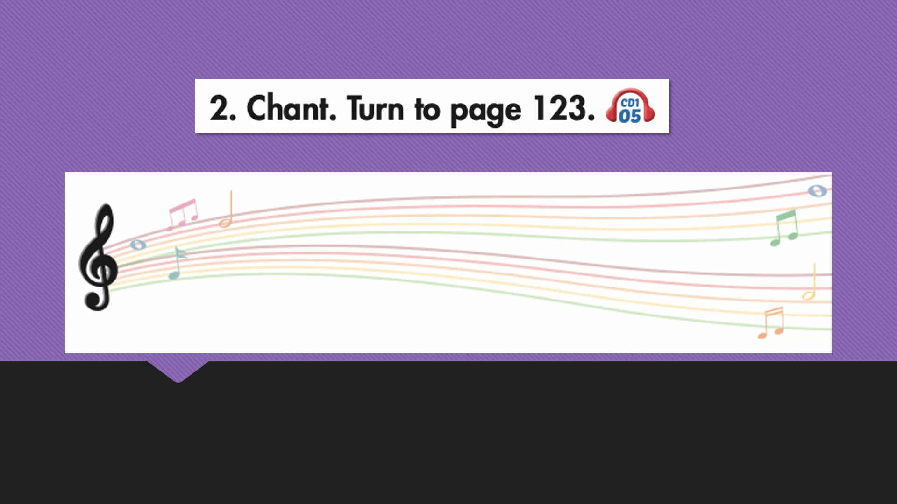

Slide 7

New words
geography, history,
science, I.T.,
Vietnamese, ethics.

Slide 8

Click on the right word
SCHOOL
SUBJECTS
GAME
Notes:
8

Slide 9

MATHS
GEOGRAPHY
ENGLISH
GEOGRAPHY
Notes:
9

Slide 10

SCIENCE
MATHS
CHEMISTRY
SCIENCE
Notes:
10

Slide 11



MATHS
I.T.
PE
I.T.
Notes:
11

Slide 12

VIETNAMESE
Con cá
ENGLISH
HISTORY
VIETNAMESE
Notes:
12

Slide 13

Structure
Which subject do you like?
- I like science.
Which subject does he like?
- He likes English.

Slide 14

Presentation

Slide 15





Slide 16

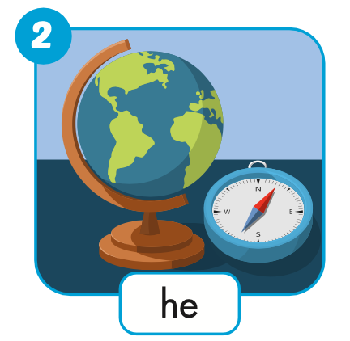


Slide 17

Practice

Slide 18
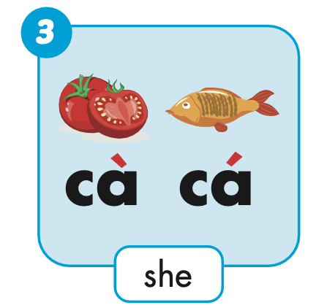
Which subject does she like?
She likes Vietnamese.

Slide 19
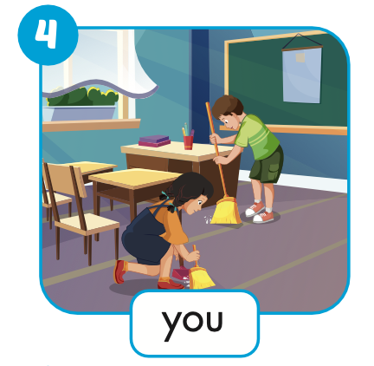
Which subject do you like?
I like ethics.

Slide 20
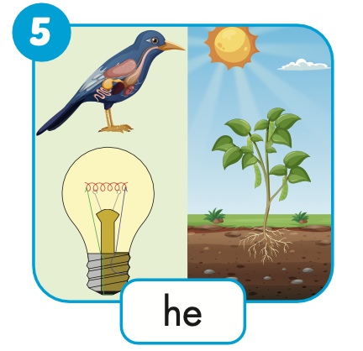
Which subject does he like?
He likes science.

Slide 21
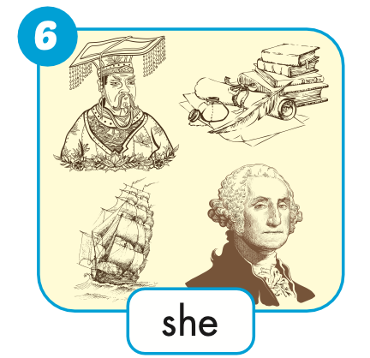
Which subject does she like?
She likes history.

Slide 22
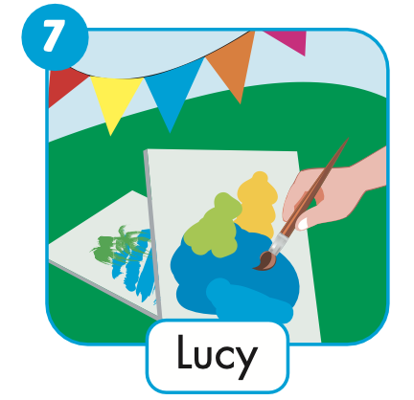
Which subject does Lucy like?
She likes art.

Slide 23
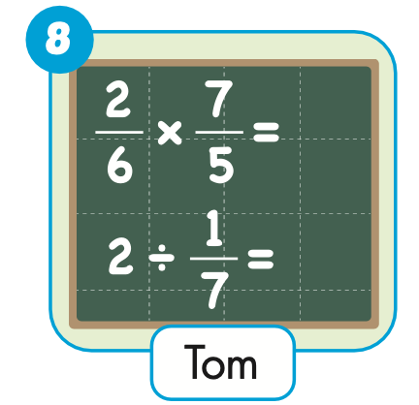
Which subject does Tom like?
He likes math.

Slide 24
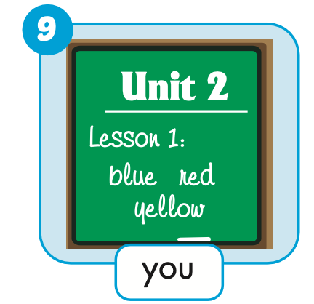
Which subject do you like?
I like English.

Slide 25

Production

Slide 27
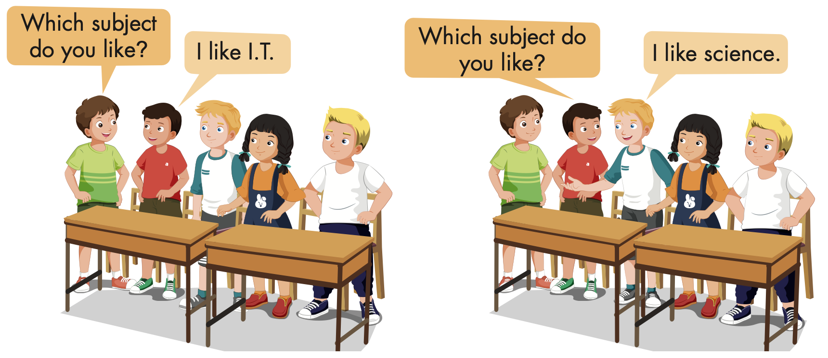

Slide 28
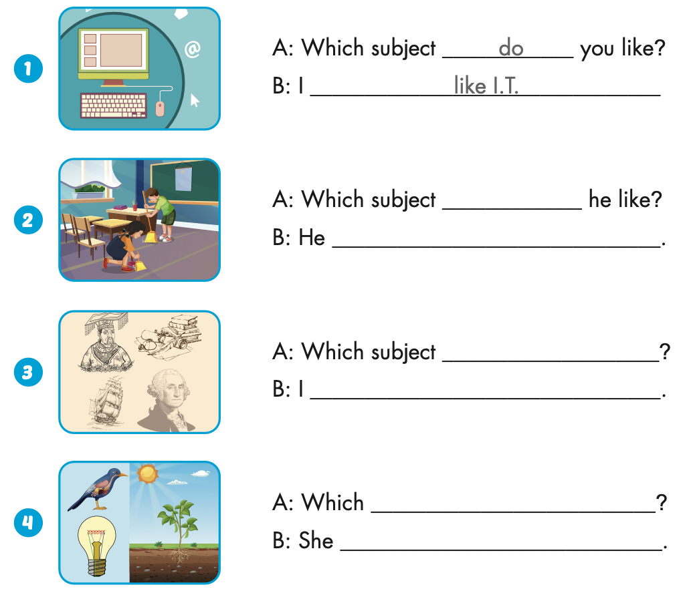

Extra Practice
WB, page 3

Slide 29
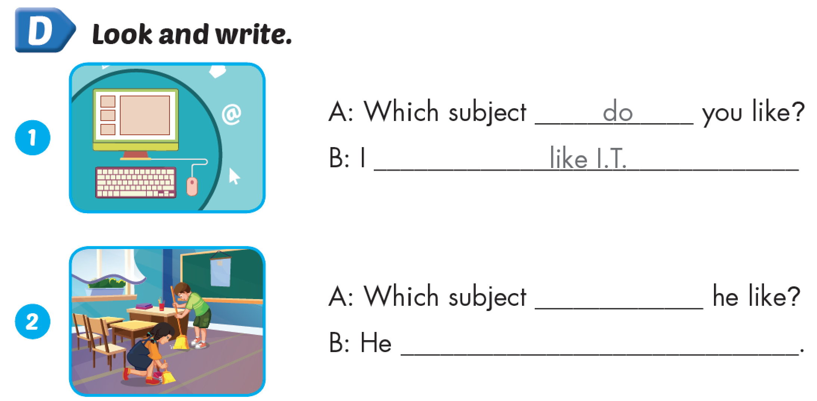
does
likes ethics

Slide 30
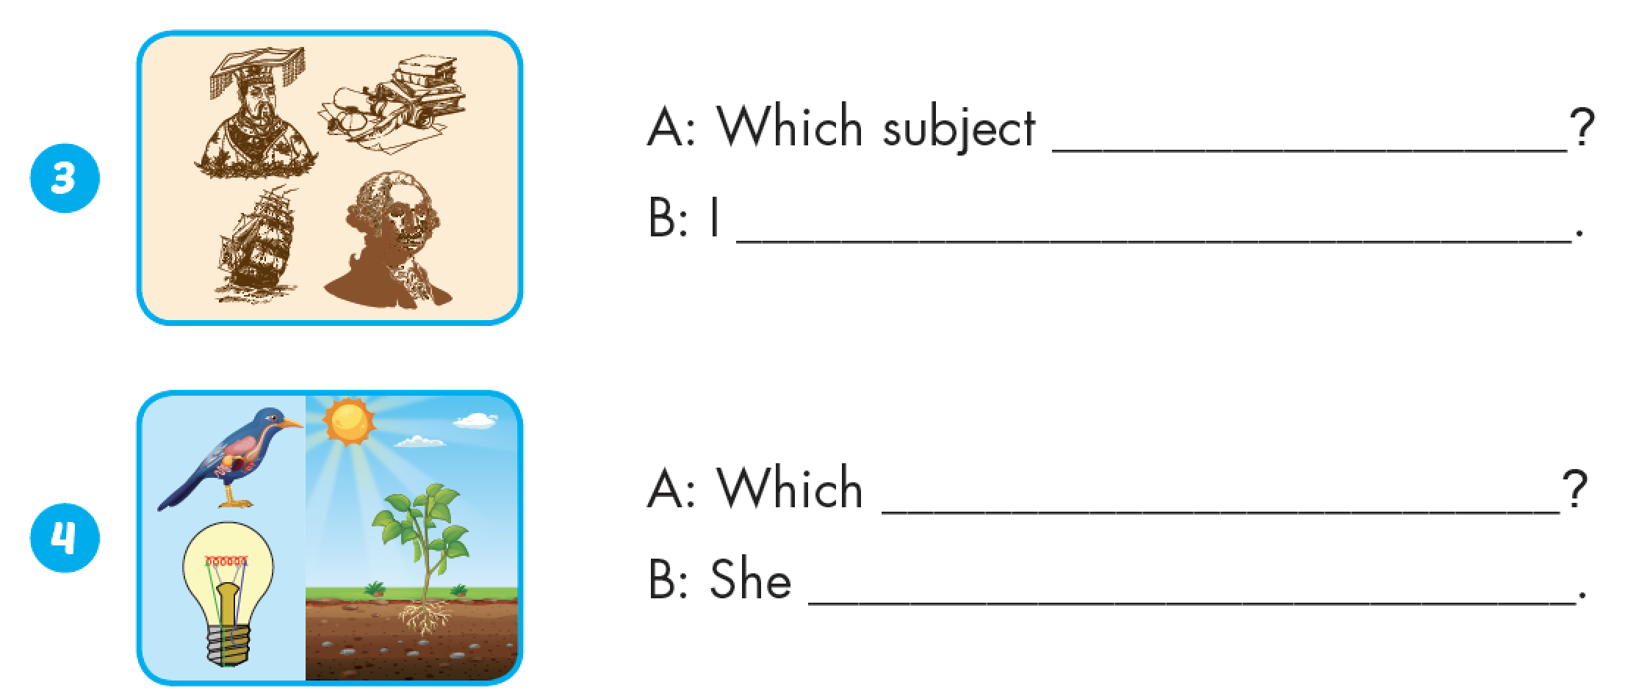
do you like
like history
subject does she like
likes science

Slide 31

CONSOLIDATION

Slide 32


Read, correct and write.

Slide 33
like
She like Vietnamese.
She likes Vietnamese.
NEXT

Slide 34
I likes I.T.
likes
I like I.T.
NEXT

Slide 35
Which subject do he like?
do
Which subject does he like?
NEXT

Slide 36
Which subject does Tom and Tim like?
does
Which subject do Tom and Tim like?
NEXT

Slide 37
like
Lucy like music.
Lucy likes music.
NEXT

Slide 38

WRAP-UP

Slide 39
Today’s lesson
Vocabulary
geography, history, science, I.T., Vietnamese, ethics.
Structures/ Sentence patterns
Which subject do you like?
- I like science.
Which subject does he like?
- He likes English.

Slide 40
Homework
Practice the vocabularies and structure, and make sentences using them.
Do the exercises in Tiếng Anh 5 i-Learn Smart Start WB (page 3).
Do the exercises in Tiếng Anh 5 i-Learn Smart Start Notebook.
Prepare the next lesson (page 9 SB).
Play the consolidation games in Tiếng Anh 5 i-Learn Smart Start DHA App on www.eduhome.com.vn

Slide 41

Enjoy your day!

Slide 42

Lesson 3
Stay positive and have a nice day!

