Slide 1

Unit 4: Travel
Lesson 1.1
Page 48

Slide 2
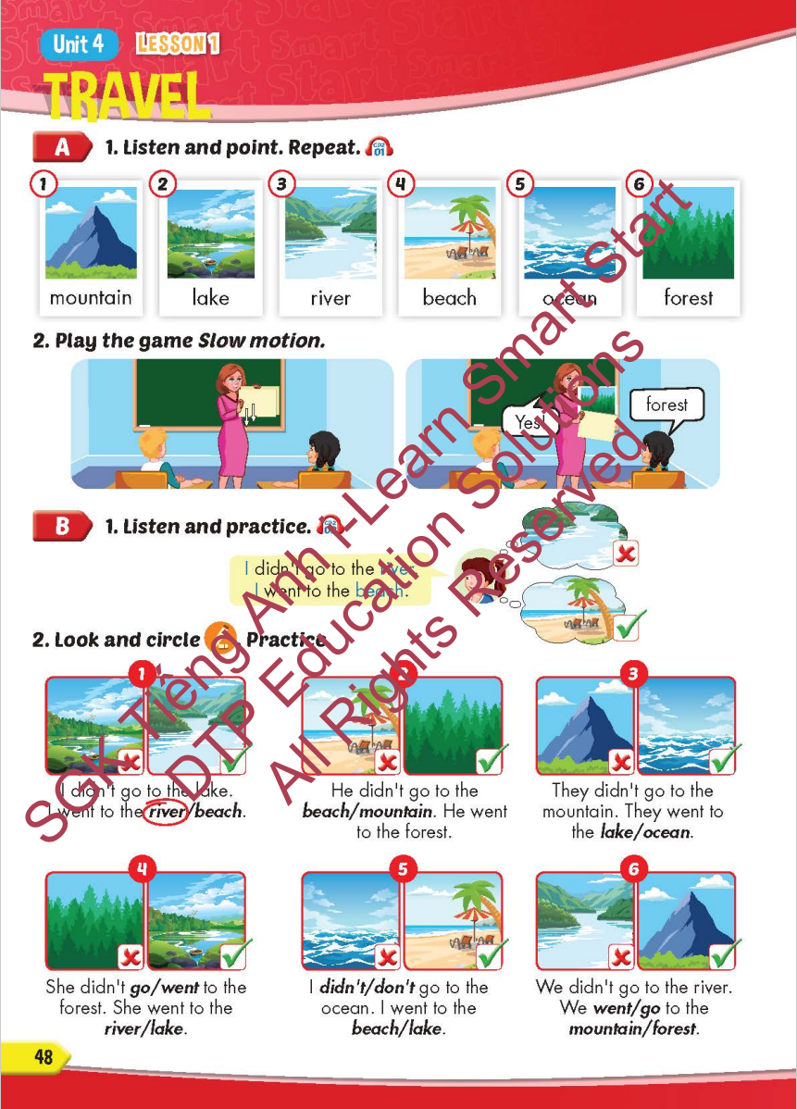
Lesson Outline
Warm-up
Vocabulary
Structure
Consolidation
Wrap-up

Slide 3
Objectives
By the end of this lesson, students will be able to…
Vocabulary: Pronounce and use the words related to the topic properly: mountain, lake, river, beach, ocean, forest New Year (Tết), Christmas, Teachers' Day, Children's Day.
Structure: Practise
I didn't go to the river. I went to the beach.

Slide 4

WARM-UP

Slide 5



Slide 6

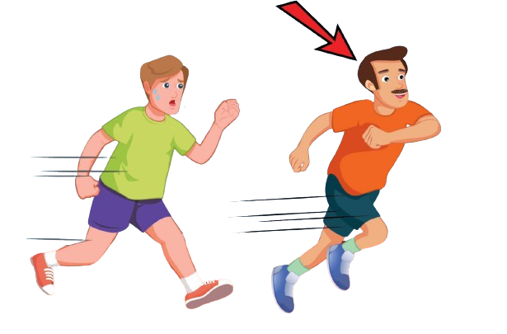
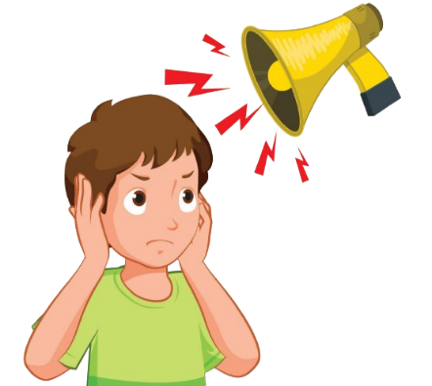
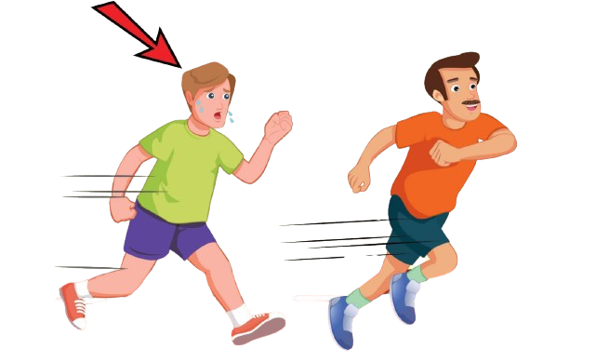

Click on the right option
slowly

Slide 7
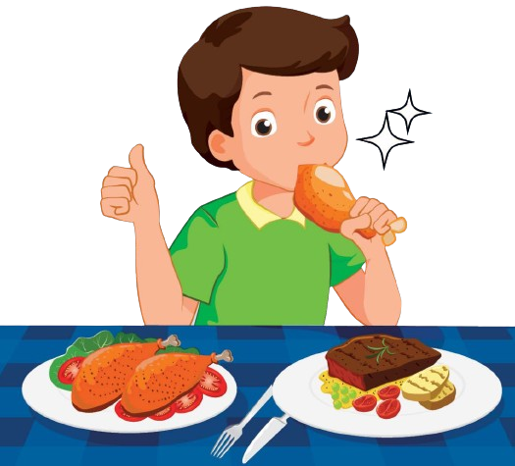


Click on the right option
delicious

Slide 8
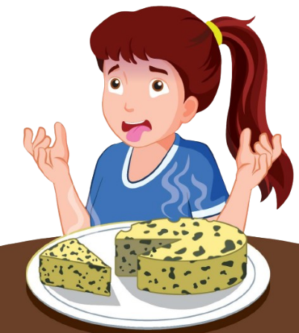

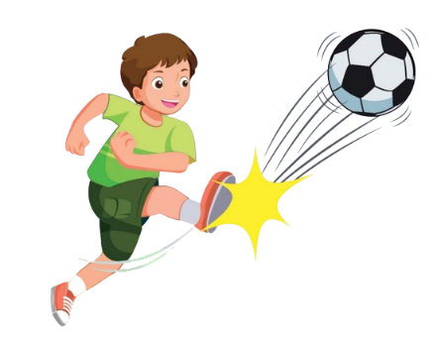
Click on the right option
noisy

Slide 9



Click on the right option
well

Slide 10

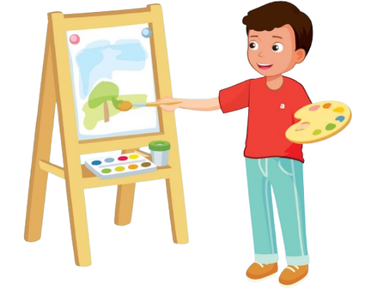
Click on the right option
badly

Slide 11


Click on the right option
paint a picture

Slide 12
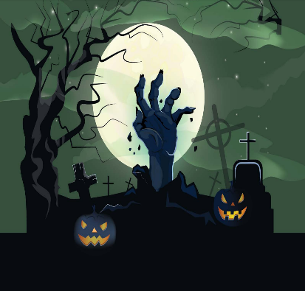
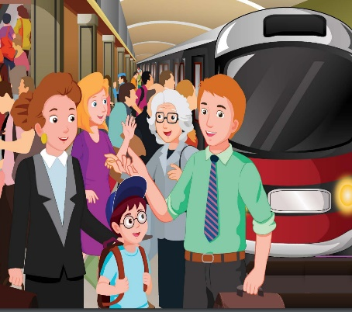
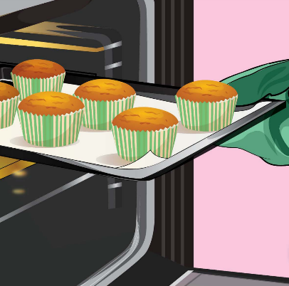
Click on the right option
busy

Slide 13

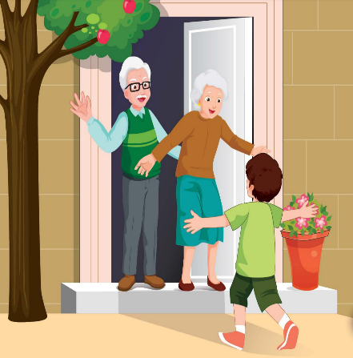
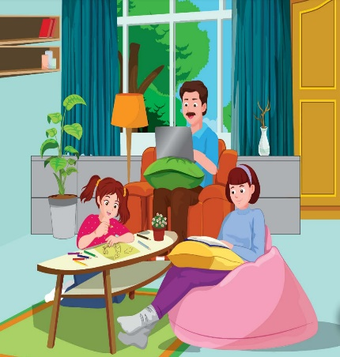
Click on the right option
scary

Slide 14
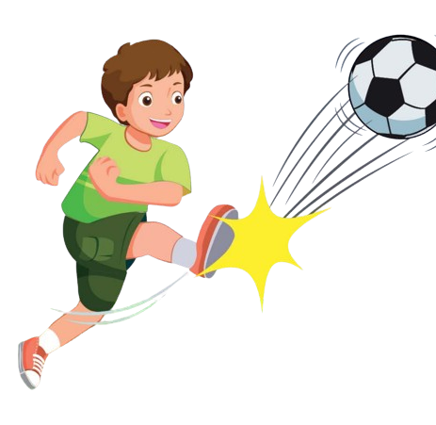
Click on the right option
hard

Slide 15

It’s time to learn …

Slide 16

New words
mountain, lake, river,
beach, ocean, forest

Slide 17

Presentation

Slide 18


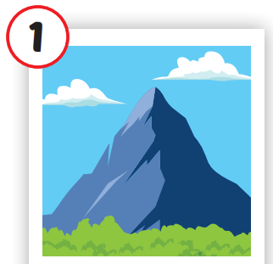
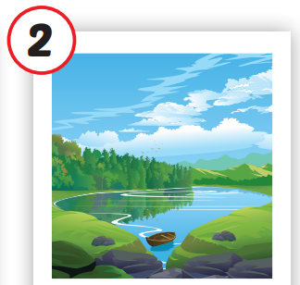
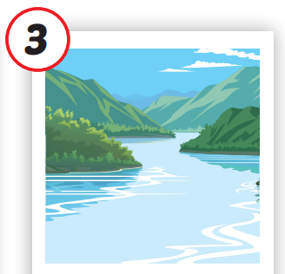
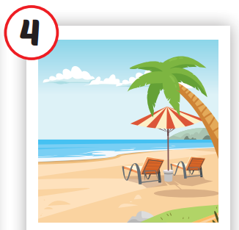
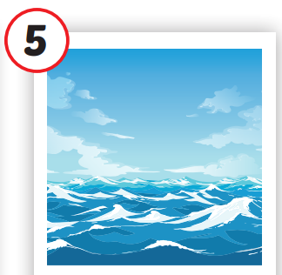
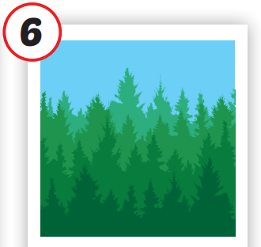






/ˌmaʊntən/
ngọn núi
/leɪk/
hồ
/ˈrɪvər/
sông
/biːtʃ/
bãi biển
/ˈoʊʃən/
đại dương
/ˈfɔrəst/
rừng
Notes:
Click vào hình A. 1. Listen and point. Repeat để cho cả audio full chạy

Slide 19
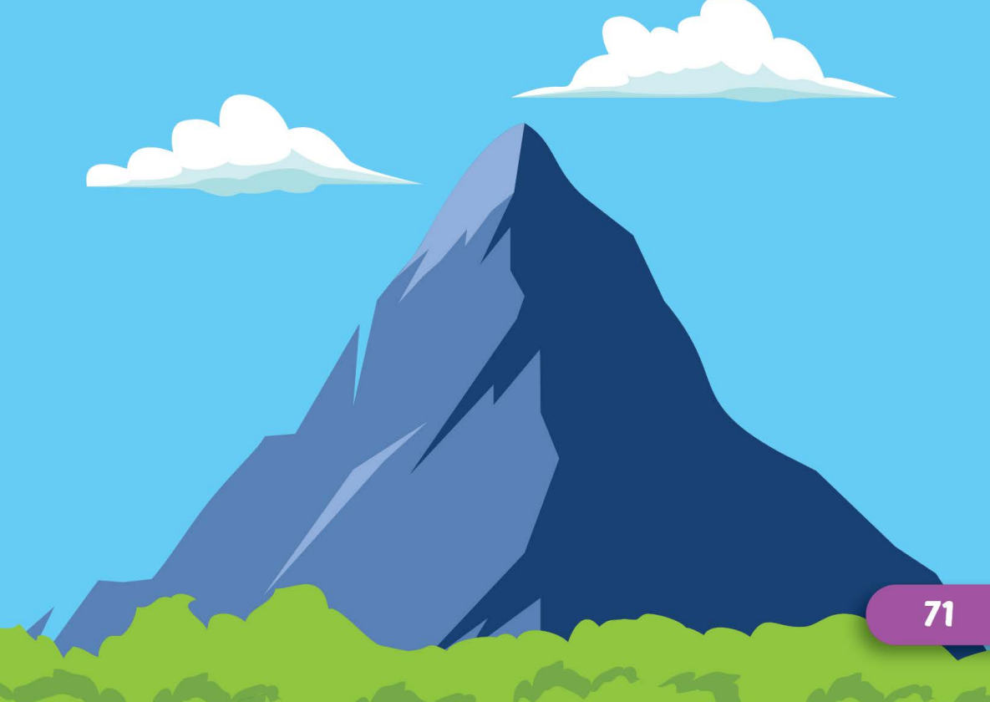
/ˌmaʊntən/
ngọn núi

Slide 20
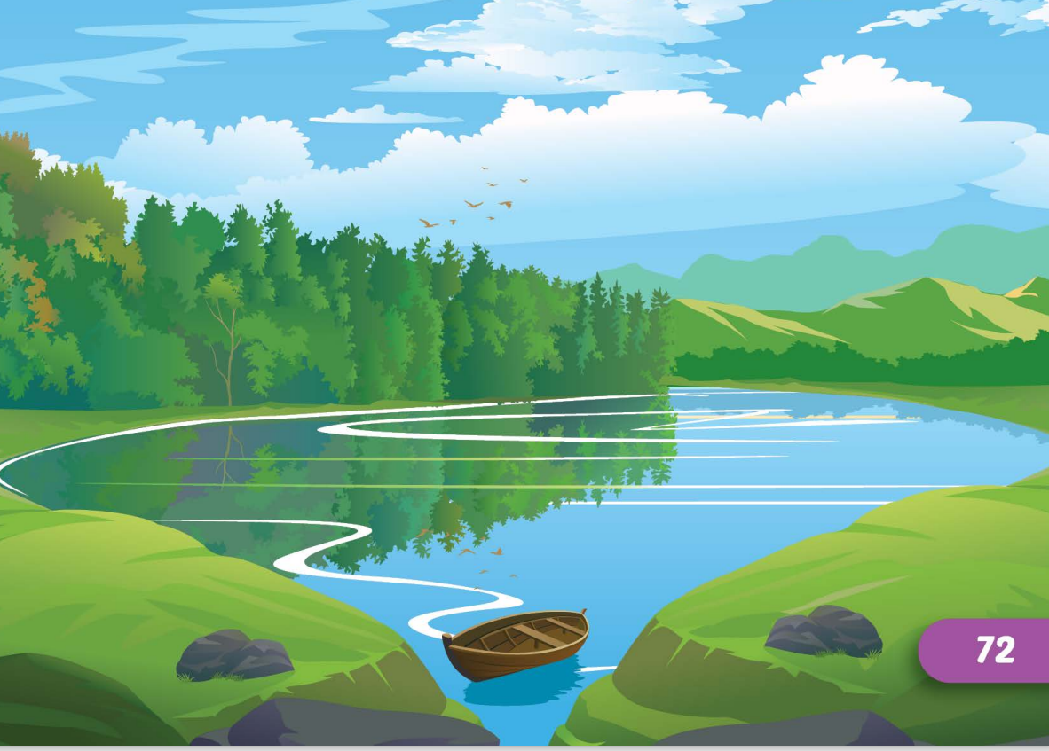
/leɪk/
hồ

Slide 21
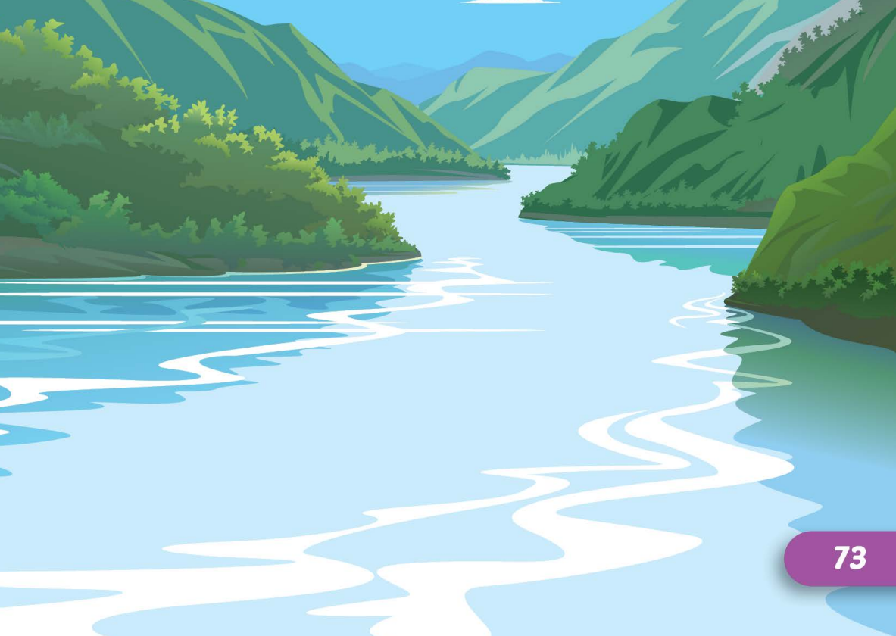
/ˈrɪvər/
sông

Slide 22
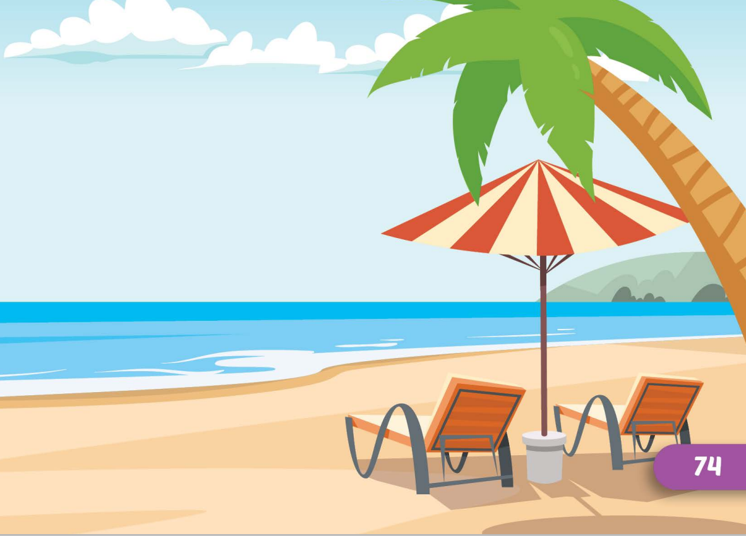
/biːtʃ/
bãi biển

Slide 23
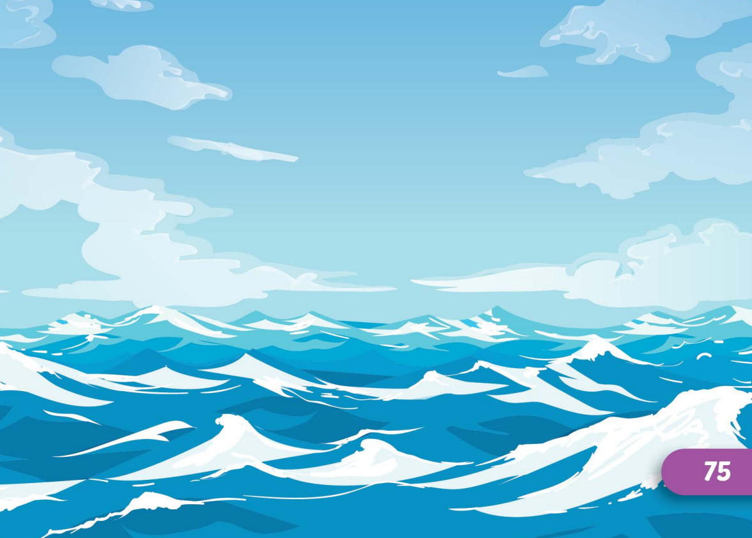
/ˈoʊʃən/
đại dương

Slide 24
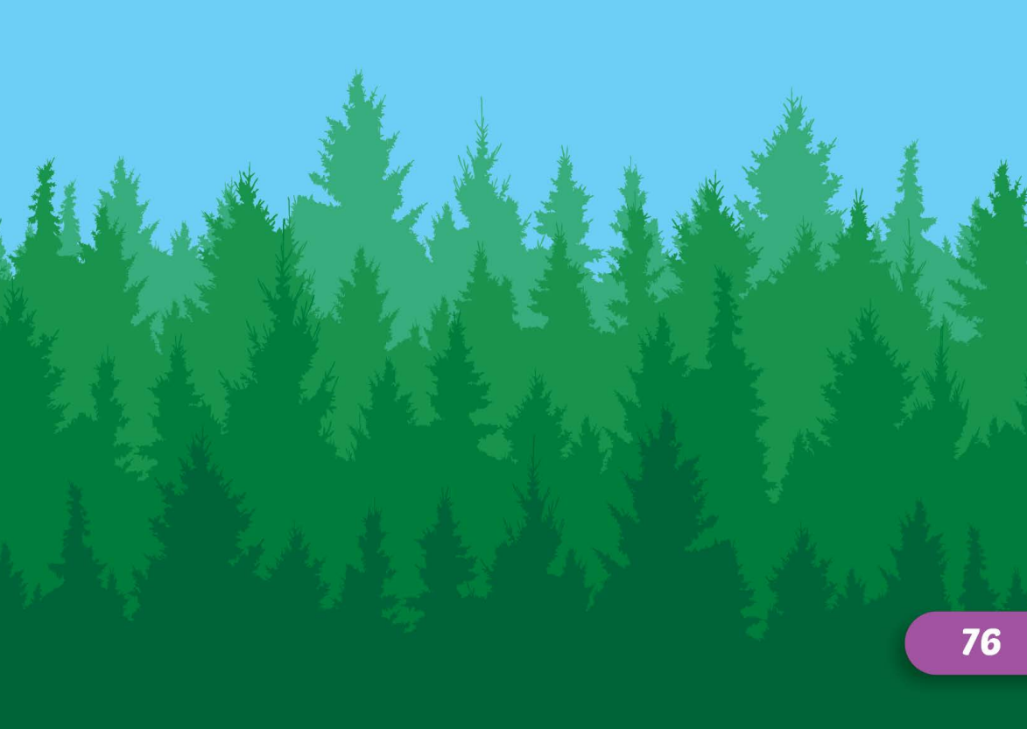
/ˈfɔrəst/
rừng

Slide 25
Practice

Slide 26
Check your memory

Slide 27









Find the best picture
Next
moutain

Slide 28


Find the best picture
Next
lake

Slide 29
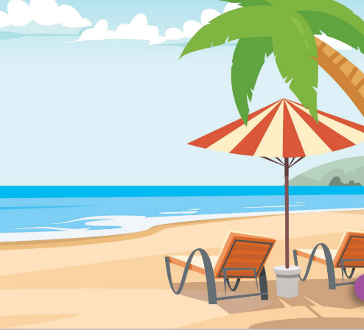

Find the best picture
Next
river

Slide 30

Find the best picture
Next
beach

Slide 31


Find the best picture
Next
ocean

Slide 32


Find the best picture
Next
forest

Slide 33

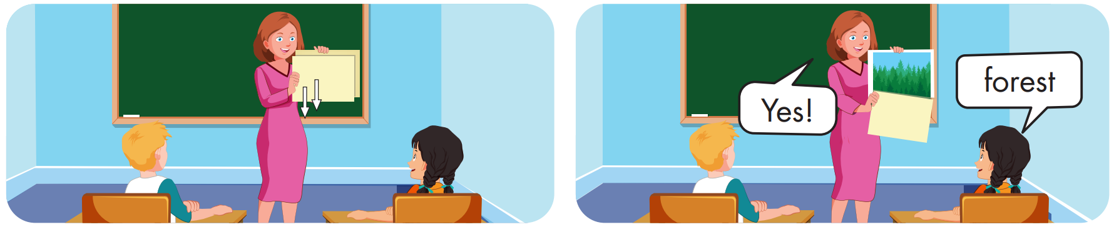

Slide 34
Structure
I didn't go to the river.
I went to the beach.

Slide 35
Presentation

Slide 36
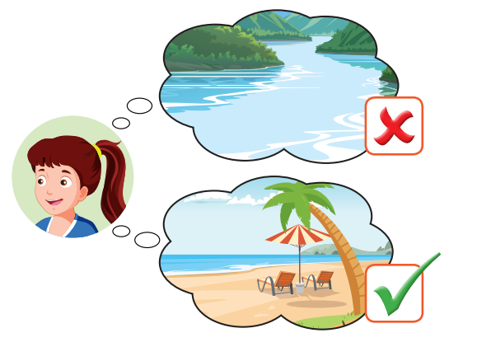
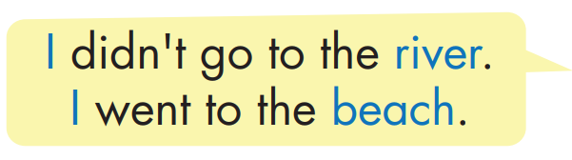
Structure

Slide 37

Practice

Slide 38


Slide 39

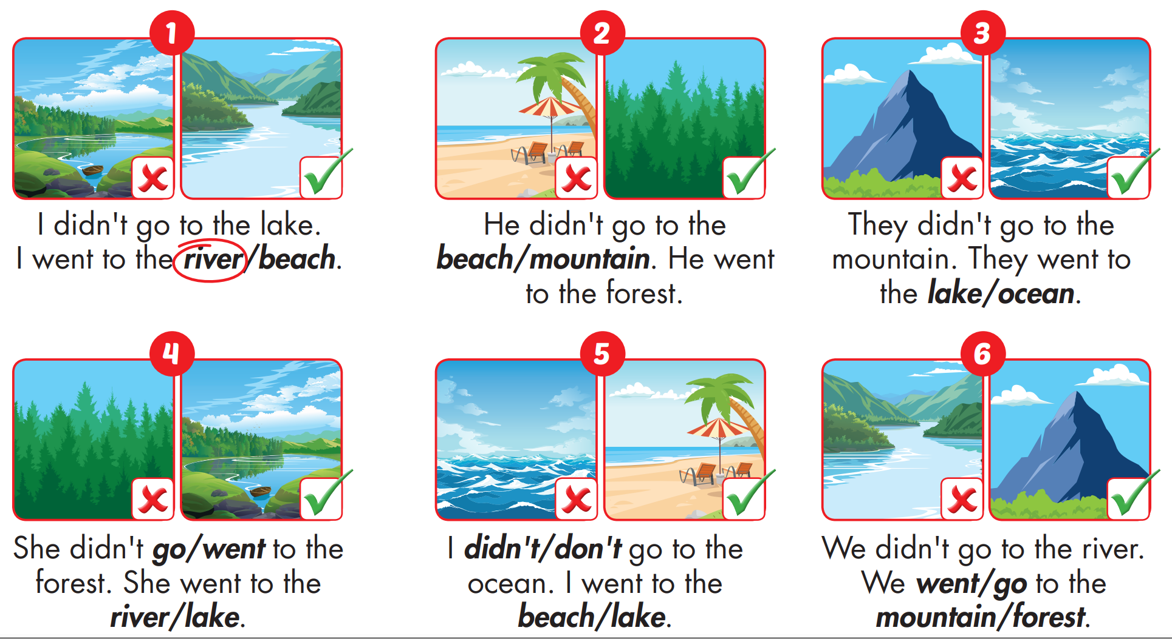


Slide 40

Production

Slide 41

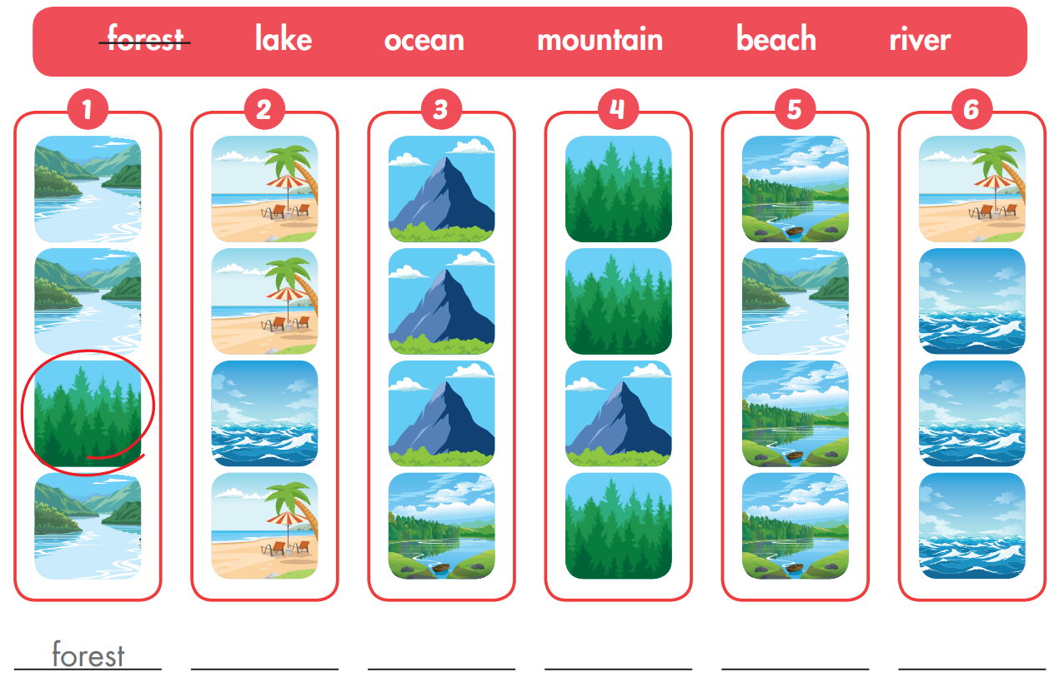
Extra Practice
WB, page 32
ocean
lake
moutain
river
beach

Slide 42

CONSOLIDATION

Slide 43

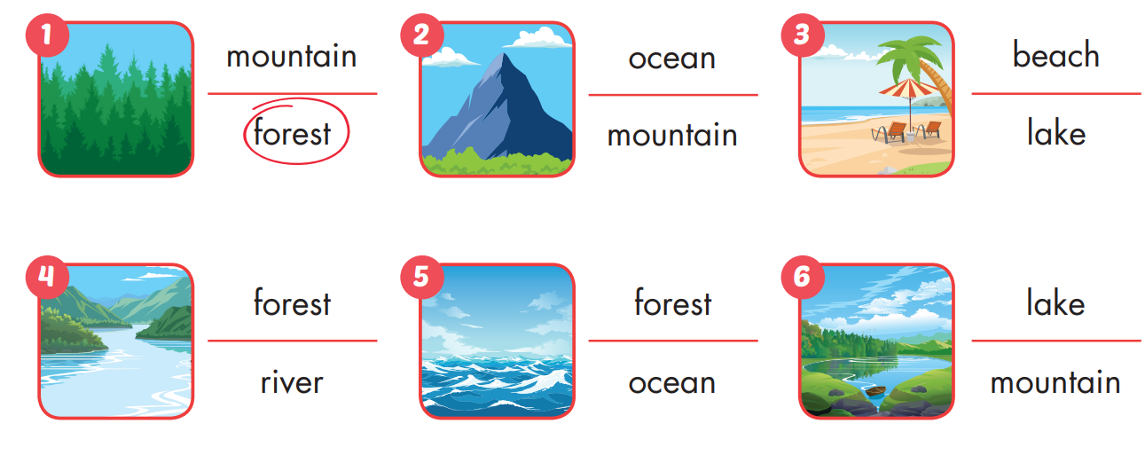
Extra Practice
WB, page 32

Slide 44

WRAP-UP

Slide 45
Today’s lesson
Vocabularies
mountain, lake, river, beach, ocean, forest
Structures/ Sentence patterns
I didn't go to the river.
I went to the beach.

Slide 46
Homework
Practice the vocabularies and structure, and make sentences using them.
Do the exercises in Tiếng Anh 5 i-Learn Smart Start WB (page 32)
Do the exercises in Tiếng Anh 5 i-Learn Smart Start Notebook (page 22)
Prepare the next lesson (page 49 SB)
Play the consolidation games in Tiếng Anh 5 i-Learn Smart Start DHA App on www.eduhome.com.vn

Slide 47

Enjoy your day!

Slide 48

Lesson 3
Stay positive and have a nice day!

