Slide 1
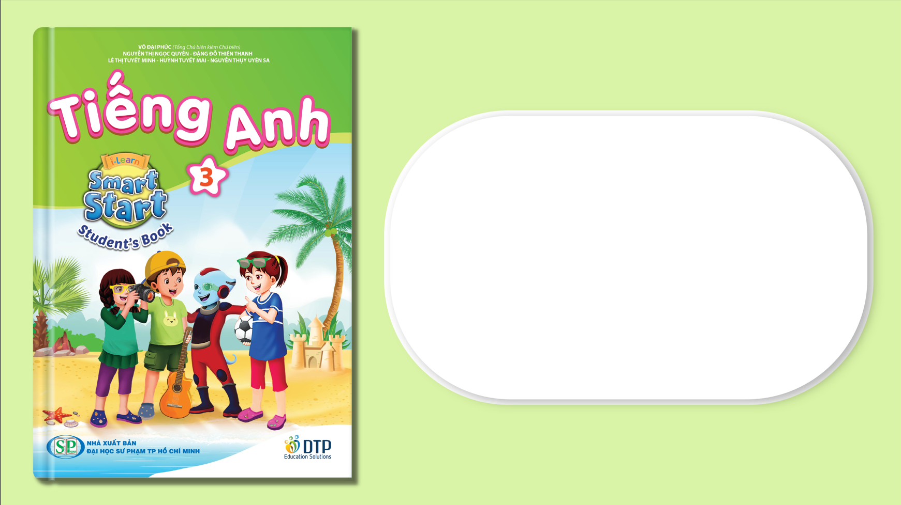
Unit 3: School
Lesson 4.3
Page 49

Slide 2
Lesson Outline
Warm-up
Reading
Writing
Consolidation
Wrap-up

Slide 3
Objectives
By the end of this lesson, students will be able to understand a paragraph and write about their favorite color, using the target language.
Vocabulary: green, orange, pink, purple, gray, favorite
Structure: What's your favorite color?
- My favorite color is orange.
I can make orange with yellow and red.

Slide 4

WARM UP

Slide 5

Let’s play!
Touch
Have students run around the classroom touching things in the color that the teacher shouts out: "Touch something green".

Slide 6

It’s time to learn …

Slide 7
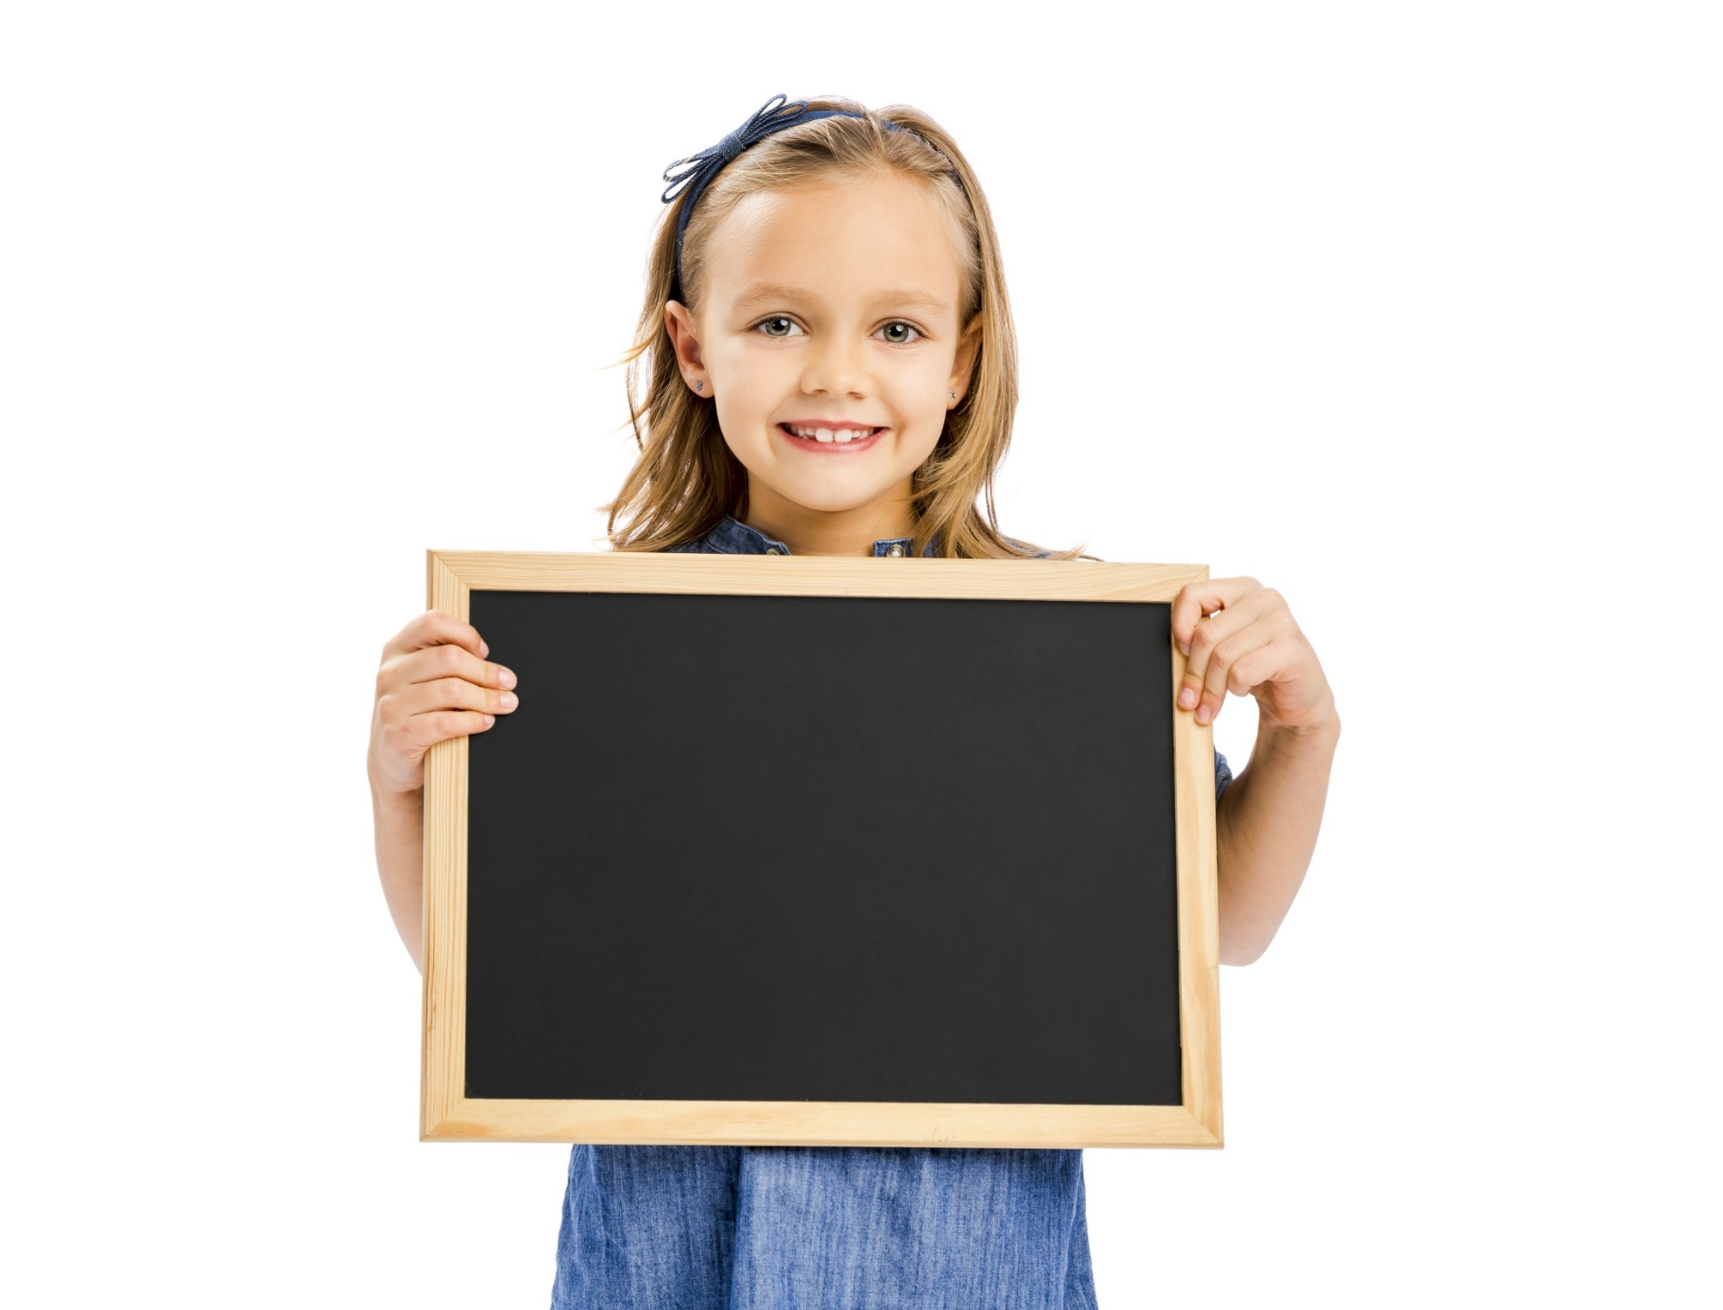
Reading

Slide 8
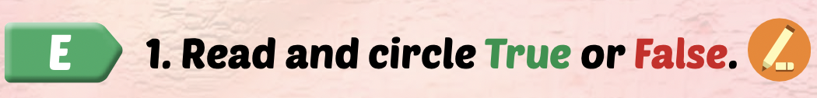
Have students read the text individually.
Read the text as a whole class.
Demonstrate the activity using the example.

Slide 9
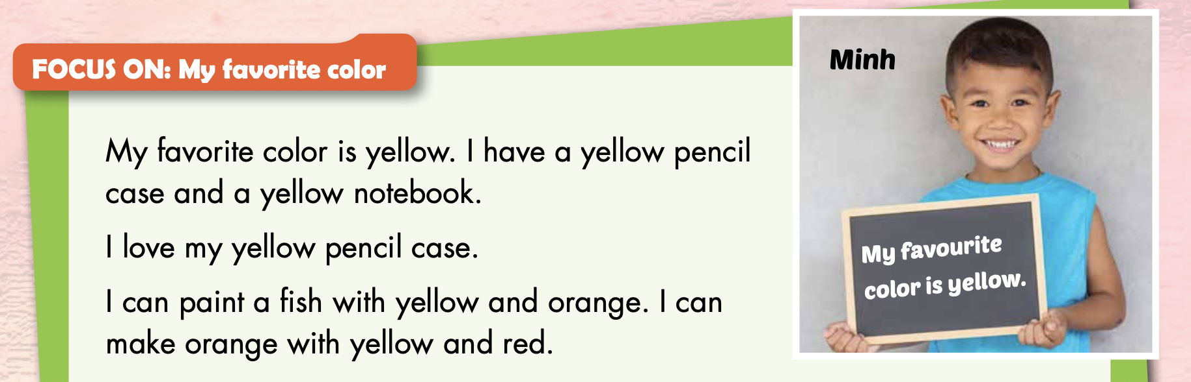
1 Minh has a blue notebook. True / False

Slide 10
2 Minh can paint a fish. True / False

Slide 11
3 Minh can make yellow with orange and red. True / False

Slide 12
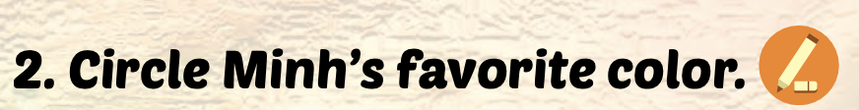
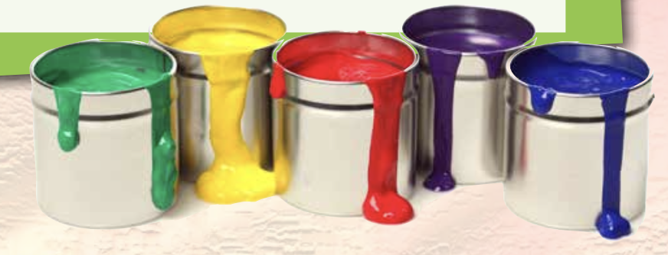

Slide 13
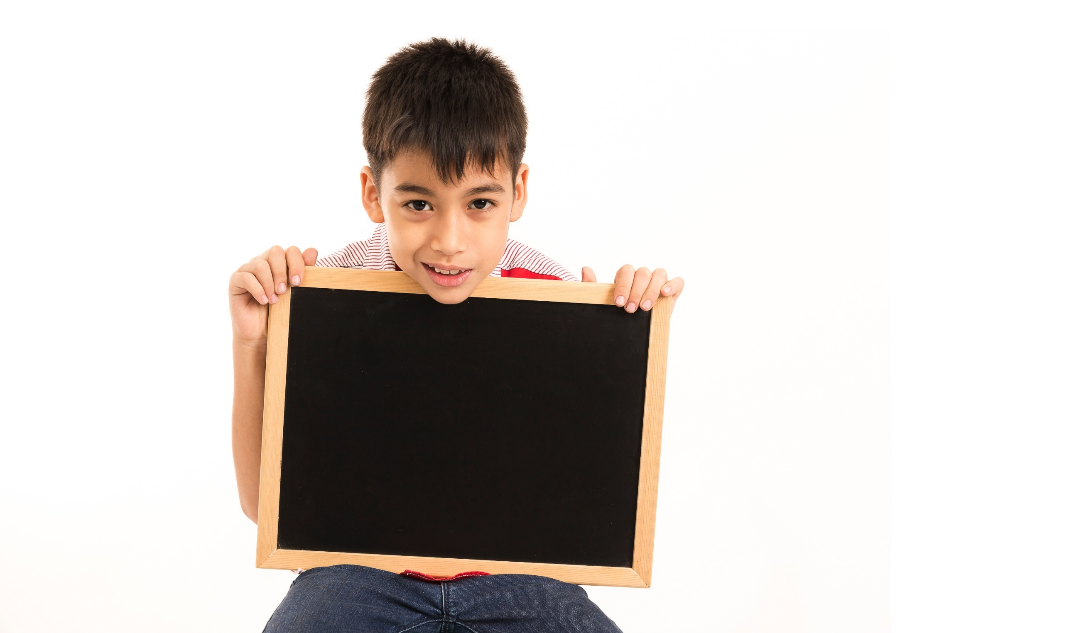
Writing

Slide 14
Have students read the text in Part E again.
Have students fill in the blanks about their favorite color.

Slide 15
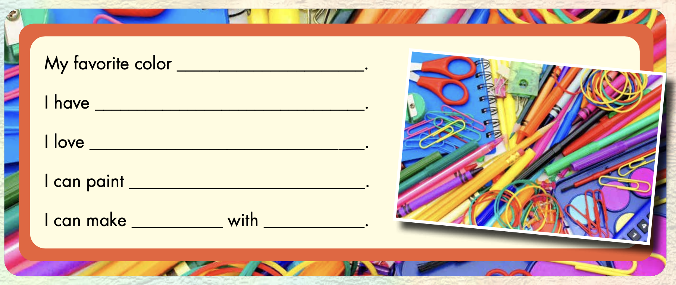
Example:
is red
a red pencil
my red pencil
a pencil case
pink
red and white

Slide 16
Let’s play!

Slide 17
Top
5
QUIZ

Slide 18
HOW TO PLAY
Ask students to read the questions.
They write down ONE answer.
Students get points if their answer in “top 5”.

Slide 19
# 1

Slide 20
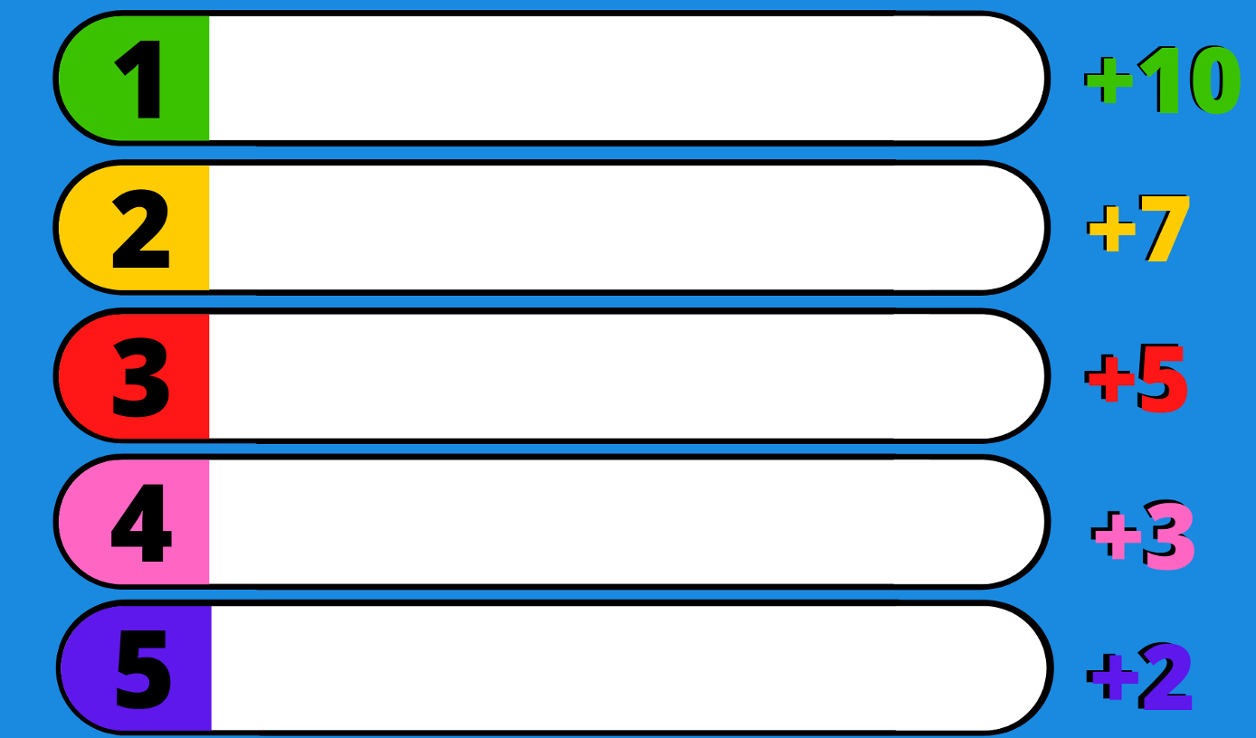
Name a color.
green
orange
red
pink
purple

Slide 21
# 2

Slide 22
Name something green.
frog
tree
grass
turtle
leaf

Slide 23
# 3

Slide 24
Name something blue.
jeans
sky
swimming pool
sea
balloon

Slide 25
# 4

Slide 26
Name something red.
strawberry
apple
tomato
cherry
blood

Slide 27

CONSOLIDATION

Slide 28
Divide the class into fours.
Have students read their sentences to their group.
Afterward, have some students read their sentences in front of the class.

Slide 29
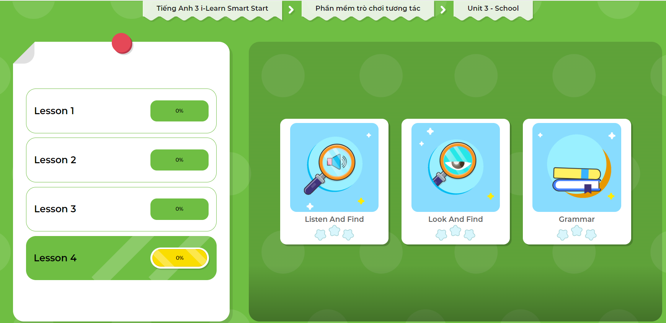
Extra Practice
DHA App
Let’s play!
Click here to play the game.

Slide 30
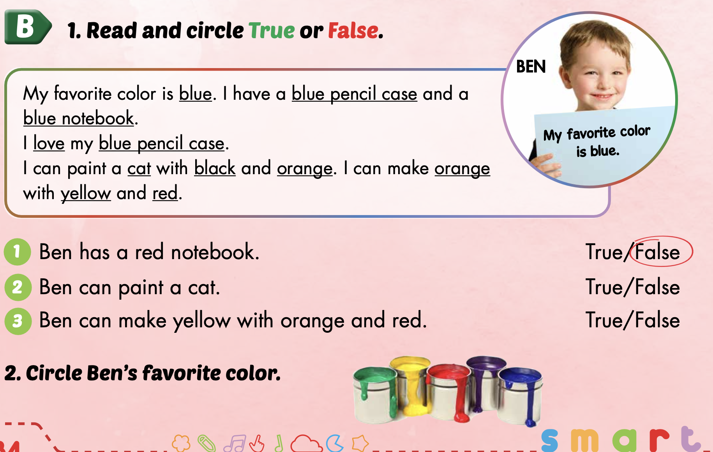
Extra Practice
WB p. 34

Slide 31

WRAP-UP

Slide 32
Today’s lesson
Vocabularies
green, orange, pink, purple, gray, favorite
Structures/ Sentence patterns
What's your favorite color?
- My favorite color is orange.
I can make orange with yellow and red.

Slide 33
Homework
Learn by heart vocabularies, structures and make sentences using them.
Do the exercises on page 35 WB
Do exercises in Tiếng Anh 3 i-Learn Smart Start Notebook on page 25.
Prepare the next lesson (page 50 SB)
Play the consolidation games in Tiếng Anh 3 i-Learn Smart Start DHA App on www.eduhome.com.vn

Slide 34
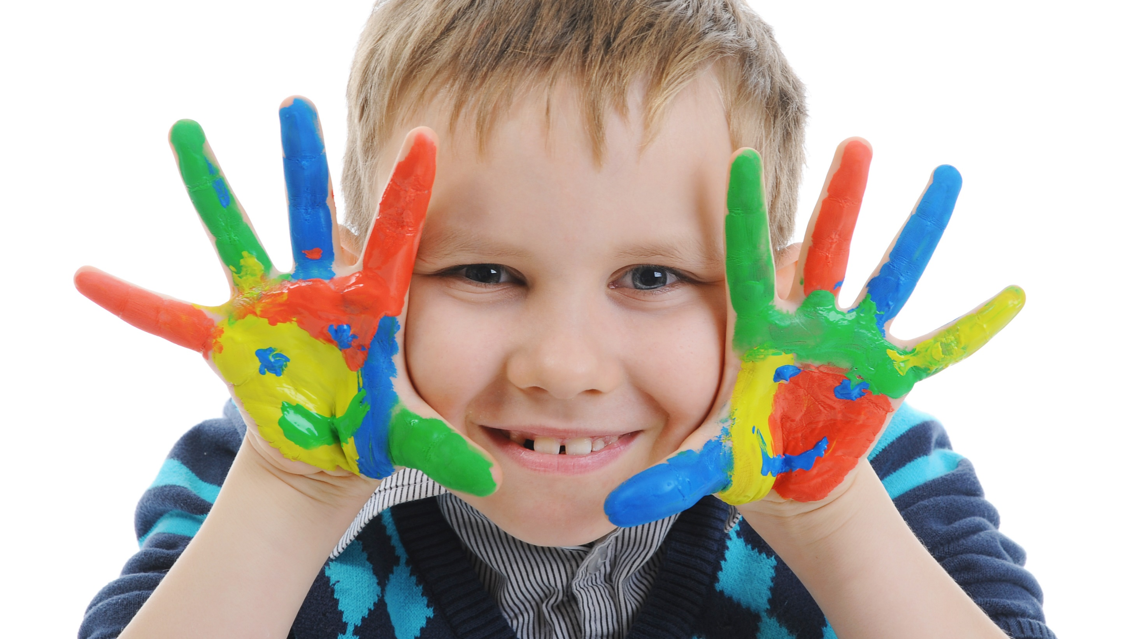
Enjoy your day!

Slide 35
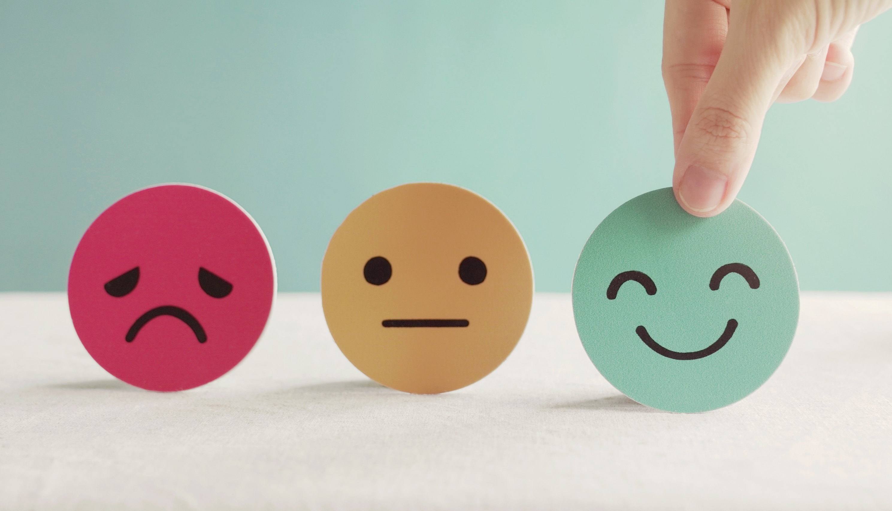
Lesson 3
Stay positive and have a nice day!

