Slide 1

Unit 3: MY FRIENDS AND I
Lesson 2.3
Page 39

Slide 2
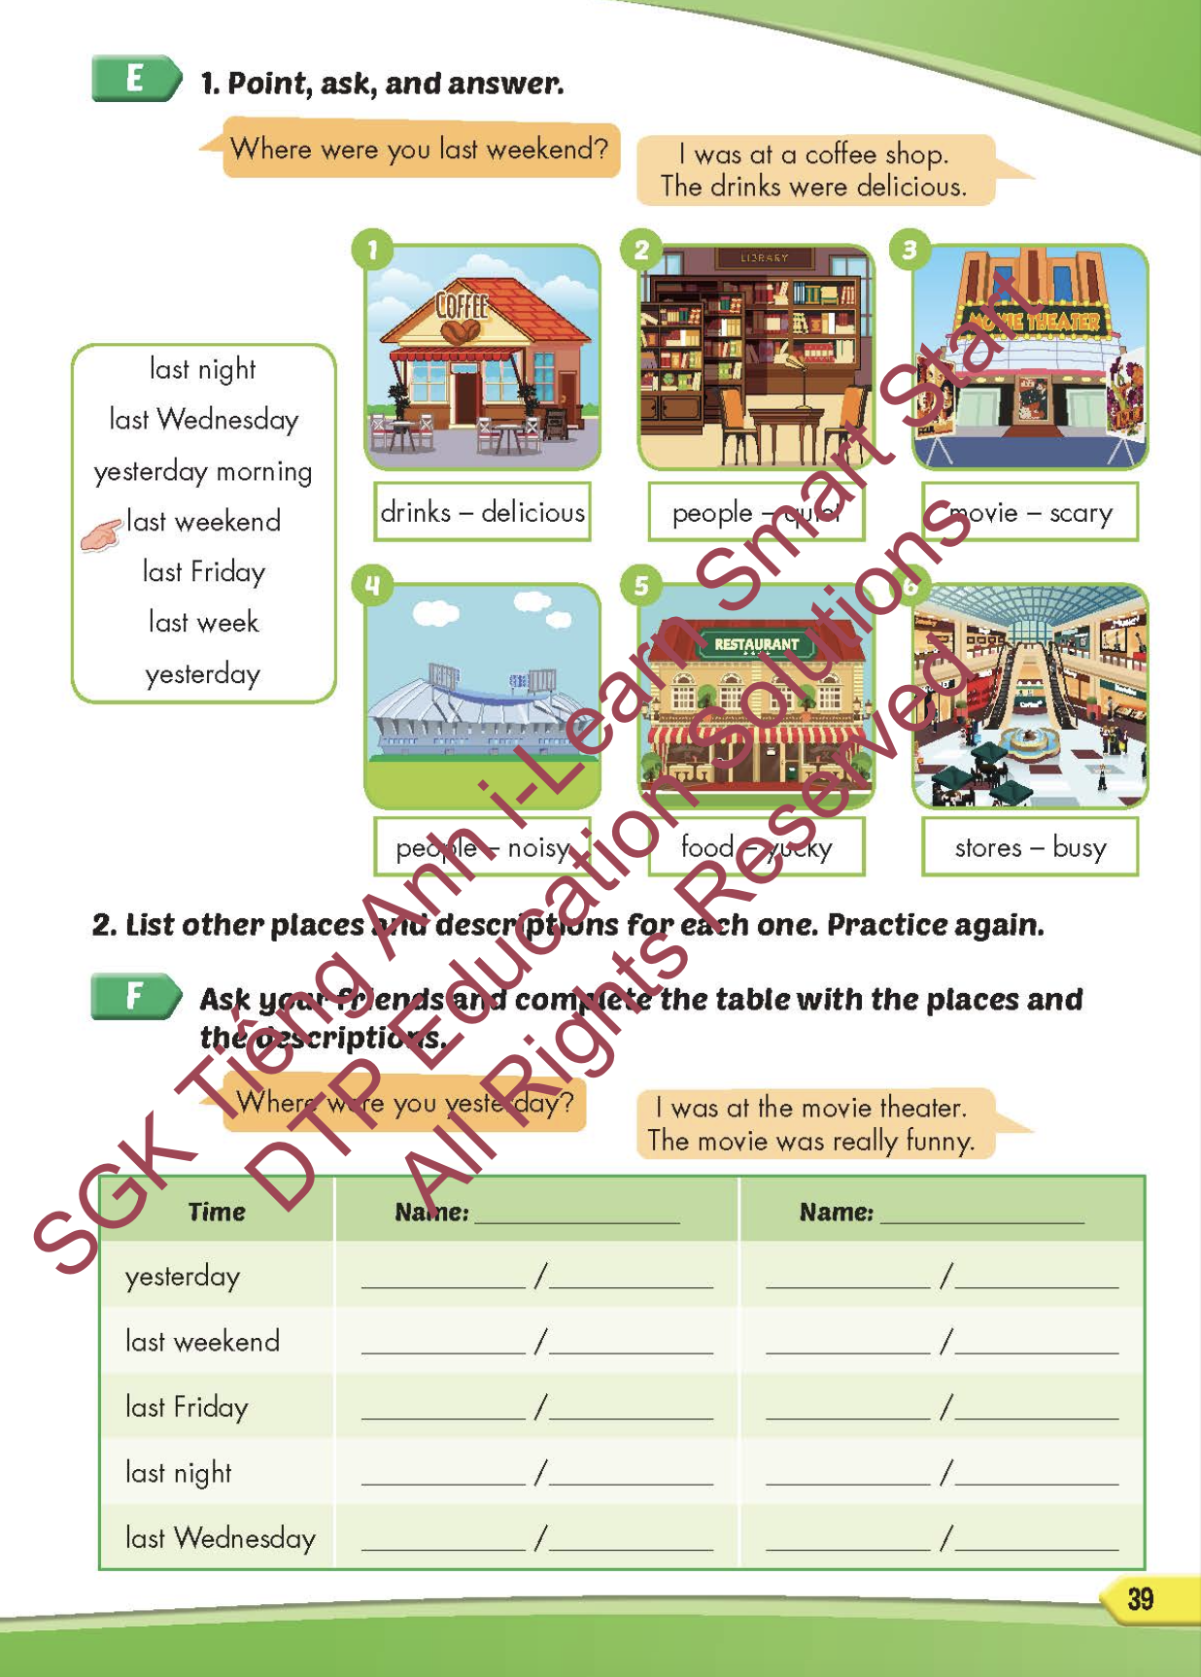
Lesson Outline
Warm-up
Practice
Speaking
Consolidation
Wrap-up

Slide 3
Objectives
By the end of this lesson, students will be able to talk about where they were correctly.
Vocabulary: noisy, quiet, busy, delicious, yucky, scary.
Structure: Where were you last night?
I was at the movie theater. The movie was scary.

Slide 4

WARM-UP

Slide 5



Slide 6
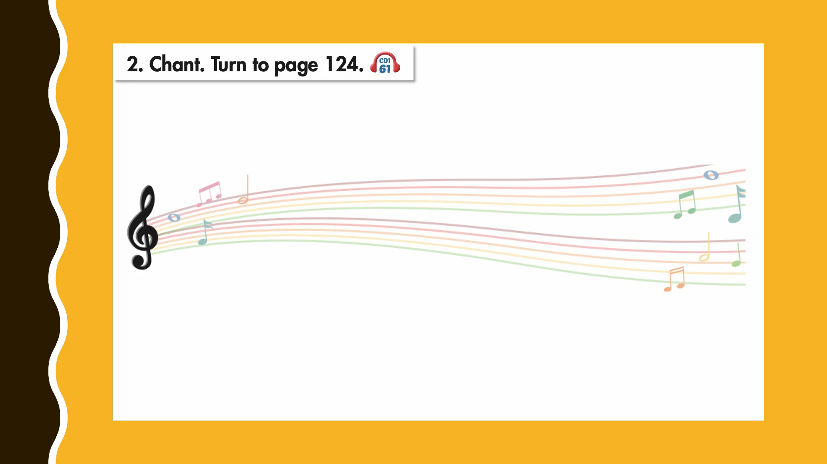

Slide 7

New words
noisy,
quiet,
busy,
delicious,
yucky,
scary.

Slide 8
LOOK, READ AND CHOOSE.

Slide 9
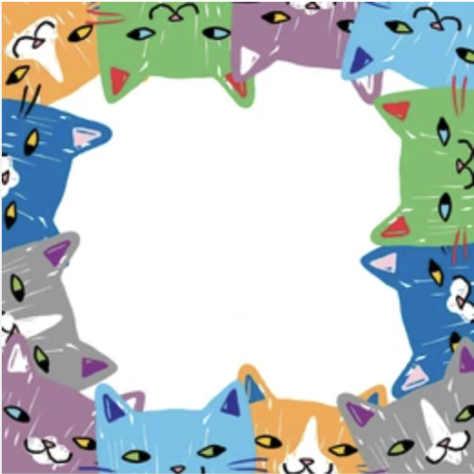

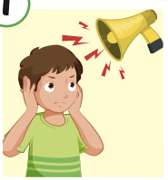
NOISY
QUIET
YUCKY
NOISY

Slide 10
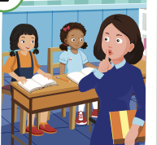
SCARY
QUIET
YUCKY
QUIET

Slide 11
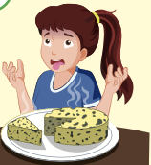
SCARY
DELICIOUS
YUCKY
THE FOOD WAS…..……..
YUCKY

Slide 12
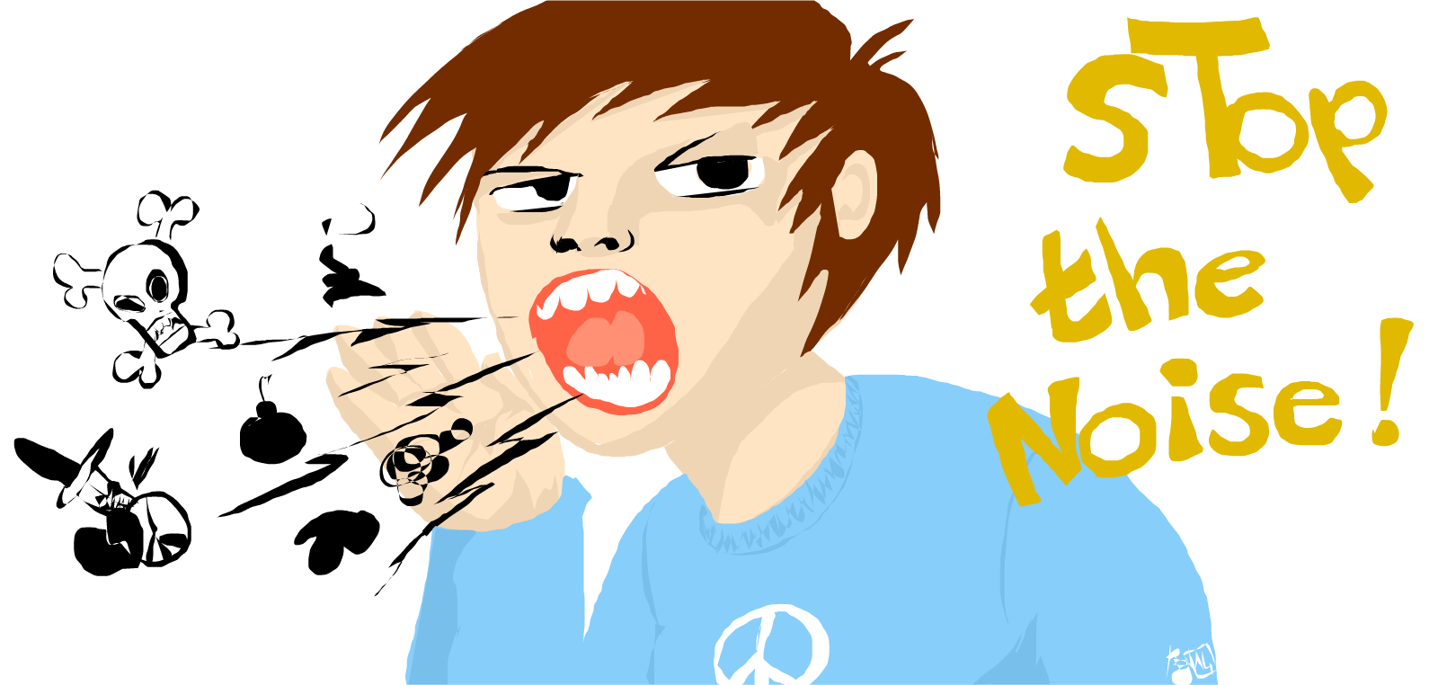
WAS
WERE
THE PEOPLE …………. NOISY.
WERE

Slide 13
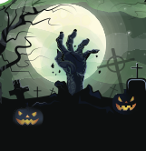
WAS
WERE
THE FILM …………. SCARY.
WAS

Slide 14
Structure
Where were you last night?
- I was at the movie theater.
The movie was scary.

Slide 15

Practice

Slide 16


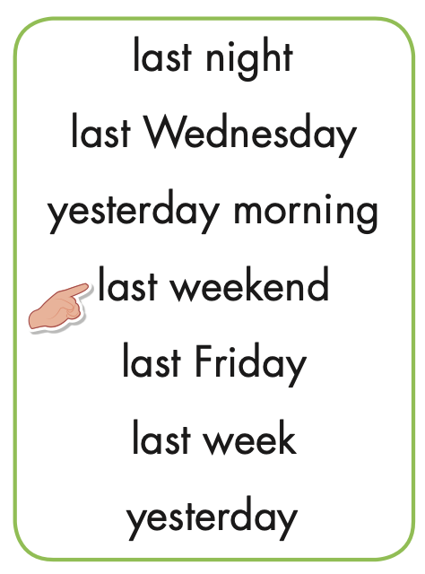
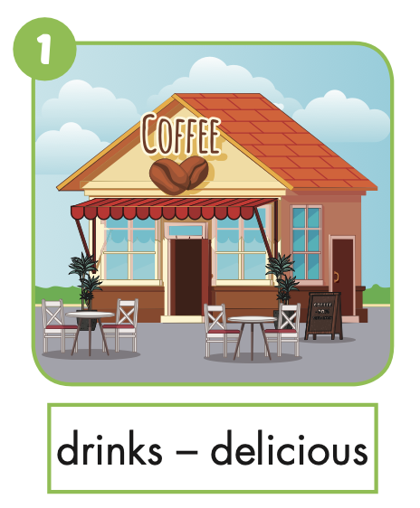

Slide 17

Speaking

Slide 18
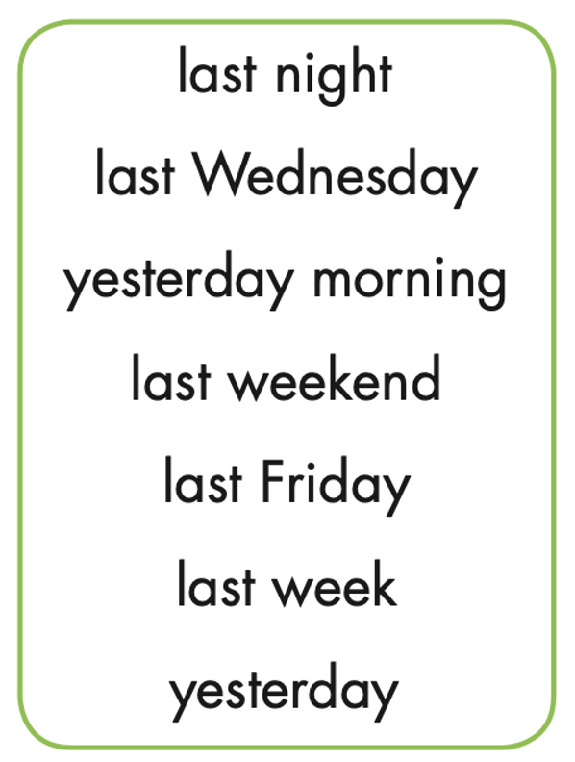

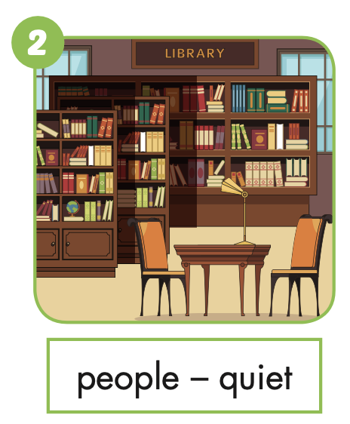
Where were you last night?
I was at the library.
The people were quiet.

Slide 19
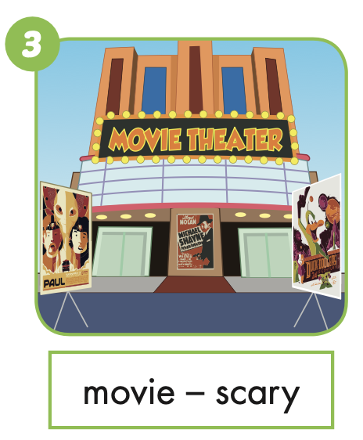
Where were you last Wednesday?
I was at the movie theater.
The movie was scary.

Slide 20
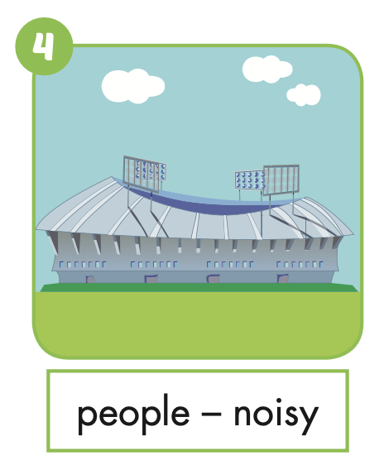
Where were you yesterday morning?
I was at the stadium.
The people were noisy.

Slide 21
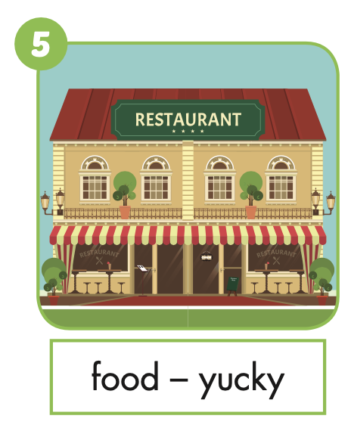
Where were you last Friday?
I was at the restaurant.
The food was yucky.

Slide 22
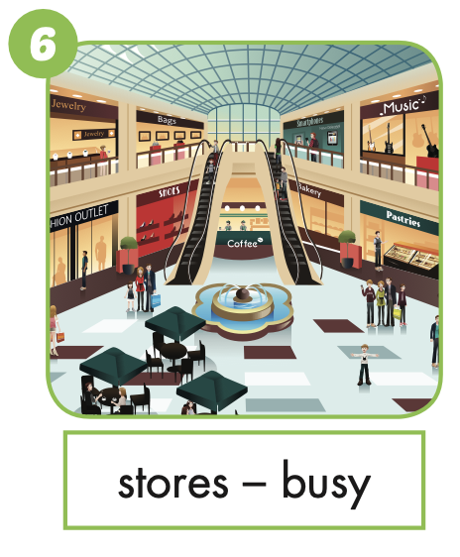
Where were you yesterday?
I was at the mall.
The stores were busy.

Slide 23

Production

Slide 25
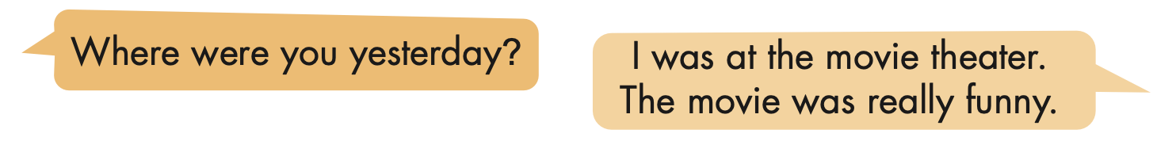
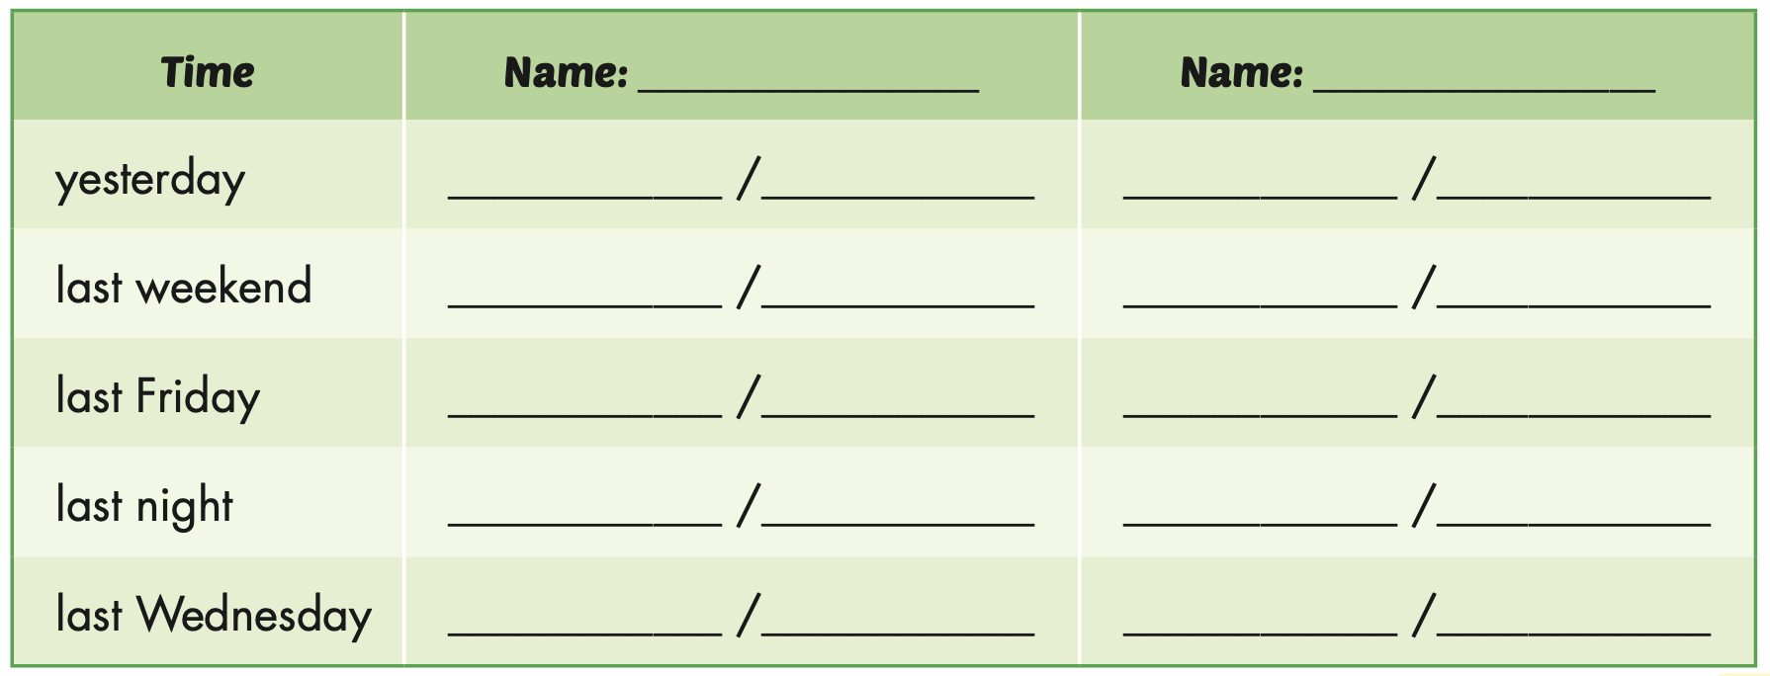

Slide 26

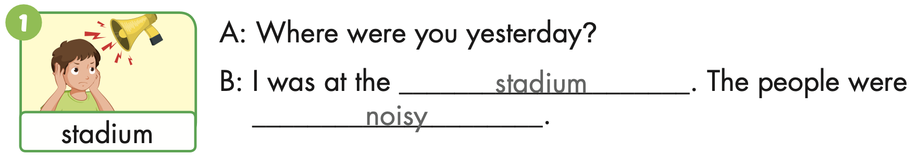
Extra Practice
WB, page 24

Slide 27

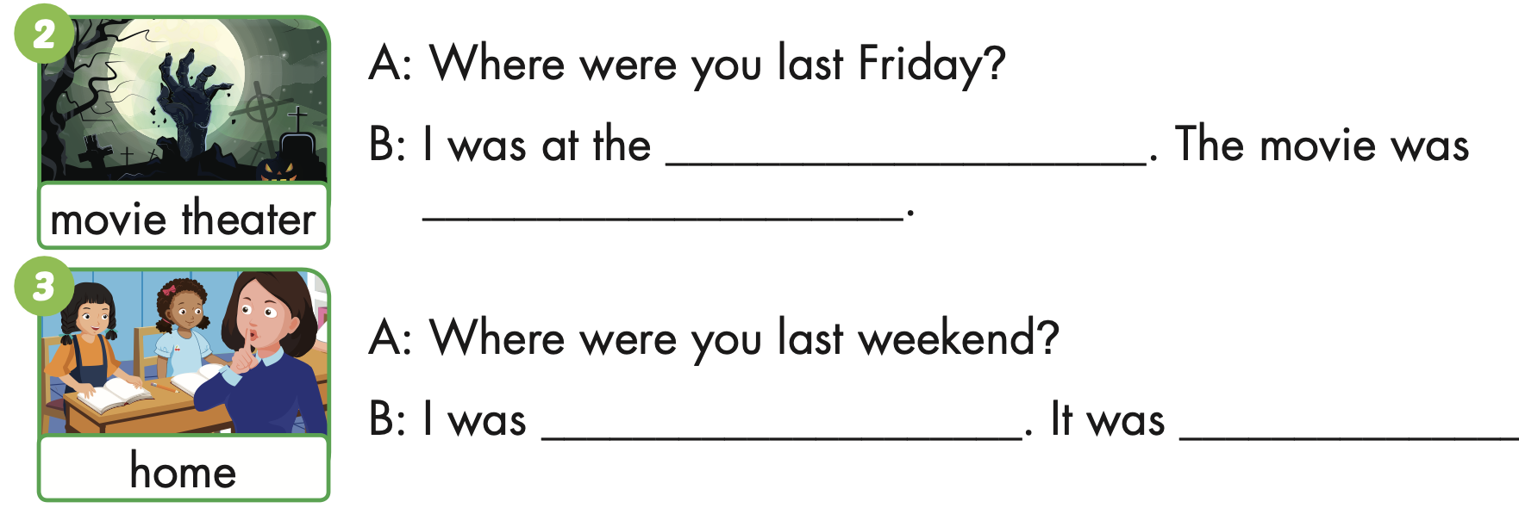
Extra Practice
WB, page 24
movie theater
scary
at home
quiet

Slide 28
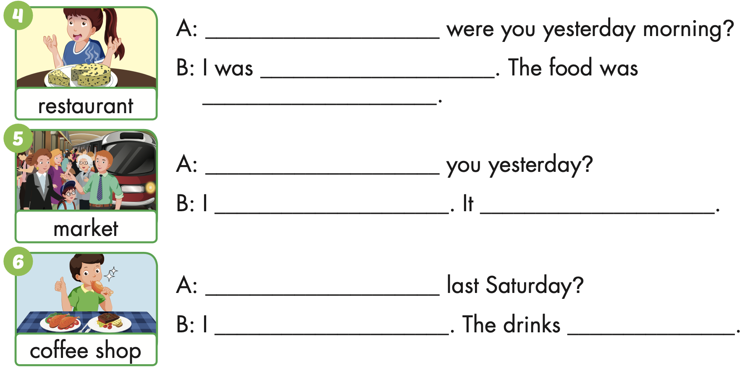
Extra Practice
WB, page 24
Where
at the restaurant
yucky
Where were
Was at the market
was busy

Slide 29
Extra Practice
WB, page 24
Where were you
was at the coffee shop
was delicious

Slide 30

CONSOLIDATION

Slide 31
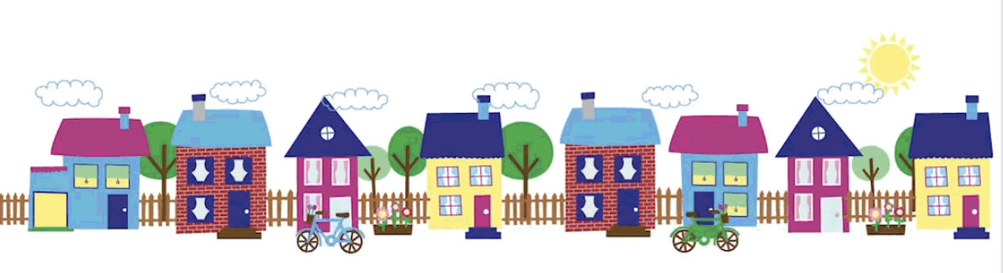
UNSCRAMBLE THE SENTENCES

Slide 32

were / at / They / last / the / restaurant / Sunday.
They were at the restaurant last Sunday.

Slide 33
was / food / The / yucky.
The food was yucky.

Slide 34
was / I / at/ library / the / yesterday.
I was at the library yesterday.

Slide 35
The / were / people / quiet.
The people were quiet.

Slide 36
last / wasn’t / Lucy / at/ party / the / weekend.
Lucy wasn’t at the party last weekend.

Slide 37

WRAP-UP

Slide 38
Today’s lesson
Vocabularies
noisy,
quiet,
busy,
delicious,
yucky,
scary.
Structures/ Sentence patterns
Where were you last night?
I was at the movie theater. The movie was scary.

Slide 39
Homework
Practice the vocabularies and structure, and make sentences using them.
Do the exercises in Tiếng Anh 5 i-Learn Smart Start WB (page 24).
Do the exercises in Tiếng Anh 5 i-Learn Smart Start Notebook.
Prepare the next lesson (page 40 SB).
Play the consolidation games in Tiếng Anh 5 i-Learn Smart Start DHA App on www.eduhome.com.vn

Slide 40

Enjoy your day!

Slide 41

Lesson 3
Stay positive and have a nice day!

