Slide 1

Unit 2: Holidays
Lesson 1.1
Page 20

Slide 2
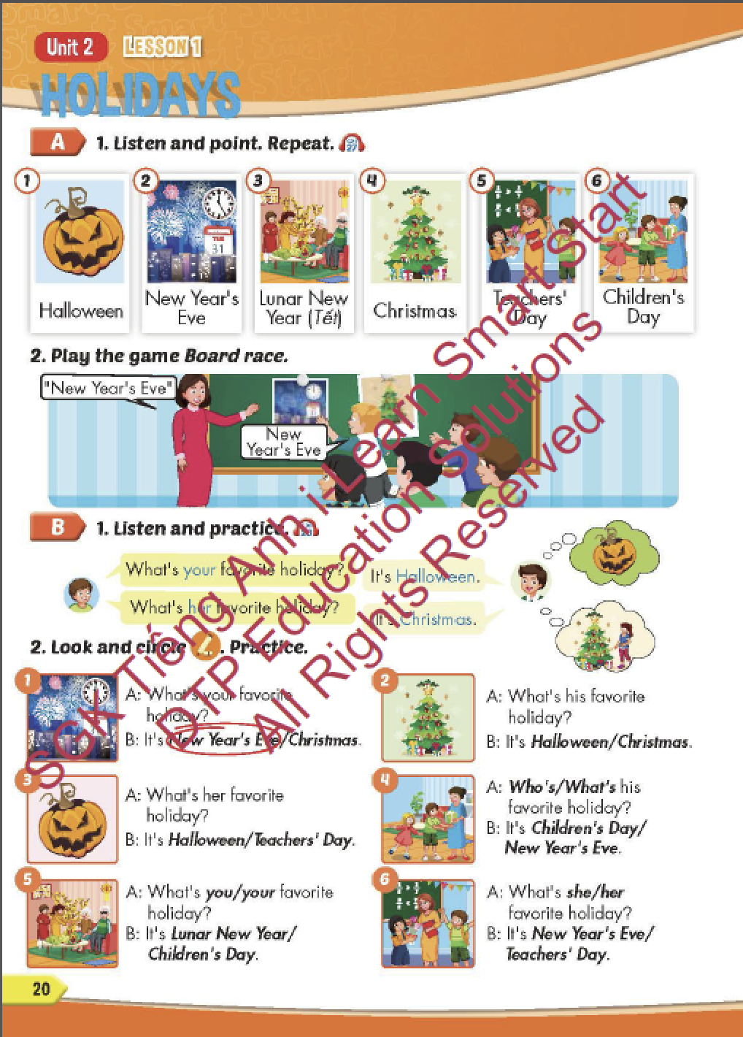
Lesson Outline
Warm-up
Vocabulary
Structure
Consolidation
Wrap-up

Slide 3
Objectives
By the end of this lesson, students will be able to…
Vocabulary: Pronounce and identify the words related to the topic properly: Halloween, New Year's Eve, Lunar New Year (Tết), Christmas, Teachers' Day, Children's Day.
Structure: What's your favorite holiday? - It's Halloween.
What's her favorite holiday? - It's Christmas

Slide 4

WARM-UP

Slide 5
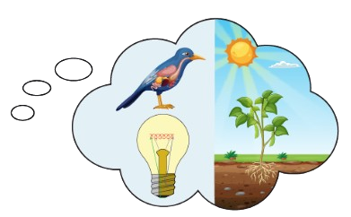






History
Science

Slide 6
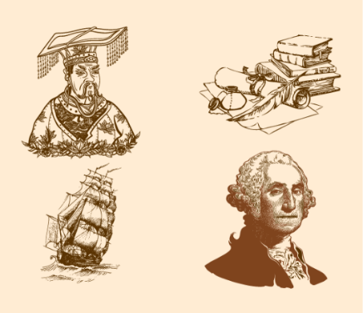
History
English

Slide 7
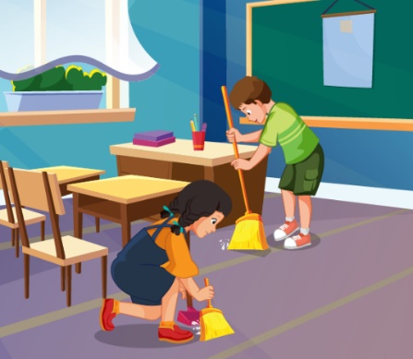
IT
Ethics

Slide 8

Geography
Science

Slide 9
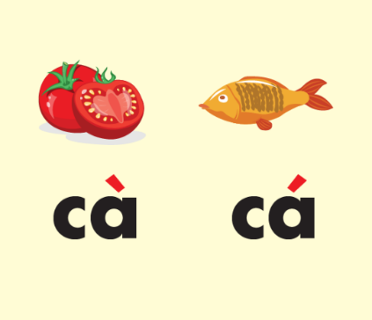
History
Vietnamese

Slide 10

using computers
making things

Slide 11

reading stories
learning languages

Slide 12
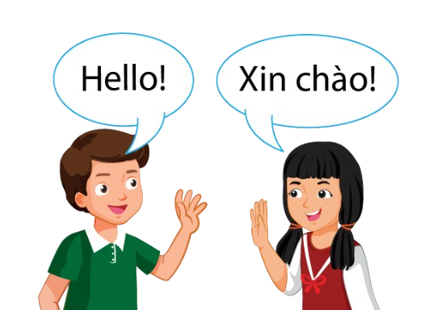
learning languages
do experiments

Slide 13
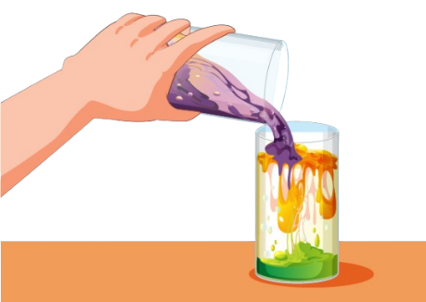
do experiments
solving problems

Slide 14
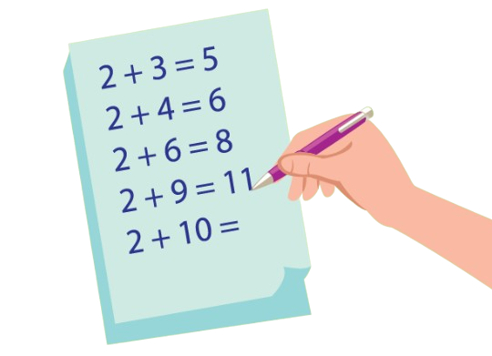
using computers
solving problems

Slide 15


Slide 16

It’s time to learn …

Slide 17

New words
Halloween, New Year's Eve,
Lunar New Year (Tết),
Christmas, Teachers' Day,
Children's Day

Slide 18

Presentation

Slide 19


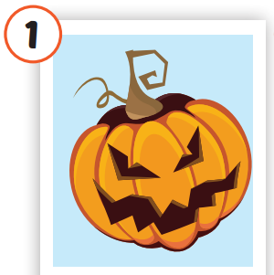
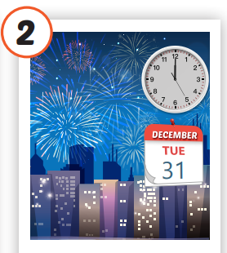
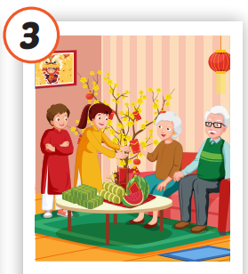
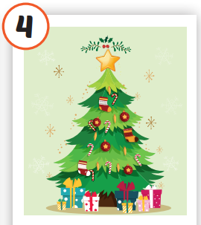
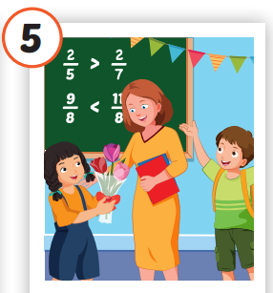
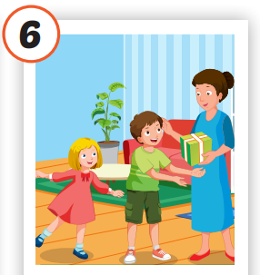
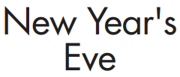
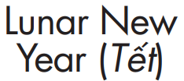

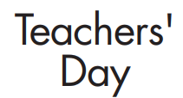
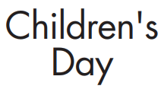

/ˌhæloʊˈiːn/
lễ hội Halloween
/ˈtʃɪldrənz deɪ/
Ngày Quốc tế
Thiếu nhi
/ˌnjuː jɪrz ˈiːv/
đêm Giao thừa
/ˈluːnər nuː jɪrz/
tết Nguyên đán
/ˈkrɪsməs/
Giáng sinh
/ˈtiːtʃərz deɪ/
Ngày Nhà giáo
Notes:
Click vào hình A. 1. Listen and point. Repeat để cho cả audio full chạy

Slide 20


/ˌhæloʊˈiːn/
lễ hội Halloween

Slide 21
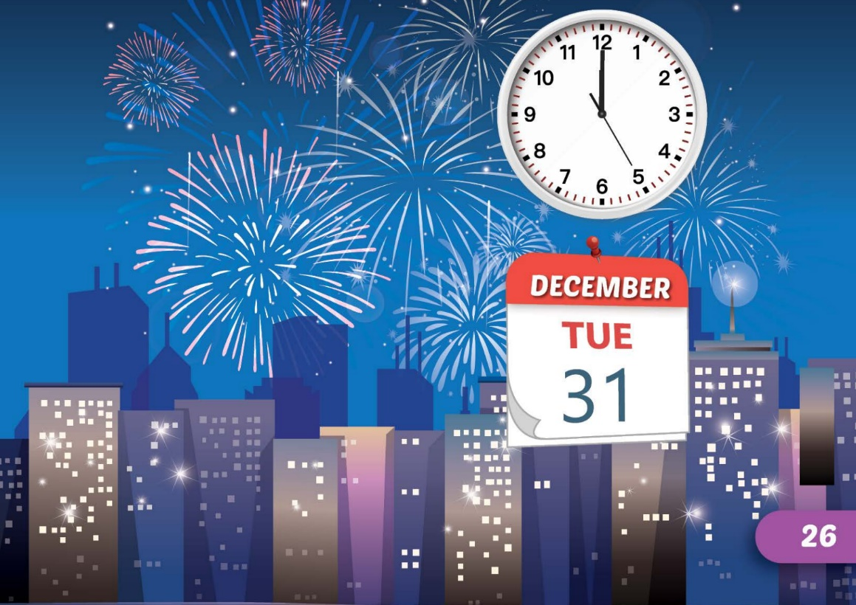

/ˌnjuː jɪrz ˈiːv/
đêm Giao thừa

Slide 22
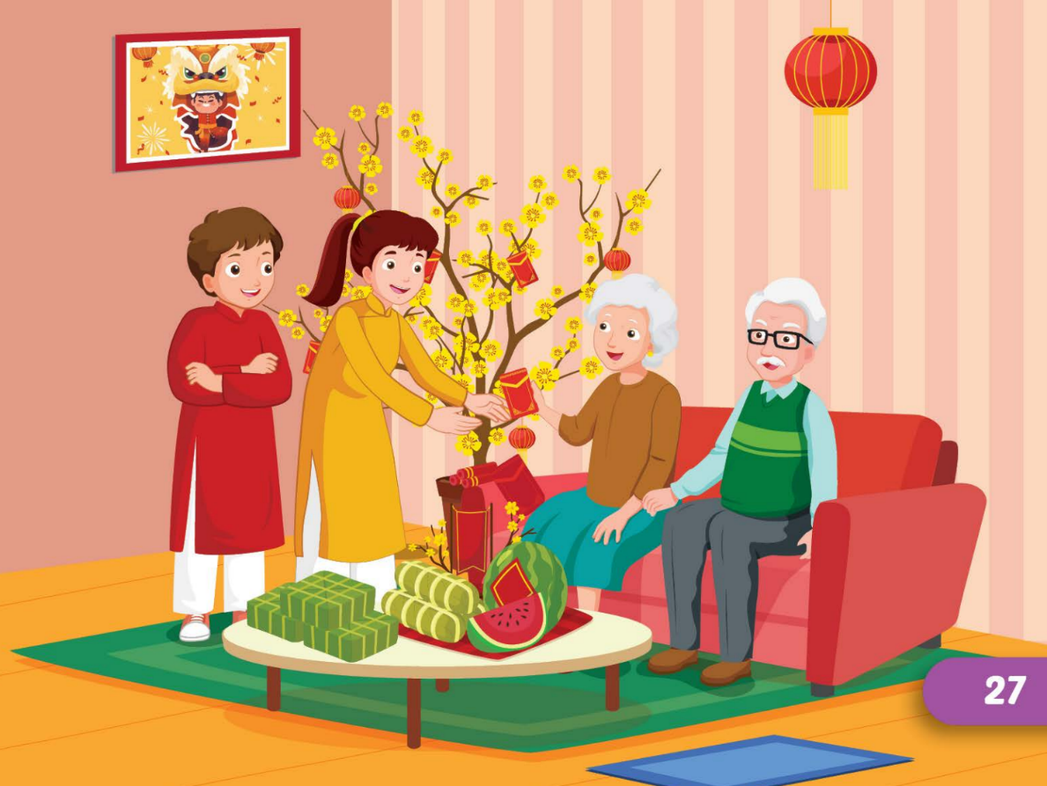

/ˈluːnər nuː jɪrz/
tết Nguyên đán

Slide 23


/ˈkrɪsməs/
Giáng sinh

Slide 24
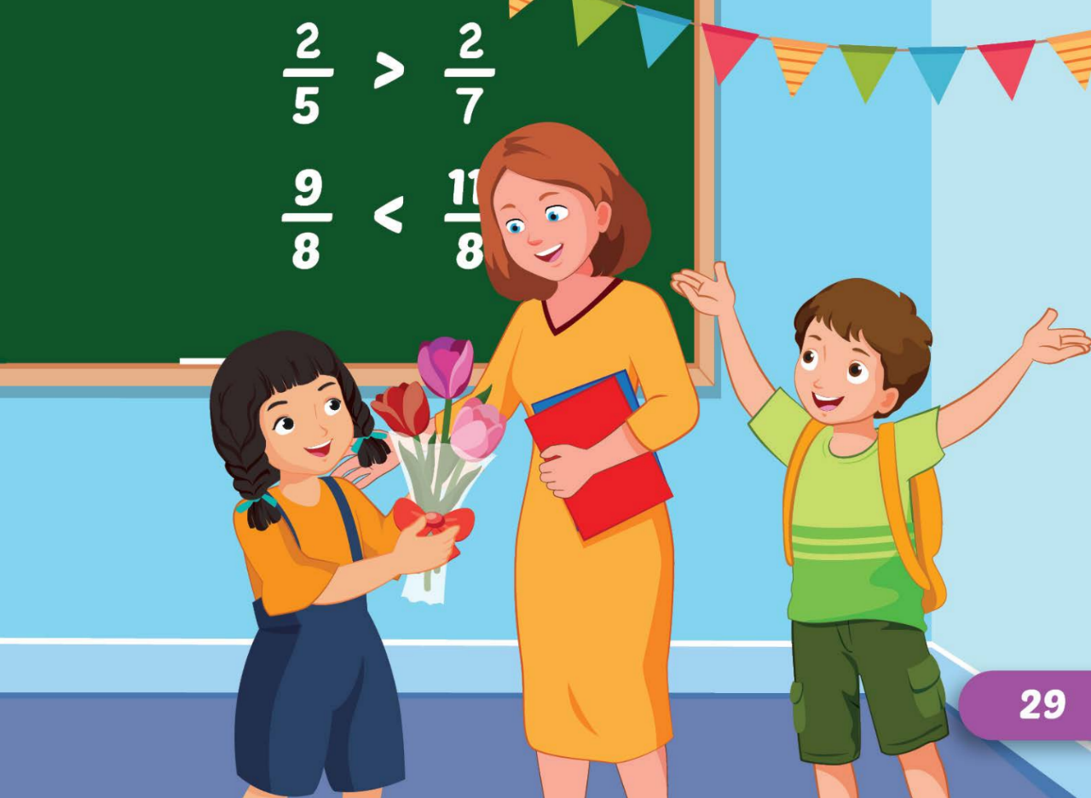
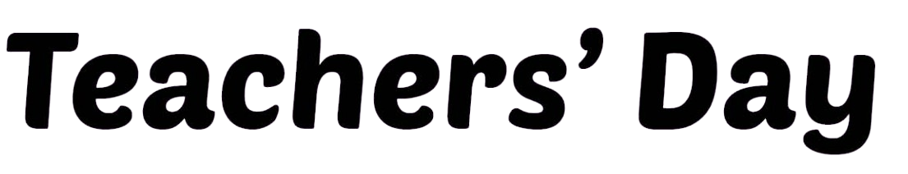
/ˈtiːtʃərz deɪ/
Ngày Nhà giáo

Slide 25
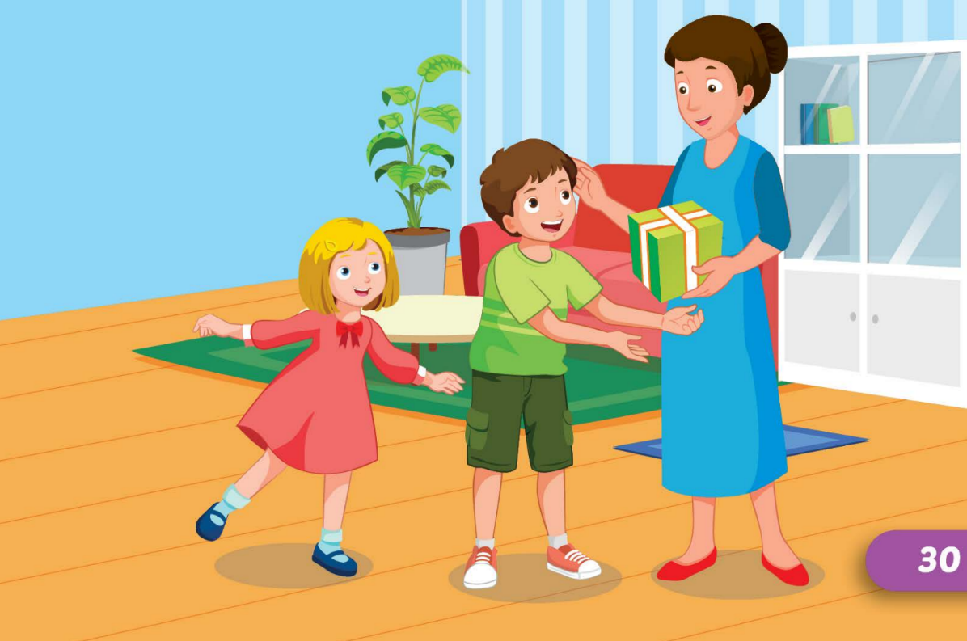

/ˈtʃɪldrənz deɪ/
Ngày Quốc tế
Thiếu nhi

Slide 26
Practice

Slide 27
Check your memory

Slide 28






What’s next?
?
Christmas
Halloween

Slide 29




What’s next?
?
Teachers' Day
Children's Day

Slide 30




What’s next?
?
Children's Day
Lunar New Year

Slide 31
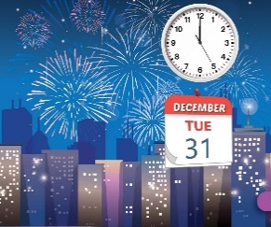


What’s next?
?
New Year's Eva
Children's Day

Slide 32



What’s next?
?
Children's Day
Christmas

Slide 33



Slide 34
Structure
What's your favorite holiday?
- It's Halloween.
What's her favorite holiday?
- It's Christmas.

Slide 35
Presentation

Slide 36
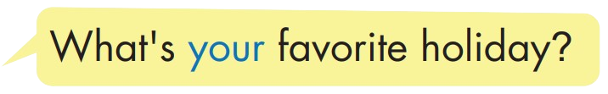
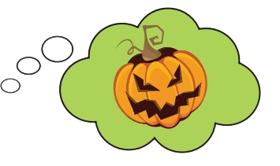
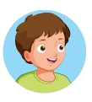
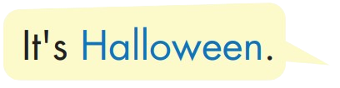

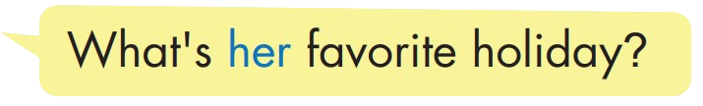
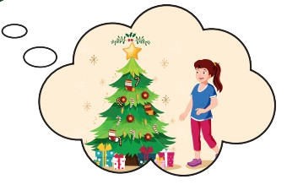
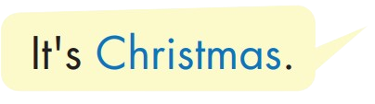
Structure

Slide 37
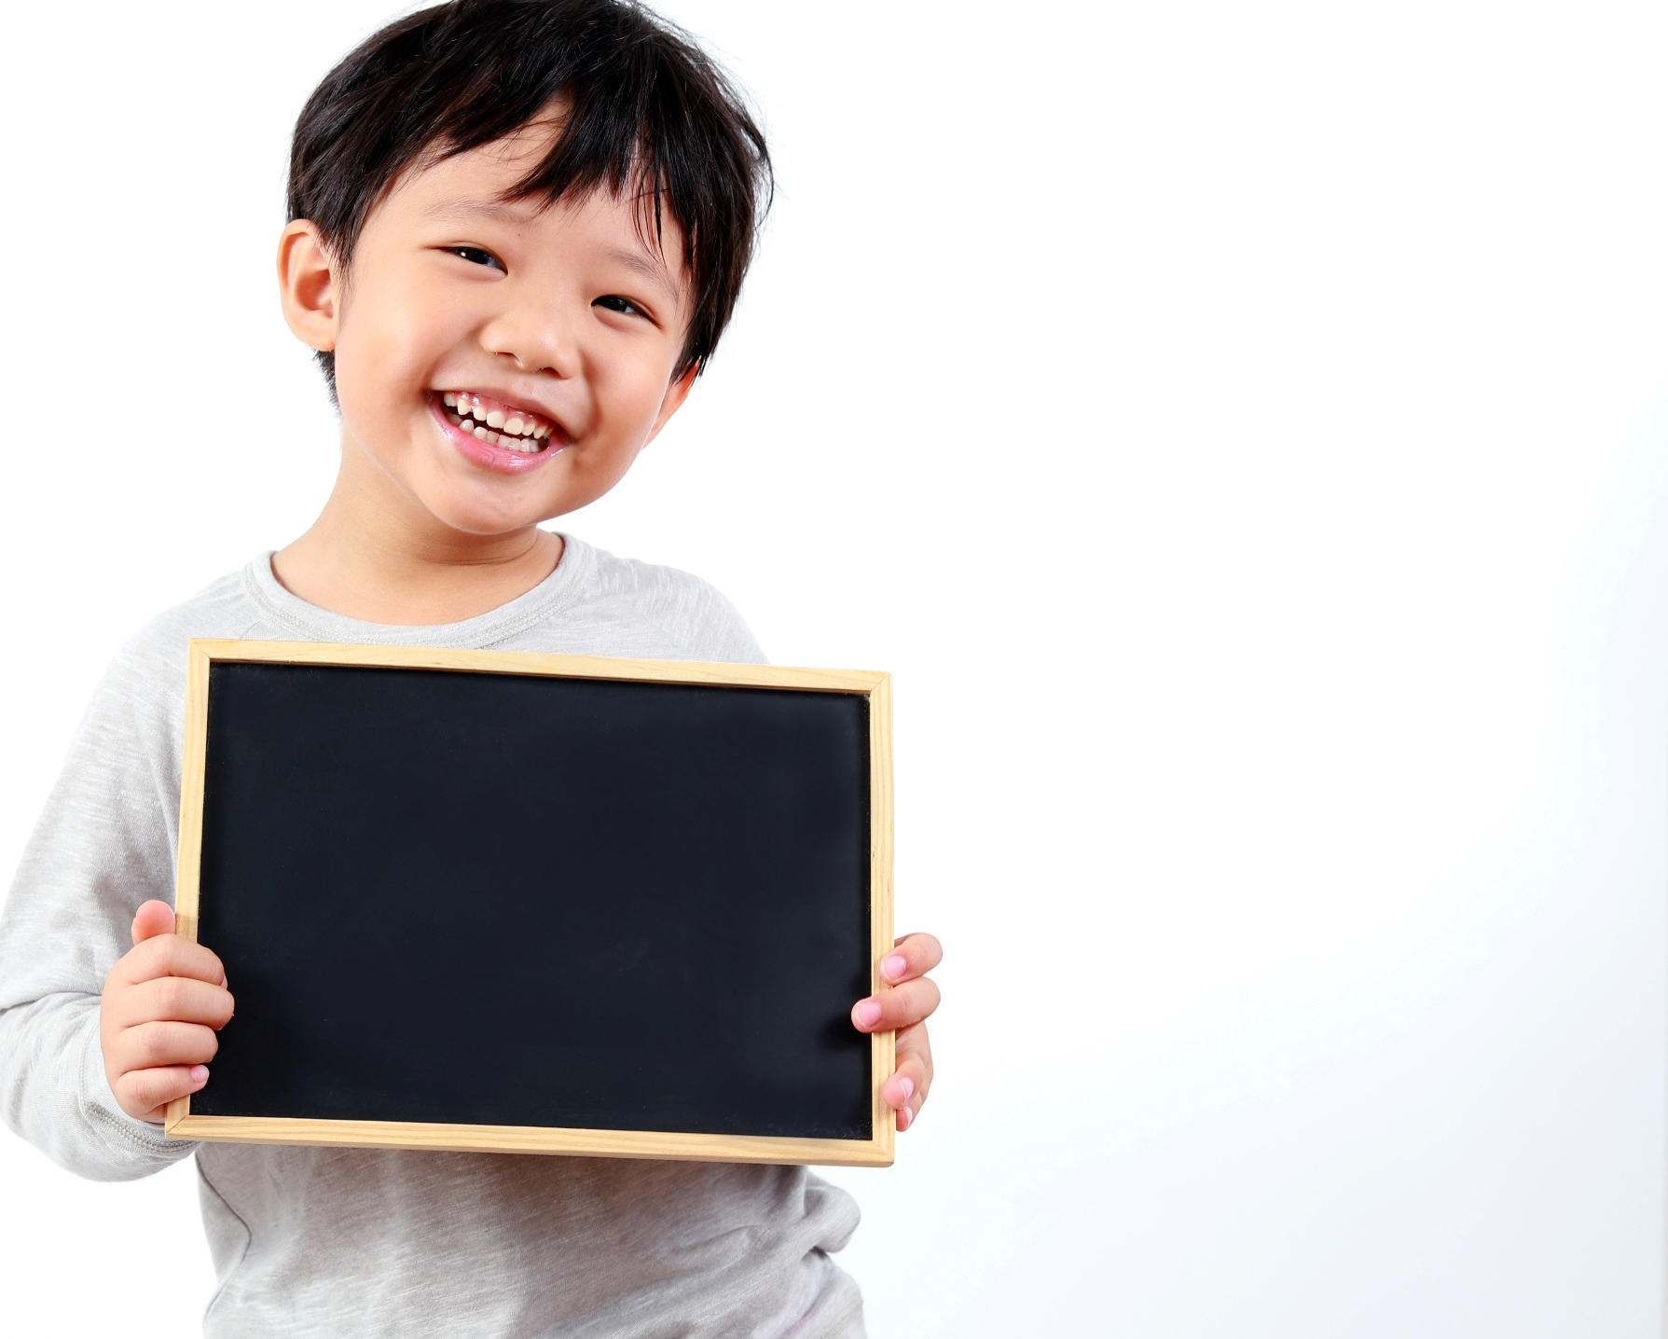
Practice

Slide 38


Slide 39

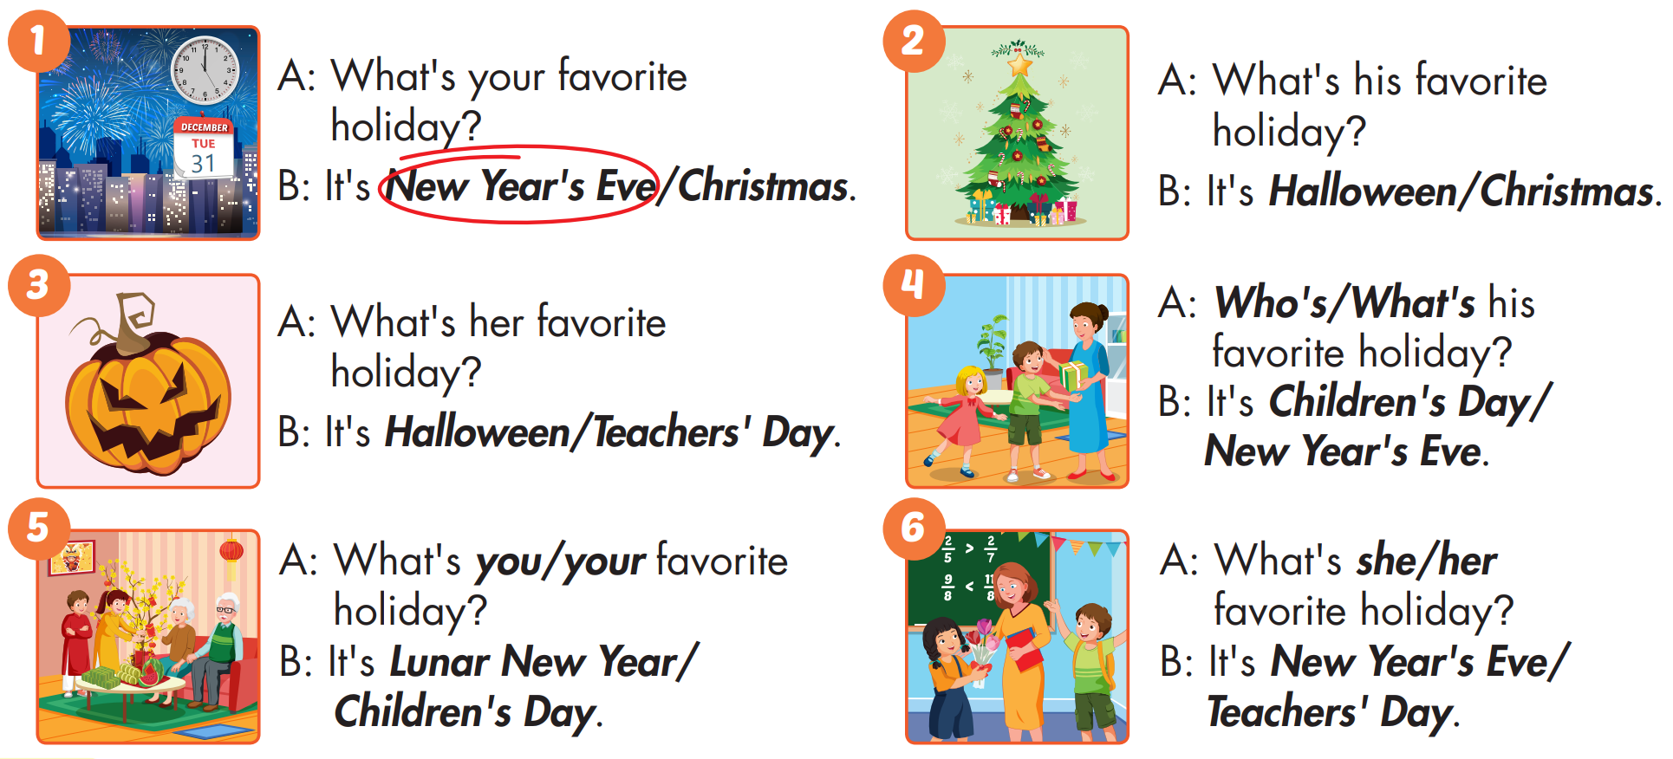


Slide 40

Production

Slide 41

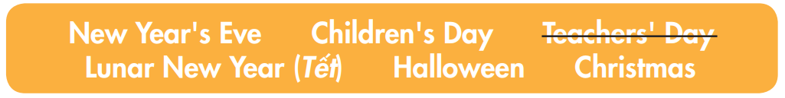
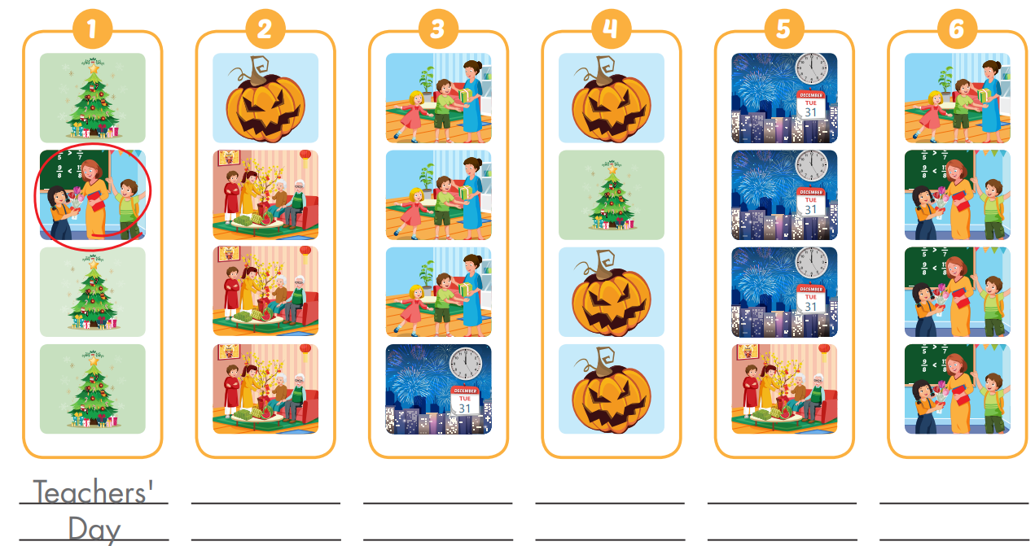
Extra Practice
WB, page 12

Slide 42

CONSOLIDATION

Slide 43

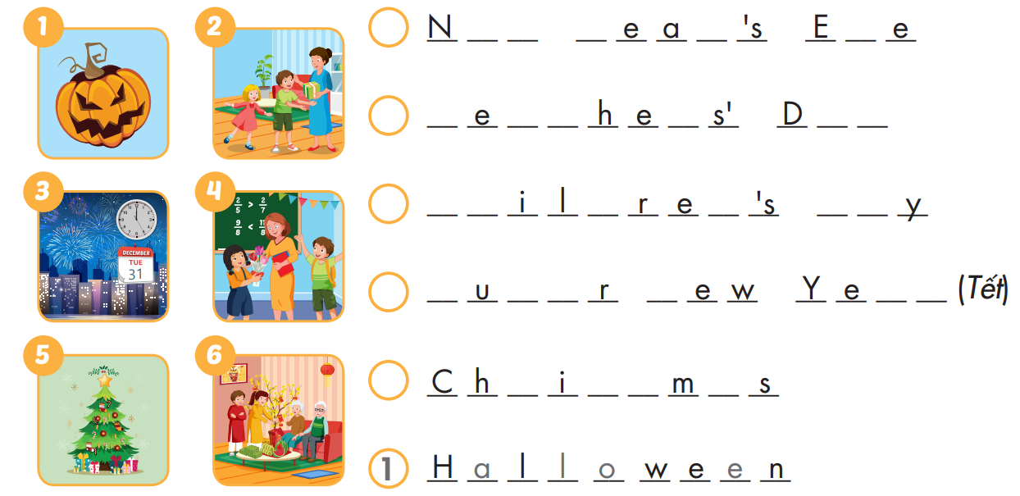
Extra Practice
WB, page 12
3
e
w
Y
r
v
2
T
a
c
r
a
y
2
C
h
d
n
D
a
6
L
n
a
N
a
r
5
r
s
t
a

Slide 44
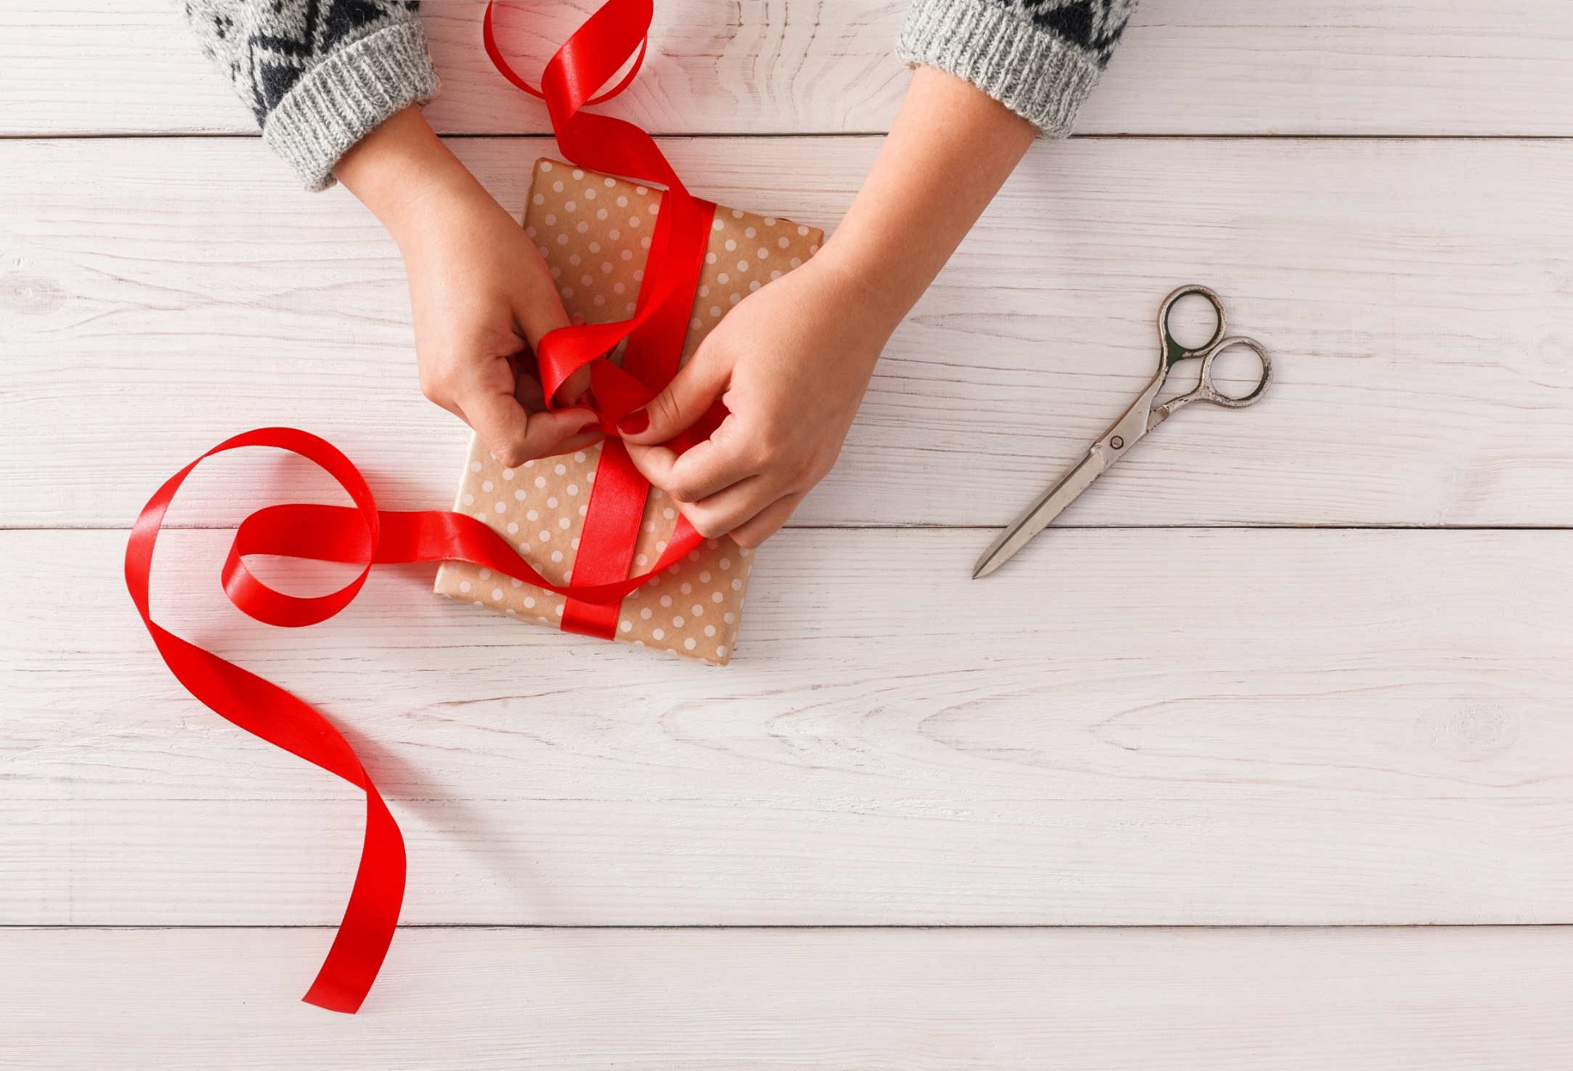
WRAP-UP

Slide 45
Today’s lesson
Vocabularies
Halloween, NewYear's Eve, Lunar New Year (Tết), Christmas, Teachers' Day,
Children's Day
Structures/ Sentence patterns
What's your favorite holiday?
- It's Halloween.
What's her favorite holiday?
- It's Christmas.

Slide 46
Homework
Practice the vocabularies and structure, and make sentences using them.
Do the exercises in Tiếng Anh 5 i-Learn Smart Start WB (page 12)
Do the exercises in Tiếng Anh 5 i-Learn Smart Start Notebook (page 10)
Prepare the next lesson (page 21 SB)
Play the consolidation games in Tiếng Anh 5 i-Learn Smart Start DHA App on www.eduhome.com.vn

Slide 47

Enjoy your day!

Slide 48

Lesson 3
Stay positive and have a nice day!

