Slide 1

Unit 2
WHAT I CAN DO
LESSON 1.1 - PAGE 20

Slide 2
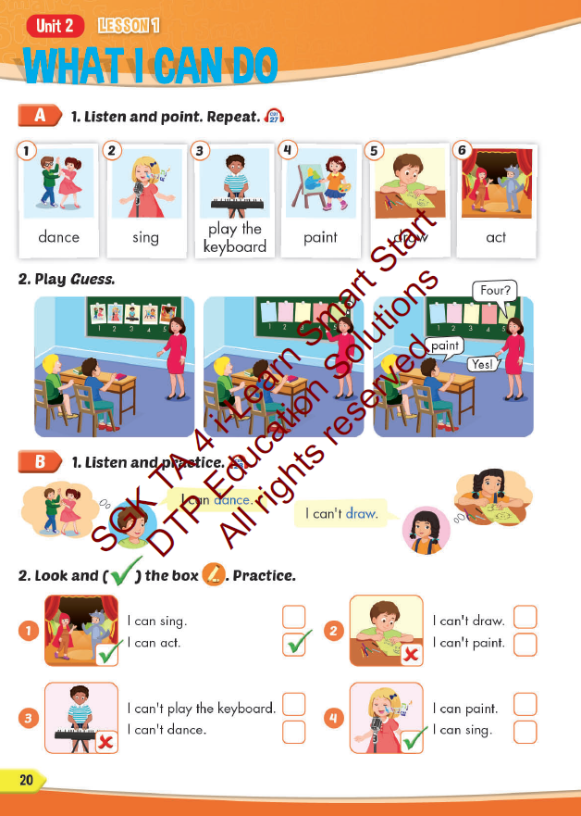
Lesson Outline
Warm-up
Vocabulary
Structure
Consolidation
Wrap-up

Slide 3
Objectives
By the end of this lesson, students will be able to talk about things they can and can't do.
Vocabulary: dance, sing, play the keyboard, paint, draw, act
Structure: I can dance.
I can't draw.

Slide 4

WARM UP

Slide 5

4 things
1 animal

Slide 6

It’s gray.
It’s big.
It has 4 legs.
It has a tail.
e
l
e
p
h
a
n
t

Slide 7
It’s small.
It has 2 legs.
It has feather.
It has 2 wings.
b
i
r
d

Slide 8
It’s tall.
It has 4 legs.
It has a long neck.
It has a tail.
g
i
r
a
f
f
e

Slide 9

It’s time to learn …

Slide 10
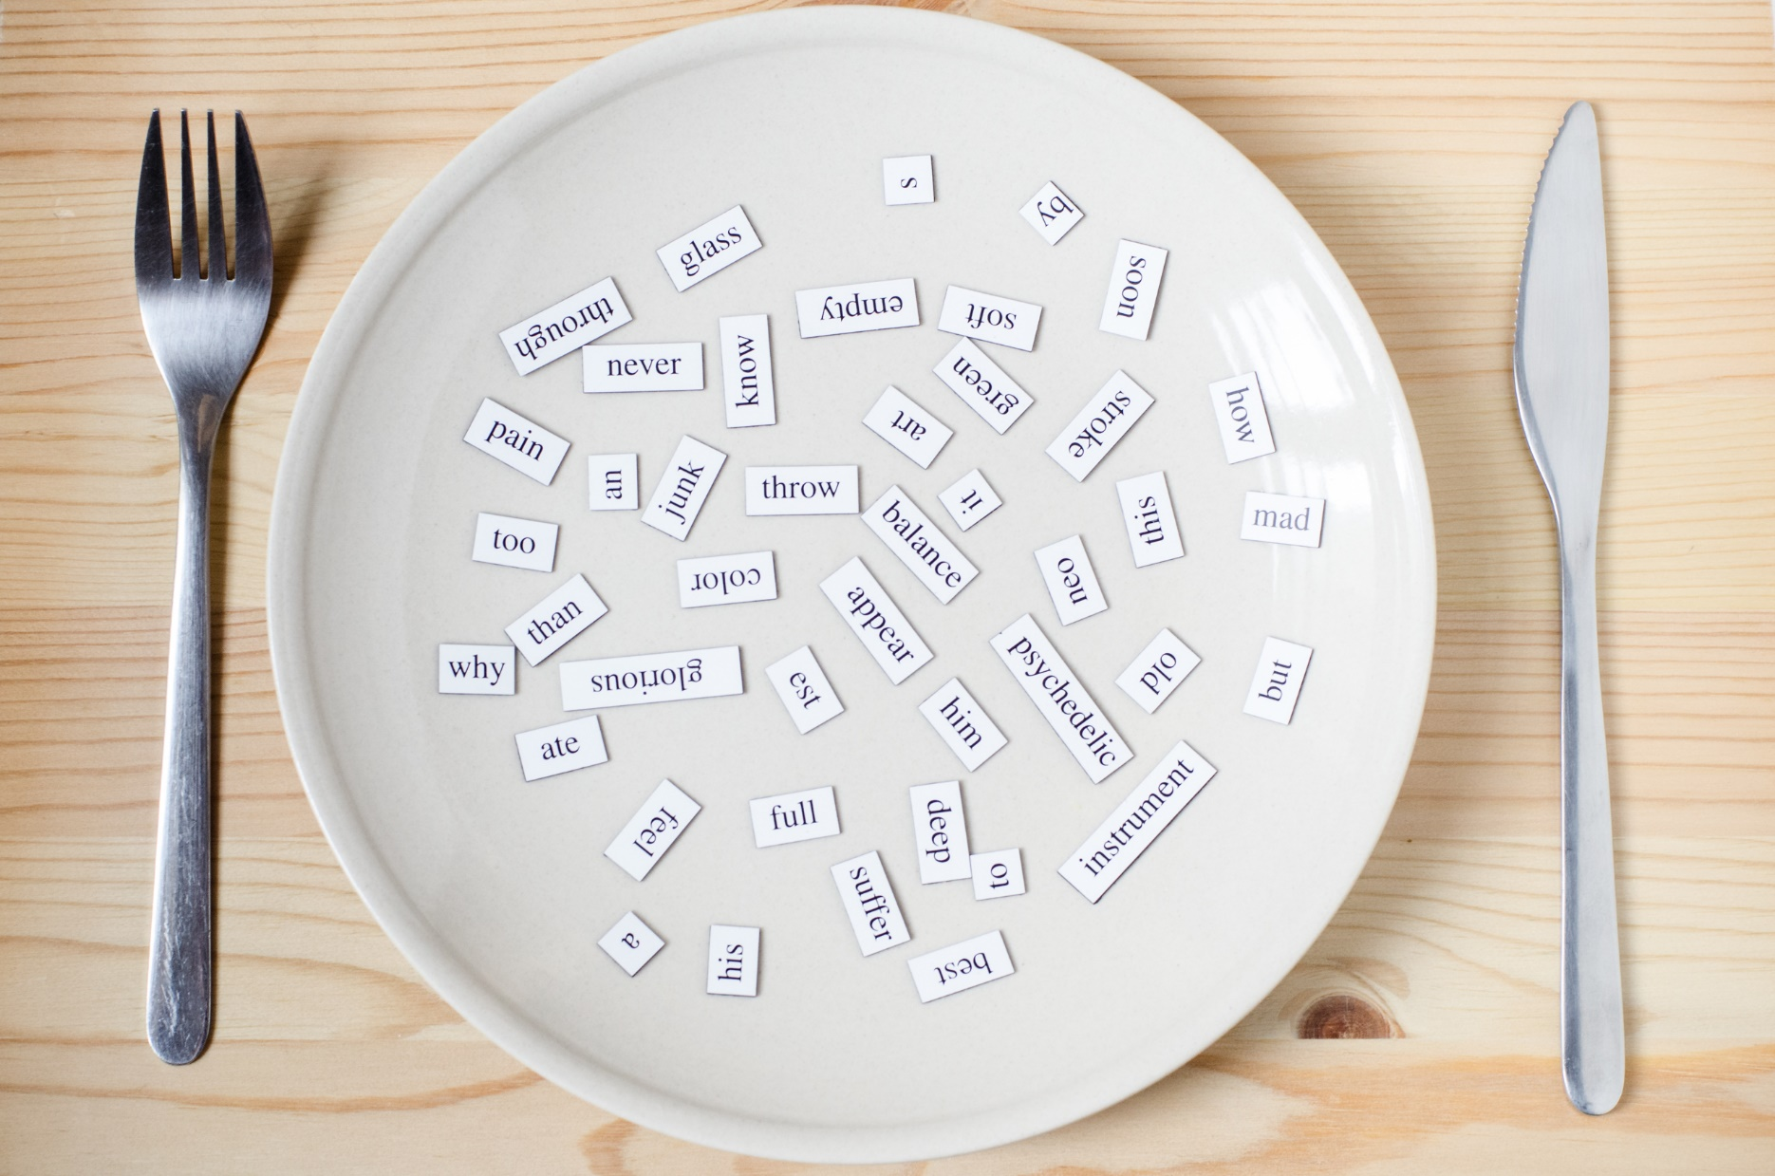
New words
dance,
sing,
play the keyboard, paint,
draw,
act

Slide 11

Presentation

Slide 12


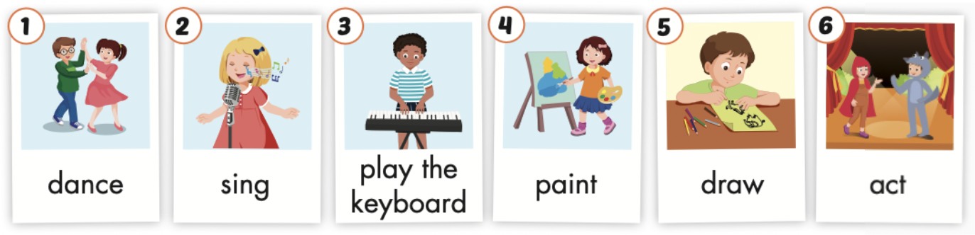
Click the icon to hear the sound.

Slide 13
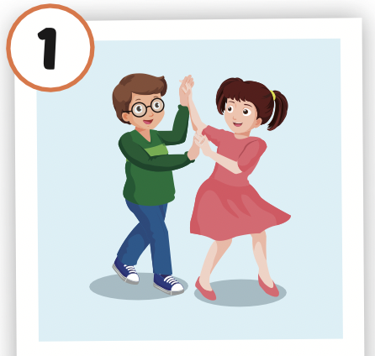
Click the picture to hear the sound.
dance
/ˈdæns/
nhảy múa

Slide 14
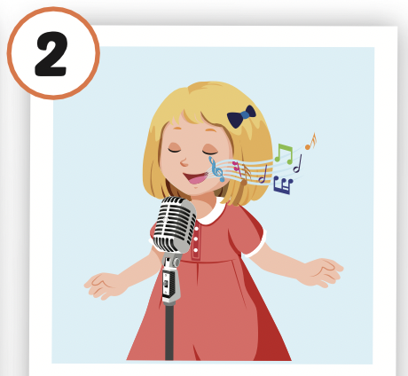
Click the picture to hear the sound.
sing
/sɪŋ/
hát

Slide 15
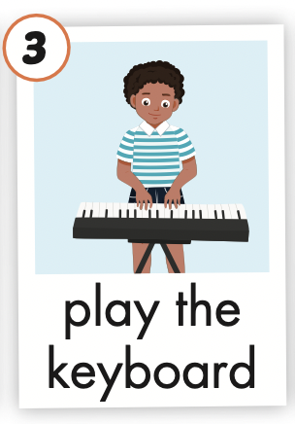
Click the picture to hear the sound.
play the keyboard
/pleɪ ðə ˈkiːbɔːrd/
chơi đàn phím

Slide 16

Click the picture to hear the sound.
paint
/peɪnt/
vẽ, sơn

Slide 17
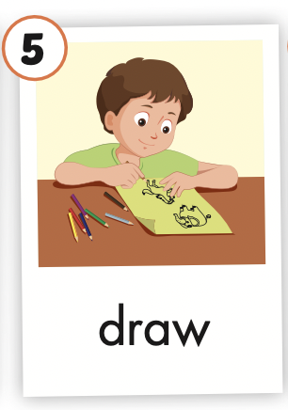
Click the picture to hear the sound.
draw
/drɑː/
vẽ

Slide 18
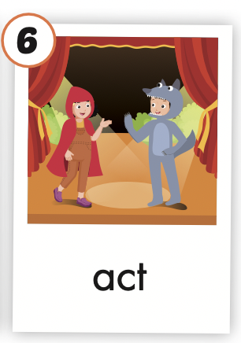
Click the picture to hear the sound.
act
/ækt/
diễn xuất

Slide 19

Practice

Slide 20



LISTEN AND CHOOSE

Slide 22
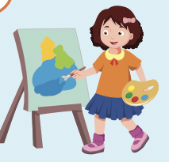

Slide 25

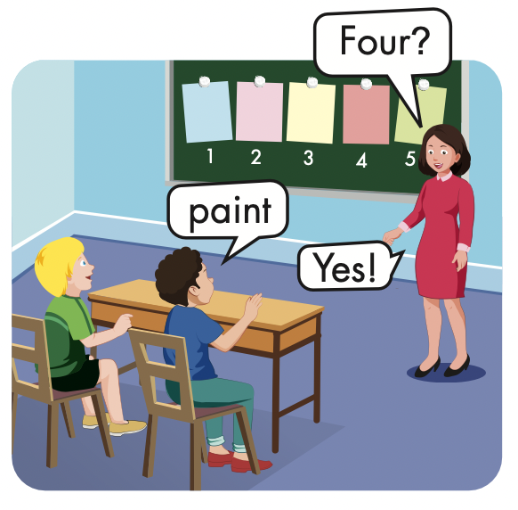
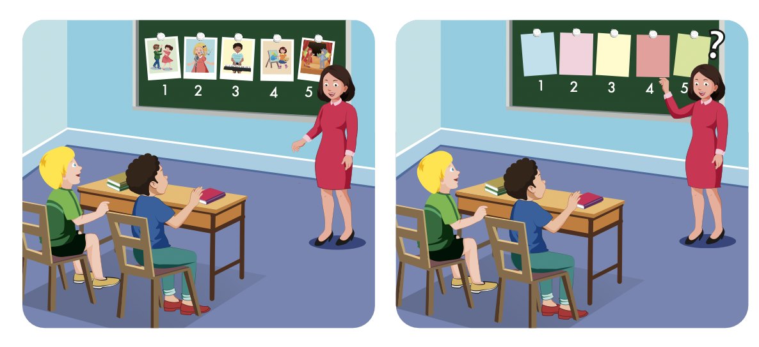

Slide 26
Structures
I can dance.
I can't draw.

Slide 27
Presentation

Slide 28

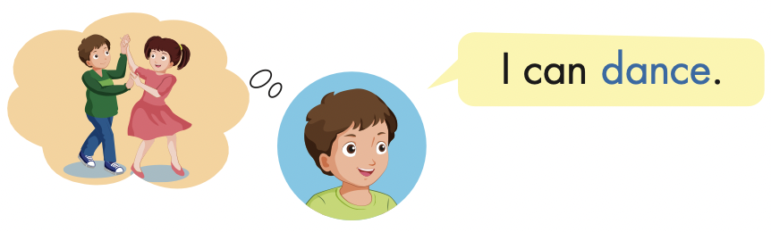
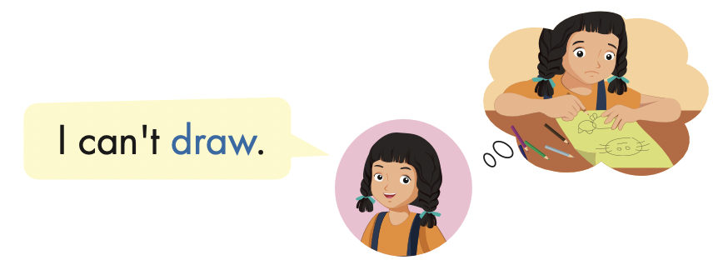

Slide 29
Practice

Slide 30
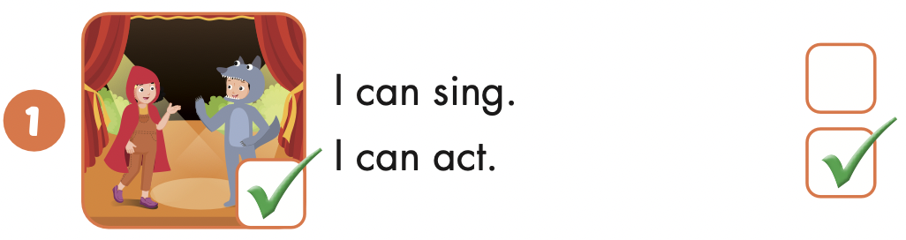
I can act.

Slide 31
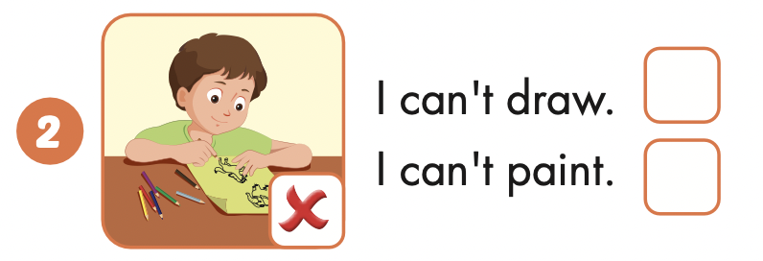
I can’t draw.

Slide 32
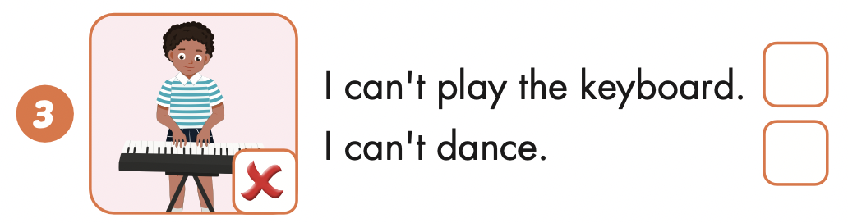
I can’t play the keyboard.

Slide 33
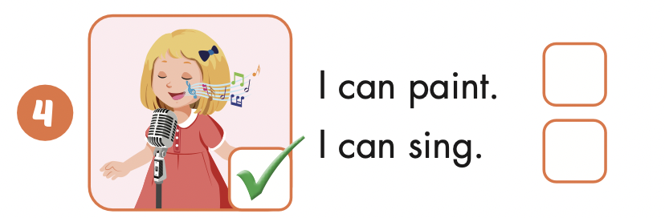
I can sing.

Slide 34

Writing

Slide 35


Slide 36


Slide 39

Production

Slide 40
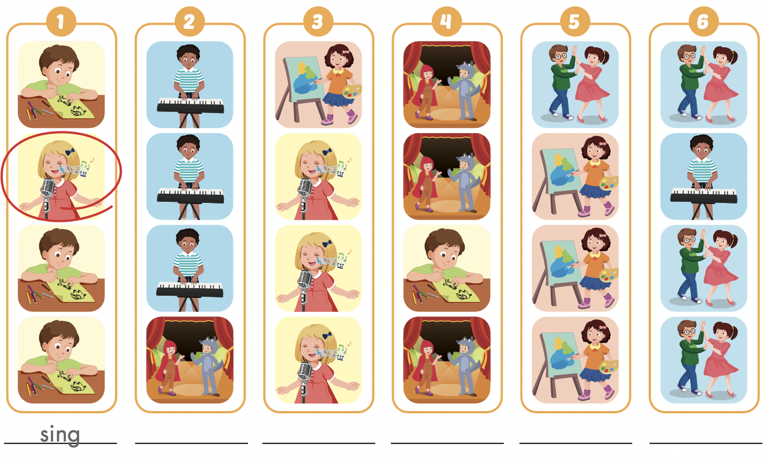

Extra Practice
WB, page 12
act
paint
draw
dance
play the keyboard

Slide 41

CONSOLIDATION

Slide 42
LET’S PLAY!
WHAT’S MISSING?

Slide 49

WRAP-UP

Slide 50
Today’s lesson
Vocabularies
dance,
sing,
play the keyboard, paint,
draw,
act
Structures/ Sentence patterns
I can dance.
I can't draw.

Slide 51
Homework
Practice the vocabularies and structure; and make sentences using them.
Do the exercises in Tiếng Anh 4 i-Learn Smart Start WB (page 12)
Do the exercises in Tiếng Anh 4 i-Learn Smart Start Notebook (page 10)
Prepare the next lesson (page 21 SB)
Play the consolidation games in Tiếng Anh 4 i-Learn Smart Start DHA App on www.eduhome.com.vn

Slide 52

Enjoy your day!

