Slide 1

Unit 1: Animals
Lesson 4.1 Science
Page 15

Slide 2
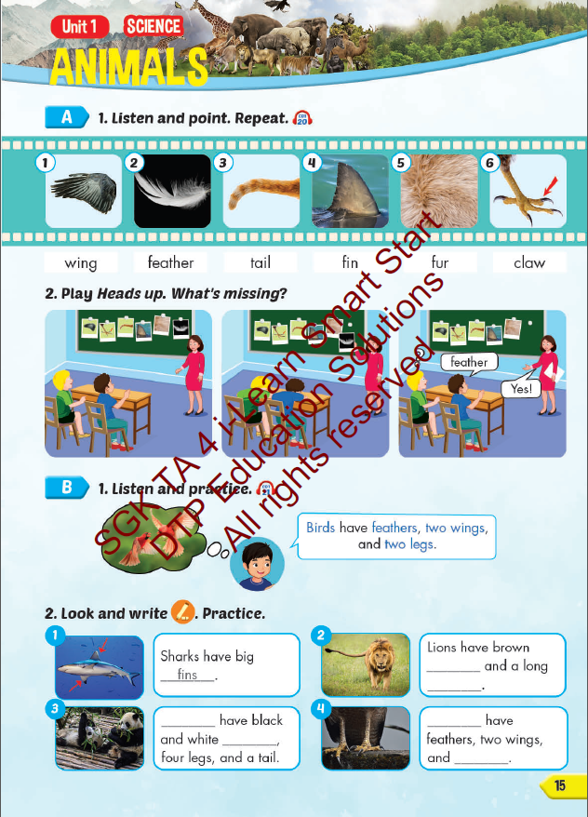
Lesson Outline
Warm-up
Vocabulary
Structure
Consolidation
Wrap-up

Slide 3
Objectives
By the end of this lesson, students will be able to…
Vocabulary: Pronounce and use the words related to the topic properly: wing, feather, tail, fin, fur, claw.
Structure: Birds have feathers, two wings, and two legs.

Slide 4
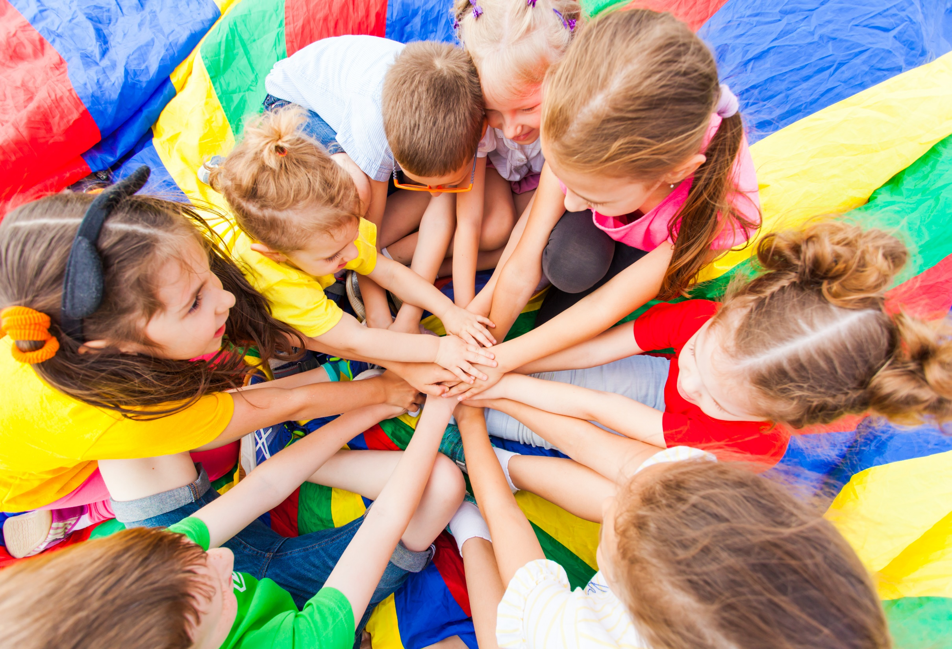
WARM UP

Slide 5

Whisper...
Try to convey the message to your friends as fast as possible!

Slide 6

It’s time to learn …

Slide 7
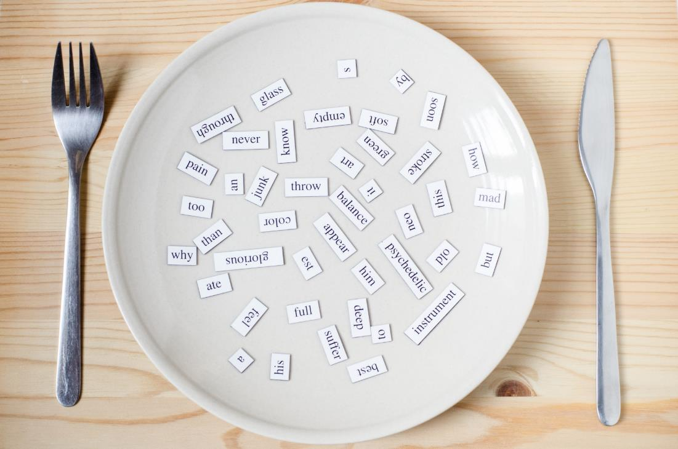
New words
wing, feather, tail,
fin, fur, claw

Slide 8

Presentation

Slide 9


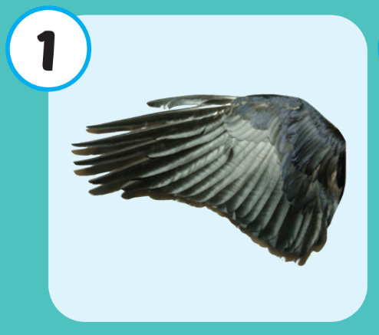
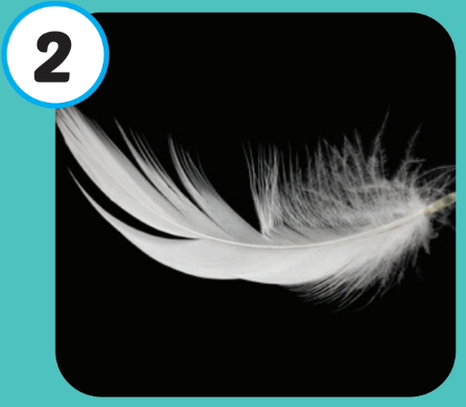
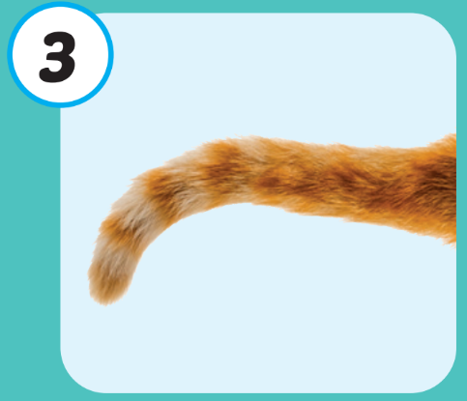
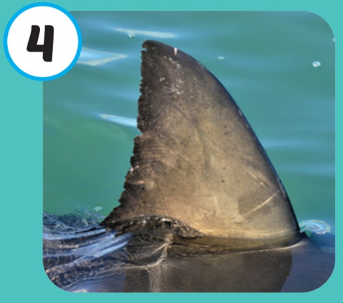
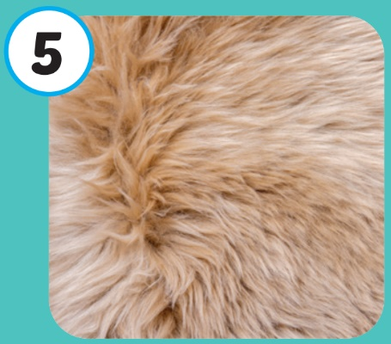
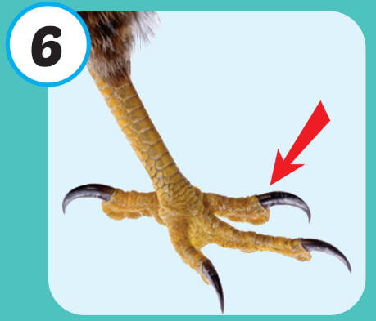



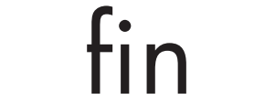


Click on each picture to hear the sound.
/klɑː/
móng vuốt
/wɪŋ/
cánh
/ˈfeðər/
lông vũ
/teɪl/
cái đuôi
/fɪn/
vây cá
/fɜːr/
lông (thú)
/klɑː/
móng vuốt
Notes:
Click vào hình A. 1. Listen and point. Repeat để cho cả audio full chạy

Slide 10
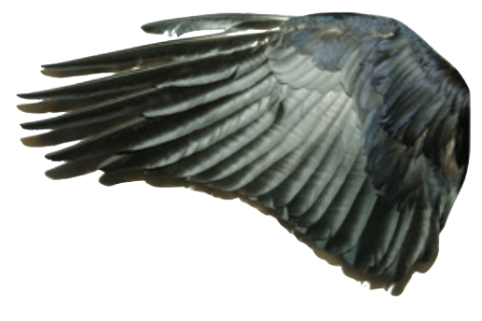
Click on each picture to hear the sound.
/wɪŋ/
cánh

Slide 11
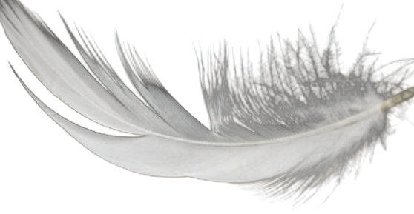
Click on each picture to hear the sound.
/ˈfeðər/
lông vũ

Slide 12
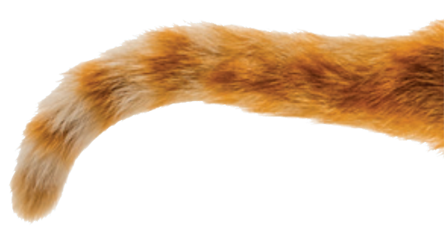
Click on each picture to hear the sound.
/teɪl/
cái đuôi
Notes:
Click vào hình A. 1. Listen and point. Repeat để cho cả audio full chạy

Slide 13
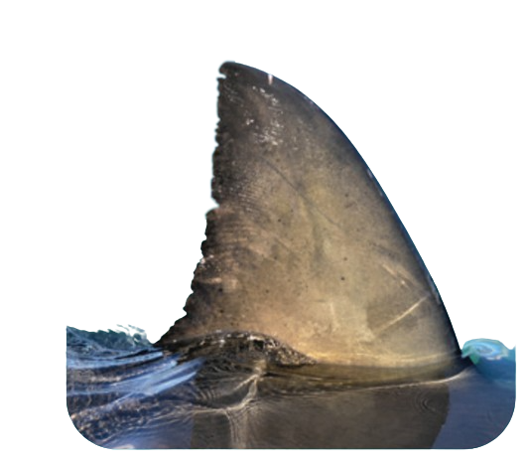
Click on each picture to hear the sound.
/fɪn/
vây cá
Notes:
Click vào hình A. 1. Listen and point. Repeat để cho cả audio full chạy

Slide 14
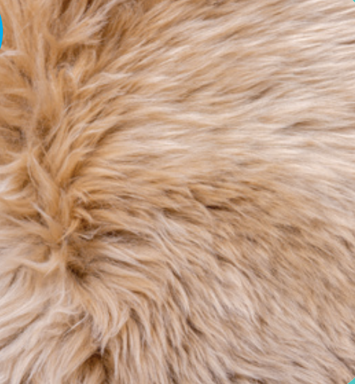
Click on each picture to hear the sound.
/fɜːr/
lông (thú)

Slide 15
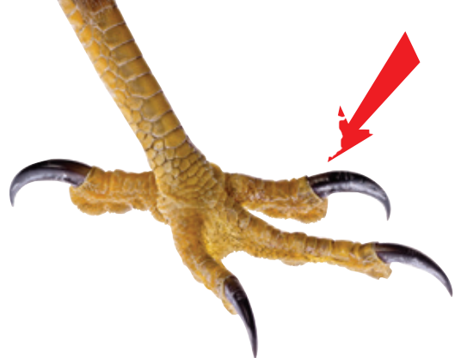
Click on each picture to hear the sound.
/klɑː/
móng vuốt

Slide 16
Practice

Slide 17
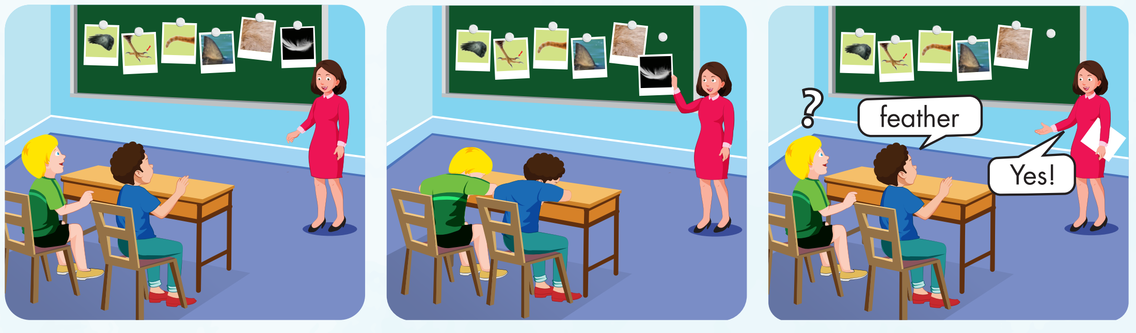

Slide 18
Check your memory

Slide 19
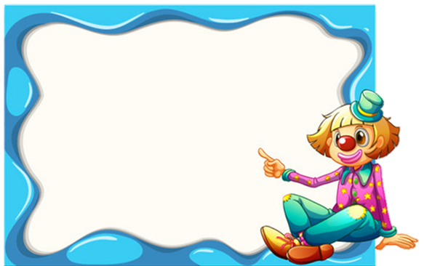





Find the best picture
Next
TAIL

Slide 20

Find the best picture
Next
WING

Slide 21
Find the best picture
Next
FIN

Slide 22
Find the best picture
DTP education
Next
FEATHER

Slide 23
Structure
Birds have feathers,
two wings, and two legs.

Slide 24
Presentation

Slide 25
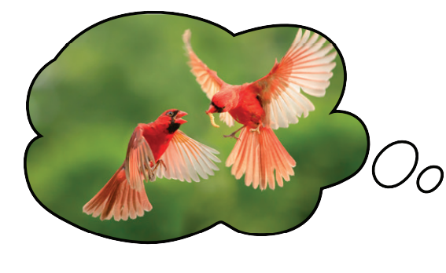
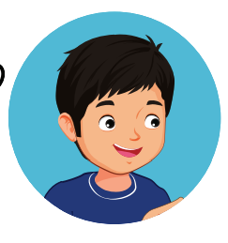
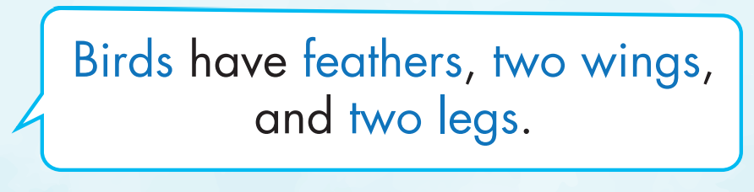
Structure

Slide 26

Practice

Slide 27
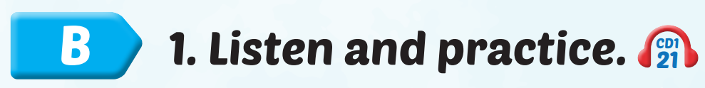

Slide 28
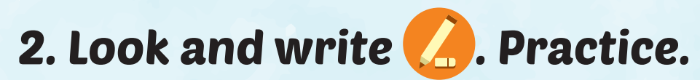
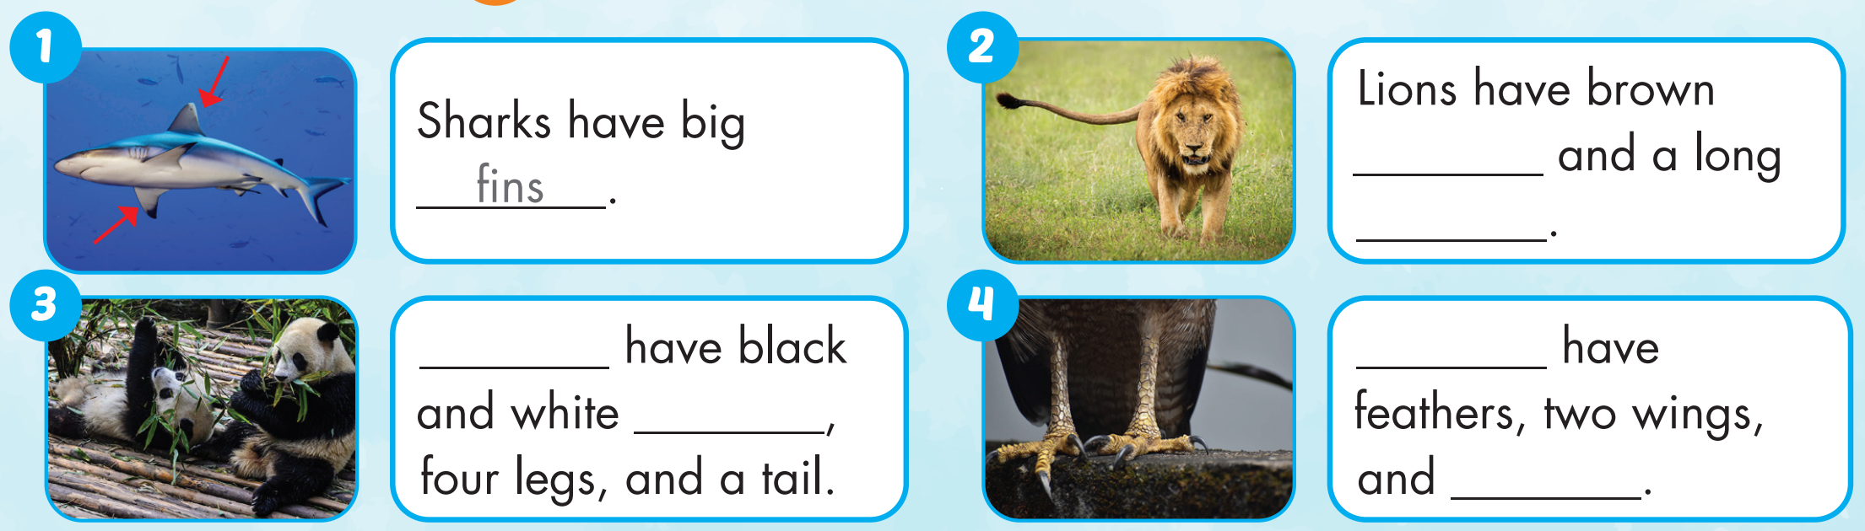
fur
tail
Pandas
Birds
fur
claws

Slide 29

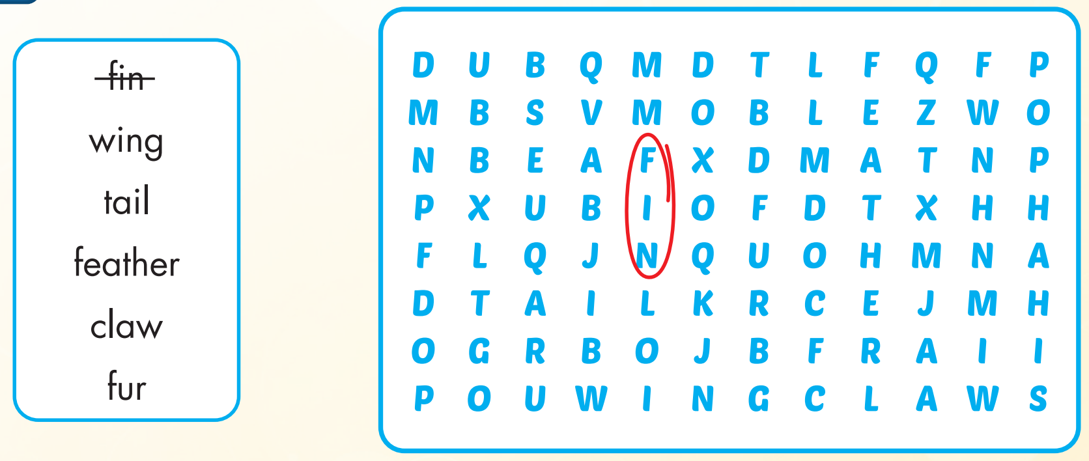

Extra Practice
WB, page 8

Slide 30
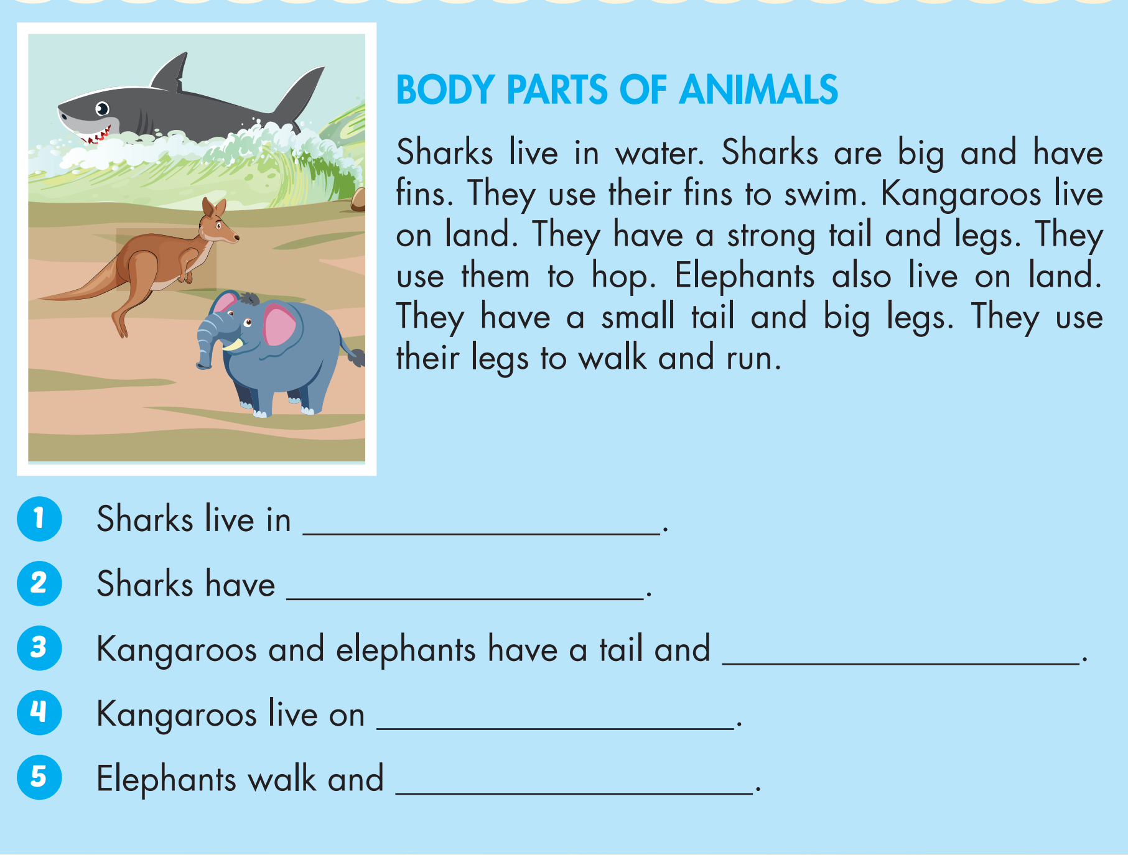

Extra Practice
WB, page 8

Slide 31

WRAP-UP

Slide 32
Today’s lesson
Vocabularies
wing, feather, tail, fin, fur, claw.
Structures/ Sentence patterns
Birds have feathers, two wings, and two legs.

Slide 33
Homework
Practice the vocabularies and structure; and make sentences using them.
Do the exercises in Tiếng Anh 4 i-Learn Smart Start WB (page 8)
Do the exercises in Tiếng Anh 4 i-Learn Smart Start Notebook (page 7)
Prepare the next lesson (page 16 SB)
Play the consolidation games in Tiếng Anh 4 i-Learn Smart Start DHA App on www.eduhome.com.vn

Slide 34

Enjoy your day!

