Slide 1

Unit 2: Holidays
Lesson 3.2
Page 27

Slide 2
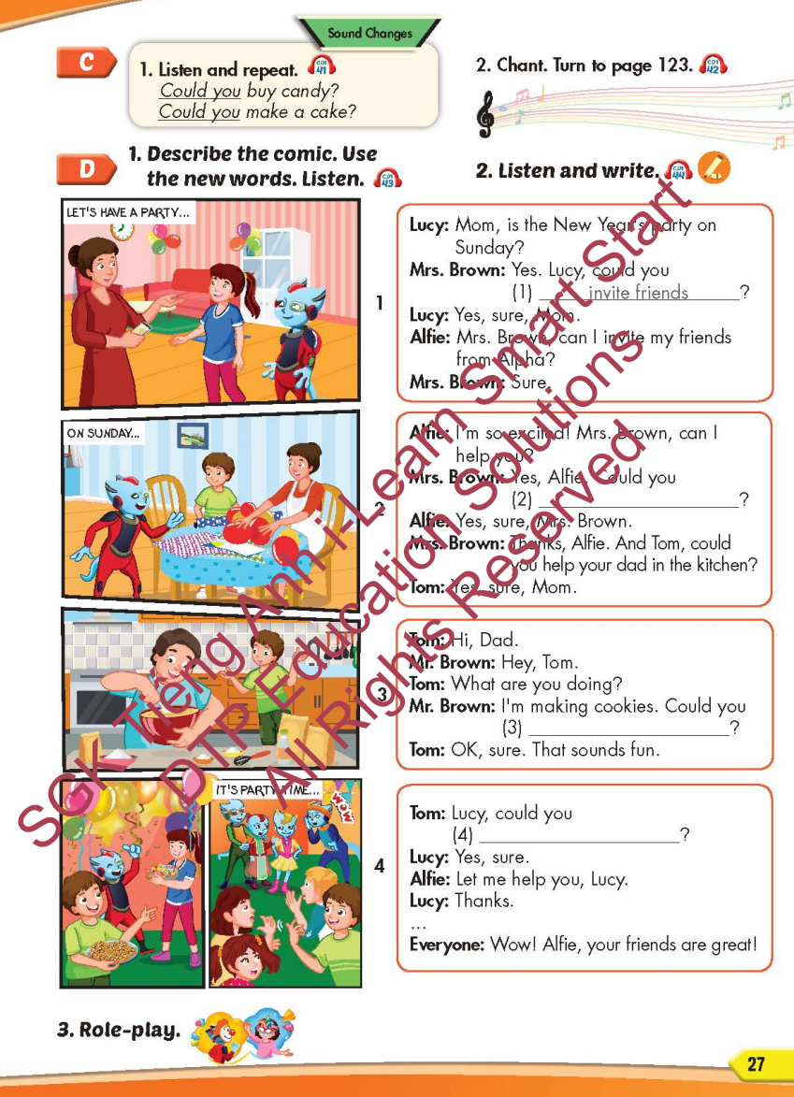
Lesson Outline
Warm-up
Listening
Consolidation
Wrap-up

Slide 3
Objectives
By the end of this lesson, students will be able to…
Sound change: Could you...?
Structure: Could you blow up the balloons? - Yes, sure.

Slide 4

WARM-UP

Slide 5


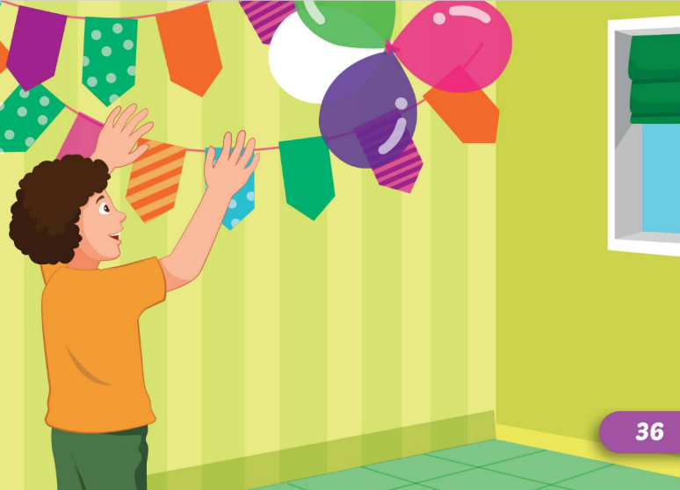

invite friends
put up colored
paper

Slide 6

invite friends
make a cake

Slide 7
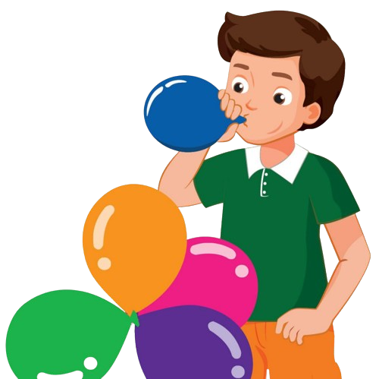
make a cake
blow-up the
balloons

Slide 8

buy candy
wrap the presents

Slide 9
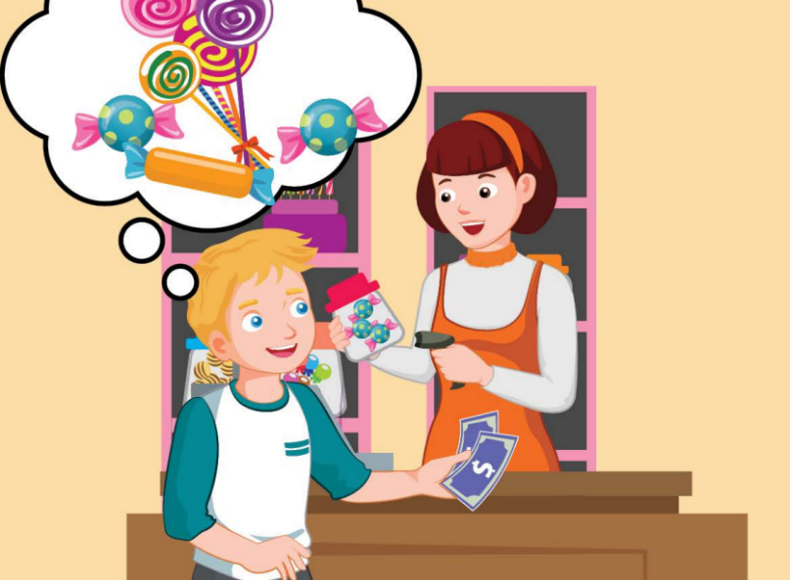
buy candy
make a cake

Slide 10
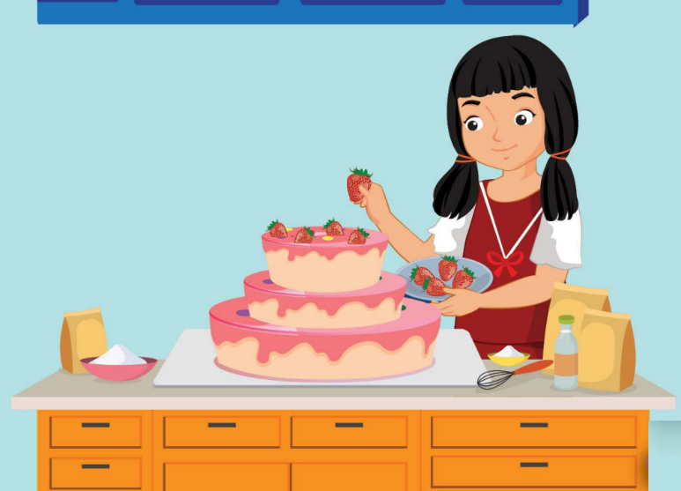
blow-up the
balloons
make a cake

Slide 11

It’s time to learn …

Slide 12

Sound change
Could you...?

Slide 13

Listening

Slide 14
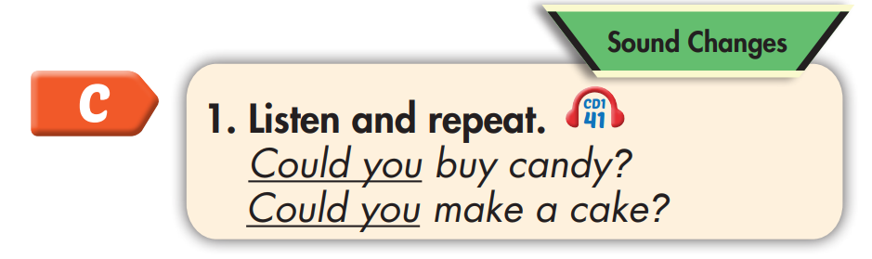

Could you buy candy?
Could you make a cake?

Slide 15
Practice

Slide 16



Slide 17
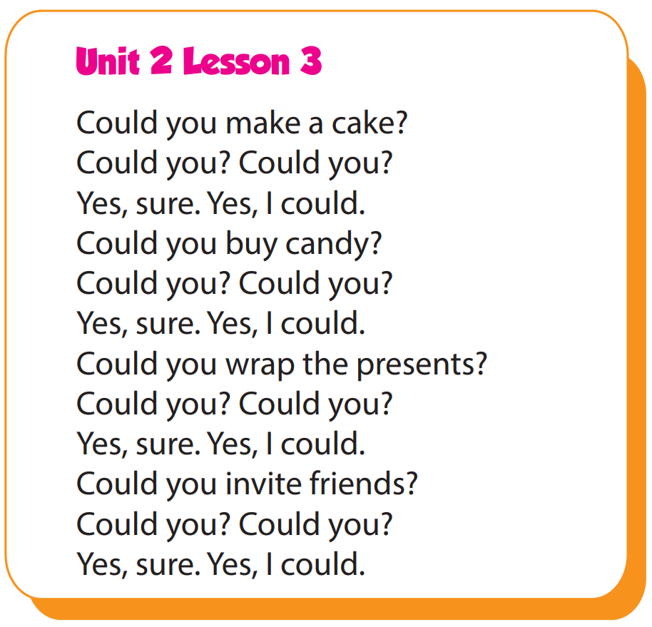

Slide 18
Structure
When's Christmas Day?
- It's on December twenty-fifth.

Slide 19

Speaking

Slide 20
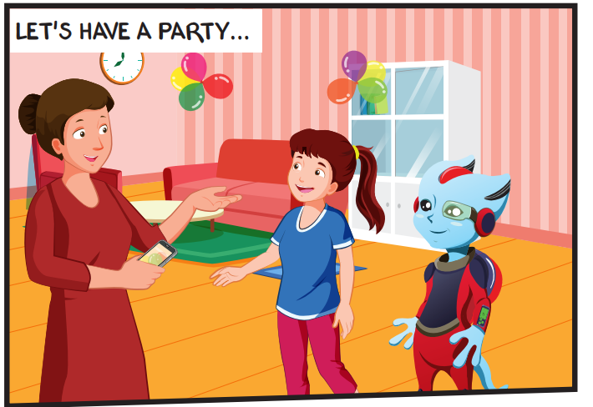
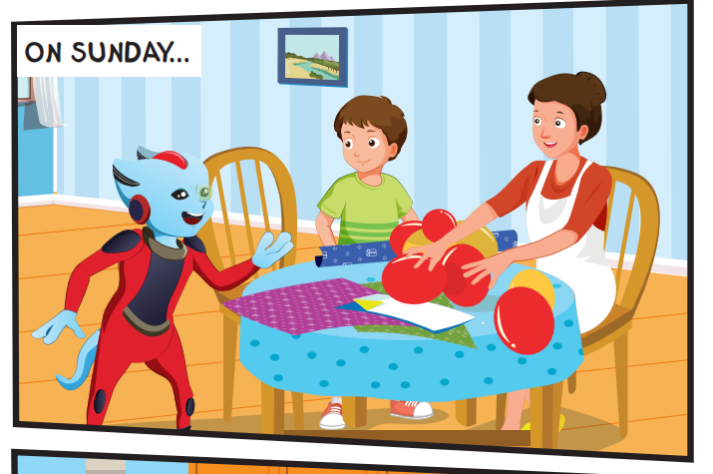
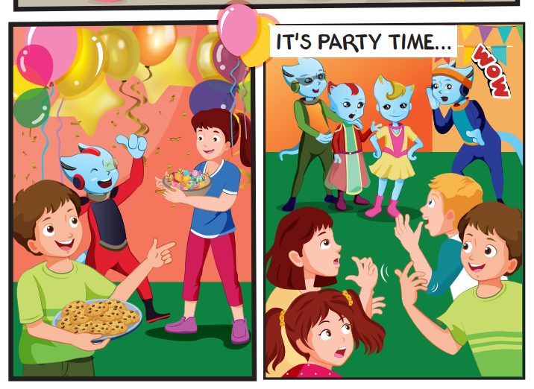
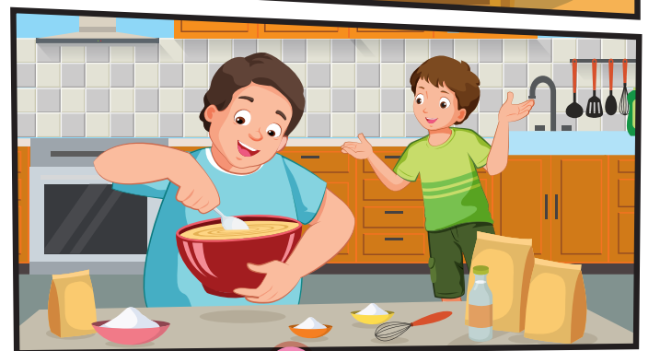
Who can you see?
Mr. and Mrs. Brown, Lucy, Tom, Alfie, their friends.

Slide 21
Where are they?
They're at home.

Slide 22
What are they doing?
They're having a party.

Slide 23

Listening

Slide 24


Slide 25

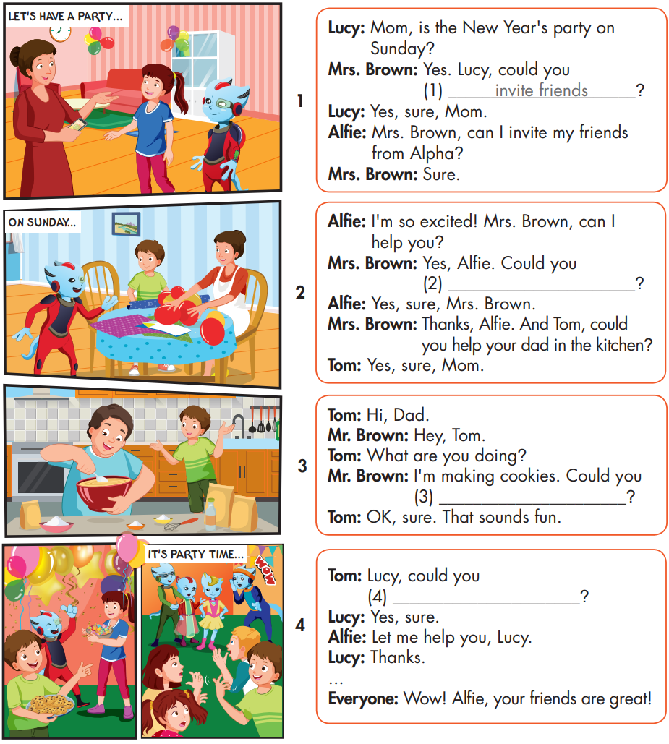

Slide 26
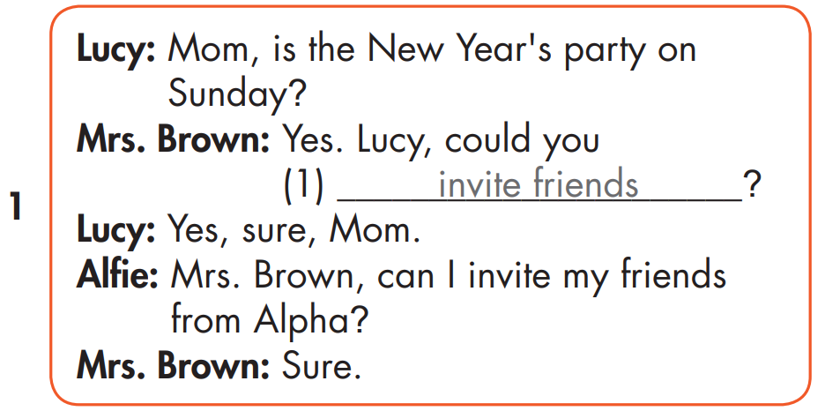

Slide 27
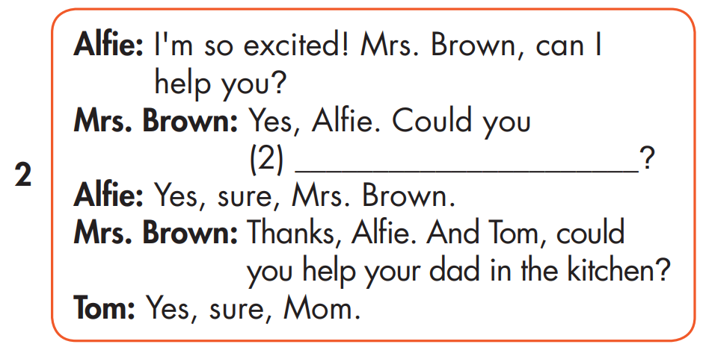
blow up the balloons

Slide 28
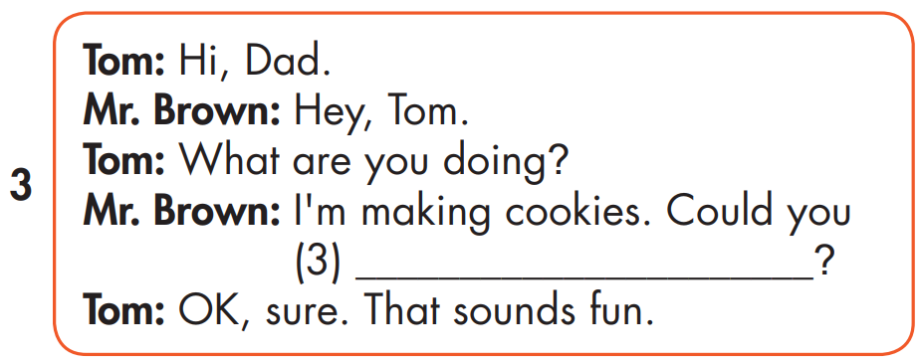
make a cake

Slide 29
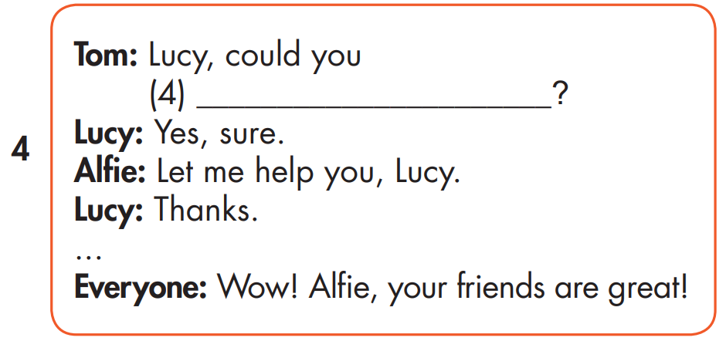
put up colored paper

Slide 30

Speaking

Slide 31



Slide 32

Writing

Slide 33
MAKE YOUR OWN STORY
blow up the balloons
put up colored paper
make a cake

Slide 34

Production

Slide 35
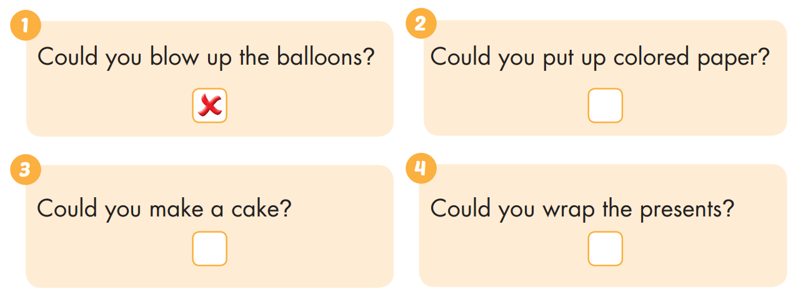


Extra Practice
WB, page 16

Slide 36

CONSOLIDATION

Slide 37

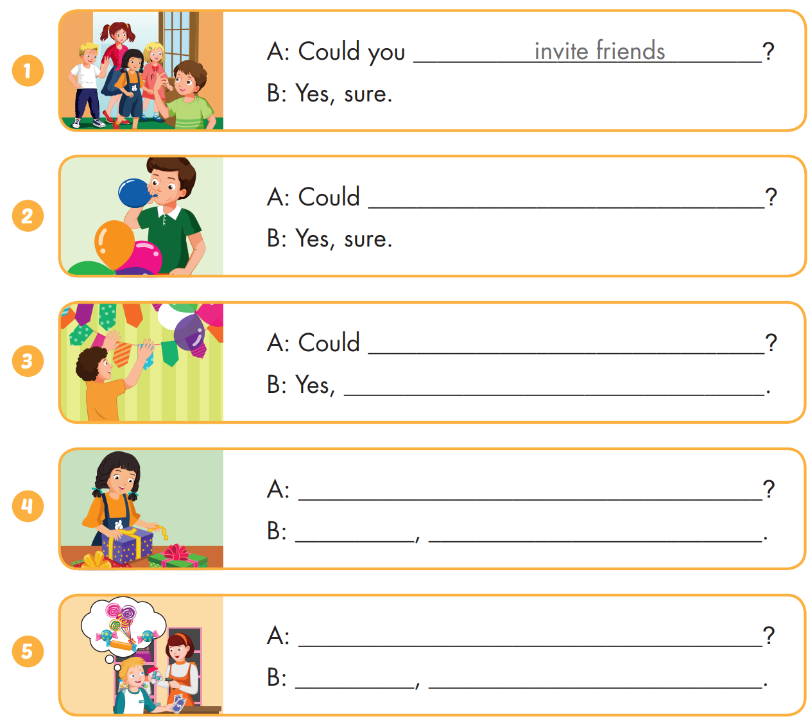
Extra Practice
WB, page 16

Slide 38
Extra Practice
WB, page 16
you blow up the balloons

Slide 39

Extra Practice
WB, page 16
you put up colored paper
sure
Could you wrap the presents
Yes sure
Could you buy candy
Yes sure

Slide 40

WRAP-UP

Slide 41
Today’s lesson
Structures/ Sentence patterns
Could you blow up the balloons? - Yes, sure.
Sound change
Could you...?

Slide 42
Homework
Practice the vocabularies and structure, and make sentences using them.
Do the exercises in Tiếng Anh 5 i-Learn Smart Start WB (page 15)
Do the exercises in Tiếng Anh 5 i-Learn Smart Start Notebook (page 12)
Prepare the next lesson (page 28 SB)
Play the consolidation games in Tiếng Anh 5 i-Learn Smart Start DHA App on www.eduhome.com.vn

Slide 43

Enjoy your day!

Slide 44
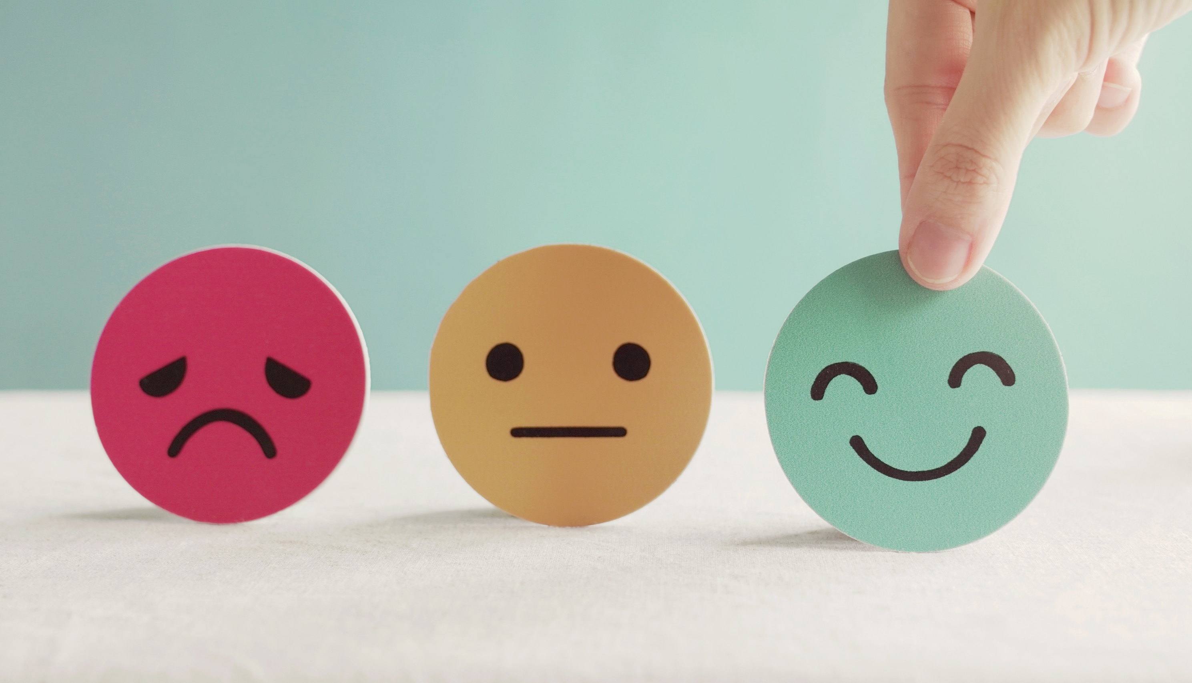
Lesson 3
Stay positive and have a nice day!

