Slide 1

Unit 2: Holidays
Lesson 2.3
Page 25

Slide 2
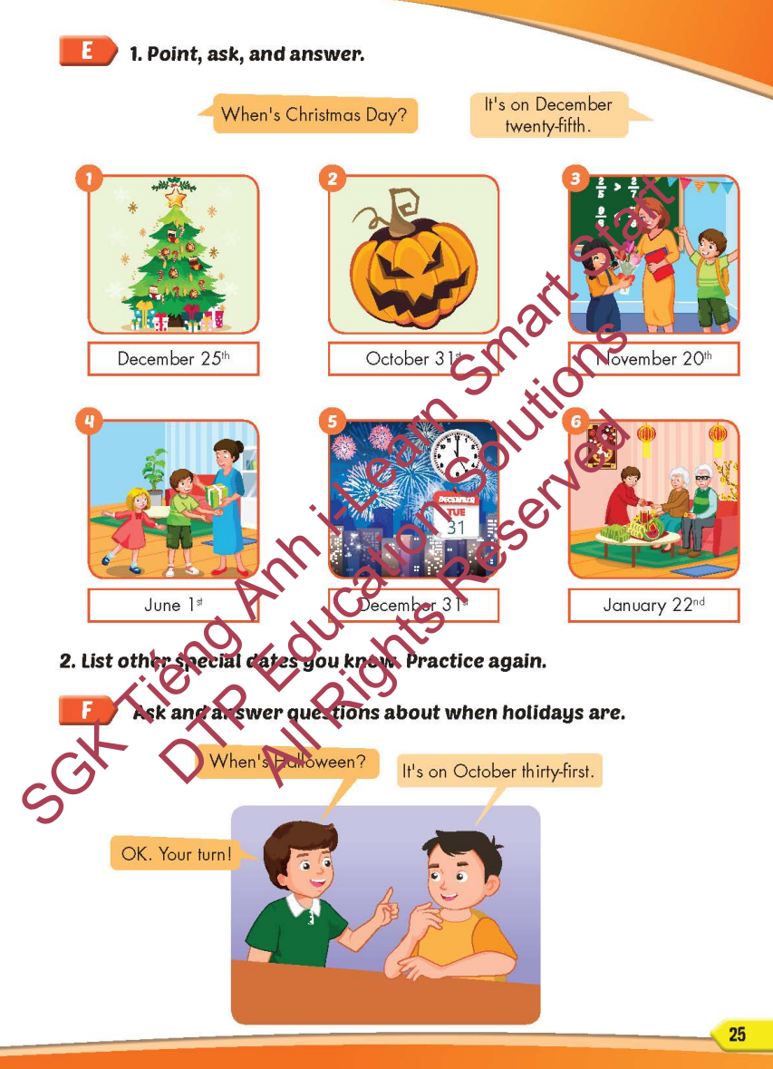
Lesson Outline
Warm-up
Practice
Speaking
Consolidation
Wrap-up

Slide 3
Objectives
By the end of this lesson, students will be able to…
Vocabulary: Pronounce and use the words related to the topic properly: first, second, third, fourth, fifth
Structure: ask and answer about dates, using
When's Christmas Day?
- It's on December twenty-fifth.

Slide 4

WARM-UP

Slide 5



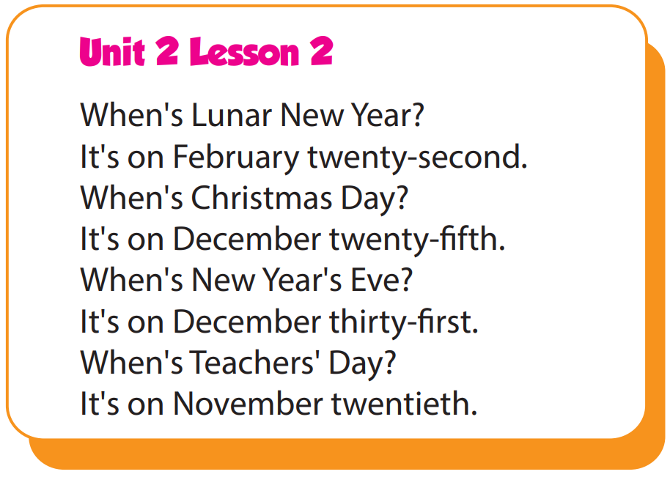

Slide 6

It’s time to learn …

Slide 7

Practice

Slide 8

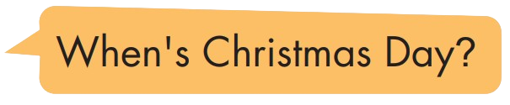
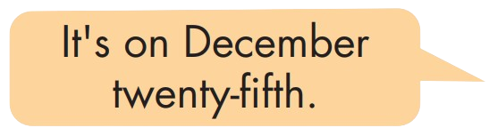
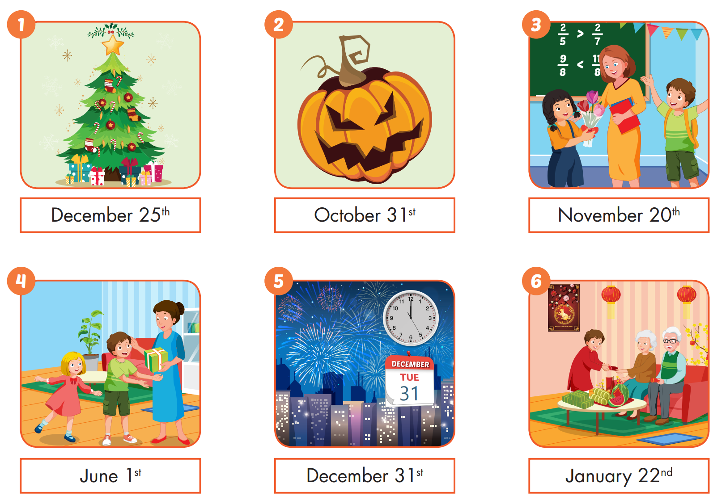

Slide 9

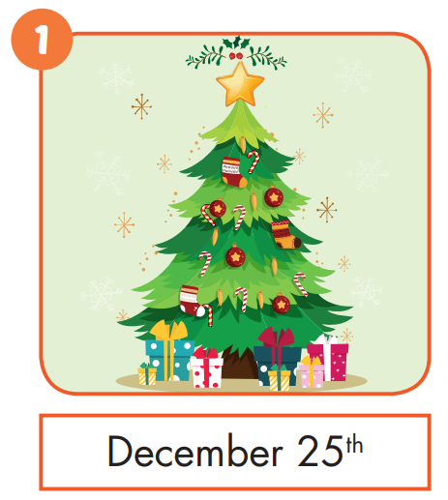
When's Christmas Day?
It's on December twenty-fifth.

Slide 10
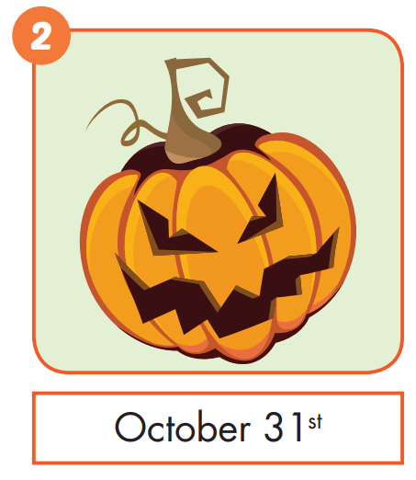
When's Halloween Day?
It's on October thirty-first.

Slide 11
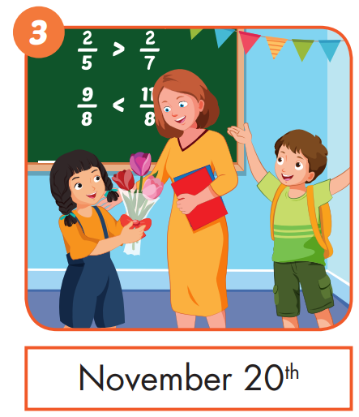
When's Teachers' Day?
It's on November twentieth.

Slide 12
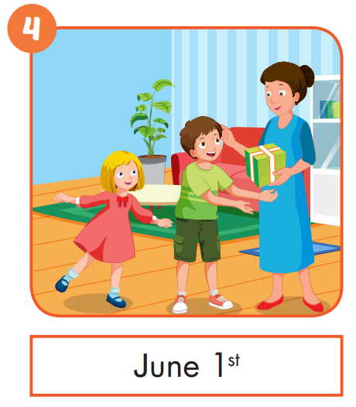
When's Children's Day?
It's on June first.

Slide 13
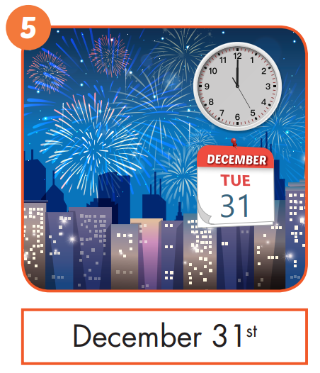
When's New Year's Eva?
It's on December thirty-first.

Slide 14
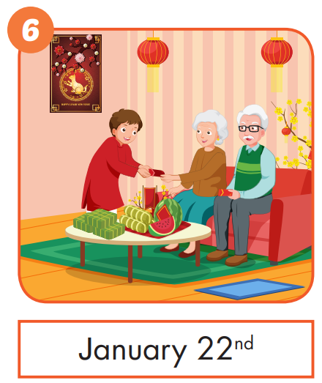
When's Lunar New Year?
It's on January twenty-second.

Slide 15



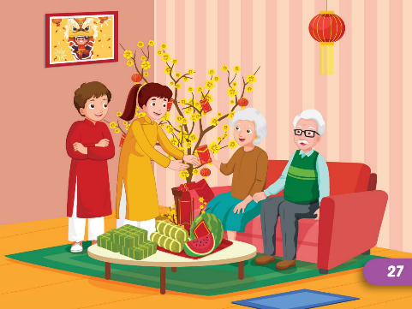


When's ........?
It's on .....

Slide 16

Production

Slide 17

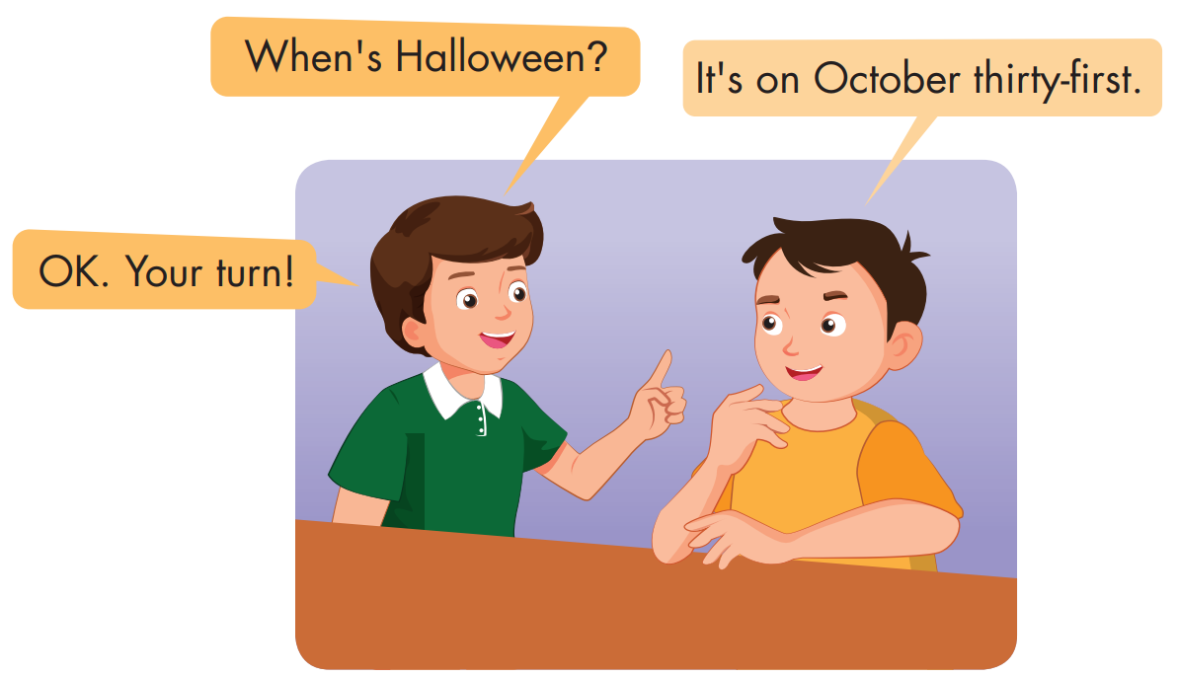


Slide 18

CONSOLIDATION

Slide 19








fifth
fourth
five

Slide 20

fouth
fourth
fiveth

Slide 21

second
third
first

Slide 22

second
fourth
fifth

Slide 23

fifth
third
first

Slide 24

WRAP-UP

Slide 25
Today’s lesson
Vocabularies
first, second, third, fourth, fifth
Structures/ Sentence patterns
When's Christmas Day?
- It's on December twenty-fifth.

Slide 26
Homework
Practice the vocabularies and structure, and make sentences using them.
Do the exercises in Tiếng Anh 5 i-Learn Smart Start WB (page 15)
Do the exercises in Tiếng Anh 5 i-Learn Smart Start Notebook (page 11)
Prepare the next lesson (page 26 SB)
Play the consolidation games in Tiếng Anh 5 i-Learn Smart Start DHA App on www.eduhome.com.vn

Slide 27

Enjoy your day!

Slide 28

Lesson 3
Stay positive and have a nice day!

