Slide 1

Unit 2: Family
Lesson 1.1
Page 24

Slide 2
Lesson Outline
Warm-up
Vocabulary
Structure
Consolidation
Wrap-up

Slide 3
Objectives
By the end of this lesson, students will be able to pronounce and use properly structures to introduce family members.
Vocabulary: Father, mother, brother, sister
Structure: This is my father.
Hello, I’m Alfie.
Hello, Alfie

Slide 4

WARM UP

Slide 5

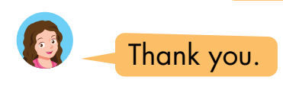
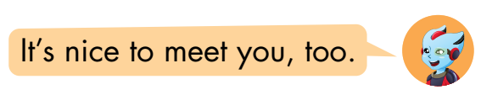
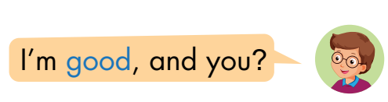
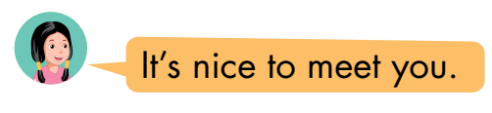

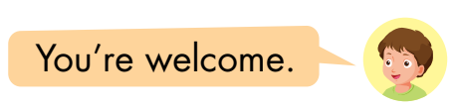
Look and read. Then listen and match.
1
a
2
b
3
c
Click here to listen
1
2
3
Click on squares 1,2,3 to show answers.
Notes:
click on square 1,2,3 to show answer. Let students practice in big groups then call some to stand up and practice together.

Slide 6

It’s time to learn …

Slide 7

New words
father
mother
brother
sister

Slide 8

Presentation

Slide 9


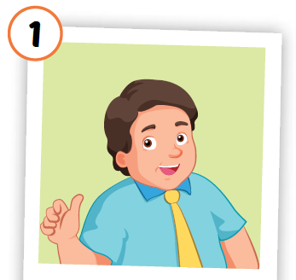
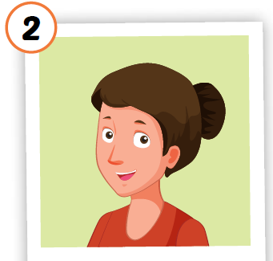
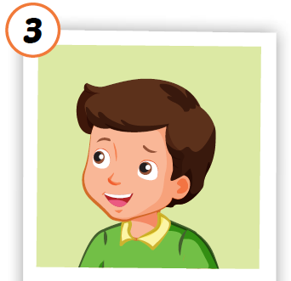
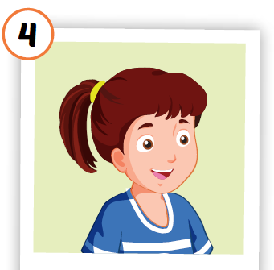
Click each English word to hear the sound.



father
mother
brother
sister




/ˈfɑːðər/
bố, ba
/ˈmʌðər/
mẹ

/ˈbrʌðər/
anh / em trai
/ˈsɪstər/
chị / em gái
Notes:
Click vào từ tiếng Anh để nghe phát âm của từ
Khai thác nghĩa bằng tranh, cuối cùng mới giải thích phiên âm và nghĩa bằng tiếng Việt

Slide 10

Practice

Slide 11











Activity 1
Look and read. Then listen and point to the right picture .
a
b
c
d
e
f
g
h
i
j
k
father
mother
brother
sister
Click on the animals to play audios.
Notes:
Click vào các con vật a-không để nghe âm thanh
HS có thể chọn bất kì con vật nào để nghe âm thanh của từ vựng

Slide 12




Activity 2
Look at the pictures and say the right number
2
3
1
4
father
mother
brother
sister
brother
mother
father
mother
sister
brother
father
sister
mother
brother
STOP
Notes:
GV ấn enter để chạy hiệu ứng, HS nói to số tranh có chứa từ tương ứng

Slide 13

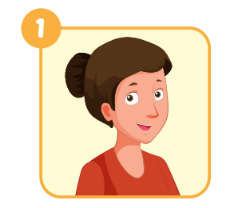
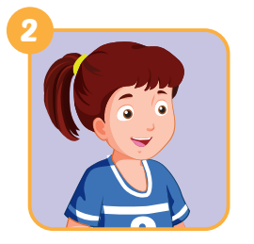

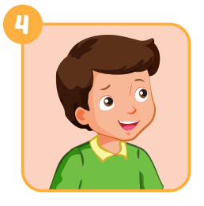




Extra Activity 1 WB p. 18
i
s
t
e
r
a
t
h
e
r
r
o
t
h
e
r
Notes:
GV giới thiệu tranh, HS điền từ còn thiếu
Step 1: open the pictures one by one and let student say what it is.
Step 2: Show the first answer ans an example. Then give sts sometimes to finish their answer
Step 3: ask for a volunteer, then let him/her say the answer. Ask the person to spell the word (if he/she can)

Slide 14

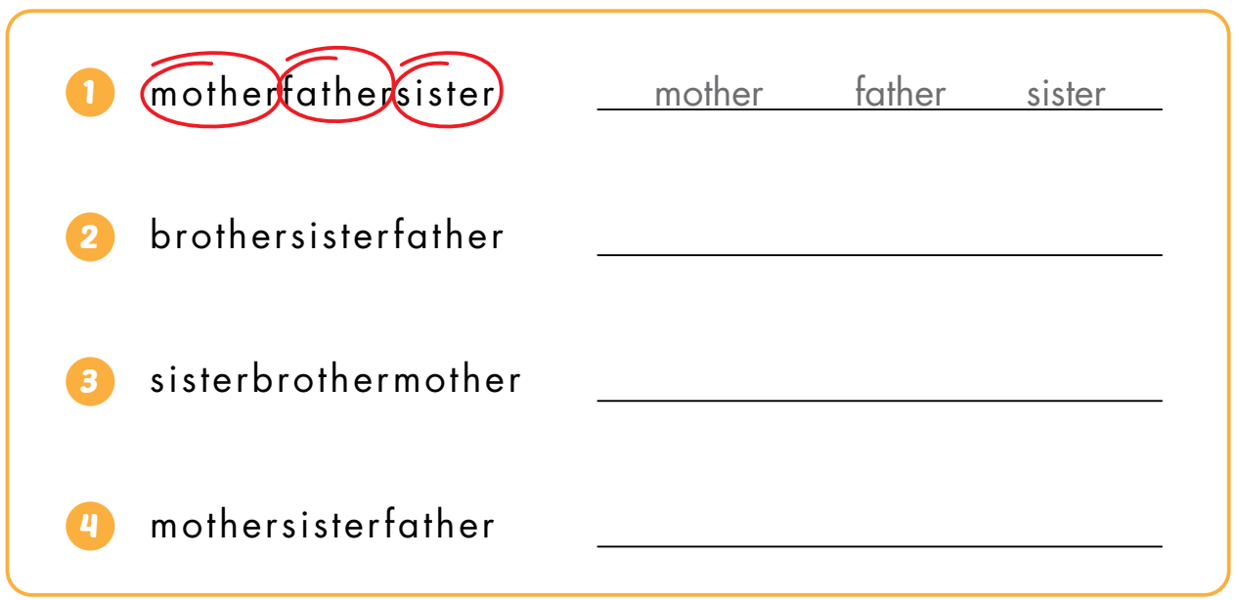
Extra Activity 2 WB p. 18
brother
sister
father
sister
brother
mother
mother
sister
father
Notes:
Câu 1 là ví dụ. HS khoanh đáp án trước rồi viết từ vào chỗ trống sau

Slide 15
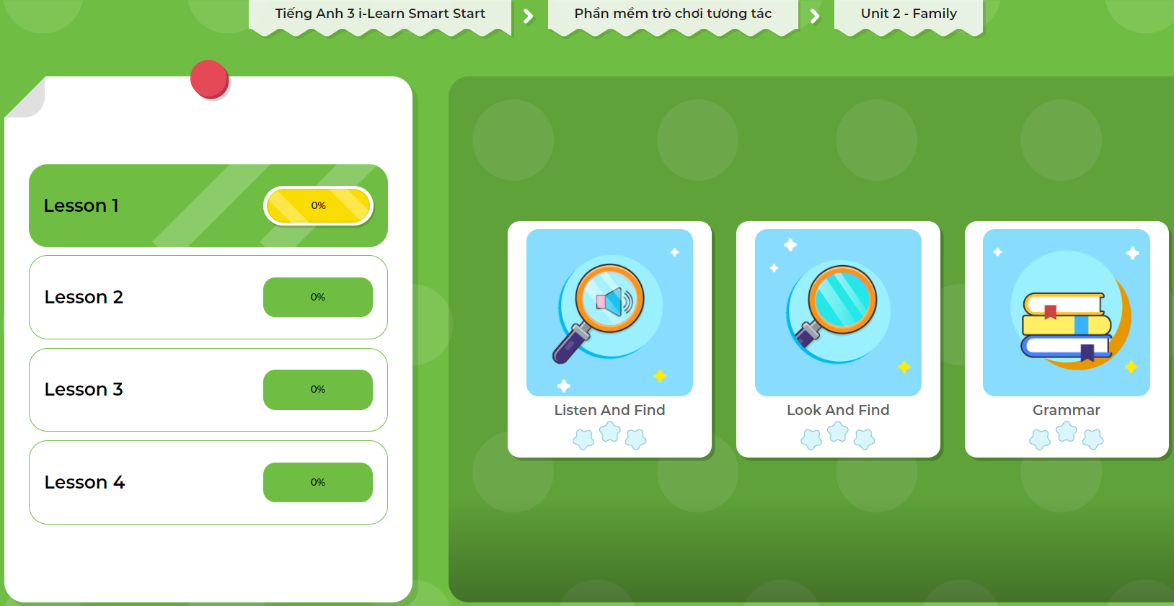
Extra Practice
DHA App
LET’S PLAY!
Click on the picture below

Slide 16
Structures
This is my father.
Hello, I’m Alfie.
Hello, Alfie.

Slide 17

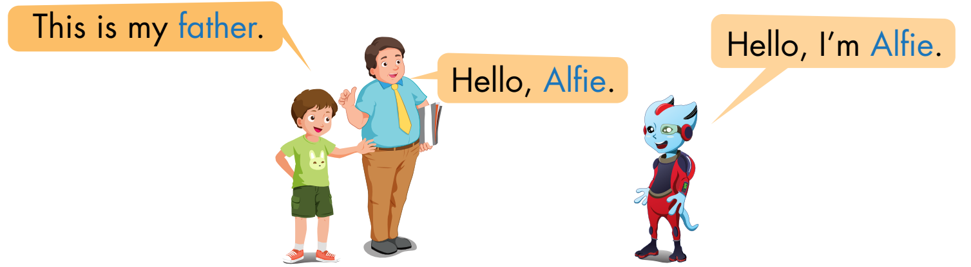
1
2
3
Tom
Sam
Alfie
Notes:
Giơi thiệu nhân vật
Click vào số để nghe nội dung.
Click vào bóng nói để xuất hiện chữ

Slide 18

Practice

Slide 19

Activity 1
Help Tom introducing his family members
This is my ……..
Look at the pictures and complete what Tom’s saying.
Notes:
Devide sts into teams, explain the game and show the pictures one by one. Who knows the answer says " BINGO" will get the chance to answer.

Slide 20
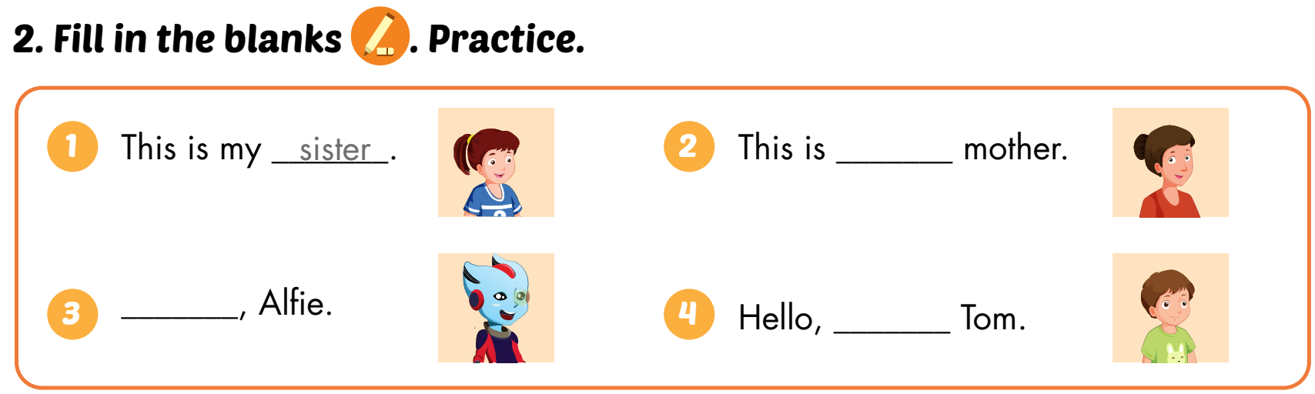
Activity 2
SB p.24
my
Hello
I’m

Slide 21

Activity 3
Tom is introducing his family members to Alfie.
Hello, Alfie.
Hello, I’m Alfie.
This is my ……..
3
2
1
Now it’s your turn. Let’s practice together.
Notes:
Let sts practice in pairs

Slide 22
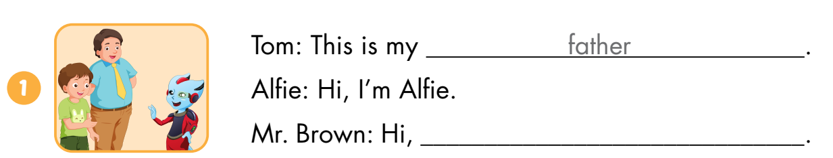
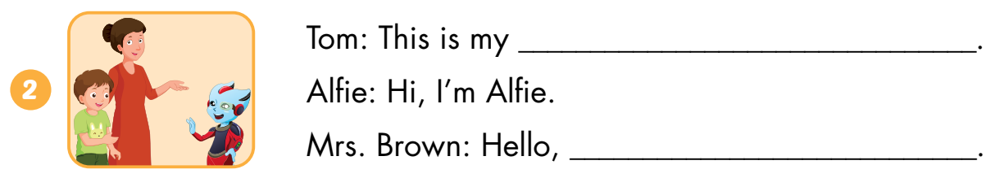
Extra Activity WB p.18
Look and write
Alfie
mother
Alfie

Slide 23
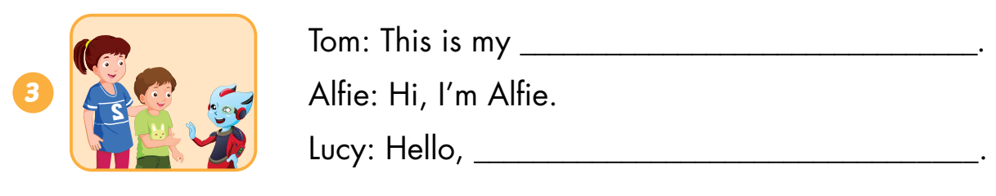
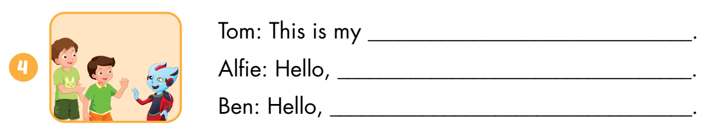
Extra Activity WB p.18
Look and write
sister
Alfie
brother
I’m Alfie
Alfie

Slide 24
Extra Practice
DHA App
LET’S PLAY!
Click on the picture below

Slide 25
Consolidation

Slide 26
Draw your family members on A4 paper and introduce them to your classmates.
1
2
3
4
This is my ……..
Hello, …..
Hello, I’m …….
1
3
2

Slide 27

WRAP-UP

Slide 28
Family members
father
mother
brother
sister

Slide 29
Lesson 3
Today’s lesson
Structures/ Sentence patterns
Tom: This is my father.
Alfie: Hello, I’m Alfie.
Sam: Hello, Alfie.

Slide 30
Lesson 3
Homework
Practice vocabulary and structure. Make sentences using them.
Do the exercises in Tiếng Anh 3 i-Learn Smart Start Workbook (pages 18,19)
Practice the vocabulary and structure in Tiếng Anh 3 i-Learn Smart Start Notebook (page 16)
Play the consolidation games in Tiếng Anh 3 i-Learn Smart Start DHA App on www.eduhome.com.vn
Prepare the next lesson (page 25)

Slide 31

Have a nice day!

