Slide 1

Unit 2
WHAT I CAN DO
LESSON 2.3 - PAGE 25

Slide 2

Lesson Outline
Warm-up
Practice
Speaking
Consolidation
Wrap-up

Slide 3
Objectives
By the end of this lesson, students will be able to ask and answer what others can or can't do.
Vocabulary: hop, fly, jump (rope), swim, run, climb (a tree) Structure: Can Tom and Ben swim?
- Yes, they can./ No, they can't.
Can you you jump rope?
- Yes, we can./ No, we can't.

Slide 4

WARM UP

Slide 5



Slide 6
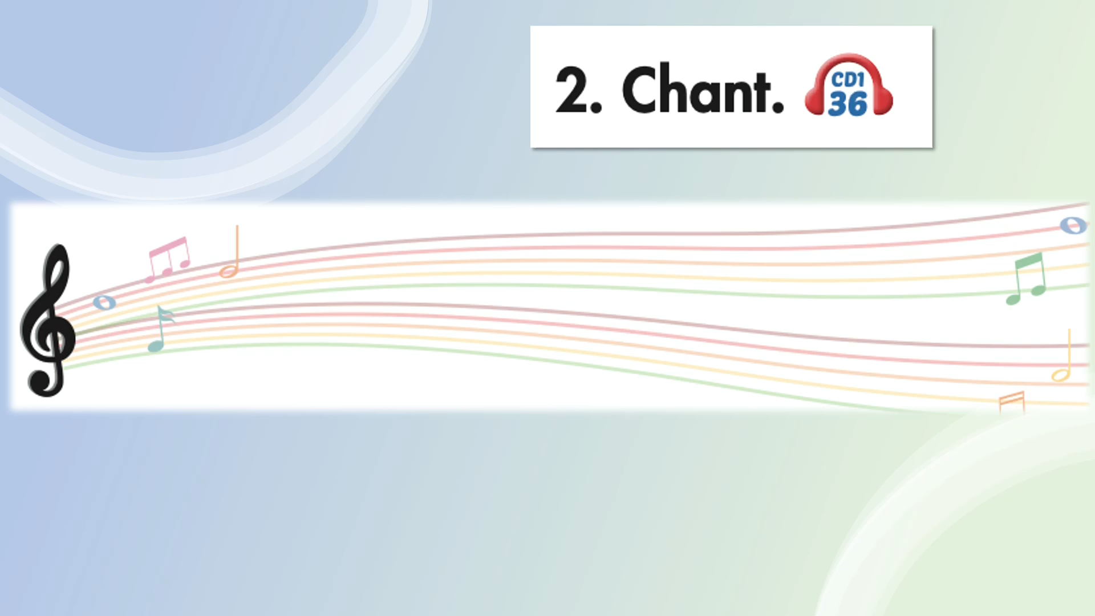

Slide 7

It’s time to learn …

Slide 8

can or can’t
GAME

Slide 9
Great
No, I ________.
can
can’t

Slide 10
Great
Yes, they _____ .
can
can’t

Slide 11
Great
No, she_______.
can
can’t

Slide 12
Great
_______ your climb a tree.
Can
Can’t

Slide 13

Practice

Slide 14


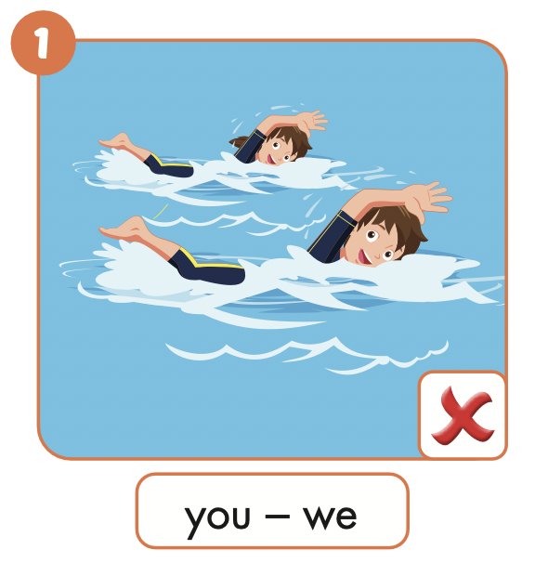

Slide 15

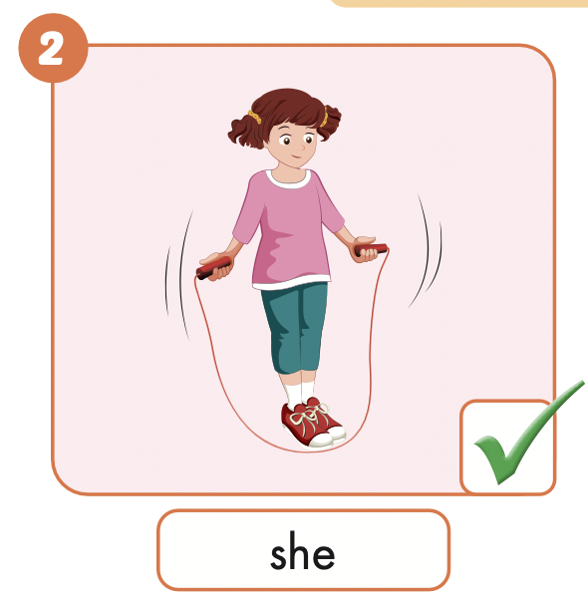
Can she jump rope?
Yes, she can.

Slide 16
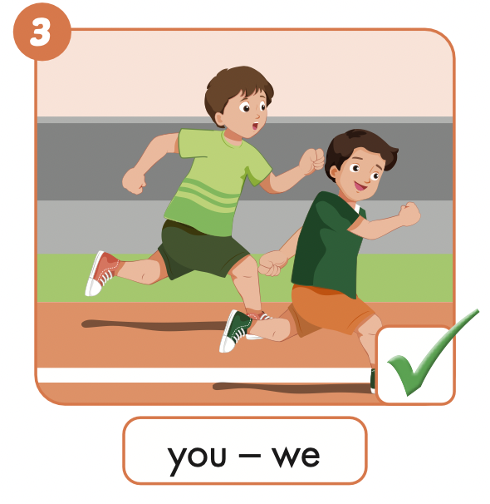
Can you run?
Yes, we can.

Slide 17
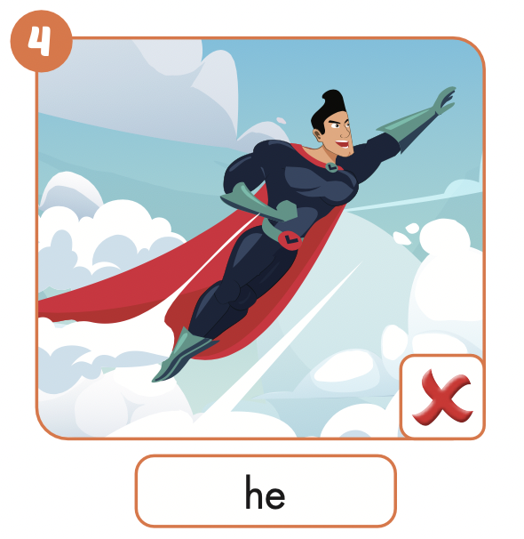
Can he fly?
No, he can’t.

Slide 18
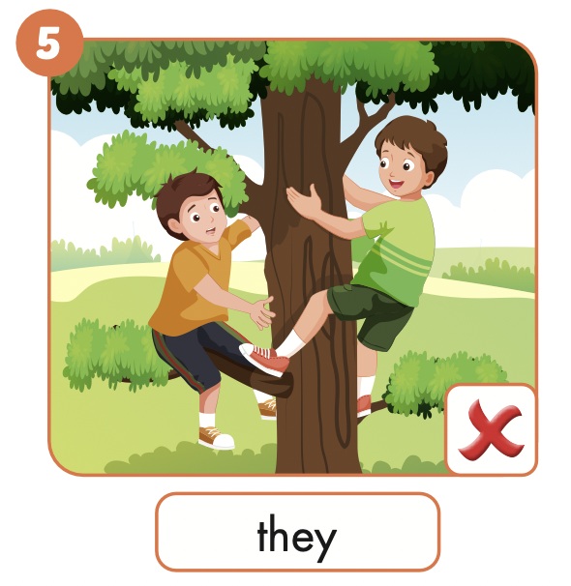
Can they climb a tree?
No, they can’t.

Slide 19
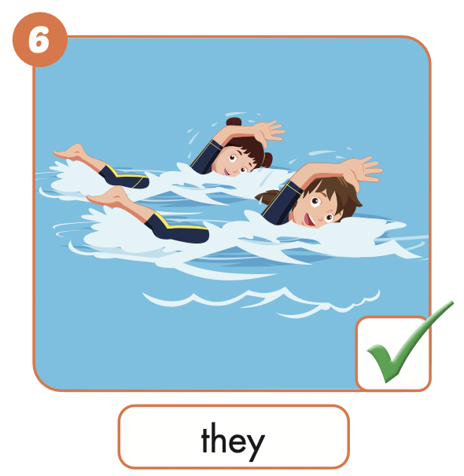
Can they swim?
Yes, they can.

Slide 20
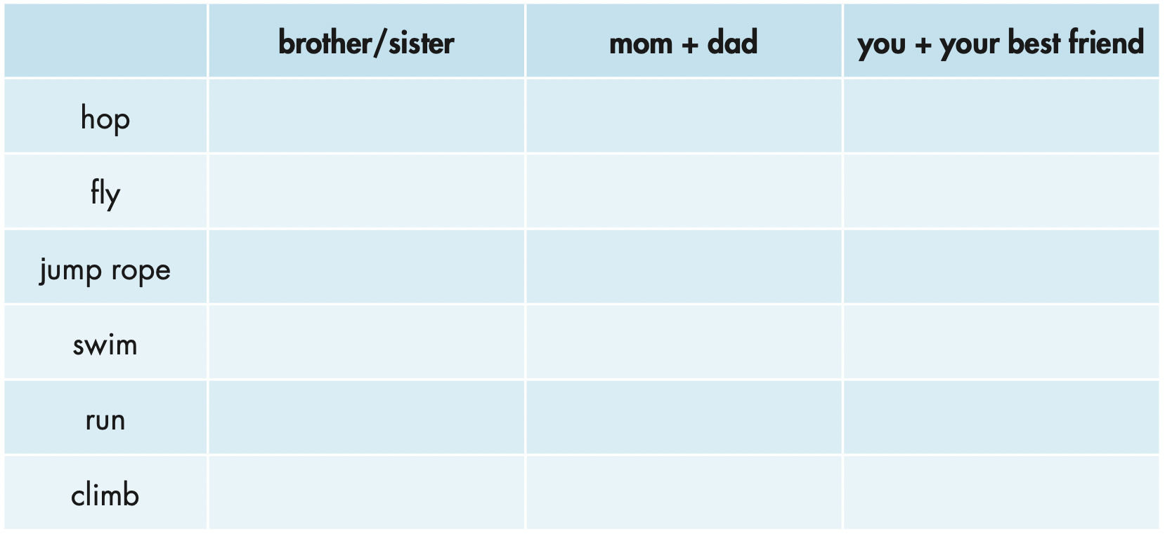


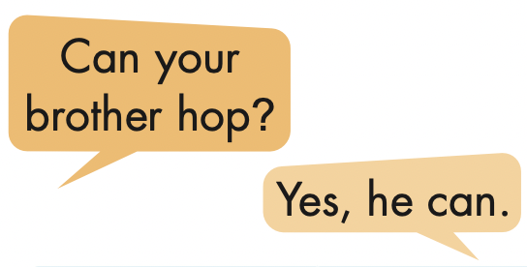
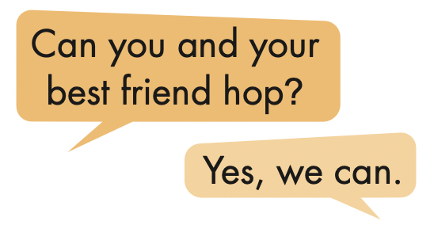
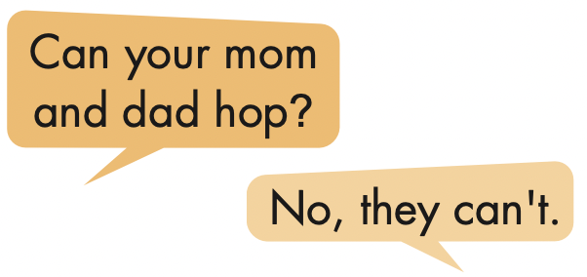

Slide 21

Production

Slide 22

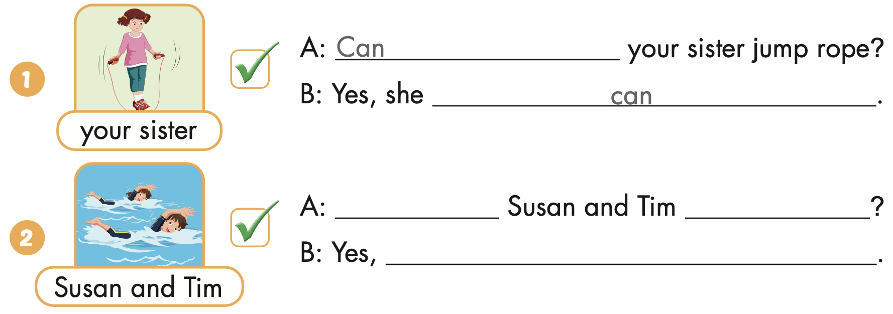
Extra Practice
WB, page 15
Can
swim
they can

Slide 23
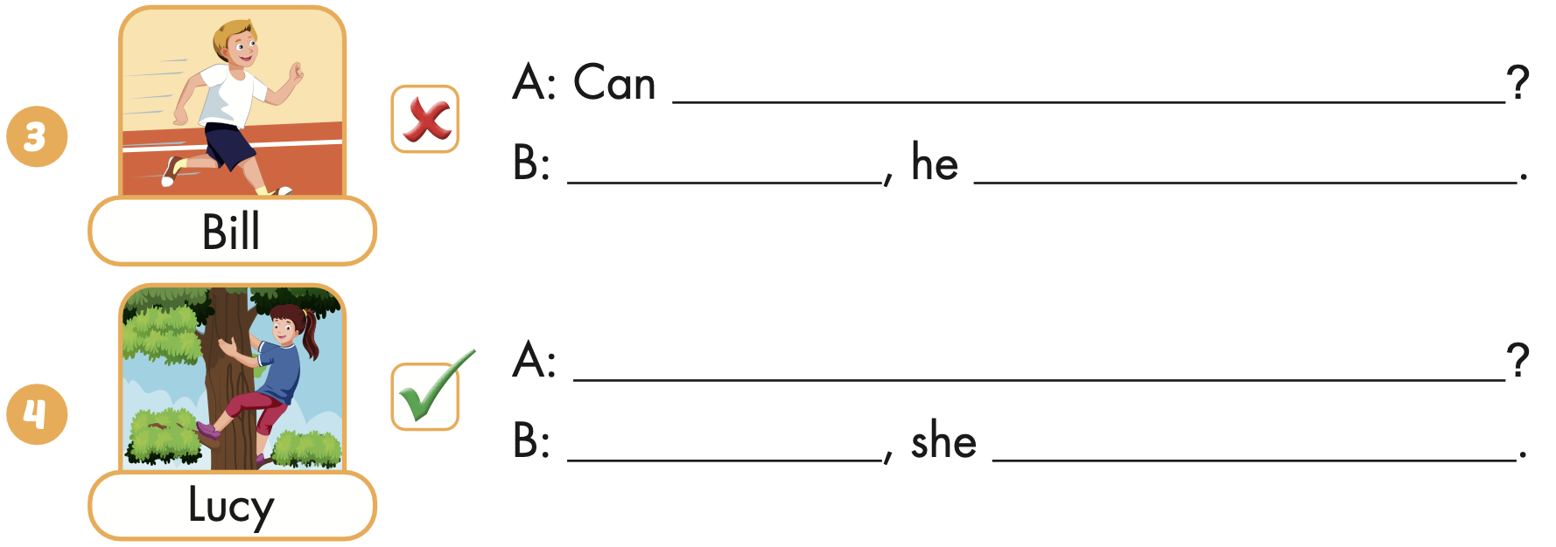
Extra Practice
WB, page 15
Bill run
No
can’t
Can Lucy climb a tree
Yes
can

Slide 24
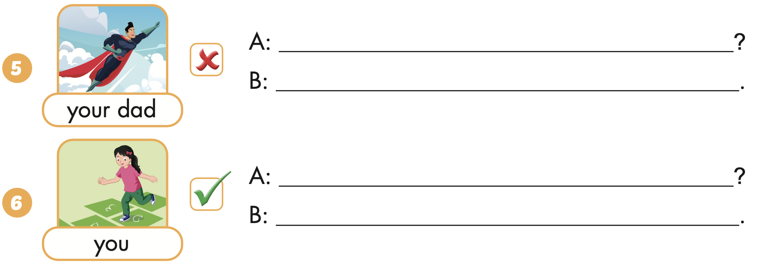
Extra Practice
WB, page 15
Can your dad fly
No, he can’t
Can you hop
Yes, I can

Slide 25

CONSOLIDATION

Slide 26

WRAP-UP

Slide 27
Today’s lesson
Vocabularies
hop,
fly,
jump (rope),
swim,
run,
climb (a tree)
Structures/ Sentence patterns
Can Tom and Ben swim?
- Yes, they can./ No, they can’t.
Can you you jump rope?
- Yes, we can./ No, we can't.

Slide 28
Homework
Practice the vocabularies and structure; and make sentences using them.
Do the exercises in Tiếng Anh 4 i-Learn Smart Start WB (page 15)
Do the exercises in Tiếng Anh 4 i-Learn Smart Start Notebook (page 11)
Prepare the next lesson (page 26 SB)
Play the consolidation games in Tiếng Anh 4 i-Learn Smart Start DHA App on www.eduhome.com.vn

Slide 29

Enjoy your day!

