Slide 1















Unit 1: My family
and friends
Lesson 1. Task 1 2 3

Slide 2

1
Warm Up
Guess “Who“?

Slide 3

Presentation
2

Slide 4

father
Notes:
Remember to tell students that “ Dad” and “father” is the same meaning.

Slide 5

mother
Notes:
Remember to tell students that “ Mum” and “ mother” is the same meaning.

Slide 6
father
mother

Slide 7

son
daughter
Notes:
Mũi tên chỉ sai. Mặc dù có dấu ngoặc sang – nhưng 1 slide 2 mũi tên - confusing

Slide 8
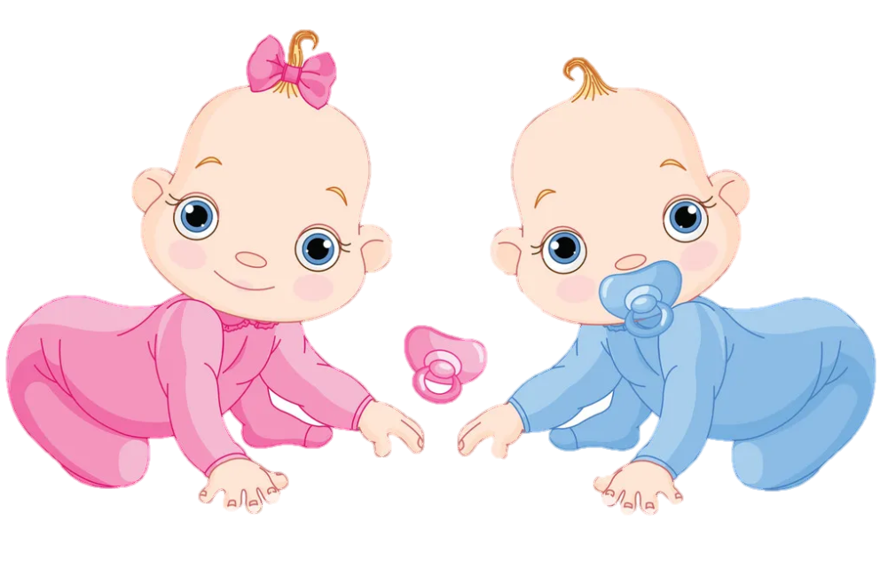
twins

Slide 9
3
Practice

Slide 10

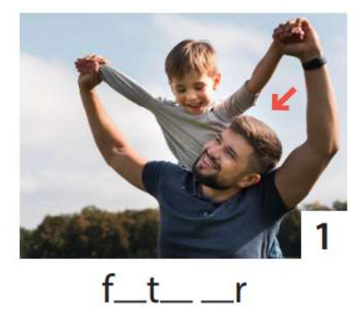
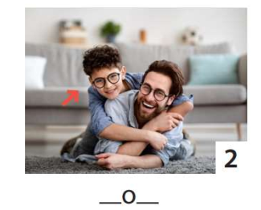
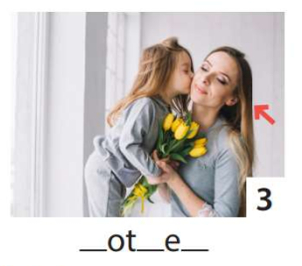
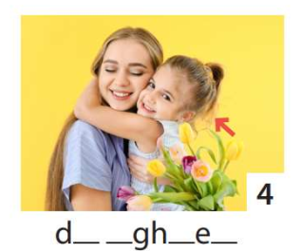
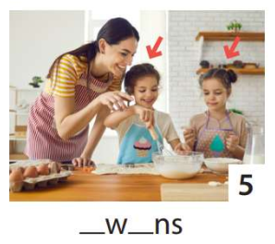
3 Write. Point and say.
1
2
3
4
5
He’s my father.
He’s my son.
She’s my daughter.
She’s my mother.
They’re twins.

Slide 11
5
Assessment

Slide 12
UNIT 1: Family and Friends
LESSON 1 – PERIOD 1
What we learnt today
Vocabulary:
father
mother
son
daughter
twins
Structure:
She‘s my mother.
He’s my father.

Slide 13
UNIT 1: Family and Friends
LESSON 1 – PERIOD 1
Thank you & goodbye!

