Slide 1


Unit 1
MsPham
0936082789
My friends
Lesson 2

Slide 2
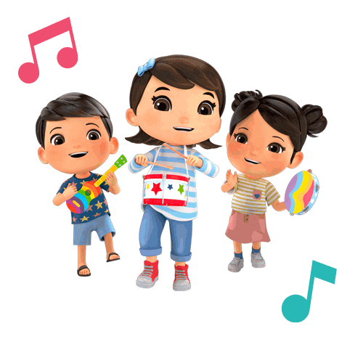
MsPham
0936082789
Warm-up

Slide 3

https://www.youtube.com/watch?v=Y-g1pJ0FUTY

Slide 4

MsPham
0936082789
Vocabulary

Slide 5

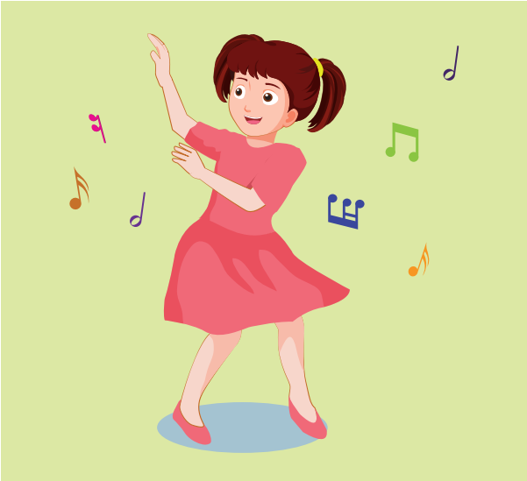
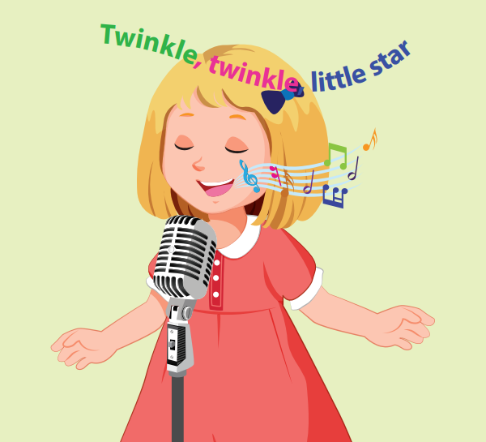
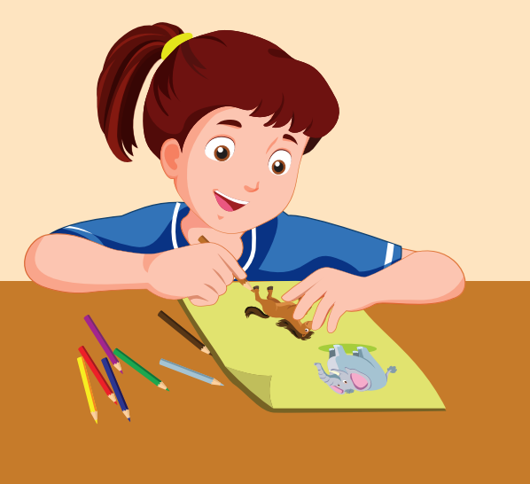

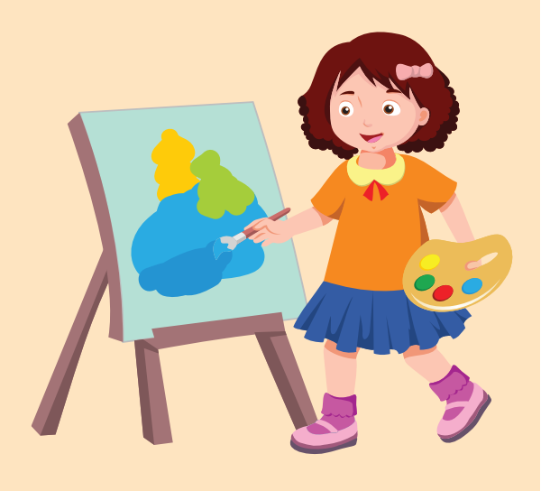
A
1. Listen and point. Repeat.
MsPham
0936082789
dancing
singing
/dænsɪŋ/
nhảy, nhảy múa
/sɪŋɪŋ/
hát, ca hát
drawing
reading
painting
/drɑːɪŋ/
vẽ
/riːdɪŋ/
đọc
/peɪntɪŋ/
vẽ bằng cọ

Slide 6
Vocabulary
MsPham
0936082789
dancing
/dænsɪŋ/
nhảy, nhảy múa

Slide 7
Vocabulary
MsPham
0936082789
singing
/sɪŋɪŋ/
hát, ca hát

Slide 8
Vocabulary
MsPham
0936082789
drawing
/drɑːɪŋ/
vẽ

Slide 9
Vocabulary
MsPham
0936082789
reading
/riːdɪŋ/
đọc

Slide 10
Vocabulary
MsPham
0936082789
painting
/peɪntɪŋ/
vẽ bằng cọ

Slide 11
A
1. Listen and point. Repeat.
MsPham
0936082789
dancing
singing
/dænsɪŋ/
nhảy, nhảy múa
/sɪŋɪŋ/
hát, ca hát
drawing
reading
painting
/drɑːɪŋ/
vẽ
/riːdɪŋ/
đọc
/peɪntɪŋ/
vẽ bằng cọ

Slide 12
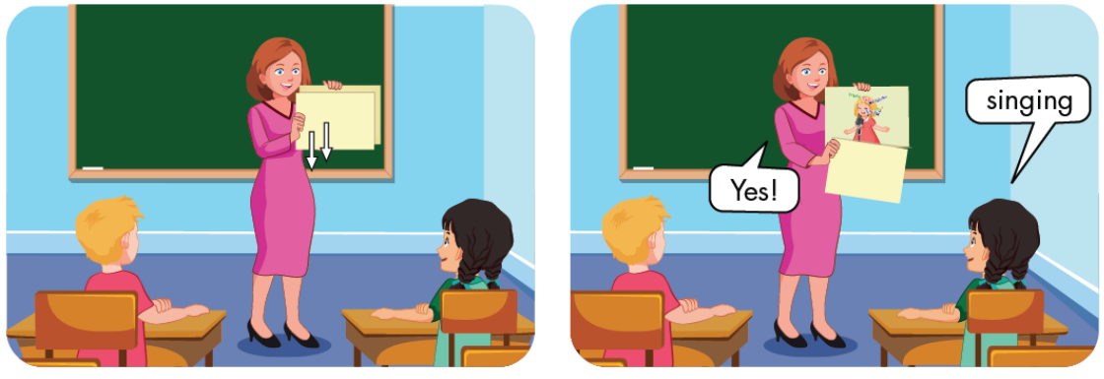
A
2. Play SLOW MOTION.

Slide 13
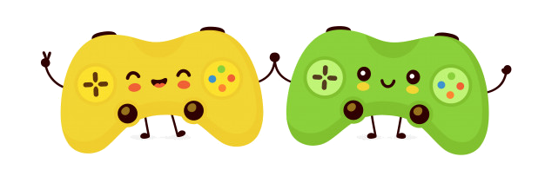

MsPham
0936082789
BRICK WALL GAME
PLAY

Slide 14
singing
MsPham
0936082789
Open
Next
Check

Slide 15
drawing
MsPham
0936082789
Open
Next
Check

Slide 16
reading
Open
Next
Check

Slide 17
painting
MsPham
0936082789
Open
Next
Check

Slide 18
dancing
MsPham
0936082789
Open
Next
Check

Slide 19


MsPham
0936082789
Next

Slide 20
Vocabulary
MsPham
0936082789
dancing
singing
/dænsɪŋ/
nhảy, nhảy múa
/sɪŋɪŋ/
hát, ca hát
drawing
reading
painting
/drɑːɪŋ/
vẽ
/riːdɪŋ/
đọc
/peɪntɪŋ/
vẽ bằng cọ

Slide 21

MsPham
0936082789
Structure

Slide 22



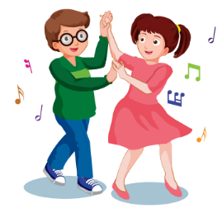

B
1. Listen and practice.
Do your friends like dancing?
Yes, they do.
MsPham
0936082789
No, they don’t.
Click on each sentence to hear the sound.

Slide 23
B
1. Listen and practice.
Do your friends like ________?
dancing
Yes, they do.
MsPham
0936082789

Slide 24

B
1. Listen and practice.
Do your friends like ________?
reading
No, they don’t.
MsPham
0936082789

Slide 25

B
1. Listen and practice.
Do your friends like ________?
singing
Yes, they do.
MsPham
0936082789

Slide 26
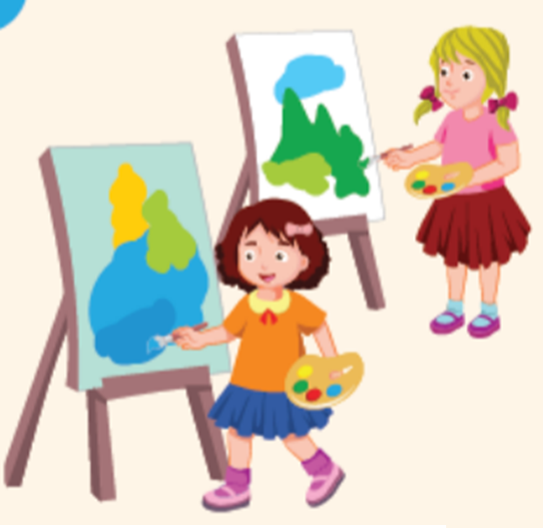
B
1. Listen and practice.
Do your friends like ________?
painting
No, they don’t.
MsPham
0936082789

Slide 27
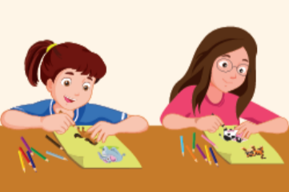
B
1. Listen and practice.
Do your friends like ________?
drawing
No, they don’t.
MsPham
0936082789

Slide 28
Structure
Yes, they do.
Do your friends
like _______?
No, they don’t.
MsPham
0936082789
dancing
painting
singing
drawing
reading

Slide 29



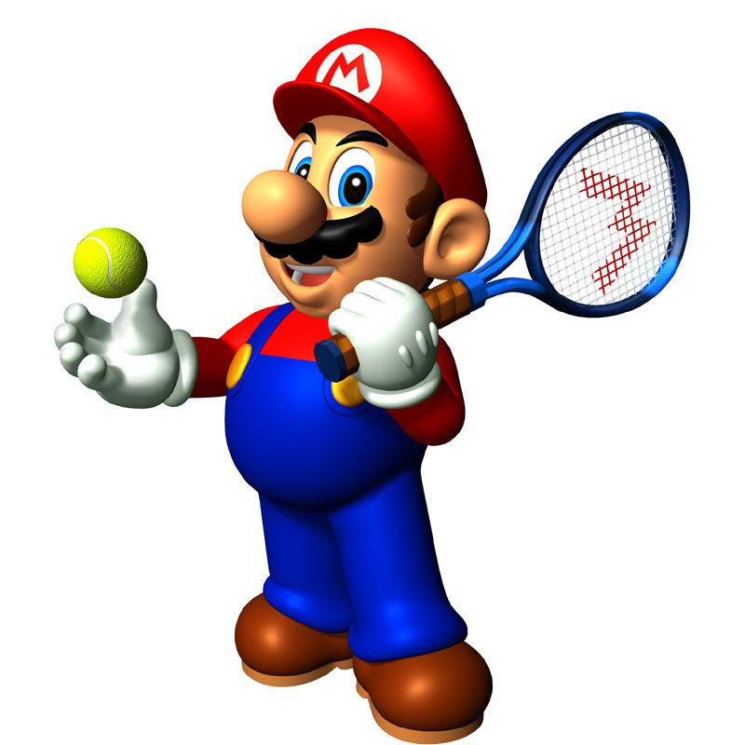





Slide 30
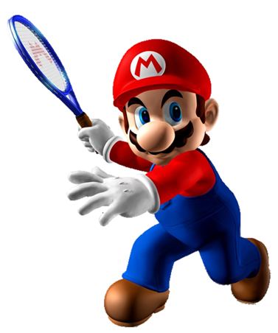
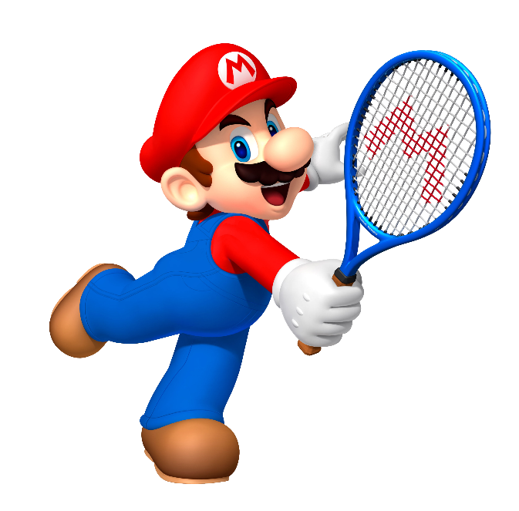


painting
reading
Do your friends like _____?
singing

Slide 31
dancing
drawing
Do your friends like _____?
reading

Slide 32
singing
drawing
Do your friends like _____?
dancing

Slide 33
painting
singing
Do your friends like _____?
reading

Slide 34
painting
singing
Do your friends like _____?
dancing

Slide 35
Yes, they do.
No, they don’t.
Do your friends like drawing?
Yes, they don’t.

Slide 36
Yes, they do.
No, they don’t.
Do your friends like reading?
No, they do.

Slide 37
Good job!

Slide 38
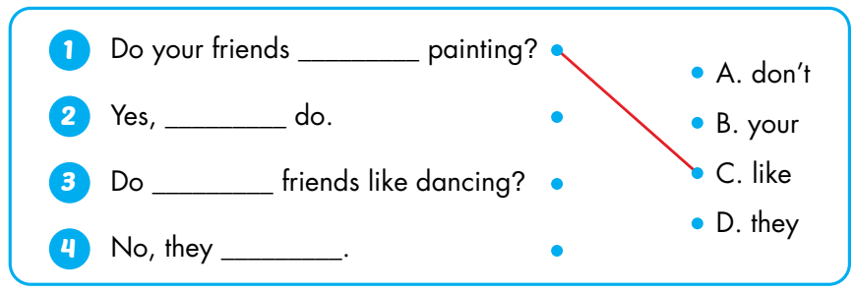
B
2. Look and match. Practice.
✗
like
MsPham
0936082789
they
✓
your
don’t

Slide 39
MsPham
0936082789
Practice
Workbook

Slide 40
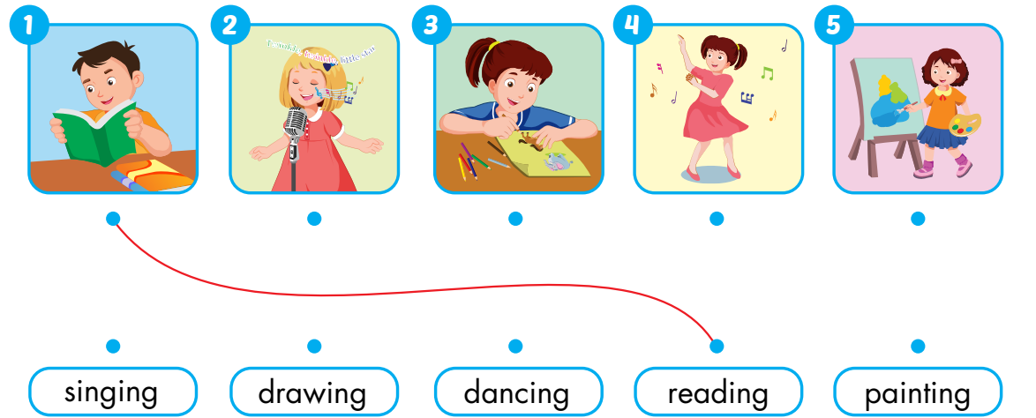
A
Draw lines. (P.12)

Slide 41
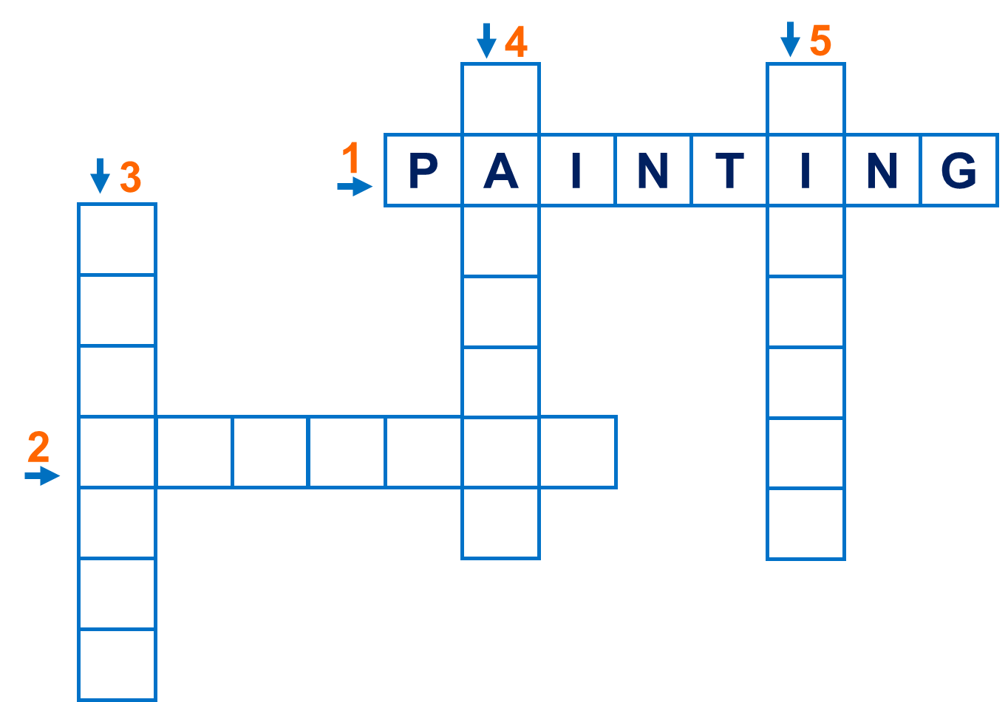
Click the each number to open.
B
Look and write (P.12)
Across
D
S
1
2
MsPham
0936082789
R
N
N
E
C
G
3
A
I
I
Down
4
D
R
A
W
I
N
G
N
I
G
G
5
N
G

Slide 42


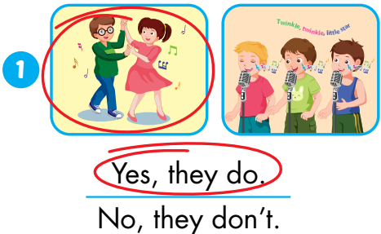
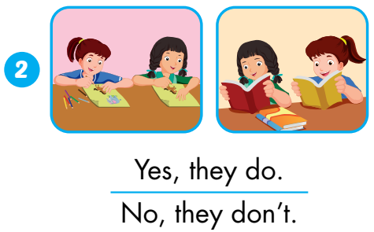
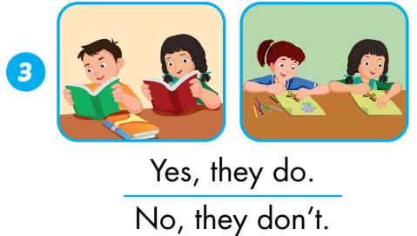
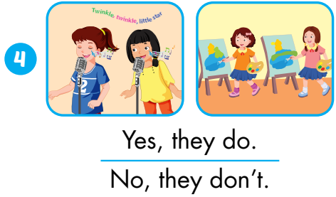
C
Listen and circle. (P.13)
MsPham
0936082789

Slide 43



THANK YOU!
MsPham
0936082789
Welcome to join with me!
MsPham Powerpoint
Mspham

