Slide 1

Unit 1: SCHOOL
Culture - Lesson 3
Page 17

Slide 2
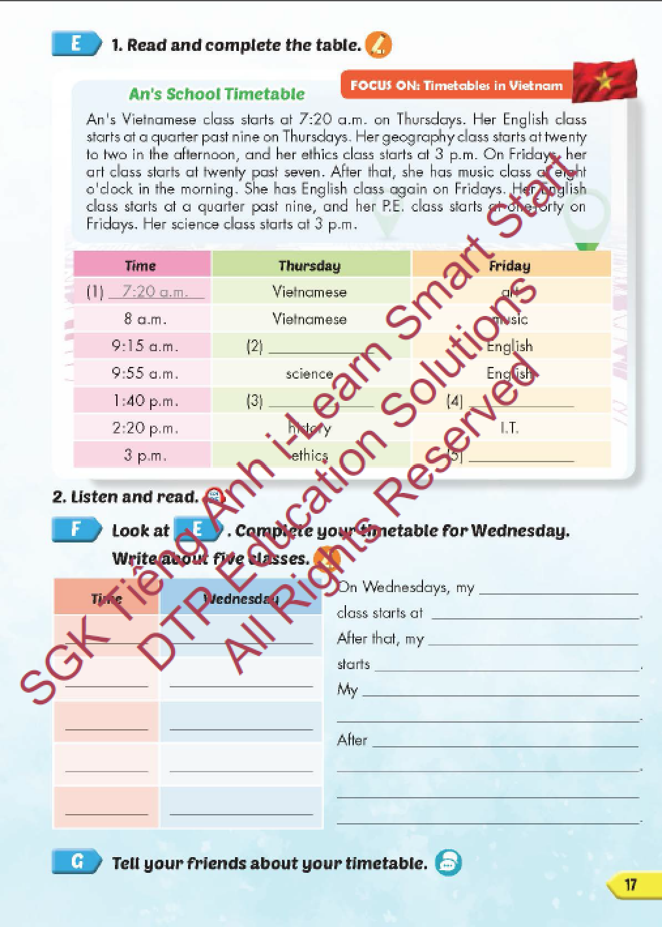
Lesson Outline
Warm-up
Reading
Writing
Speaking
Consolidation
Wrap-up

Slide 3
Objectives
By the end of this lesson, students will be able to learn about Vietnamese culture and practice reading, listening, writing and talking about their school timetables.
Vocabulary: a.m., p.m., eight o'clock, two- thirty, a quarter to four, five past nine.
Structure: What time does your English class start?
It starts at eight o'clock.

Slide 4

WARM-UP

Slide 5




TELLING THE TIME
12
11
1
10
2
9
3
8
4
7
5
6

Slide 6
WHAT TIME DOES YOUR HISTORY CLASS START?
12
11
1
10
2
9
3
8
4
7
5
6
It starts at two o’clock.

Slide 7
WHAT TIME DOES YOUR ETHICS CLASS START?
12
11
1
10
2
9
3
8
4
7
5
6
It starts at five past nine.

Slide 8
WHAT TIME DOES YOUR ENGLISH CLASS START?
12
11
1
10
2
9
3
8
4
7
5
6
It starts at a quarter past seven.

Slide 9
WHAT TIME DOES YOUR ART CLASS START?
12
11
1
10
2
9
3
8
4
7
5
6
It starts at twenty to ten.

Slide 10
It starts at half-past three.
12
11
1
10
2
9
3
8
4
7
5
6
WHAT TIME DOES YOUR VIETNAMESE CLASS START?

Slide 11
WHAT TIME DOES YOUR MUSIC CLASS START?
12
11
1
10
2
9
3
8
4
7
5
6
It starts at twenty-five to eight.

Slide 12
WHAT TIME DOES YOUR SCIENCE CLASS START?
12
11
1
10
2
9
3
8
4
7
5
6
It starts at a quarter to five.

Slide 13
WHAT TIME DOES YOUR I.T. CLASS START?
12
11
1
10
2
9
3
8
4
7
5
6
It starts at five to four.

Slide 14

It’s time to learn …

Slide 15

Lead-in

Slide 16

WHAT COUNTRY IS IT?

Slide 17
LIST 5 THINGS ABOUT VIETNAM!
It’s a beautiful country in Asia.
Hanoi is the capital city.
Ho Chi Minh is in the south.
…………………..
…………………..

Slide 18
Practice

Slide 19

Reading

Slide 20
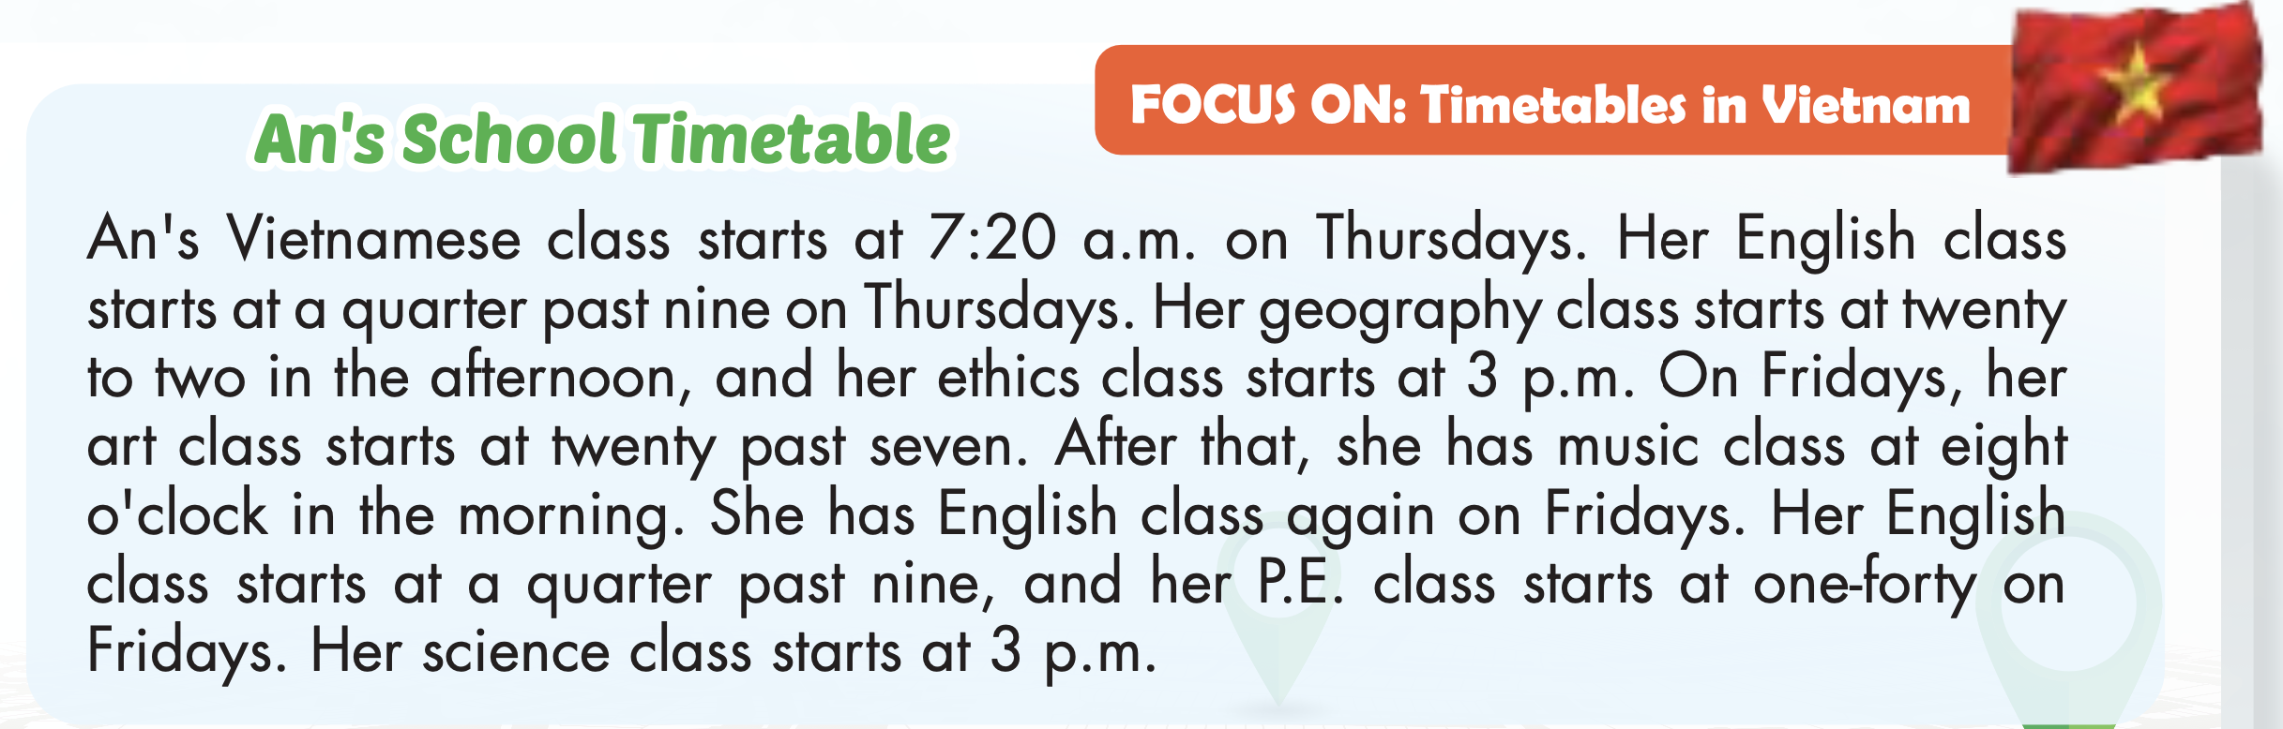

Slide 21
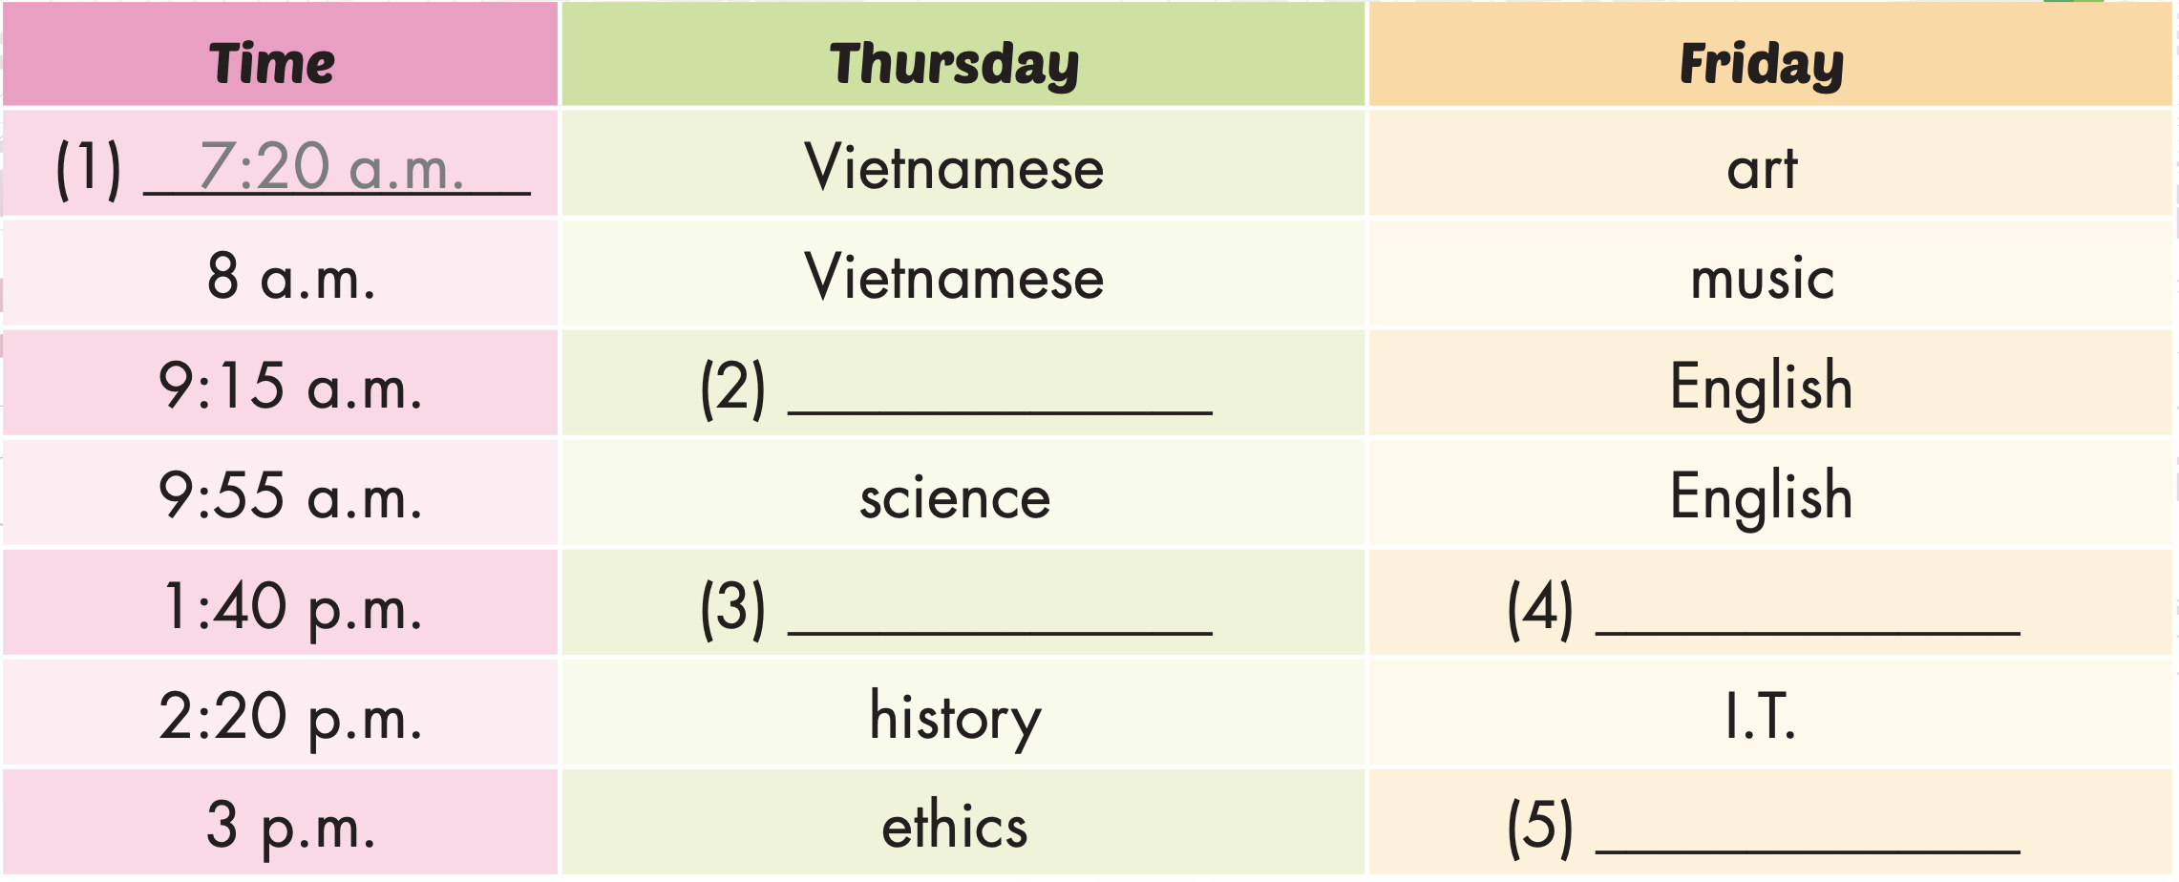
English
geography
P.E.
science

Slide 22
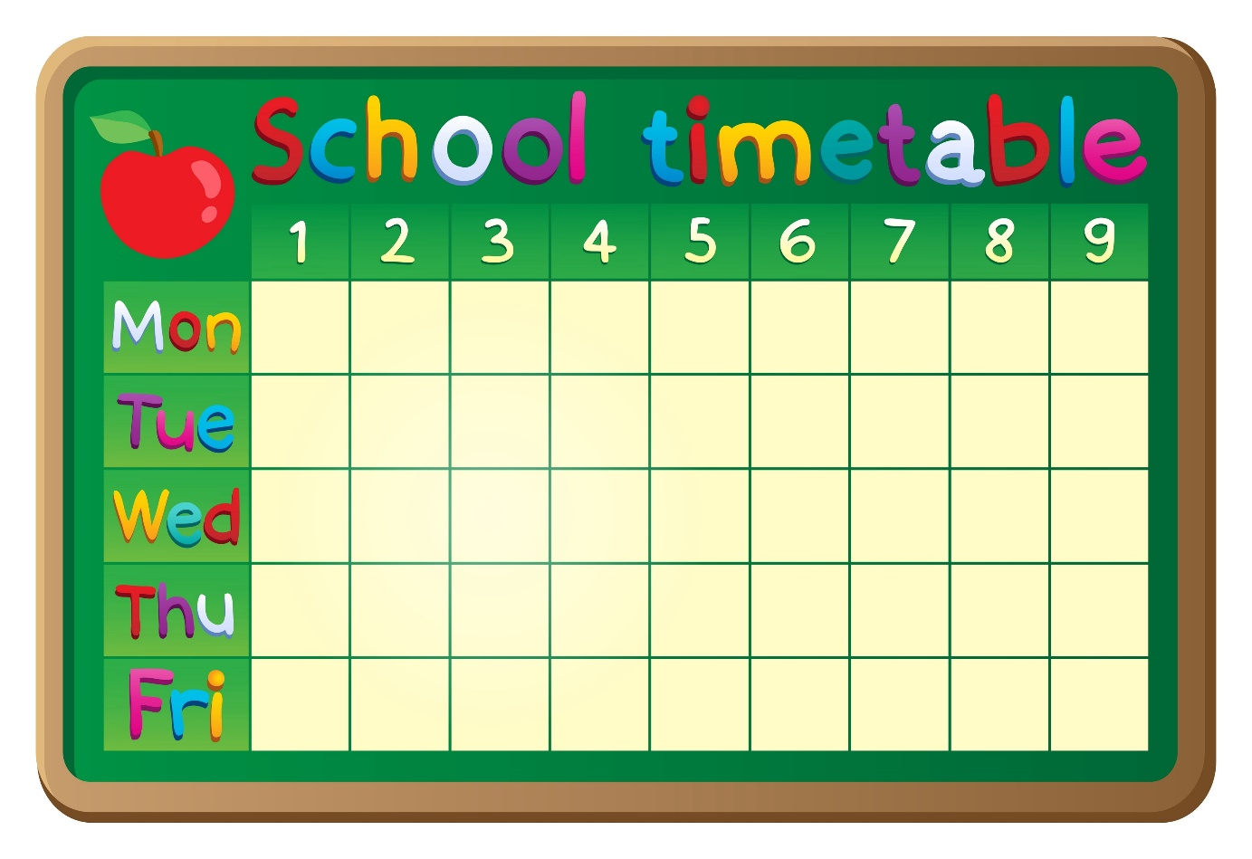
READ AND CHOOSE THE CORRECT OPTION.
START

Slide 23


7:20 a.m.
An’s Vietnamese class starts at …........ on Thursdays.
7:30 a.m.

Slide 24
math
English
Her …… class starts at a quarter past nine on Thursdays .

Slide 25
past
to
Her geography class starts at twenty ….. two in the afternoon .

Slide 26
p.m.
Her science class starts at 3 …...
a.m.

Slide 27

Writing

Slide 28
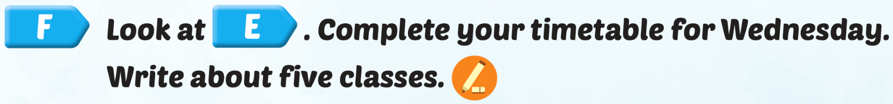
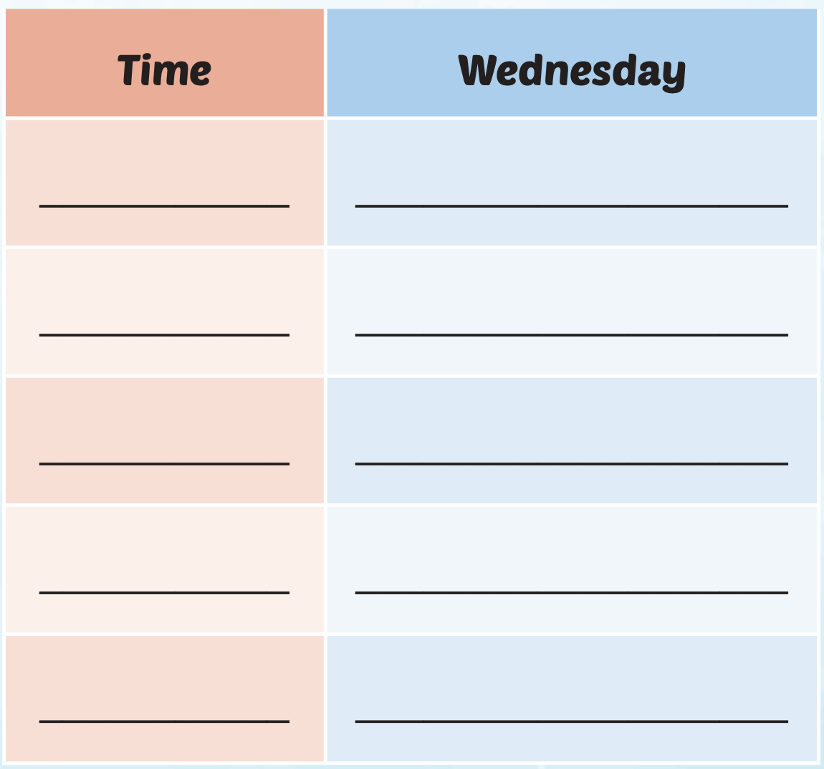
Examples:
7:30 a.m.
English
8:10 a.m.

Slide 29
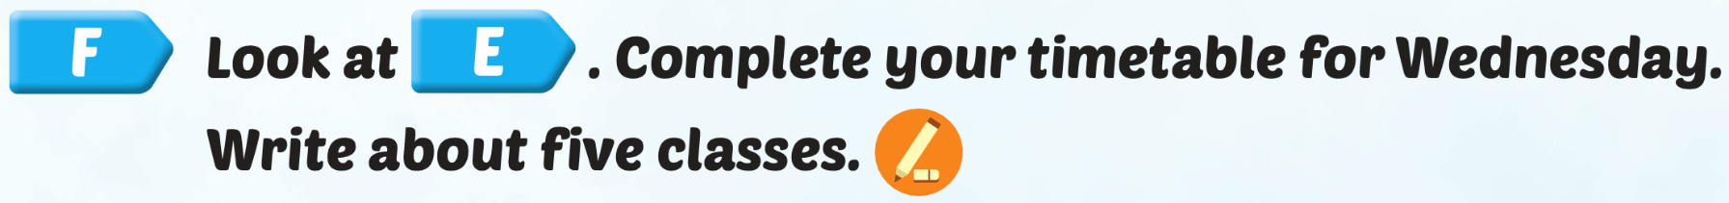
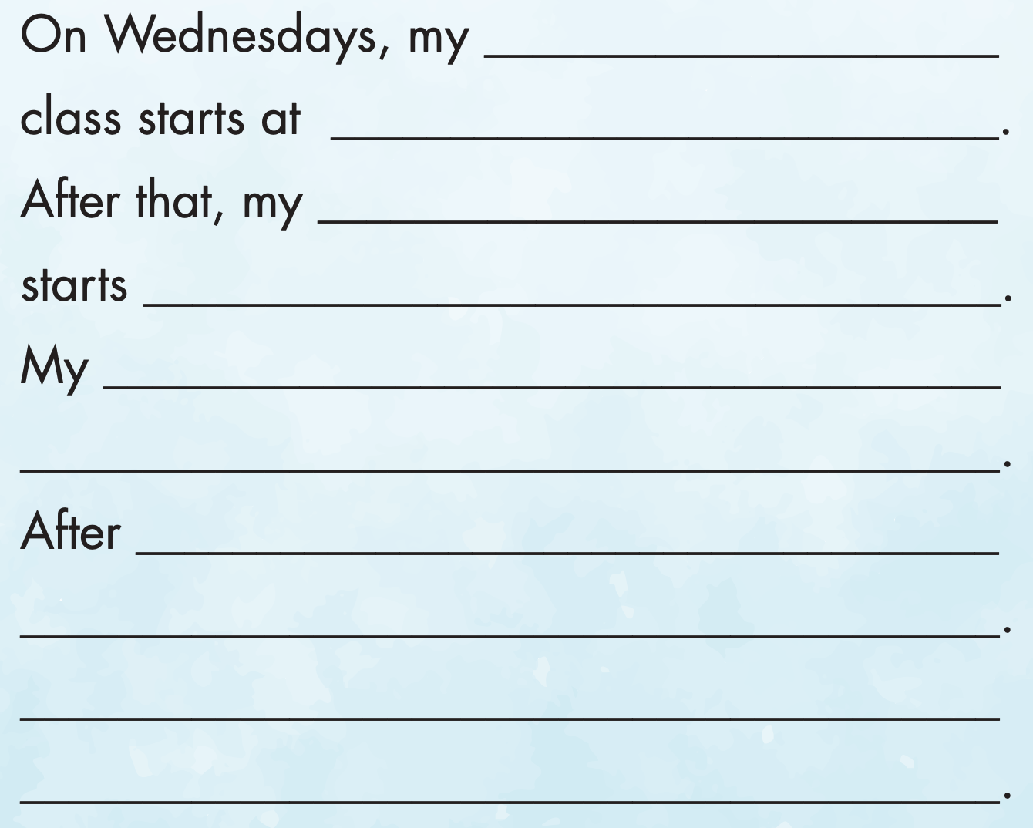
English
Examples:
7:30 a.m.

Slide 30

Production

Slide 31

Speaking

Slide 32


Slide 33

CONSOLIDATION

Slide 34

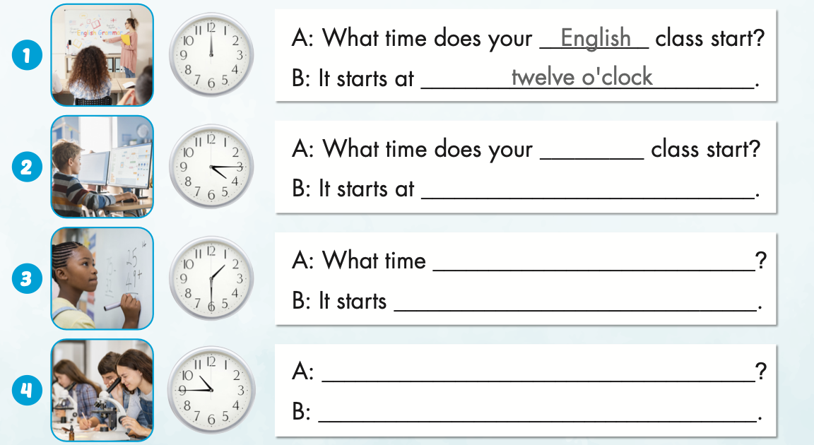
Extra Practice
WB, page 9
I.T.
a quarter past four
does your math class start?
at one thirty
What time does your science class start?
It starts at a quarter to eleven.

Slide 35
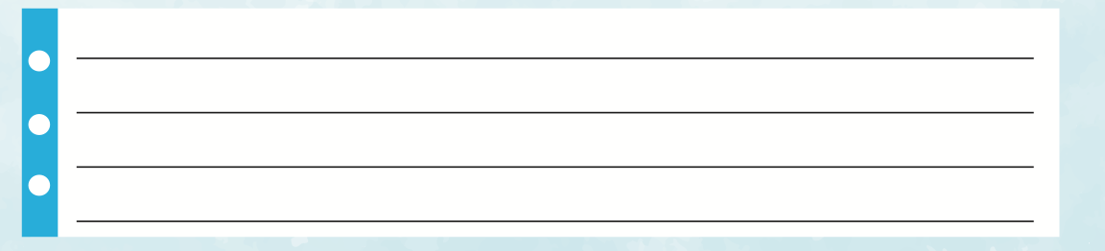
Extra Practice
WB, page 9
Example:
On Mondays, my science class starts at 7:30 a.m. Then, my English class starts at a quarter past nine. My math class starts at five past ten. After lunch, my history class starts at 1:40 p.m. School is fun.

Slide 36

WRAP-UP

Slide 37
Today’s lesson
Vocabularies
a.m.,
p.m.,
eight o'clock,
two- thirty,
a quarter to four,
five past nine.
Structures/ Sentence patterns
What time does your English class start?
It starts at eight o'clock.

Slide 38
Homework
Practice the vocabularies and structure, and make sentences using them.
Do the exercises in Tiếng Anh 5 i-Learn Smart Start WB (page 9).
Do the exercises in Tiếng Anh 5 i-Learn Smart Start Notebook.
Prepare the next lesson (page 18 SB).
Play the consolidation games in Tiếng Anh 5 i-Learn Smart Start DHA App on www.eduhome.com.vn

Slide 39

Enjoy your day!

Slide 40

Lesson 3
Stay positive and have a nice day!

