Slide 1

Unit 1: SCHOOL
Culture - Lesson 2
Page 16

Slide 2
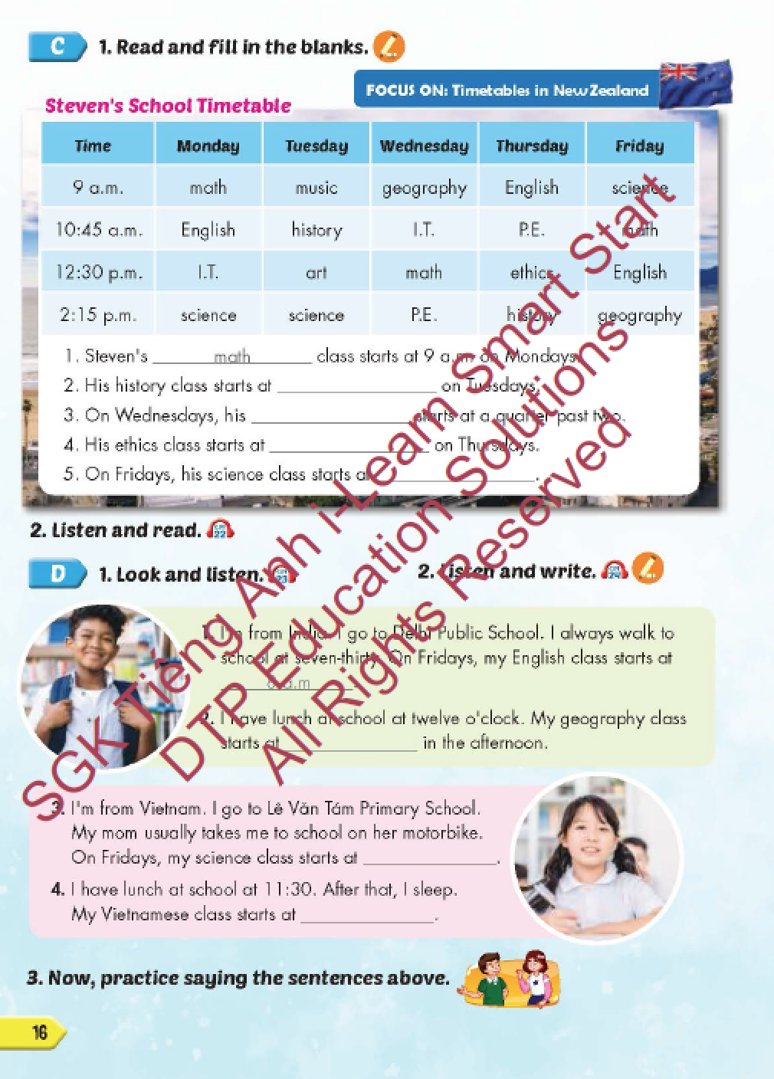
Lesson Outline
Warm-up
Reading
Listening
Speaking
Consolidation
Wrap-up

Slide 3
Objectives
By the end of this lesson, students will be able to review the target language and familiarize themselves with aspects of New Zealand and practice reading comprehension.
Vocabulary: a.m., p.m., eight o'clock, two- thirty, a quarter to four, five past nine.
Structure: What time does your English class start?
It starts at eight o'clock.

Slide 4

WARM-UP

Slide 5
Listen and choose. Then say.

Slide 6
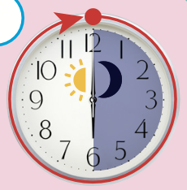
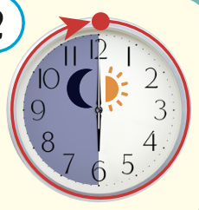
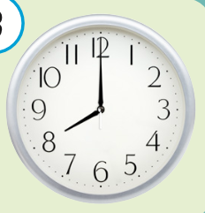


Listen and choose
A
B
C

Slide 7
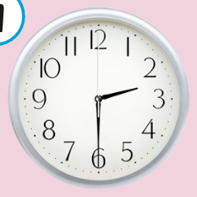
Listen and choose
C
A
B

Slide 8
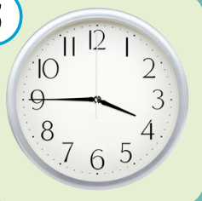
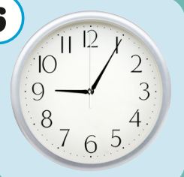
Listen and choose
B
C
A

Slide 9
Listen and choose
A
B
C

Slide 10

It’s time to learn …

Slide 11

Lead-in

Slide 12

WHAT COUNTRY IS IT?
New Zealand
Its capital is Wellington.
It is an island country in the South Pacific Ocean.

Slide 13
Practice

Slide 14

Reading

Slide 15


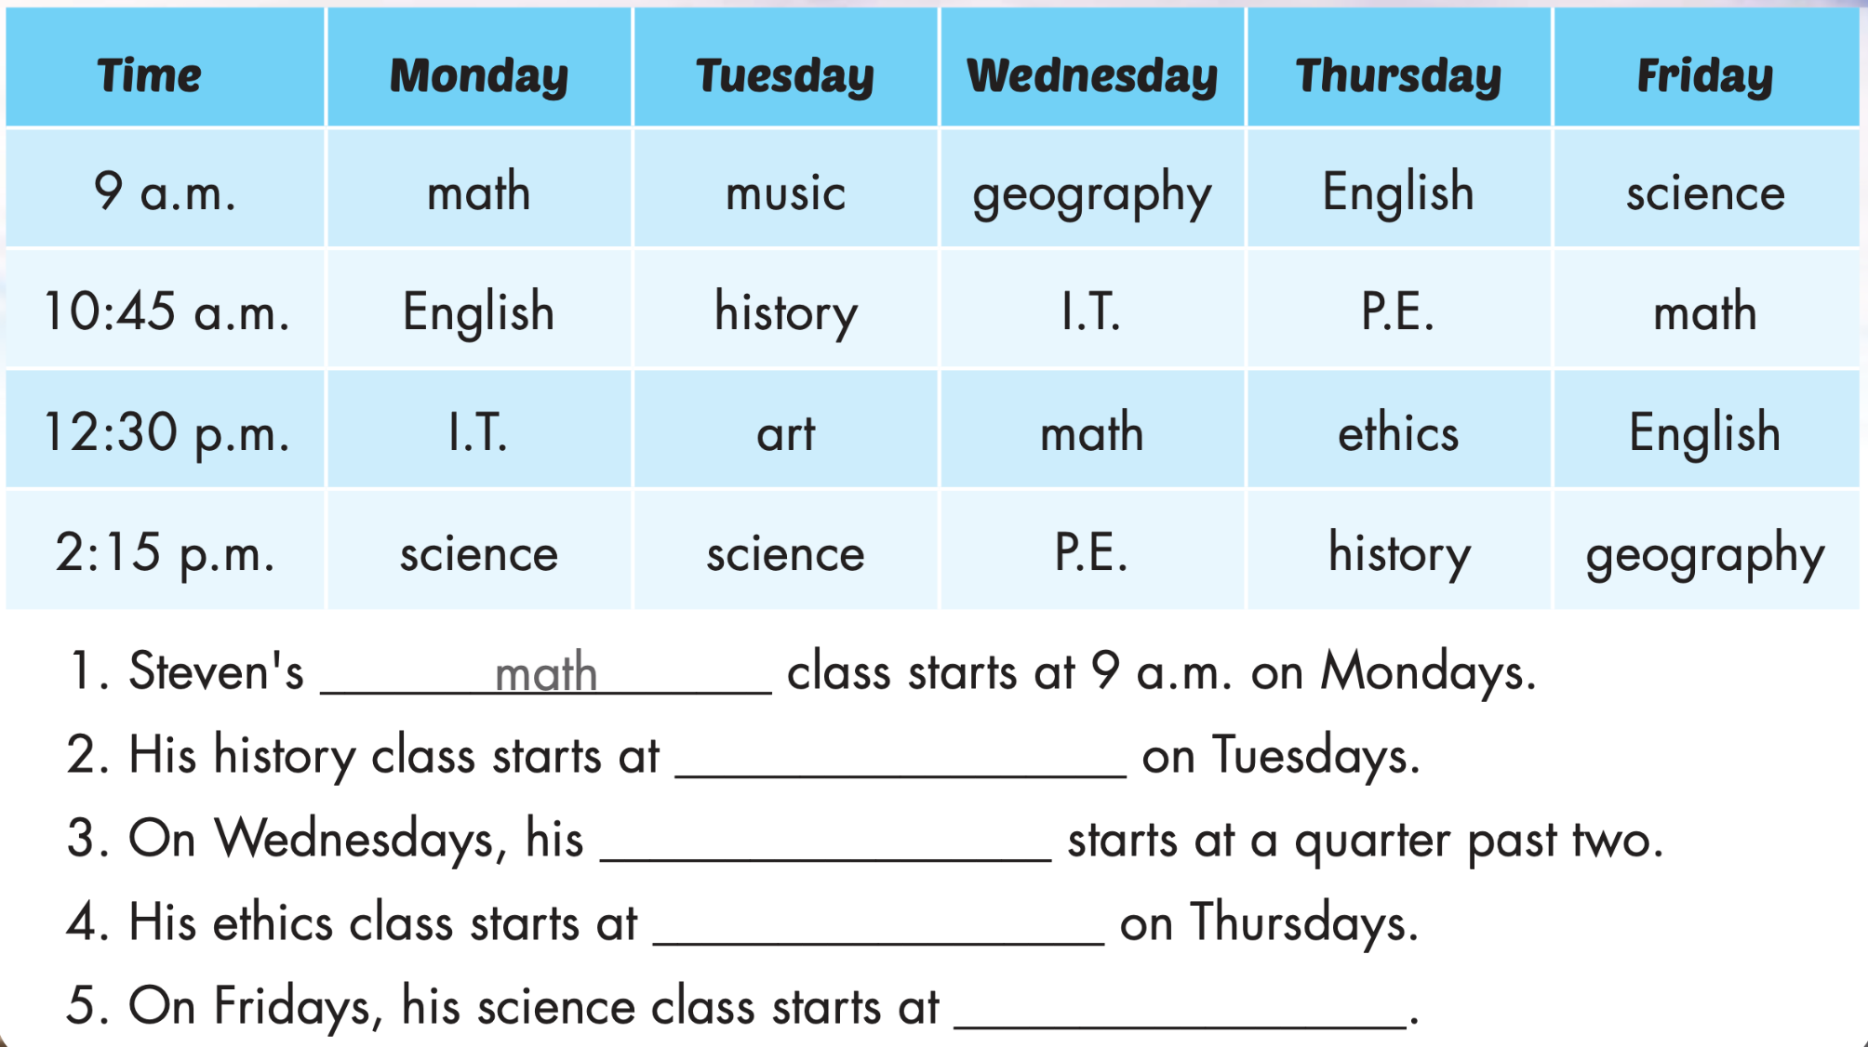
10:45 a.m.
P.E. class
12:30 p.m.
9 a.m.

Slide 16
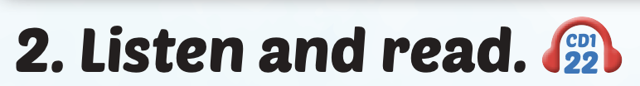
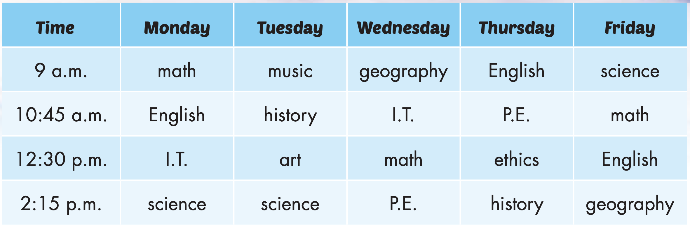
Click on the picture to hear the sound.

Slide 17
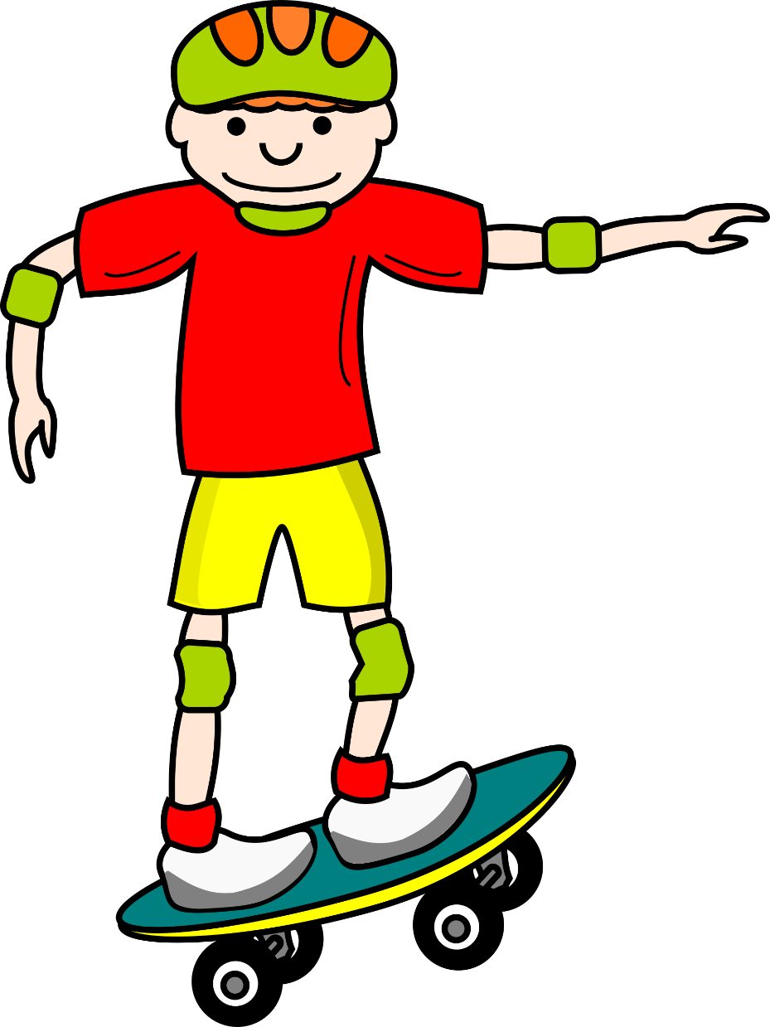
WHERE IS MY SKATEBOARD?
START

Slide 18


His P.E. class starts at a quarter past two on Wednesdays.
TRUE
FALSE

Slide 19
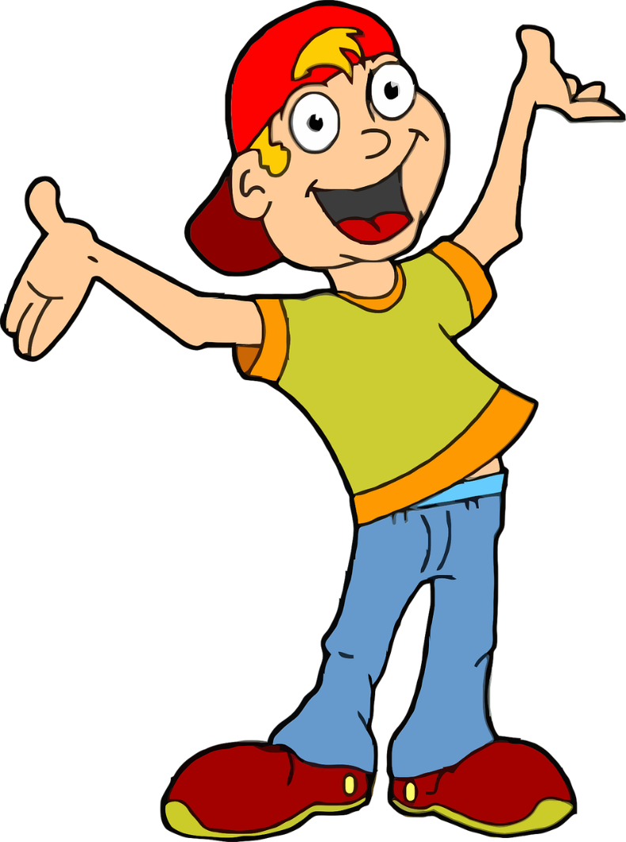
His history class starts on 10 a.m. on Tuesdays.
TRUE
FALSE

Slide 20
Steve’s math class starts at 9 a.m. on Mondays.
TRUE
FALSE

Slide 21
His science class starts at 9 a.m. on Thursday.
TRUE
FALSE

Slide 22

Listening

Slide 23
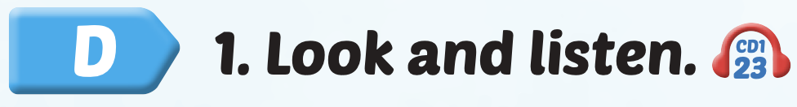

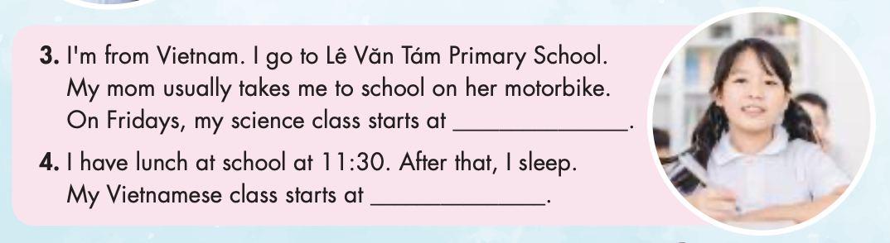
Click on D to hear the sound.

Slide 24

Reading

Slide 25

Writing

Slide 26

Click on 2 to hear the sound.
one o’clock
7:30 a.m.
1:40 p.m.

Slide 27

Production

Slide 28

Speaking

Slide 29


Slide 30

CONSOLIDATION

Slide 31
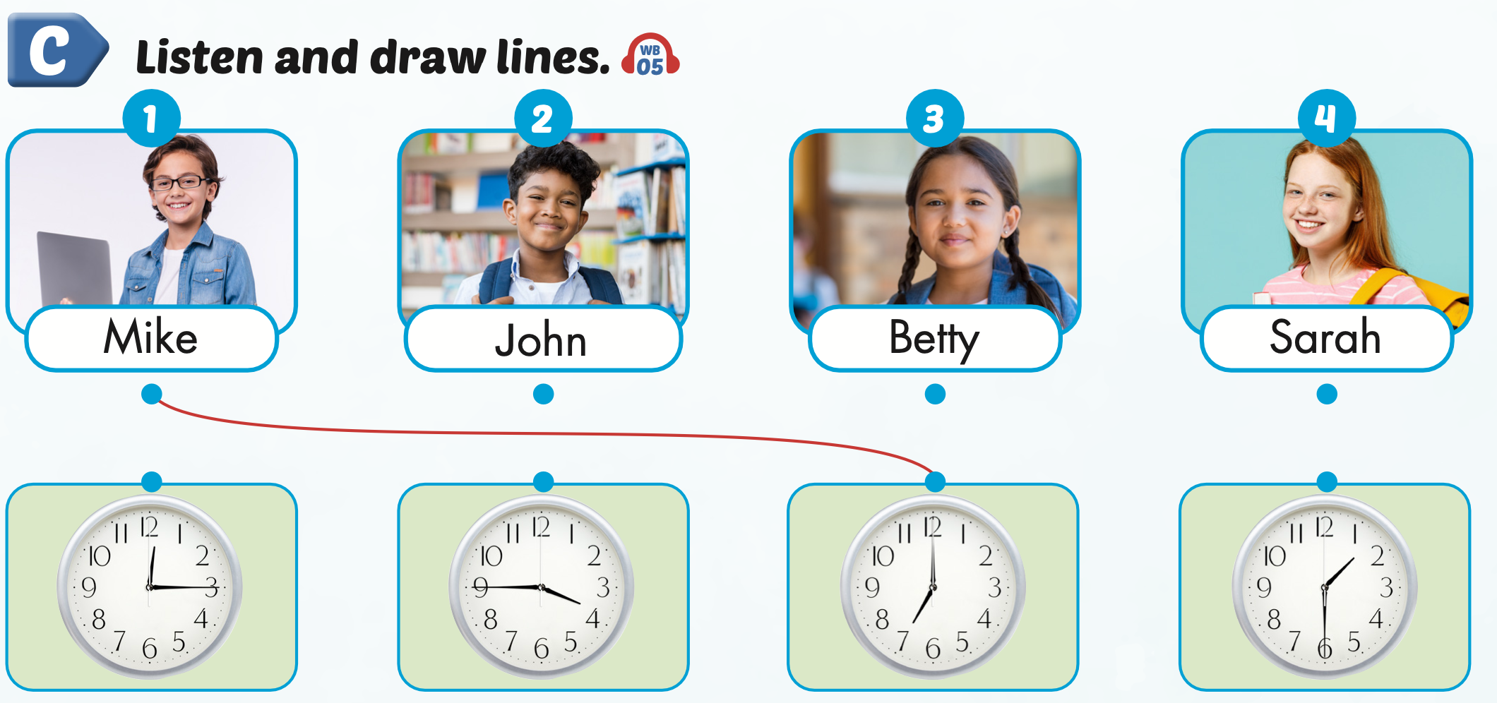
Extra Practice
WB, page 9
Click on the picture to hear the sound.

Slide 32

WRAP-UP

Slide 33
Today’s lesson
Vocabularies
a.m.,
p.m.,
eight o'clock,
two- thirty,
a quarter to four,
five past nine.
Structures/ Sentence patterns
What time does your English class start?
It starts at eight o'clock.

Slide 34
Homework
Practice the vocabularies and structure, and make sentences using them.
Do the exercises in Tiếng Anh 5 i-Learn Smart Start WB (page 9).
Do the exercises in Tiếng Anh 5 i-Learn Smart Start Notebook.
Prepare the next lesson (page 17 SB).
Play the consolidation games in Tiếng Anh 5 i-Learn Smart Start DHA App on www.eduhome.com.vn

Slide 35

Enjoy your day!

Slide 36

Lesson 3
Stay positive and have a nice day!

