Slide 1

Unit 1: SCHOOL
Culture – Lesson 1
Page 15

Slide 2
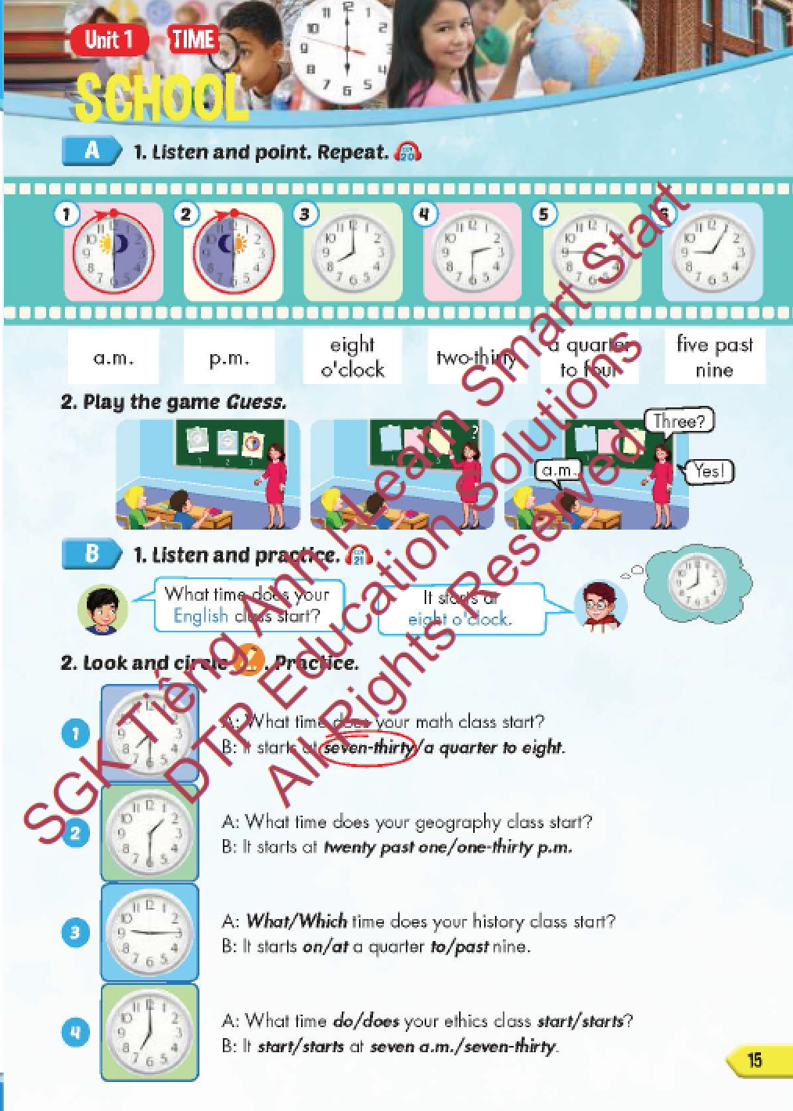
Lesson Outline
Warm-up
Vocabulary
Structure
Consolidation
Wrap-up

Slide 3
Objectives
By the end of this lesson, students will be able to recognize vocabulary expressing time and familiarize themselves with asking and answering about what time each class starts.
Vocabulary: a.m., p.m., eight o'clock, two- thirty, a quarter to four, five past nine.
Structure: What time does your English class start?
It starts at eight o'clock.

Slide 4

WARM-UP

Slide 5

Read and choose. Then say.

Slide 6
She always …………………… computers in I.T. class.
use
uses
using
NEXT

Slide 7
They never …………………… sports in P.E. class.
play
plays
playing
NEXT

Slide 8
She likes …………………… problems.
solve
solves
solving
NEXT

Slide 9
He rarely …………………… things in science class.
make
makes
making
NEXT

Slide 10

It’s time to learn …

Slide 11

New words
a.m.,
p.m.,
eight o'clock,
two- thirty,
a quarter to four,
five past nine.

Slide 12

Presentation

Slide 13
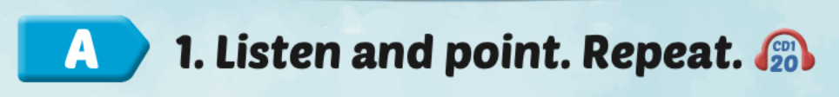

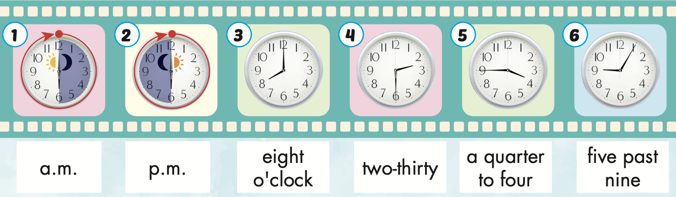
Click on A to hear the sound.
/ˌpiː ˈem/
(giờ) buổi chiều
/eɪt əˈklɑːk/
Tám giờ đúng
/tuː ˈθɜːrti/
hai giờ ba mươi phút
/ə ˈkwɔːrtər tə fɔːr/
bốn giờ kém mười lăm phút
/ˌeɪ ˈem/
(giờ) buổi sáng
/faɪv pæst naɪn/
chín giờ năm phút
Notes:
Click vào hình A. 1. Listen and point. Repeat để cho cả audio full chạy

Slide 14
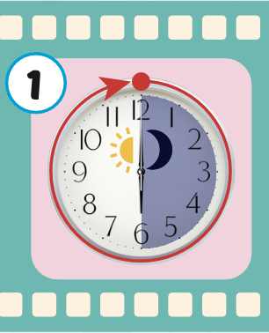
Click on the picture to hear the sound.
a.m.
/ˌeɪ ˈem/
(giờ) buổi sáng

Slide 15
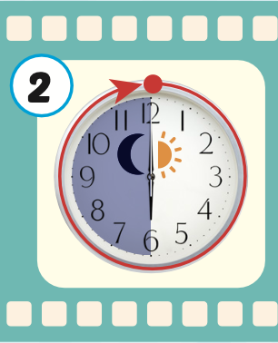
Click on the picture to hear the sound.
p.m.
/ˌpiː ˈem/
(giờ) buổi chiều

Slide 16
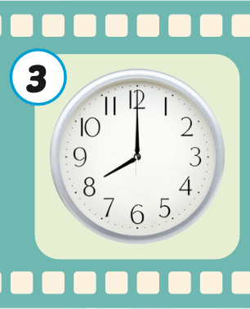
Click on the picture to hear the sound.
eight o’clock
/eɪt əˈklɑːk/
Tám giờ đúng

Slide 17
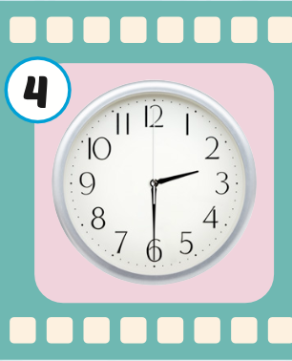
Click on the picture to hear the sound.
two thirty
/tuː ˈθɜːrti/
hai giờ ba mươi phút

Slide 18
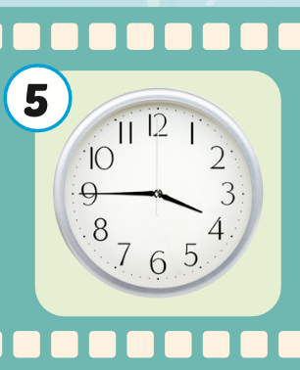
Click on each picture to hear the sound.
a quarter to four
/ə ˈkwɔːrtər tə fɔːr/
bốn giờ kém mười lăm phút

Slide 19
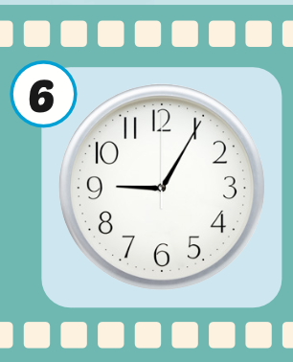
Click on the picture to hear the sound.
five past nine
/faɪv pæst naɪn/
chín giờ năm phút

Slide 20
Practice

Slide 21
Listen and choose. Then say.

Slide 22

Listen and choose
A
B
C

Slide 23
Listen and choose
C
A
B

Slide 24
Listen and choose
B
C
A

Slide 25
Listen and choose
A
B
C

Slide 26

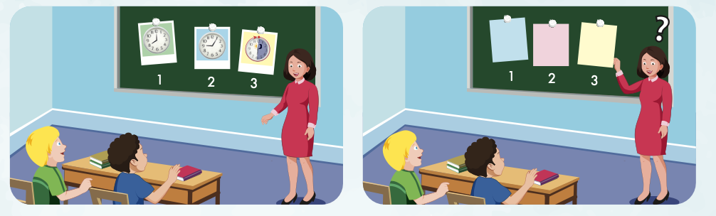
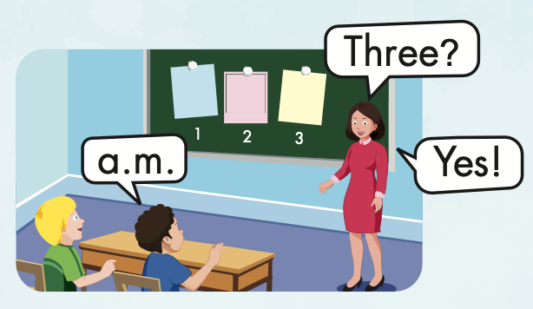

Slide 27
Structure
What time does your English class start?
It starts at eight o'clock.

Slide 28
Presentation

Slide 29
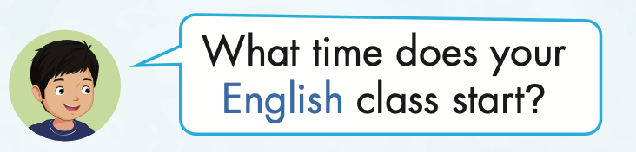
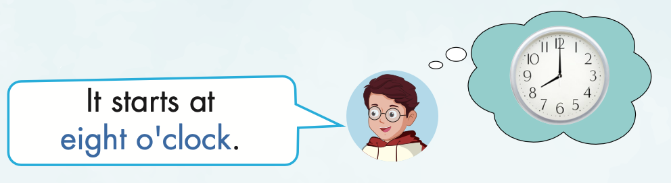
Structure

Slide 30

Listening

Slide 31

Click on B to hear the sound.

Slide 32

Practice

Slide 33

Writing

Slide 34
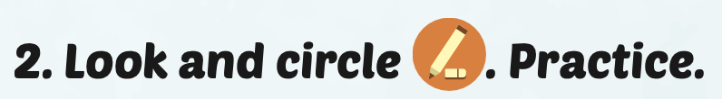
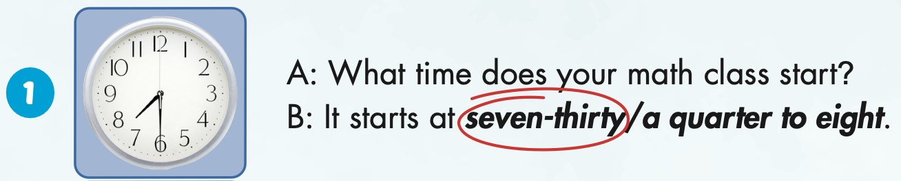
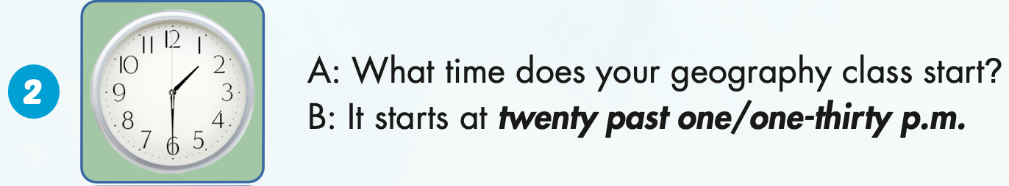

Slide 35
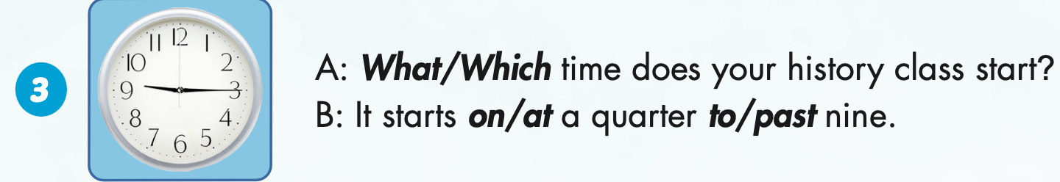

Slide 36
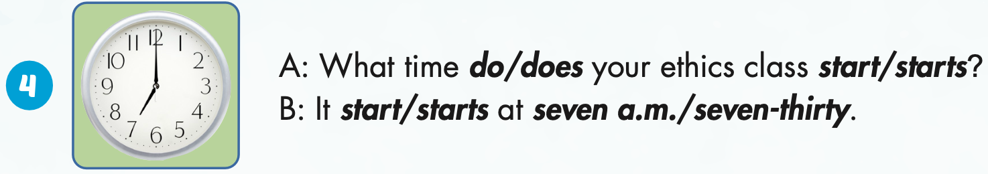

Slide 37

Production

Slide 38

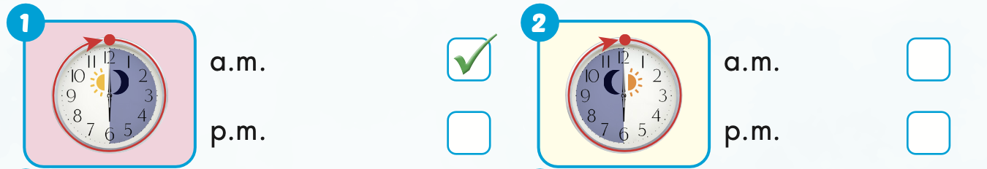

Extra Practice
WB, page 8

Slide 39
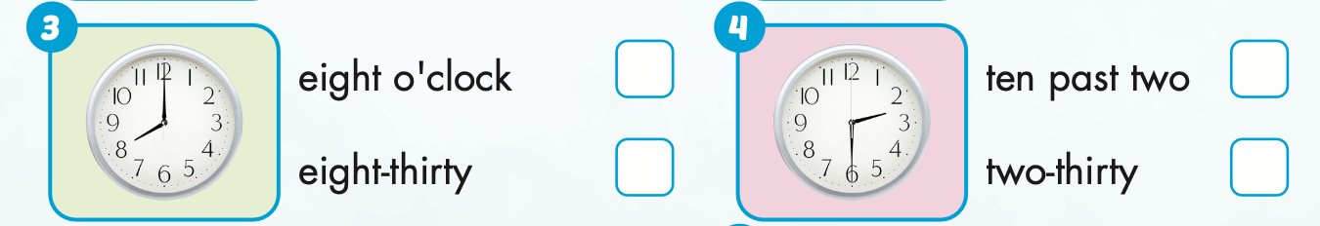
Extra Practice
WB, page 8

Slide 40
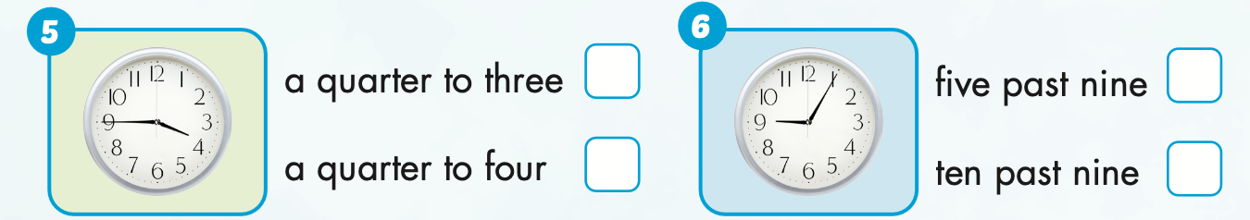
Extra Practice
WB, page 8

Slide 41

CONSOLIDATION

Slide 42




TELLING THE TIME
12
11
1
10
2
9
3
8
4
7
5
6

Slide 43
WHAT TIME DOES YOUR HISTORY CLASS START?
12
11
1
10
2
9
3
8
4
7
5
6
It starts at two o’clock.

Slide 44
WHAT TIME DOES YOUR ETHICS CLASS START?
12
11
1
10
2
9
3
8
4
7
5
6
It starts at five past nine.

Slide 45
WHAT TIME DOES YOUR ENGLISH CLASS START?
12
11
1
10
2
9
3
8
4
7
5
6
It starts at a quarter past seven.

Slide 46
WHAT TIME DOES YOUR ART CLASS START?
12
11
1
10
2
9
3
8
4
7
5
6
It starts at twenty to ten.

Slide 47
It starts at half-past three.
12
11
1
10
2
9
3
8
4
7
5
6
WHAT TIME DOES YOUR VIETNAMESE CLASS START?

Slide 48
WHAT TIME DOES YOUR MUSIC CLASS START?
12
11
1
10
2
9
3
8
4
7
5
6
It starts at twenty-five to eight.

Slide 49
WHAT TIME DOES YOUR SCIENCE CLASS START?
12
11
1
10
2
9
3
8
4
7
5
6
It starts at a quarter to five.

Slide 50
WHAT TIME DOES YOUR I.T. CLASS START?
12
11
1
10
2
9
3
8
4
7
5
6
It starts at five to four.

Slide 51

WRAP-UP

Slide 52
Today’s lesson
Vocabularies
a.m.,
p.m.,
eight o'clock,
two- thirty,
a quarter to four,
five past nine.
Structures/ Sentence patterns
What time does your English class start?
It starts at eight o'clock.

Slide 53
Homework
Practice the vocabularies and structure, and make sentences using them.
Do the exercises in Tiếng Anh 5 i-Learn Smart Start WB (page 8).
Do the exercises in Tiếng Anh 5 i-Learn Smart Start Notebook.
Prepare the next lesson (page 16 SB).
Play the consolidation games in Tiếng Anh 5 i-Learn Smart Start DHA App on www.eduhome.com.vn

Slide 54

Enjoy your day!

Slide 55
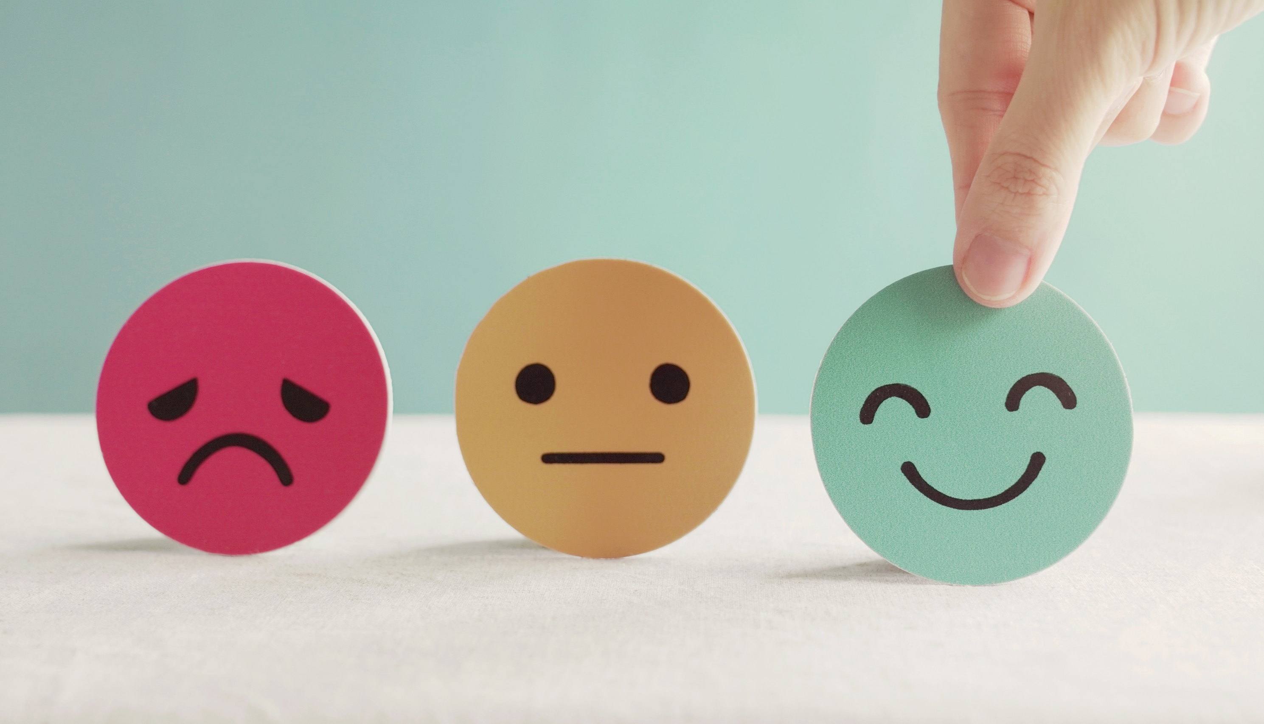
Lesson 3
Stay positive and have a nice day!

