Slide 1

Unit 1: SCHOOL
Lesson 2.3
Page 11

Slide 2
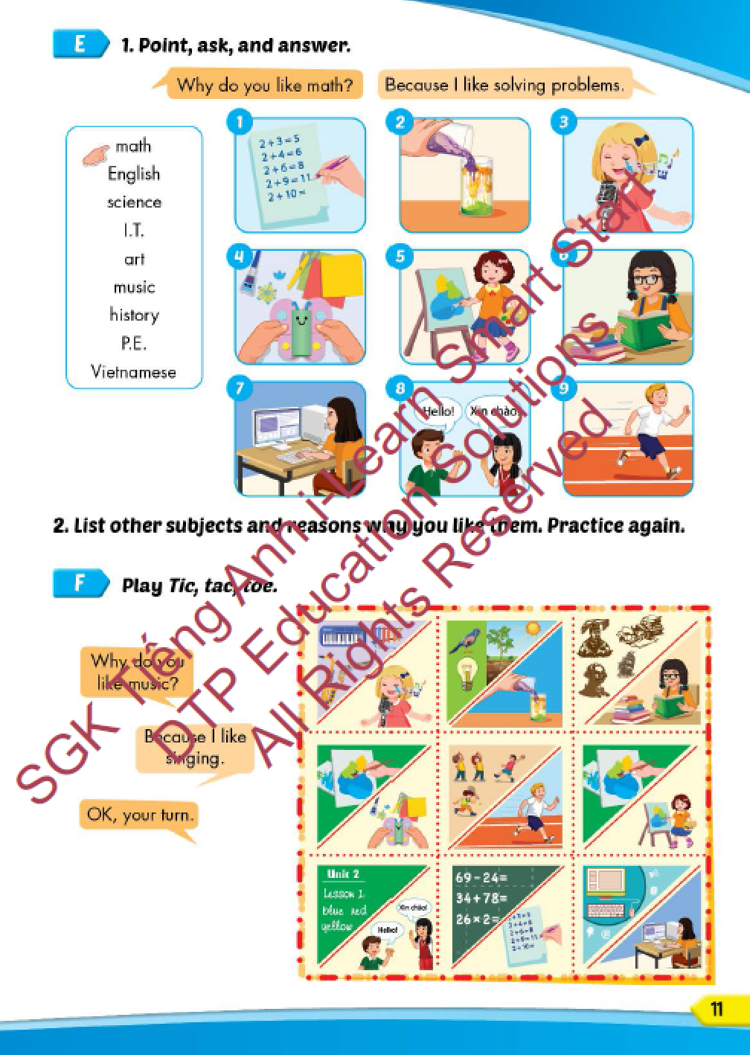
Lesson Outline
Warm-up
Practice
Speaking
Consolidation
Wrap-up

Slide 3
Objectives
By the end of this lesson, students will be able to ask and answer about why they like different school subjects correctly.
Vocabulary: solving problems, doing experiments, making things, using computers, reading stories, learning languages.
Structure: Why do you like math?
Because I like solving problems.

Slide 4

WARM-UP

Slide 5



Slide 6
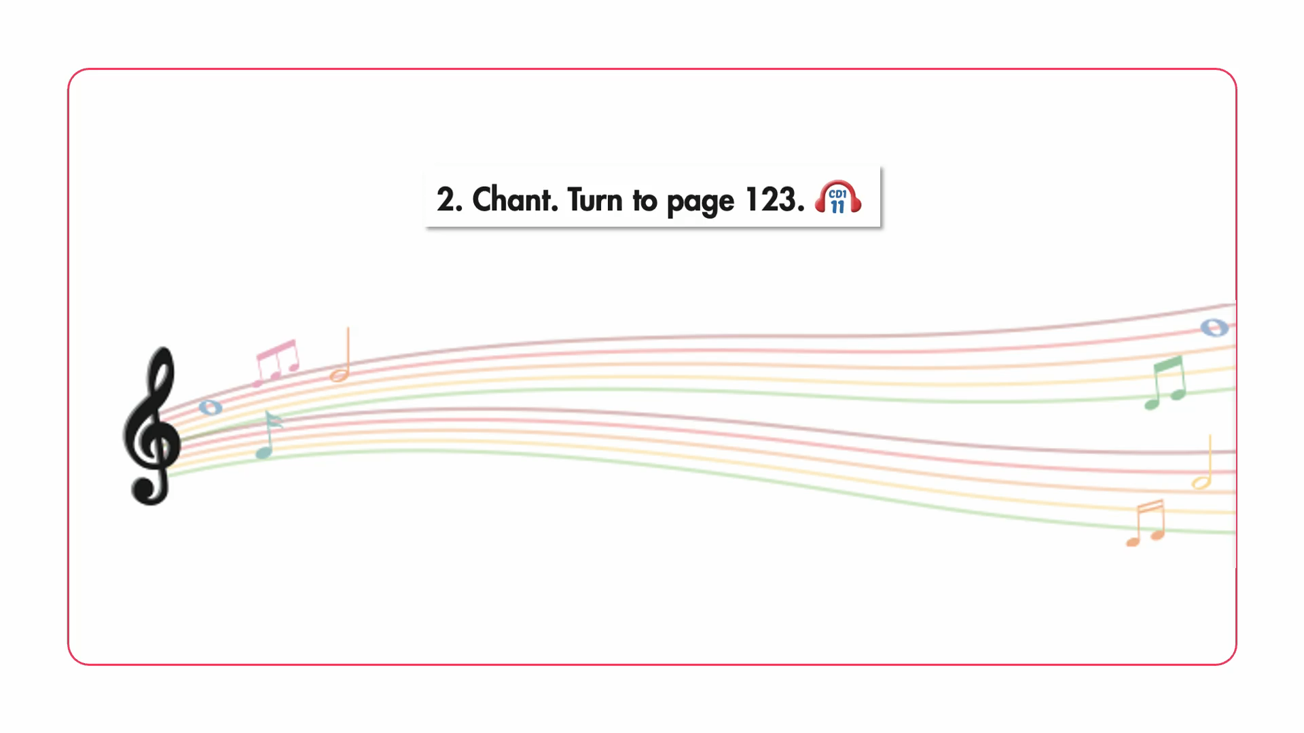

Slide 7

New words
solving problems,
doing experiments,
making things,
using computers,
reading stories,
learning languages.

Slide 8
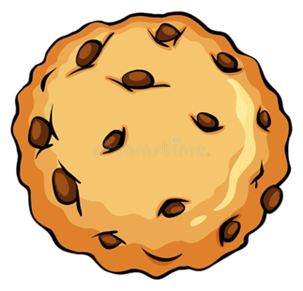

WHERE IS THE COOKIE ?

Slide 9
Chooses a cookie jar and reads the word.
Click on the jar to find out if the cookie is hidden in it.

Slide 10

geography
Vietnamese
I.T.
ethics
history

Slide 11
science
experiment
stories
languages
using

Slide 12
solving
doing
making
learning
reading

Slide 13
solving problems
reading stories
doing experiments
using computers
learning languages

Slide 14
Structure
Why do you like math?
- Because I like solving problems.

Slide 15

Practice

Slide 16

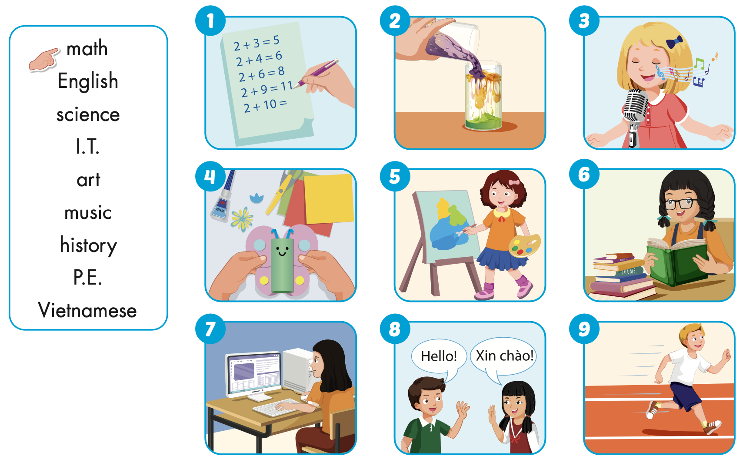

Slide 17

Speaking

Slide 18
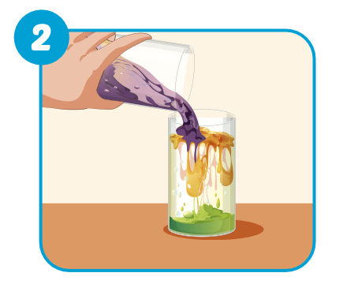
Why do you like sicence?
Because I like doing experiments.

Slide 19
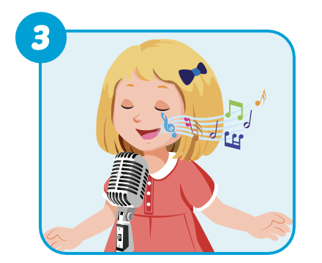
Why do you like music?
Because I like singing.

Slide 20
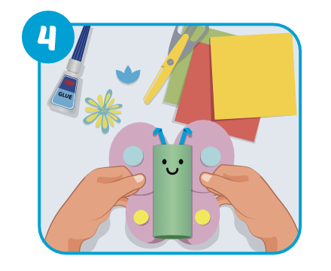
Why do you like arts and crafts?
Because I like making things.

Slide 21
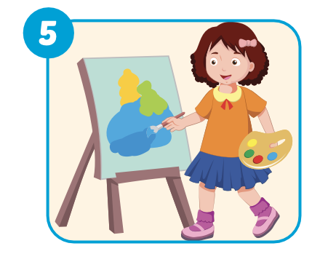
Why do you like art?
Because I like painting.

Slide 22

Why do you like history?
Because I like reading stories.

Slide 23
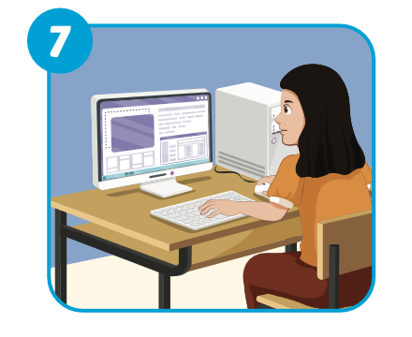
Why do you like I.T.?
Because I like using computers.

Slide 24
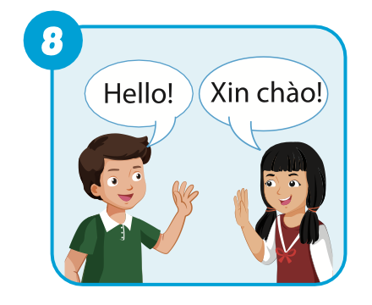
Why do you like English?
Because I like learning languages.

Slide 25
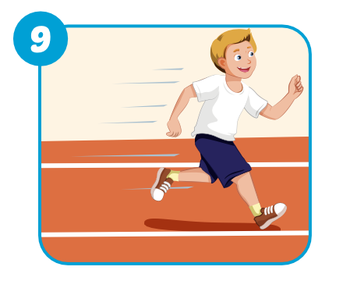
Why do you like P.E.?
Because I like playing sports.

Slide 26

Production

Slide 28

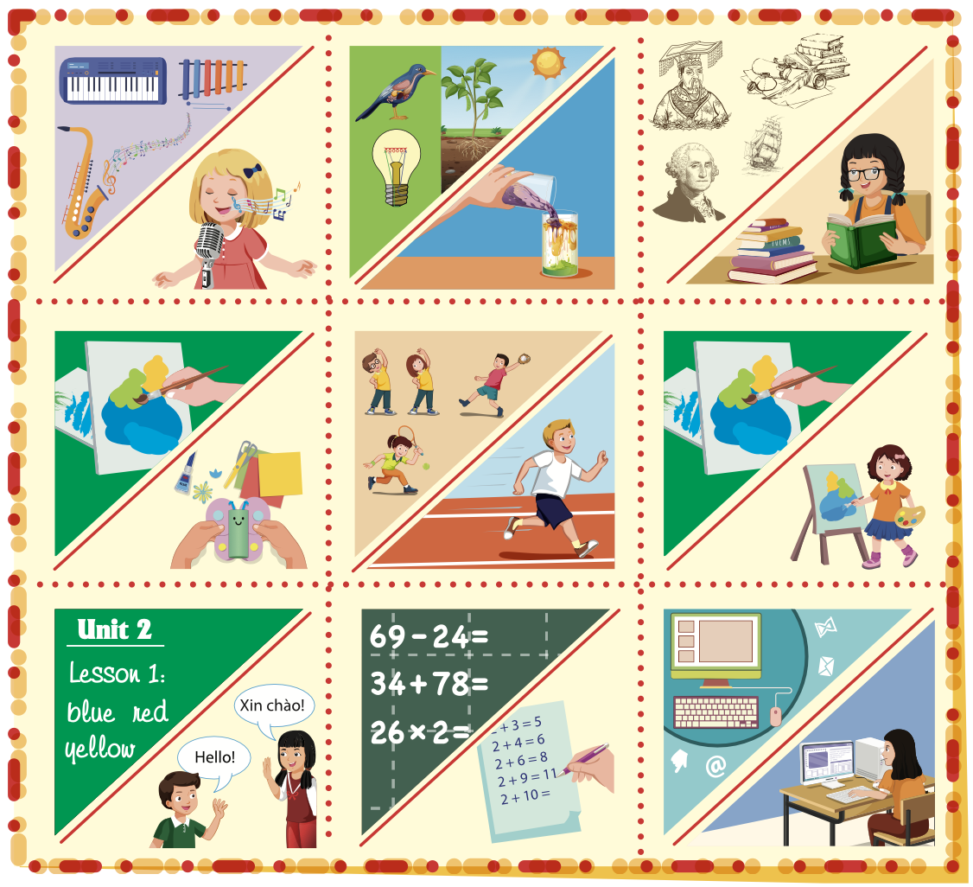
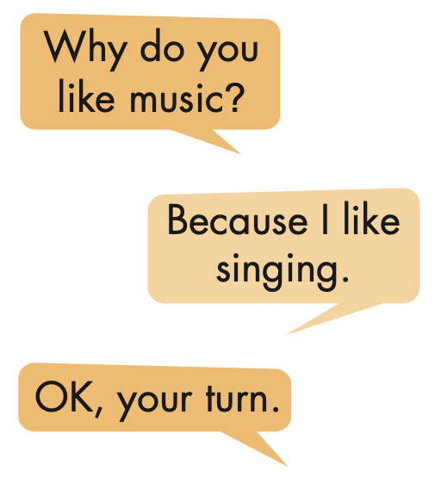

Slide 29

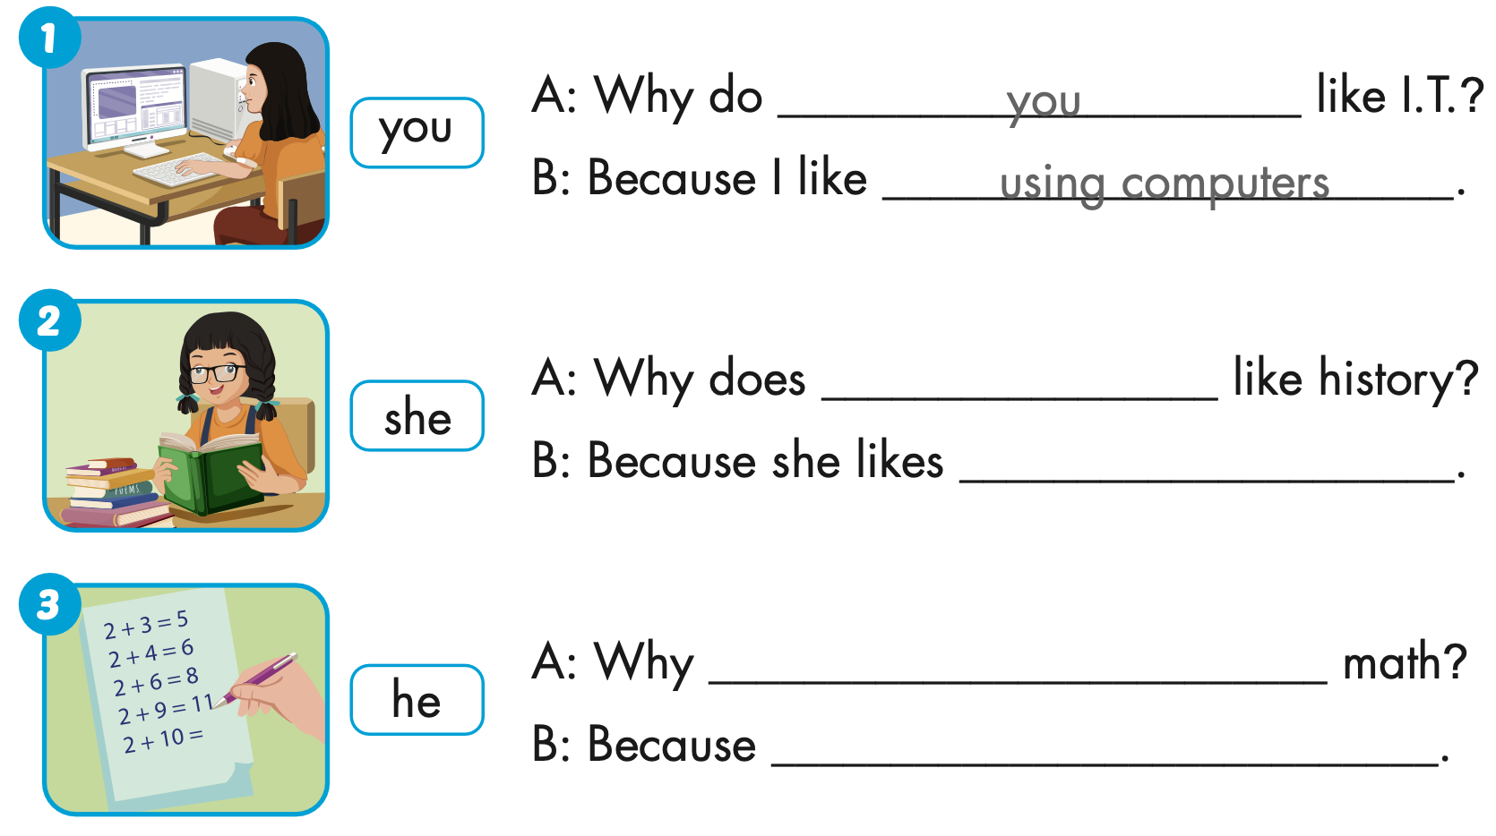
Extra Practice
WB, page 5
she
reading stories
does he like
he likes solving problems.

Slide 30
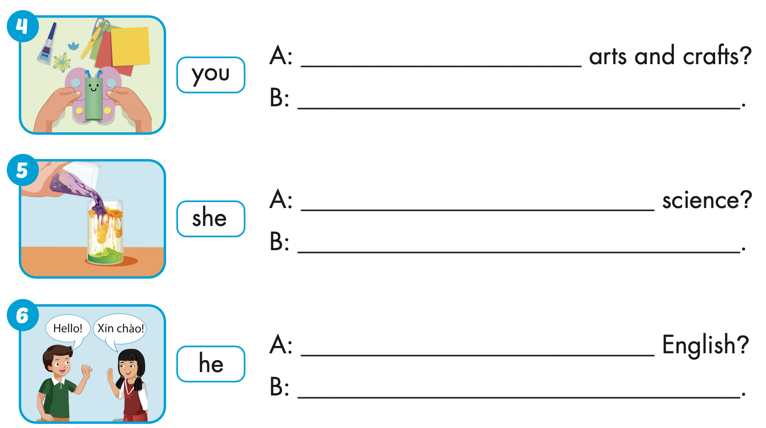
Extra Practice
WB, page 5
Why do you like
Because I like making things.
Why does she like
Because she likes doing experiments.
Why does he like
Because he likes learning languages.

Slide 31

CONSOLIDATION

Slide 32
READ AND CHOOSE.

Slide 33
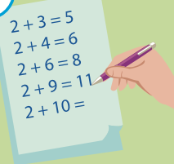
SOLVING
PAINTING
LEARNING
solving
I like …………….. problems.

Slide 34
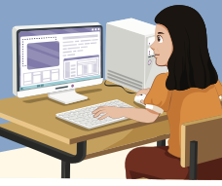
PAINTING
USING
READING
using
I like …………….. computers.

Slide 35
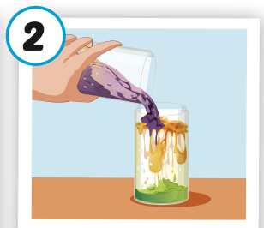
LEARNING
PAINTING
DOING
doing
She likes …………….. experiments.

Slide 36
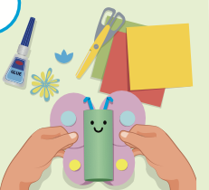
MAKING
READING
LEARNING
making
We like …………….. things.

Slide 37

WRAP-UP

Slide 38
Today’s lesson
Vocabularies
solving problems, doing experiments, making things,
using computers, reading stories, learning languages.
Structures/ Sentence patterns
Why do you like math?
- Because I like solving problems.

Slide 39
Homework
Practice the vocabularies and structure, and make sentences using them.
Do the exercises in Tiếng Anh 5 i-Learn Smart Start WB (page 5).
Do the exercises in Tiếng Anh 5 i-Learn Smart Start Notebook.
Prepare the next lesson (page 12 SB).
Play the consolidation games in Tiếng Anh 5 i-Learn Smart Start DHA App on www.eduhome.com.vn

Slide 40

Enjoy your day!

Slide 41

Lesson 3
Stay positive and have a nice day!

