Slide 1

Unit 1: SCHOOL
Lesson 3.1
Page 12

Slide 2
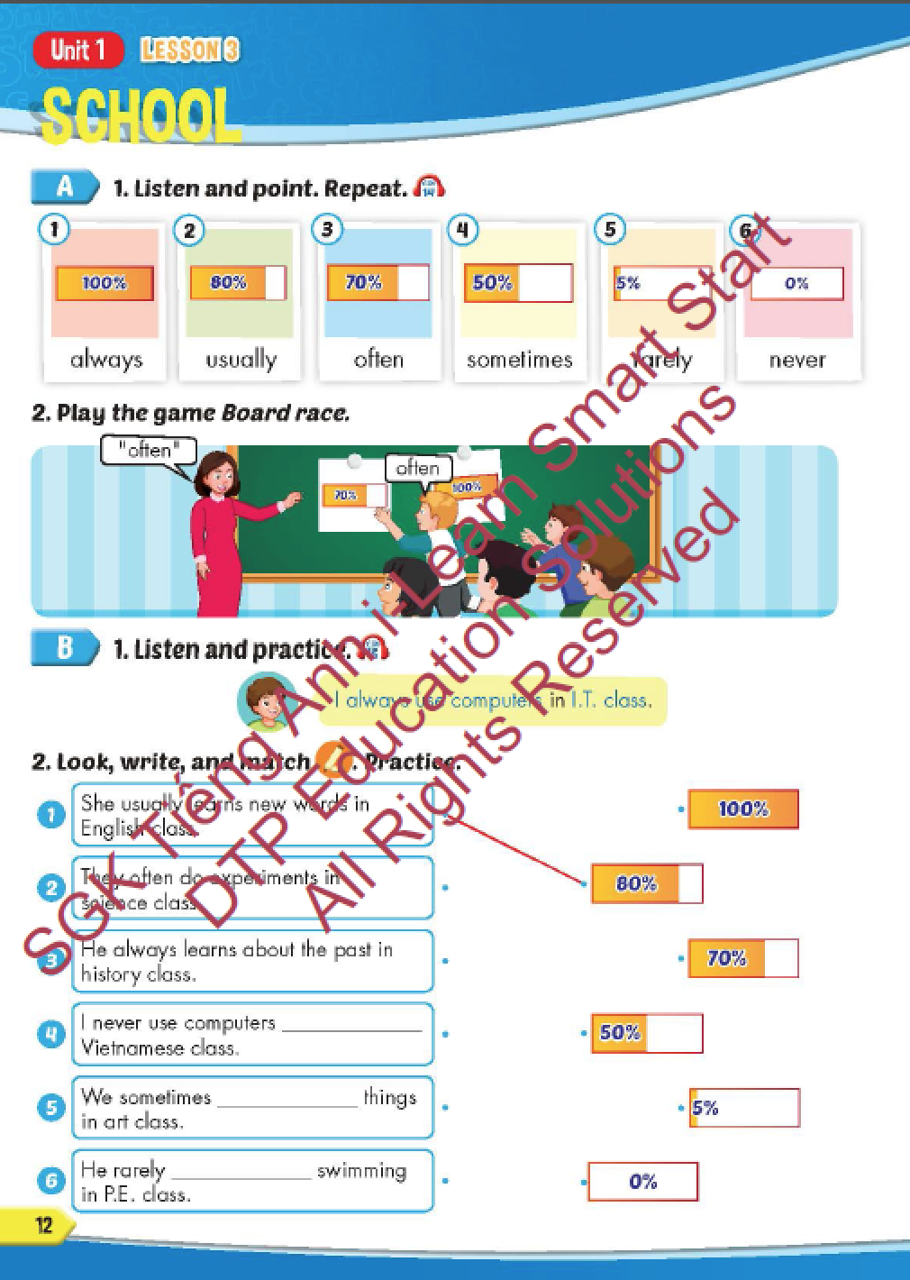
Lesson Outline
Warm-up
Vocabulary
Structure
Consolidation
Wrap-up

Slide 3
Objectives
By the end of this lesson, students will be able to recognize and practice adverbs of frequency and practice saying how often they do things in different classes.
Vocabulary: always, usually, often, sometimes, rarely, never.
Structure: I always use computers in I.T. class.

Slide 4

WARM-UP

Slide 5
READ AND CHOOSE.

Slide 6
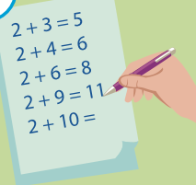
SOLVING
PAINTING
LEARNING
solving
I like …………….. problems.

Slide 7
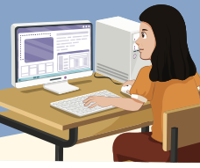
PAINTING
USING
READING
using
I like …………….. computers.

Slide 8
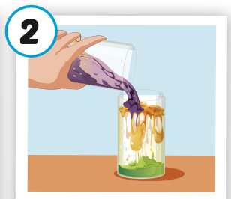
LEARNING
PAINTING
DOING
doing
She likes …………….. experiments.

Slide 9
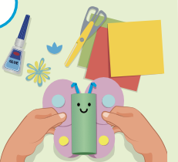
MAKING
READING
LEARNING
making
We like …………….. things.

Slide 10

It’s time to learn …

Slide 11

New words
always,
usually,
often,
sometimes,
rarely,
never.

Slide 12

Presentation

Slide 13


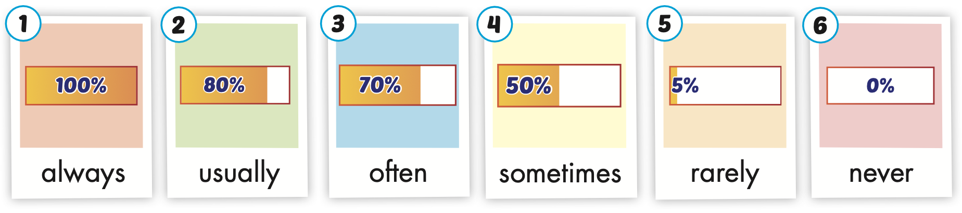
Click on the picture to hear the sound.
/ˈɑːlweɪz/
luôn luôn
/ˈjuːʒuəli/
thường xuyên
/ˈɔːfən/
thường
/ˈsʌmtaɪmz/
thỉnh thoảng
/ˈrerli/
hiếm khi
/ˈnevər/
không bao giờ
Notes:
Click vào hình A. 1. Listen and point. Repeat để cho cả audio full chạy

Slide 14
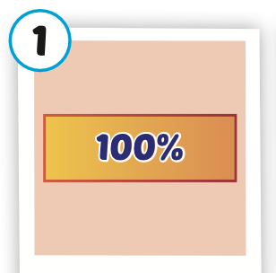
Click on the picture to hear the sound.
always
/ˈɑːlweɪz/
luôn luôn

Slide 15
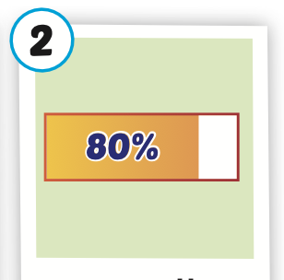
Click on the picture to hear the sound.
usually
/ˈjuːʒuəli/
thường xuyên

Slide 16
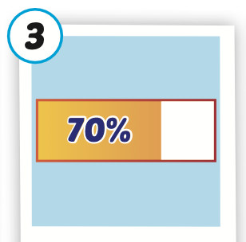
Click on the picture to hear the sound.
often
/ˈɔːfən/
thường

Slide 17
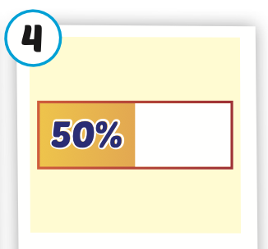
Click on the picture to hear the sound.
sometimes
/ˈsʌmtaɪmz/
thỉnh thoảng

Slide 18
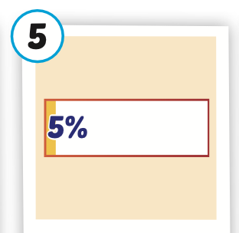
Click on the picture to hear the sound.
rarely
/ˈrerli/
hiếm khi

Slide 19
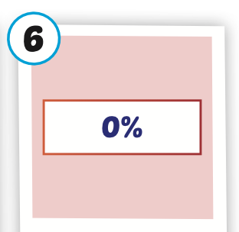
Click on the picture to hear the sound.
never
/ˈnevər/
không bao giờ

Slide 20
Practice

Slide 21
Look, read and choose

Slide 22

Look, read and choose
NEVER
A
B
C

Slide 23
Look, read and choose
SOMETIMES
A
B
C

Slide 24
Look, read and choose
RARELY
A
B
C

Slide 25
Look, read and choose
ALWAYS
A
B
C

Slide 26
Look, read and choose
OFTEN
A
B
C

Slide 27

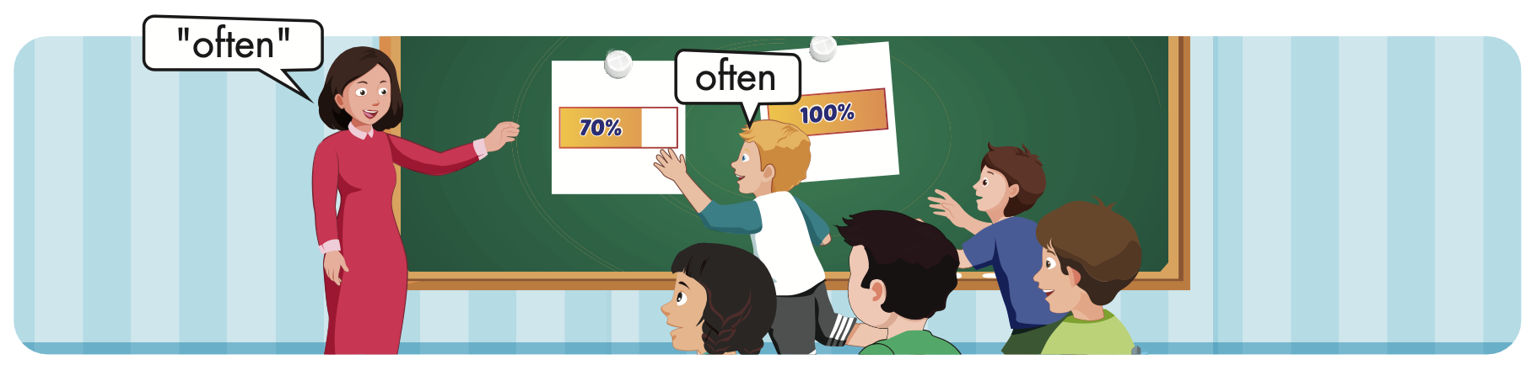

Slide 28
Structure
I always use computers in I.T. class.

Slide 29
Presentation

Slide 30

Structure

Slide 31

Practice

Slide 32

Click on B to hear the sound.

Slide 33
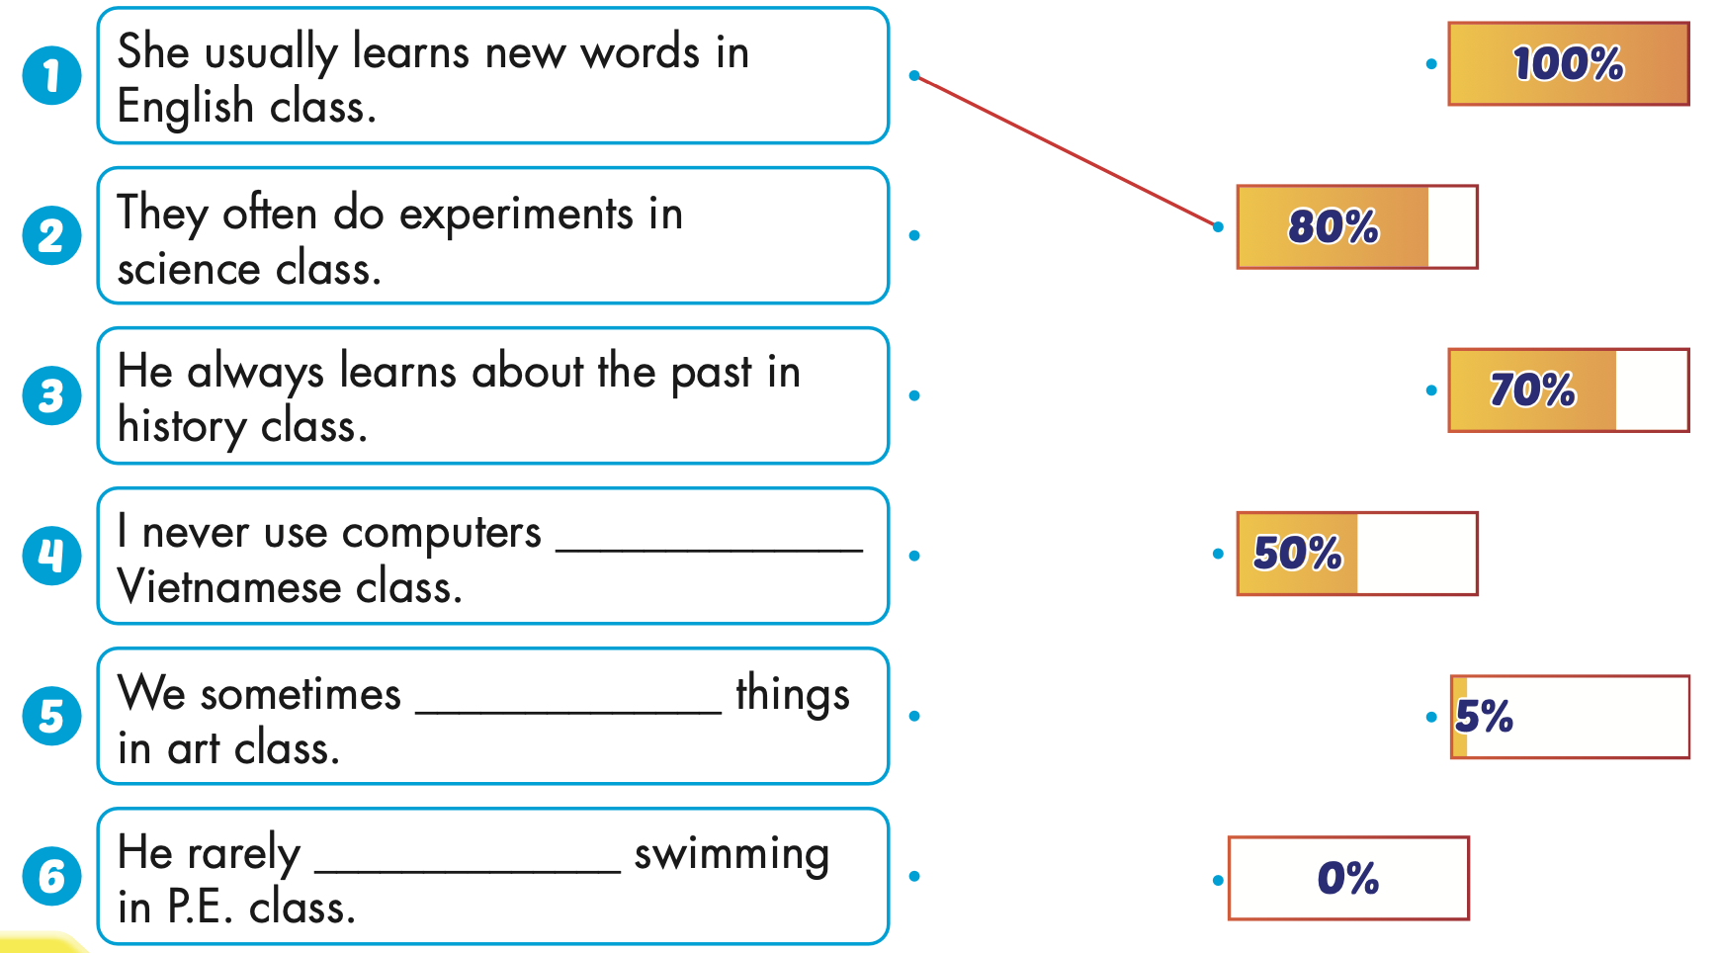
in
make
go

Slide 34
Work in pairs. One points at the percentages, and the other reads the sentences.
in
make
go

Slide 35

Production

Slide 36
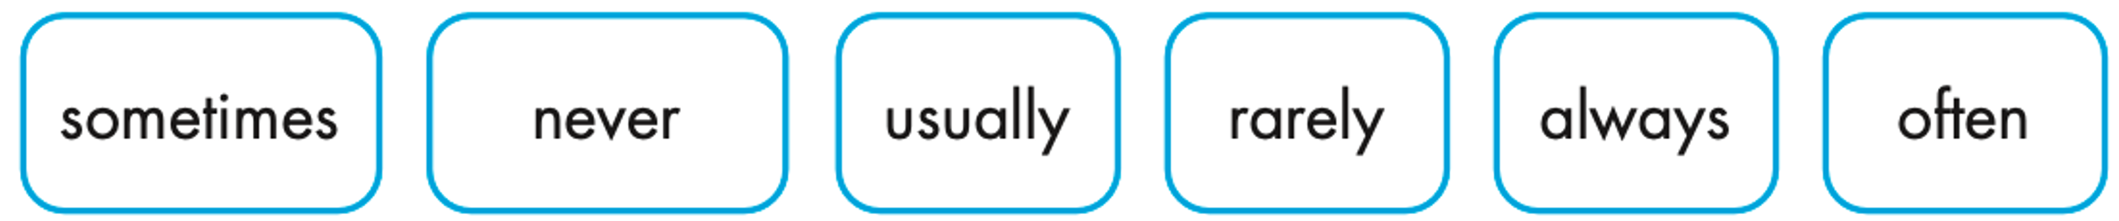
Make sentences using these words. Then read your sentences to a partner.
I sometimes do experiments in my science class.

Slide 37

CONSOLIDATION

Slide 38

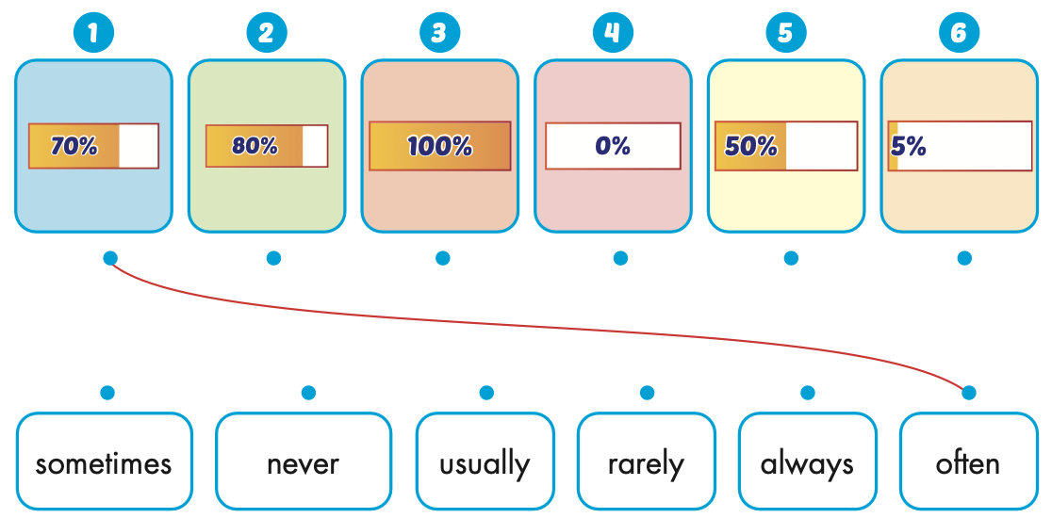
Extra Practice
WB, page 6

Slide 39

WRAP-UP

Slide 40
Today’s lesson
Vocabularies
always, usually, often, sometimes, rarely, never.
Structures/ Sentence patterns
I always use computers in I.T. class.

Slide 41
Homework
Practice the vocabularies and structure, and make sentences using them.
Do the exercises in Tiếng Anh 5 i-Learn Smart Start WB (page 6).
Do the exercises in Tiếng Anh 5 i-Learn Smart Start Notebook.
Prepare the next lesson (page 13 SB).
Play the consolidation games in Tiếng Anh 5 i-Learn Smart Start DHA App on www.eduhome.com.vn

Slide 42

Enjoy your day!

Slide 43

Lesson 3
Stay positive and have a nice day!

