Slide 1

Unit 2: Holidays
Lesson 2.2
Page 24

Slide 2
Objectives
By the end of this lesson, students will be able to…
Word stress: Practice word stress - 'twenty-fifth, 'thirty-first
Structure: Practice asking and answering about dates
When's Christmas Day?
- It's on December twenty-fifth.

Slide 3

WARM-UP

Slide 4
CHECK-UP

Slide 5

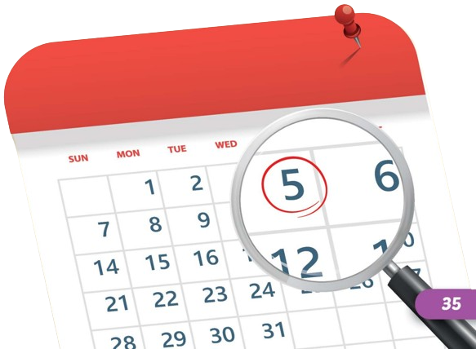
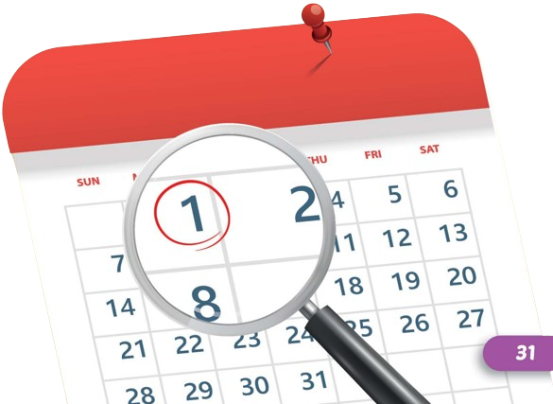
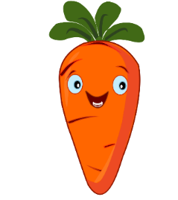
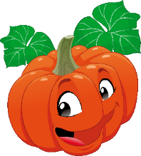


Listen and choose
A
B

Slide 6
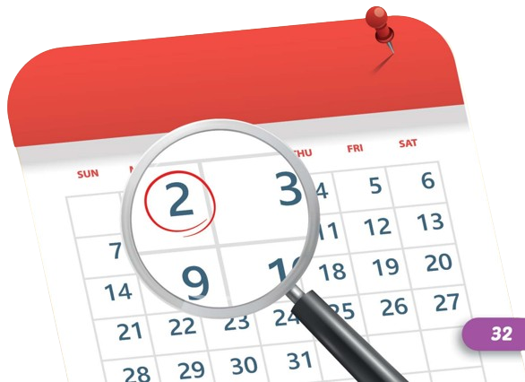

Listen and choose
A
B

Slide 7
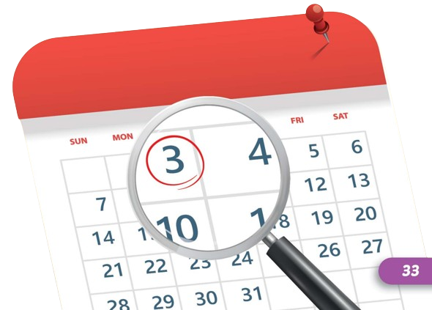
Listen and choose
A
B

Slide 8
Listen and choose
B
A

Slide 9
Listen and choose
A
B

Slide 10

It’s time to learn …

Slide 11

Stress
'twenty-fifth, 'thirty-first

Slide 12
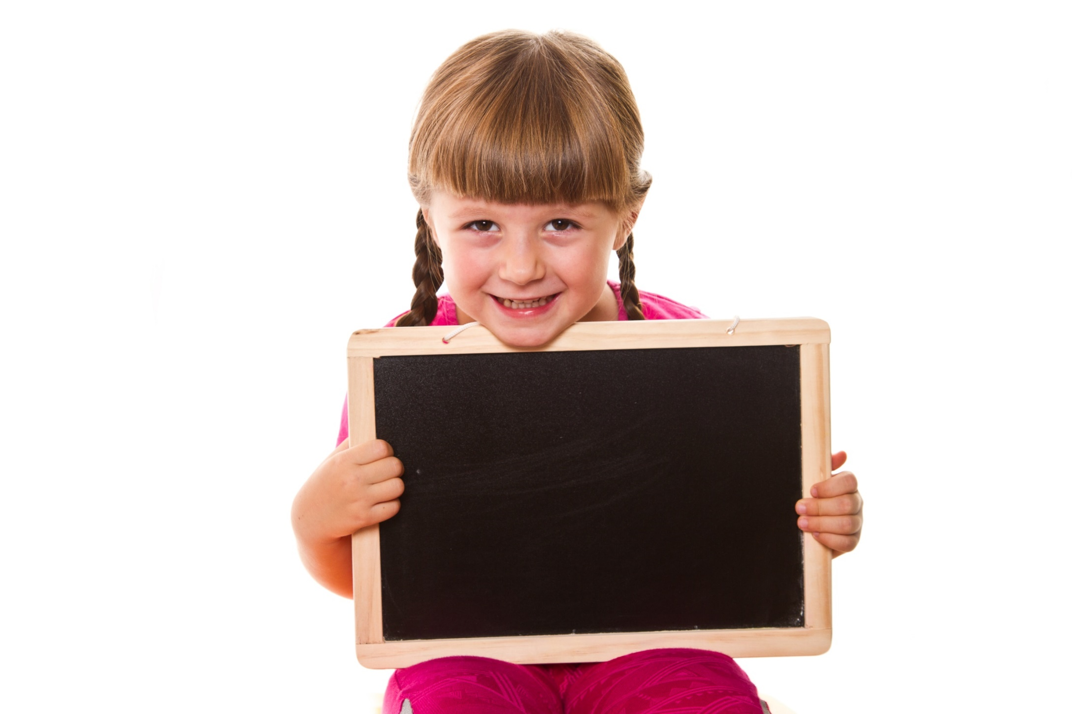
Listening

Slide 13
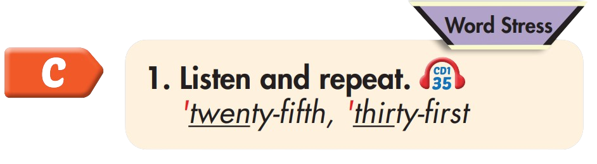
'twenty-fifth
'thirty-first

Slide 14
Practice

Slide 15

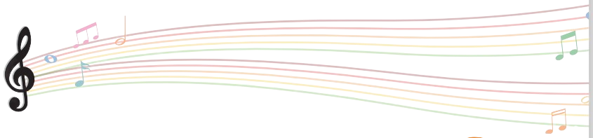

Slide 16
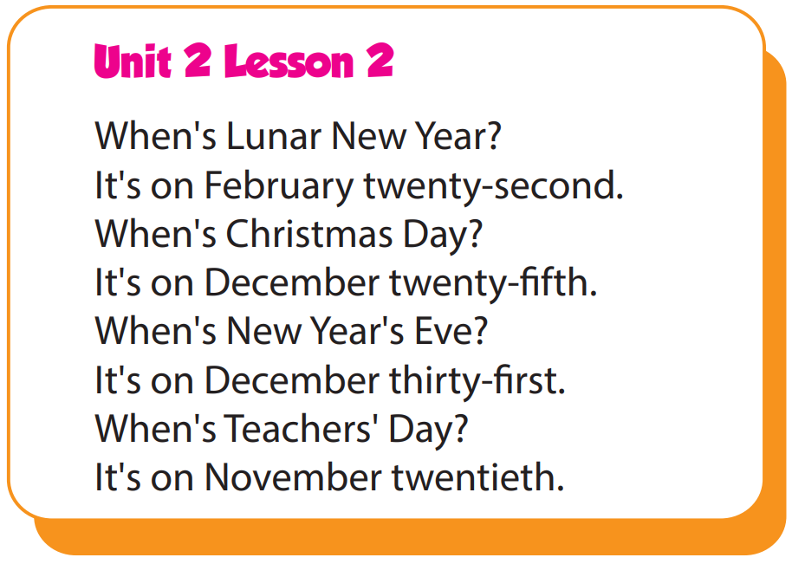

Slide 17
Structure
When's Christmas Day?
- It's on December twenty-fifth.

Slide 18
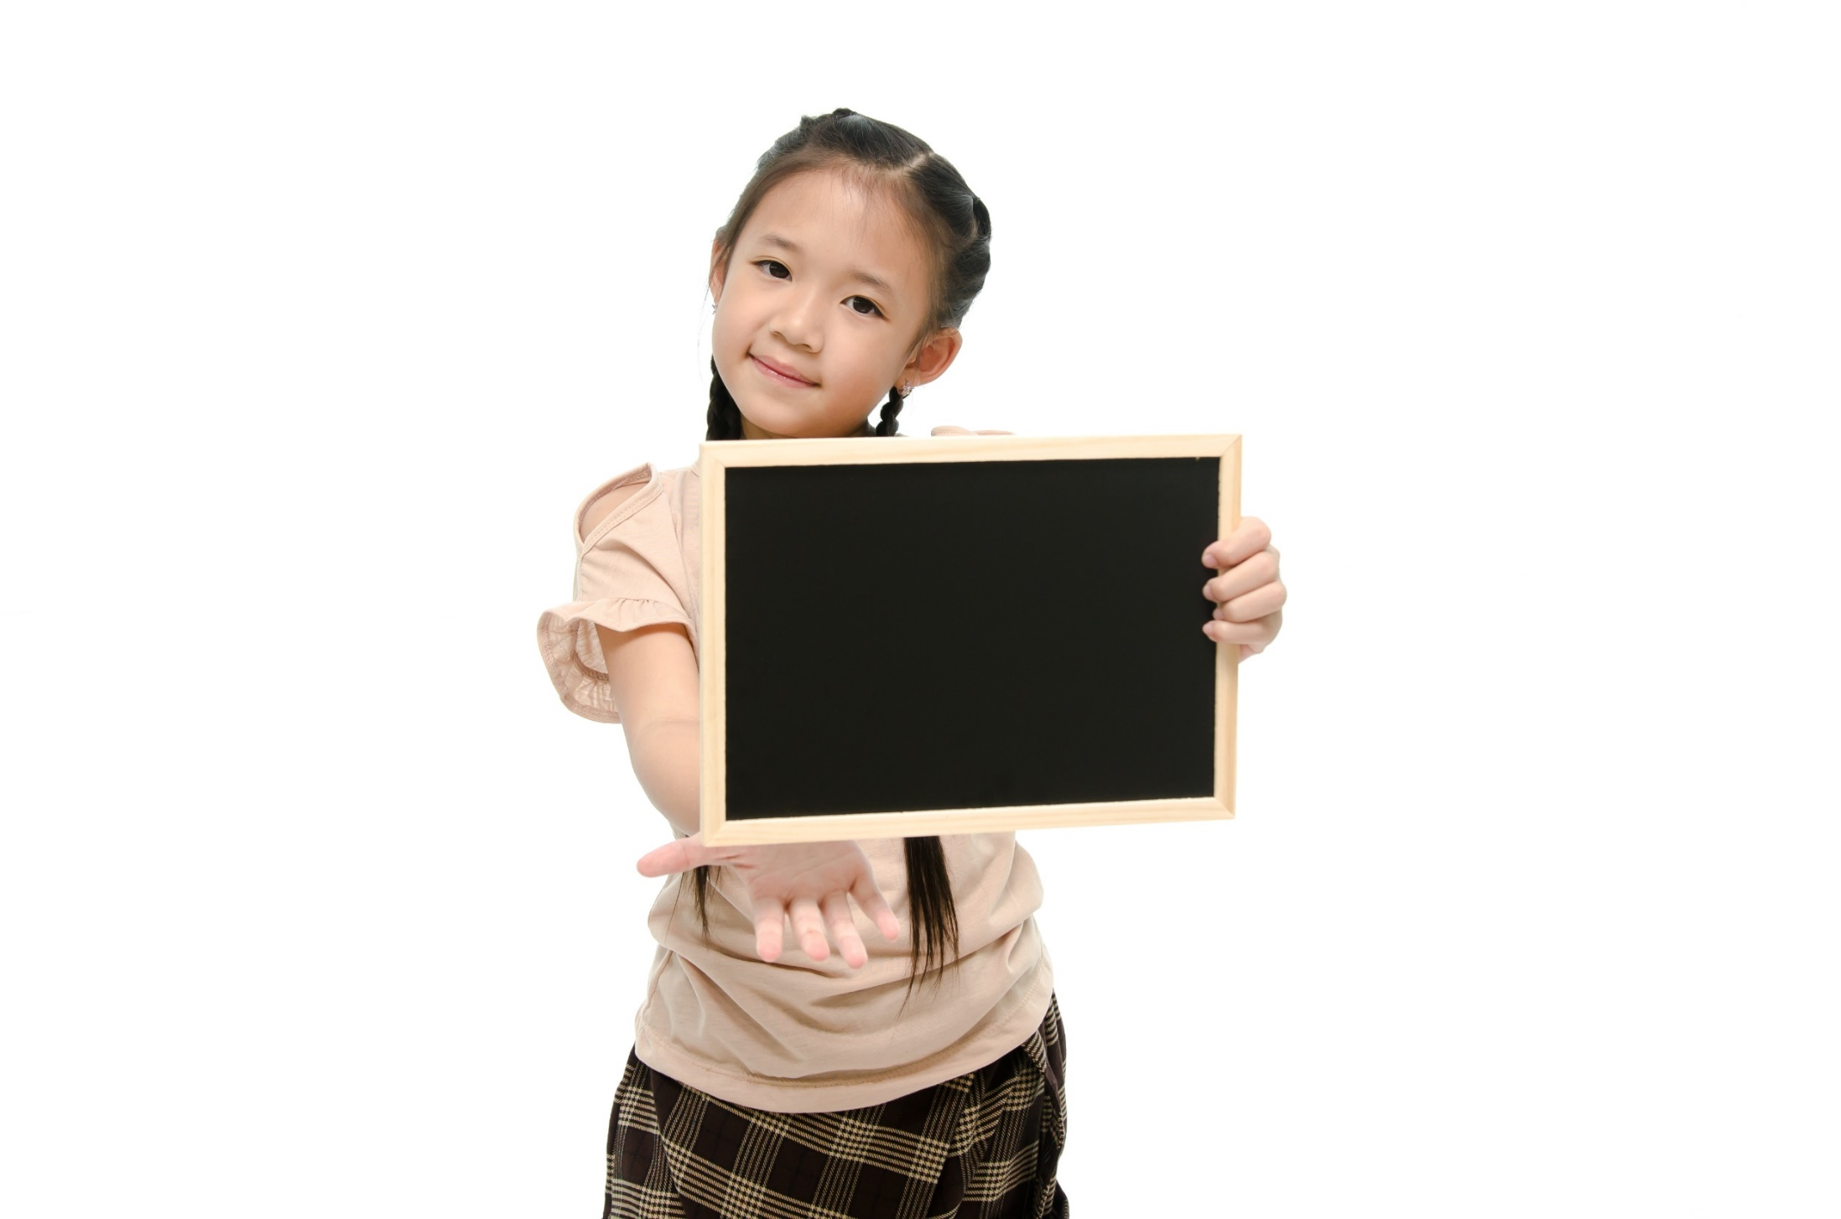
Speaking

Slide 19
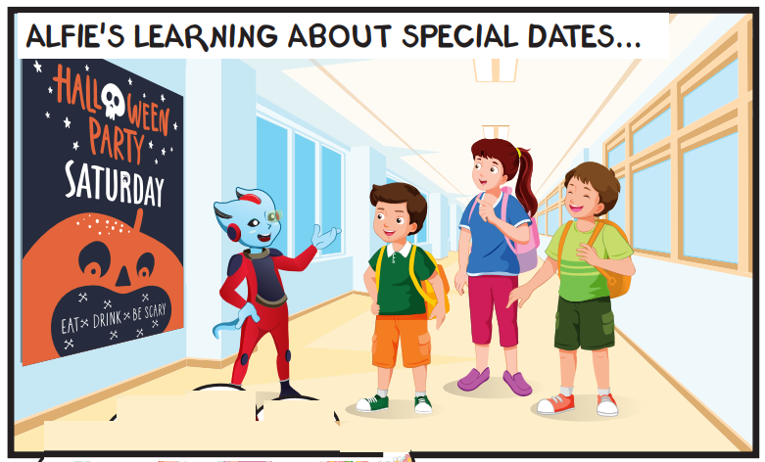
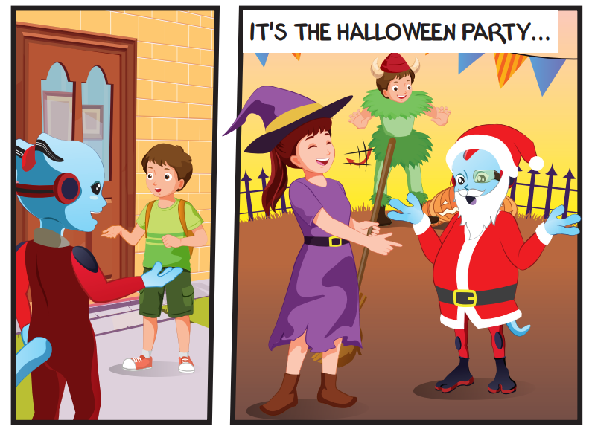
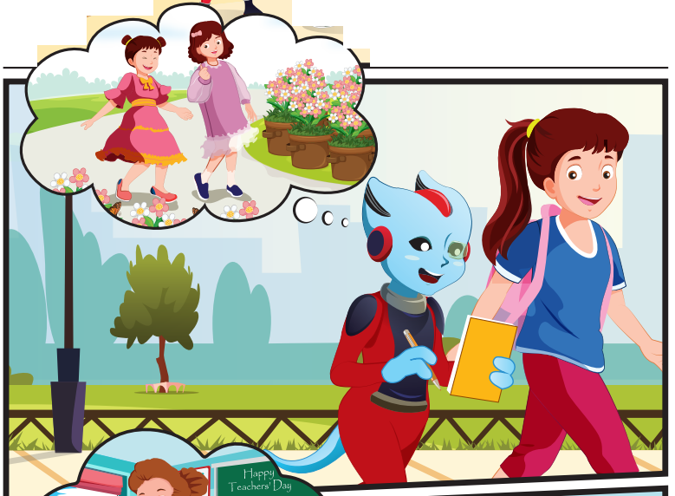
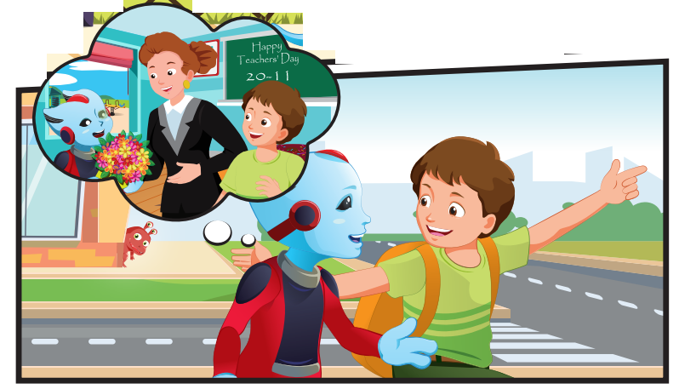
Who can you see?
Alfie, Tom, Lucy, Ben

Slide 20
Where are they?
They're outside.

Slide 21
What are they talking about?
They're talking about holidays.

Slide 22
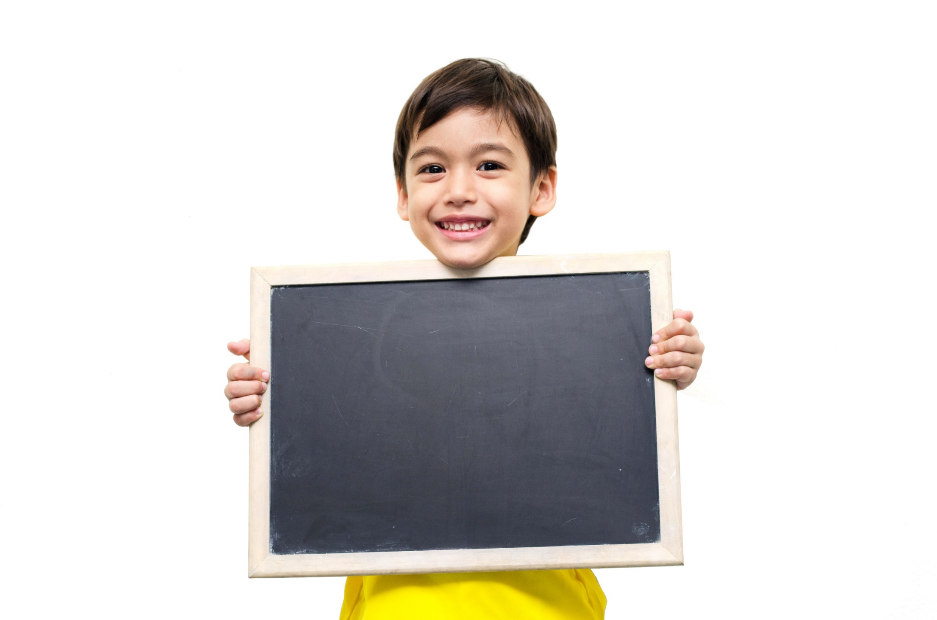
Listening

Slide 23


Slide 24

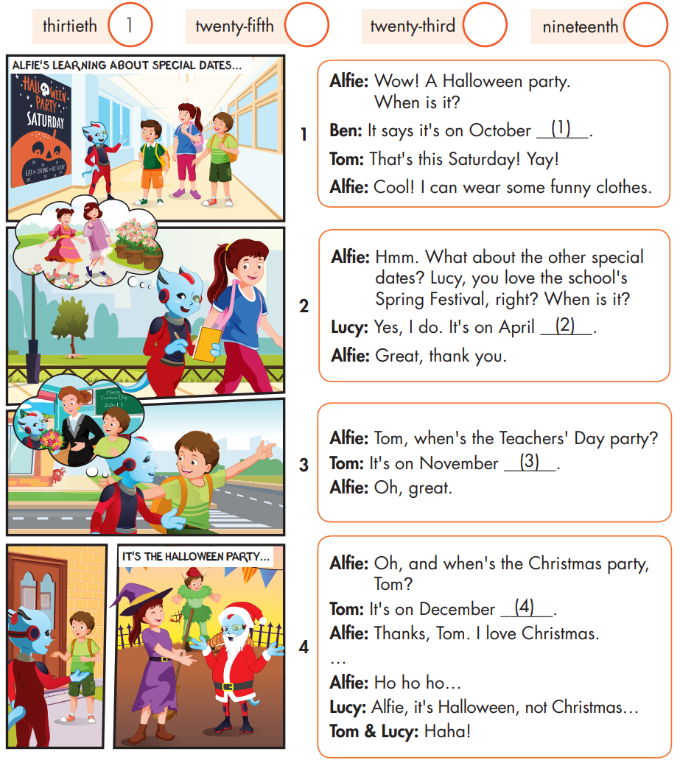

Slide 25
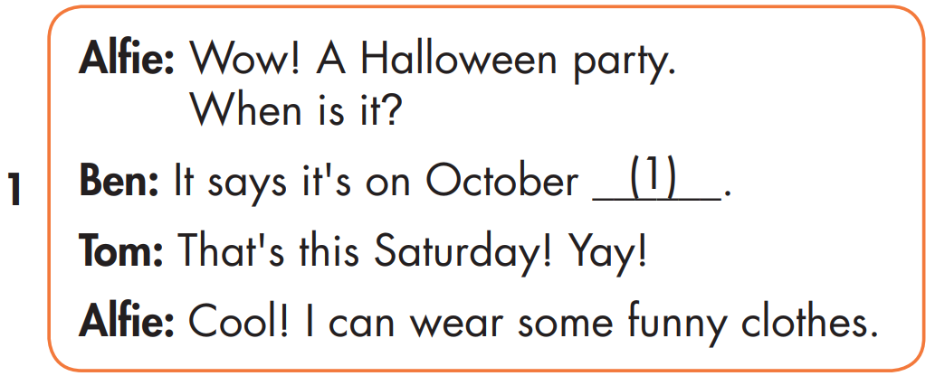

Slide 26
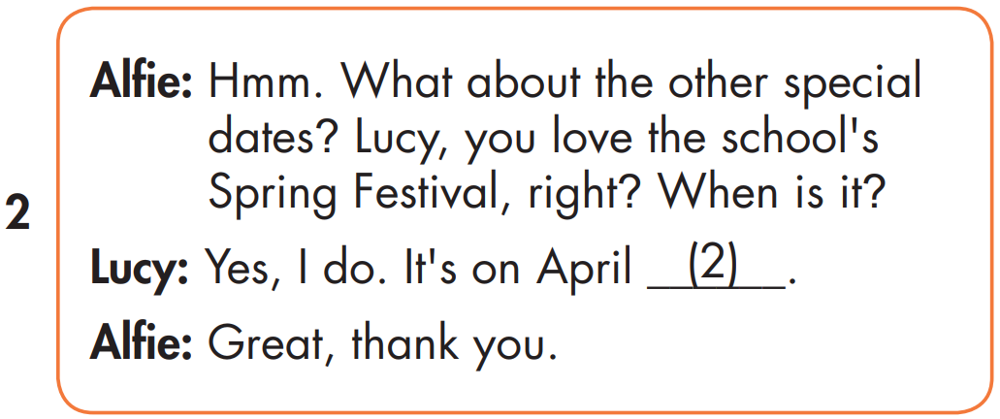
2
twenty-fifth

Slide 27
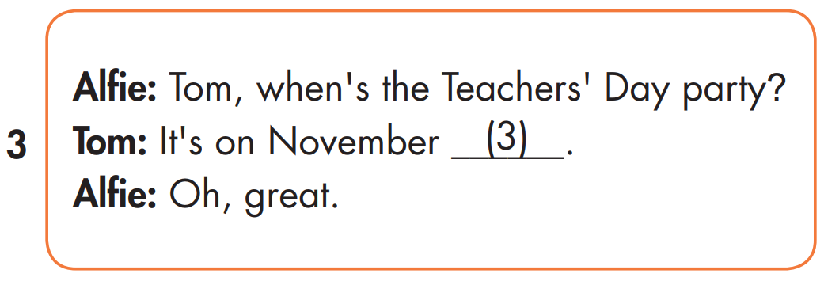
2
3
nineteenth

Slide 28
2
4
3
twenty-third

Slide 29

Speaking

Slide 30
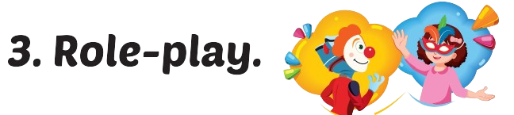
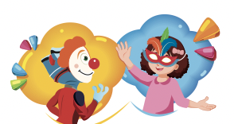

Slide 31
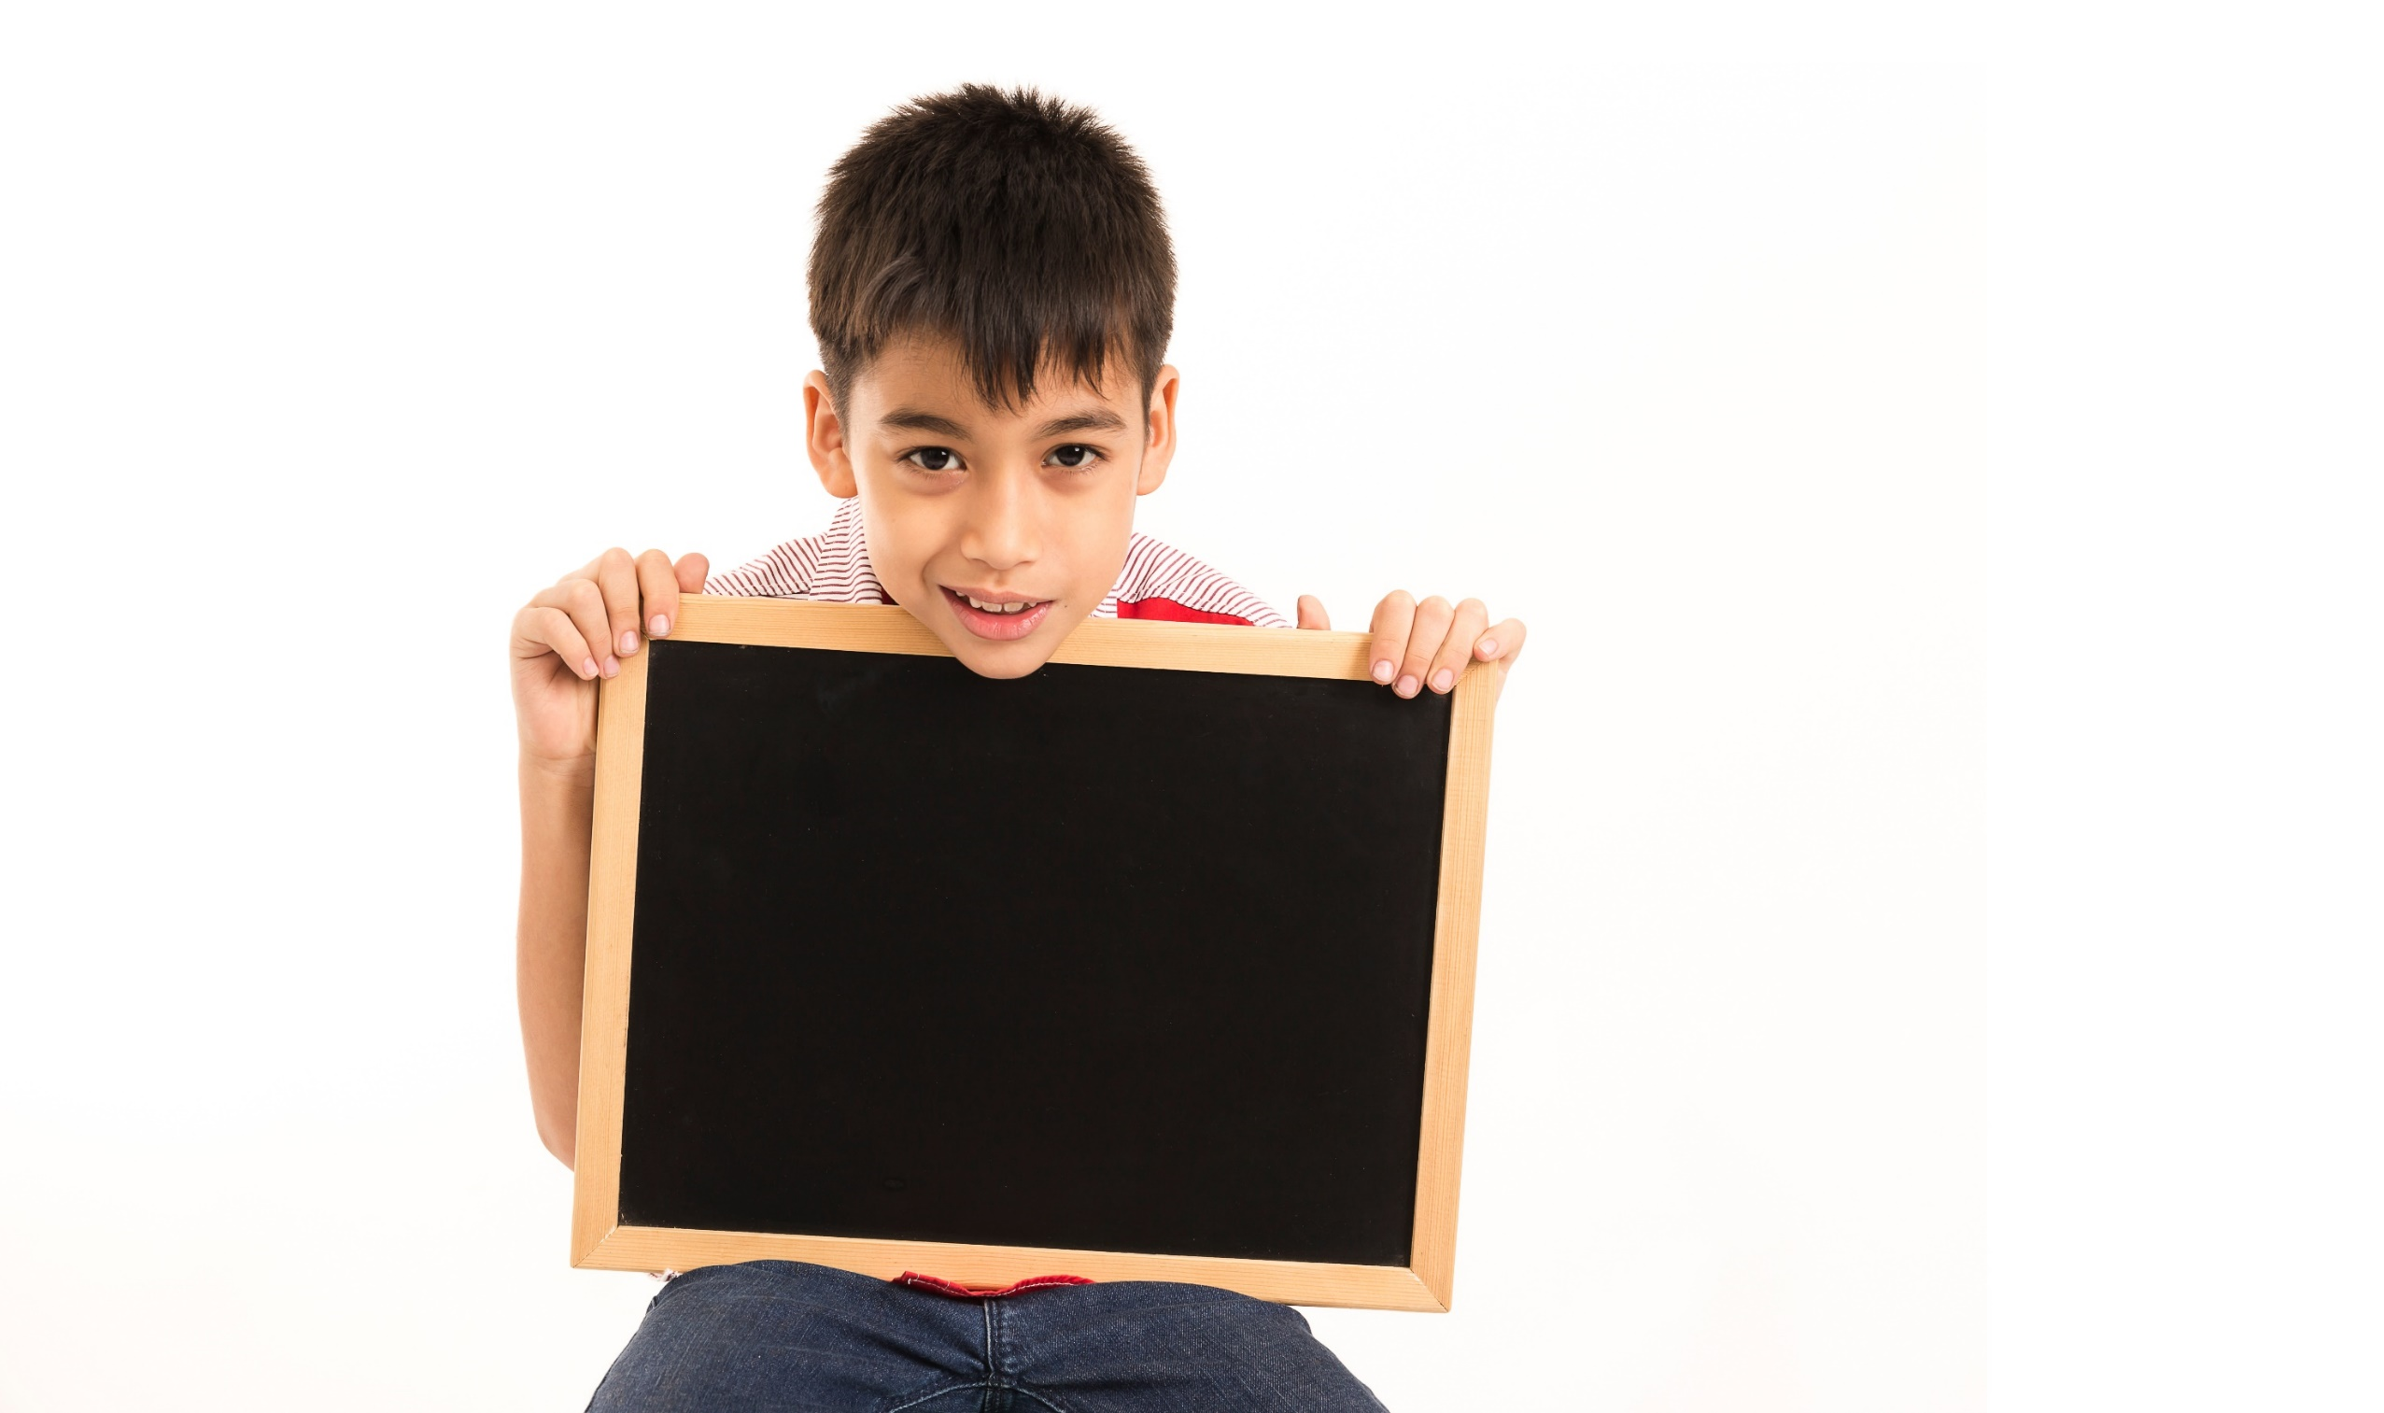
Writing

Slide 32
MAKE YOUR OWN STORY
twenty-fifth
nineteenth
twenty-third

Slide 33
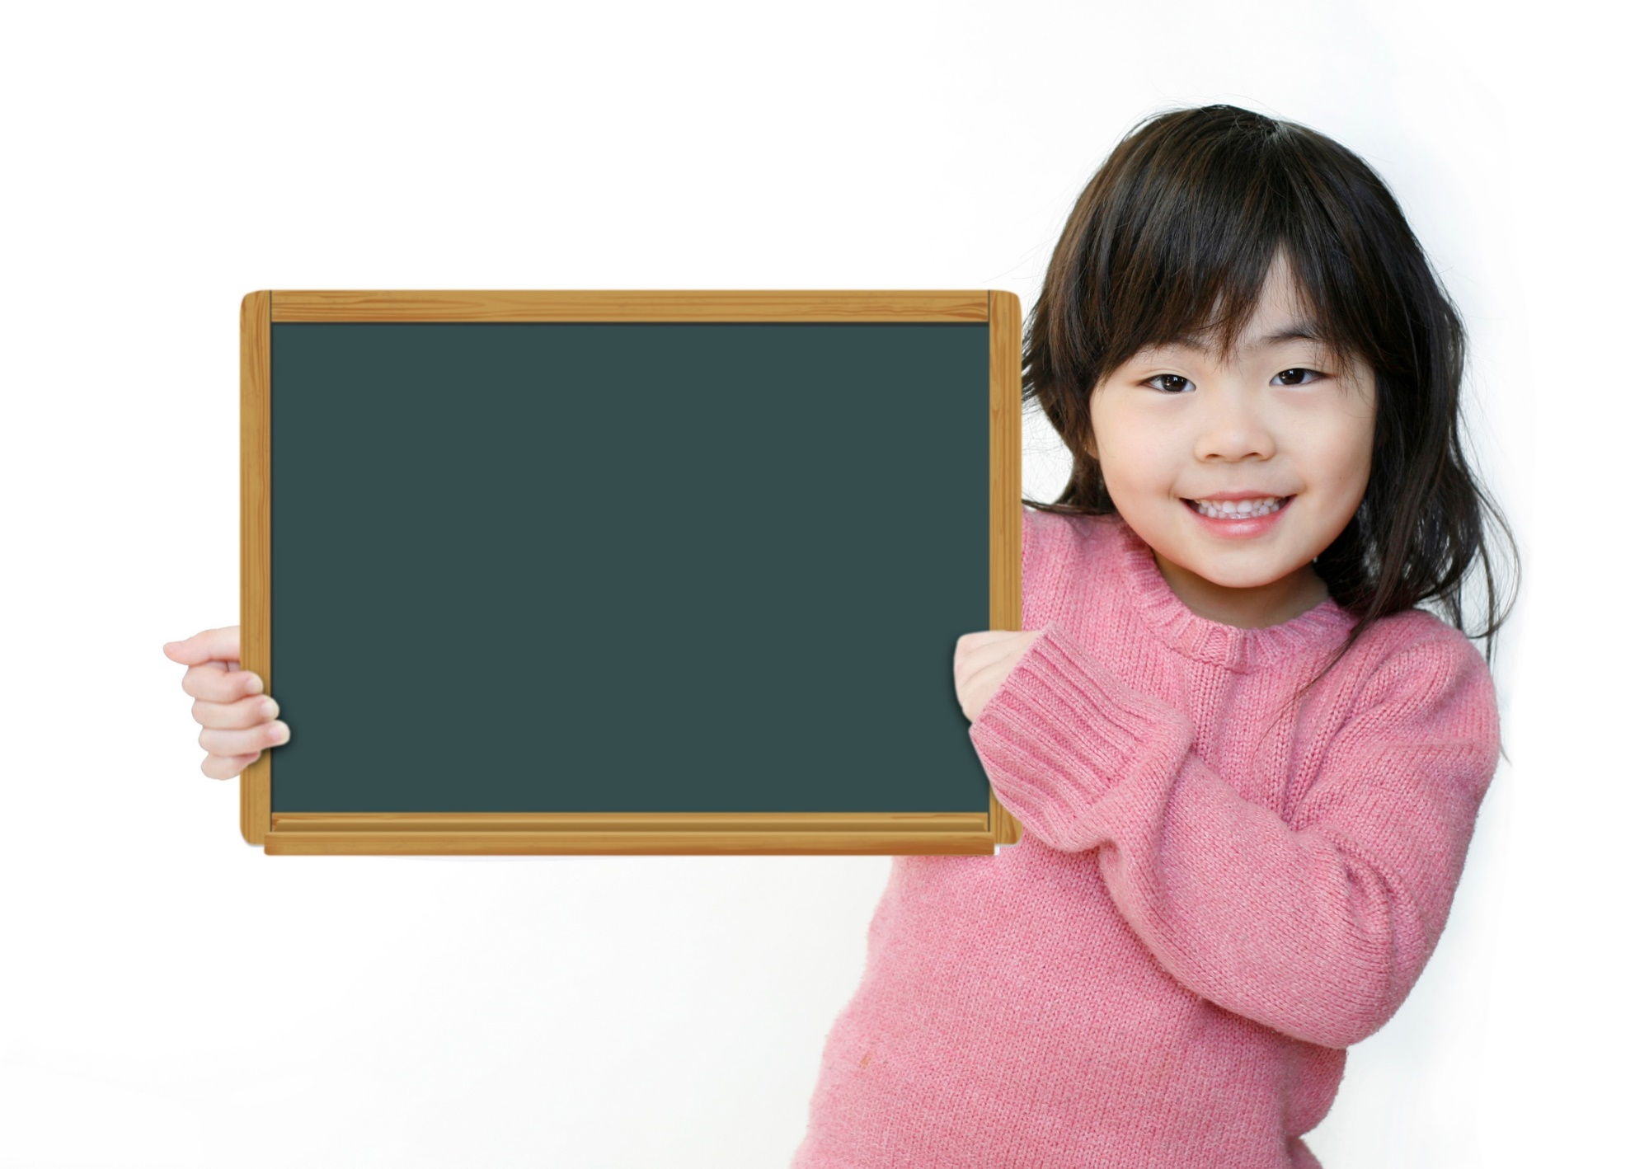
Production

Slide 34

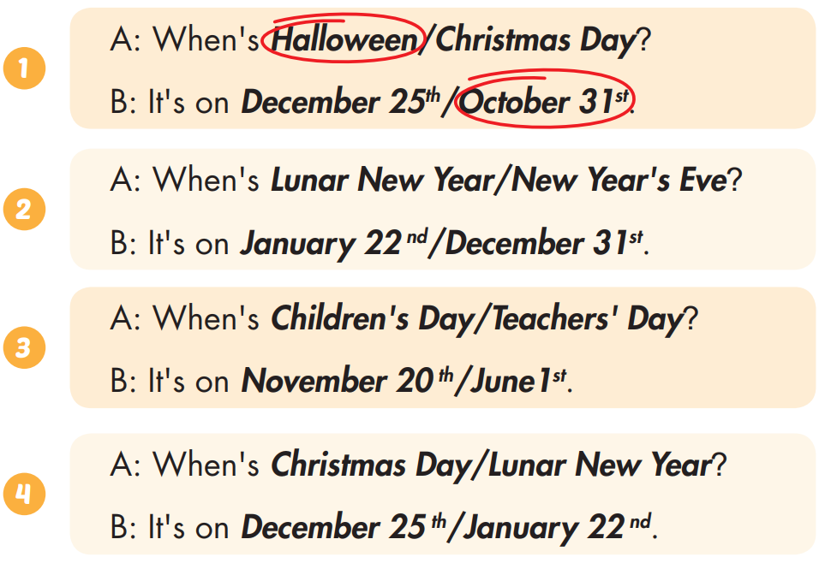
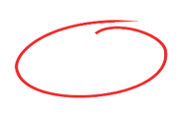
Extra Practice
WB, page 15

Slide 35

CONSOLIDATION

Slide 36

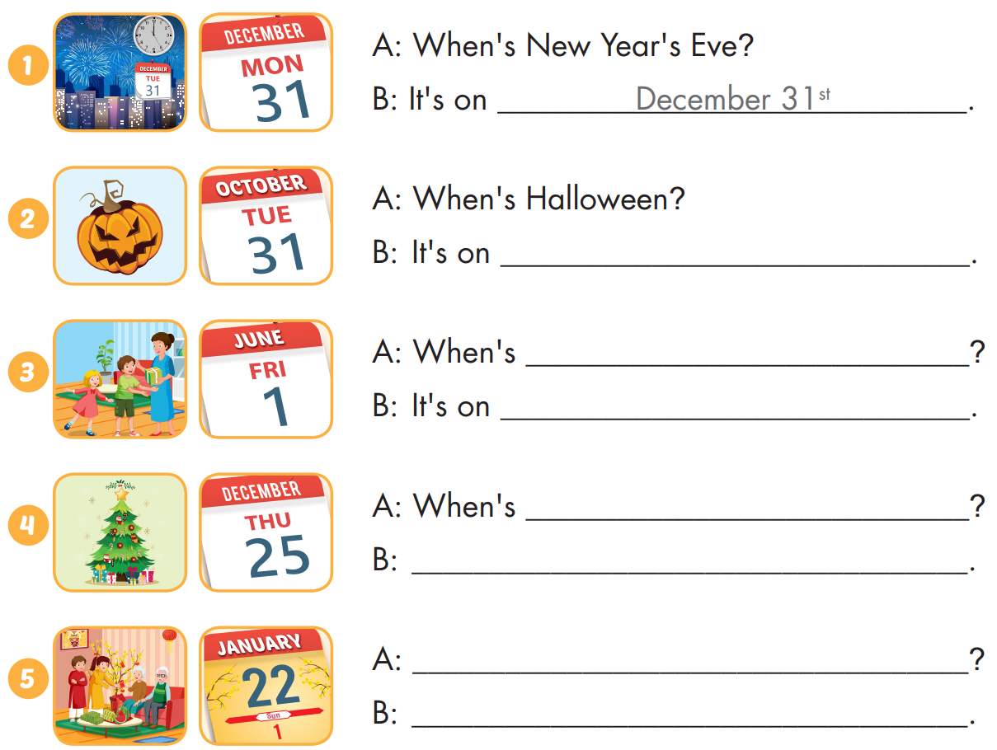
Extra Practice
WB, page 15

Slide 37

Extra Practice
WB, page 15
October 31st.

Slide 38
Extra Practice
WB, page 15
Children's Day
June 1st
Christmas Day
: It's on December 25th
When's Lunar New Year?
It's on January 22nd

Slide 39

WRAP-UP

Slide 40
Today’s lesson
Stress
Word stress: 'twenty-fifth, 'thirty-first
Structures/ Sentence patterns
When's Christmas Day?
- It's on December twenty-fifth.

Slide 41
Homework
Practice the vocabularies and structure, and make sentences using them.
Do the exercises in Tiếng Anh 5 i-Learn Smart Start WB (page 15)
Do the exercises in Tiếng Anh 5 i-Learn Smart Start Notebook (page 11)
Prepare the next lesson (page 25 SB)
Play the consolidation games in Tiếng Anh 5 i-Learn Smart Start DHA App on www.eduhome.com.vn

Slide 42

Enjoy your day!

