Slide 1
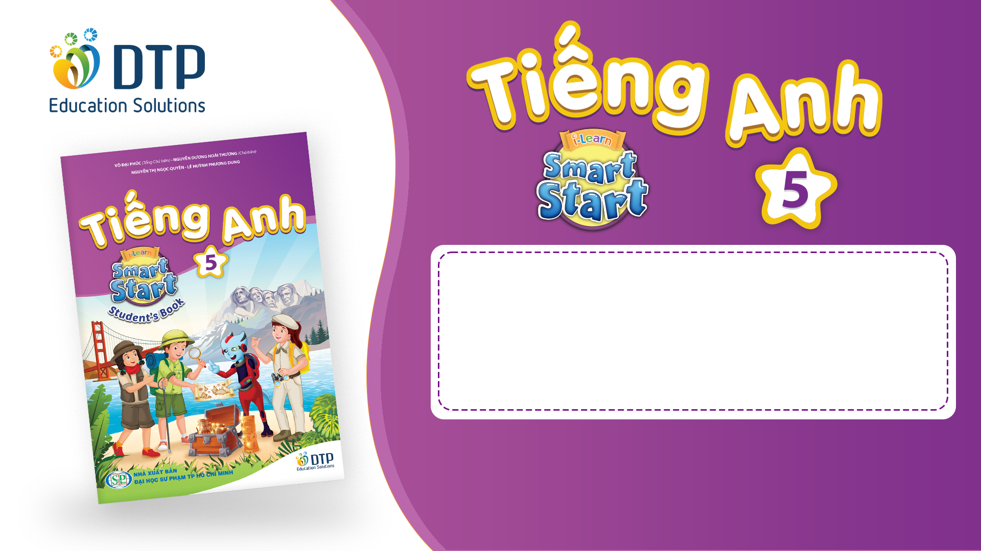
Unit 2: Holidays
Lesson 2.1
Page 23

Slide 2
Objectives
By the end of this lesson, students will be able to…
Vocabulary: Pronounce and identify the words related to the topic properly: first, second, third, fourth, fifth
Structure: When's Christmas Day?
- It's on December twenty-fifth.

Slide 3

WARM-UP

Slide 4


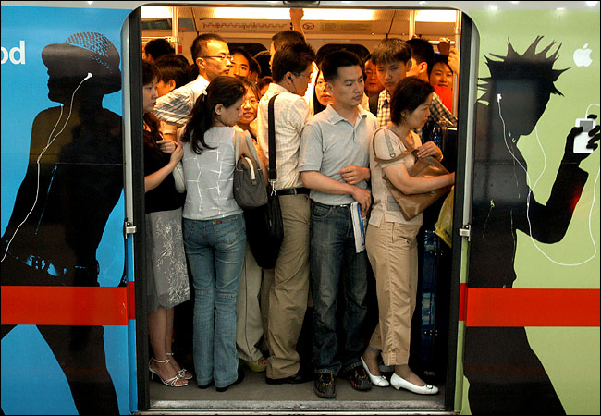
0
ORDINAL
NUMBERS

Slide 5
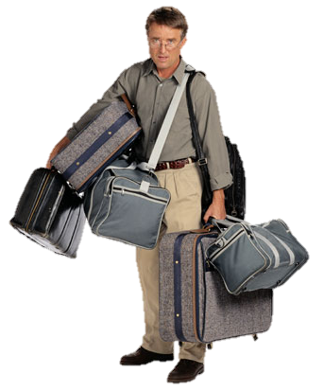
1 st
FIRST

Slide 6
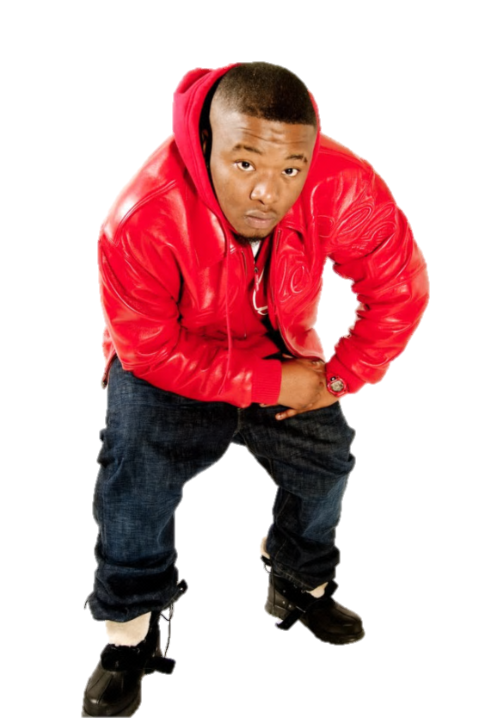
2 nd
SECOND

Slide 7

3 rd
THIRD

Slide 8
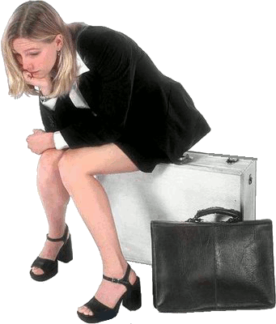
4 th
FOURTH

Slide 9

5 th
FIFTH

Slide 10

6 th
SIXTH

Slide 11

7 th
SEVENTH

Slide 12
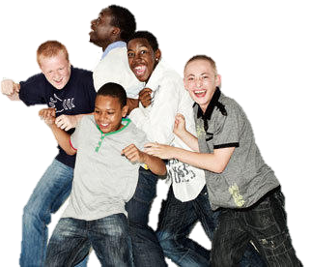
8 th
EIGHTH

Slide 13
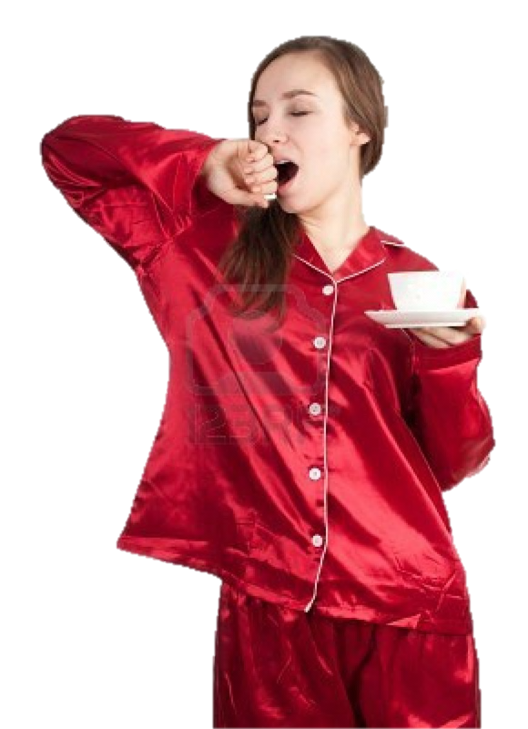
9 th
NINTH

Slide 14

10 th
TENTH

Slide 15

It’s time to learn …

Slide 16

New words
first, second, third,
fourth, fifth

Slide 17

Presentation

Slide 18


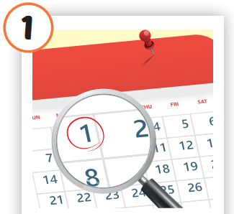
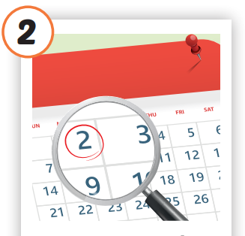
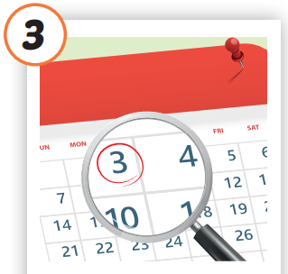
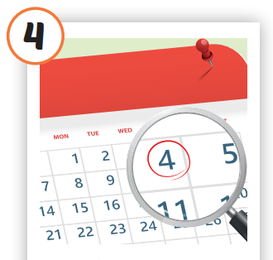
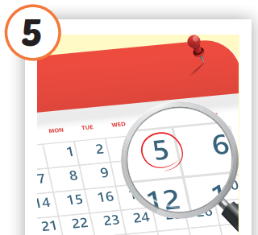

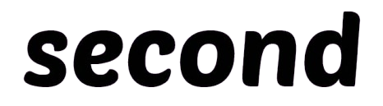
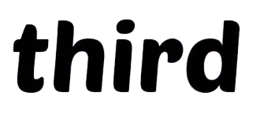


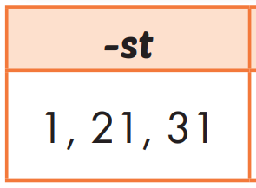
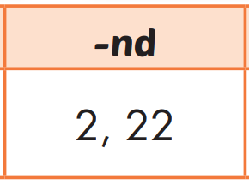
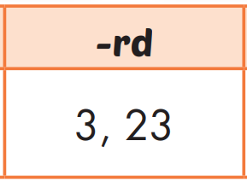
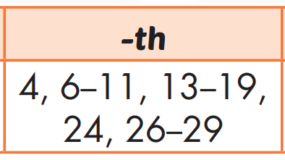
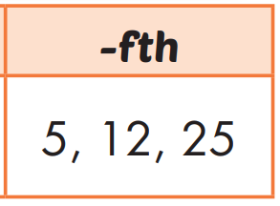
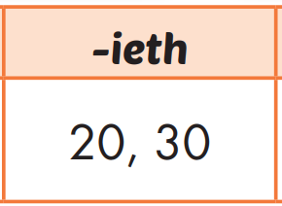
/fɜːrst/
thứ nhất
/fɔːrθ/
thứ tư
/fɪfθ/
thứ năm
/ˈsekənd/
thứ hai
/θɜːrd/
thứ ba
Notes:
Click vào hình A. 1. Listen and point. Repeat để cho cả audio full chạy

Slide 19
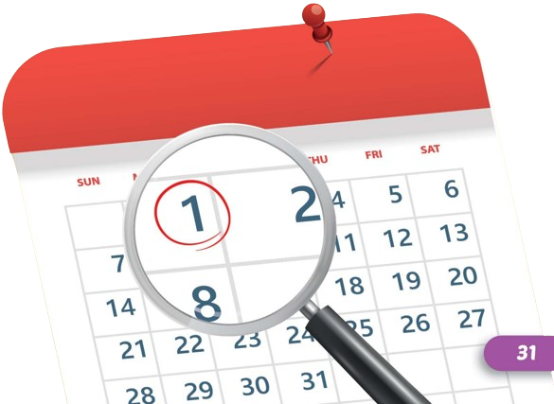
/fɜːrst/
thứ nhất

Slide 20
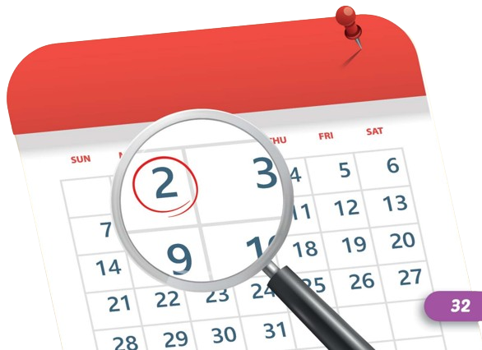
/ˈsekənd/
thứ hai

Slide 21
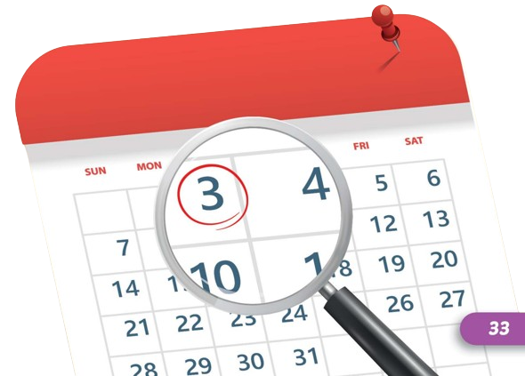
/θɜːrd/
thứ ba

Slide 22
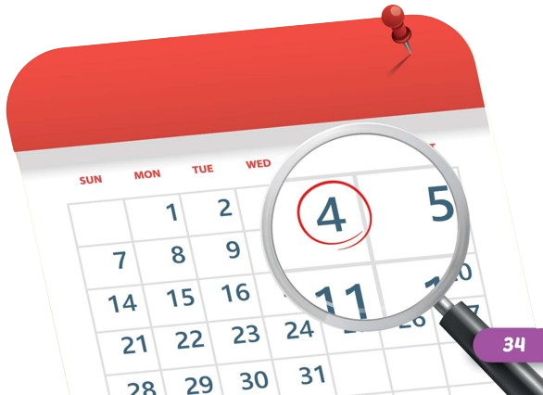
/fɔːrθ/
thứ tư

Slide 23

/fɪfθ/
thứ năm

Slide 24
Practice

Slide 25
Check your memory

Slide 26



Help me, please! I’m going to the third floor
11
12
9
10
7
8
5
6
3
4
1
2

Slide 27
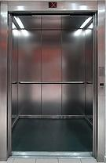
3 rd
third
Thank you!

Slide 28
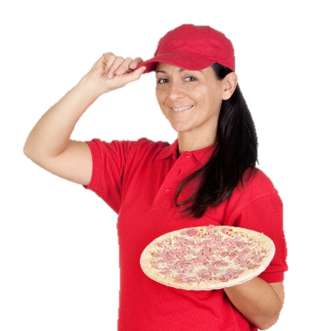
I’m going to the fifth floor
11
12
9
10
7
8
5
6
3
4
1
2

Slide 29

5 th
fifth
Thank you!

Slide 30

I’m going to the ninth floor
11
12
9
10
7
8
5
6
3
4
1
2

Slide 31
9 th
ninth
Thank you!

Slide 32
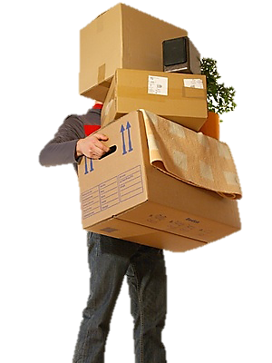
I’m going to the second floor
11
12
9
10
7
8
5
6
3
4
1
2

Slide 33
2 nd
second
Thank you!

Slide 34
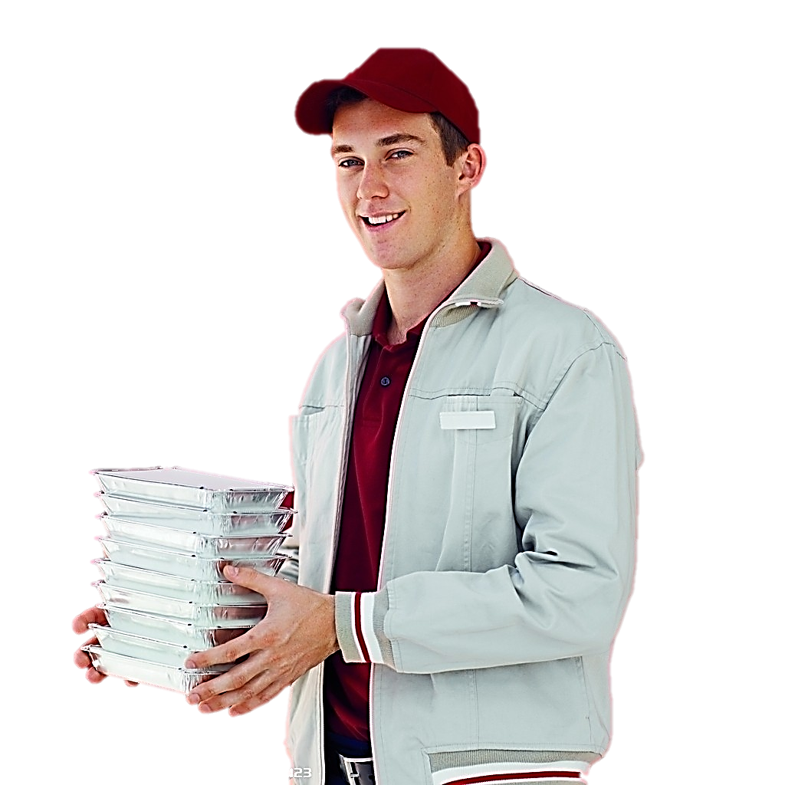
I’m going to the first floor
11
12
9
10
7
8
5
6
3
4
1
2

Slide 35
1 st
first
Thank you!

Slide 36
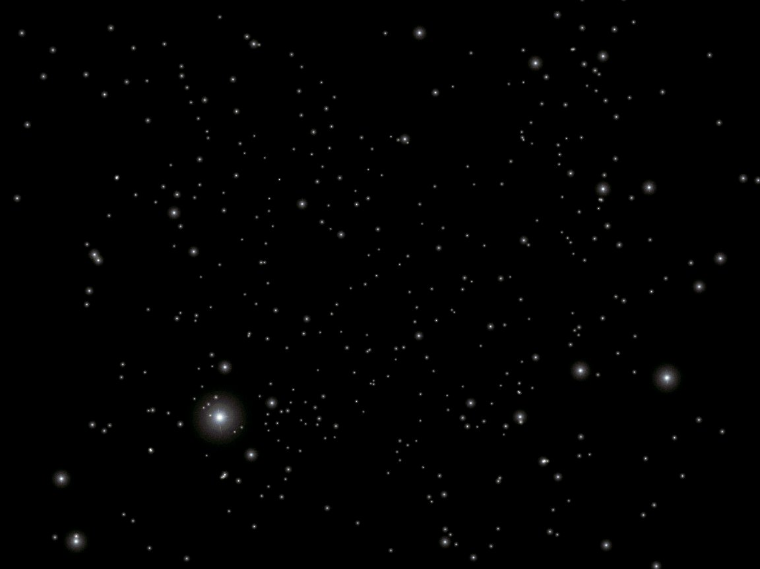
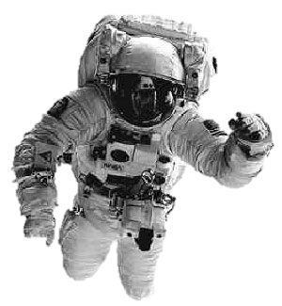
What floor are we on?
?

Slide 37
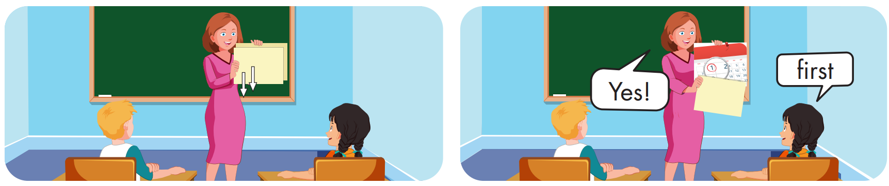

Slide 38
Structure
When's Christmas Day?
- It's on December twenty-fifth.

Slide 39
Presentation

Slide 40
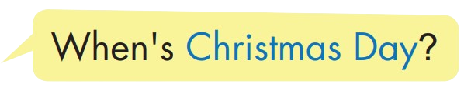
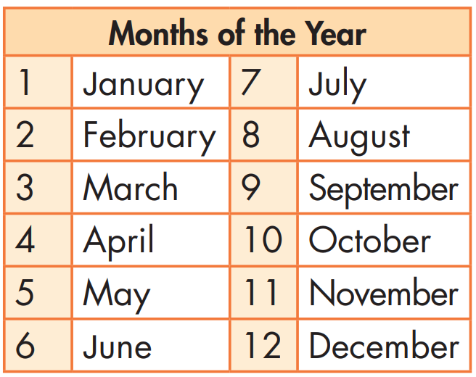
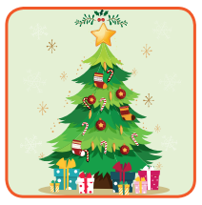


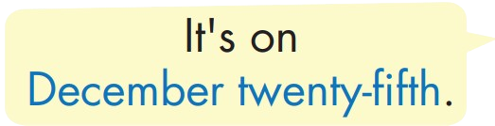

Structure

Slide 41

Practice

Slide 42


Slide 43
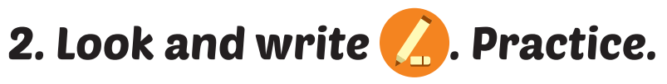
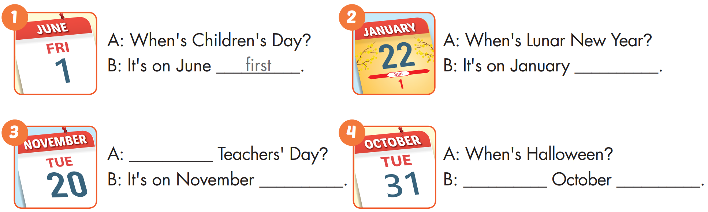
twenty-second
When's
twentieth
It's on
thirty-first

Slide 44

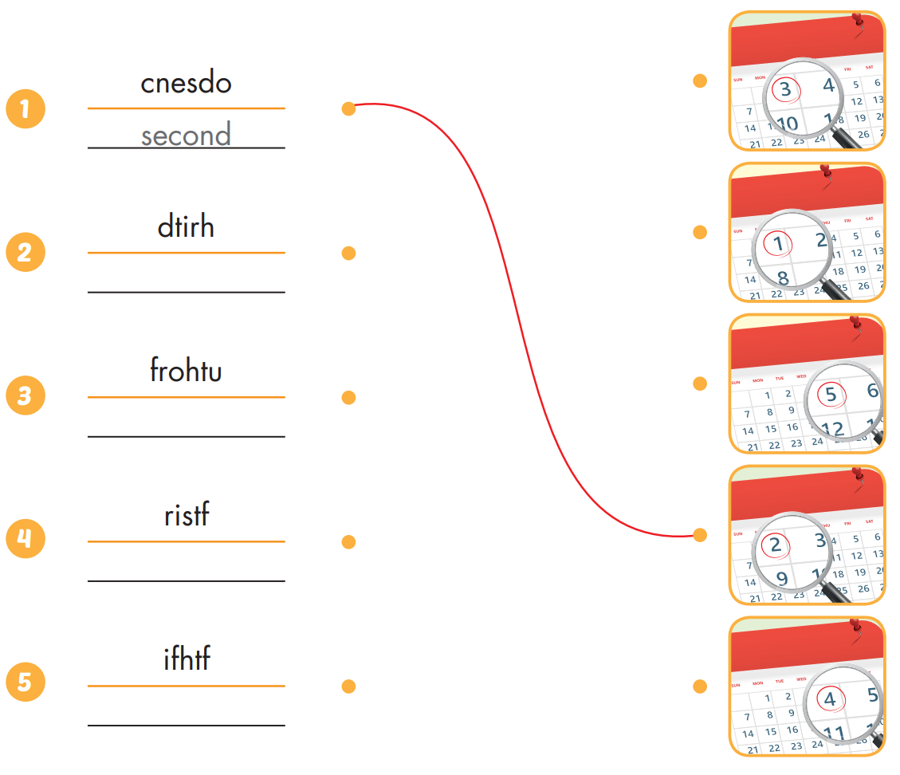
Extra Practice
WB, page 14
third
fourth
first
fifth

Slide 45

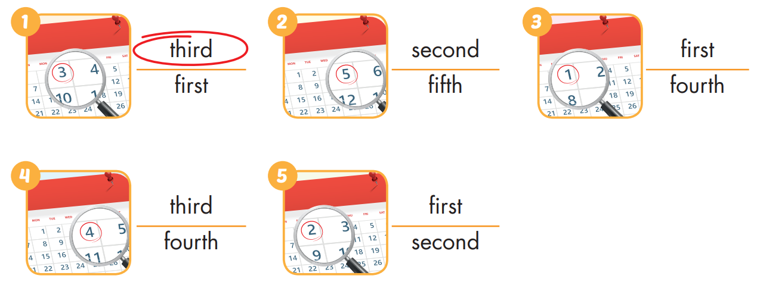
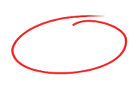
Extra Practice
WB, page 14

Slide 46

Production

Slide 47

CONSOLIDATION

Slide 48

WRAP-UP

Slide 49
Today’s lesson
Vocabularies
first, second, third, fourth, fifth
Structures/ Sentence patterns
When's Christmas Day?
- It's on December twenty-fifth.

Slide 50
Homework
Practice the vocabularies and structure, and make sentences using them.
Do the exercises in Tiếng Anh 5 i-Learn Smart Start WB (page 14)
Do the exercises in Tiếng Anh 5 i-Learn Smart Start Notebook (page 11)
Prepare the next lesson (page 24 SB)
Play the consolidation games in Tiếng Anh 5 i-Learn Smart Start DHA App on www.eduhome.com.vn

Slide 51

Enjoy your day!

