Slide 1

Unit 2: Holidays
Lesson 1.3
Page 22

Slide 2
Objectives
By the end of this lesson, students will be able to…
Vocabulary: Pronounce and use the words related to the topic properly: Halloween, New Year's Eve, Lunar New Year (Tết), Christmas, Teachers' Day, Children's Day.
Structure: Ask and answer about someone’s favorite holiday
What's your favorite holiday? - It's Halloween.
What's her favorite holiday? - It's Christmas

Slide 3

WARM-UP

Slide 4



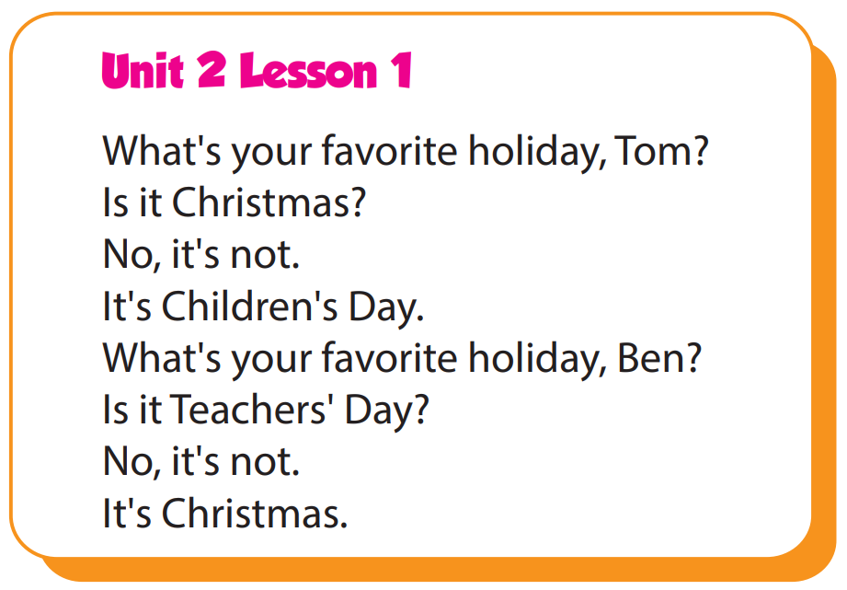

Slide 5

It’s time to learn …

Slide 6

Practice

Slide 7

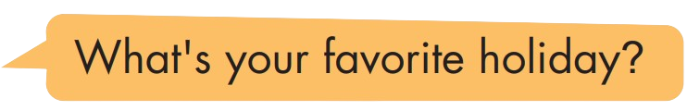
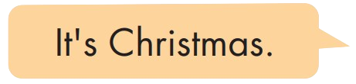
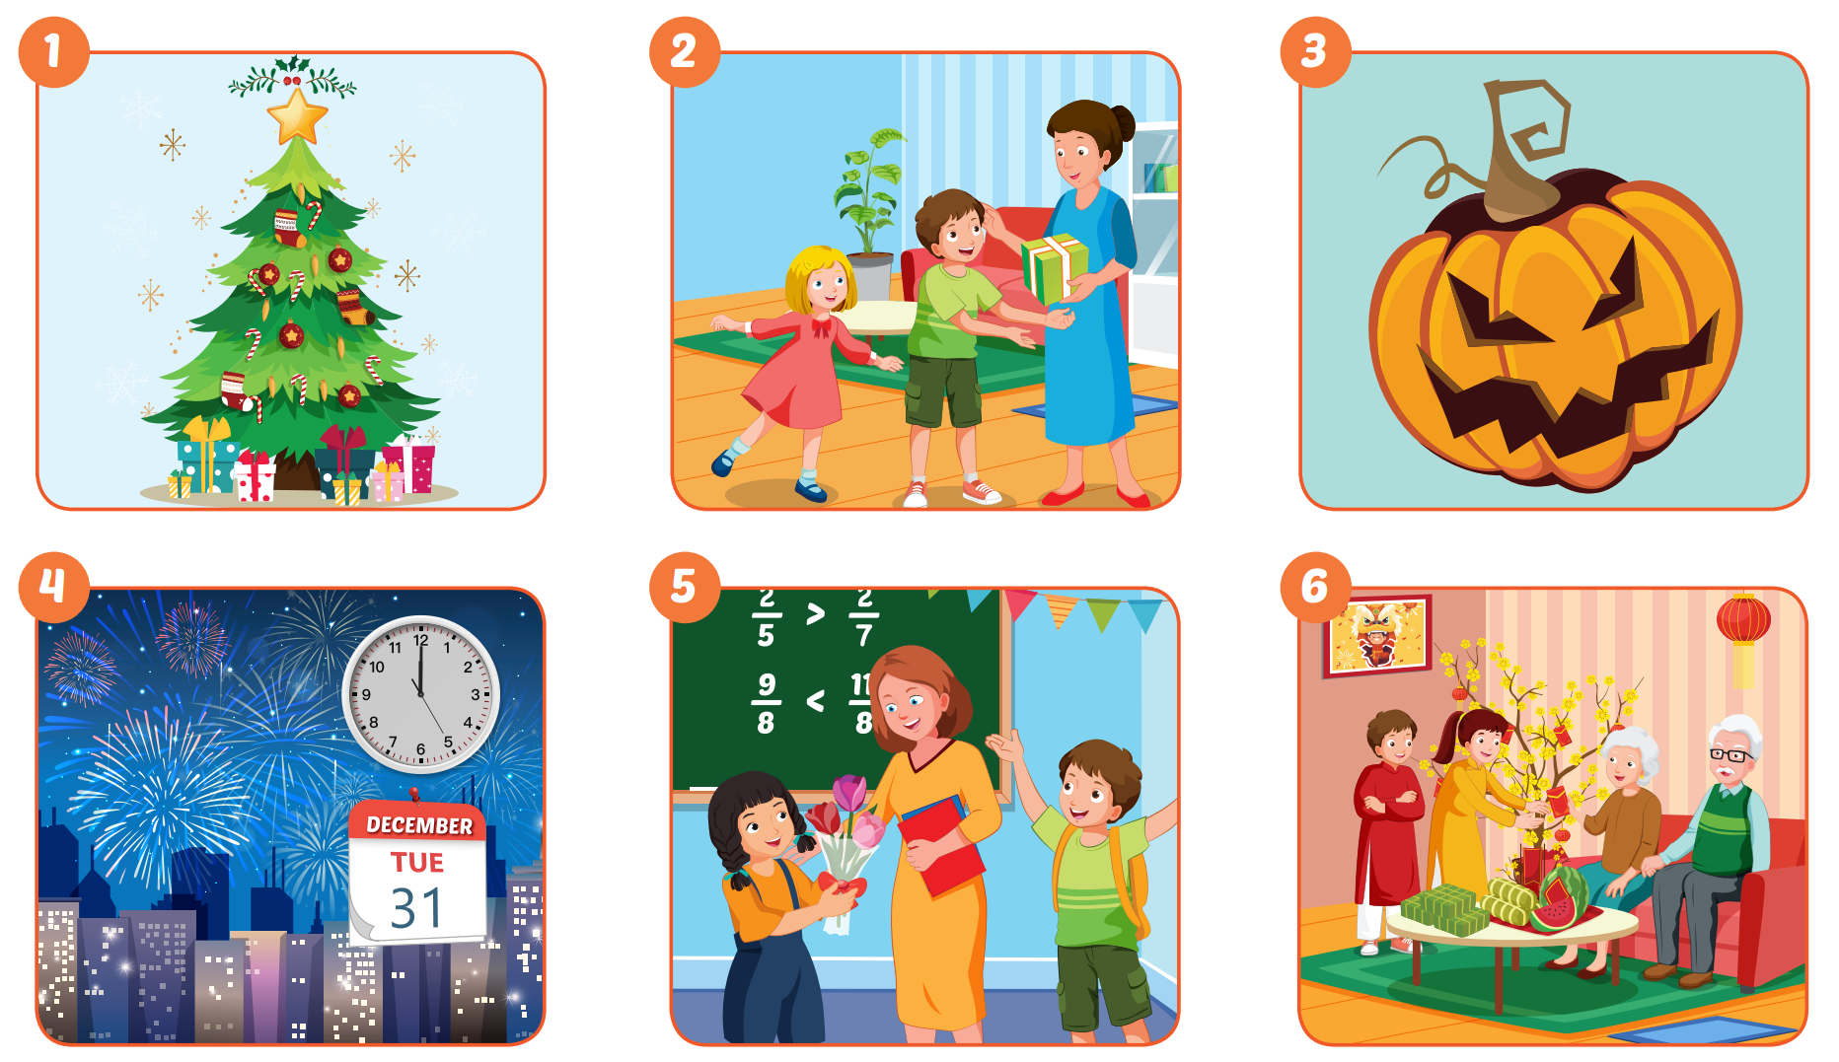

Slide 8
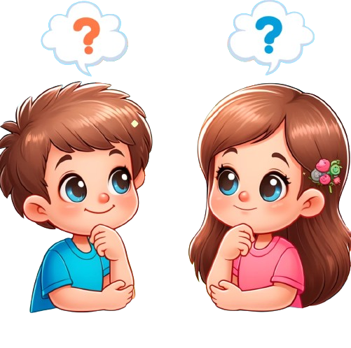
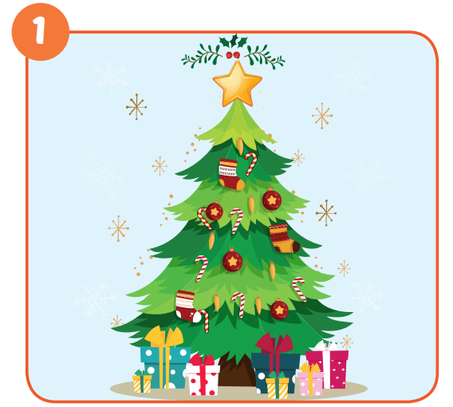
It's Christmas Day.

Slide 9
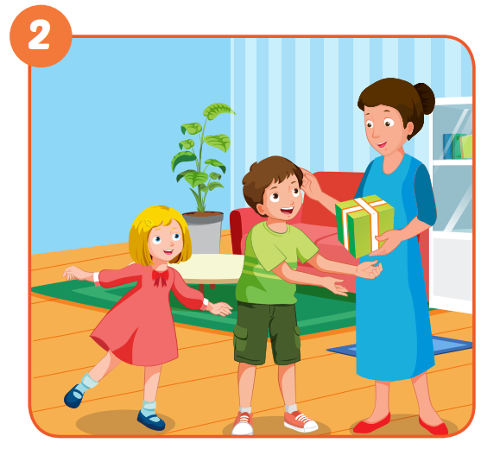
It's Children's Day.

Slide 10
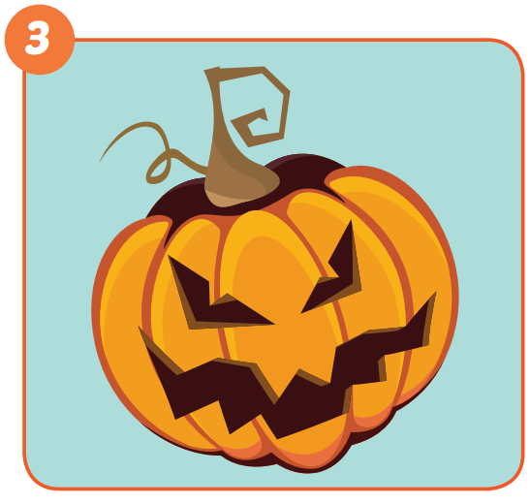
It's Halloween Day.

Slide 11
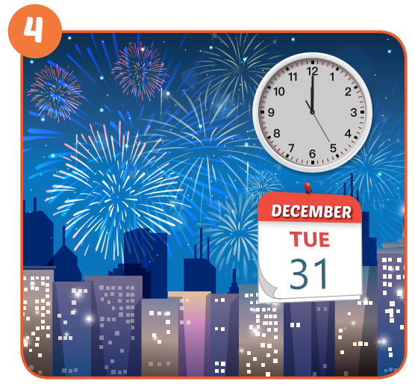
It's New Year's Eve.

Slide 12
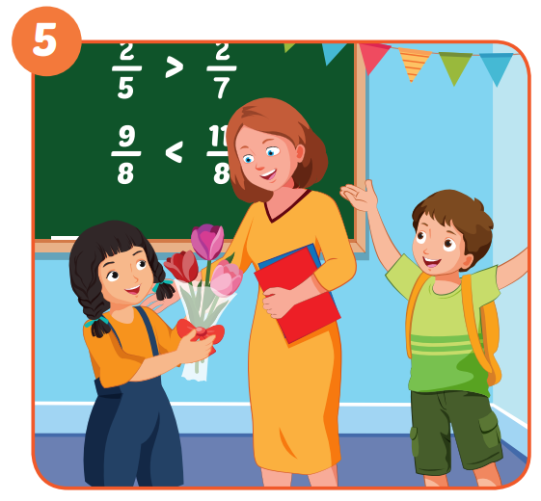
It's Teachers' Day.

Slide 13
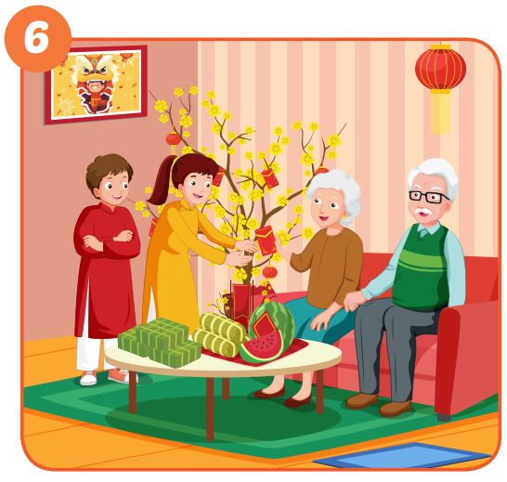
It's Lunar New Year.

Slide 14
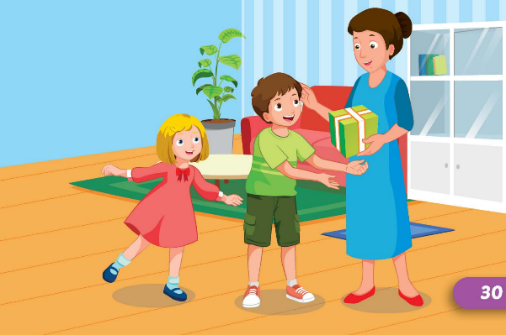
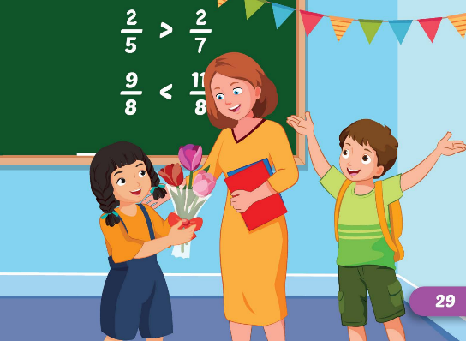
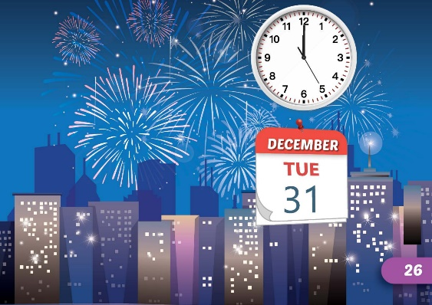
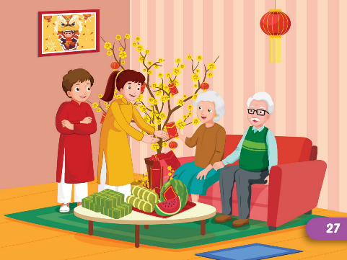
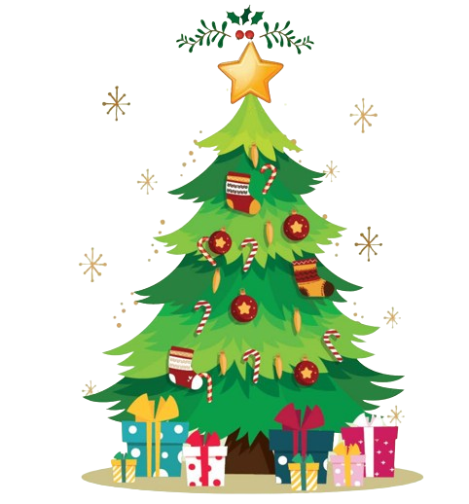
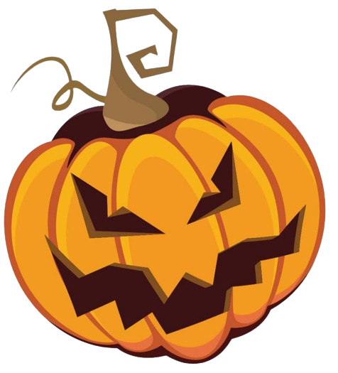
It's Christmas Day.

Slide 15

Production

Slide 16
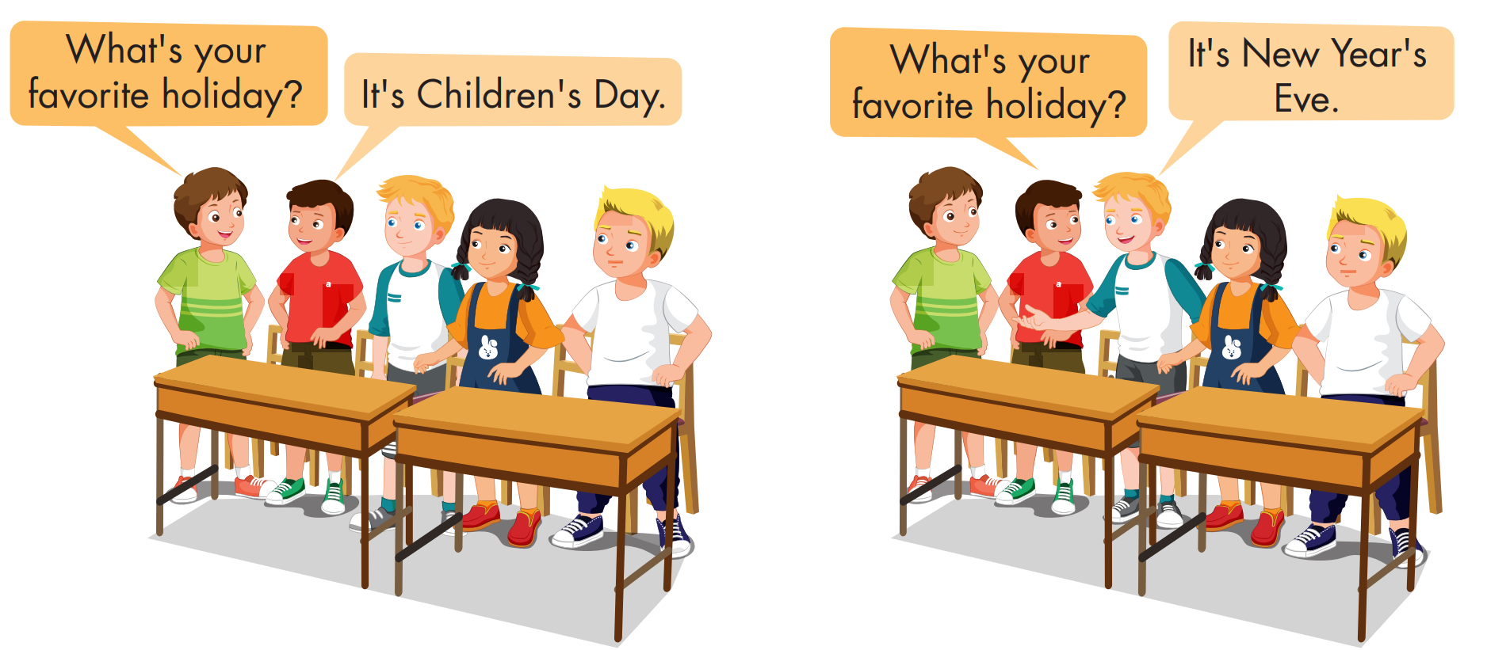

Slide 17

CONSOLIDATION

Slide 18

UNSCRAMBLE THE WORDS

Slide 19
holiday?/What's/favorite/your
What's your favorite holiday?

Slide 20
New/Eve/Year's/It's
It's New Year's Eve.

Slide 21
Day/It's/Children
It's Children's Day.

Slide 22
It's/Year/Lunar/New
It's Lunar New Year.

Slide 23
Christmas/Day/It's
It's Christmas Day.

Slide 24
It's/Day/Teachers'
It's Teachers' Day.

Slide 25
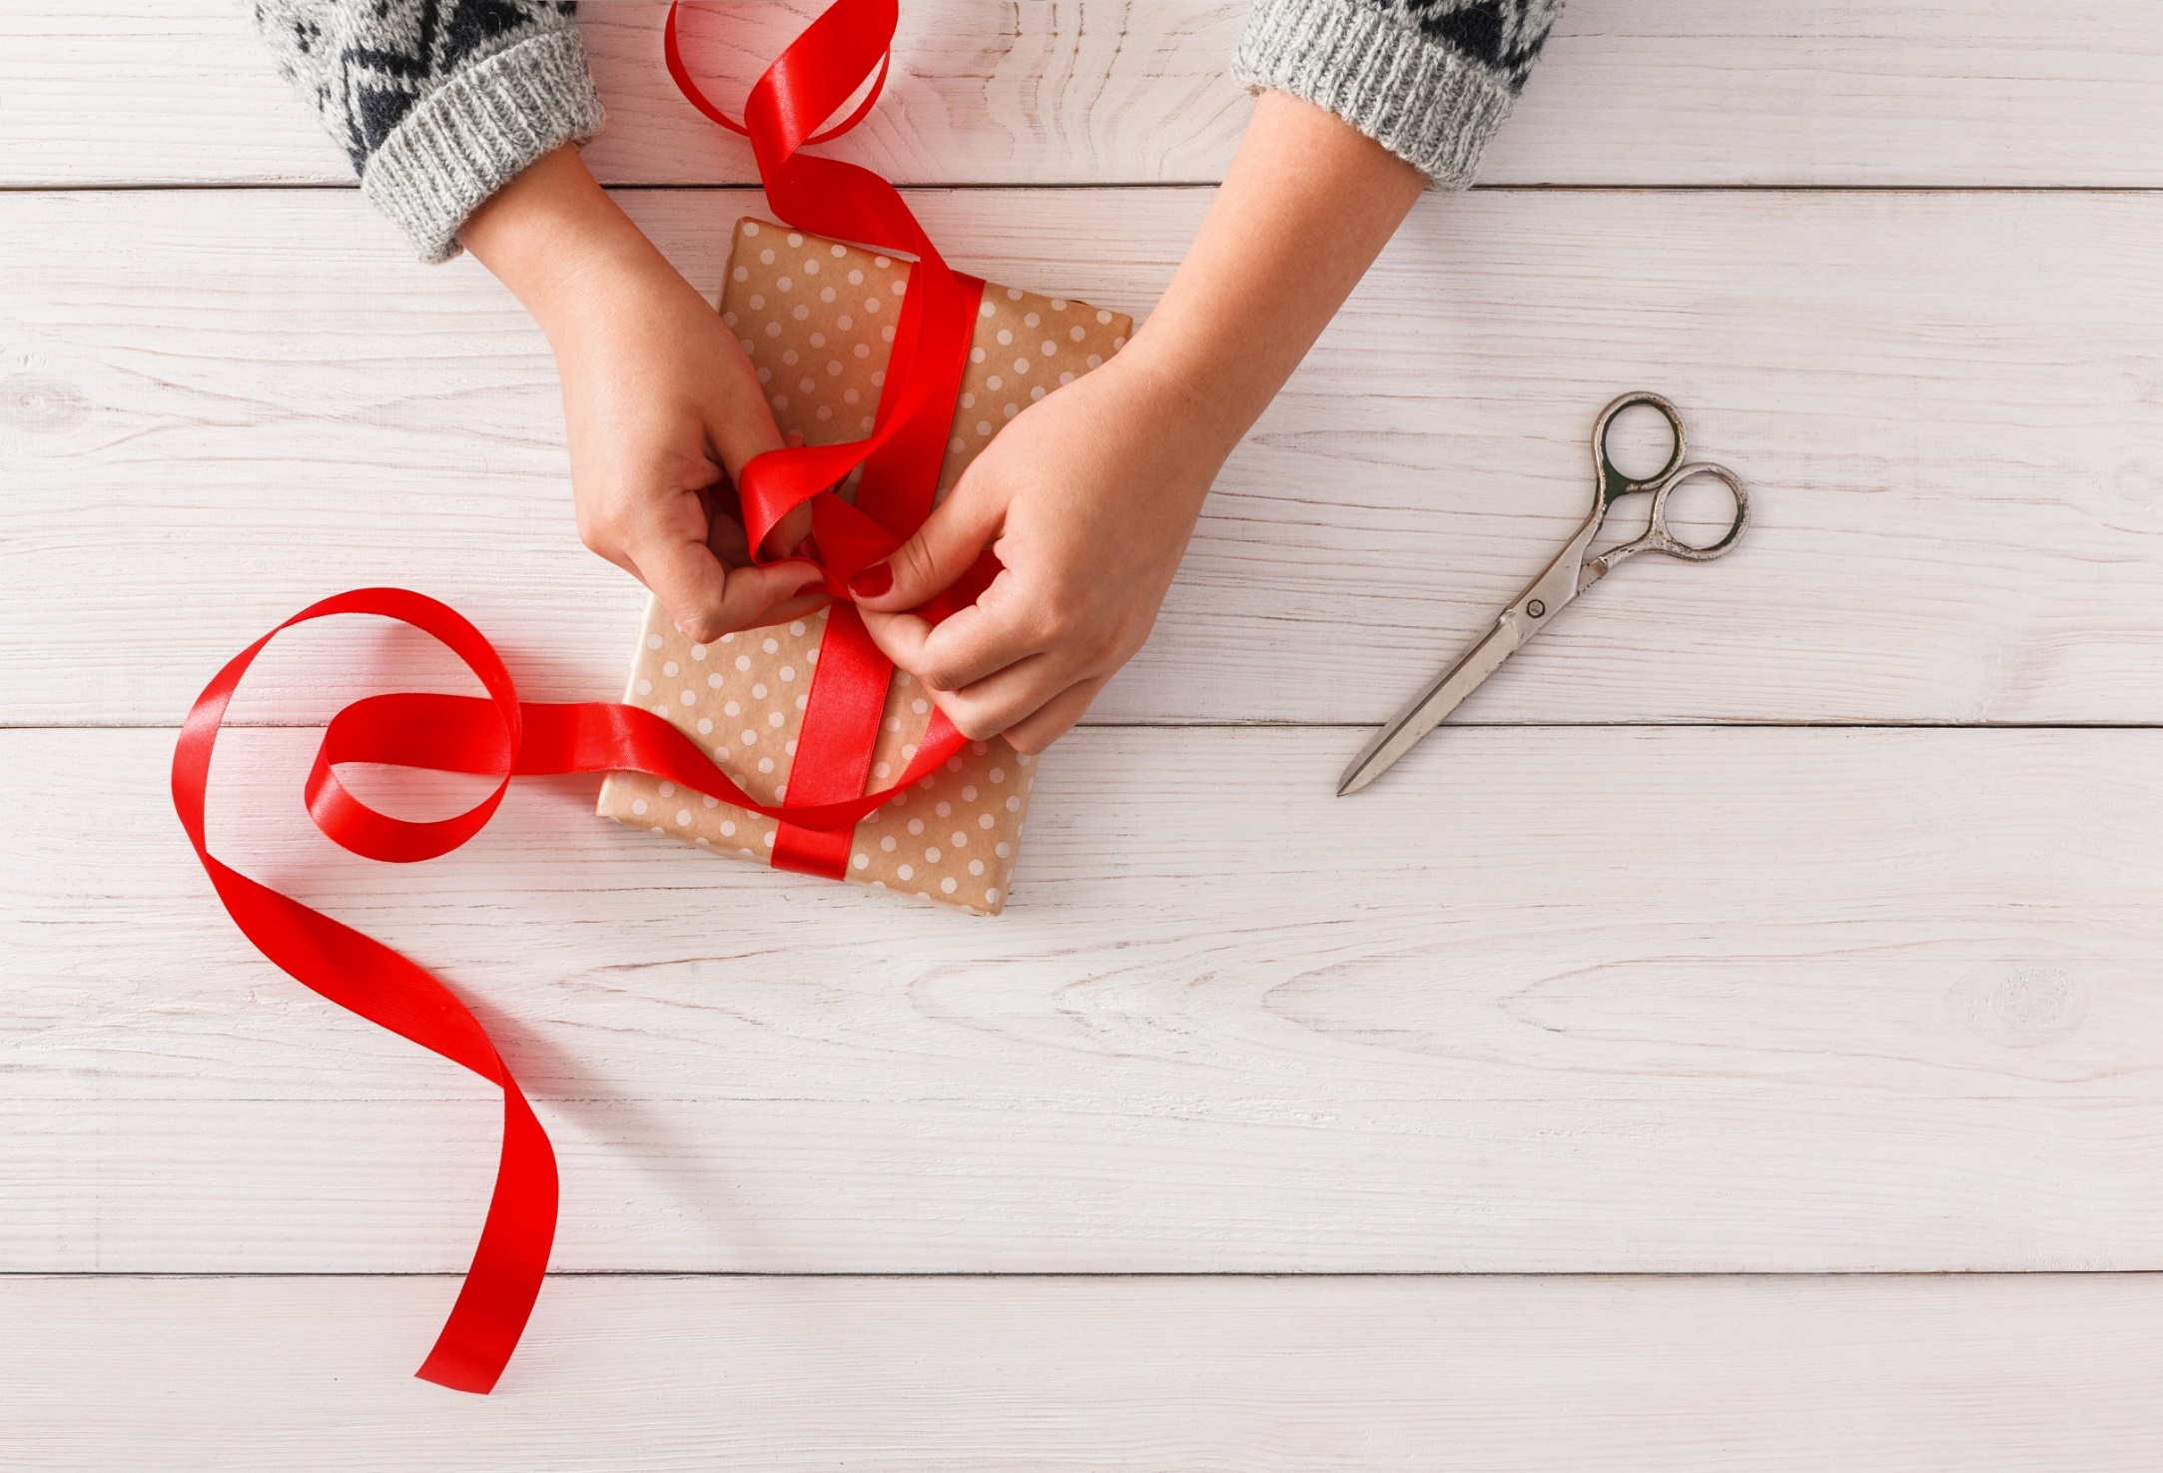
WRAP-UP

Slide 26
Today’s lesson
Vocabularies
Halloween, NewYear's Eve, Lunar New Year (Tết), Christmas, Teachers' Day,
Children's Day
Structures/ Sentence patterns
What's your favorite holiday?
- It's Halloween.
What's her favorite holiday?
- It's Christmas.

Slide 27
Homework
Practice the vocabularies and structure, and make sentences using them.
Do the exercises in Tiếng Anh 5 i-Learn Smart Start WB (page 13)
Do the exercises in Tiếng Anh 5 i-Learn Smart Start Notebook (page 10)
Prepare the next lesson (page 23 SB)
Play the consolidation games in Tiếng Anh 5 i-Learn Smart Start DHA App on www.eduhome.com.vn

Slide 28

Enjoy your day!

