Slide 1
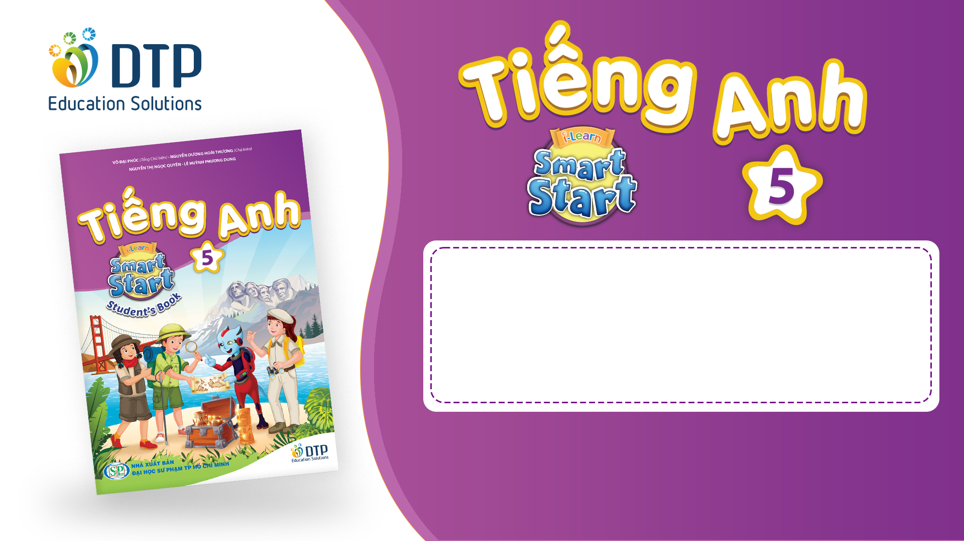
Unit 2: Holidays
Lesson 1.2
Page 21

Slide 2
Objectives
By the end of this lesson, students will be able to…
Stress: For most holidays, we usually stress the first syllable.
Structure: What's your favorite holiday? - It's Halloween.
What's her favorite holiday? - It's Christmas

Slide 3

WARM-UP

Slide 4
HIDDEN PICTURE

Slide 5


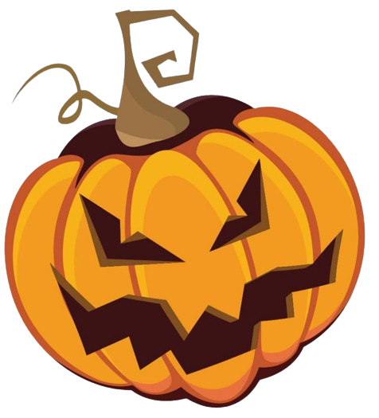
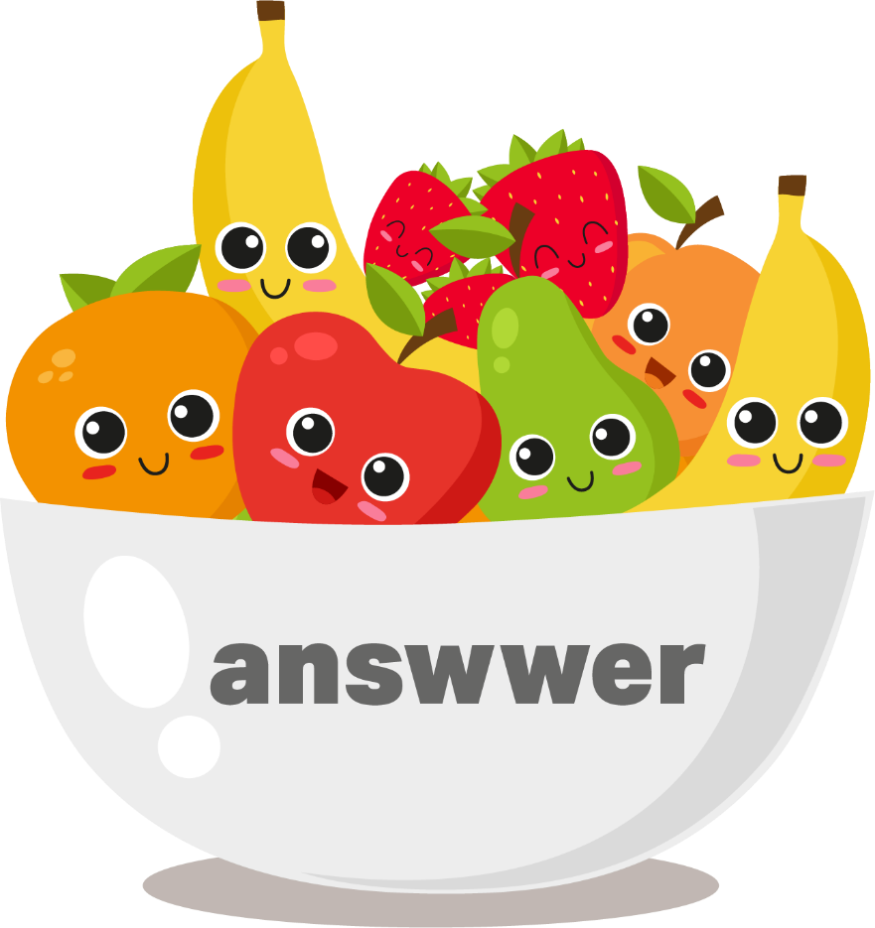

Halloween

Slide 6
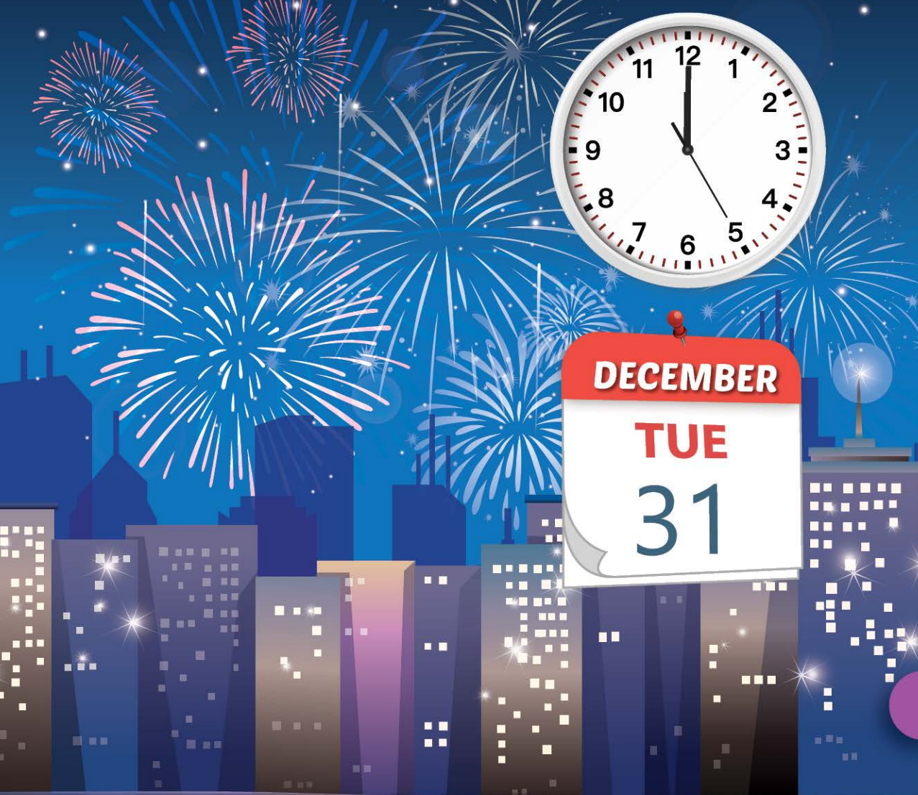
New Year's Eve

Slide 7
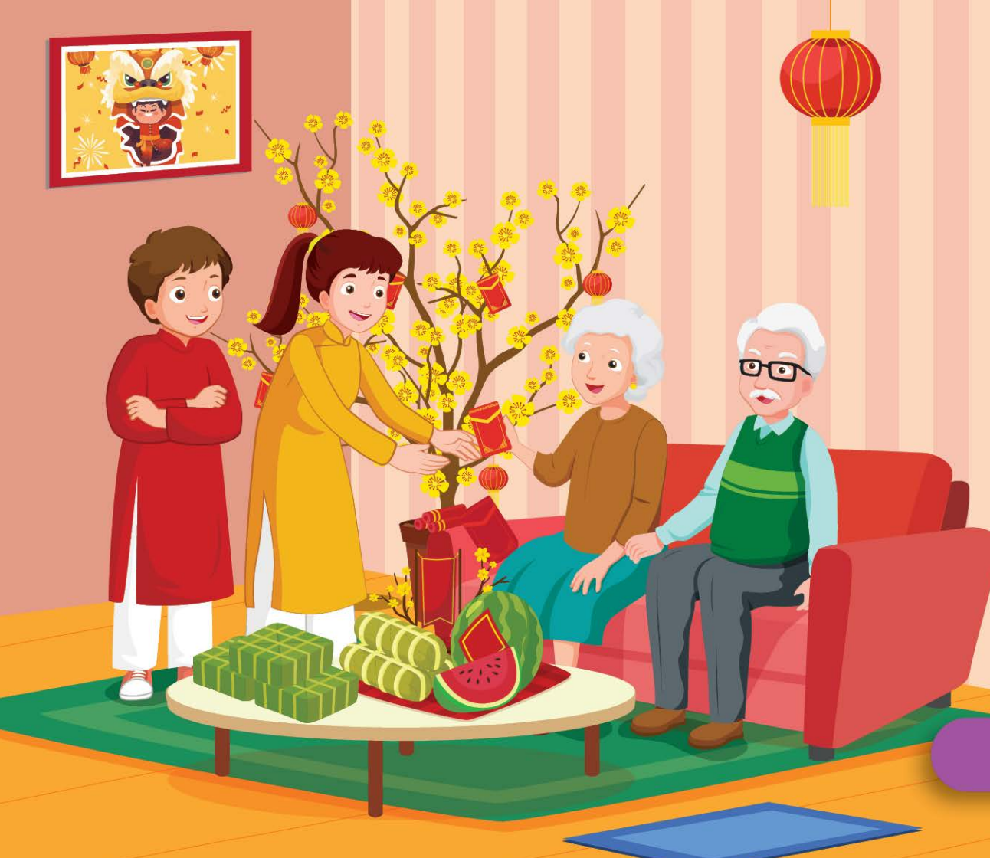
Lunar New Year (Tết)

Slide 8
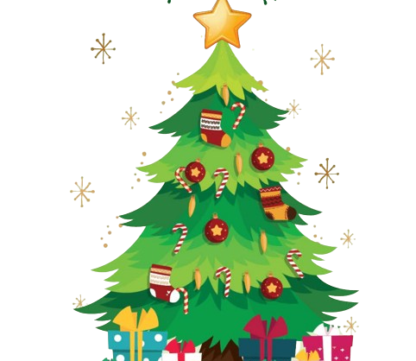
Christmas

Slide 9
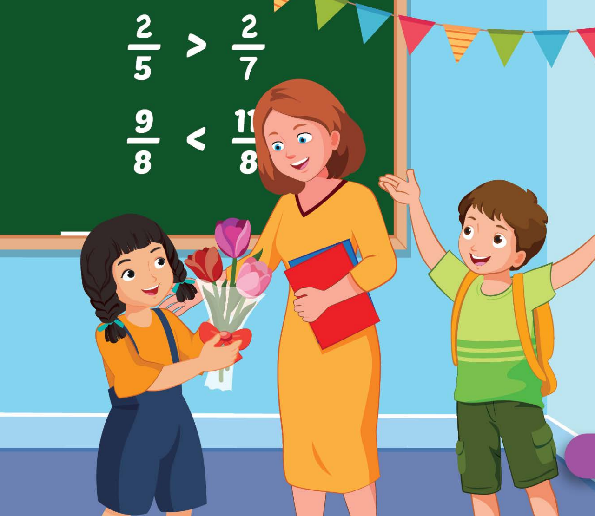
Teachers' Day

Slide 10
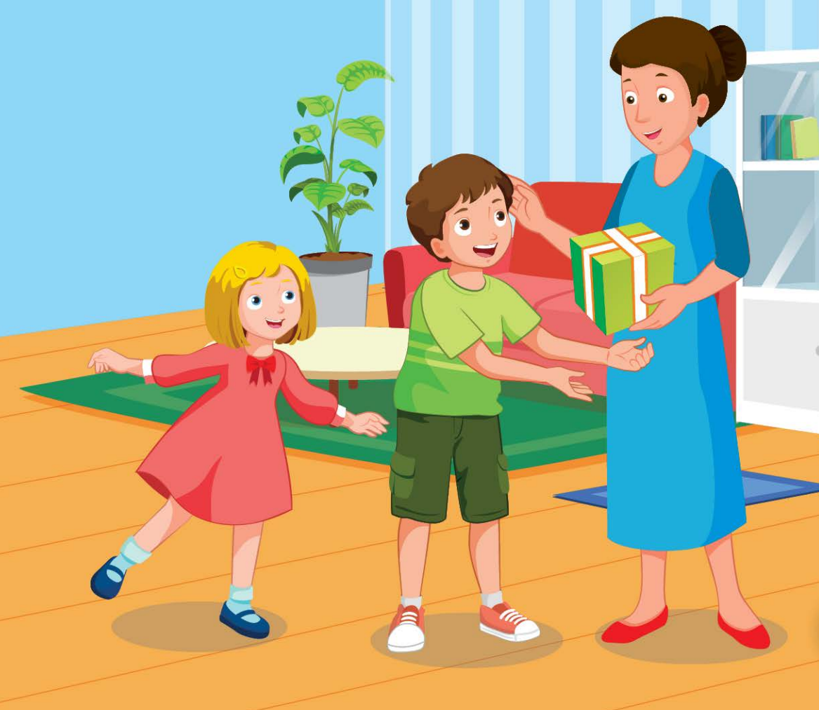
Children's Day

Slide 11

It’s time to learn …

Slide 12

Stress
'Christmas, 'Teachers' Day,
'Children's Day

Slide 13
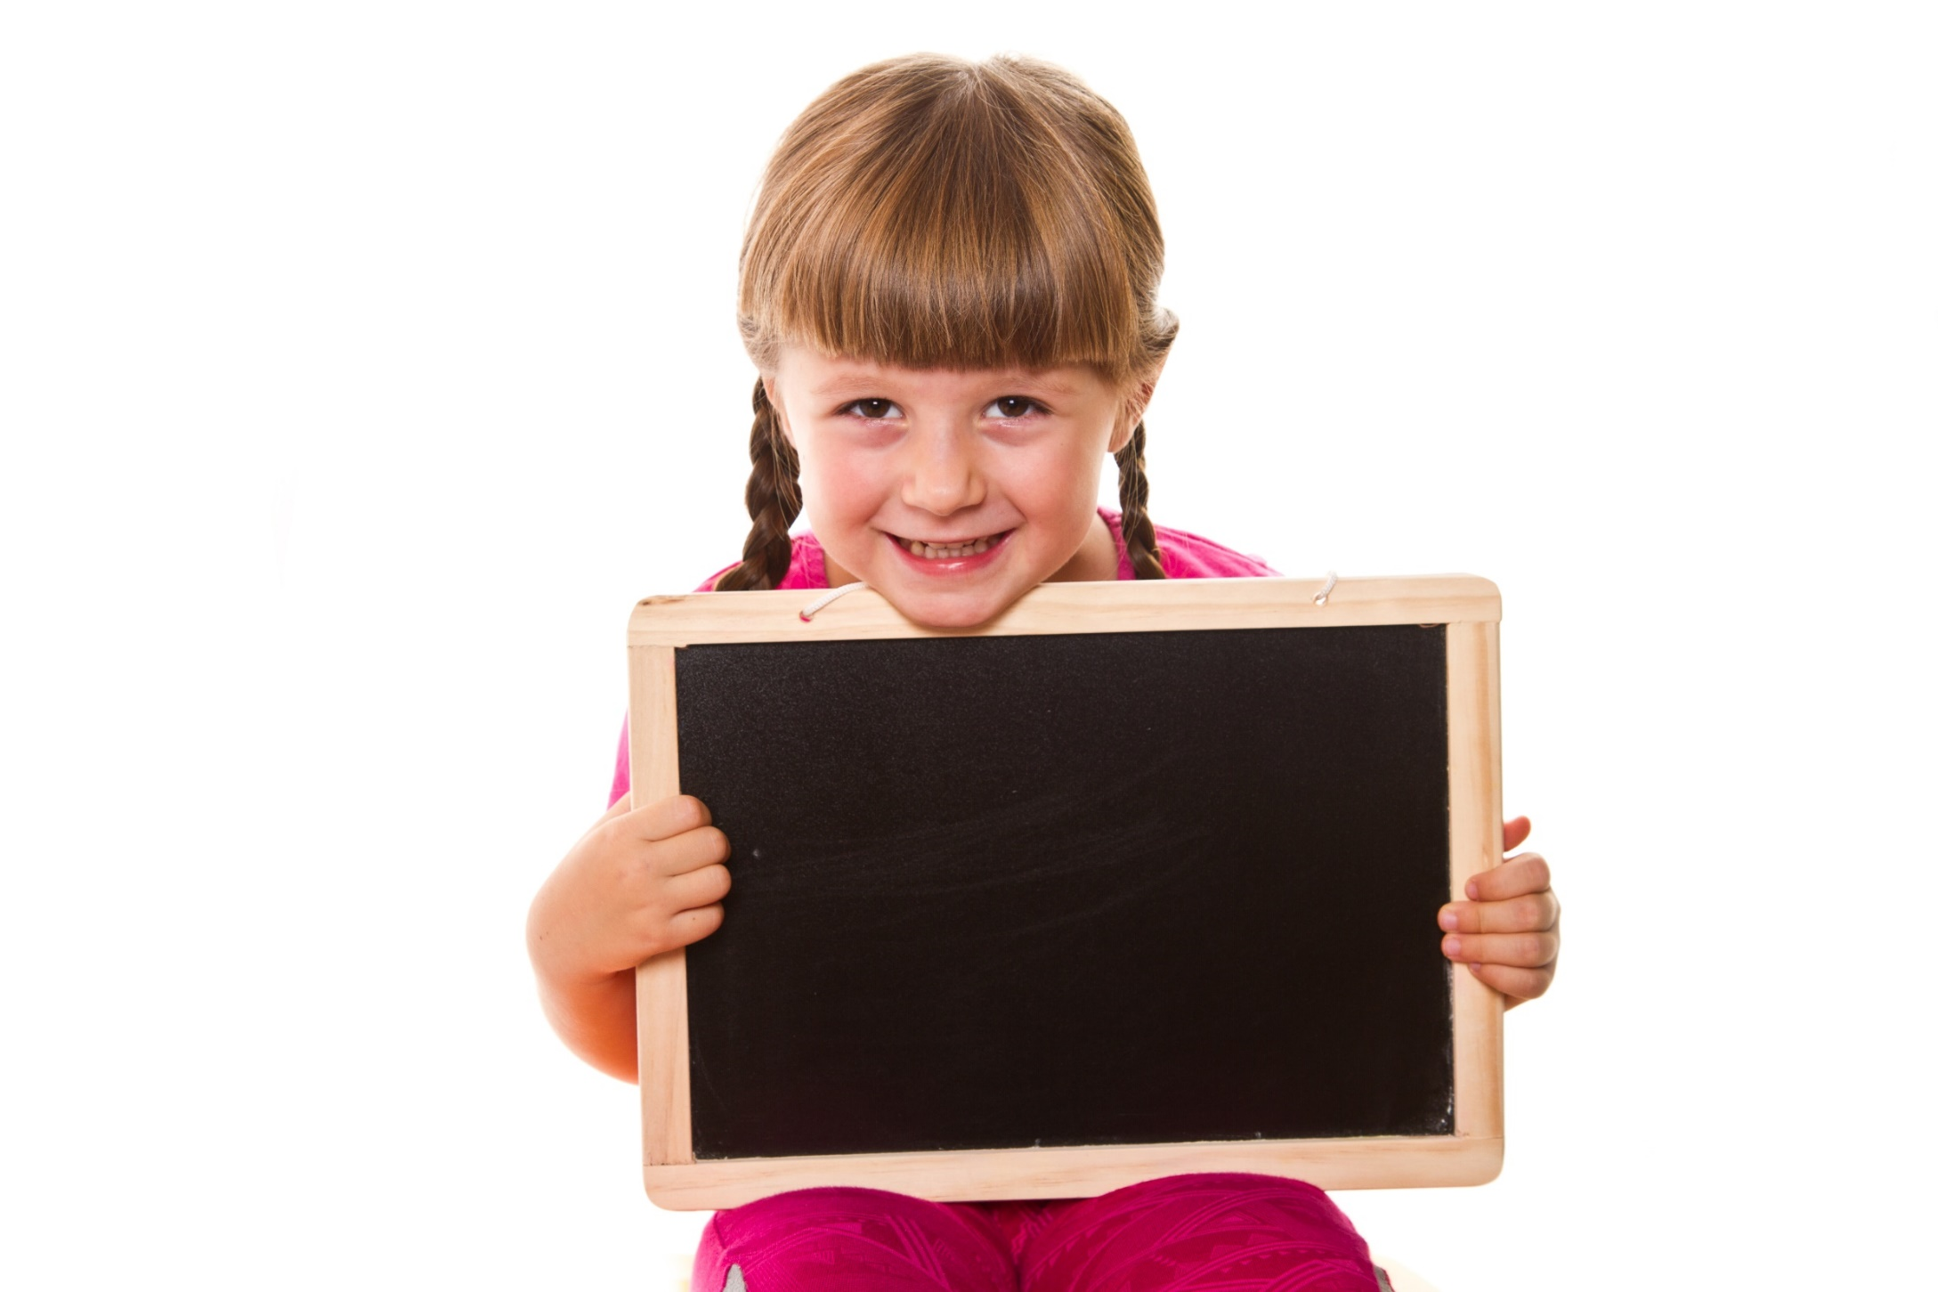
Listening

Slide 14
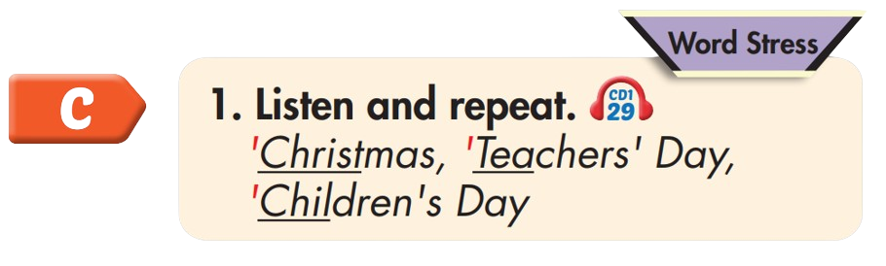

'Christmas
'Teachers' Day
'Children's Day

Slide 15
Practice

Slide 16

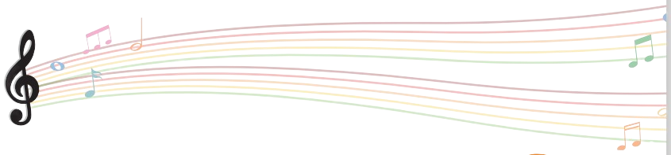

Slide 17
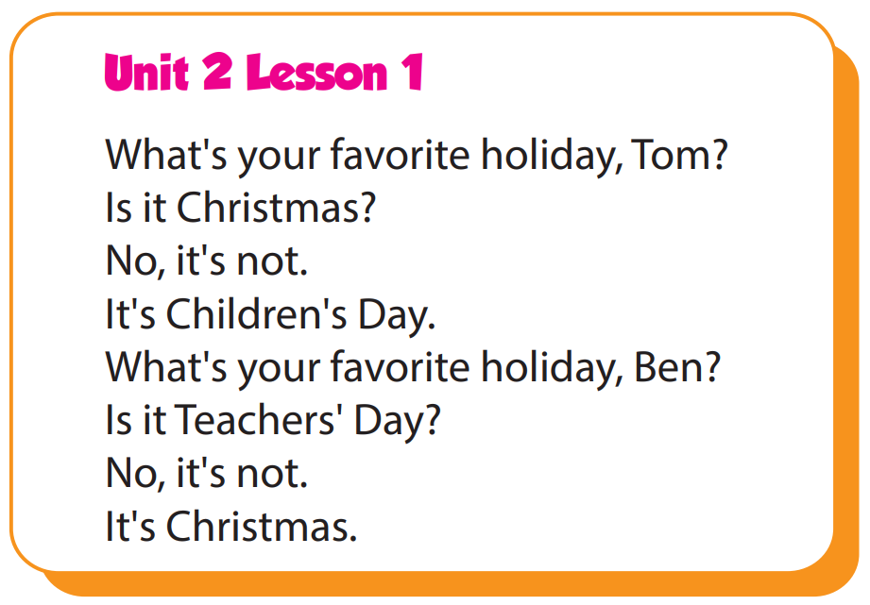

Slide 18
Structure
What's your favorite holiday?
- It's Halloween.
What's her favorite holiday?
- It's Christmas.

Slide 19
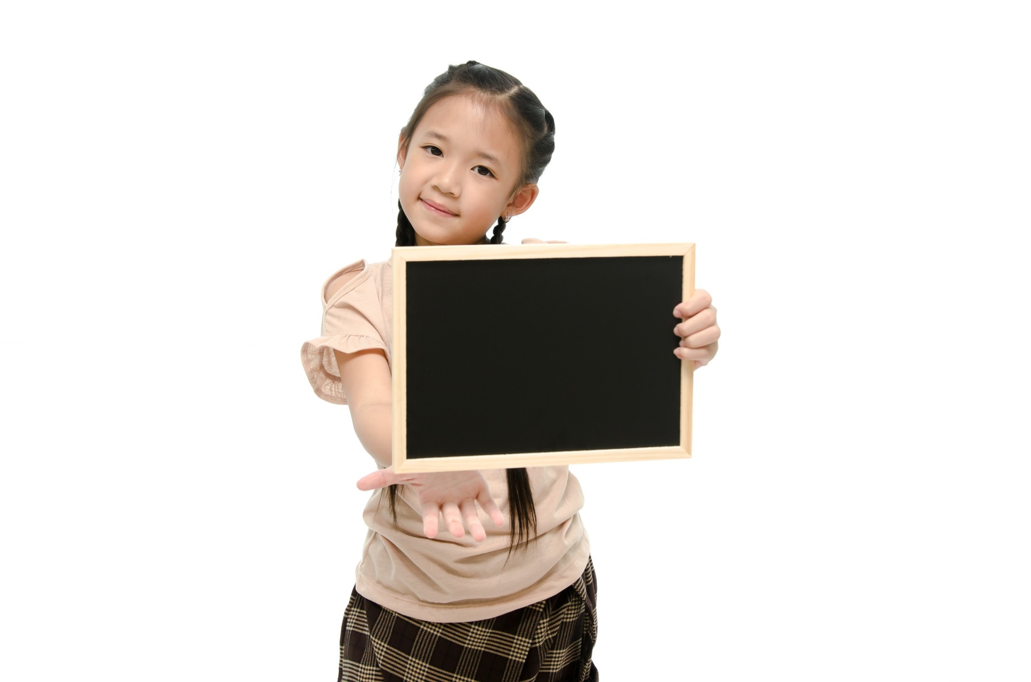
Speaking

Slide 20
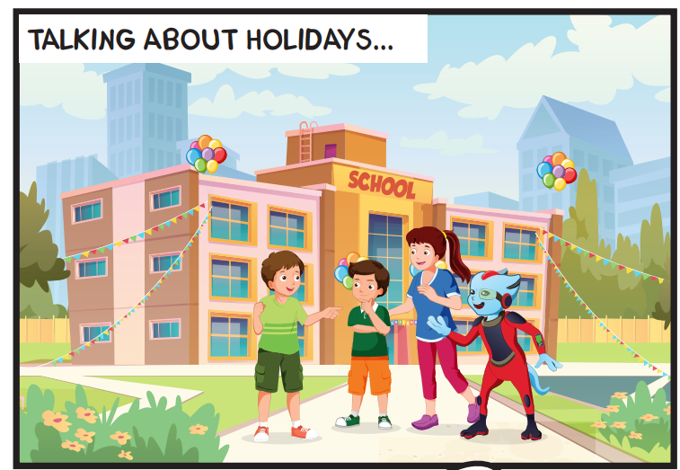
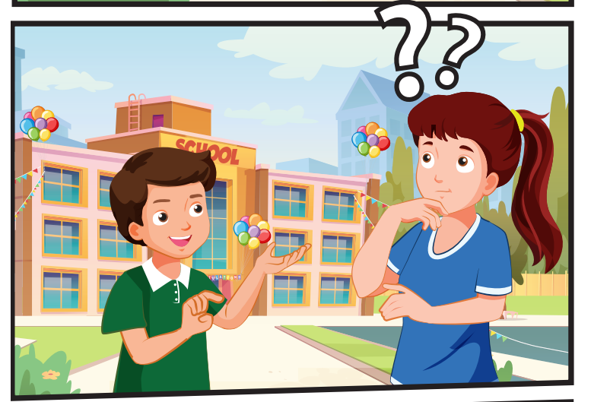
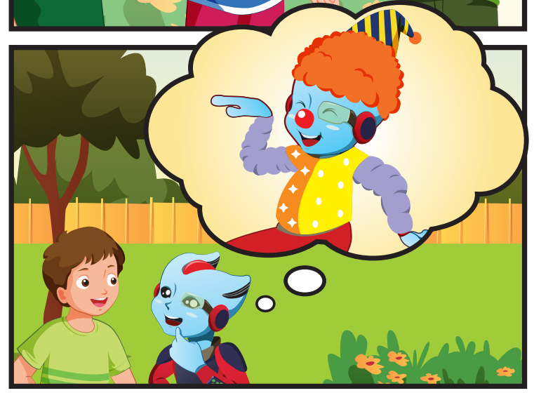
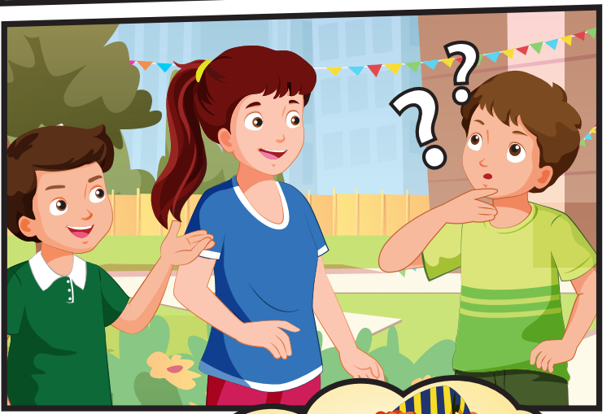
Who can you see?
(Tom, Ben, Lucy, Alfie

Slide 21
Where are they?
They're at school.

Slide 22
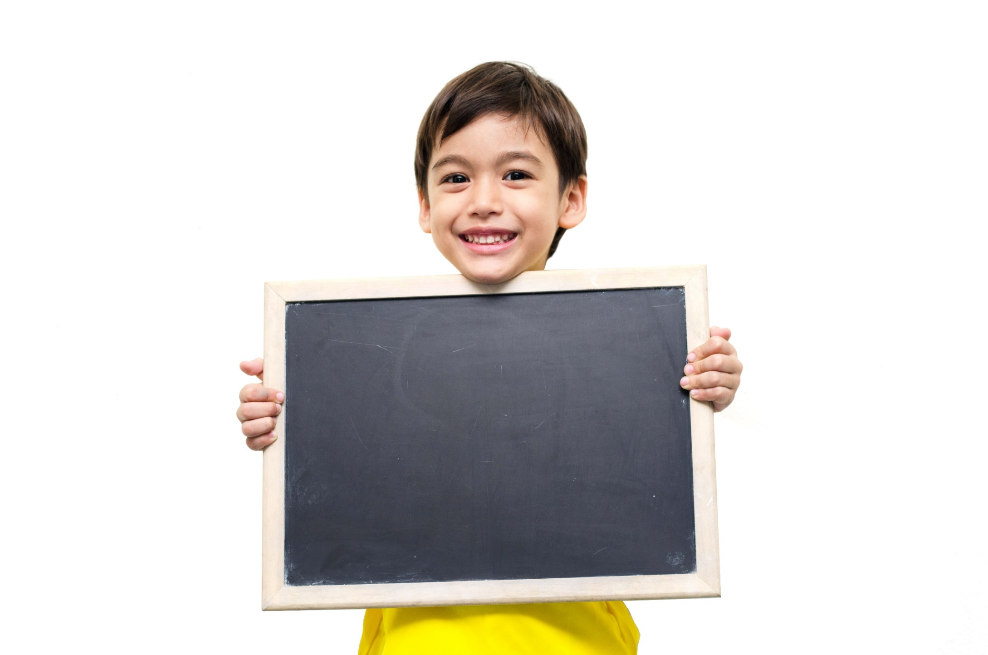
Listening

Slide 23
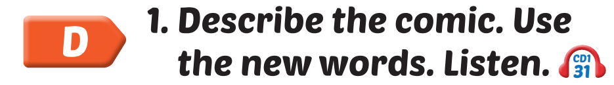

Slide 24

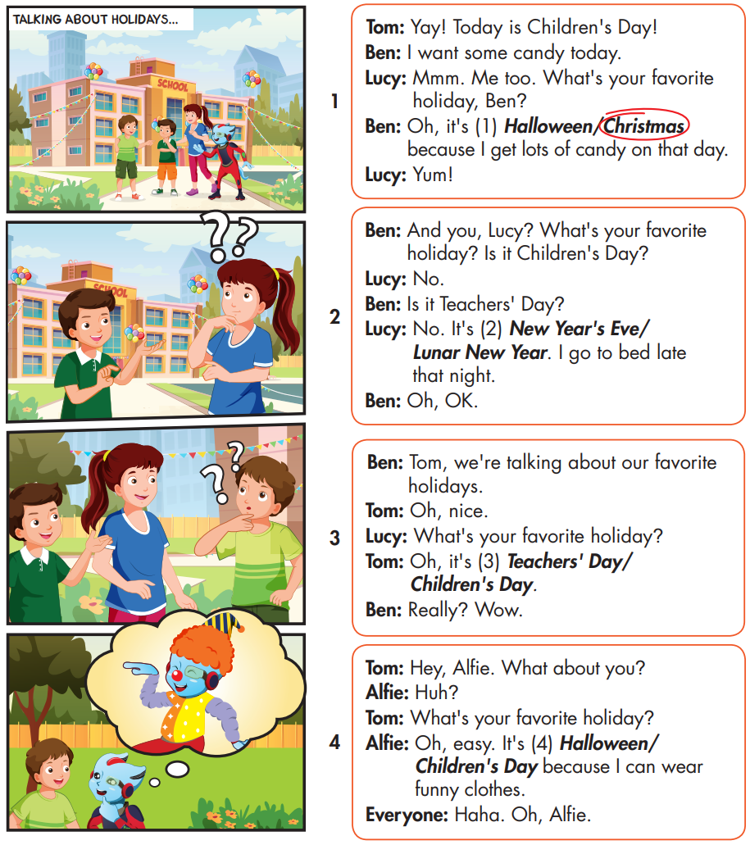

Slide 25
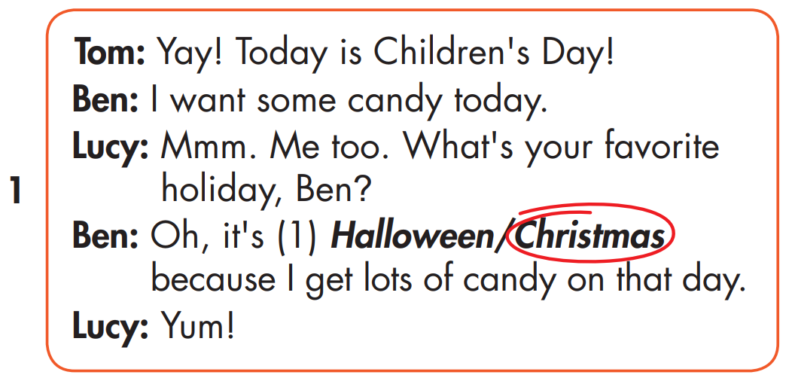

Slide 26
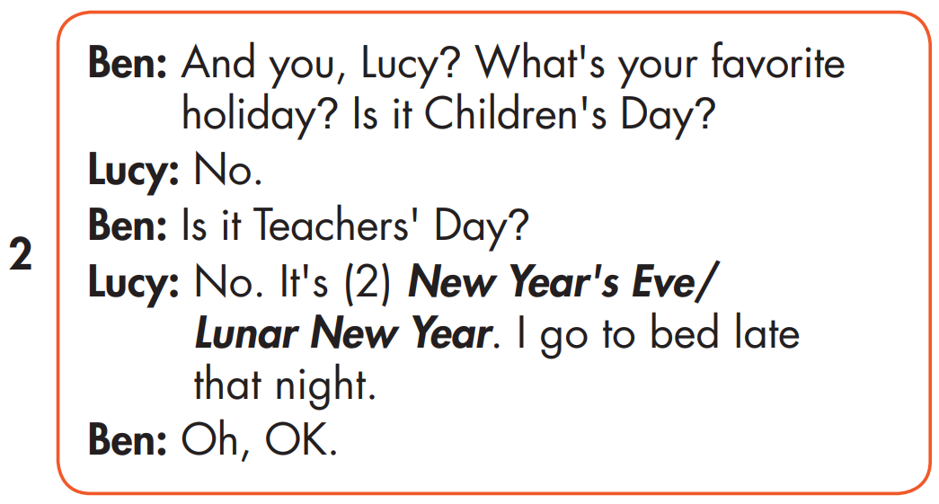
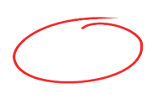

Slide 27
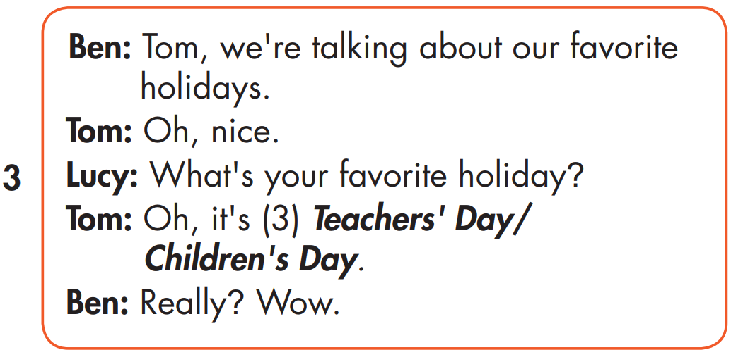

Slide 28
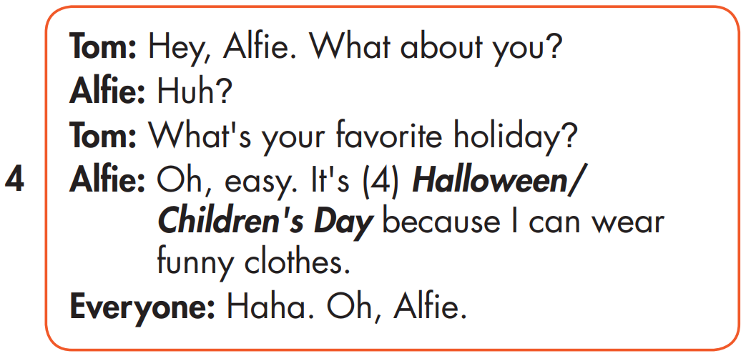

Slide 29
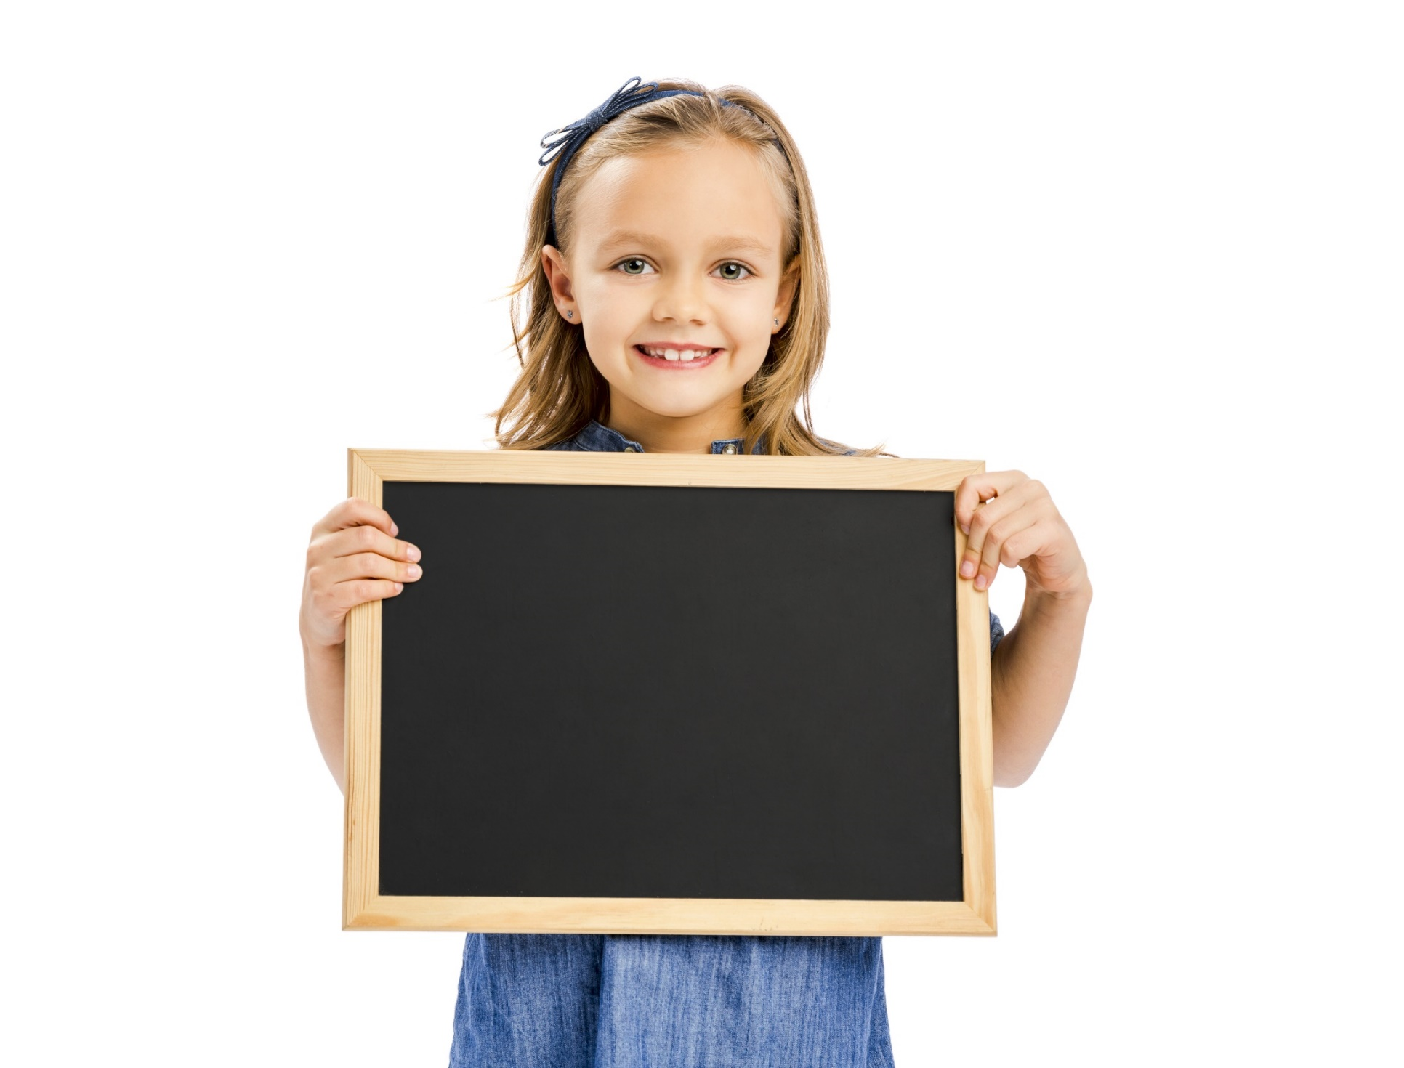
Speaking

Slide 30
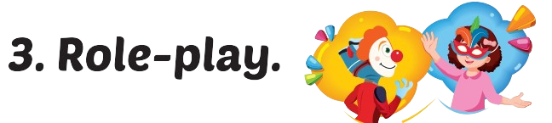
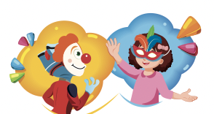

Slide 31
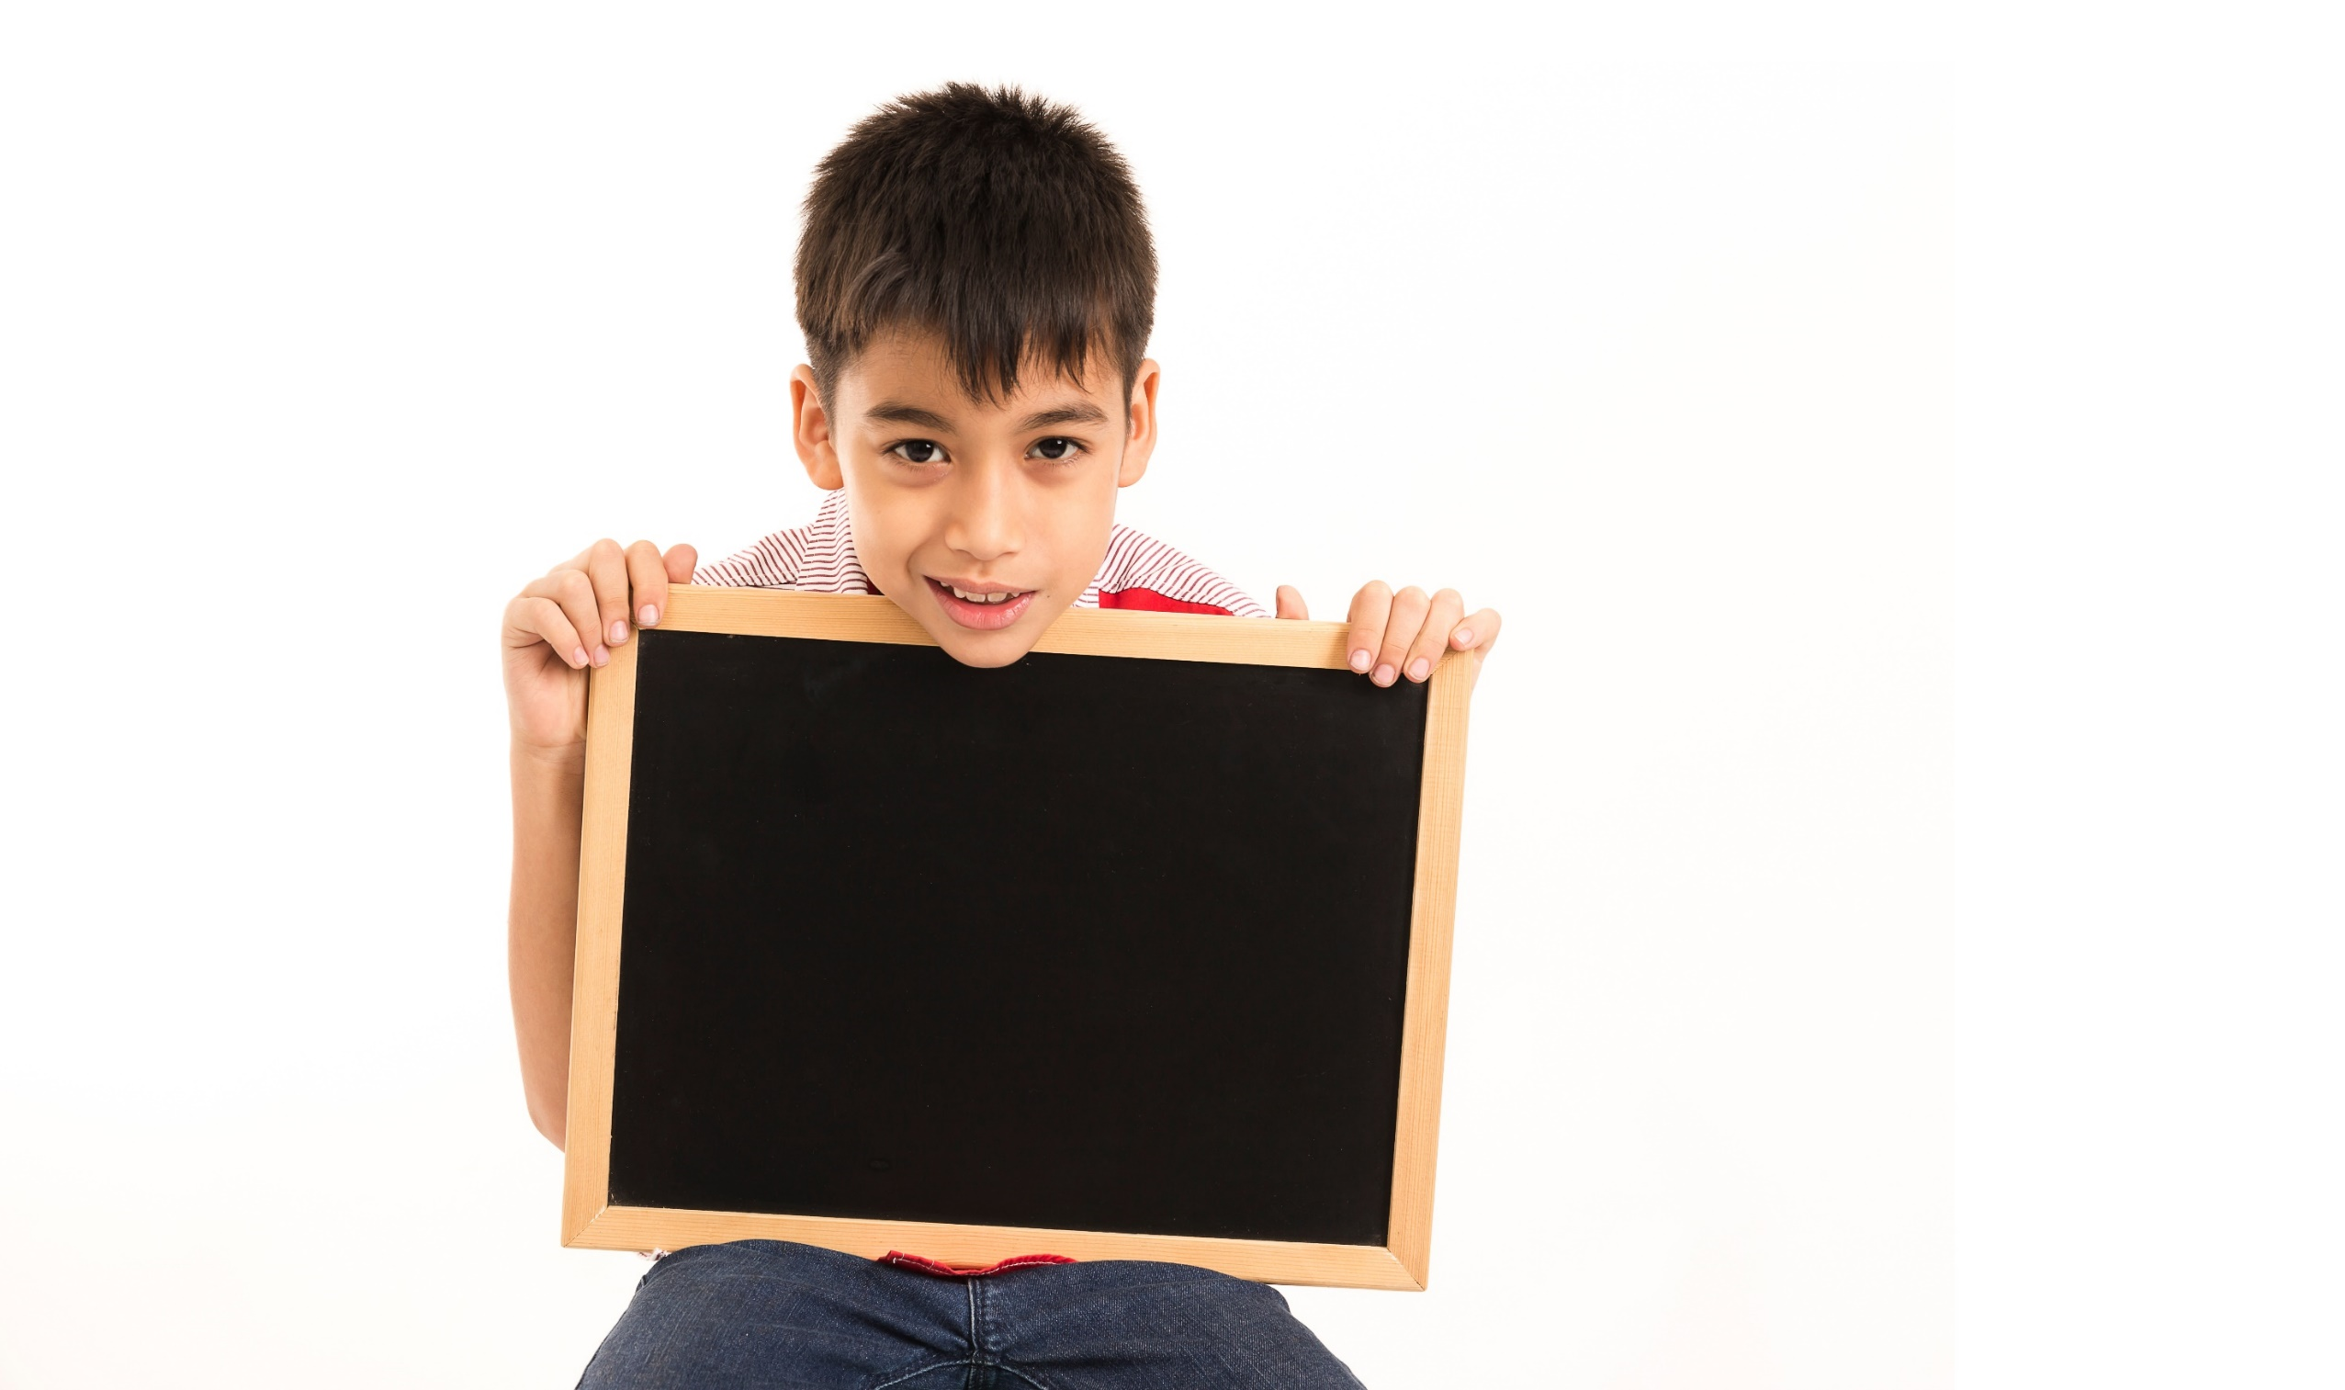
Writing

Slide 32
MAKE YOUR OWN STORY

Slide 33
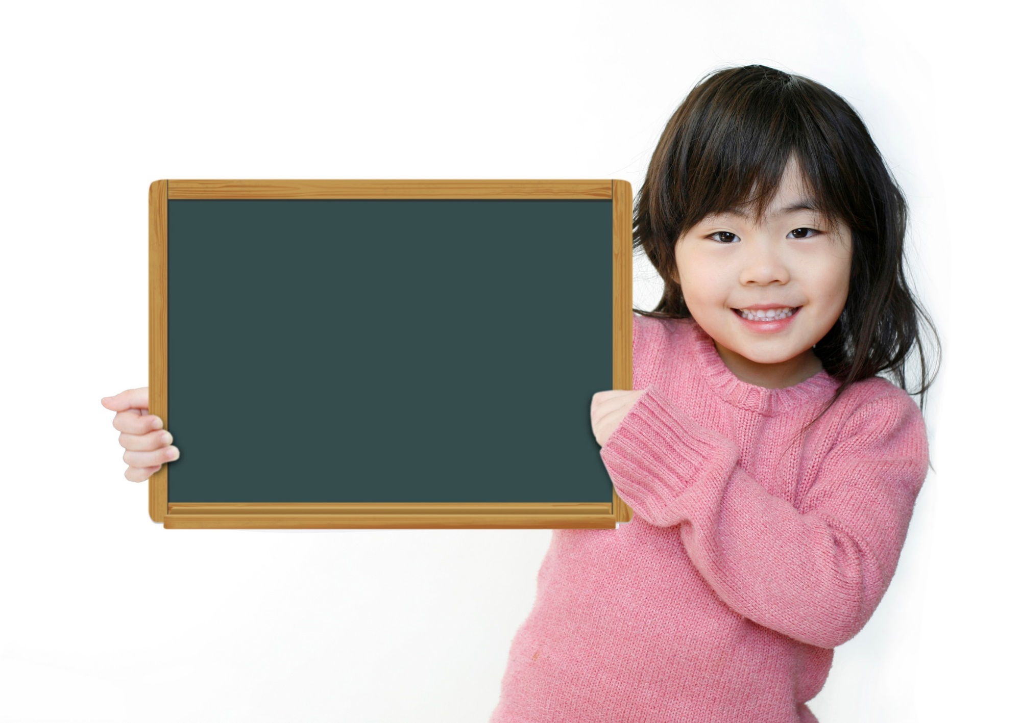
Production

Slide 34

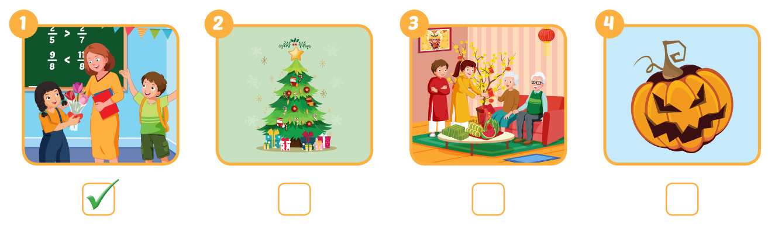


Extra Practice
WB, page 13

Slide 35

CONSOLIDATION

Slide 36

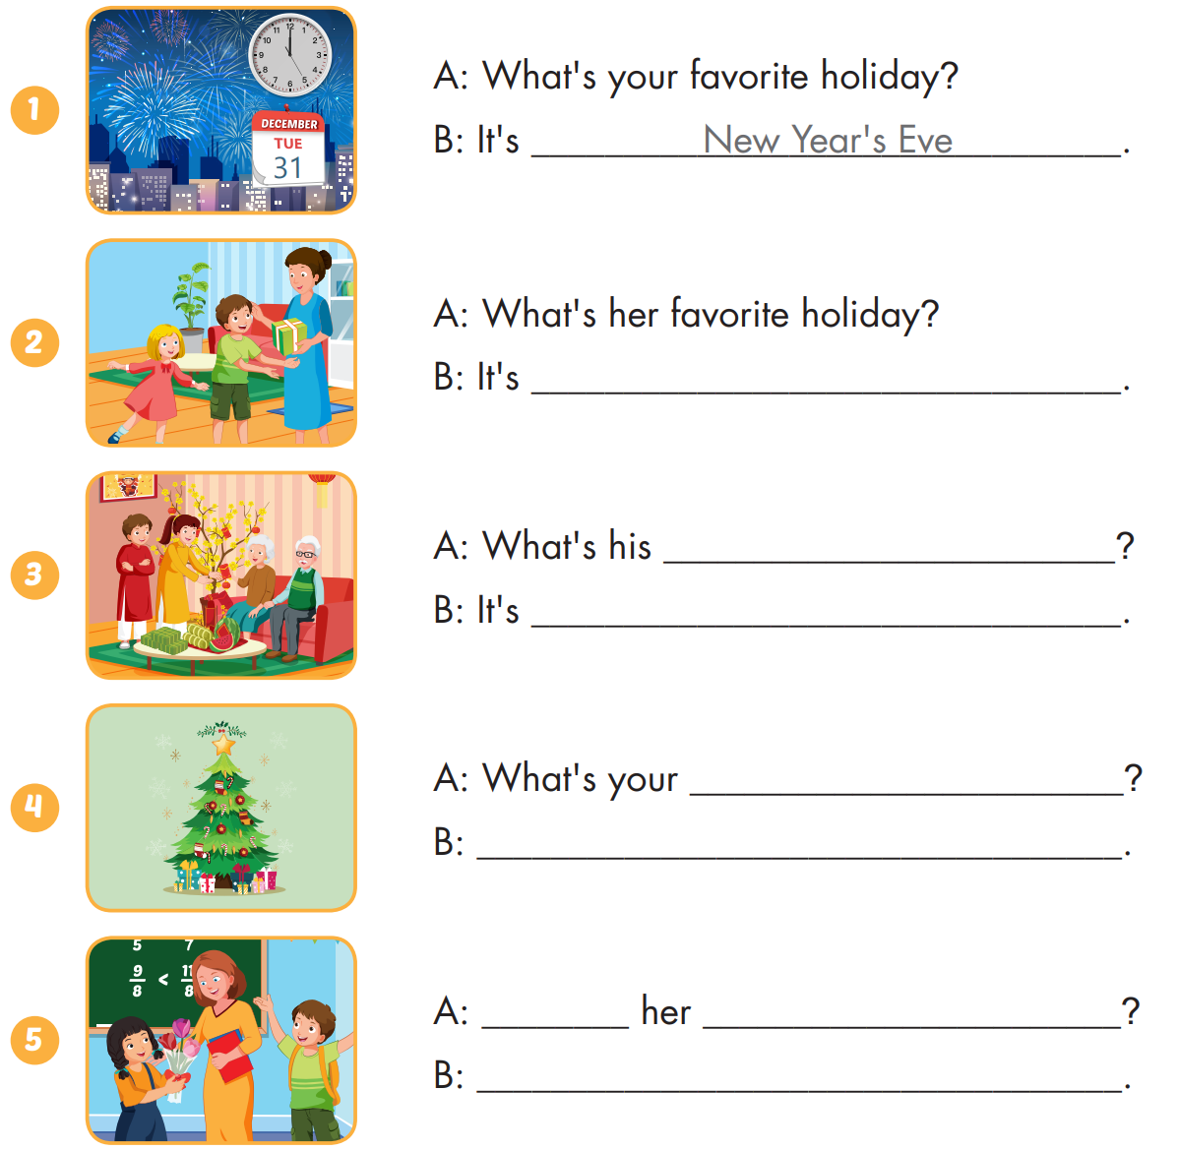
Extra Practice
WB, page 13

Slide 37
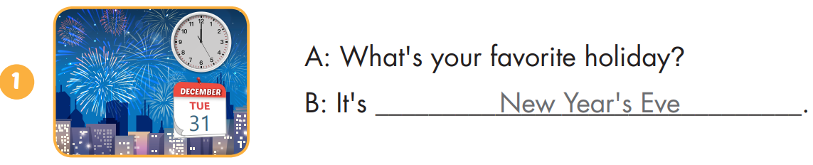
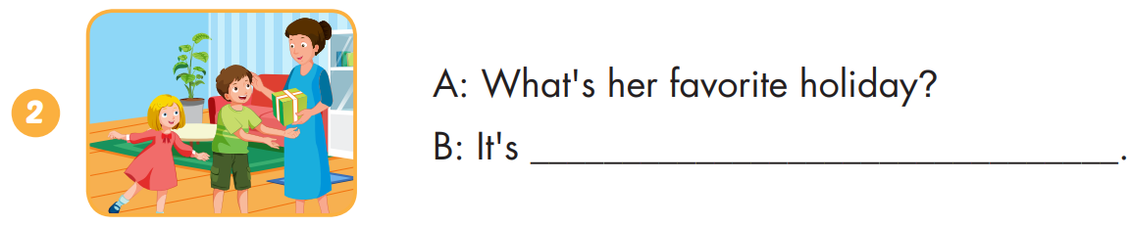
Extra Practice
WB, page 13
Children's Day

Slide 38
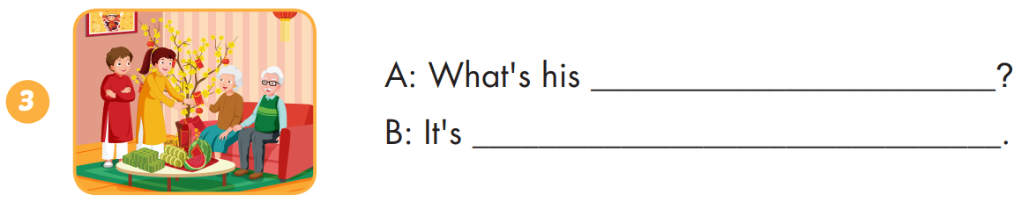
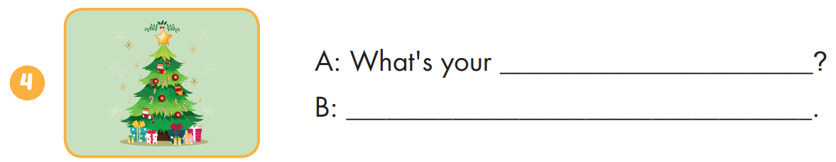
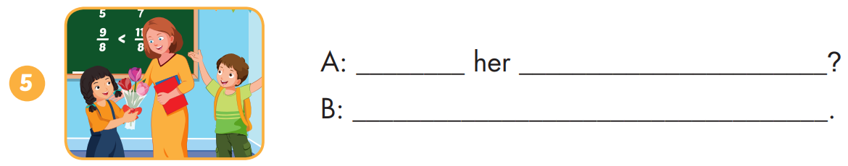
Extra Practice
WB, page 13
favorite holiday
Lunar New Year
favorite holiday
It's Christmas Day.
What's favorite holiday
It's Teachers' Day

Slide 39
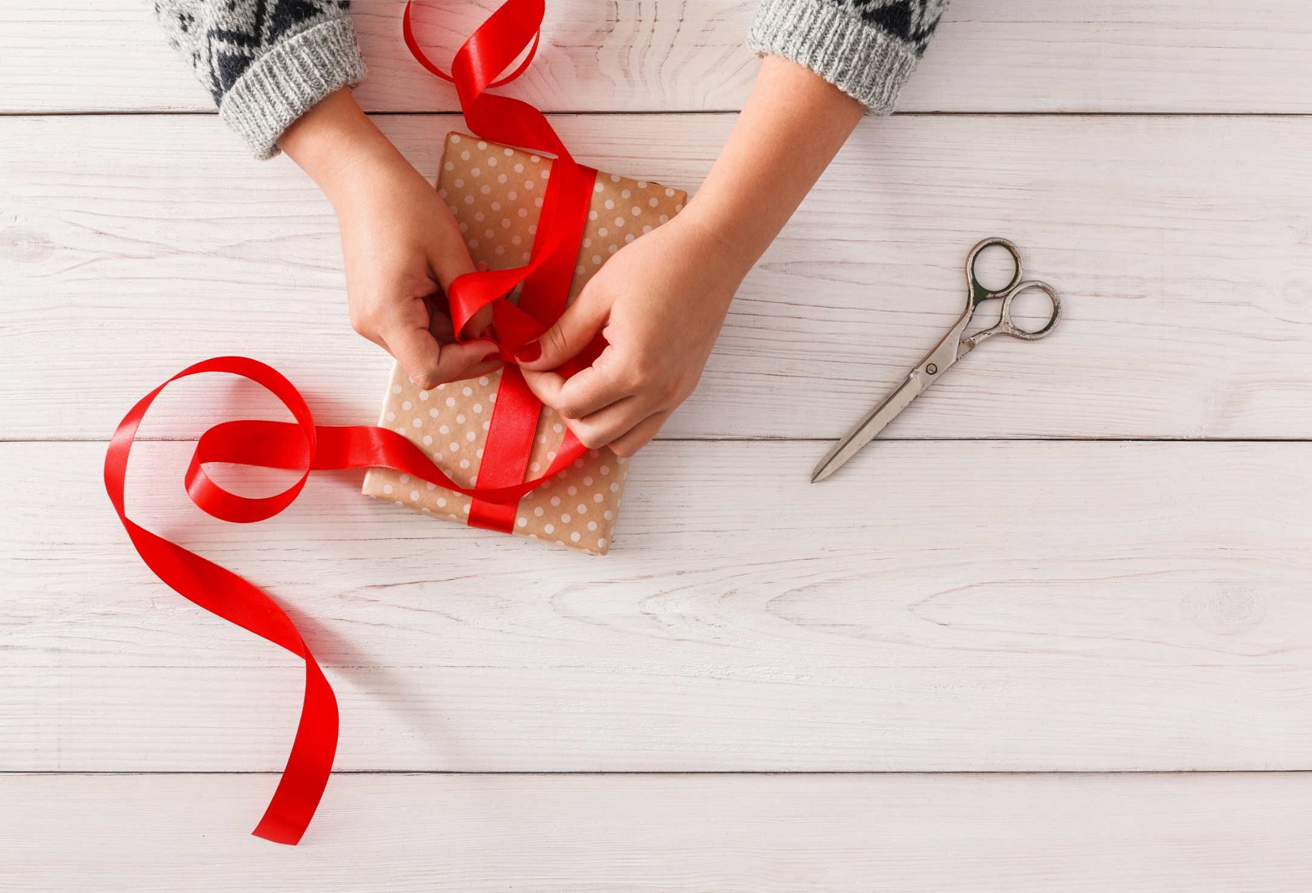
WRAP-UP

Slide 40
Today’s lesson
Stress
For most holidays, we usually stress the first syllable.
Structures/ Sentence patterns
What's your favorite holiday?
- It's Halloween.
What's her favorite holiday?
- It's Christmas.

Slide 41
Homework
Practice the vocabularies and structure, and make sentences using them.
Do the exercises in Tiếng Anh 5 i-Learn Smart Start WB (page 13)
Do the exercises in Tiếng Anh 5 i-Learn Smart Start Notebook (page 10)
Prepare the next lesson (page 22 SB)
Play the consolidation games in Tiếng Anh 5 i-Learn Smart Start DHA App on www.eduhome.com.vn

Slide 42

Enjoy your day!

