Slide 1

Unit 2: Holidays
Lesson 1.1
Page 20

Slide 2
Objectives
By the end of this lesson, students will be able to…
Vocabulary: Pronounce and identify the words related to the topic properly: Halloween, New Year's Eve, Lunar New Year (Tết), Christmas, Teachers' Day, Children's Day.
Structure: What's your favorite holiday? - It's Halloween.
What's her favorite holiday? - It's Christmas

Slide 3

WARM-UP

Slide 4
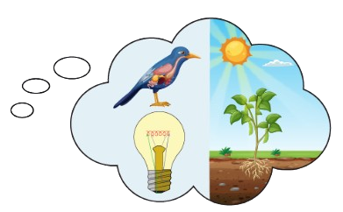






History
Science

Slide 5
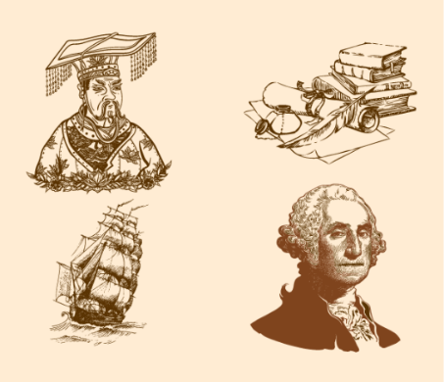
History
English

Slide 6
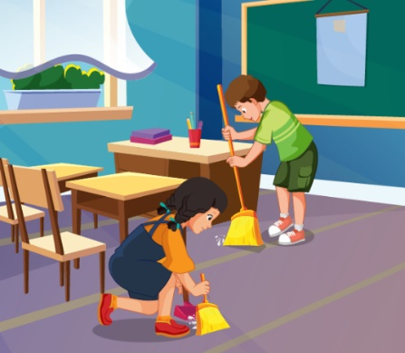
IT
Ethics

Slide 7

Geography
Science

Slide 8
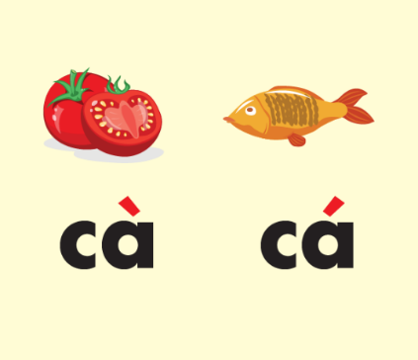
History
Vietnamese

Slide 9

using computers
making things

Slide 10

reading stories
learning languages

Slide 11
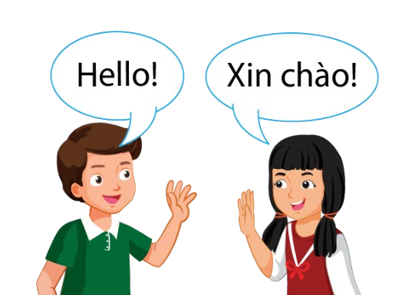
learning languages
do experiments

Slide 12
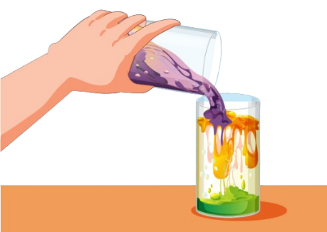
do experiments
solving problems

Slide 13
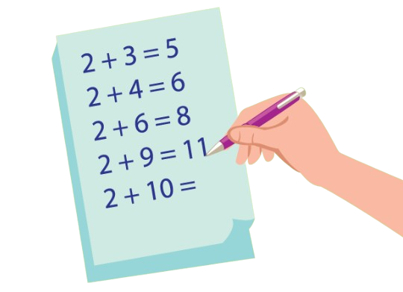
using computers
solving problems

Slide 14


Slide 15

It’s time to learn …

Slide 16

New words
Halloween, New Year's Eve,
Lunar New Year (Tết),
Christmas, Teachers' Day,
Children's Day

Slide 17

Presentation

Slide 18


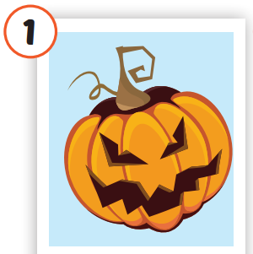
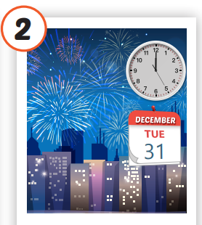
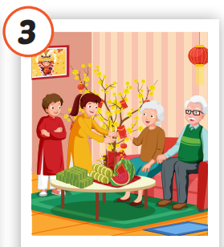
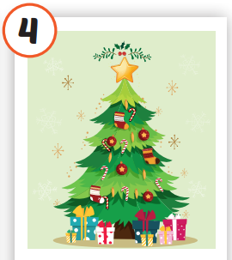
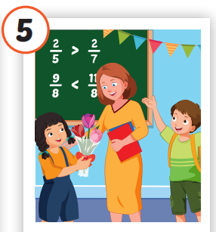
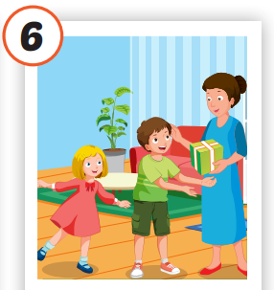
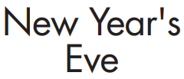
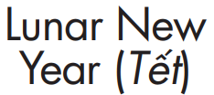

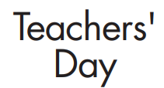
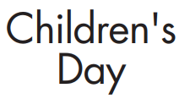

/ˌhæloʊˈiːn/
lễ hội Halloween
/ˈtʃɪldrənz deɪ/
Ngày Quốc tế
Thiếu nhi
/ˌnjuː jɪrz ˈiːv/
đêm Giao thừa
/ˈluːnər nuː jɪrz/
tết Nguyên đán
/ˈkrɪsməs/
Giáng sinh
/ˈtiːtʃərz deɪ/
Ngày Nhà giáo
Notes:
Click vào hình A. 1. Listen and point. Repeat để cho cả audio full chạy

Slide 19


/ˌhæloʊˈiːn/
lễ hội Halloween

Slide 20
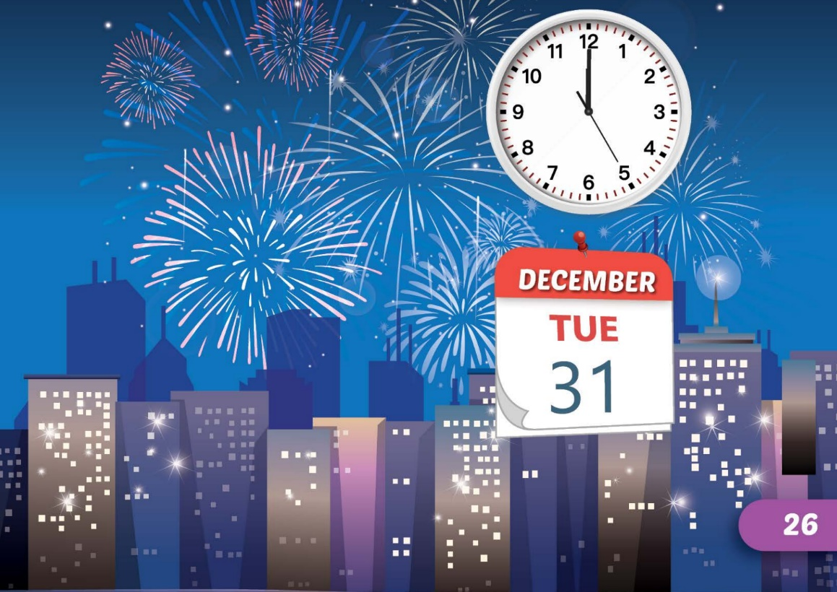

/ˌnjuː jɪrz ˈiːv/
đêm Giao thừa

Slide 21
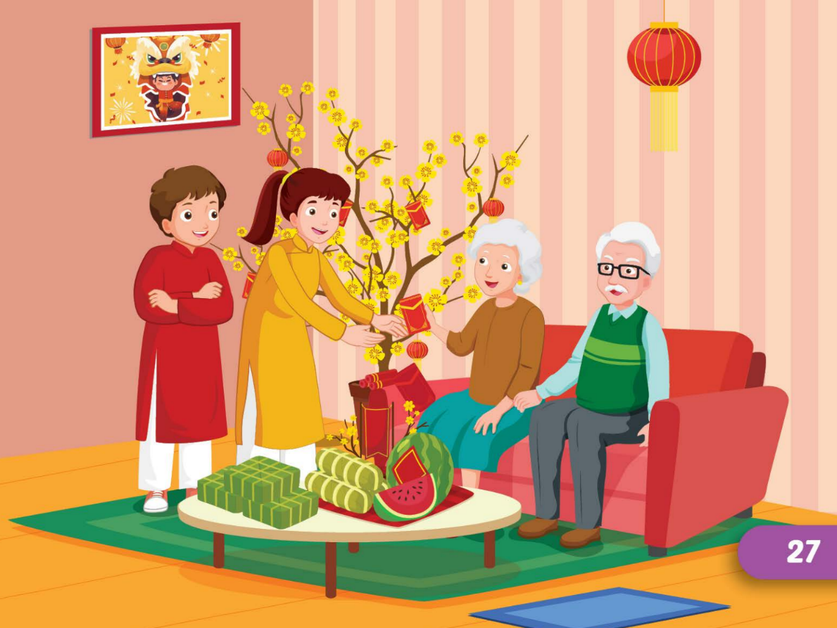

/ˈluːnər nuː jɪrz/
tết Nguyên đán

Slide 22
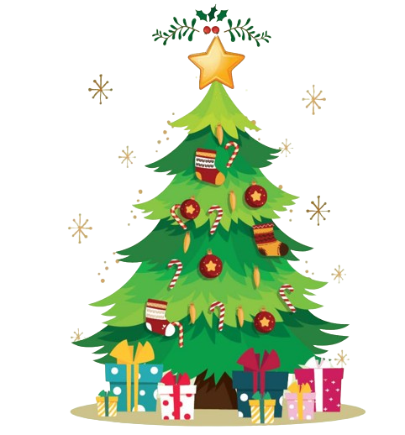

/ˈkrɪsməs/
Giáng sinh

Slide 23
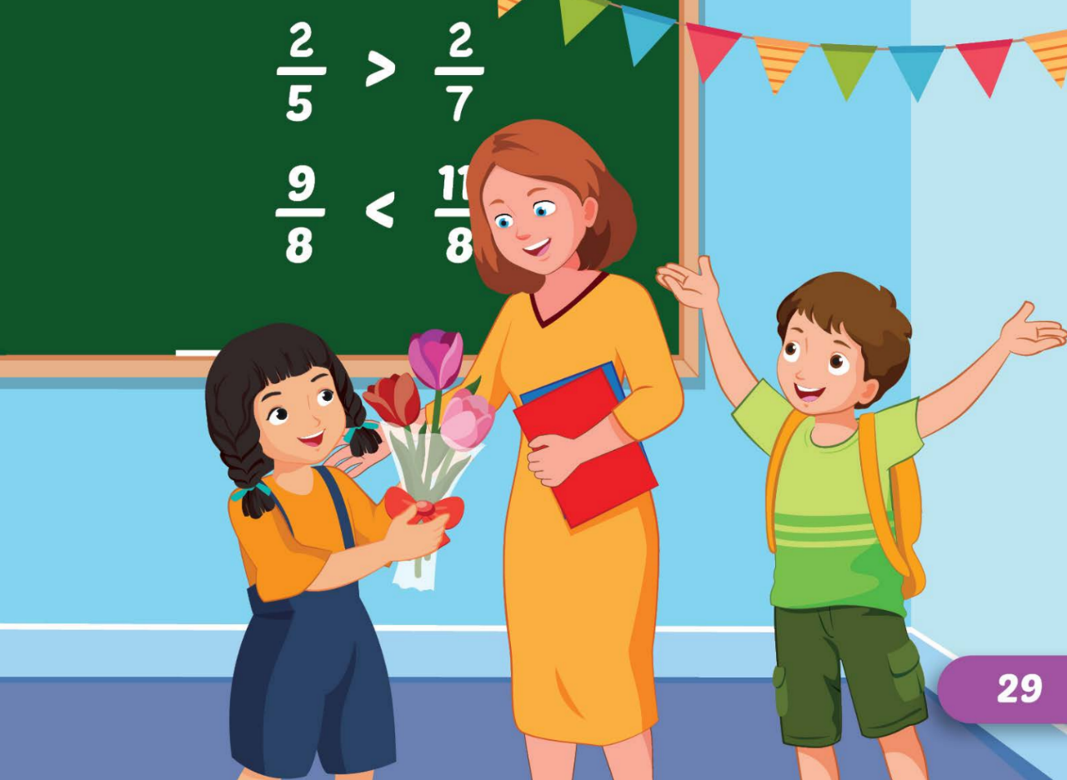

/ˈtiːtʃərz deɪ/
Ngày Nhà giáo

Slide 24
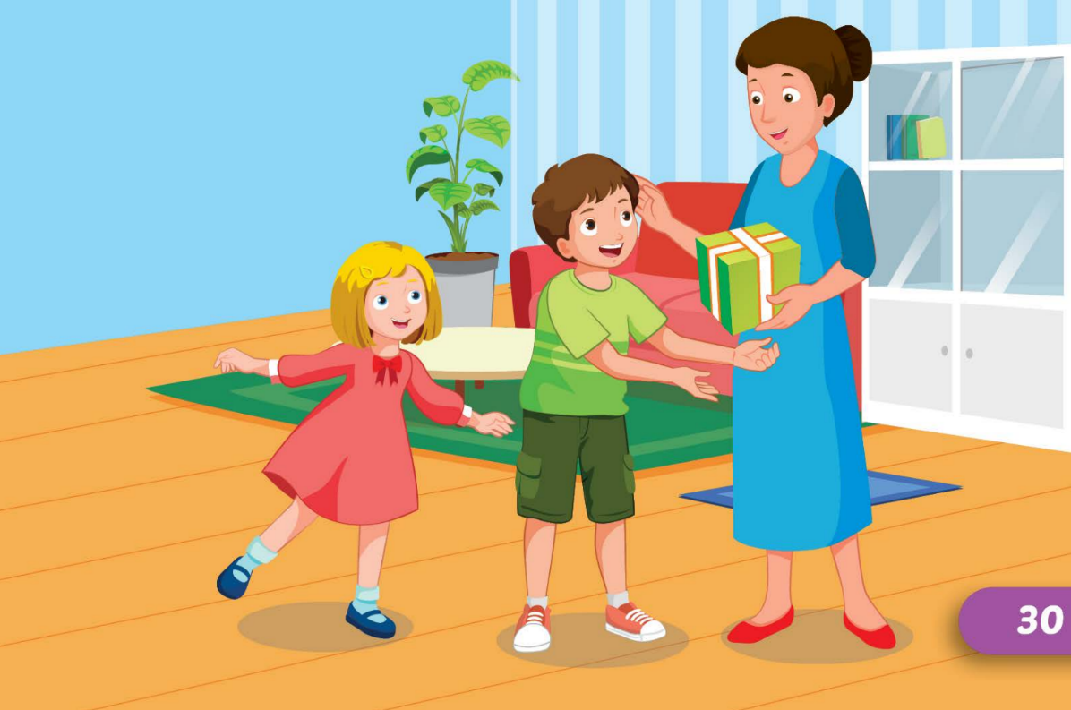

/ˈtʃɪldrənz deɪ/
Ngày Quốc tế
Thiếu nhi

Slide 25
Practice

Slide 26
Check your memory

Slide 27
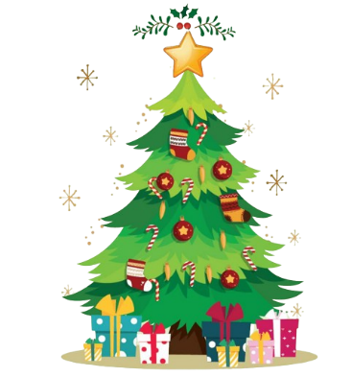





What’s next?
?
Christmas
Halloween

Slide 28




What’s next?
?
Teachers' Day
Children's Day

Slide 29




What’s next?
?
Children's Day
Lunar New Year

Slide 30
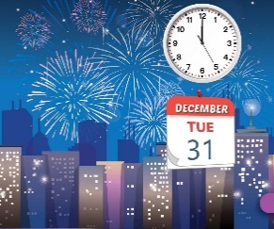


What’s next?
?
New Year's Eva
Children's Day

Slide 31

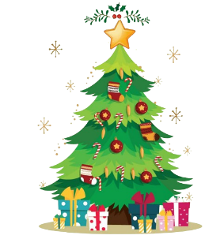

What’s next?
?
Children's Day
Christmas

Slide 32



Slide 33
Structure
What's your favorite holiday?
- It's Halloween.
What's her favorite holiday?
- It's Christmas.

Slide 34
Presentation

Slide 35
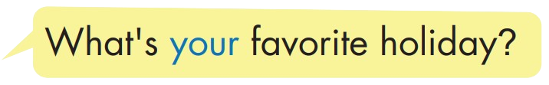
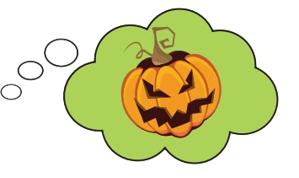
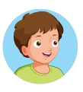
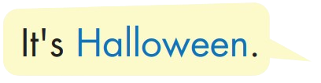

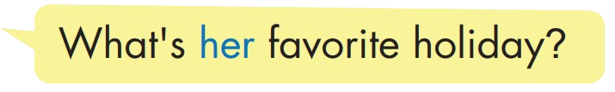
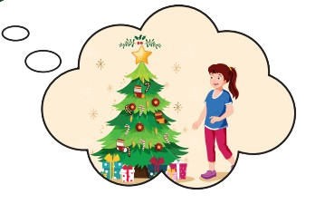
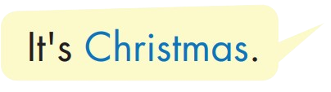
Structure

Slide 36
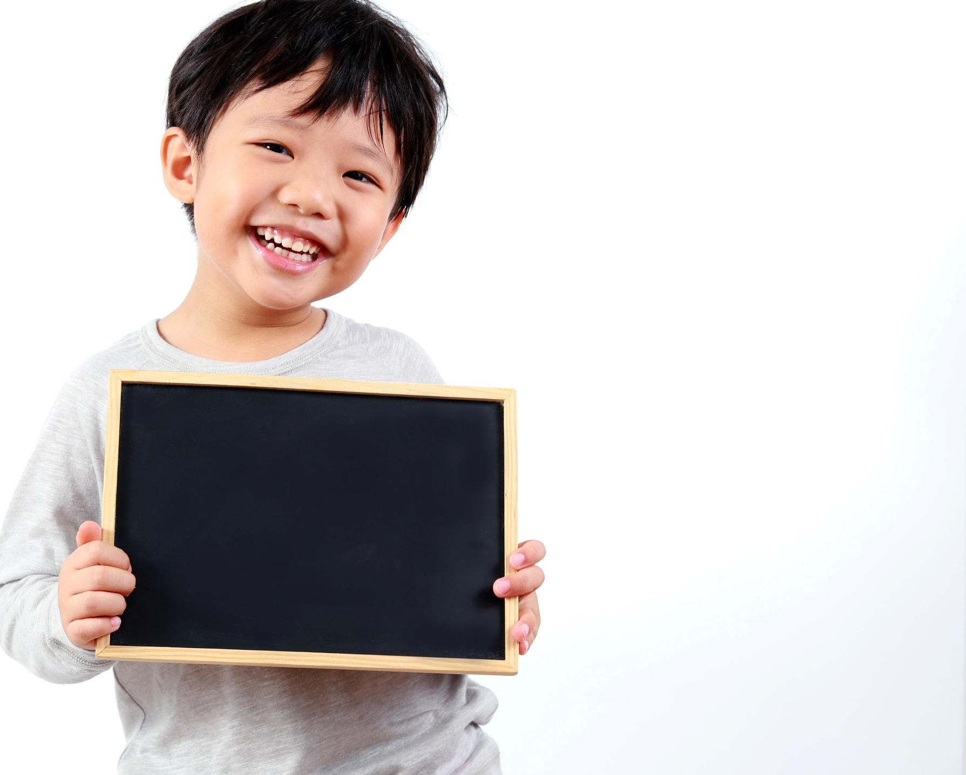
Practice

Slide 37


Slide 38

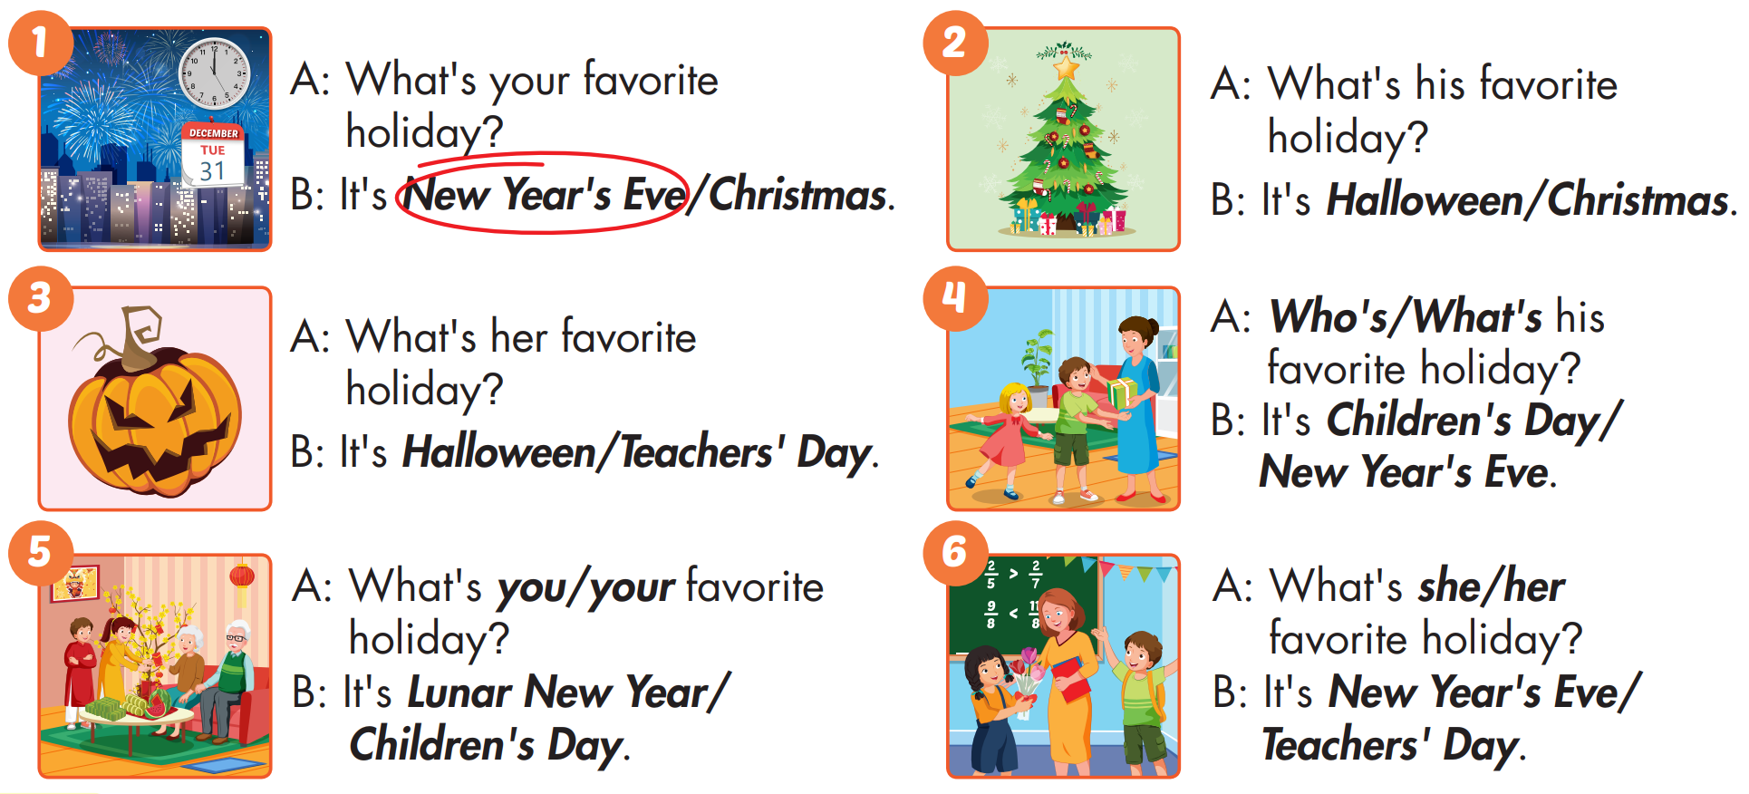


Slide 39

Production

Slide 40

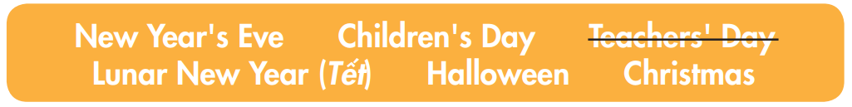
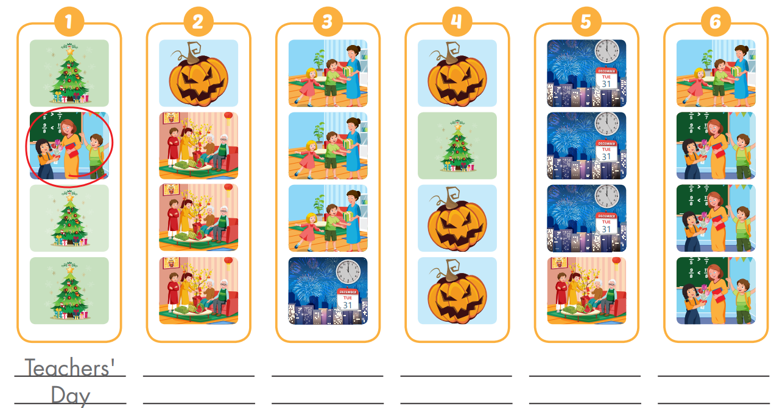
Extra Practice
WB, page 12

Slide 41

CONSOLIDATION

Slide 42

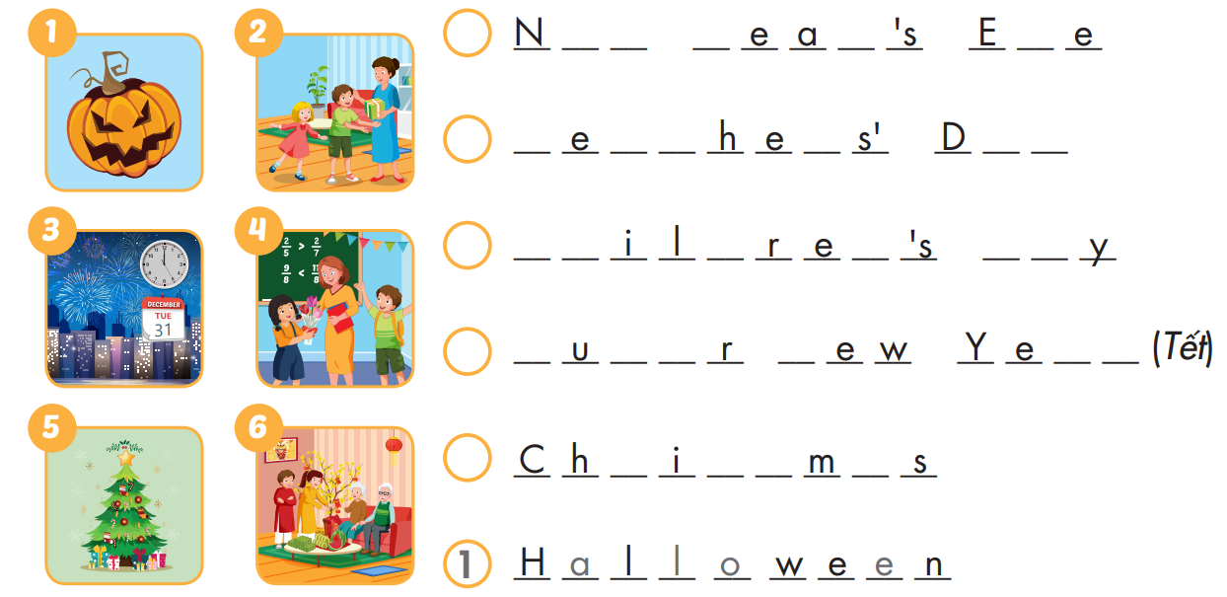
Extra Practice
WB, page 12
3
e
w
Y
r
v
2
T
a
c
r
a
y
2
C
h
d
n
D
a
6
L
n
a
N
a
r
5
r
s
t
a

Slide 43
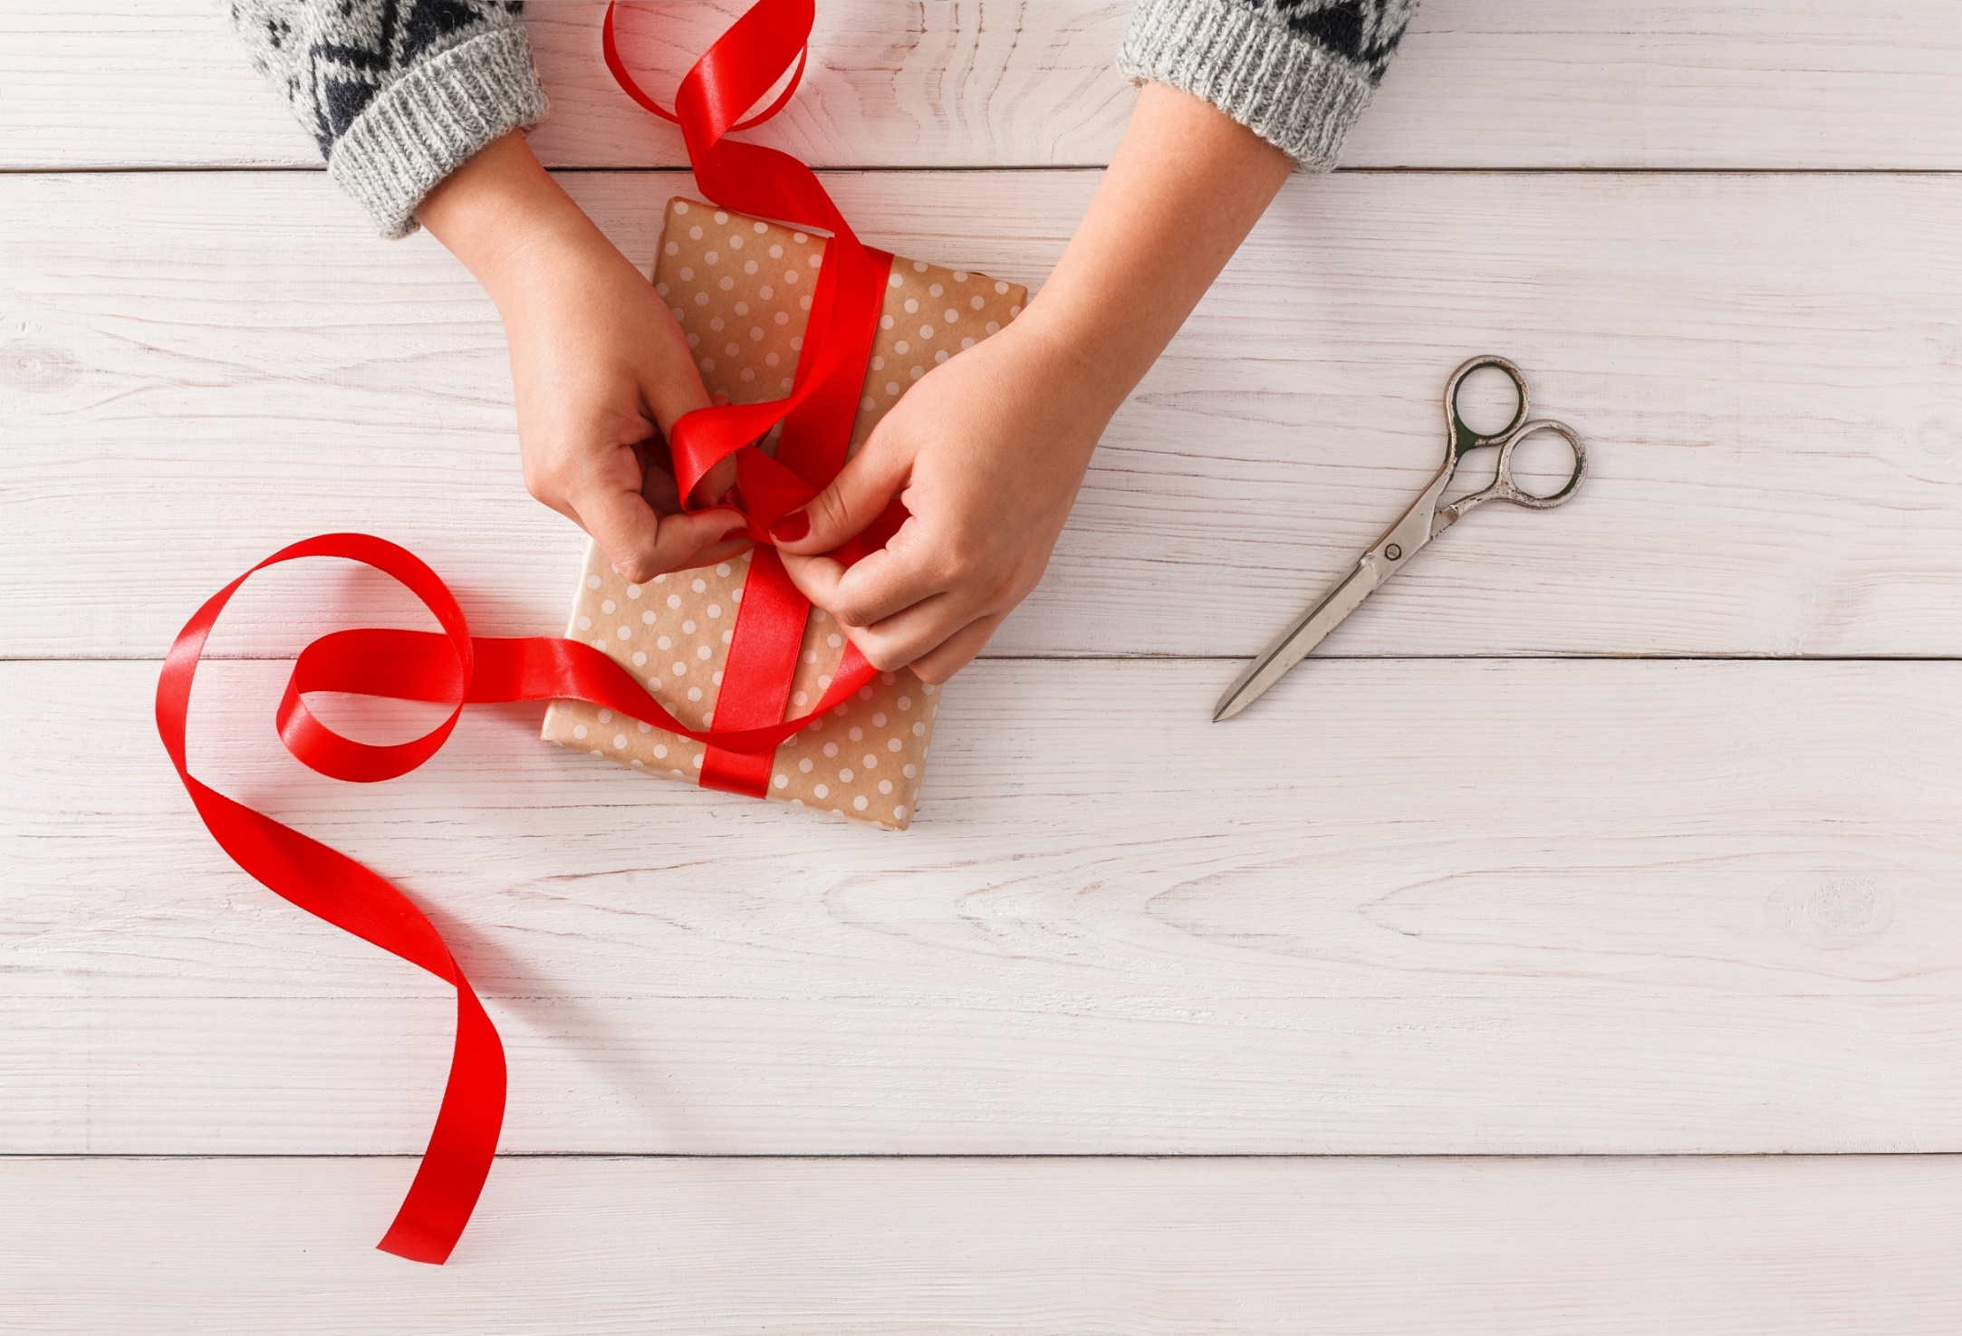
WRAP-UP

Slide 44
Today’s lesson
Vocabularies
Halloween, NewYear's Eve, Lunar New Year (Tết), Christmas, Teachers' Day,
Children's Day
Structures/ Sentence patterns
What's your favorite holiday?
- It's Halloween.
What's her favorite holiday?
- It's Christmas.

Slide 45
Homework
Practice the vocabularies and structure, and make sentences using them.
Do the exercises in Tiếng Anh 5 i-Learn Smart Start WB (page 12)
Do the exercises in Tiếng Anh 5 i-Learn Smart Start Notebook (page 10)
Prepare the next lesson (page 21 SB)
Play the consolidation games in Tiếng Anh 5 i-Learn Smart Start DHA App on www.eduhome.com.vn

Slide 46

Enjoy your day!

