Slide 1

Unit 1: SCHOOL
Review 2
Page 19

Slide 2
Objectives
By the end of this lesson, students will be able to review and practice the target language and skills in unit 1.
Vocabulary: unit 1
Structure: unit 1

Slide 3

WARM-UP

Slide 4

Guess the SCHOOL SUBJECT

Slide 5

You learn about kings, queens, wars and facts from the past.
H I S T O R Y

Slide 6
You add, subtract, divide and multiply numbers.
M A T H S
3 x 4 = 12
25 : 5 = 5
10 + 7 = 17

Slide 7

You learn about continents, countries, oceans, rivers, lakes and cities.
G E O G R A P H Y

Slide 8
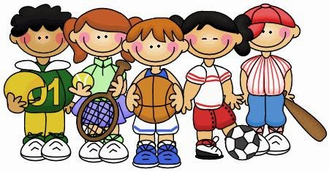
You do gymnastics and play sports there.
P.E.

Slide 9
You learn about plants, animals and human body.
S C I E N C E

Slide 10

You learn about composers, singing and listening to music.
M U S I C

Slide 11

You draw and paint there.
A R T

Slide 12

You learn how to use a computer there.
I.T.
Microsoft
Windows

Slide 13

It’s time to learn …

Slide 14

Review

Slide 15


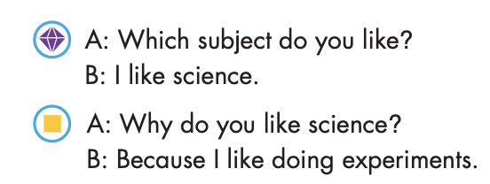

Slide 16


Slide 17
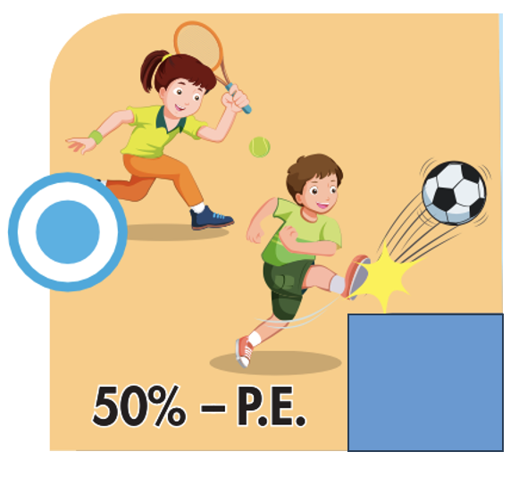


Slide 18
Practice

Slide 19
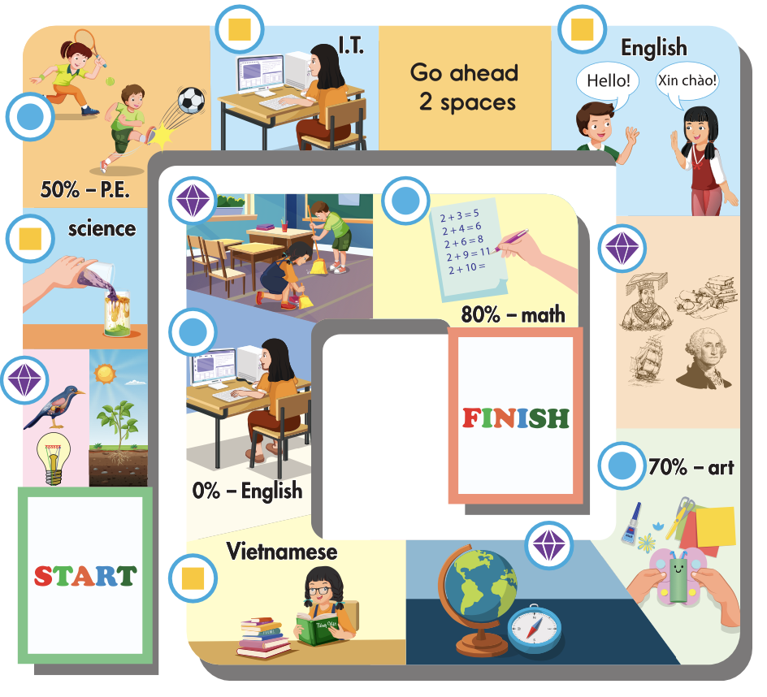
Work in pairs and play the game.

Slide 20
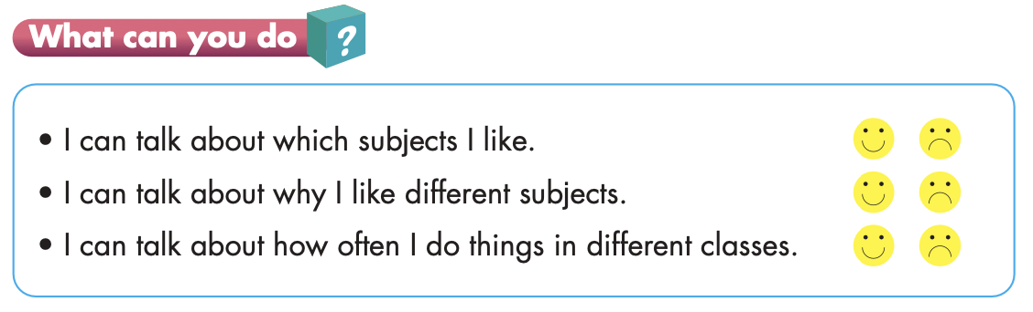

Slide 21

Production

Slide 22

Listening

Slide 23


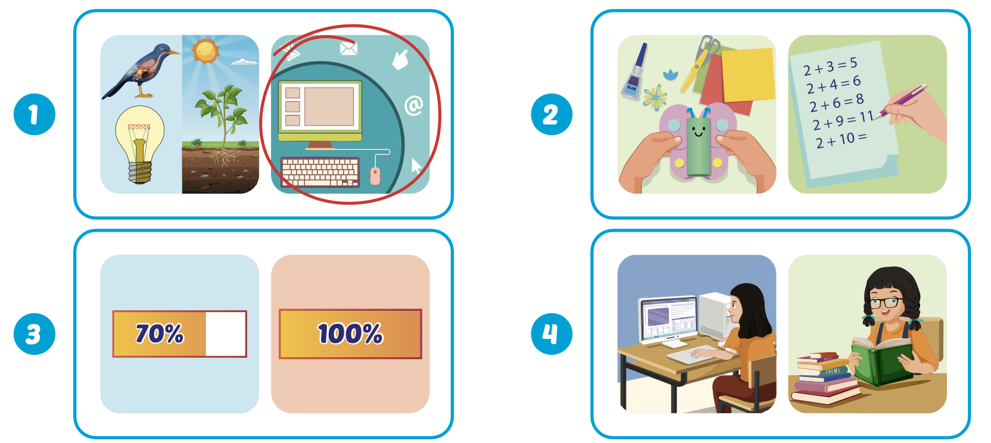
Extra Practice
WB, page 11
Click on the picture to hear the sound.

Slide 24

Writing

Slide 25

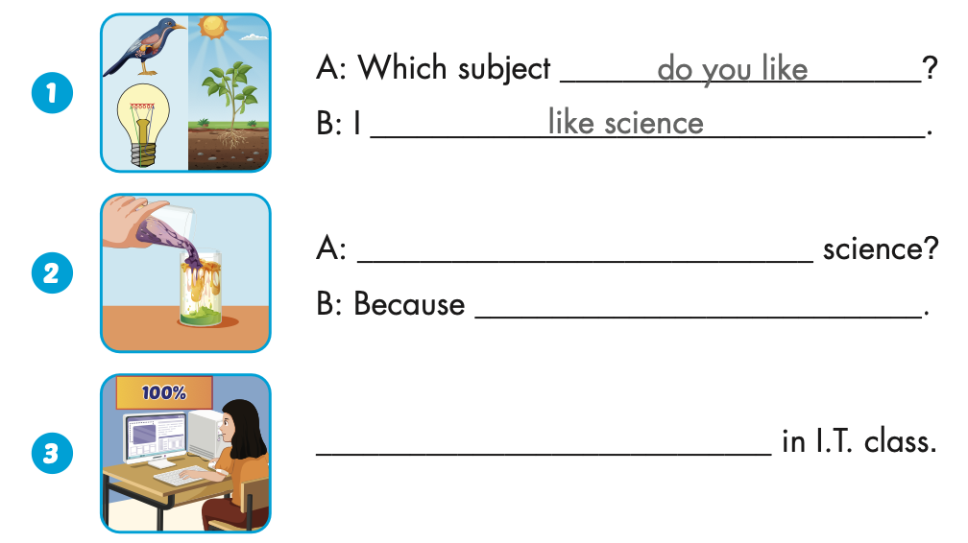
Extra Practice
WB, page 11
Why do you like
I like doing experiments.
I always use computers

Slide 26
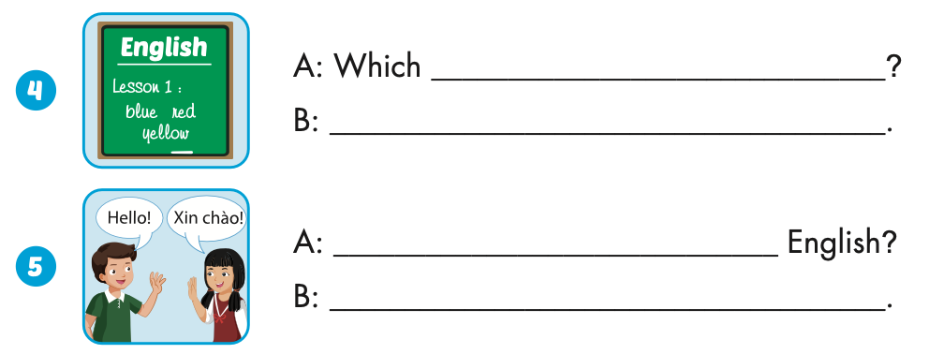
Extra Practice
WB, page 11
subject do you like
I like English
Why do you like
Because I like learning languages

Slide 27

CONSOLIDATION

Slide 28

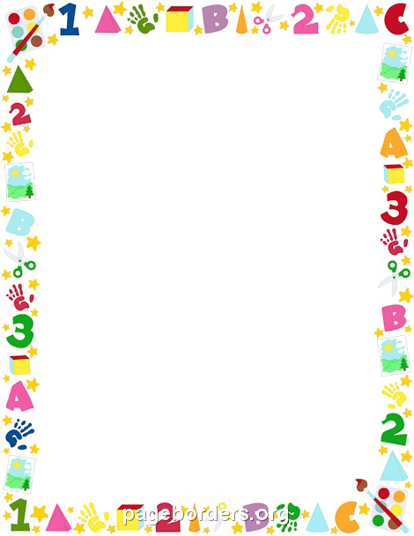
Read, correct and write.

Slide 29
Yola
like
She like Vietnamese.
She likes Vietnamese.
NEXT

Slide 30
Yola
I likes I.T.
likes
I like I.T.
NEXT

Slide 31
Yola
Which subject do he like?
do
Which subject does he like?
NEXT

Slide 32
Yola
Which subject does Tom and Tim like?
does
Which subject do Tom and Tim like?
NEXT

Slide 33
Yola
like
Lucy like music.
Lucy likes music.
NEXT

Slide 34
Yola
always
She reads always books.
She always reads books.
NEXT

Slide 35
Yola
My I.T. class start at 3:30 p.m.
start
My I.T. class starts at 3:30 p.m.
NEXT

Slide 36
Yola
Her English class starts on 7:30 on Mondays.
on
Her English class starts at 7:30 on Mondays.
END

Slide 37

WRAP-UP

Slide 38
Today’s lesson
Vocabularies
Unit 1
Structures/ Sentence patterns
Unit 1

Slide 39
Homework
Practice the vocabularies and structure, and make sentences using them.
Do the exercises in Tiếng Anh 5 i-Learn Smart Start WB (page 11).
Do the exercises in Tiếng Anh 5 i-Learn Smart Start Notebook.
Prepare the next lesson (page 20 SB).
Play the consolidation games in Tiếng Anh 5 i-Learn Smart Start DHA App on www.eduhome.com.vn

Slide 40

Enjoy your day!

