Slide 1

Ngoc Lam
Primary School
Unit 1: SCHOOL
Lesson 2.2
Page 10

Slide 2
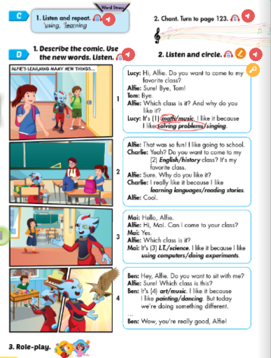
Lesson Outline
Warm-up
Pronunciation
Listening
Speaking
Consolidation
Wrap-up

Slide 3
Objectives
By the end of this lesson, students will be able to practice intonation, the target language and the conversations about why they like different subjects.
Pronunciation: word stress for verb-ing
Structure: Why do you like math?
Because I like solving problems.

Slide 4

WARM-UP

Slide 5
Read and choose. Then say.

Slide 6



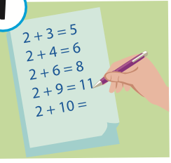
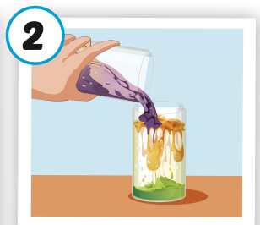
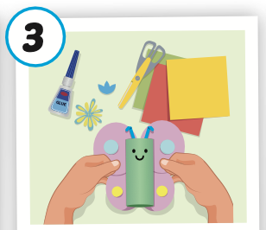

Read and choose
A
B
C
solving problems

Slide 7



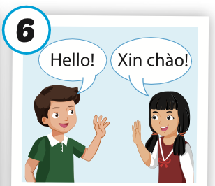
Read and choose
A
B
C
making things

Slide 8

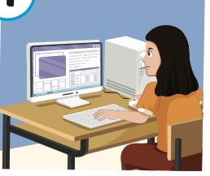
Read and choose
A
B
C
using computers

Slide 9

Read and choose
A
C
B
doing experiments

Slide 10

It’s time to learn …

Slide 11

Pronunciation
Word stress for verb-ing

Slide 12

Presentation

Slide 13

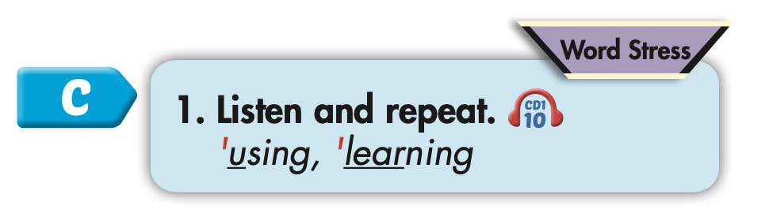
Click on C to hear the sound.

Slide 14
Practice

Slide 15



Slide 16
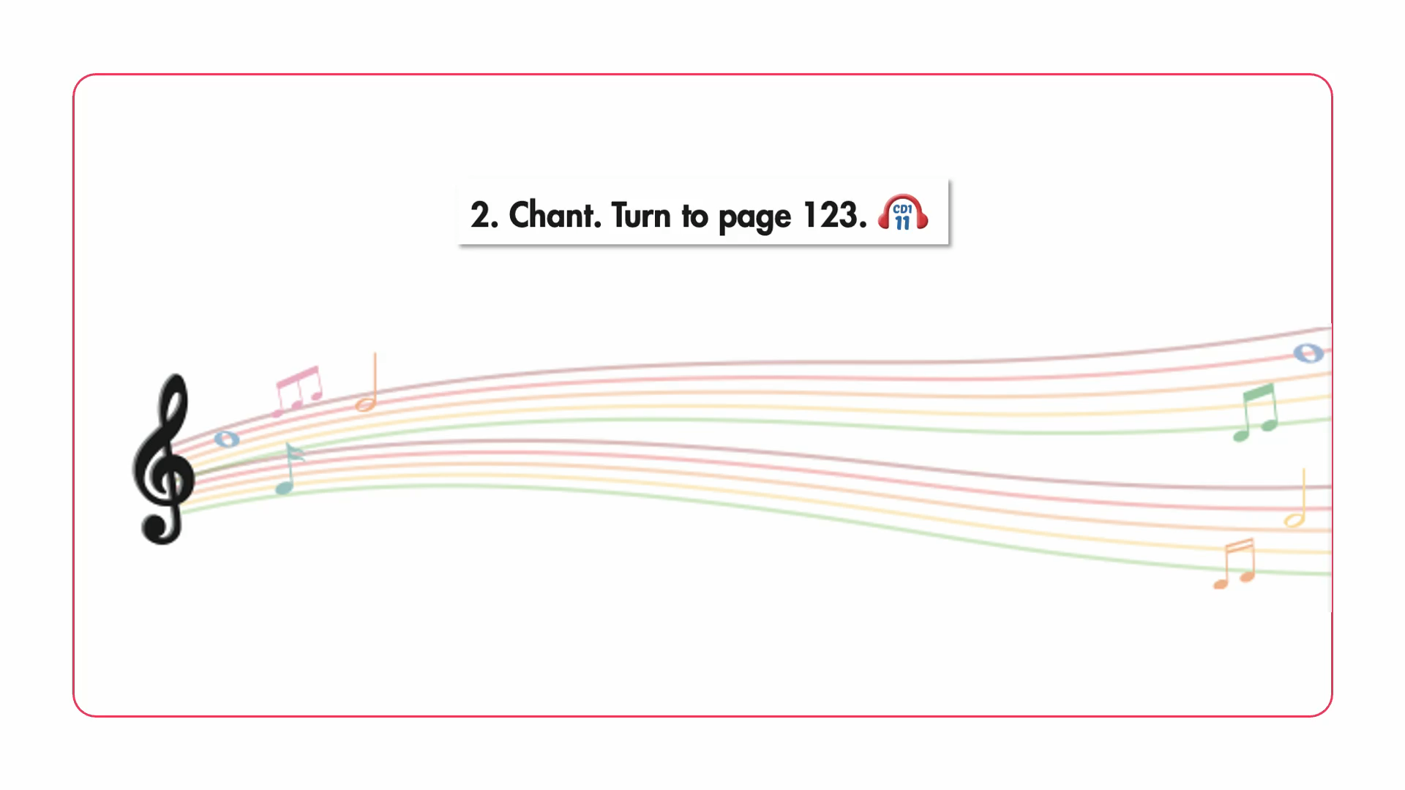

Slide 17

Structure
Why do you like math?
Because I like solving problems.

Slide 18

Speaking

Slide 19
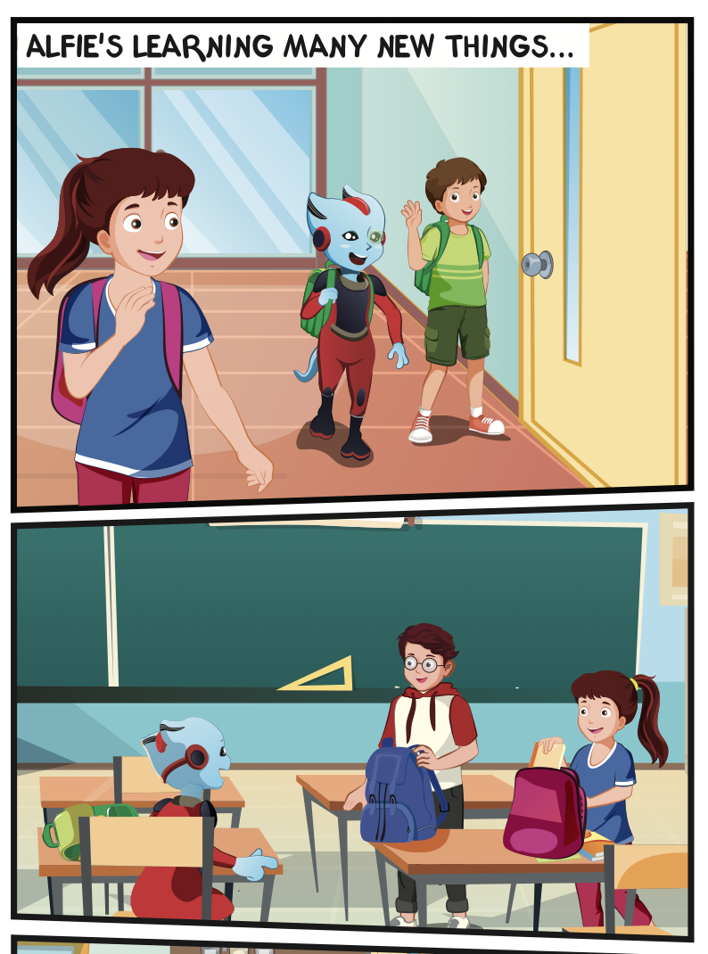
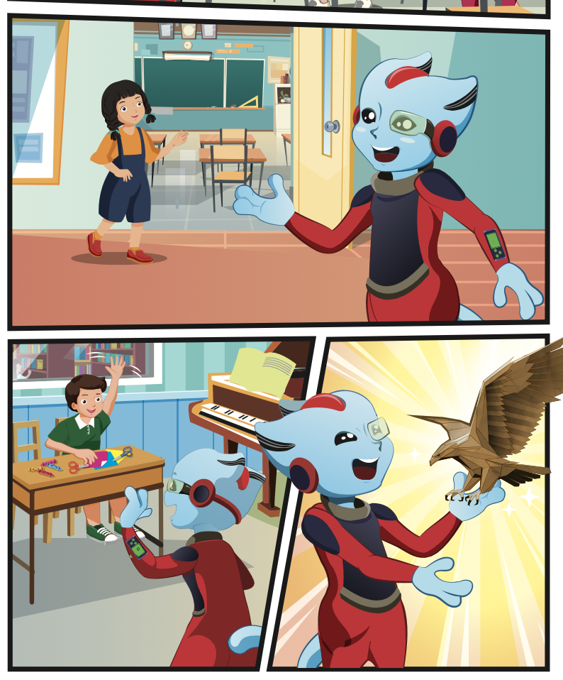
Who is talking?
Where are they?

Slide 20

Listening

Slide 21

Click on D to hear the sound.

Slide 22

Practice

Slide 23

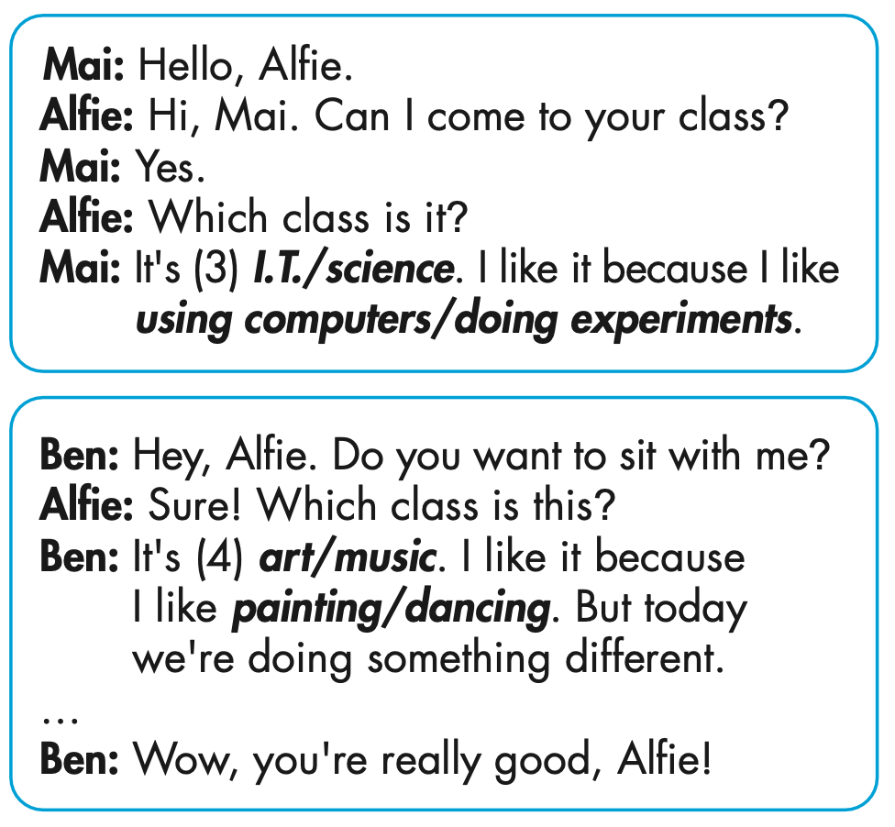
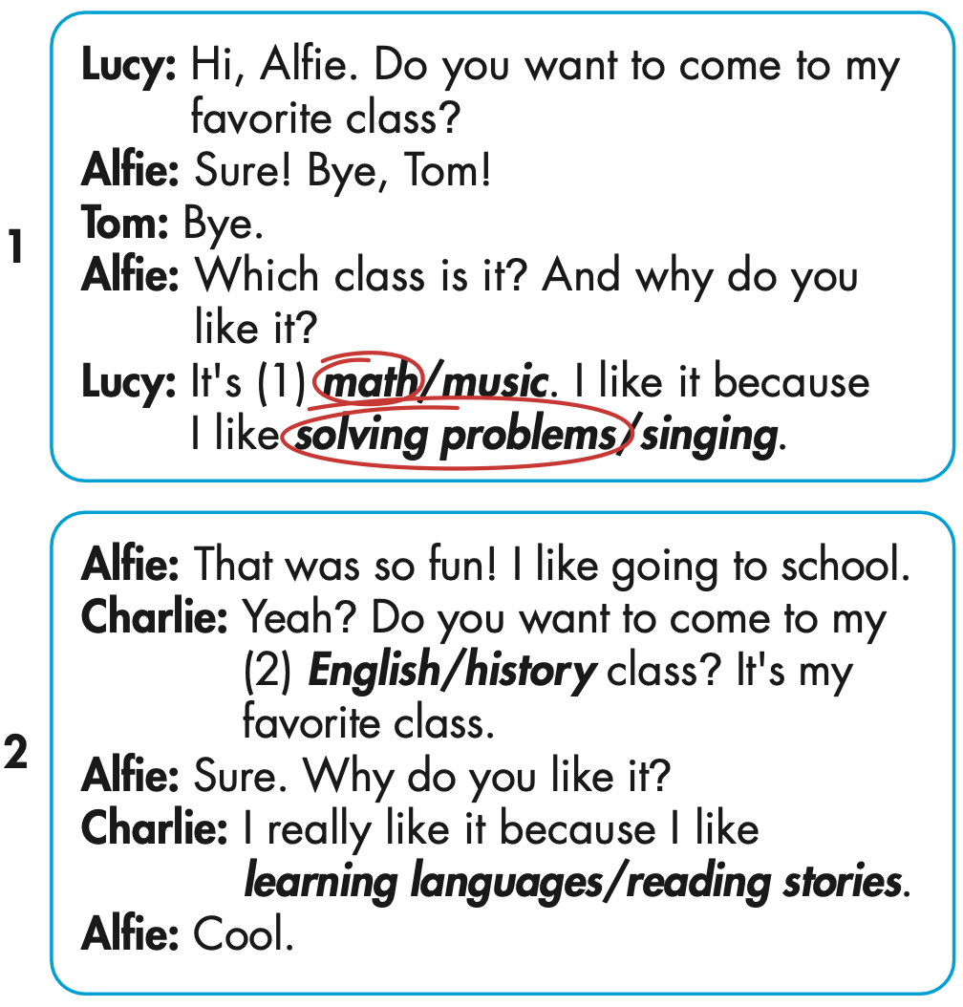
Click on 2 to hear the sound.
3
4

Slide 24
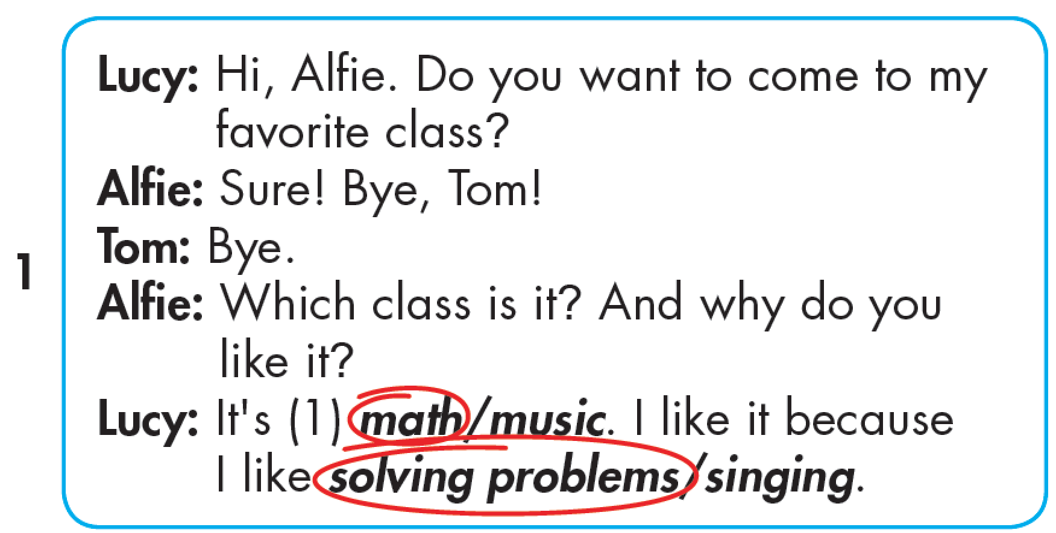

Slide 25
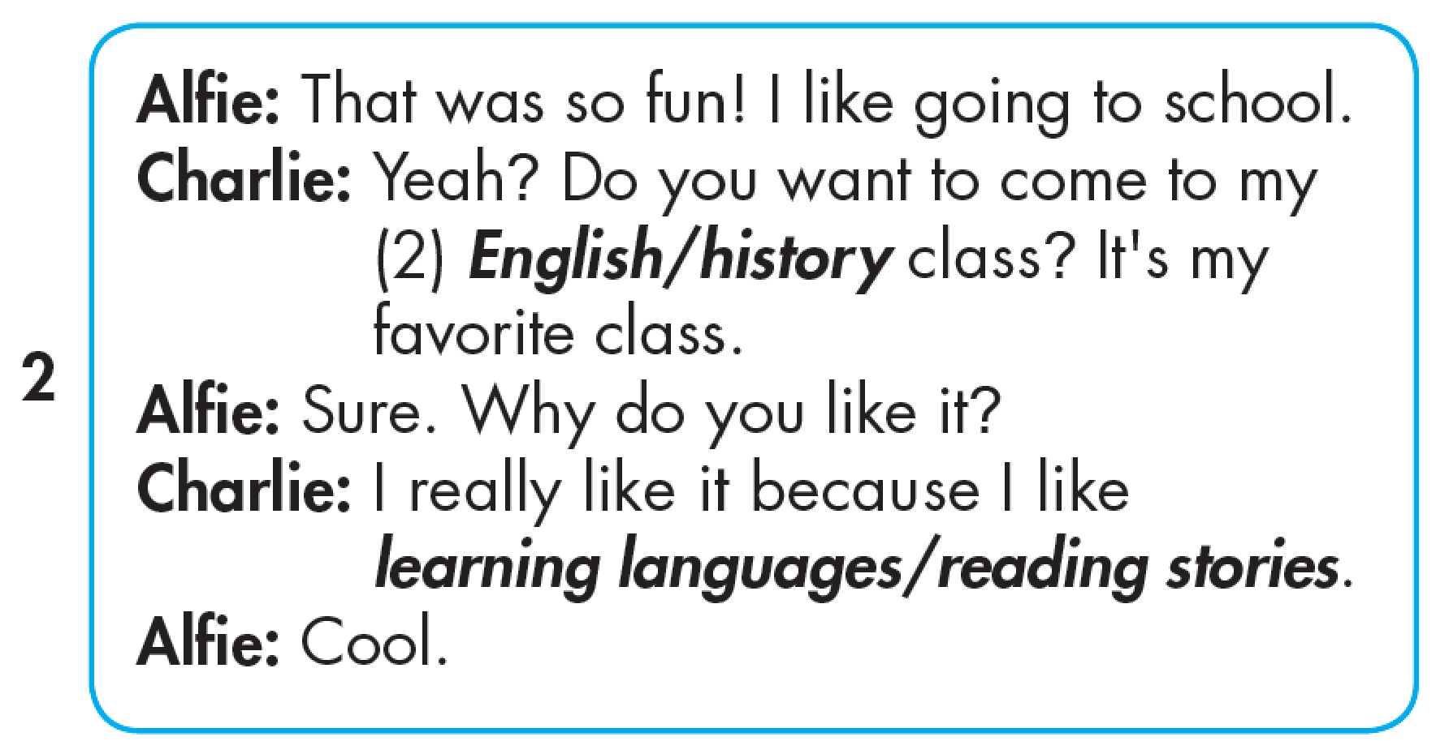

Slide 26
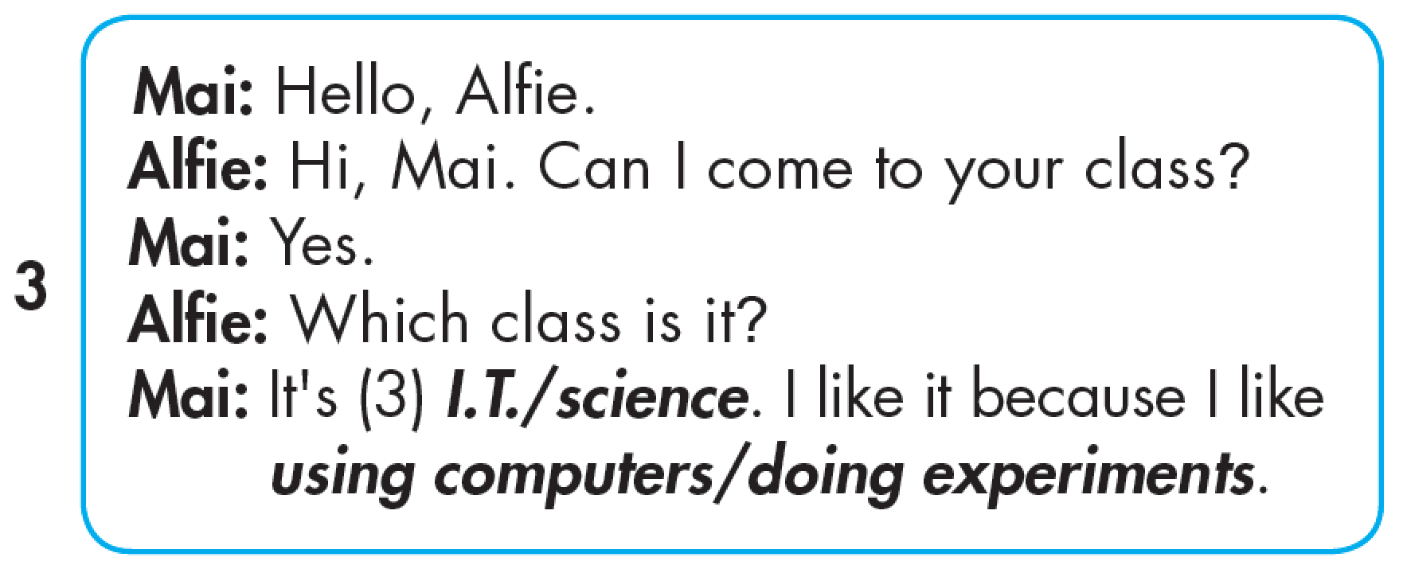

Slide 27
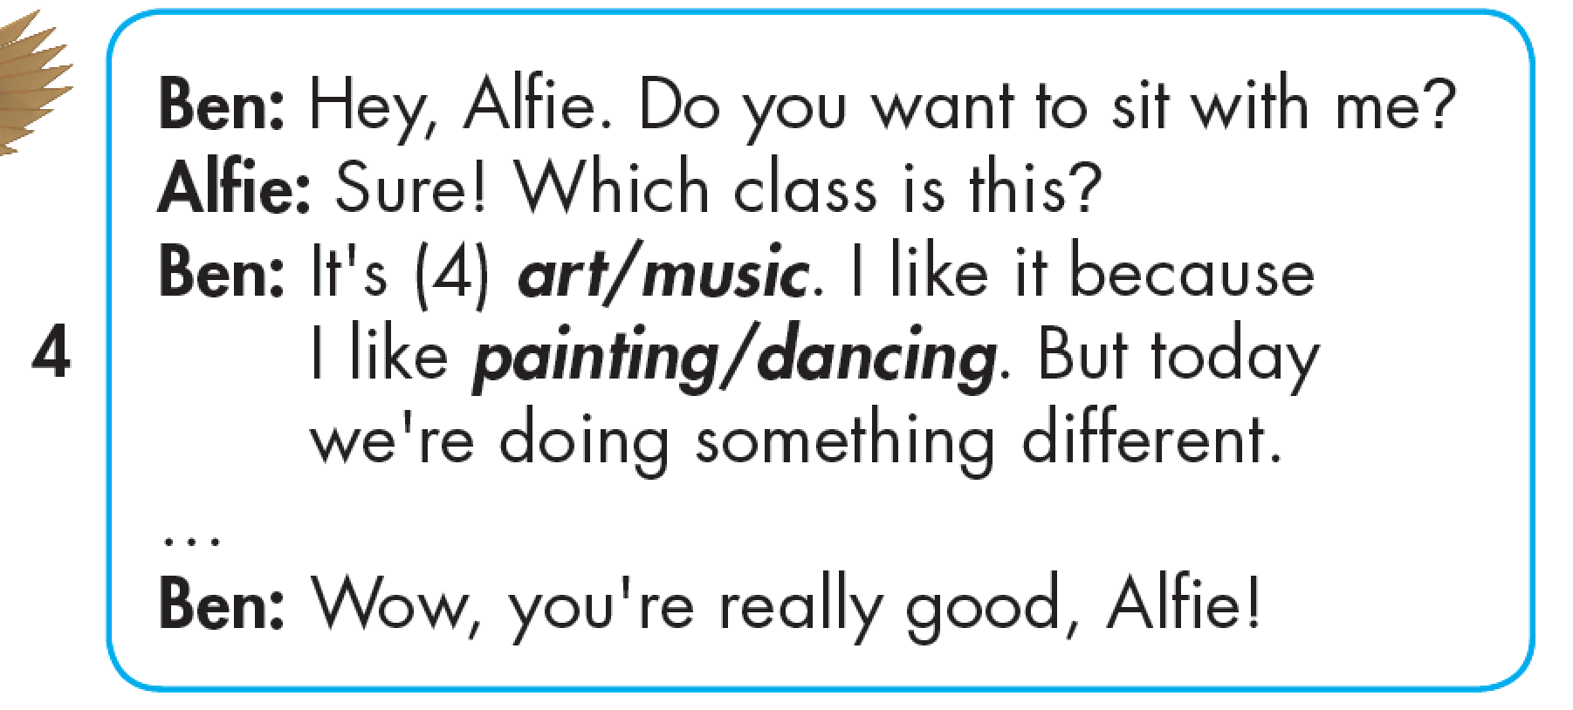

Slide 28

Reading

Slide 29


Slide 30

Production

Slide 31

Writing

Slide 32
MAKE YOUR OWN STORY
3
4

Slide 33

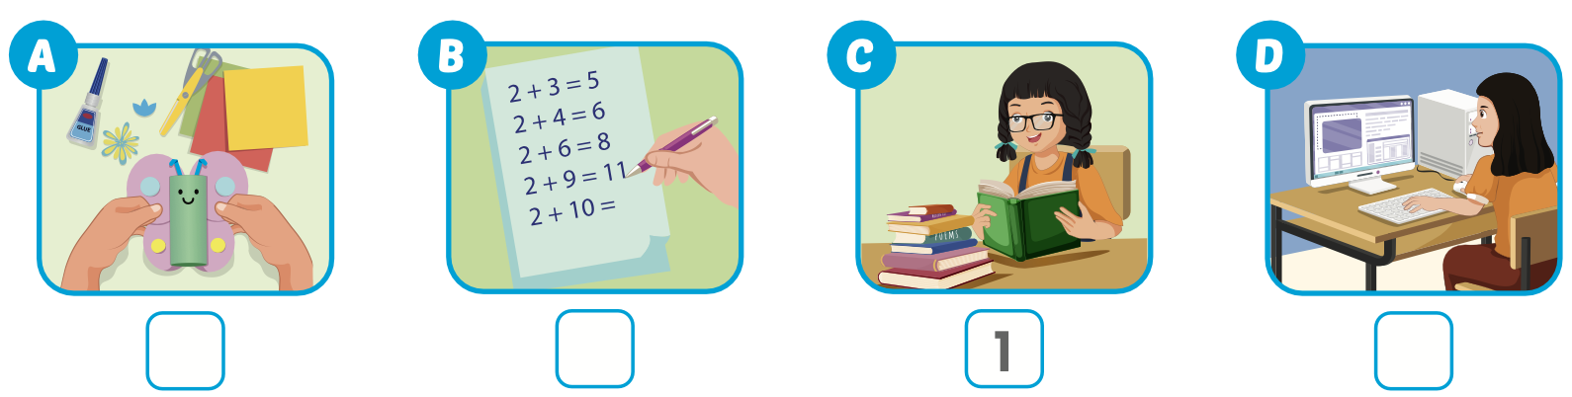
Extra Practice
WB, page 5
Click on the picture to hear the sound.
4
2
3

Slide 34

CONSOLIDATION

Slide 35


WHERE IS THE COOKIE ?

Slide 36
Chooses a cookie jar and reads the word.
Click on the jar to find out if the cookie is hidden in it.

Slide 37


geography
Vietnamese
I.T.
ethics
history

Slide 38
science
experiment
stories
languages
using

Slide 39
solving
doing
making
learning
reading

Slide 40
solving problems
reading stories
doing experiments
using computers
learning languages

Slide 41

WRAP-UP

Slide 42
Today’s lesson
Pronunciation
word stress for verb-ing
Structures/ Sentence patterns
Why do you like math?
Because I like solving problems.

Slide 43
Homework
Practice the vocabularies and structure, and make sentences using them.
Do the exercises in Tiếng Anh 5 i-Learn Smart Start WB (page 5).
Do the exercises in Tiếng Anh 5 i-Learn Smart Start Notebook.
Prepare the next lesson (page 11 SB).
Play the consolidation games in Tiếng Anh 5 i-Learn Smart Start DHA App on www.eduhome.com.vn

Slide 44

Enjoy your day!

Slide 45

Lesson 3
Stay positive and have a nice day!

