Slide 1

NGOC LAM PRIMARY SCHOOL`
Unit 8: MY FRIENDS AND I
Lesson 3 - Page 114

Slide 2
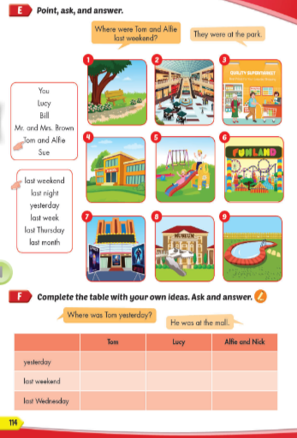
Lesson Outline
Warm-up
Practice
Speaking
Consolidation
Wrap-up

Slide 3
Objectives
By the end of this lesson, students will be able to talk about where people were.
Vocabulary: movie theater, playground, museum, mall, supermarket, amusement park.
Structure:
Where were you last night? I was at the movie theater.
Where was Nick last Saturday? He was at the mall.
Where were Alfie and Mai yesterday? They were at the park.

Slide 4

WARM UP

Slide 5

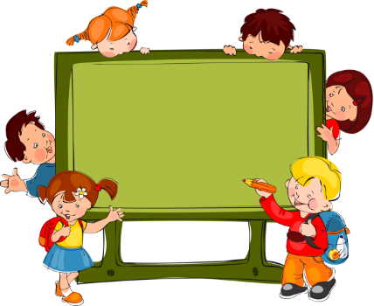
REVIEW: VOCABULARY
Notes:
Put three or four FLASHCARDS on the board and tell your child to look at them. Ask them to close their eyes and take one card away. When your child opens their eyes, ask them to guess what is missing.

Slide 6
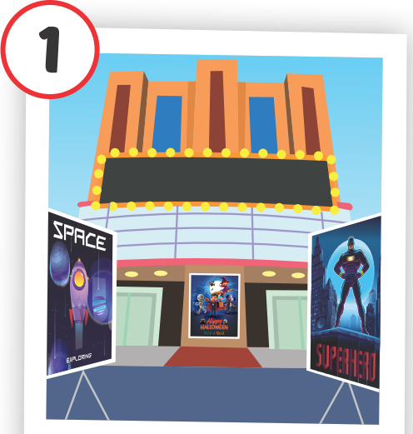
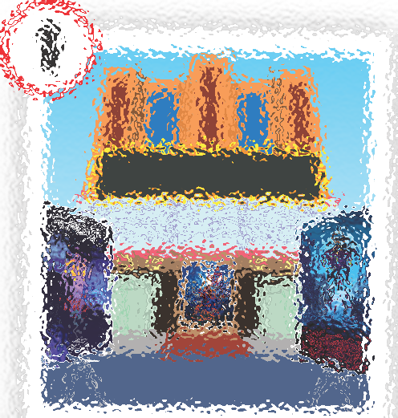
PRE
NEXT
ANSWER
stadium
museum
movie theater
school

Slide 7
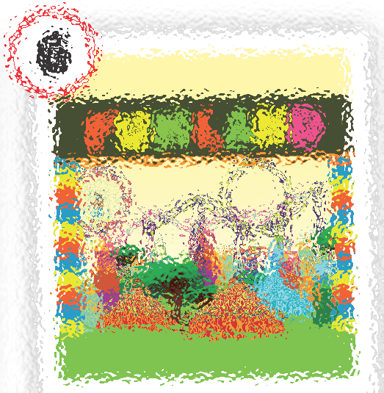

PRE
NEXT
ANSWER
stadium
amusement park
mall
museum

Slide 8
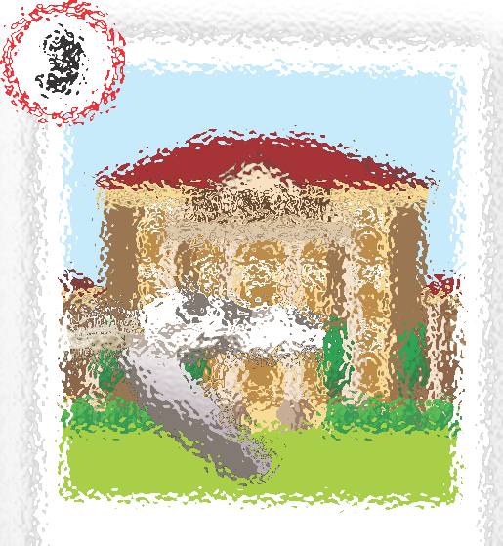

PRE
NEXT
ANSWER
park
supermarket
museum
mall

Slide 9
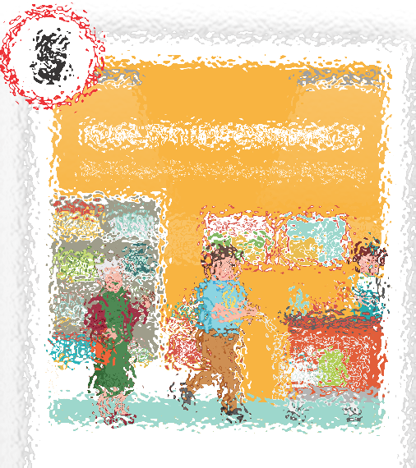

PRE
NEXT
ANSWER
market
museum
supermarket
stadium

Slide 10
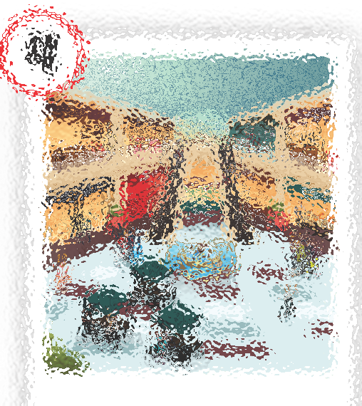
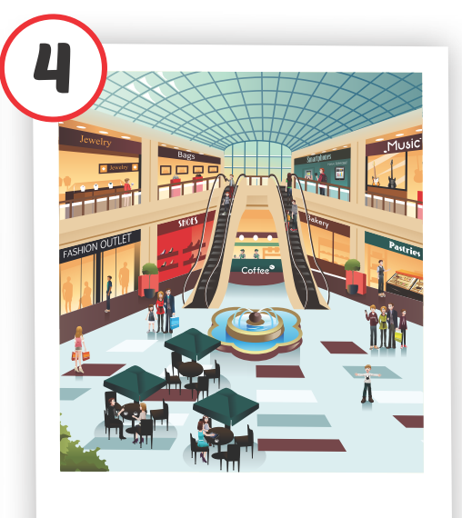
PRE
NEXT
ANSWER
movie theater
market
stadium
mall

Slide 11
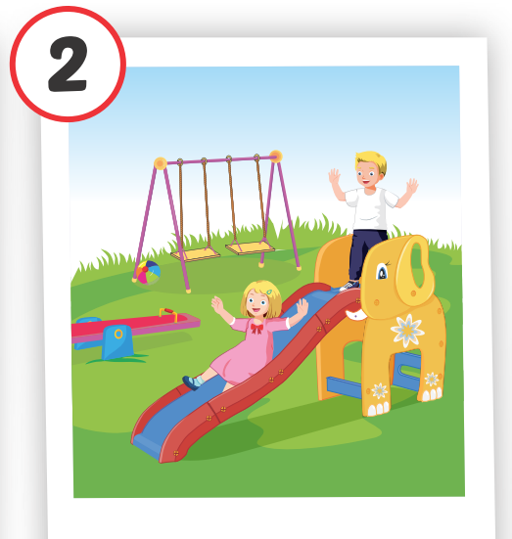
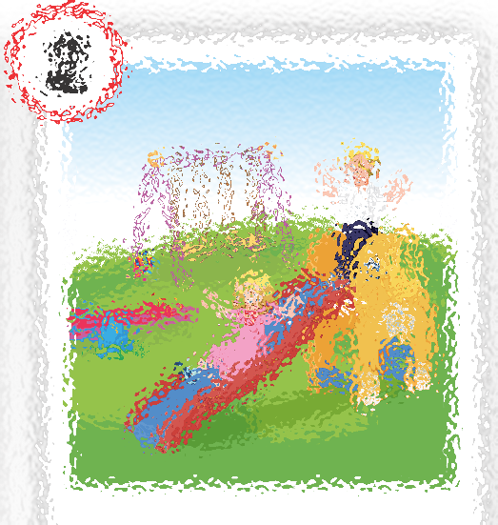
PRE
NEXT
ANSWER
movie theater
playground
mall
museum

Slide 12

It’s time to learn …

Slide 13

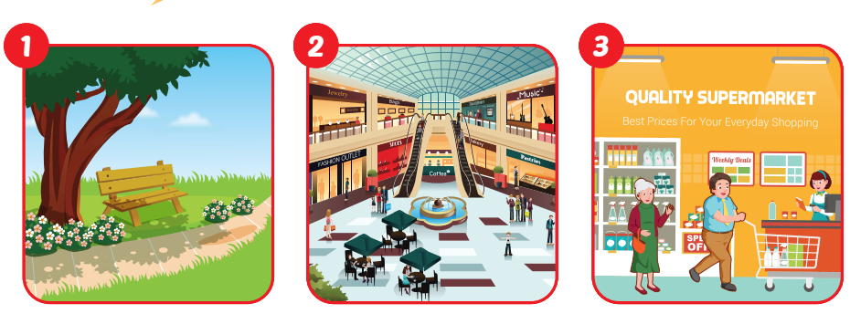
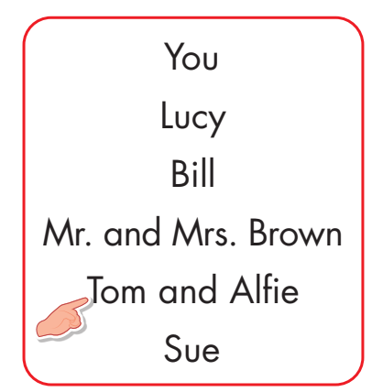
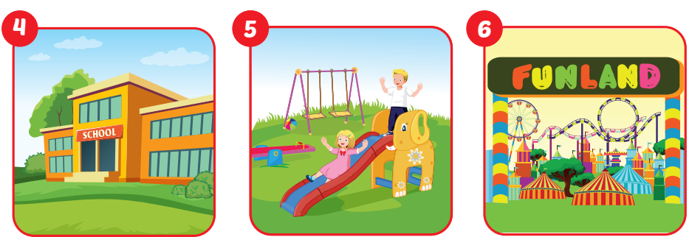
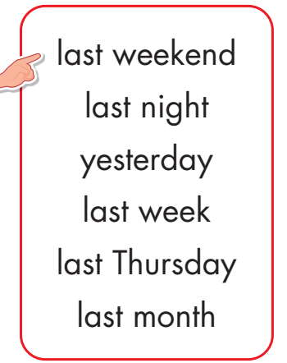
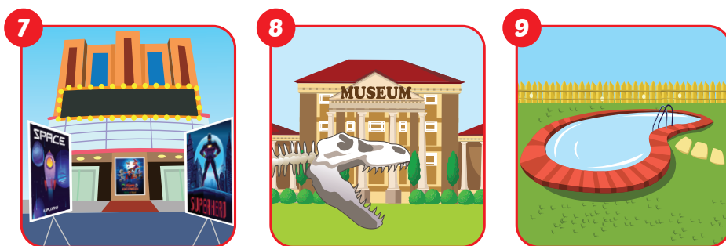

Slide 14
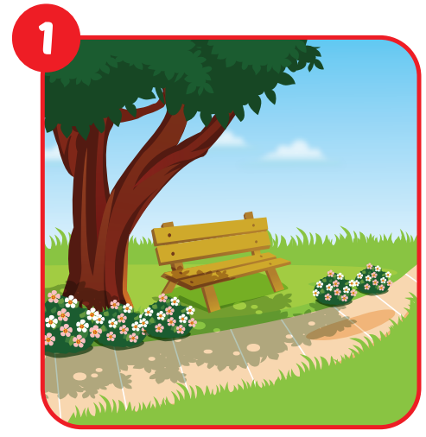
Where were Tom and Alfie last weekend?
They were at the park.

Slide 15
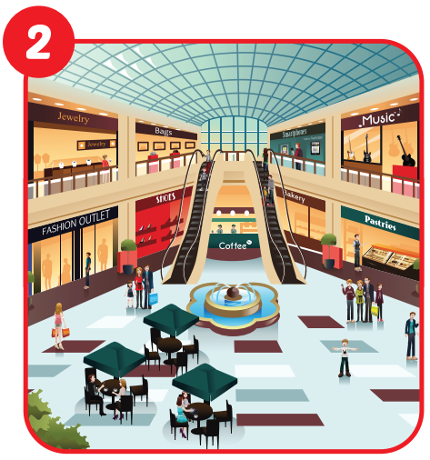
Where were you last night?
I was at the mall.

Slide 16

Where were Mr. and Mrs. Brown yesterday?
They were at the supermarket.

Slide 17
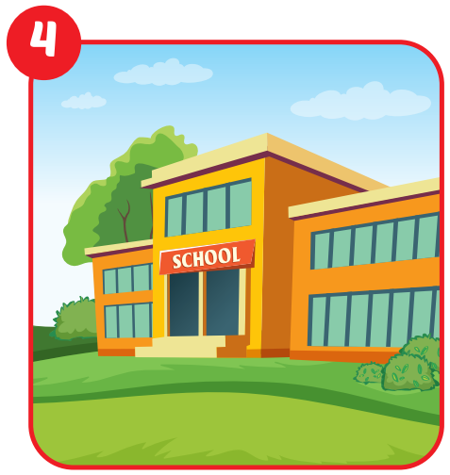
Where was Lucy last Thursday?
She was at school.

Slide 18
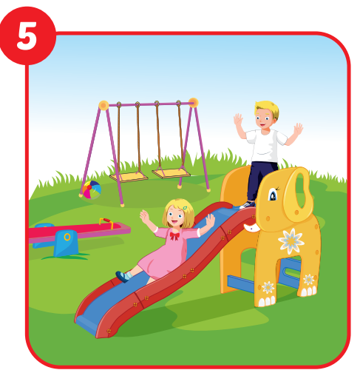
Where was Sue last week?
She was at the playground.

Slide 19
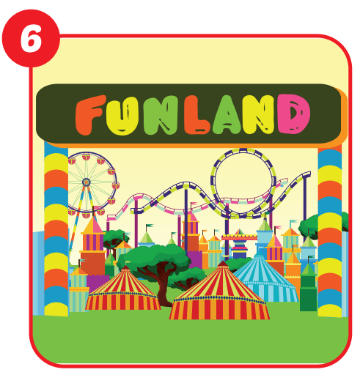
Where was Bill last month?
He was at the amusement park.

Slide 20
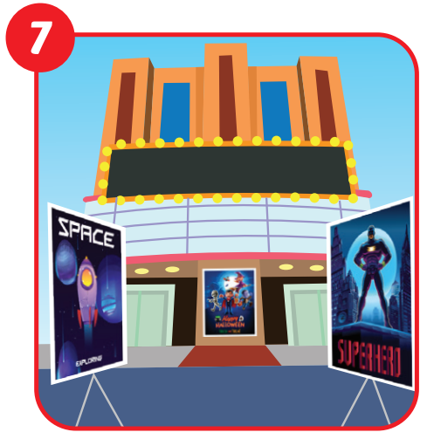
Where were you last night?
I was at the movie theater.

Slide 21
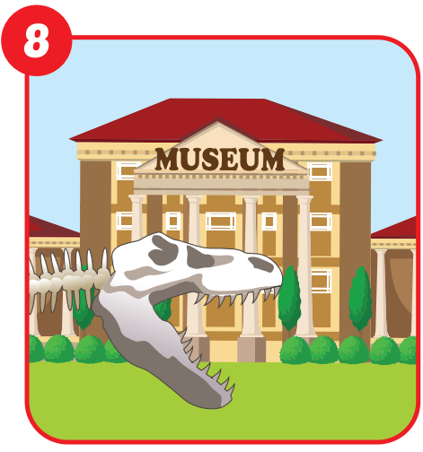
What were you last week?
I was at the museum.

Slide 22
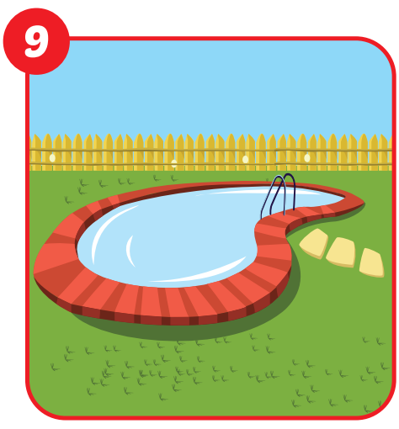
Where were Tom and Alfie last weekend?
They were at the swimming pool.

Slide 23
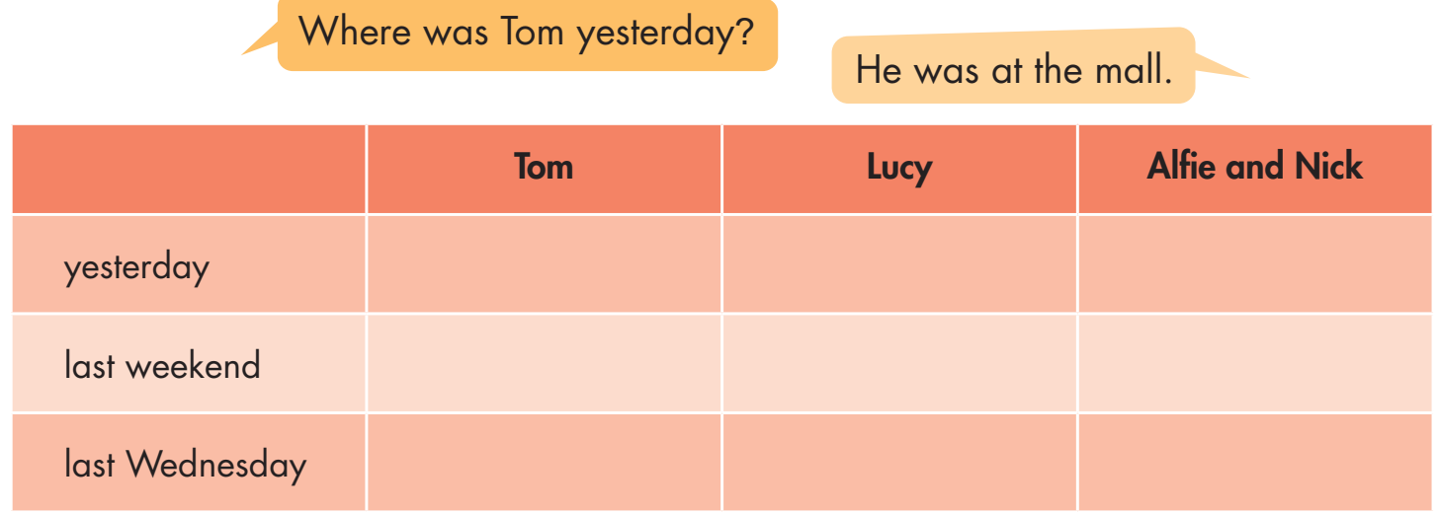
mall

Slide 24

CONSOLIDATION

Slide 25

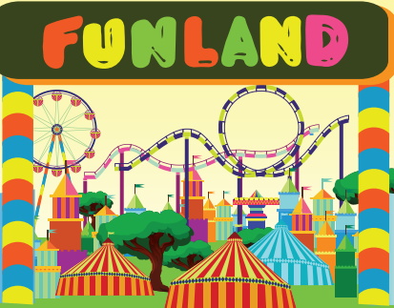
Look at the picture and write the answer.
Where were you yesterday?
______________________________
I was at school.
2. Where were you yesterday?
___________________________________
I was at the amusement park.

Slide 26
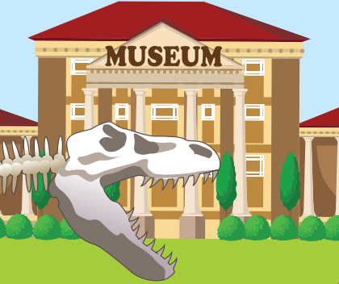

Look at the picture and write the answer.
Where was Ann yesterday?
______________________________
She was at the museum.
2. Where were Mr. and Mrs. Brown yesterday?
___________________________________
They were at the supermarket.

Slide 27

WRAP-UP

Slide 28
Today’s lesson
Vocabularies
movie theater
playground
museum
mall
supermarket
amusement park
Structures/ Sentence patterns
Where were you last night? I was at the movie theater.
Where was Nick last Saturday? He was at the mall.
Where were Alfie and Mai yesterday?
They were at the park.

Slide 29
Homework
Practice the vocabularies and structure, and make sentences using them.
Do the exercise D in Tiếng Anh 4 i-Learn Smart Start WB (page 77)
Prepare the next lesson (page 115, SB)
Play the consolidation games in Tiếng Anh 4 i-Learn Smart Start DHA App on www.eduhome.com.vn

Slide 30
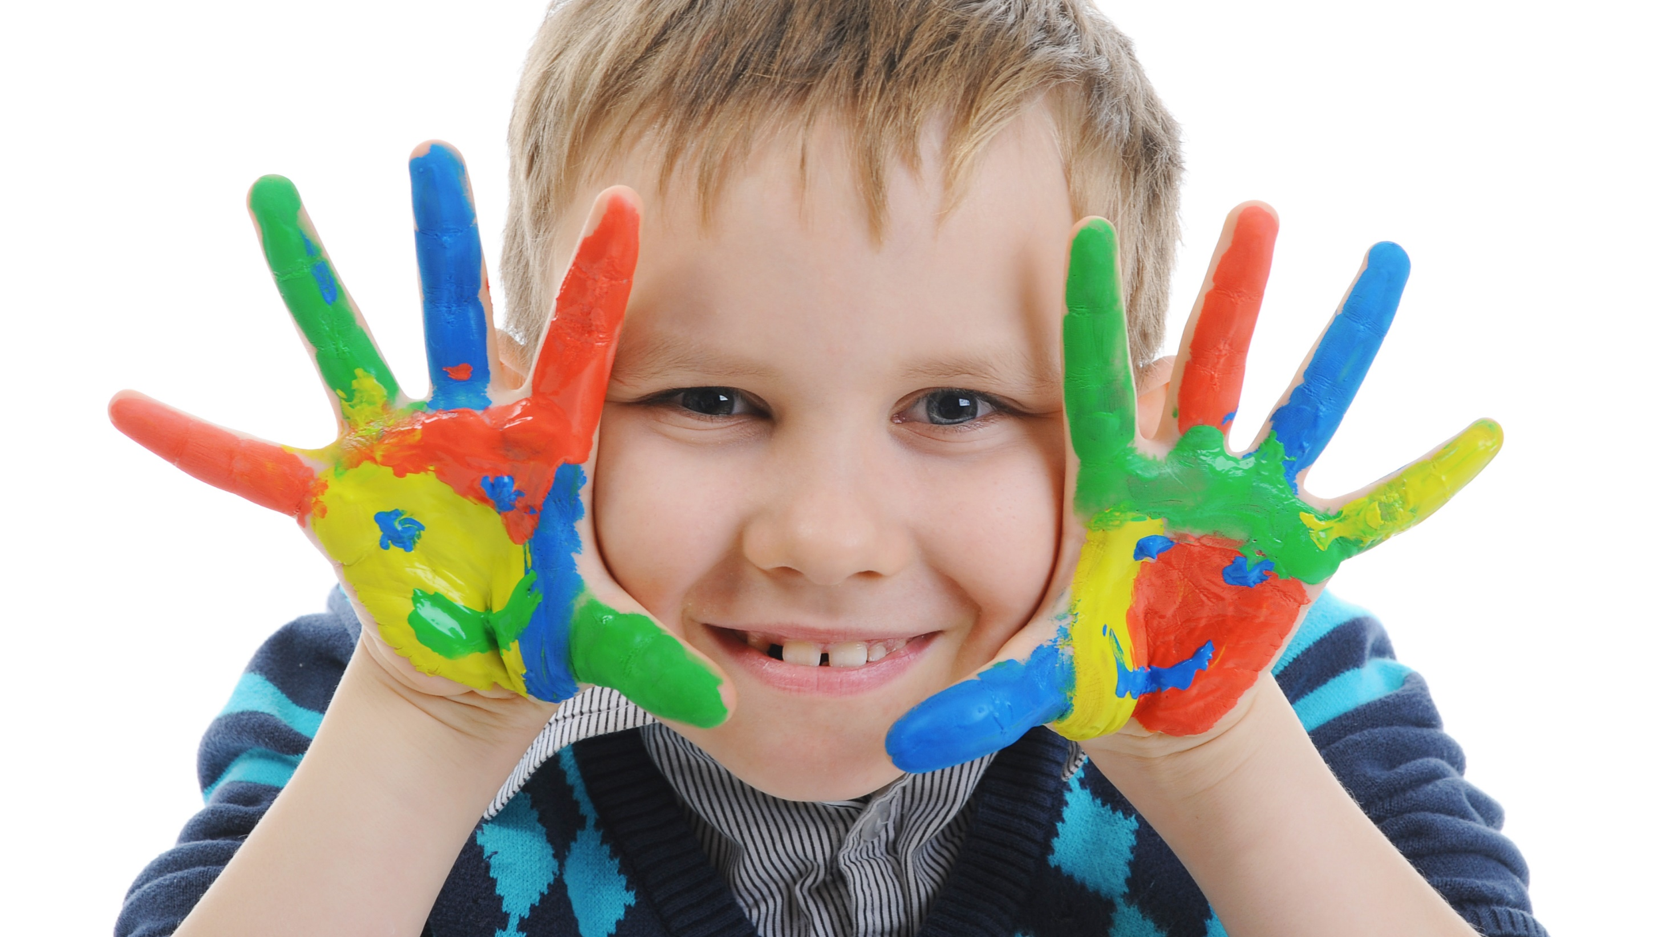
Enjoy your day!

