Slide 1

Unit 7: Toys
Review & Practice 2
Page 110

Slide 2
Lesson Outline
Warm-up
Speaking
Consolidation
Wrap-up

Slide 3
Objectives
By the end of this lesson, students will be able to…
Vocabulary: Review all vocabularies learnt in Unit 7.
Speaking: Practice asking and answering questions, playing Connect three game.

Slide 4

WARM UP

Slide 5






What’s next?
?
doll
robot

Slide 6




What’s next?
?
card
car

Slide 7




What’s next?
?
marble
block

Slide 8




What’s next?
?
card
car

Slide 9


What’s next?
?
on
in

Slide 10





What’s next?
?
marble
block

Slide 11

It’s time to learn …

Slide 12

Speaking

Slide 13
PRE-SPEAKING
Rearrange these words to make a sentence.
blocks How do many have ? you
How many blocks do you have?

Slide 14
PRE-SPEAKING
Rearrange these words to make a sentence.
ten have I blocks.
I have ten blocks.

Slide 15
PRE-SPEAKING
Rearrange these words to make a sentence.
see? you can What
What can you see?

Slide 16
PRE-SPEAKING
Rearrange these words to make a sentence.
big see I car. a can
I can see a big car.

Slide 17
PRE-SPEAKING
Rearrange these words to make a sentence.
the in Put the box. toy robot
Put the robot in the toy box.

Slide 18
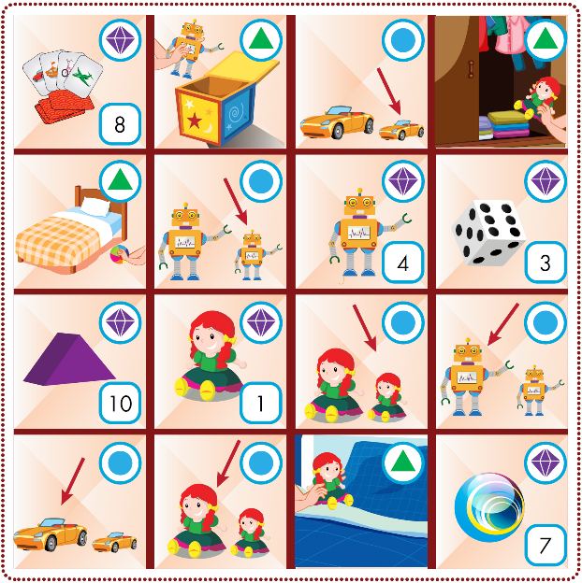

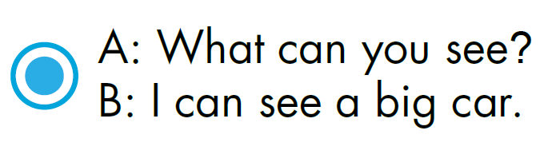

WHILE-SPEAKING
See the next slide to know how to play the game

Slide 19
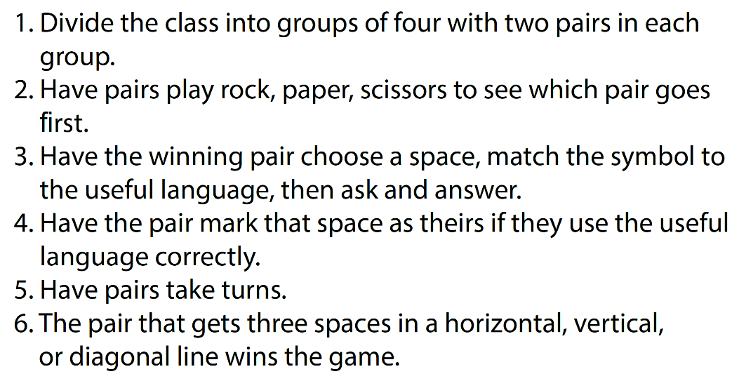
HOW TO PLAY?

Slide 20
WHILE-SPEAKING
See the next slide to know how to play the game

Slide 21

CONSOLIDATION

Slide 22
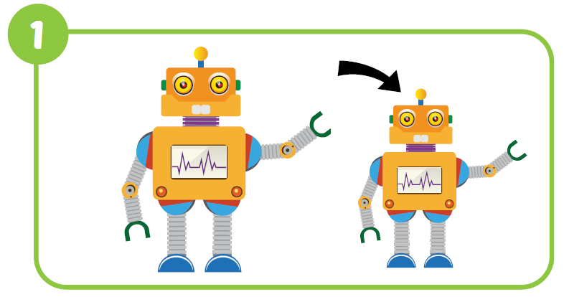


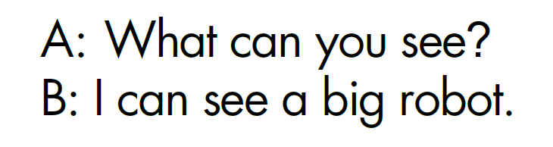
Workbook, p.76

Slide 23
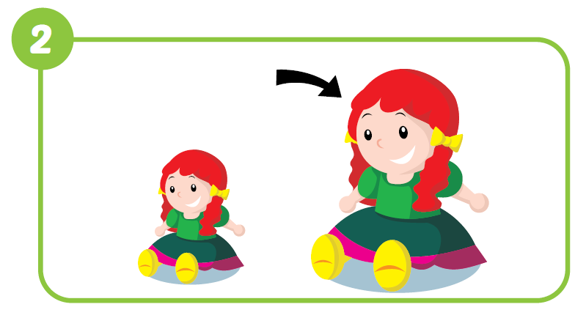

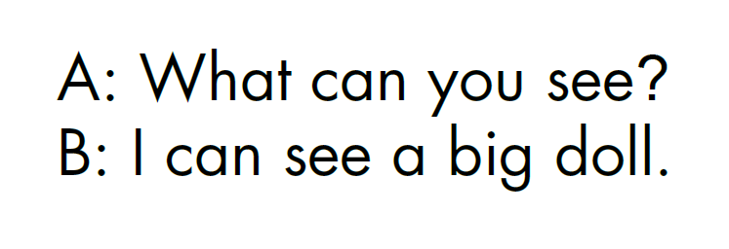
Workbook, p.76

Slide 24

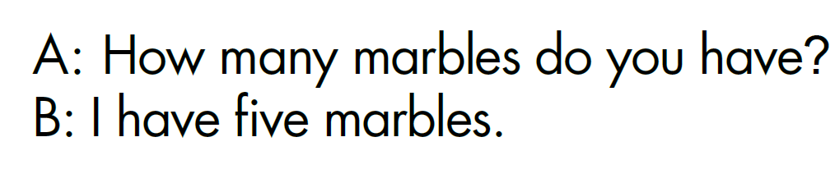
Workbook, p.76

Slide 25
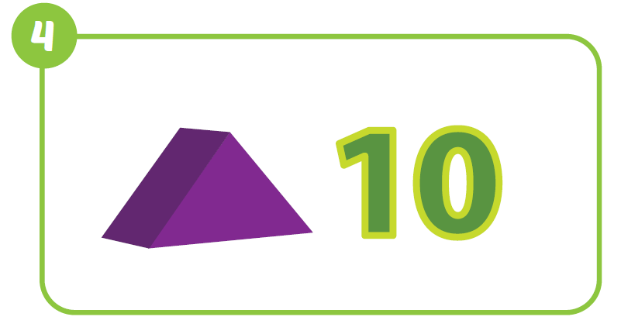
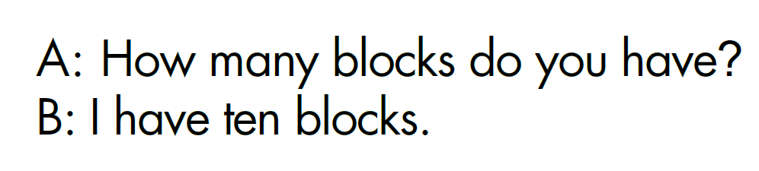
Workbook, p.76

Slide 26
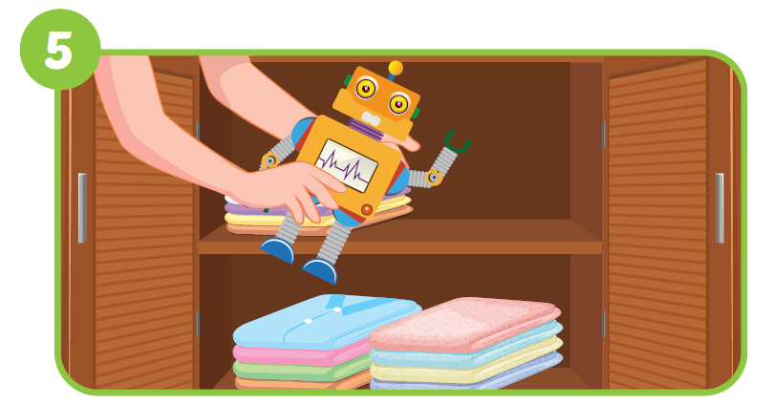
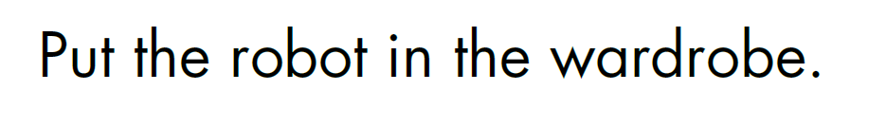
Workbook, p.76

Slide 27
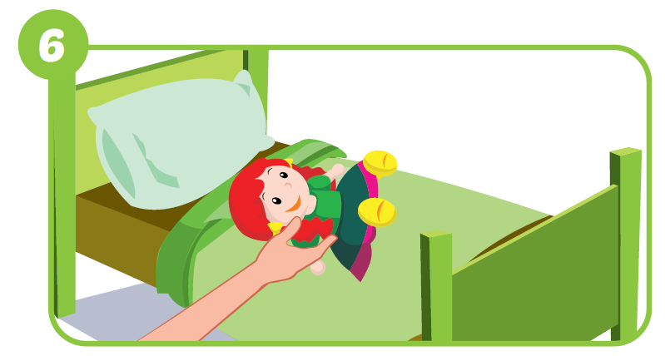


Workbook, p.76

Slide 28
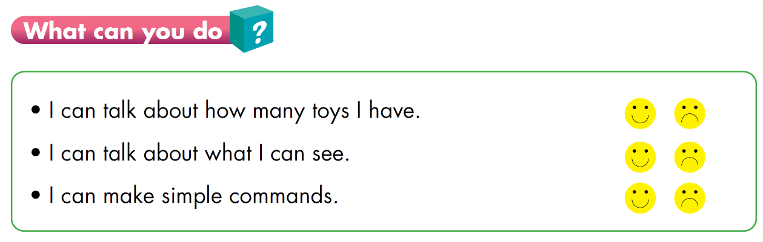

Slide 29
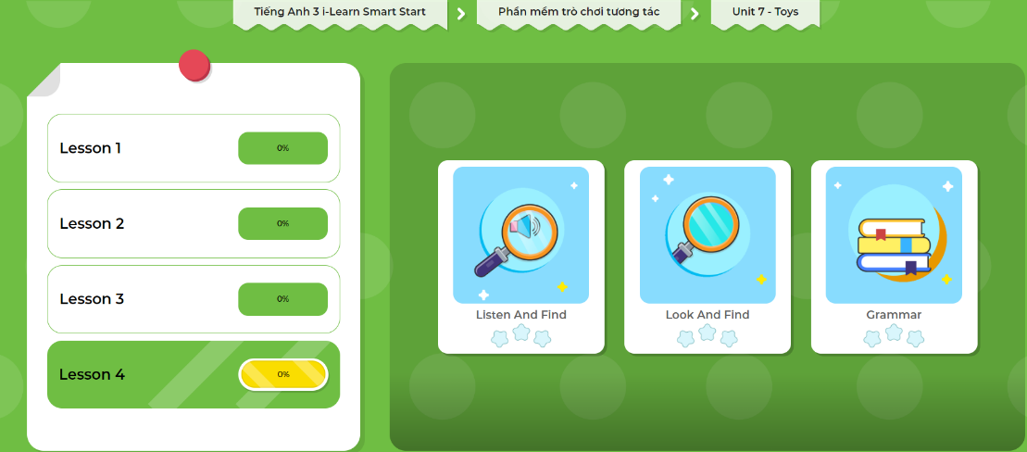
Extra Practice
DHA on Eduhome
LET’S PLAY!
Click here to play the games.

Slide 30

WRAP-UP

Slide 31
Today’s lesson
Vocabulary
Review all vocabularies learnt in Unit 7
Speaking
Practice asking and answering questions by playing connect three game

Slide 32
Homework
Review the vocabularies and structure; and make sentences using them.
Do the exercises in Tiếng Anh 3 i-Learn Smart Start WB (page 76)
Do the exercises in Tiếng Anh 3 i-Learn Smart Start Notebook (page 51)
Prepare the next lesson (page 110SB)
Play games in Tiếng Anh 3 i-Learn Smart Start DHA App on www.eduhome.com.vn

Slide 33

Have a nice day!

