Slide 1
Tiếng Anh 5
Unit 16
WHERE’S THE POST OFFICE?
Lesson 3

Slide 2
Objectives
By the end of this lesson, students will be able to ….
- Say questions and answers with the correct intonation.
- Skill : listening, reading, speaking.

Slide 3

WARM UP

Slide 4


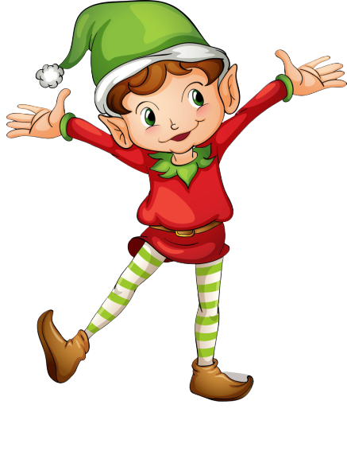
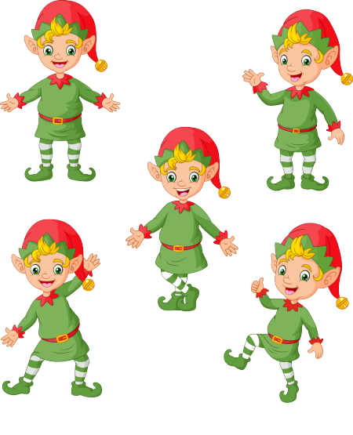
RING THE GOLDEN BELL
PLAY
Notes:
Ms Huyền Phạm - 0936.082.789 – YOUTUBE: MsPham. Facebook: Dạy và học cùng công nghệ.

Slide 5




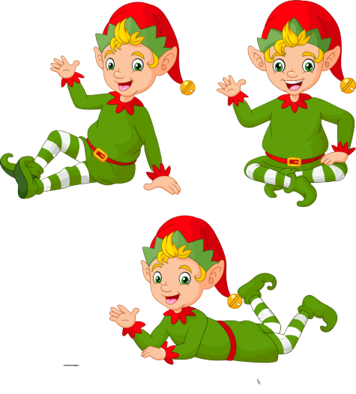
Ring The Golden Bell
Question 1
Answer
Where’s the ____?
pharmacy
1
2
3
4
5
6
7
8
9
10
Next
Notes:
Ms Huyền Phạm - 0936.082.789 – YOUTUBE: MsPham. Facebook: Dạy và học cùng công nghệ.

Slide 6
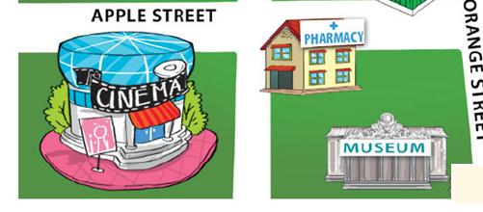
Ring The Golden Bell
Question 2
Answer
It’s _____ the cinema.
opposite
1
2
3
4
5
6
7
8
9
10
Next
Notes:
Ms Huyền Phạm - 0936.082.789 – YOUTUBE: MsPham. Facebook: Dạy và học cùng công nghệ.

Slide 7
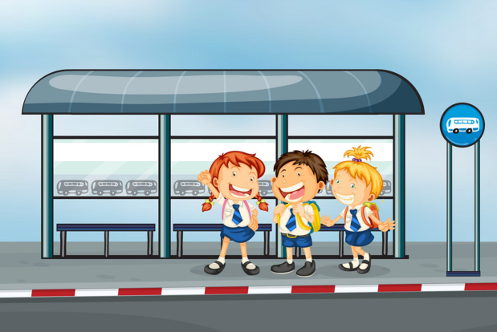
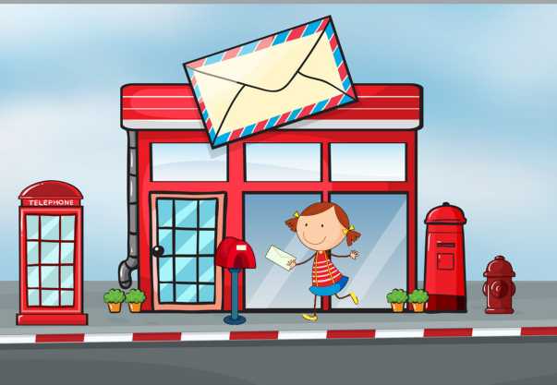
Ring The Golden Bell
Question 3
Answer
Where’s the post office?
It’s next to the bus stop
1
2
3
4
5
6
7
8
9
10
Next
Notes:
Ms Huyền Phạm - 0936.082.789 – YOUTUBE: MsPham. Facebook: Dạy và học cùng công nghệ.

Slide 8
Ring The Golden Bell
Question 4
Answer
______?
The theatre is near the museum.
Where is the theatre?
1
2
3
4
5
6
7
8
9
10
Next
Notes:
Ms Huyền Phạm - 0936.082.789 – YOUTUBE: MsPham. Facebook: Dạy và học cùng công nghệ.

Slide 9
Ring The Golden Bell
Question 5
Answer
Where’s the stadium?
It’s is ____ the post office and bus stop.
between
1
2
3
4
5
6
7
8
9
10
Next
Notes:
Ms Huyền Phạm - 0936.082.789 – YOUTUBE: MsPham. Facebook: Dạy và học cùng công nghệ.

Slide 10
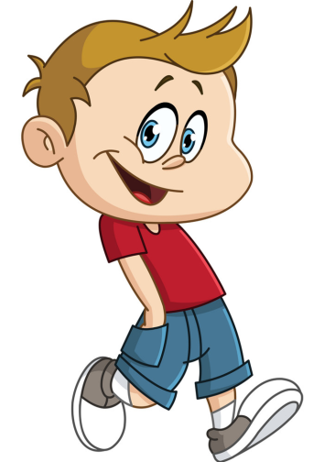
Ring The Golden Bell
Question 6
Answer
How can I get to the theatre?
You can walk.
1
2
3
4
5
6
7
8
9
10
Next
Notes:
Ms Huyền Phạm - 0936.082.789 – YOUTUBE: MsPham. Facebook: Dạy và học cùng công nghệ.

Slide 11
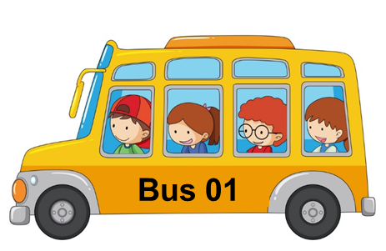
Ring The Golden Bell
Question 7
Answer
How can I get to the market?
You can take a bus
1
2
3
4
5
6
7
8
9
10
Next
Notes:
Ms Huyền Phạm - 0936.082.789 – YOUTUBE: MsPham. Facebook: Dạy và học cùng công nghệ.

Slide 12
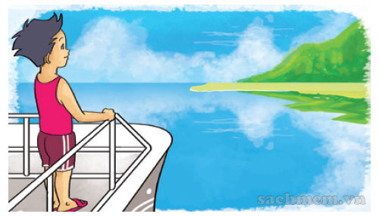
Ring The Golden Bell
Question 8
Answer
How can I get to Cat Ba Island?
You can take a boat
1
2
3
4
5
6
7
8
9
10
Next
Notes:
Ms Huyền Phạm - 0936.082.789 – YOUTUBE: MsPham. Facebook: Dạy và học cùng công nghệ.

Slide 13
Ring The Golden Bell
Question 9
Answer
____ Da Nang?
You can go by plane.
How can I get to
1
2
3
4
5
6
7
8
9
10
Next
Notes:
Ms Huyền Phạm - 0936.082.789 – YOUTUBE: MsPham. Facebook: Dạy và học cùng công nghệ.

Slide 14
Ring The Golden Bell
Question 10
Answer
____ Ho Chi Minh city?
They can take a coach.
How can they get to
1
2
3
4
5
6
7
8
9
10
Next
Notes:
Ms Huyền Phạm - 0936.082.789 – YOUTUBE: MsPham. Facebook: Dạy và học cùng công nghệ.

Slide 15
Rung chuông

Slide 16
Pronunciation

Slide 17

1. Listen and repeat.
1. | Where's the post office? ↷ It's opposite the stadium. ↷
2. | Where's the cinema? ↷ It's next to the post office. ↷
3. | Where's the supermarket? ↷ It's on the corner of the street. ↷

Slide 18
2. Listen and circle a or b.
a. It's opposite the museum.
b. It's opposite the library.
1. Where's the cinema?
a. It's next to the supermarket.
b. It's next to the stadium.
2. Where's the restaurant?
a. It's on the corner of the street.
b. It's at the end of the street.
3. Where's the park?

Slide 19
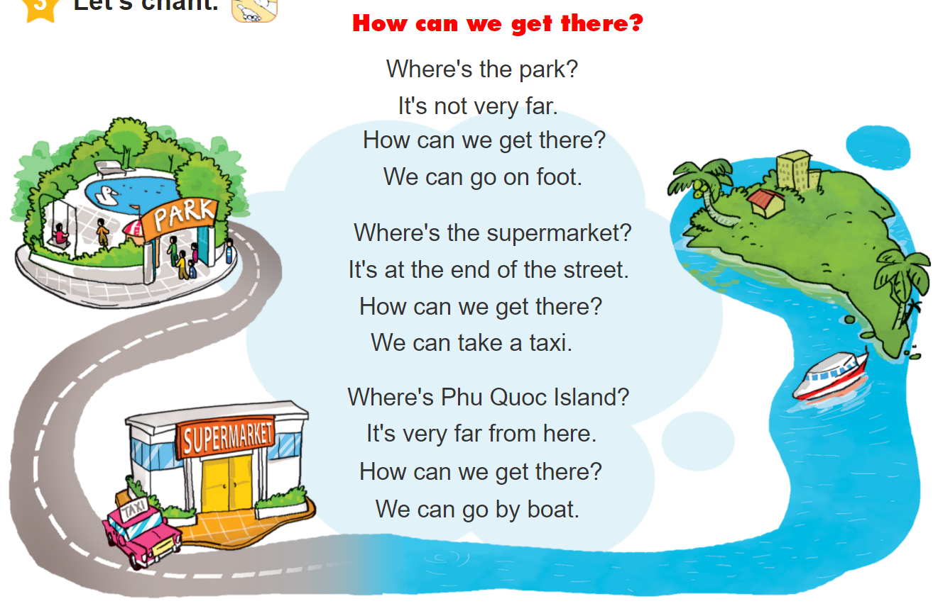


3. Let’s chant.

Slide 20
HomeLink

