Slide 1
TIẾNG ANH 5
Unit 15 – Lesson 3
What would you like to be in the future?

Slide 2

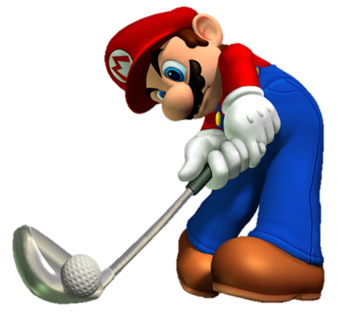
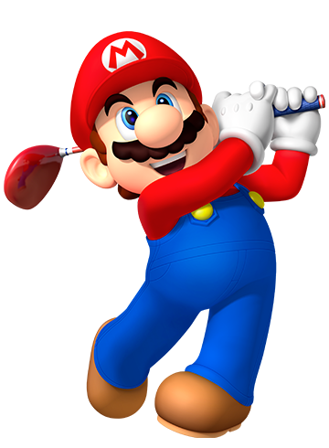
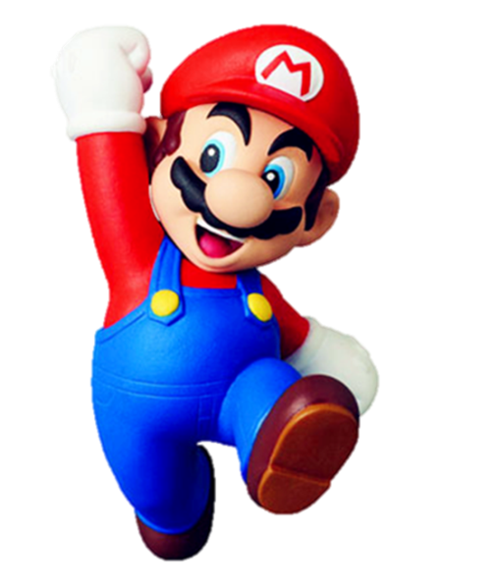


Mario
PLAYING GOLF

Slide 3








___ would you like to be in the future?
- I'd like to be a nurse.
Why
What
Where

Slide 4
What would you like to be in the future?
- ____ to be a teacher.
I'd like
I'd
I like

Slide 5
What would you like to be in the future?
- I’d like to be ___ architect.
a
an
the

Slide 6
What _____ you like to be in the future?
- I’d like to be a pilot.
would
should
do

Slide 7
What would he like to be in the future?
- ___ like to be a writer.
He’d
She’d
I’d

Slide 8
What would _____ like to be in the future?
- She’d like to be a doctor.
your sister
your brother
you

Slide 9
Why would you like to be a nurse?
- ________ I'd like to look after patients.
And
Because
But

Slide 10
______ would you like to be a writer?
- Because I'd like to write stories for children.
What
Why
How

Slide 11
Why __________ to be a pilot?
- Because I'd like to fly a plane.
would you like
do you like
are you like

Slide 12
Why would you like to be an architect?
- Because I'd like to _______.
design building
fly a plane
draw picture

Slide 13
WELLDONE!

Slide 14

1. Listen and repeat
What would you like to be in the future? ↷ I'd like to be a nurse. ↷
Why would you like to be a nurse? ↷ Because I'd like to look after patients. ↷

Slide 15
2. Listen and mark the sentence intonation (↷)
A: What would he like to be in the future?
B: He'd like to be a teacher.
A: Where would he like to work?
B: He'd like to work in a school.
A: Why would he like to be a teacher?
B: Because he'd like to teach young children.
1
↷
↷
↷
2
↷
↷
3
↷

Slide 16
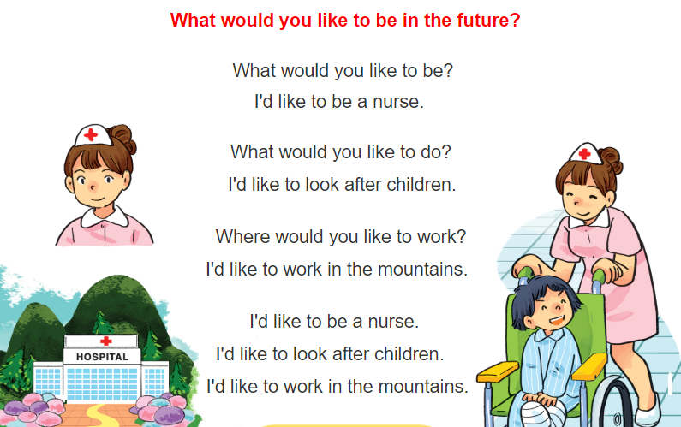


3. Let’s chant

